Slide 1
TO FIND THE NATURAL GROUPING PRESENT IN A GIVEN DATA SET USING MST OF DATA POINTS

Slide 2
Objective of the work
To find the “natural grouping” of a given data set using MST of data points.
Clustering techniques aim to extract such “natural groups”
present in a given data set and each such group is termed
as a cluster.

Slide 3
CLUSTERING
Let the set of n patterns S= {x₁, x₂,….,x_{n} } ∈ ℜ^{m} and K clusters are represented by C₁, C₂,….,C_{K} then
1. C_{i} ≠ φ, for i= 1, 2, …..,K
2. C_{i} ∩C_{j} = φ for i ≠j and
3. ∪_{i=1}^{K} C_{i} =S where φ represents null set.

Slide 4
What is Natural Grouping?
For a data set S= {x₁, x₂,….,x_{n} } ∈ ℜ^{m} , what one perceives
to be the groups present in S by viewing the scatter diagram
of S, is termed as natural groups of S.

Slide 5
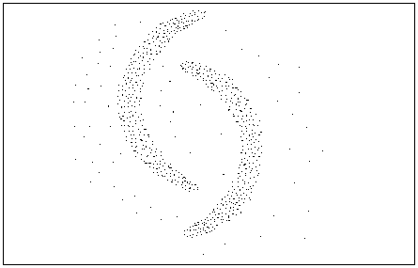
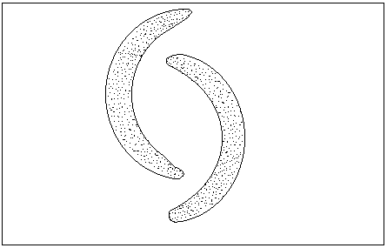
Natural Grouping
Scatter Diagram
Natural Grouping

Slide 6
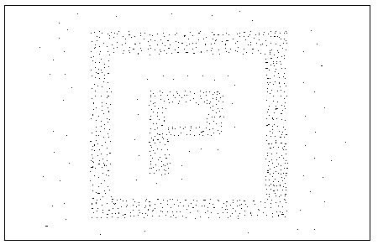
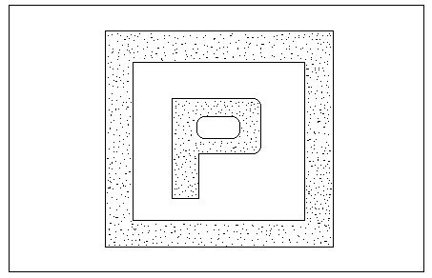
Natural Grouping
Scatter Diagram
Natural Grouping

Slide 7
Widely used Algorithms
K-Means Algorithm.
ISODATA Algorithm.
Disadvantage of K-Means Algorithm
It needs the number of clusters to be known a priori.
It can find the grouping if clusters exhibit characteristics
pocket and are not placed very close to each other.
It may stack at a local minima.
It can not provide proper grouping in case of some data
having typical shape and size.

Slide 8
To find the natural grouping based on local densities of the data points
To find high density regions of a given data set.
To merge those high density regions “suitably” along with the data
points of other regions to result in clustering.
To eliminates noise if any from the final clustering.

Slide 9

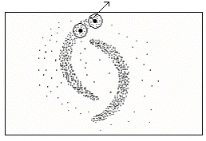
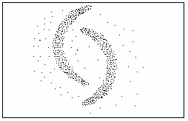
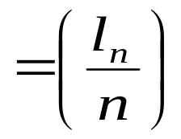
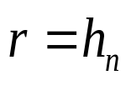
Scatter Diagram
Finding density of each data points
Radius for the open disk to compute the density of each data point is taken to be
l_{n} → Sum of edge weights of minimal spanning tree of S.
n → Number of data points in S.
The edge weight is taken to be the Euclidean distance.

Slide 10
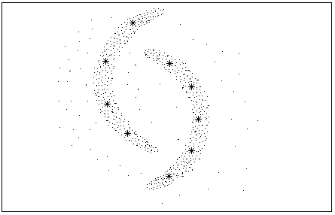
Scatter diagram with seed points

Slide 11
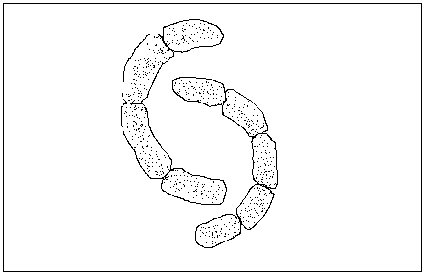
Scatter Diagram with 9 Groups
Natural Grouping By Proposed Method

Slide 12
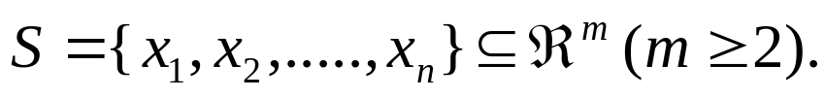
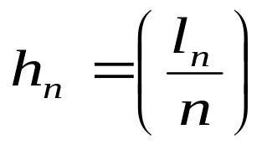

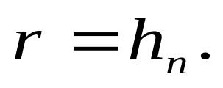


Algorithm AL-1:
Step 1: Let Find the MST of
with the edge weight as the Euclidean distance. Let
and the radius
Step 2: Compute the density (the number of points) for each datum x as
the number of other data units within an open disc of radius h_{n} with
x as center. m_{i} denote the density of the point x _{i} , i=1, …, n.
In other words, let
and ( #A means the number of points of the
set A).

Slide 13



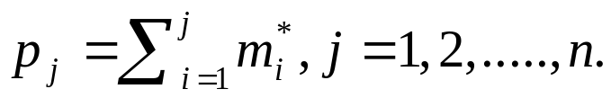
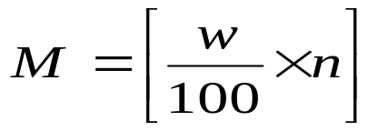


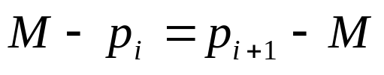
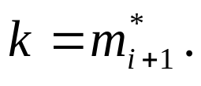

Step 3: Rearrange in increasing order. Let the
rearrangement be Let represent
the corresponding cumulative sums of i.e.
Step 4: Compute where [a] means integral part of ‘a’
i.e. the largest integer ≤ a. Find the value of i for which p_{i} is
nearest to M.
Choose for that i.
If and then choose
We have taken the value of to be 85.

Slide 14

Step 5: Find the set S₁ ⊆ S such that every point in S₁ has density at
least equal to k i.e. Let represents
the set of high density points of S.
Step 6: Arrange the points of S₁ according to their density. Choose the
point having highest density as the first seed point.
Step 7: Choose subsequent seed points from the array of points from S₁
subject to the stipulation that each new seed point is at least at a
distance 2h_{n} from all other previously chosen seed points. Continue
until all remaining data units of S₁ are exhausted. Let V be the set
of seed points of S. Let t = #V. Let V = { z_{j} , j=1, 2, …,t }. V is the
output of the algorithm representing the local best representative
points or seed points.
Step 8: Stop.

Slide 15

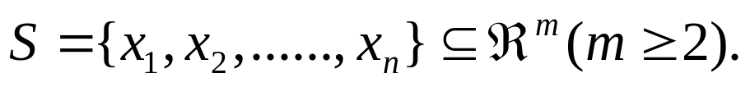
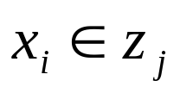
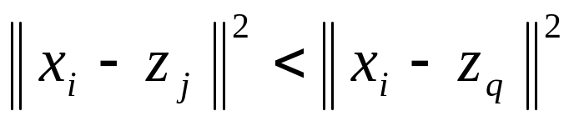
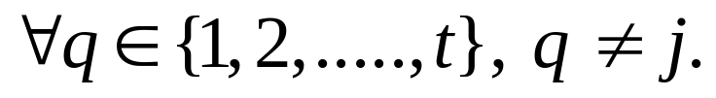
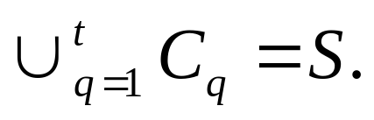
ALGORITHM AL-2
Step 1: Let
be the set of seed points of
Step 2: Divide the n points of S into t groups in the following way:
Put x_{i} in the j_{th} group C_{j} utilizing the minimum squared Euclidean distance classifier concept: i. e. if
and

Slide 16



Step 3: For two groups C_{i} and C_{j} find d_{ij} where
If
then merge those two groups
C_{i} and C_{j} into one group and name it as C_{i} .
Step 4: Repeat Step 3 for all possible pairs of i and j.
Step 5: Stop.

Slide 17


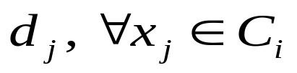


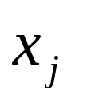


Algorithm to Eliminate Noise
Step 1: Let
be the K clusters of
Step 2: For each group
, compute the distance
where
. If
then remove the data point
from the clustering obtained by AL-2.
and
Step 3: Repeat Step 2 for all possible pairs of
Step 4: Stop.

Slide 18
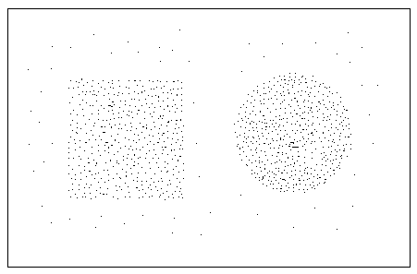
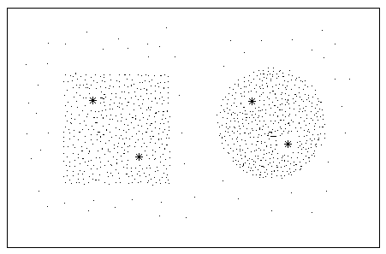
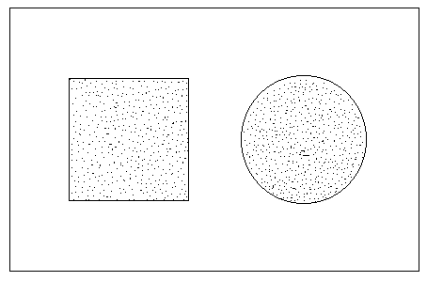
Experimental Results
Scatter diagram of synthetic data with noise
Scatter diagram with seed points
Clustering by the proposed method

Slide 19
Scatter diagram of synthetic data with noise
Scatter diagram with seed points
Clustering by the proposed method

Slide 20
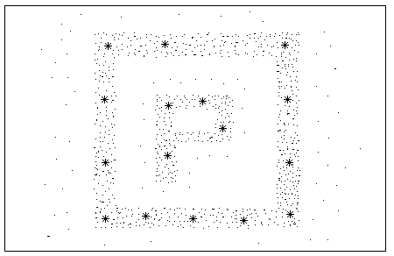
Scatter diagram of synthetic data with noise
Scatter diagram with seed points
Clustering by the proposed method

Slide 21
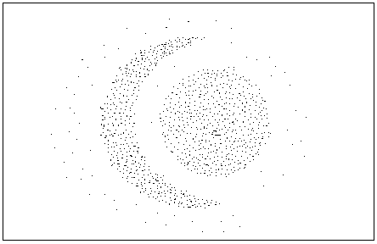
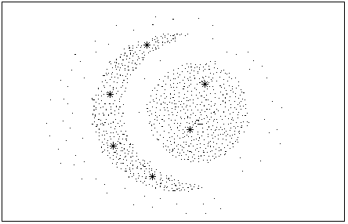
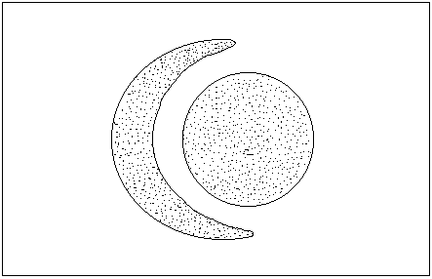
Scatter diagram of synthetic data with noise
Scatter diagram with seed points
Clustering by the proposed method

Slide 22
Thank You

