Slide 1
CSE / T / 423C
Distributed Computing
Topic 1: Introduction
Sarbani Roy
Department of Computer Science & Engineering
Jadavpur University
E-mail: sarbani.roy@jadavpuruniversity.in
Room: CC-5-7
Phone: 9051639328

Slide 2
Course Objectives (COs)
CO1. Understand the evolution, architecture, principles, middleware and key components of distributed computing environments.
CO2: Understand the techniques of communication in distributed environment.
CO3: Demonstrate knowledge of the core design and architectural aspects of distributed computing environments like Cluster, P2P, Grid and Cloud.
CO4: Understand the design of distributed computing software and framework like Hadoop and MapReduce

Slide 3
Suggested Readings
Distributed Computing: Principles and Applications, M. L. Liu, Pearson
Cloud Computing Principles and Paradigms - Rajkumar Buyya, James Broberg, Andrzej M. Goscinski, Wiley
Hadoop: The Definitive Guide Book by Tom White, O’Reilly
Map Reduce Design Patterns: Building Effective Algorithms and Analytics for Hadoop by Donald Miner, O’Reilly
Slides are mainly prepared using online documents available of the above books and course materials of different institutes

Slide 4
CSE / T / 423C Distributed Computing
Introduction to distributed environment [4L]: Goals, hardware & software concepts, Overview of high performance computing, Parallel computing. Collaborative computing, architecture, middleware, Strengths and weaknesses of distributed computing, Single System Image (SSI), Service oriented design, Service level agreement, Quality of Service.
Communication [8]: Message-oriented communication, stream oriented communication, MPI, Socket, sockets with non-blocking I/O, secure socket API, WebSocket, Remote procedure call, Remote method Invocation, registry, remote Interface.

Slide 5
Client Server model [2L]: Architecture, multi-tier design, applications (e.g., email, chat)
Mobile Agents: [2L] Basic architecture, advantages, mobile agent framework systems
P2P [2L]: Architecture, design, application (e.g., Napster).
Cluster Computing [3L]: Hardware and software, Architecture, middleware, cluster computing environments, cluster resource management, SSI, Level of abstractions, performance metrics, case study (e.g., Condor, LSF)
Grid Computing [3L]: Grid Service Architecture, Infrastructure, middleware, resource management, application, case study (e.g., Globus Toolkit)

Slide 6
Cloud Computing [8L]: Architecture, types of cloud services (IaaS, PaaS, SaaS, XaaS), Parallel processing in the cloud, Distributed storage systems, Virtualization, Pros and cons of Virtualization, Types of Virtualization – System VM, Process VM, Virtual Machine monitor, Virtual machine properties, Interpretation and binary translation, Hypervisors (e.g., Xen, KVM, VMWare, Virtual Box, Hyper-V), state-of-the-art solutions for cloud computing (e.g., GCP, AWS (EC2, S3), Azure, Heroku etc.), Federated Cloud.
Hadoop [5]: core components of Hadoop, Hadoop master-slave architecture, Hadoop Cluster, Daemon types - Name node, Data node, Secondary Name node, HDFS, Hadoop Ecosystem, HDFS
MapReduce [5]: Overview of MapReduce Framework, MapReduce Architecture, Job tracker and Task tracker, Use cases of MapReduce.

Slide 7
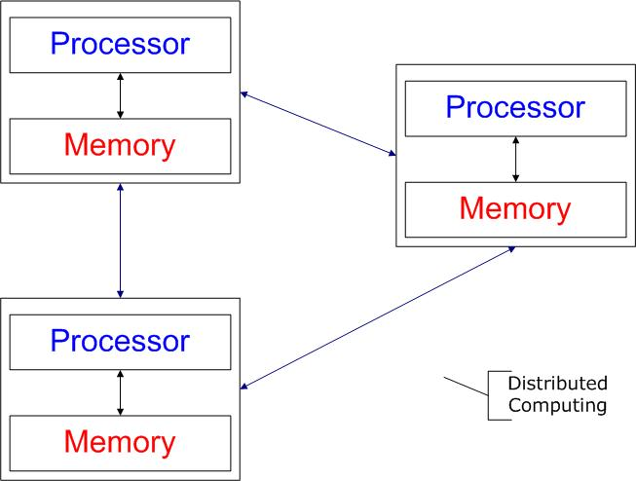
What is Distributed Computing/System?
Distributed system
  Wikipedia
    There are several autonomous computational entities, each of which has its own local memory.
    The entities communicate with each other by message passing.
  Operating System Concept
    The processors communicate with one another through various communication lines, such as high-speed buses or telephone lines.
    Each processor has its own local memory.
Distributed computing
  A field of computing science that studies distributed system.
  The use of distributed systems to solve computational problems.

Slide 8

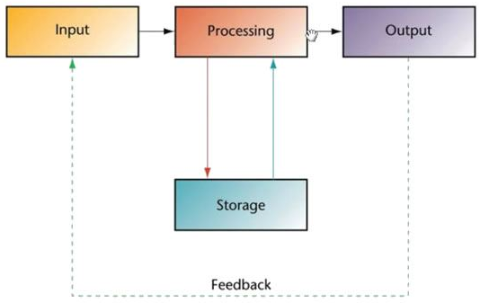
Interaction Flow

Slide 9
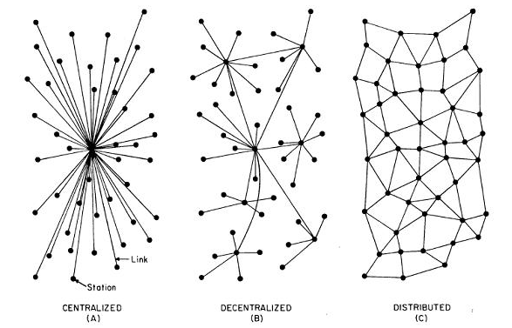
Centralized→ Decentralized → Distributed

Slide 10
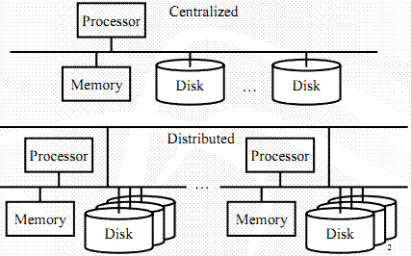
Centralized vs Distributed

Slide 11
Evolution of Distributed Computing

Slide 12
Common properties
Fault tolerance
    When one or some nodes fails, the whole system can still work fine except performance.
    Need to check the status of each node
  Each node play partial role
    Each computer has only a limited, incomplete view of the system. Each computer may know only one part of the input.
  Resource sharing
    Each user can share the computing power and storage resource in the system with other users
  Load Sharing
    Dispatching several tasks to each nodes can help share loading to the whole system.
  Easy to expand
    We expect to use few time when adding nodes. Hope to spend no time if possible.
Notes:
Resource sharing: if a number of different sites are connected to one another, then a user at one site A may connect to/use the resource in site B. For example, HDFS in hadoop
Load balancing: if a particular computation can be split into several tasks that can run concurrently. Then distributed system can execute these program in several nodes.

Slide 13
Why Distributed Computing?
The nature of application
Performance
  Computing intensive
    The task could consume a lot of time on computing. For example, compute intensive tasks like solving complex numerical problem
  Data intensive
    The task that deals with a lot amount or large size of files. For example, Facebook, Twitter
Robustness
  No SPOF (Single Point Of Failure)
  Other nodes can execute the same task executed on failed node.
A distributed system can be more reliable than a non-distributed system, as there is no single point of failure.
Notes:
A distributed system can be more reliable than a non-distributed system, as there is no single point of failure.

Slide 14
Why do we use distributed systems?
The alternative to using a distributed system is to have a huge centralized system, such as a mainframe.
  Cost: Better price/performance as long as commodity hardware is used for the component computers.
  Performance: By using the combined processing and storage capacity of many nodes, performance levels can be reached that are beyond the range of centralized machines.
  Scalability: Resources such as processing and storage capacity can be increased incrementally.
  Inherent distribution: Some applications, such as email and the Web (where users are spread out over the whole world), are naturally distributed. This includes cases where users are geographically dispersed as well as when single resources (e.g., printers, data) need to be shared.
  Reliability: By having redundant components the impact of hardware and software faults on users can be reduced.

Slide 15
Problems
Network: Networks are needed to connect independent nodes and are subject to performance limitations. Besides these limitations, networks also constitute new potential points of failure.
Security: Because a distributed system consists of multiple components there are more elements that can be compromised and must, therefore, be secured. This makes it easier to compromise distributed systems.
Software complexity: Distributed software is more complex and harder to develop than conventional software; hence, it is more expensive to develop and there is a greater chance of introducing errors.

Slide 16
Hardware and Software Architectures
A key characteristic of our definition of distributed systems is that it includes both a hardware aspect (independent computers) and a software aspect (performing a task and providing a service).
  From a hardware point of view distributed systems are generally implemented on multicomputers.
  From a software point of view they are generally implemented as distributed operating systems or middleware.

Slide 17
Architectures of Distributed programming
client–server
3-tier architecture
n-tier architecture
distributed objects
loose coupling
tight coupling

Slide 18
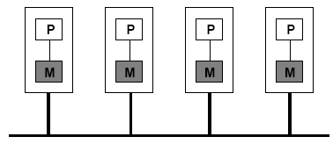
Multicomputers
A multicomputer consists of separate computing nodes connected to each other over a network.
Multicomputers generally differ from each other in three ways:
  Node resources: This includes the processors, amount of memory, amount of secondary storage, etc. available on each node.
  Network connection: The network connection between the various nodes can have a large impact on the functionality and applications that such a system can be used for. A multicomputer with a very high bandwidth network is more suitable for applications that actively share data over the nodes and modify large amounts of that shared data. A lower bandwidth network, however, is sufficient for applications where there is less intense sharing of data.
  Homogeneity: A homogeneous multicomputer is one where all the nodes are the same, that is they are based on the same physical architecture (e.g. processor, system bus, memory, etc.). A heterogeneous multicomputer is one where the nodes are not expected to be the same.
One common characteristic of all types of multicomputers is that the resources on any particular node cannot be directly accessed by any other node. All access to remote resources ultimately takes the form of requests sent over the network to the node where that resource resides.

Slide 19
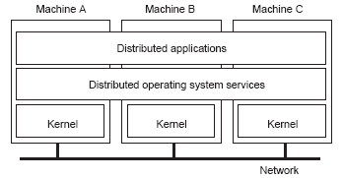
Distributed Operating
System
A distributed operating system (DOS) is a an operating system that is built, from the ground up, to provide distributed services.
As such, a DOS integrates key distributed services into its architecture. These services may include
  distributed shared memory,
  assignment of tasks to processors,
  masking of failures,
  distributed storage,
  interprocess communication,
  transparent sharing of resources,
  distributed resource management, etc.

Slide 20
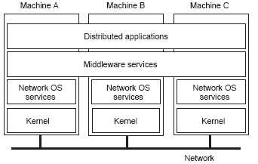
Middleware
The goal of middleware is to create system independent interfaces for distributed applications.
Middleware services facilitate the implementation of distributed applications and attempt to hide the heterogeneity (both hardware and software) of the underlying system architectures.
The principle aim of middleware, namely raising the level of abstraction for distributed programming, is achieved in three ways:
  communication mechanisms that are more convenient and less error prone than basic message passing;
  Independence from OS, network protocol, programming language, etc. and
  standard services (such as a naming service, transaction service, security service, etc.).

Slide 21
Goal of middleware
Hide the heterogeneity of the underlying systems (and in particular of the services offered by the underlying OS)
Middleware systems often try to offer a complete set of services so that clients do not have to rely on underlying OS services directly.
  This provides transparency for programmers writing distributed applications using the given middleware.

Slide 22
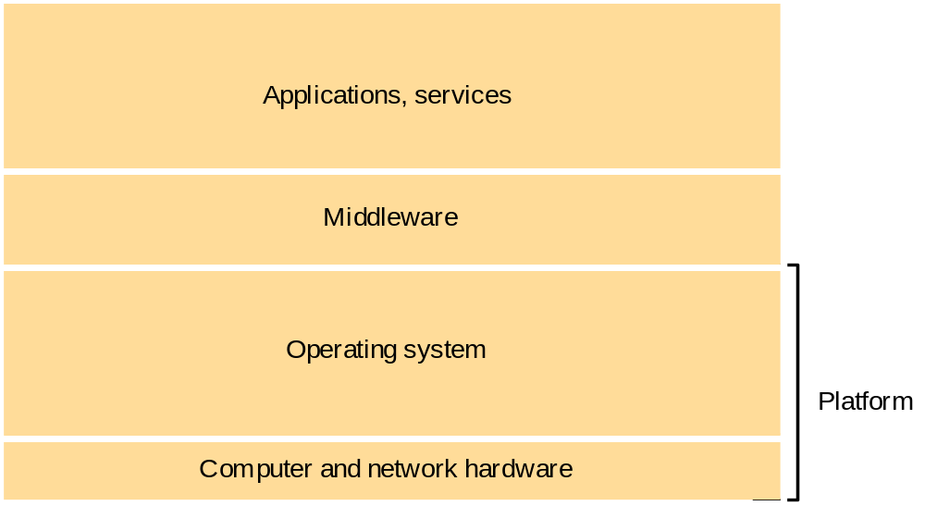
Layers in Distributed Systems

Slide 23
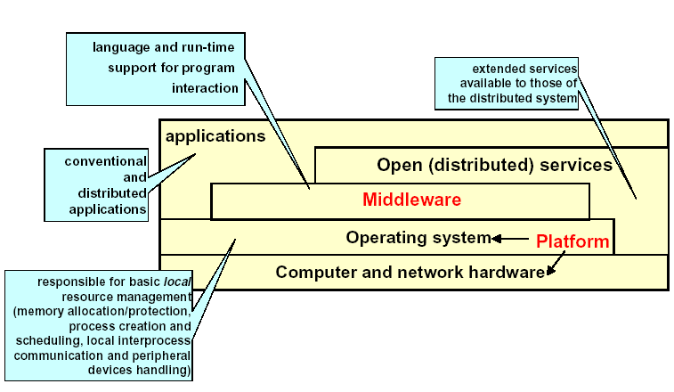
Software Layers

Slide 24
Distributed systems and parallel computing
Parallel computing systems aim for improved performance by employing multiple processors to execute a single application.
They come in two flavors:
  shared-memory systems: use multiple processors that share a single bus and memory sub-system.
  distributed memory systems: use independent computing nodes connected via a network (i.e., a multicomputer).
Despite the promise of improved performance, parallel programming remains difficult and if care is not taken performance may end up decreasing rather than increasing.

Slide 25
Basic problems and challenges
Throughout the study of the various aspects of distributed systems, we will repeatedly encounter a number of challenges that are inherent in the distributed nature of these systems:
  Transparency
  Scalability
  Dependability
  Performance
  Flexibility
These challenges can also be seen as the goals (or desired properties) of a distributed system.

Slide 26
Transparency
Transparency is the concealment from the user and the application programmer of the separation of the components of a distributed system (i.e., a single image view). Transparency is a strong property that is often difficult to achieve. There are a number of different forms of transparency including the following:
  Access Transparency: Local and remote resources are accessed in same way
  Location Transparency: Users are unaware of the location of resources
  Migration Transparency: Resources can migrate without name change
  Replication Transparency: Users are unaware of the existence of multiple copies of resources
  Failure Transparency: Users are unaware of the failure of individual components
  Concurrency Transparency: Users are unaware of sharing resources with others
  Performance Transparency: users and application programmers are not aware as to how the performance that a distributes system has is actually achieved
  Scalability Transparency: Scalability denotes the fact that the distributed system can be adjusted to accommodate a growing load / number of users
Note that complete transparency is not always desirable due to the trade-offs with performance and scalability, as well as the problems that can be caused when confusing local and remote operations. Furthermore complete transparency may not always be possible since nature imposes certain limitations on how fast communication can take place in wide-area networks.

Slide 27
Dimensions Of Transparency
Scalability Transparency
Performance Transparency
Failure Transparency
Migration Transparency
Replication Transparency
Concurrency Transparency
Access Transparency
Location Transparency

Slide 28
Scalability
Scalability is important in distributed systems, and in particular in wide area distributed systems, and those expected to experience large growth.
According to Neuman a system is scalable
“If It can handle the addition of users and resources without suffering a noticeable loss of performance or increase in administrative complexity.”
Adding users and resources causes a system to grow. This growth has three dimensions:
  Size: number of users or resources
  Geography: distance between nodes
  Administration: cross administrative domains

Slide 29
Dependability
Distributed systems provide the potential for higher availability due to replication.
The distributed nature of services means that more components have to work properly for a single service to function.
Hence, there are more potential points of failure and if the system architecture does not take explicit measures to increase reliability, there may actually be degradation of availability.
Dependability requires consistency, security, and fault tolerance.

Slide 30
Performance
Any system should strive for maximum performance, but in the case of distributed systems this is a particularly interesting challenge, since it directly conflicts with some other desirable properties.
In particular, transparency, security, dependability and scalability can easily be risky to performance.

Slide 31
Flexibility
A flexible distributed system can be configured to provide exactly the services that a user or programmer needs. A system with this kind of flexibility generally provides a number of key properties.
  Extensibility allows one to add or replace system components in order to extend or modify system functionality.
  Openness means that a system provides its services according to standard rules regarding invocation syntax and semantics. Openness allows multiple implementations of standard components to be produced. This provides choice and flexibility.
  Interoperability ensures that systems implementing the same standards can interoperate.

Slide 32
Motivation for Distribution
Share resources
Personalise environments
Location independence
People & information are distributed
Performance & cost
Modularity & expandability
Availability & reliability
Scalability

Slide 33
Principles
There are several key principles underlying all distributed systems. As such, any distributed system can be described based on how those principles apply to that system.
  System Architecture
  Communication
  Synchronization
  Replication and Consistency
  Fault Tolerance
  Security
  Naming

Slide 34
Security issues
Centralized systems:
  can rely on physical security
  Users understand what trust to assign to the system
  System administrators are responsible
Distributed systems:
  None of the above applies !
  Hard to know what is being trusted or what can be trusted

Slide 35
Paradigms
Most middleware systems (and, therefore, most distributed systems) are based on a particular paradigm, or model, for describing distribution and communication.
Some of these paradigms are:
  Shared memory
  Distributed objects
  Distributed file system
  Shared documents
  Distributed coordination
  Agents

