Slide 1
CSE / T / 423C
Distributed Computing
Topic 3: Cluster Computing
Sarbani Roy
Department of Computer Science & Engineering
Jadavpur University
E-mail: sarbani.roy@jadavpuruniversity.in
Room: CC-5-7
Phone: 9051639328

Slide 2
Motivation
Need more computing power
  Improve the operating speed of processors & other components
    high financial costs for processor fabrication
  Connect multiple processors together & coordinate their computational efforts
    parallel computers
    allow the sharing of a computational task among multiple processors

Slide 3
How to run applications faster?
There are 3 ways to improve performance:
  Work Harder
  Work Smarter
  Get Help
Computer Analogy
  Using faster hardware
  Optimized algorithms and techniques used to solve computational tasks
  Multiple computers to solve a particular task

Slide 4
Era of Computing
Rapid technical advances
  the recent advances in VLSI technology
  software technology
    OS, PL, development methodologies, & tools
Parallel computing
  one of the best ways to overcome the speed bottleneck of a single processor
  good price/performance ratio of a small cluster-based parallel computer

Slide 5
Scalable Parallel Computer Architectures
Taxonomy
  based on how processors, memory & interconnect are laid out
Massively Parallel Processors (MPP)
Symmetric Multiprocessors (SMP)
Cache-Coherent Nonuniform Memory Access (CC-NUMA)
Distributed Systems
Clusters

Slide 6
Scalable Parallel Computer Architectures
MPP
  A large parallel processing system with a shared-nothing architecture
  Consist of several hundred nodes with a high-speed interconnection network/switch
  Each node consists of a main memory & one or more processors
    Runs a separate copy of the OS
SMP
  2-more processors
  Shared-everything architecture
  All processors share all the global resources available
  Single copy of the OS runs on these systems

Slide 7
Scalable Parallel Computer Architectures
CC-NUMA
  a scalable multiprocessor system having a cache-coherent nonuniform memory access architecture
  every processor has a global view of all of the memory
Distributed systems
  considered conventional networks of independent computers
  have multiple system images as each node runs its own OS
  the individual machines could be combinations of MPPs, SMPs, clusters, & individual computers
Clusters
  a collection of workstations of PCs that are interconnected by a high-speed network
  work as an integrated collection of resources
  have a single system image spanning all its nodes

Slide 8
Towards Low Cost Parallel Computing
  Parallel processing
    linking together 2 or more computers to jointly solve some computational problem
    since the early 1990s, an increasing trend to move away from expensive and specialized proprietary parallel supercomputers towards networks of workstations
    the rapid improvement in the availability of commodity high performance components for workstations and networks
      Low-cost commodity supercomputing
    from specialized traditional supercomputing platforms to cheaper, general purpose systems consisting of loosely coupled components built up from single or multiprocessor PCs or workstations
    need to standardization of many of the tools and utilities used by parallel applications (e.g., MPI)

Slide 9
Motivations of using NOW over Specialized Parallel Computers
Individual workstations are becoming increasing powerful
Communication bandwidth between workstations is increasing and latency is decreasing
Workstation clusters are easier to integrate into existing networks
Typical low user utilization of personal workstations
Development tools for workstations are more mature
Workstation clusters are a cheap and readily available
Clusters can be easily grown

Slide 10
Cluster Computer and its Architecture
A cluster is a type of parallel or distributed processing system, which consists of a collection of interconnected stand-alone computers cooperatively working together as a single, integrated computing resource
In general
  a single or multiprocessor system with memory, I/O facilities, & OS
  generally 2 or more computers (nodes) connected together
  in a single cabinet, or physically separated & connected via a LAN
  appear as a single system to users and applications
  provide a cost-effective way to gain features and benefits

Slide 11

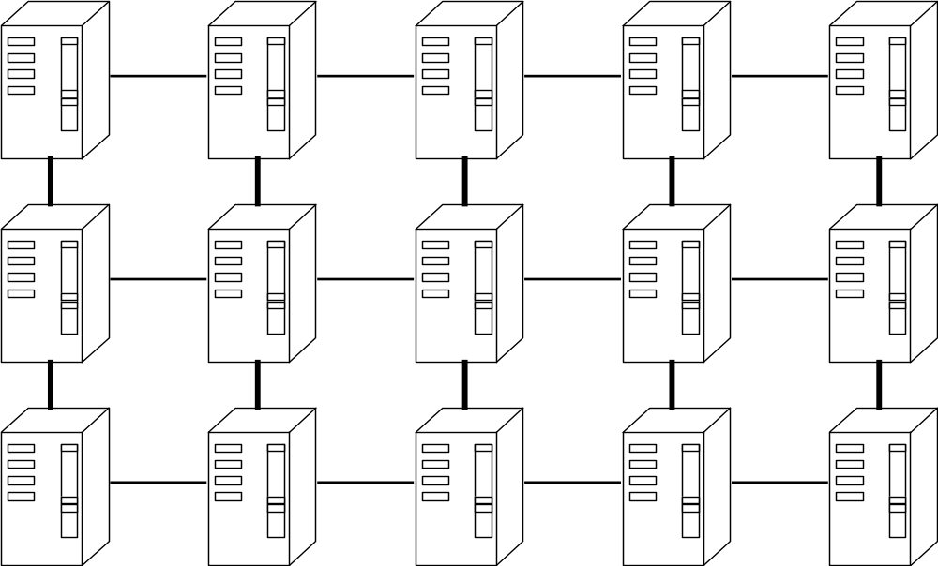
Low Cost Supercomputing
No
Parallel Processing on Linux Clusters

Slide 12
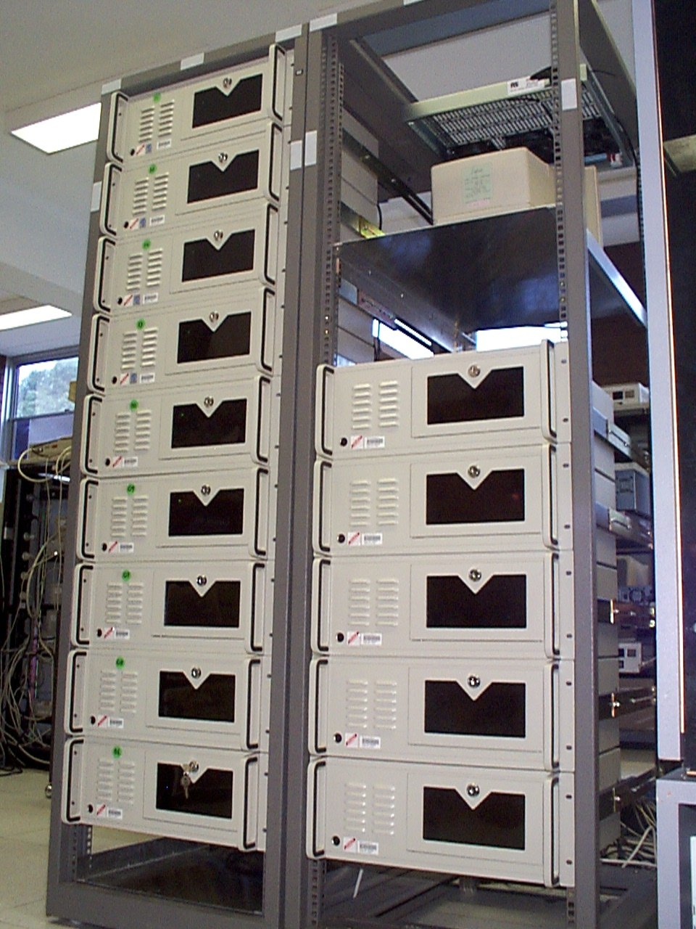
Cluster Computing
Notes:
3

Slide 13
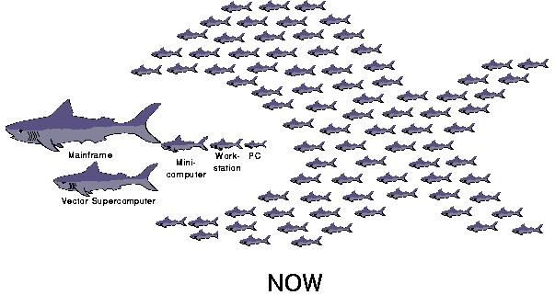
Computer Food Chain (Now and Future)
Demise of Mainframes, Supercomputers, & MPPs
Notes:
2

Slide 14
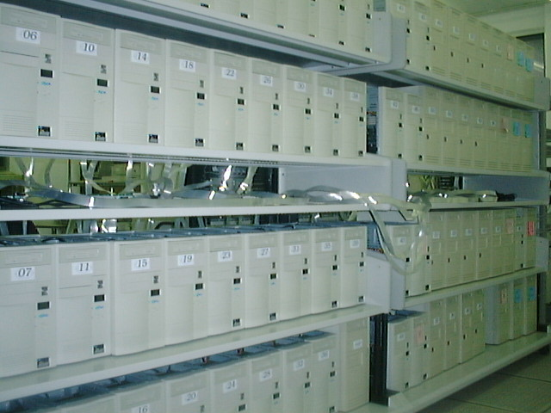
Cluster Configuration..1
Dedicated Cluster
Notes:
3

Slide 15

Cluster Configuration..2
Enterprise Clusters
Shared Pool of
Computing Resources:
Processors, Memory, Disks
Interconnect
Guarantee at least one
workstation to many individuals
(when active)
Deliver large % of collective
resources to few individuals
at any one time
Notes:
3

Slide 16
Key Operational Benefits of Clustering
High Performance
Expandability and Scalability
High Throughput
High Availability

Slide 17
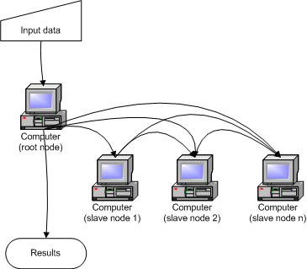
Cluster Architecture

Slide 18
Cluster Computer Architecture
Parallel Applications
Parallel Applications
Parallel Applications
Sequential Applications
Sequential Applications
Sequential Applications
Parallel Programming Environment
Cluster Middleware
(Single System Image and Availability Infrastructure)
PC/Workstation
PC/Workstation
PC/Workstation
PC/Workstation
Communications
Software
Communications
Software
Communications
Software
Communications
Software
Network Interface Hardware
Network Interface Hardware
Network Interface Hardware
Network Interface Hardware
Cluster Interconnection Network/Switch

Slide 19
Cluster Middleware & SSI
SSI
  Supported by a middleware layer that resides between the OS and user-level environment
  Middleware consists of essentially 2 sublayers of SW infrastructure
    SSI infrastructure
      Glue together OSs on all nodes to offer unified access to system resources
    System availability infrastructure
      Enable cluster services such as checkpointing, automatic failover, recovery from failure, & fault-tolerant support among all nodes of the cluster

Slide 20

SSI Support Services
Single Entry Point
  telnet cluster.myinstitute.edu
  telnet node1.cluster. myinstitute.edu
Single File Hierarchy: xFS, AFS, Solaris MC Proxy
Single Management and Control Point: Management from single GUI
Single Virtual Networking
Single Memory Space - Network RAM / DSM
Single Job Management: GLUnix, LSF
Single User Interface: Like workstation/PC windowing environment, may it can use Web technology

Slide 21
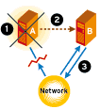
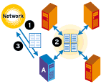
Availability Vs Performance
High Availability Computing
High Performance Computing

Slide 22
Availability Support Functions
Single I/O Space (SIOS):
  any node can access any peripheral or disk devices without the knowledge of physical location.
Single Process Space (SPS)
  Any process on any node create process with cluster wide process wide and they communicate through signal, pipes, etc, as if they are one a single node.
Checkpointing and Process Migration.
  Saves the process state and intermediate results in memory to disk to support rollback recovery when node fails
  Migration for dynamic load balancing among the cluster nodes

Slide 23
Resource Management and Scheduling (RMS)
RMS is the act of distributing applications among computers to maximize their throughput
Enable the effective and efficient utilization of the resources available
Software components
  Resource manager
    Locating and allocating computational resource, authentication, process creation and migration
  Resource scheduler
    Queuing applications, resource location and assignment. It instructs resource manager what to do when (policy)
Reasons for using RMS
  Provide an increased, and reliable, throughput of user applications on the systems
  Load balancing
  Utilizing spare CPU cycles
  Providing fault tolerant systems
  Manage access to powerful system, etc
Basic architecture of RMS: client-server system

Slide 24
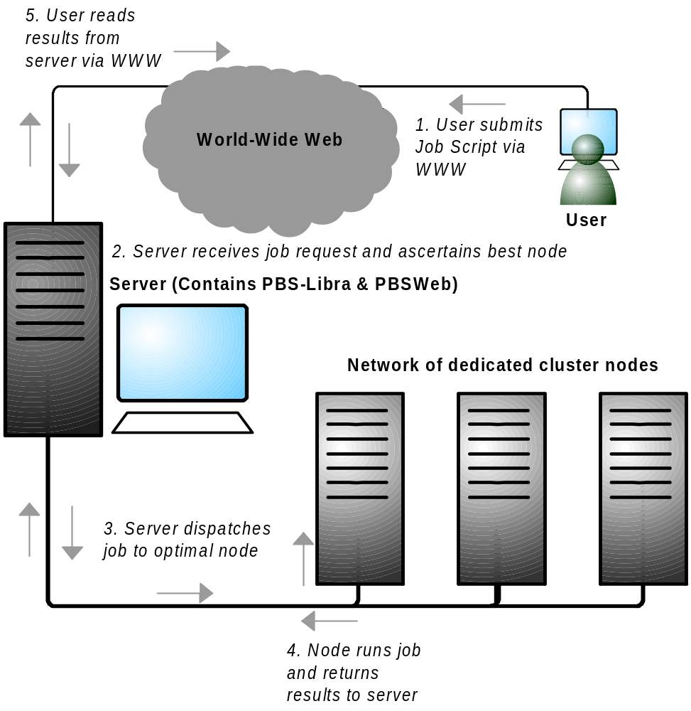
RMS Components

Slide 25

Libra: An example cluster scheduler
User
Cluster Management System
(PBS)
Application
Job
Input
Control
Job Dispatch Control
(node 1)
Application
Budget
Check
Control
Best
Node
Evaluator
User
.
(node 2)
.
.
Deadline Control
Node Querying Module
(node N)
Scheduler (Libra)
Cluster Worker Nodes
with node monitor (pbs_mom)
Server: Master Node

Slide 26
Services provided by RMS
Process Migration
  Computational resource has become too heavily loaded
  Fault tolerant concern
Checkpointing
Scavenging Idle Cycles
  70% to 90% of the time most workstations are idle
Fault Tolerance
Minimization of Impact on Users
Load Balancing
Multiple Application Queues

Slide 27
Cluster Programming Environments
Shared Memory Based
  DSM
  Threads/OpenMP (enabled for clusters)
  Java threads (HKU JESSICA, IBM cJVM)
Message Passing Based
  PVM (PVM)
  MPI (MPI)
Parametric Computations
  Nimrod
  Condor
Automatic Parallelising Compilers
Parallel Libraries & Computational Kernels (e.g., NetSolve)
Notes:
14

Slide 28


Levels of Parallelism
Code-Granularity
Code Item
Large grain
(task level)
Program
Medium grain
(control level)
Function (thread)
Fine grain
(data level)
Loop (Compiler)
Very fine grain
(multiple issue)
With hardware
PVM/MPI
Task i-l
Task i
Task i+1
func1 ( )
{
....
....
}
func2 ( )
{
....
....
}
func3 ( )
{
....
....
}
Threads
Compilers
a ( 0 ) =..
b ( 0 ) =..
a ( 1 )=..
b ( 1 )=..
a ( 2 )=..
b ( 2 )=..
CPU
+
x
Load

Slide 29
Representative Cluster Systems
The Berkeley Network of Workstations (NOW) Project
  Demonstrate building of a large-scale parallel computer system using mass produced commercial workstations & the latest commodity switch-based network components
  Interprocess communication
    Active Messages (AM)
      basic communication primitives in Berkeley NOW
      A simplified remote procedure call that can be implemented efficiently on a wide range of hardware
  Global Layer Unix (GLUnix)
    An OS layer designed to provide transparent remote execution, support for interactive parallel & sequential jobs, load balancing, & backward compatibility for existing application binaries
    Aim to provide a cluster-wide namespace and uses Network PIDs (NPIDs), and Virtual Node Numbers (VNNs)

Slide 30
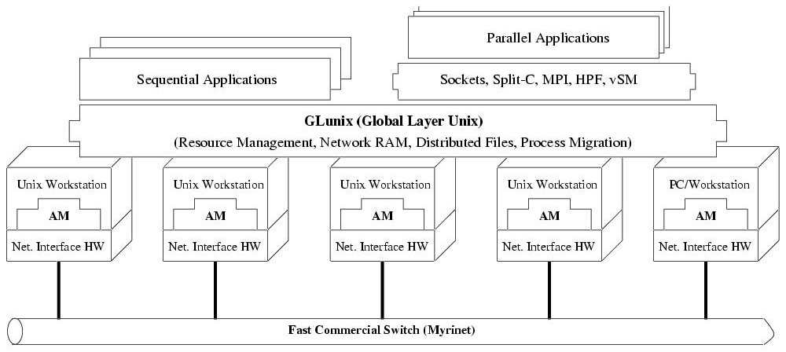
Architecture of NOW System
http://now.cs.berkeley.edu/

Slide 31
Condor
Condor
  Computing intensive jobs
  Queuing policy
    Match task and computing nodes
  Resource Classification
    Each resource can advertise its attributes and master can classify according to this

Slide 32
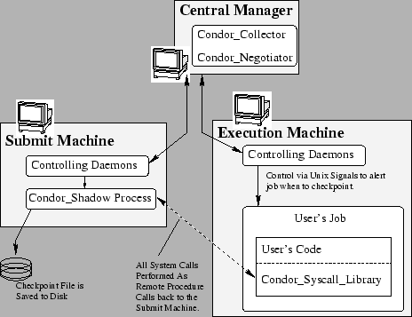
Case study - Condor
http://www.cs.wisc.edu/condor/
Notes:
This program runs on the machine where a given request was submitted and acts as the resource manager for the request. Jobs that are linked for Condor's standard universe, which perform remote system calls, do so via the condor_shadow. Any system call performed on the remote execute machine is sent over the network, back to the condor_shadow which actually performs the system call (such as file I/O) on the submit machine, and the result is sent back over the network to the remote job. In addition, the shadow is responsible for making decisions about the request (such as where checkpoint files should be stored, how certain files should be accessed, etc).

Slide 33
Case study - Condor
Role
  Central Manger
    The collector of information, and the negotiator between resources and resource requests
  Execution machine
    Responsible for executing condor tasks
  Submit machine
    Responsible for submitting condor tasks
  Checkpoint servers
    Responsible for storing all checkpoint files for the tasks
Notes:
Every machine in a Condor pool can serve a variety of roles. Most machines serve more than one role simultaneously. Certain roles can only be performed by single machines in your pool. The following list describes what these roles are and what resources are required on the machine that is providing that service:
Central Manager
There can be only one central manager for your pool. The machine is the collector of information, and the negotiator between resources and resource requests. These two halves of the central manager's responsibility are performed by separate daemons, so it would be possible to have different machines providing those two services. However, normally they both live on the same machine. This machine plays a very important part in the Condor pool and should be reliable. If this machine crashes, no further matchmaking can be performed within the Condor system (although all current matches remain in effect until they are broken by either party involved in the match). Therefore, choose for central manager a machine that is likely to be up and running all the time, or at least one that will be rebooted quickly if something goes wrong. The central manager will ideally have a good network connection to all the machines in your pool, since they all send updates over the network to the central manager. All queries go to the central manager.
Execute
Any machine in your pool (including your Central Manager) can be configured for whether or not it should execute Condor jobs. Obviously, some of your machines will have to serve this function or your pool won't be very useful. Being an execute machine doesn't require many resources at all. About the only resource that might matter is disk space, since if the remote job dumps core, that file is first dumped to the local disk of the execute machine before being sent back to the submit machine for the owner of the job. However, if there isn't much disk space, Condor will simply limit the size of the core file that a remote job will drop. In general the more resources a machine has (swap space, real memory, CPU speed, etc.) the larger the resource requests it can serve. However, if there are requests that don't require many resources, any machine in your pool could serve them.
Submit
Any machine in your pool (including your Central Manager) can be configured for whether or not it should allow Condor jobs to be submitted. The resource requirements for a submit machine are actually much greater than the resource requirements for an execute machine. First of all, every job that you submit that is currently running on a remote machine generates another process on your submit machine. So, if you have lots of jobs running, you will need a fair amount of swap space and/or real memory. In addition all the checkpoint files from your jobs are stored on the local disk of the machine you submit from. Therefore, if your jobs have a large memory image and you submit a lot of them, you will need a lot of disk space to hold these files. This disk space requirement can be somewhat alleviated with a checkpoint server (described below), however the binaries of the jobs you submit are still stored on the submit machine.
Checkpoint Server
One machine in your pool can be configured as a checkpoint server. This is optional, and is not part of the standard Condor binary distribution. The checkpoint server is a centralized machine that stores all the checkpoint files for the jobs submitted in your pool. This machine should have lots of disk space and a good network connection to the rest of your pool, as the traffic can be quite heavy.
*-*- *-*- *-*- *-*- *-*- *-*- *-*- *-*- *-*- *-*- *-*- *-*- *-*- *-*- *-*- *-*- *-*-
3.1.2 The Condor Daemons
The following list describes all the daemons and programs that could be started under Condor and what they do:
condor_master
This daemon is responsible for keeping all the rest of the Condor daemons running on each machine in your pool. It spawns the other daemons, and periodically checks to see if there are new binaries installed for any of them. If there are, the master will restart the affected daemons. In addition, if any daemon crashes, the master will send e-mail to the Condor Administrator of your pool and restart the daemon. The condor_master also supports various administrative commands that let you start, stop or reconfigure daemons remotely. The condor_master will run on every machine in your Condor pool, regardless of what functions each machine are performing.
condor_startd
This daemon represents a given resource (namely, a machine capable of running jobs) to the Condor pool. It advertises certain attributes about that resource that are used to match it with pending resource requests. The startd will run on any machine in your pool that you wish to be able to execute jobs. It is responsible for enforcing the policy that resource owners configure which determines under what conditions remote jobs will be started, suspended, resumed, vacated, or killed. When the startd is ready to execute a Condor job, it spawns the condor_starter, described below.
condor_starter
This program is the entity that actually spawns the remote Condor job on a given machine. It sets up the execution environment and monitors the job once it is running. When a job completes, the starter notices this, sends back any status information to the submitting machine, and exits.
condor_schedd
This daemon represents resource requests to the Condor pool. Any machine that you wish to allow users to submit jobs from needs to have a condor_schedd running. When users submit jobs, they go to the schedd, where they are stored in the job queue, which the schedd manages. Various tools to view and manipulate the job queue (such as condor_submit, condor_q, or condor_rm) all must connect to the schedd to do their work. If the schedd is down on a given machine, none of these commands will work.
The condor_schedd advertises the number of waiting jobs in its job queue and is responsible for claiming available resources to serve those requests. Once a schedd has been matched with a given resource, the schedd spawns a condor_shadow (described below) to serve that particular request.
condor_shadow
This program runs on the machine where a given request was submitted and acts as the resource manager for the request. Jobs that are linked for Condor's standard universe, which perform remote system calls, do so via the condor_shadow. Any system call performed on the remote execute machine is sent over the network, back to the condor_shadow which actually performs the system call (such as file I/O) on the submit machine, and the result is sent back over the network to the remote job. In addition, the shadow is responsible for making decisions about the request (such as where checkpoint files should be stored, how certain files should be accessed, etc).
condor_collector
This daemon is responsible for collecting all the information about the status of a Condor pool. All other daemons periodically send ClassAd updates to the collector. These ClassAds contain all the information about the state of the daemons, the resources they represent or resource requests in the pool (such as jobs that have been submitted to a given schedd). The condor_status command can be used to query the collector for specific information about various parts of Condor. In addition, the Condor daemons themselves query the collector for important information, such as what address to use for sending commands to a remote machine.
condor_negotiator
This daemon is responsible for all the match-making within the Condor system. Periodically, the negotiator begins a negotiation cycle, where it queries the collector for the current state of all the resources in the pool. It contacts each schedd that has waiting resource requests in priority order, and tries to match available resources with those requests. The negotiator is responsible for enforcing user priorities in the system, where the more resources a given user has claimed, the less priority they have to acquire more resources. If a user with a better priority has jobs that are waiting to run, and resources are claimed by a user with a worse priority, the negotiator can preempt that resource and match it with the user with better priority.
NOTE: A higher numerical value of the user priority in Condor translate into worse priority for that user. The best priority you can have is 0.5, the lowest numerical value, and your priority gets worse as this number grows.
condor_kbdd
This daemon is used on Linux and Windows. On those platforms, the condor_startd frequently cannot determine console (keyboard or mouse) activity directly from the system, and requires a separate process to do so. On Linux, the condor_kbdd connects to the X Server and periodically checks to see if there has been any activity. On Windows, the condor_kbdd runs as the logged-in user and registers with the system to receive keyboard and mouse events. When it detects console activity, the condor_kbdd sends a command to the startd. That way, the startd knows the machine owner is using the machine again and can perform whatever actions are necessary, given the policy it has been configured to enforce.
condor_ckpt_server
This is the checkpoint server. It services requests to store and retrieve checkpoint files. If your pool is configured to use a checkpoint server but that machine (or the server itself is down) Condor will revert to sending the checkpoint files for a given job back to the submit machine.
condor_quill
This daemon builds and manages a database that represents a copy of the Condor job queue. The condor_q and condor_history tools can then query the database.
condor_dbmsd
This daemon assists the condor_quill daemon.
condor_gridmanager
This daemon handles management and execution of all grid universe jobs. The condor_schedd invokes the condor_gridmanager when there are grid universe jobs in the queue, and the condor_gridmanager exits when there are no more grid universe jobs in the queue.
condor_credd
This daemon runs on Windows platforms to manage password storage in a secure manner.
condor_had
This daemon implements the high availability of a pool's central manager through monitoring the communication of necessary daemons. If the current, functioning, central manager machine stops working, then this daemon ensures that another machine takes its place, and becomes the central manager of the pool.
condor_replication
This daemon assists the condor_had daemon by keeping an updated copy of the pool's state. This state provides a better transition from one machine to the next, in the event that the central manager machine stops working.
condor_transferer
This short lived daemon is invoked by the condor_replication daemon to accomplish the task of transferring a state file before exiting.
condor_procd
This daemon controls and monitors process families within Condor. Its use is optional in general but it must be used if privilege separation (see Section 3.6.14) or group-ID based tracking (see Section 3.13.12) is enabled.
condor_job_router
This daemon transforms vanilla universe jobs into grid universe jobs, such that the transformed jobs are capable of running elsewhere, as appropriate.
condor_lease_manager
This daemon manages leases in a persistent manner. Leases are represented by ClassAds.
condor_rooster
This daemon wakes hibernating machines based upon configuration details.
condor_shared_port
This daemon listens for incoming TCP packets on behalf of Condor daemons, thereby reducing the number of required ports that must be opened when Condor is accessible through a firewall.
condor_hdfs
This daemon manages the configuration of a Hadoop file system as well as the invocation of a properly configured Hadoop file system.

Slide 34
Case study - Condor
Robustness
  One execution machine fails
    We can execute the same task on other nodes.
  Recovery
    Only need to restart the daemon when the failed nodes are online

Slide 35
Case study - Condor
Resource sharing
  Each condor user can share computing power with other condor users.
Synchronization
  Users need to take care by themselves
    Users can execute MPI job in a condor pool but need to think of the issues of synchronization and Deadlock.
Failure detection
  Central manager can know when nodes fails
    Based on update notification sent by nodes
Scalability
  Only execute few commands when new nodes are online.

