Slide 1
Fabrication

Slide 2
Silicon vs. Germanium
Ge was used for transistors initially, but silicon took over in the late 1960s; WHY?
  (1) Large variety of process steps possible without the problem of decomposition (as in the case of compound semiconductors)
  (2) Si has a wider bandgap than Ge
    => higher operating temperature (125-175 ºC vs. ~85 ºC)
(3) Si readily forms a native oxide (SiO₂)
    high-quality insulator
    protects and “passivates” underlying circuitry
    helps in patterning
    useful for dopant masking
(4) Si is cheap and abundant (It is the second most abundant element in the earth's crust, after oxygen)

Slide 3
Silicon Disadvantages
Low carrier mobility (μ) =>
  slower circuits (compared to GaAs)
Material | Mobility (cm²/V-s)
Si | μ_{n} = 1500, μ_{p} = 460
Ge | μ_{n} = 3900, μ_{p} = 1900
GaAs | μ_{n} = 8000, μ_{p} = 380
Indirect bandgap:
  Weak absorption and emission of light
  Most optoelectronic applications not possible

Slide 4
Fabrication
Wafer Manufacturing
Purify old sand to 99.9999999%
Grow a monocrystaline ingot Cylindrical "boule“
Machine to a cylinder
Grind a flat side for orientation
Slice into wafers with diamond saw
Coat with silicon dioxide
Wafers are typically 74 to 150 mm in diameter and 0.4 mm thick

Slide 5
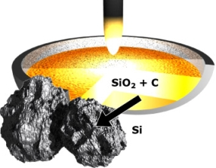
Step 1: Obtaining the Sand
The sand has to be a very clean and good form of silicon. Most of the sand used for these processes is obtained from the beaches of Australia.
Step 2: Preparing the Molten Silicon Bath
Quartz sand (SiO₂) is reduced with carbon in an electric arc furnace at > 1900°C to metallurgicalgrade Silicon (> 98 % pure).
Silicon Refining: SiO₂ + 2 C → Si + 2 CO
The metallurgical-grade Silicon is converted into trichlorosilane gas (HSiCl₃) using hydrochloric acid. Multiple distillation of HSiCl₃ improves the purity up to 99,9999999 %.
Silicon Purification: Si + 3 HCl → HSiCl₃ + H₂
Silicon Deposition: HSiCl₃ + H₂ → Si + 3 HCl

Slide 6
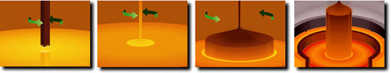
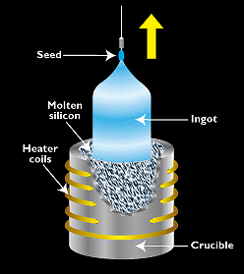
Step 3: CRYSTAL GROWTH
Czochralski Process is a Technique in Making Single-Crystal Silicon
A Solid Seed Crystal is Rotated and Slowly Extracted from a Pool of Molten Si
Requires Careful Control to Give Crystals Desired Purity and Dimensions

Slide 7
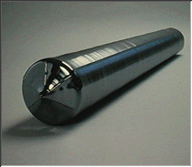
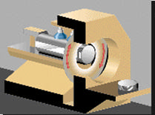
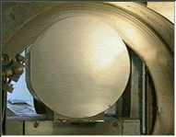
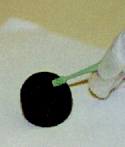
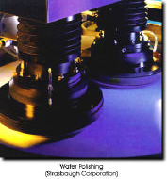
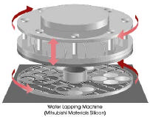
Step 4: Preparing the Wafers
Ingot is ground into the correct diameter for the wafers, the silicon ingot is sliced into very thin wafers. This is usually done with a diamond saw.
It is then polished after lapping
Wafers for IC
manufacturing
Polishing
Lapping

Slide 8







Preparation of Silicon Wafers
Polysilicon
Seed crystal
Crucible
6. Edge Rounding
7. Lapping
8. Wafer Etching
9. Polishong
10. Wafer Inspection
1. Crystal Growth
2. Single Crystal Ingot
3. Crystal Trimming and Diameter Grind
4. Flat Grinding
5. Wafer Slicing
Heater
Slurry
Polishing head
Polishing table

Slide 9
Fabrication: Basic Processing Steps
Each processing step requires that certain areas are defined on chip by appropriate masks.
Consequently, the integrated circuit may be viewed as a set of patterned layers of doped silicon, polysilicon, metal and insulating silicon dioxide.
In general, a layer must be patterned before the next layer of material is applied on chip. The process used to transfer a pattern to a layer on the chip is called lithography

Slide 10
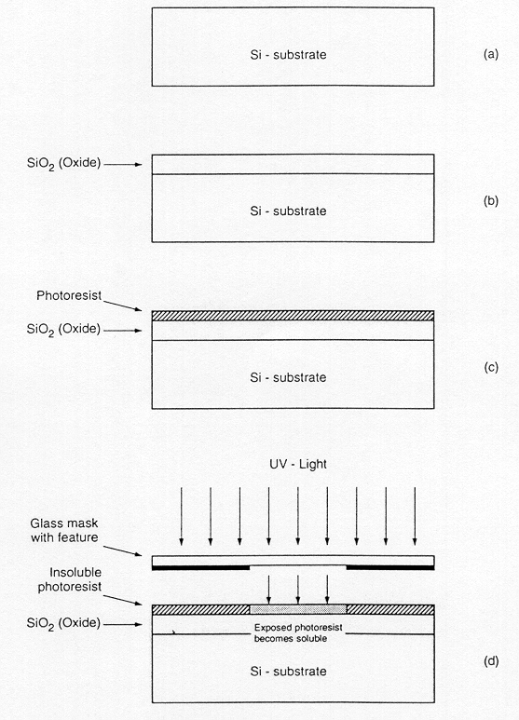
Fabrication
a) Starting Material: Lightly doped p-type Si substrate (required p impurities are introduced as the crystal is grown)
b) Oxidize small layer, about 1µm thick
c) Place photoresist (a light-sensitive, acid-resistant organic polymer) on top of SiO₂
d) Place mask(pattern) above photoresist and expose it to UV light (mask defines those regions into which diffusion is to take place together with channels)
In the areas where the UV light strikes the photoresist, it is “exposed” and becomes soluble in certain solutes

Slide 11
What is PhotoResist?
A light-sensitive, acid-resistant organic polymer
If the UV light strikes the photoresist (which is initially insoluble ), becomes soluble in certain solutes

Slide 12
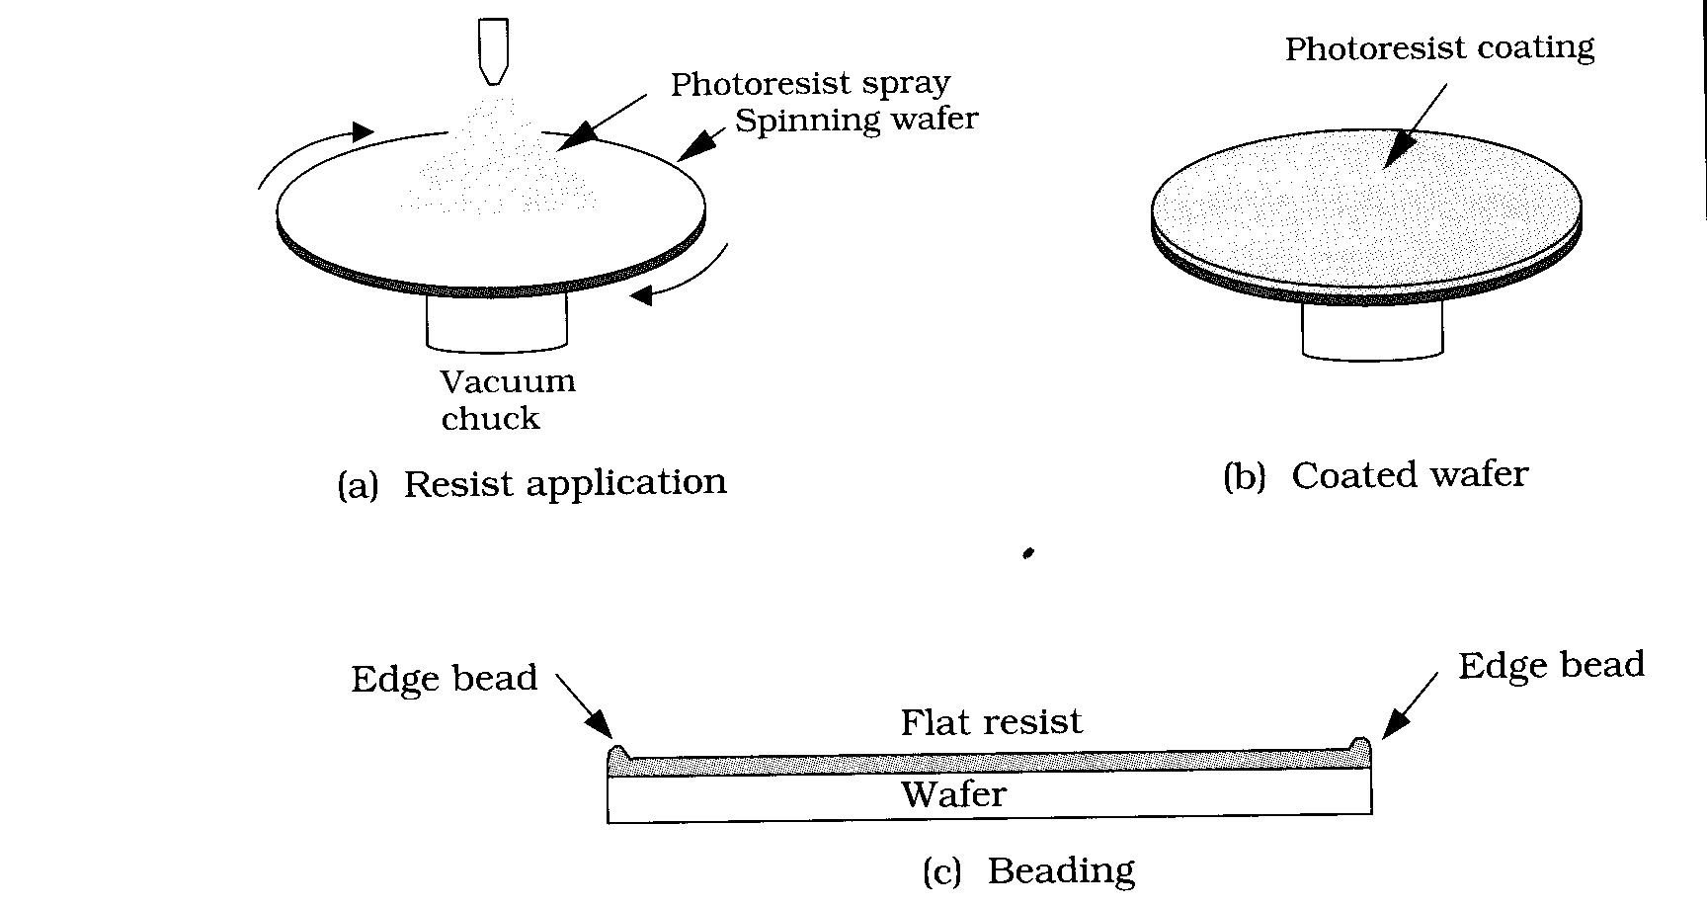
How is PhotoResist coated?
PhotoResist normally comes in powder form, which is insensitive to light. It is reconstituted into liquid form by adding a solvent, typically alcohol.
The wafer is mounted on a turntable, spinning slowly, and the photoresist is discharged into its centeer. Centrifugal force spreads the resist outward across the wafer.

Slide 13
PhotoResist
The thickness that remains on the wafer is a function of the rate of wafer spin and the viscosity of the photoresist.
The thickness is monitored by light diffraction, which is used to adjust the spin rate to reach the correct PR thickness.
After the PR is applied, the wafer is heated (~160C) to evaporate the solvent, leaving a smooth surface solid coating.
Phase Interference gives Photoresist Thickness

Slide 14
PhotoResist is used for two functions:
Delineation for Etching. A blanket deposition is made on the wafer, then photoresist patterning covers the areas to be SAVED. After developing, the wafer is etched and all parts NOT COVERED by photoresist are removed.
Delineation for Deposition. For ion implantation, areas are opened for doping the silicon. The photoresist absorbs all ions except for the areas which are open. In these areas (e.g. Drain or Source wells) the ions penetrate into the silicon.

Slide 15
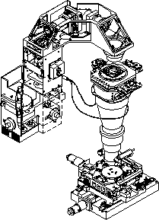
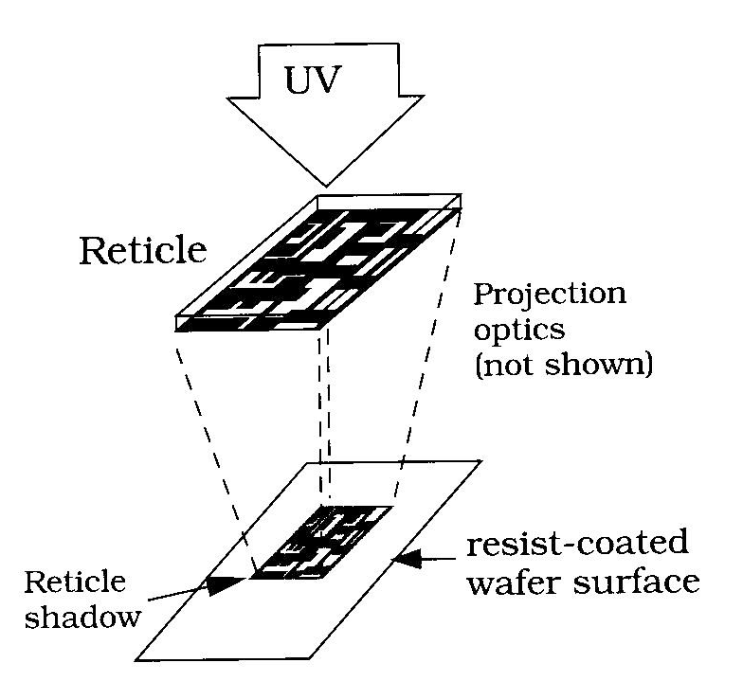
Application of Ultraviolet Light
The wafer is protected from light, and is put into the photo-lithography tool. Light is focussed on the wafer, delineating the IC pattern.
Photo Lithography Exposure Tool

Slide 16

After application of UV light
The wafer is removed and immersed in a Developer Solution. If the PR is “positive” resist, then those areas which received light will dissolve away. Negative resist reacts the opposite way, with those areas which were NOT exposed to light being dissolved. This step will leave holes in the resist layer.
The wafer is then heated to harden the patterned resist so that it will withstand immersion into acids. A typical hardening bake is ~300C.
The wafer then re-enters the processing line, for either etching or deposition in the patterned holes.
To be dissolved

Slide 17
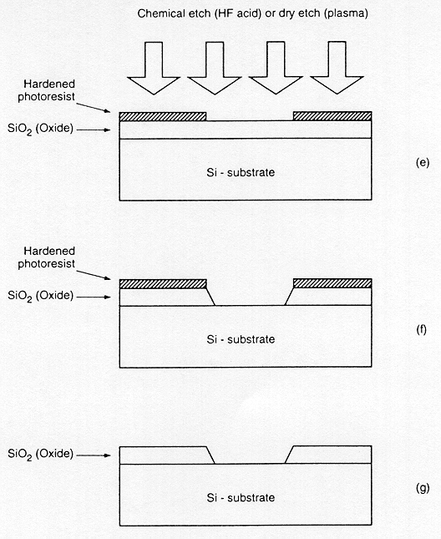
Basic Processing Steps
(e) After removal of unexposed portions of the photoresist , the silicon dioxide regions which are not covered by hardened photoresist can be etched away either by using a chemical solvent (HF acid) or by using a dry etch (plasma etch) process
(f) Note that at the end of this step, we obtain an oxide window that reaches down to the silicon surface
(g) The remaining (unexposed) photoresist can be stripped from the silicon dioxide surface by using another solvent, leaving the patterned silicon dioxide feature on the surface
The fabrication of semiconductor devices requires several such pattern transfers to be performed on silicon dioxide, polysilicon, and metal.

Slide 18
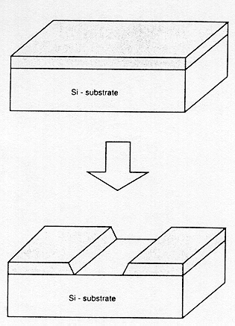
Basic Processing Steps
The result of a single lithographic patterning sequence on SiO₂, without showing the intermediate steps. It took 9 steps to make this simple hole:
Oxidize silicon surface
Deposit photoresist
Anneal photoresist
Mount mask above silicon
Expose to UV light
Develop photoresist
Etch photoresist exposed to UV
Etch SiO₂ through photoresist hole
Remove photoresist
The fabrication of semiconductor devices requires several such pattern transfers to be performed on silicon dioxide, polysilicon, and metal

Slide 19
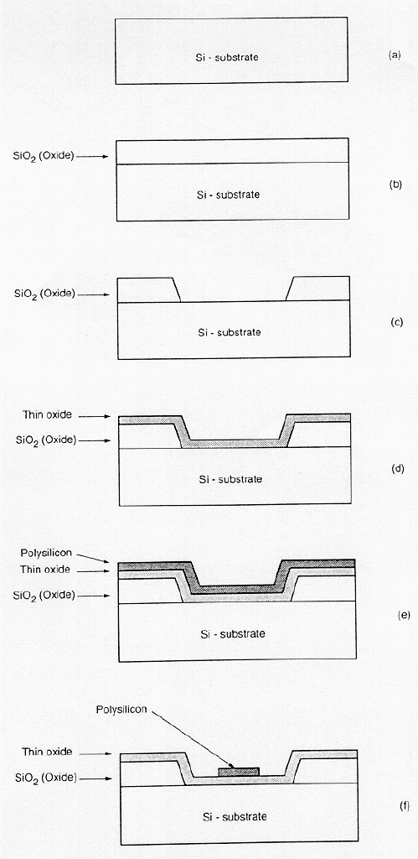
Making a NMOS Device
Start with a silicon substrate
A relatively thick silicon dioxide layer (5000A), also called field oxide, is created on the surface
Then, the field oxide is selectively etched to expose the silicon surface on which the MOS transistor will be created
The surface is covered with a thin, high-quality oxide layer (25A), which will eventually form the gate oxide of the MOS transistor
On top of the thin oxide, a layer of polysilicon (polycrystalline silicon, 3000A) is deposited. Polysilicon is used both as gate electrode material for MOS transistors and also as an interconnect medium in silicon integrated circuits. Undoped polysilicon has relatively high resistivity. The resistivity of polysilicon can be reduced, however, by doping it with impurity atoms
After deposition, the polysilicon layer is patterned and etched to form the interconnects and the MOS transistor gates. The thin gate oxide not covered by polysilicon is also etched away, which exposes the bare silicon surface on which the source and drain junctions are to be formed

Slide 20
Polysilicon
One of the most popular nonmetalic conductors
Composed of a large number of nonaligned, randomly oriented, small silicon crystals
Chemically same to but electrically different from single crystal silicon
A good conductor when heavily doped, good resistor when lightly doped

Slide 21
Interconnection Materials
Polysilicon interconnects are used to connect Gates and other short-distance connections which have minimal currents. Polysilicon is a very stable material that rarely interacts with nearby materials.
Metal interconnects have 3-5x the speed of polysilicon (electron mobility is higher) and less resistance. However, metals may react with nearby materials, and may have to be encapsulated using nitrides (e.g. Si₃N₄ or TiN) to prevent unwanted reactions, or partial erosion in subsequent etching procedures. This is expensive. In Upper Metallurgy (not local interconnects) metal is always used because processing is simple: only Metal + SiO₂.

Slide 22
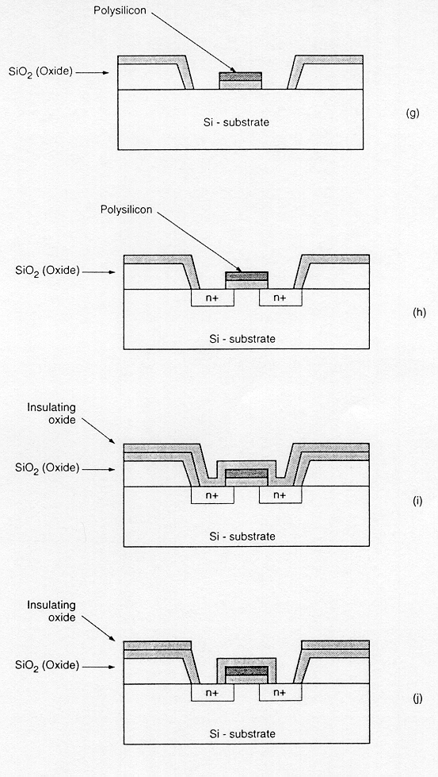
Making a NMOS Device
(g) The entire silicon surface is doped with a high concentration of impurities, either through diffusion or ion implantation (donor atoms to produce n-type doping)
(h) Doping penetrates the exposed areas on the silicon surface, ultimately creating two n-type regions (source and drain junctions) in the p-type substrate. The impurity doping also penetrates the polysilicon on the surface, reducing its resistivity.
The polysilicon gate, which is patterned before doping actually defines the precise location of the channel region and, hence, the location of the source and the drain regions. Since this procedure allows very precise positioning of the two regions relative to the gate, it is also called a self-aligned process.
(i) Once the source and drain regions are completed, the entire surface is again covered with an insulating layer of silicon dioxide
(j) The insulating oxide layer is then patterned in order to provide contact windows for the drain and source junctions

Slide 23
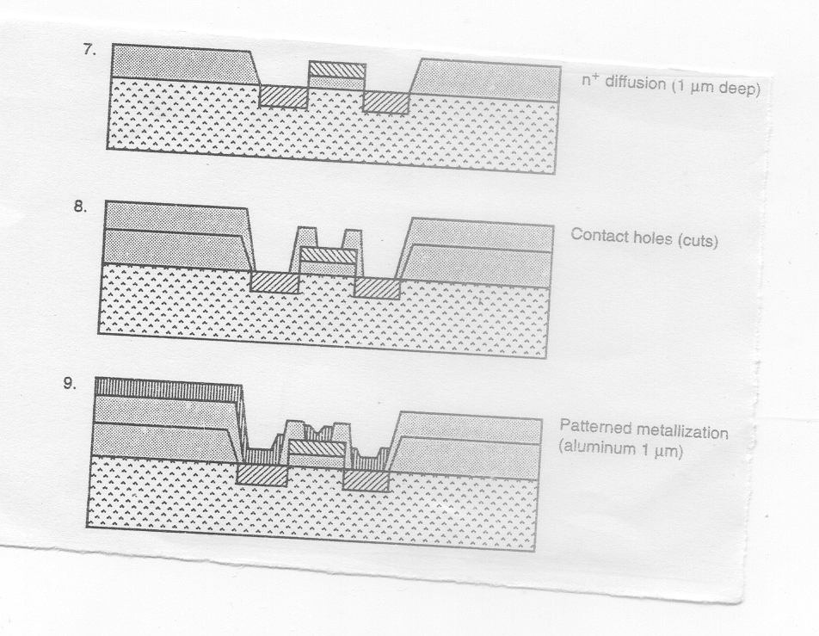
Making a NMOS Device
(k) Masked with photoresist and etched to expose selected areas of polysilicon gate and drain and source areas where connections are to be made
(l) The surface is covered with evaporated aluminum (5000A) which form the interconnects. Finally, the metal layer is patterned and etched, completing the interconnection of the MOS transistors on the surface.
(k)
(l)
Usually, a second (and third) layer of metallic interconnect (>5000A) can also be added on top of this structure by creating another insulating oxide layer, cutting contact (via) holes, depositing, and patterning the metal.

Slide 24
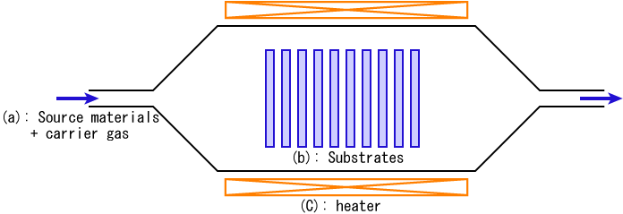
Chemical Vopor Deposition
http://en.wikipedia.org/wiki/Chemical_vapor_deposition

Slide 25
Chemical Vapour Disposition (CVD) Chemical Reactions
SiH₄(gas) + O₂(gas) ➔ SiO₂(solid) + 2H₂ (gas)
SiH₄(gas) + H₂(gas) +SiH₂(gas₎ ➔ 2H₂(gas) + PolySilicon (solid)
Continuous gas flow
Diffusion of reactants
Boundary layer
Deposited film
Silicon substrate

Slide 26
CMOS Fabrication

Slide 27
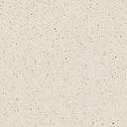
p-well CMOS
Vin
Vss
Vout
Vdd
P+ (for P-substrate contact)
N+ for N-substrate contact)
P
N+
pMOS
P+
p well
nMOS
N-type substrate

Slide 28
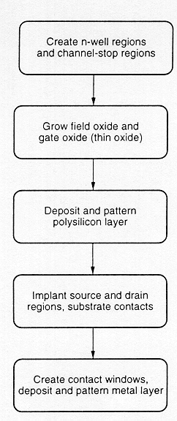
CMOS FABRICATION TECHNOLOGY
CMOS fabrication requires both nMOS and pMOS transistors to be built on the same chip substrate
To accommodate both nMOS and pMOS , special regions (called wells or tubs ) must be created in which the semiconductor type is opposite to the substrate type
A p-well is created in an n-type substrate or, alternatively, an n- well is created in a p-type substrate.
Oxide
Isolation
Metallization
G
G
-V_{SS}
S
D
D
S
+V_{DD}
n⁺
p⁺
p⁺
n⁺
n⁺
p⁺
p-well
p-MOSFET
n-MOSFET
Field oxide

Slide 29
CMOS FABRICATION TECHNOLOGY
The simplified process sequence for the fabrication of CMOS integrated circuits on a p- type silicon substrate is shown.
  The process starts with the creation of the n-well regions for pMOS transistors, by impurity implantation into the substrate.
  Then, a thick oxide is grown in the regions surrounding the nMOS and pMOS active regions.
  The thin gate oxide is subsequently grown on the surface through thermal oxidation.
  These steps are followed by the creation of n+ and p+ regions (source, drain and channel-stop implants).
  Finally the metallization is created (creation of metal interconnects).
Oxide Isolation
Metallization
G
D
G
-V_{SS}
S
D
S
+V_{DD}
n⁺
p⁺
p⁺
n⁺
n⁺
p⁺
p-well
Field oxide

Slide 30
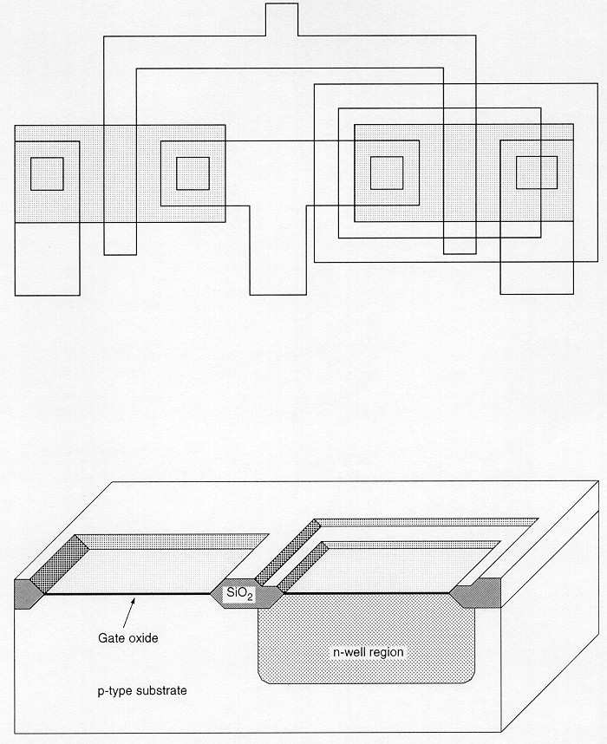
CMOS n-Well Process
The n-well CMOS process starts with a moderately doped (impurity concentration ~10¹⁶/cm³) p-type silicon substrate. Then, an initial thick “field” oxide layer (5000A) is grown on the entire surface.
The first lithographic mask defines the n-well region. Donor atoms, usually phosphorus, are implanted through this window in the oxide.
Once the n-well is created, the active areas of the nMOS and pMOS transistors can be defined.
Following the creation of the n-well region, a thick field oxide is grown around the transistor active regions, and a thin gate oxide (25A) is grown on top of the active regions.
Top view of lithographical mask
Cross-sectional view of relevant areas

Slide 31
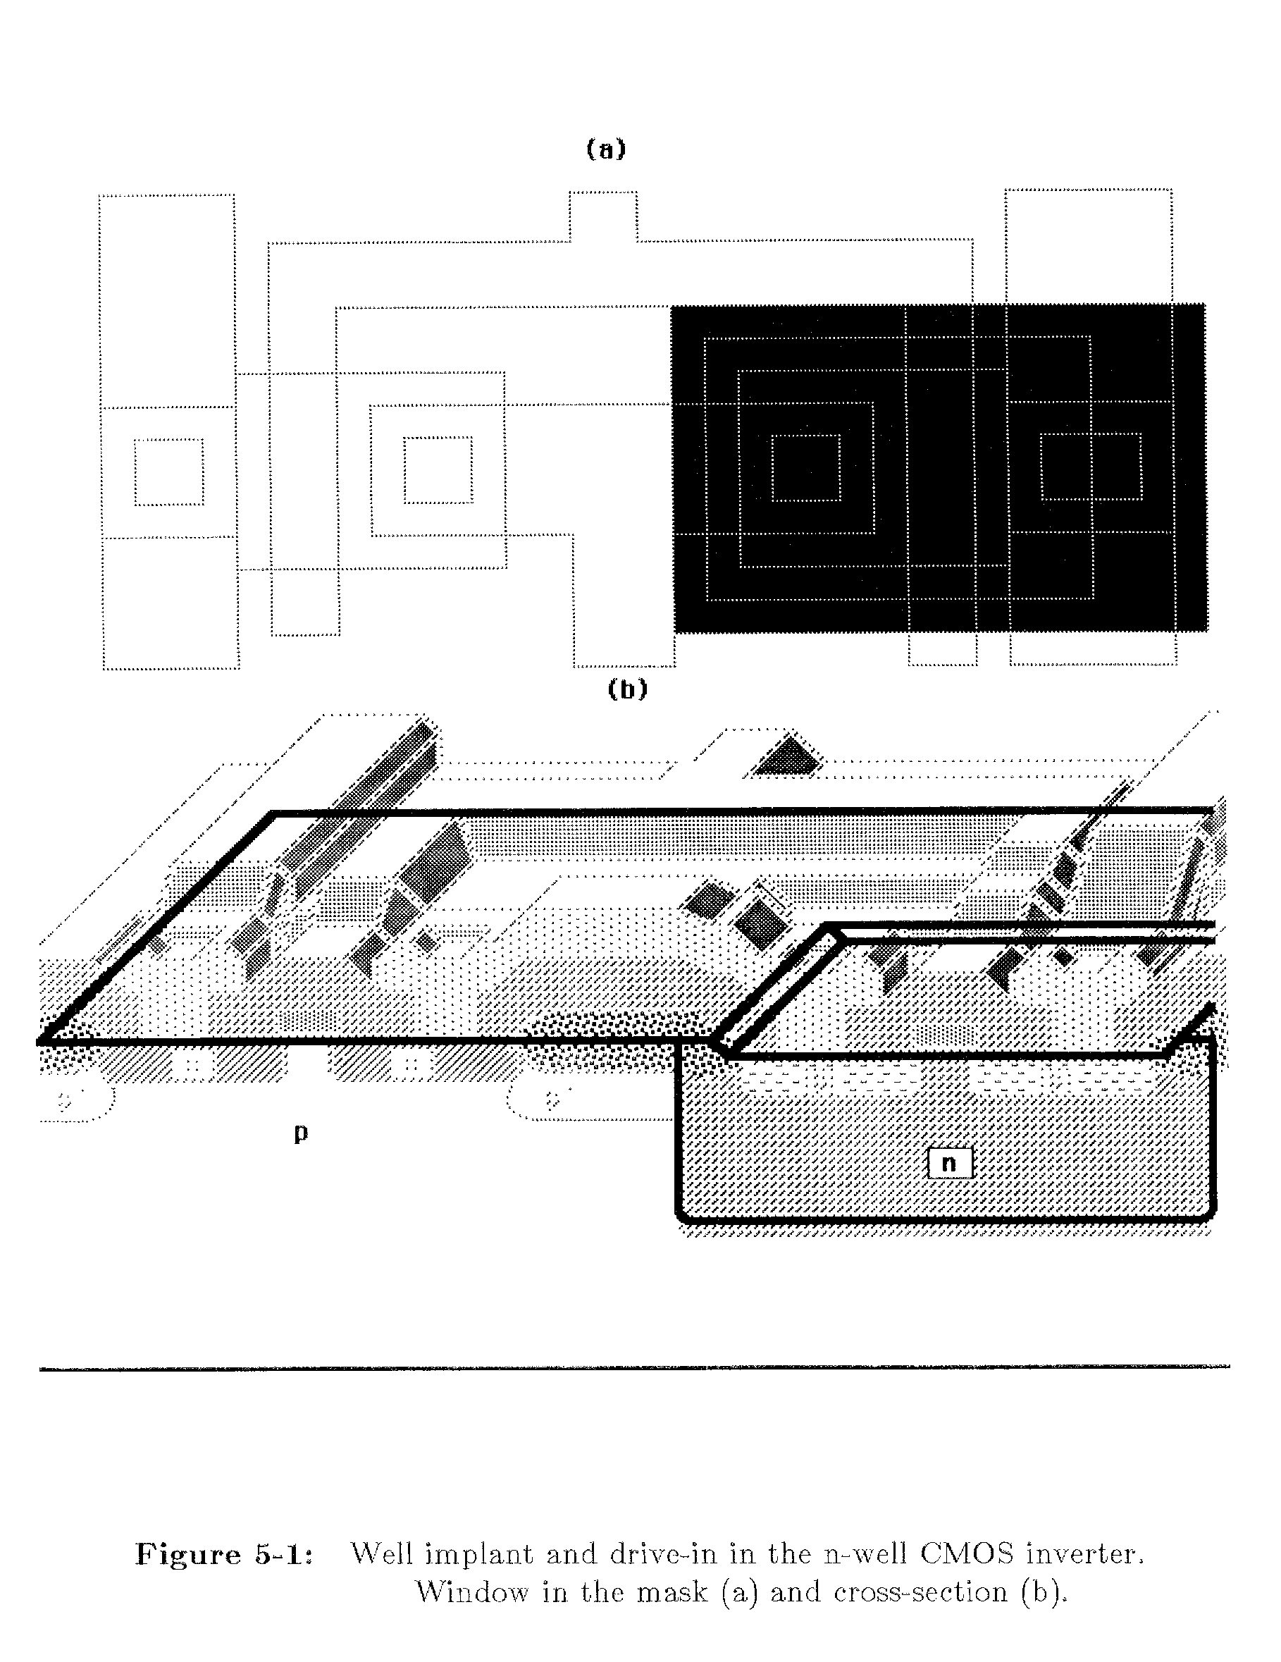
CMOS Fabrication Process
Dotted outline
is the final
circuit (for
reference).
Heavy line is the current
process step
Well Implant and drive-in in the n-well CMOS Inverter
(a) Window in the mask (b) Cross section

Slide 32
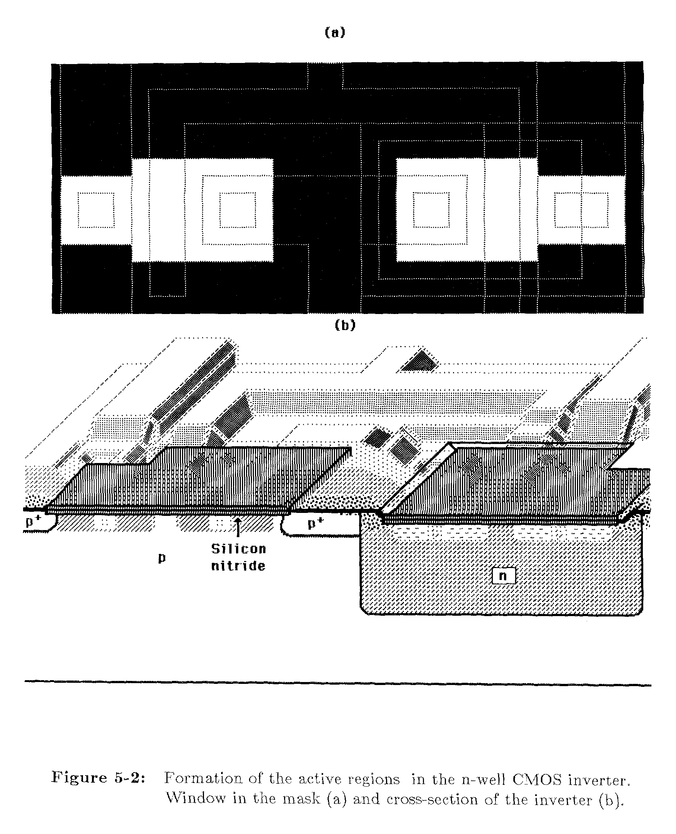
P+ Implant and Mask for Field Oxide Growth
Formation of active regions
(a) Window in the mask (b) Cross section

Slide 33
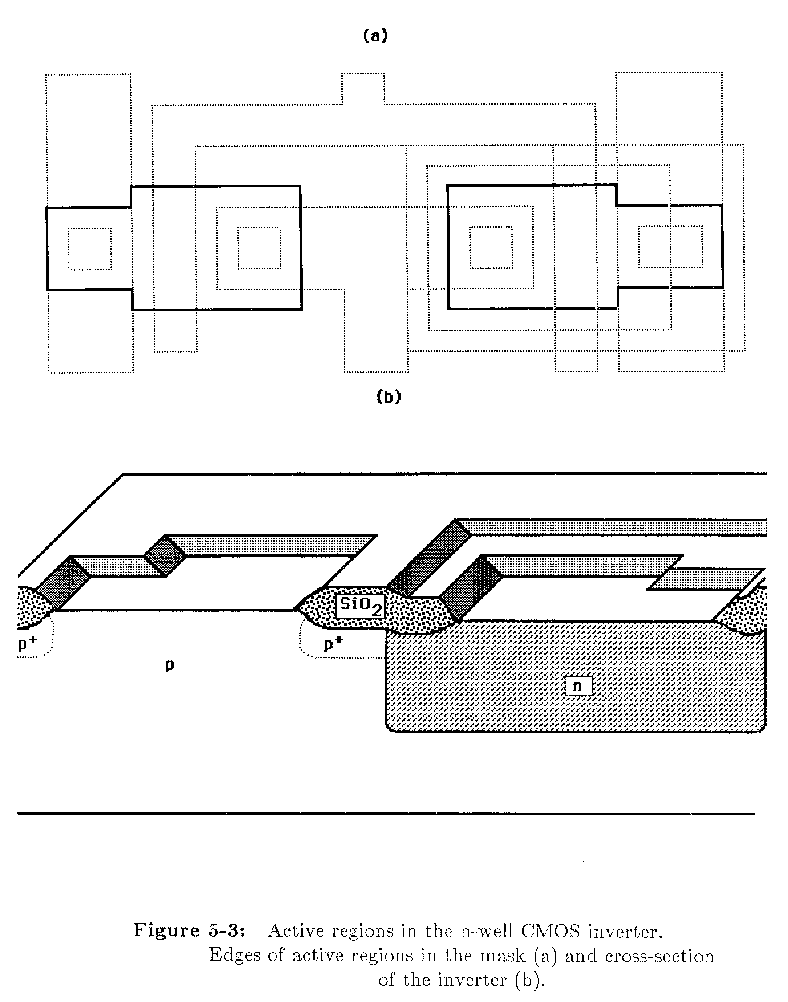
Thick Field Oxide Growth
Active regions
(a) Edges of active region in the mask (b) Cross section

Slide 34
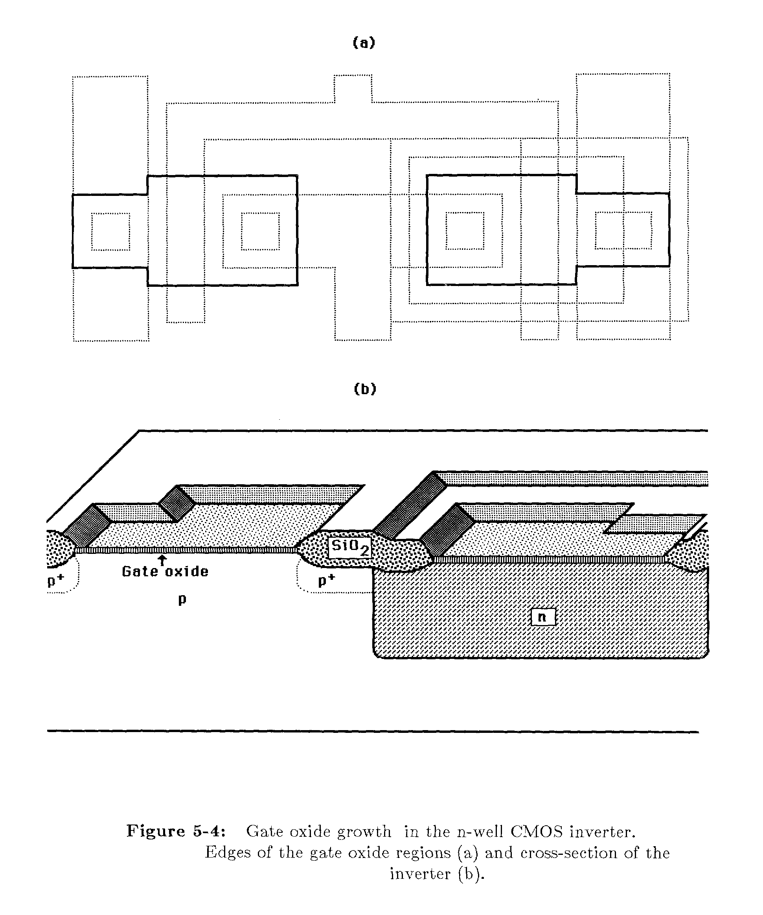
Gate Oxide Growth
Before the next process step, by masking the wafer, the channel regions can be separately
implanted. This extra step will allow adjustment of V_{tn} and V_{tp} by altering N_{B} locally under each gate.
Edges of gate oxide region (b) Cross section

Slide 35
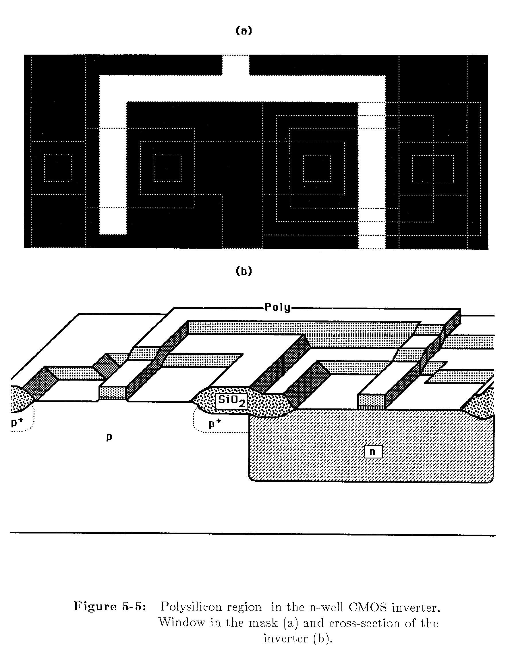
Deposit Gate Poly Si Layer and Etch
Avoid undercut of
poly so that L is
accurately transferred
from the mask.
Polysilicon Region: (a) Window in the mask (b) Cross section

Slide 36
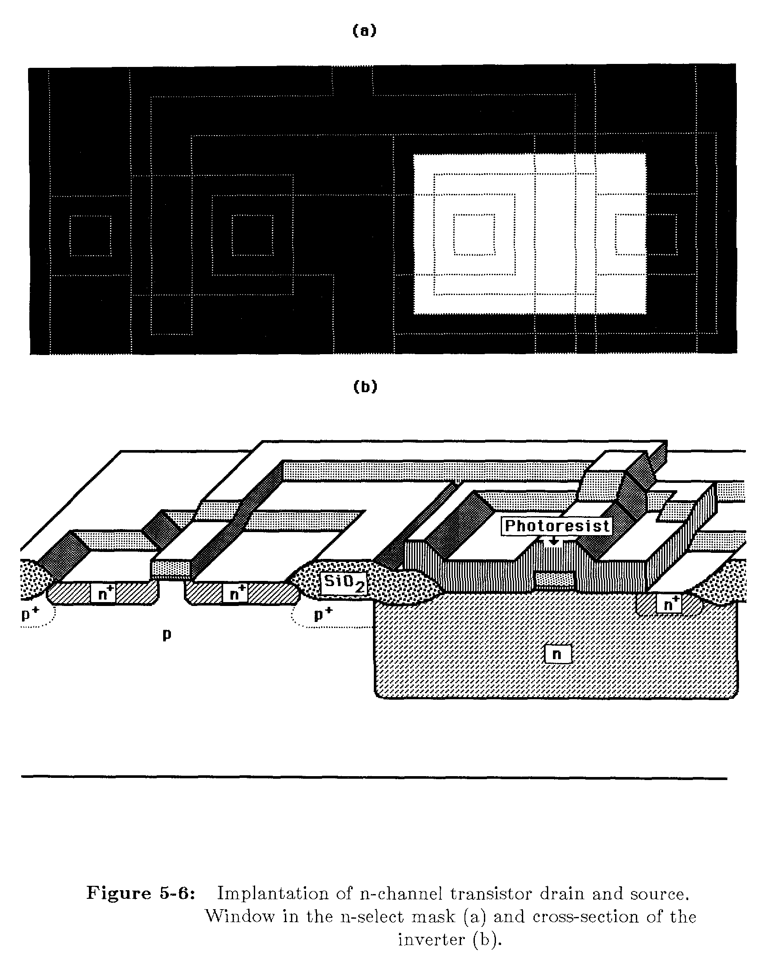
Implant n-Channel n+ Regions
Gate poly acts as mask
and thus alignment of
gate and source/drain is
automatic (self-aligned
process).
Implantation of n-channel transistor drain and source
(a) Window in the mask (b) Cross section

Slide 37
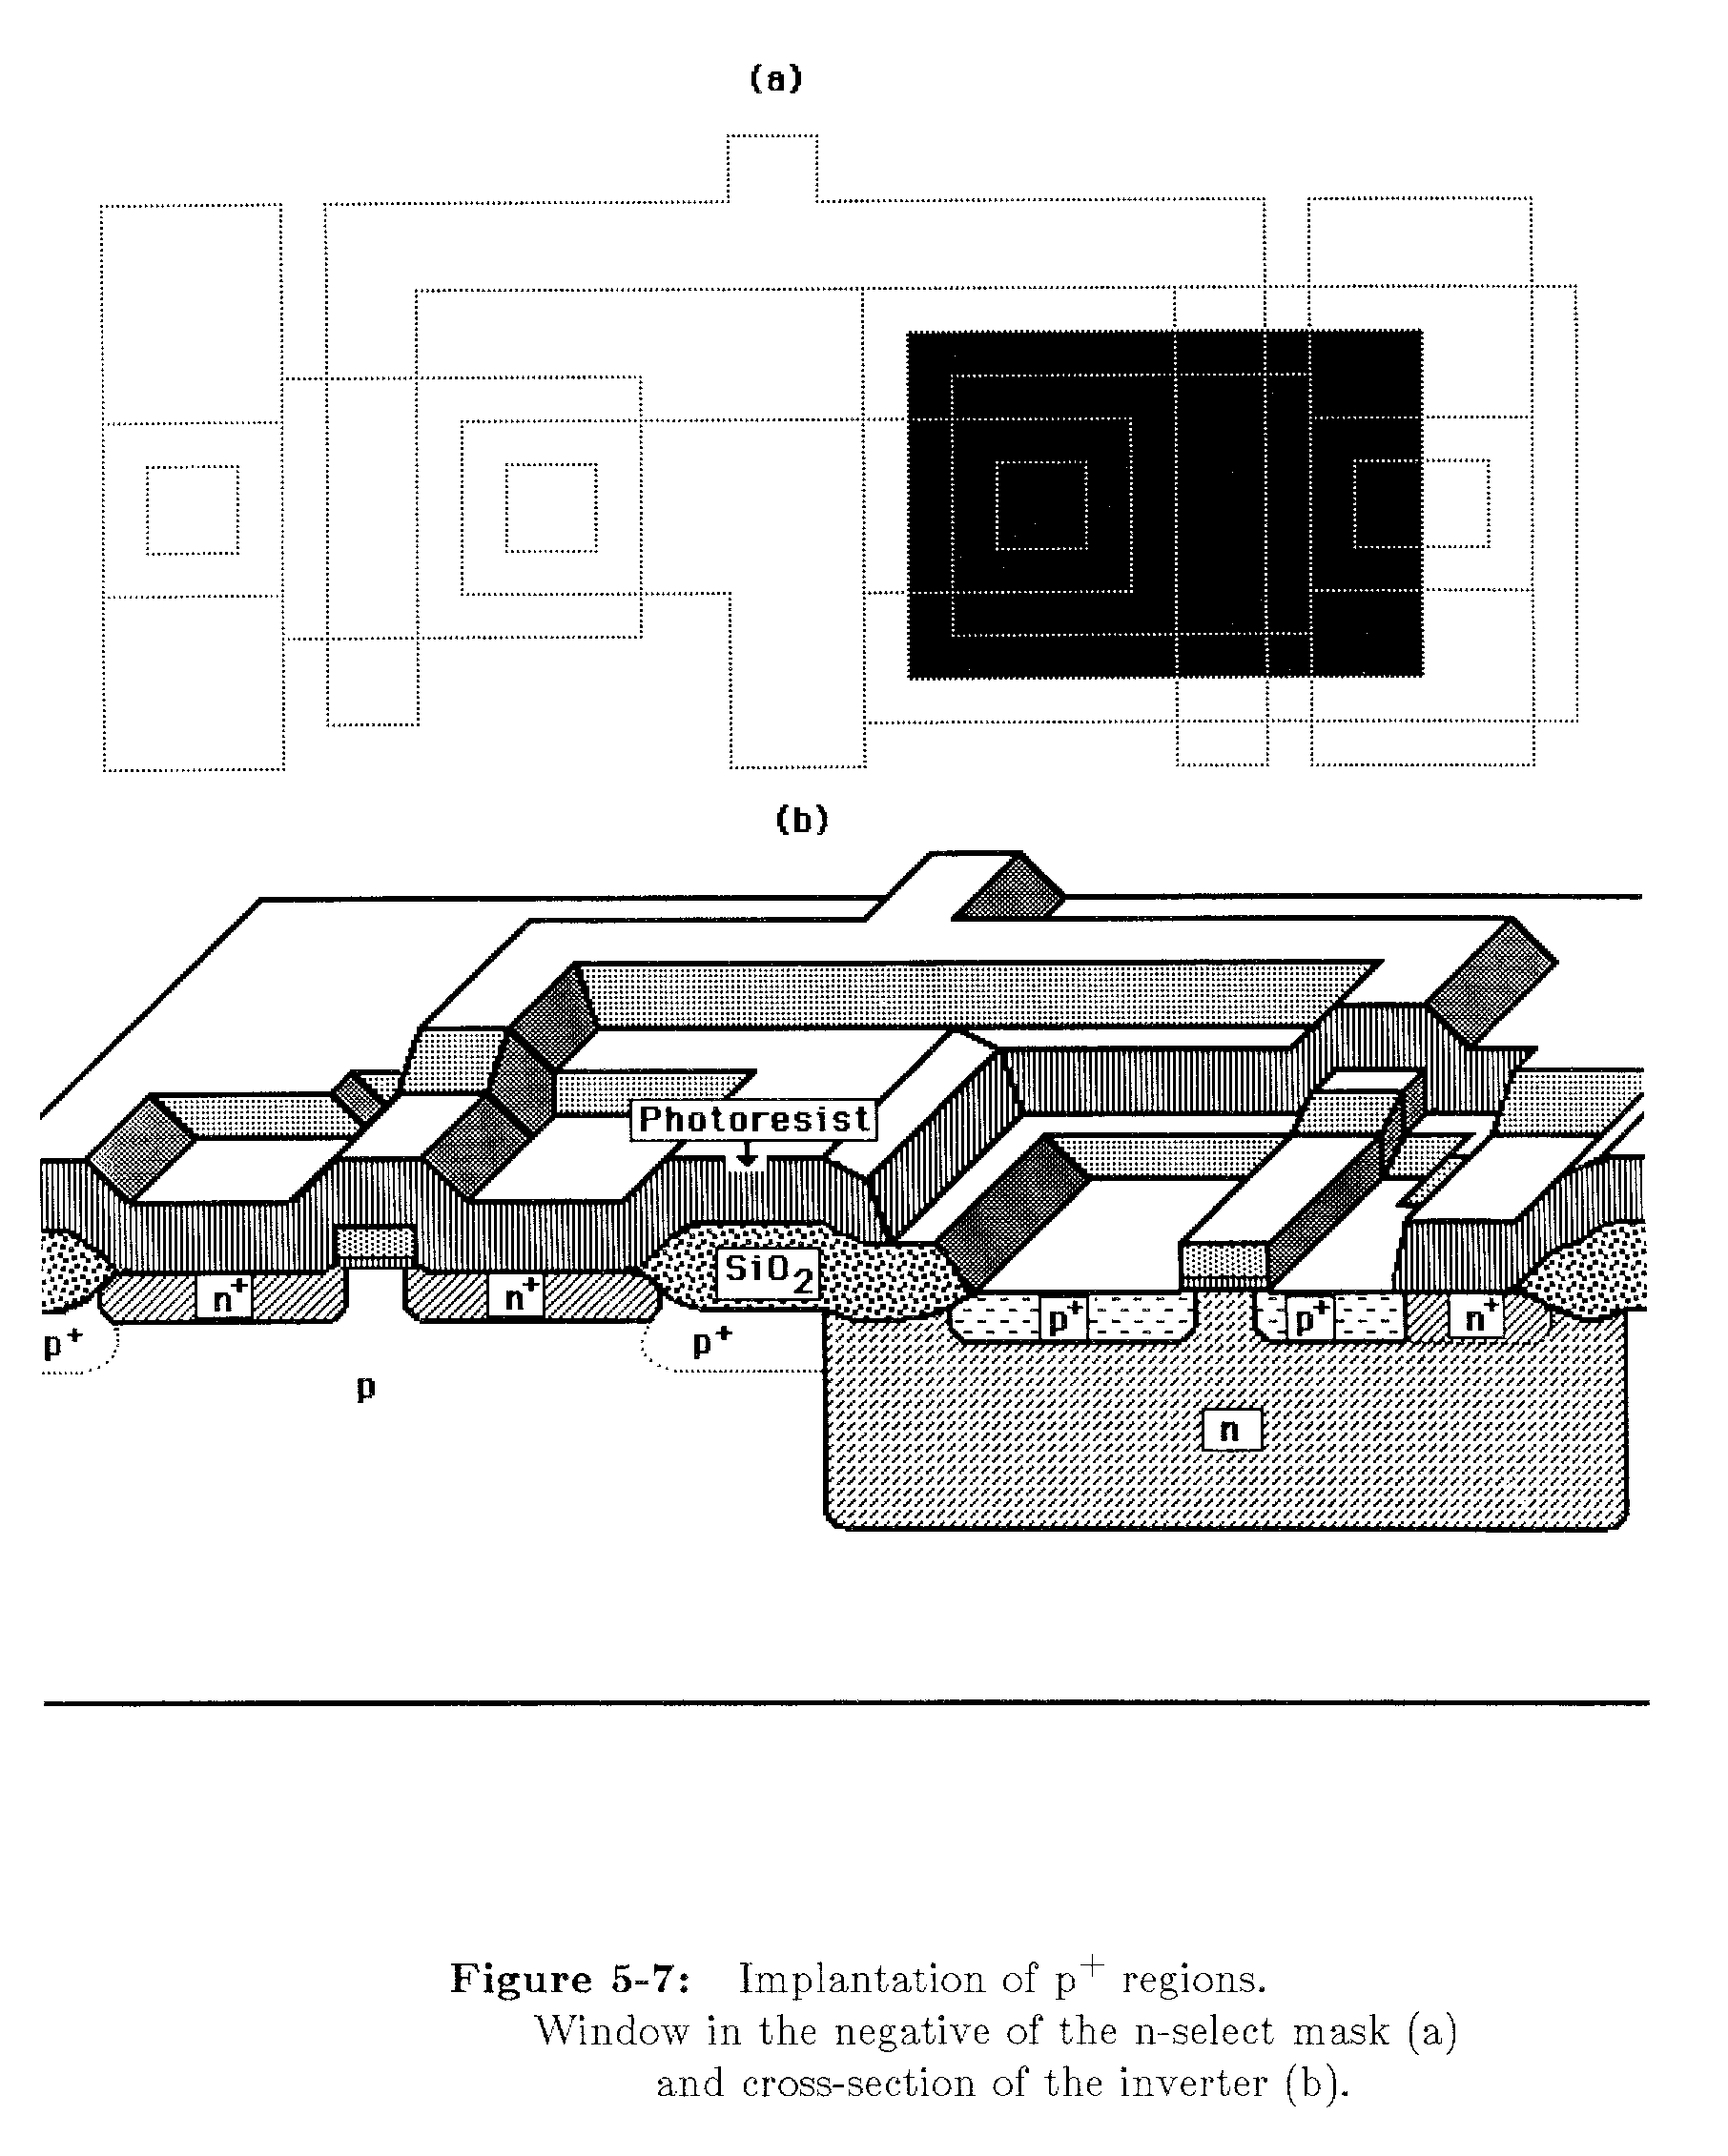
Implant n-Channel p+ Regions
Implantation of p+ regions
(a) Window in the negative of n-select mask (b) Cross section

Slide 38
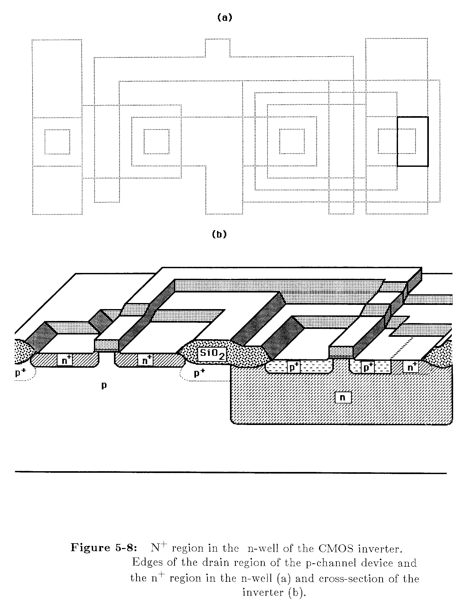
Implant n-Well n+ Region
Edges of drain region of p-channel (b) Cross section

Slide 39
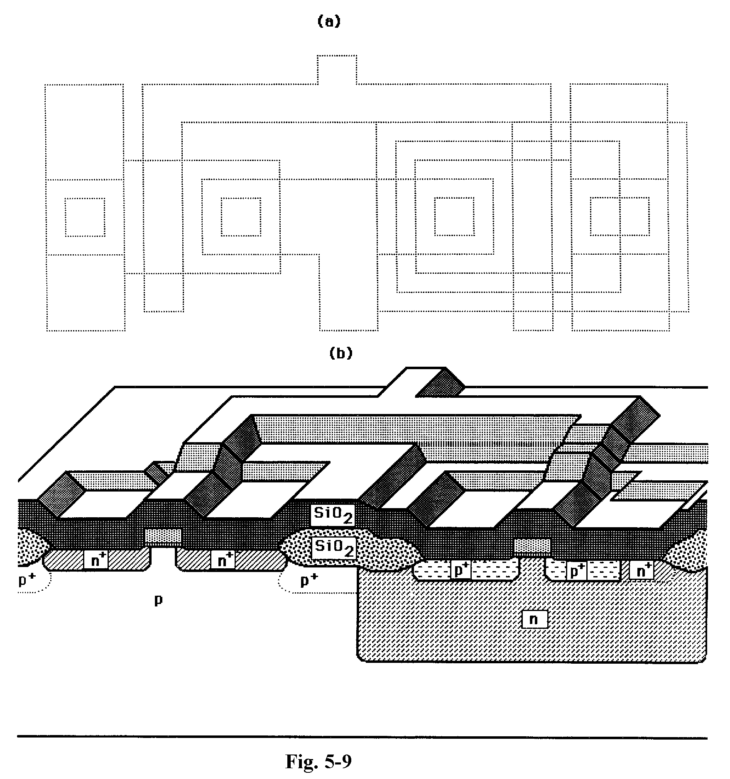
Abrupt steps are smoothed over with deposited insulating layer
Deposition of CVD SiO2 Layer

Slide 40
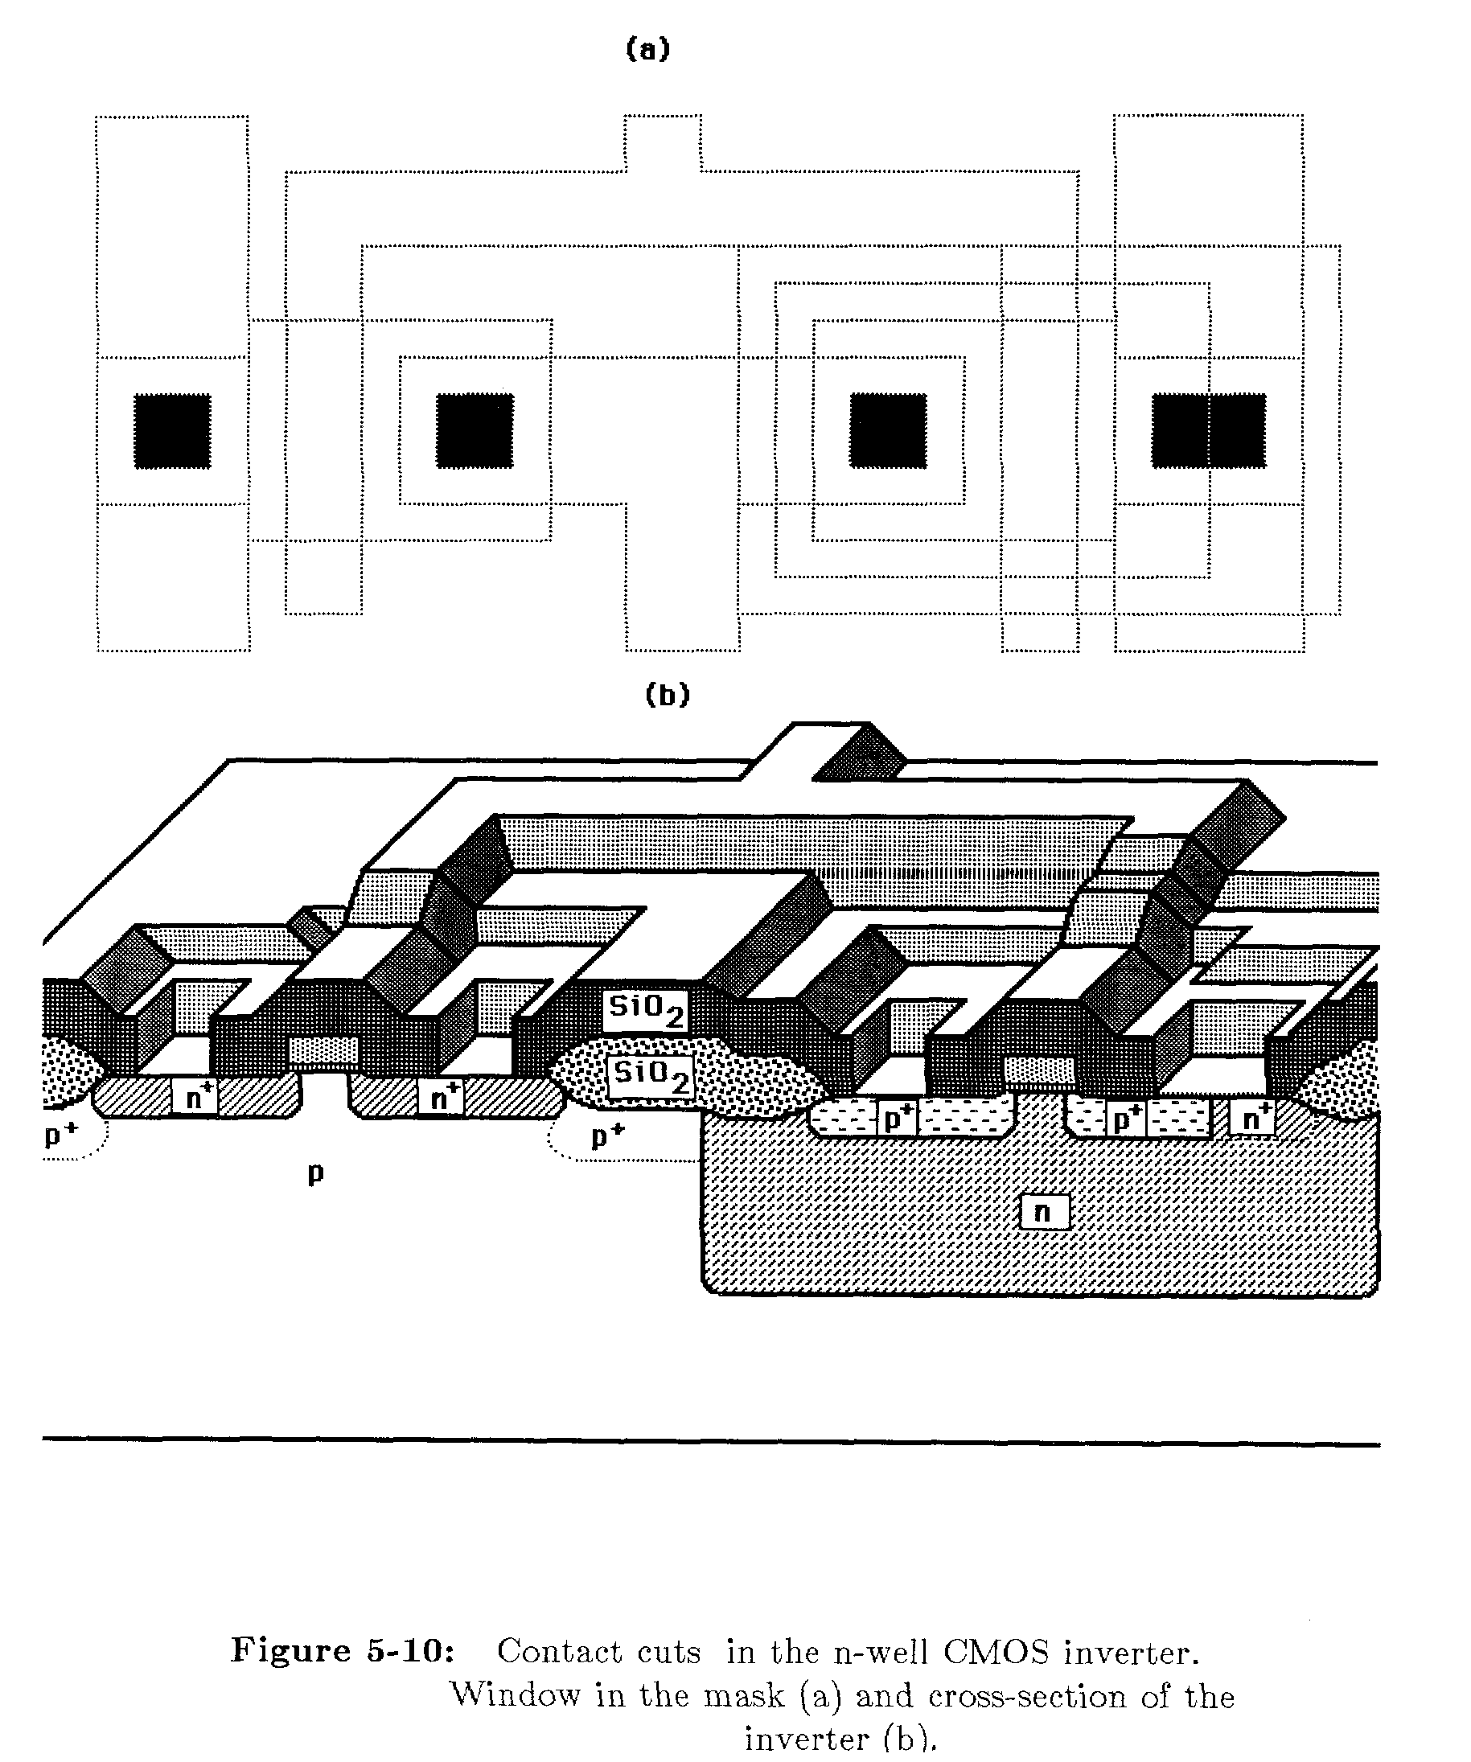
Open Contact Cuts
Contact cuts: (a) Window in the mask (b) Cross section

Slide 41
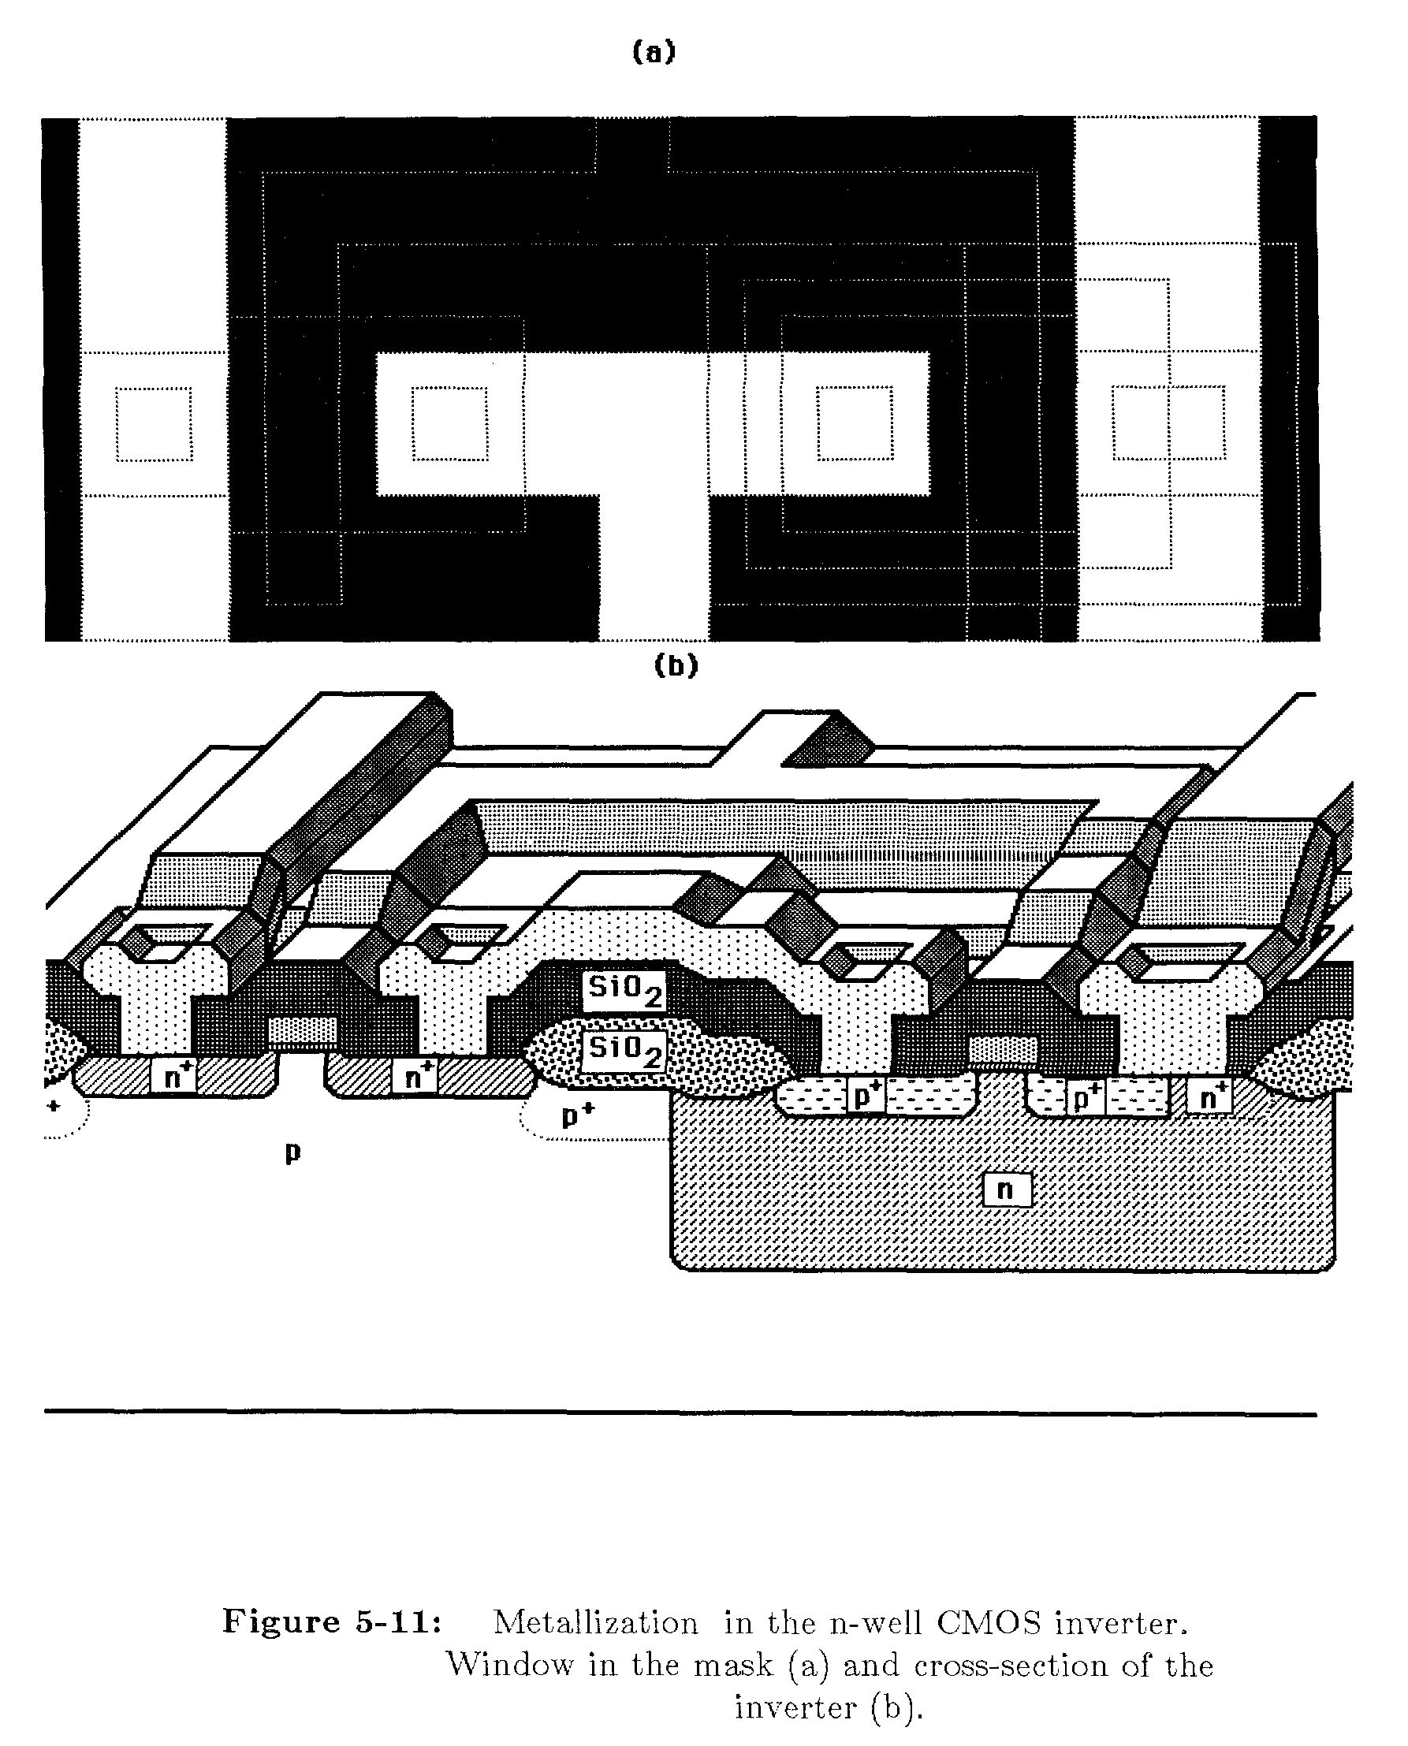
Metallization
Deposit Al Layer
Window in the mask (b) Cross section

Slide 42
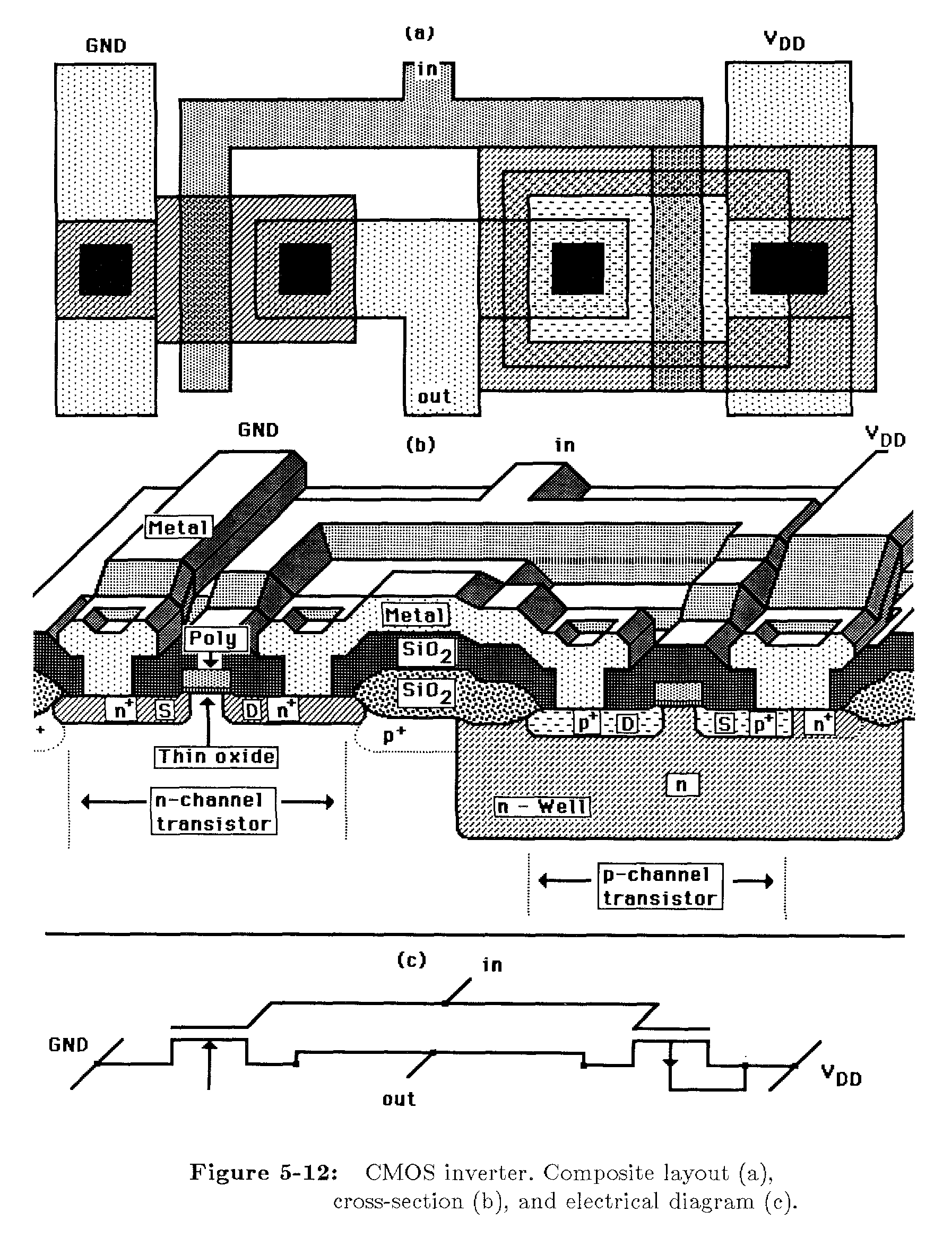
Final Circuit: CMOS Inverter
p+ contact
n+ contact
Requires a p+ contact for connection to
substrate.
Requires a n+ contact for connection to
substrate.
(a) Composite Layout (b) Cross Section (c) Electrical diagram

Slide 43
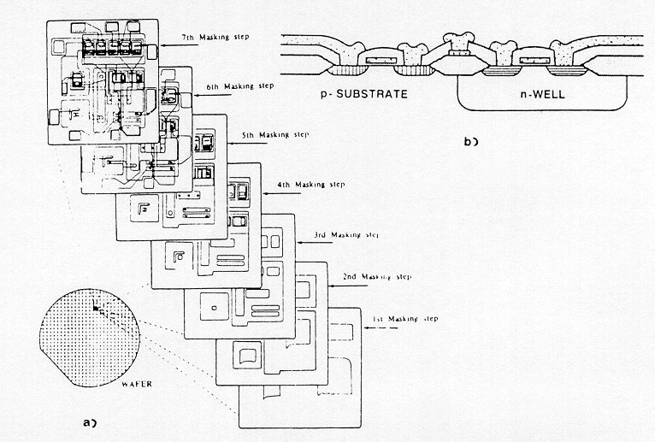
CMOS n-Well
The patterning process by the use of a succession of masks and process steps
A series of SEVEN masking steps and 34 process steps must be sequentially performed for the desired patterns to be created on wafer surface.

Slide 44
p-well | n-well
NMOS device degraded Device in the well is n-type with electron as carrier (higher mobility) weakens faster NMOS | PMOS device degraded Device in the well is p-type with hole as carrier Weakens the already weak PMOS Lower substrate bias effects on transistor threshold voltage and inherently lower parasitic capacitances associated with source and drain

