Slide 1
Partitioning-2

Slide 2
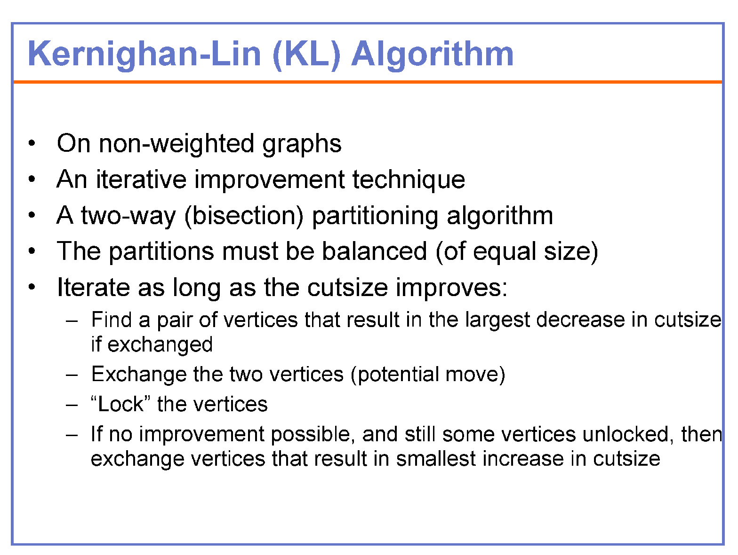

Slide 3
KERNIGHAN-LIN ALGORITHM
a
b
c
d
e
f
g
h
Step no | Vertex pair | Gain | Cut-cost
0 | -- | 0 | 5

Slide 4
KERNIGHAN-LIN ALGORITHM
 | exchange | gain
1
2
3
4
5
6
7
8
9
10
11
12
13
14
15
16
a
b
c
d
e
f
g
h
a, e 2
a, f 0
a, g 1
a, h 2
b, e 0
b, f 0
b, g 1
b, h 0
c, e 1
c, f 1
c, g 0
c, h 1
d, e 0
d, f 2
d, g 3
d, h 0
d and g are to be exchanged
a
b
c
g
e
f
d
h
d and g
locked

Slide 5
KERNIGHAN-LIN ALGORITHM
a
a
a
a
a
b
c
d
e
f
g
h
a
b
c
g
e
f
d
h
d and g locked
Step no | Vertex pair exchanged | Gain | Cut-cost
0 | -- | 0 | 5
1 | d,g
3 2

Slide 6
KERNIGHAN-LIN ALGORITHM
 | exchange | gain
1
2
3
4
5
6
7
8
9
a
b
c
g
e
f
d
h
a, e -2
a, f -2
a, h -2
b, e -2
b, f 0
b, h -2
c, e -1
c, f 1
c, h -1
c and f are to be exchanged
d
a
b
f
g
e
c
h
c and f locked

Slide 7
KERNIGHAN-LIN ALGORITHM
a
b
c
g
e
f
d
h
a
b
f
g
e
c
d
h
c and f locked
Step no | Vertex pair exchanged | Gain | Cut-cost
0 | -- | 0 | 5
1 | d,g | 3 | 2
2 | c,f
1 1

Slide 8
KERNIGHAN-LIN ALGORITHM
 | exchange | gain
1
2
3
4
a
b
f
g
e
c
d
h
a, e -4
a, h -4
b, e -2
b, h -2
Either b and e or b and h are to be exchanged
Let b and e are exchanged
a
e
f
g
b
c
d
h
b and e
locked

Slide 9
KERNIGHAN-LIN ALGORITHM
a
e
f
g
b
c
d
h
a
b
f
g
e
c
d
h
b and e
locked
Step no | Vertex pair exchanged | Gain | Cut-cost
0 | -- | 0 | 5
1 | d,g | 3 | 2
2 | c,f | 1 | 1
3 | b,e
- 2 3

Slide 10
KERNIGHAN-LIN ALGORITHM
a and h locked
a
e
f
g
h
e
f
g
b
c
d
a
b
c
d
h
 | exchange | gain
1
a and h are to be exchanged
a, h -2
Step no | Vertex pair exchanged | Gain | Cut-cost
0 | -- | 0 | 5
1 | d,g | 3 | 2
2 | c,f | 1 | 1
3 | b,e | -2 | 3
4 | a,h
- 2 5

Slide 11
KERNIGHAN-LIN ALGORITHM
Step no (k) | Vertex pair exchanged | Gain | Cut-cost
0 | -- | 0 | 5
1 | d,g | 3 | 2
2 | c,f | 1 | 1
3 | b,e | -2 | 3
4 | a,h | -2 | 5
–Find k, s.t. Σ_{i=1..k} g_{i}=Gain_{k} is maximized
- k=2
–If Gain_{k}> 0 then do exchanges up to that k
a
b
c
d
e
f
g
h
a
b
f
g
e
c
d
h

Slide 12
KERNIGHAN-LIN ALGORITHM
a
b
f
g
e
c
d
h
Step no | Vertex pair | Gain | Cut-cost
0 | -- | 0 | 1

Slide 13
KERNIGHAN-LIN ALGORITHM
 | exchange | gain
1
2
3
4
5
6
7
8
9
10
11
12
13
14
15
16
a, e -4
a, c -2
a, d -4
a, h -4
b, e -2
b, c -2
b, d -2
b, h -2
f, e -2
f, c -1
f, d -2
f, h -2
g, e -2
g, c -2
g, d -2
g, h -2
a
b
f
g
e
c
d
h
f and c are to be exchanged
a
b
c
g
e
f
d
h
f and c locked

Slide 14
KERNIGHAN-LIN ALGORITHM
a
b
c
g
e
f
d
h
a
b
f
g
e
c
d
h
f and c locked
Step no | Vertex pair exchanged | Gain | Cut-cost
0 | -- | 0 | 1
1 | f,c
-1 2

Slide 15
KERNIGHAN-LIN ALGORITHM
 | exchange | gain
1
2
3
4
5
6
7
8
9
a
b
c
g
e
f
d
h
a, e -2
a, d -2
a, h -2
b, e -2
b, d -2
b, h -2
g, e -2
g, d -2
g, h -2
Let a and e are exchanged
e
b
c
g
a
f
d
h
a and e locked

Slide 16
KERNIGHAN-LIN ALGORITHM
e
b
c
g
a
f
d
h
a
b
c
g
e
f
d
h
Step no | Vertex pair exchanged | Gain | Cut-cost
0 | -- | 0 | 1
1 | f,c | -1 | 2
2 | e,a
-2 4

Slide 17
KERNIGHAN-LIN ALGORITHM
 | exchange | gain
1
2
3
4
e
b
c
g
a
f
d
h
b, d 1
b, h 0
g, d 1
g, h 0
Let g and d are to be exchanged
e
b
c
d
a
f
g
h
g and d locked

Slide 18
KERNIGHAN-LIN ALGORITHM
e
b
c
g
a
f
d
h
e
b
c
d
a
f
g
h
Step no | Vertex pair exchanged | Gain | Cut-cost
0 | -- | 0 | 1
1 | f,c | -1 | 2
2 | e,a | -2 | 4
3 | d,g
1 3

Slide 19
KERNIGHAN-LIN ALGORITHM
e
b
c
d
a
f
g
h
e
h
c
d
a
f
g
b
 | exchange | gain
1 | b,h | 2
b and h locked
Step no | Vertex pair exchanged | Gain | Cut-cost
0 | -- | 0 | 1
1 | f,c | -1 | 2
2 | e,a | -2 | 4
3 | d,g | 1 | 3
4 | b,h
2 1

Slide 20
KERNIGHAN-LIN ALGORITHM
Step | Vertex pair exchanged | Gain | Cut-cost
0 | -- | 0 | 1
1 | f,c | -1 | 2
2 | e,a | -2 | 4
3 | d,g | 1 | 3
4 | b,h | 2 | 1
–Find k, s.t. Σ_{i=1..k} g_{i}=Gain_{k} is maximized
- k=4
–If Gain_{k}> 0 then do exchanges up to that k
a
b
f
g
e
c
d
h
NO CHANGE

Slide 21
Kernighan-Lin (KL) Algorithm
•Initialize
–Bipartition G into V₁and V₂, s.t., |V₁| = |V₂| ±1
–n = |V|
•Repeat
–for i=1 to n/2
•Find a pair of unlocked vertices v_{ai}∈V₁ and v_{bi}∈V₂ whose exchange makes the largest decrease or smallest increase in cut-cost (gain)
•Mark v_{ai} and v_{bi} as locked
•Store the gain g_{i}.
–Find k, s.t. Σ_{i=1..k} g_{i}=Gain_{k} is maximized
–If Gain_{k}> 0 then
move v_{a1},...,v_{ak} from V₁ to V₂ and v_{b1},...,v_{bk} from V₂ to V₁.
•Until Gaink≤0

Slide 22
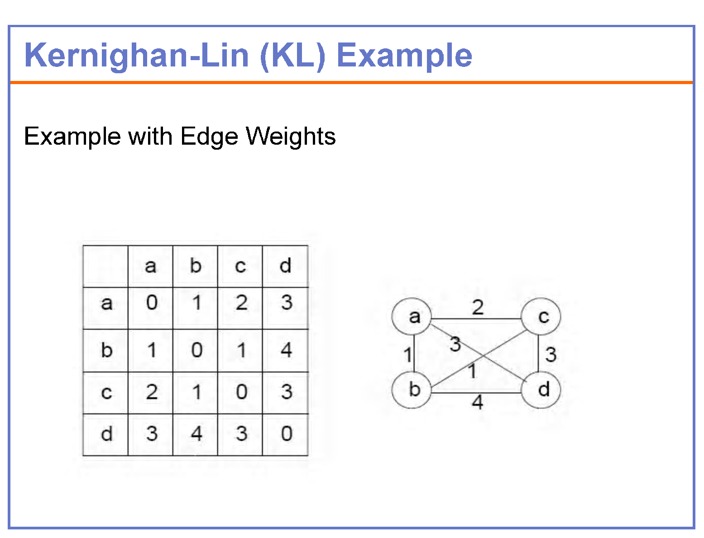

Slide 23
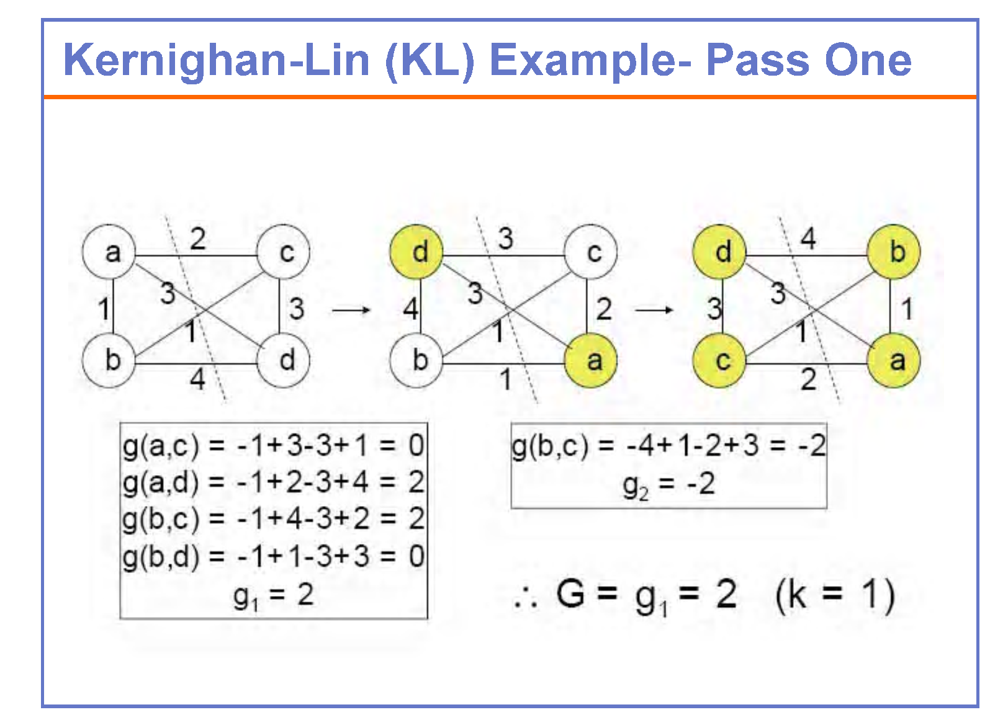

Slide 24
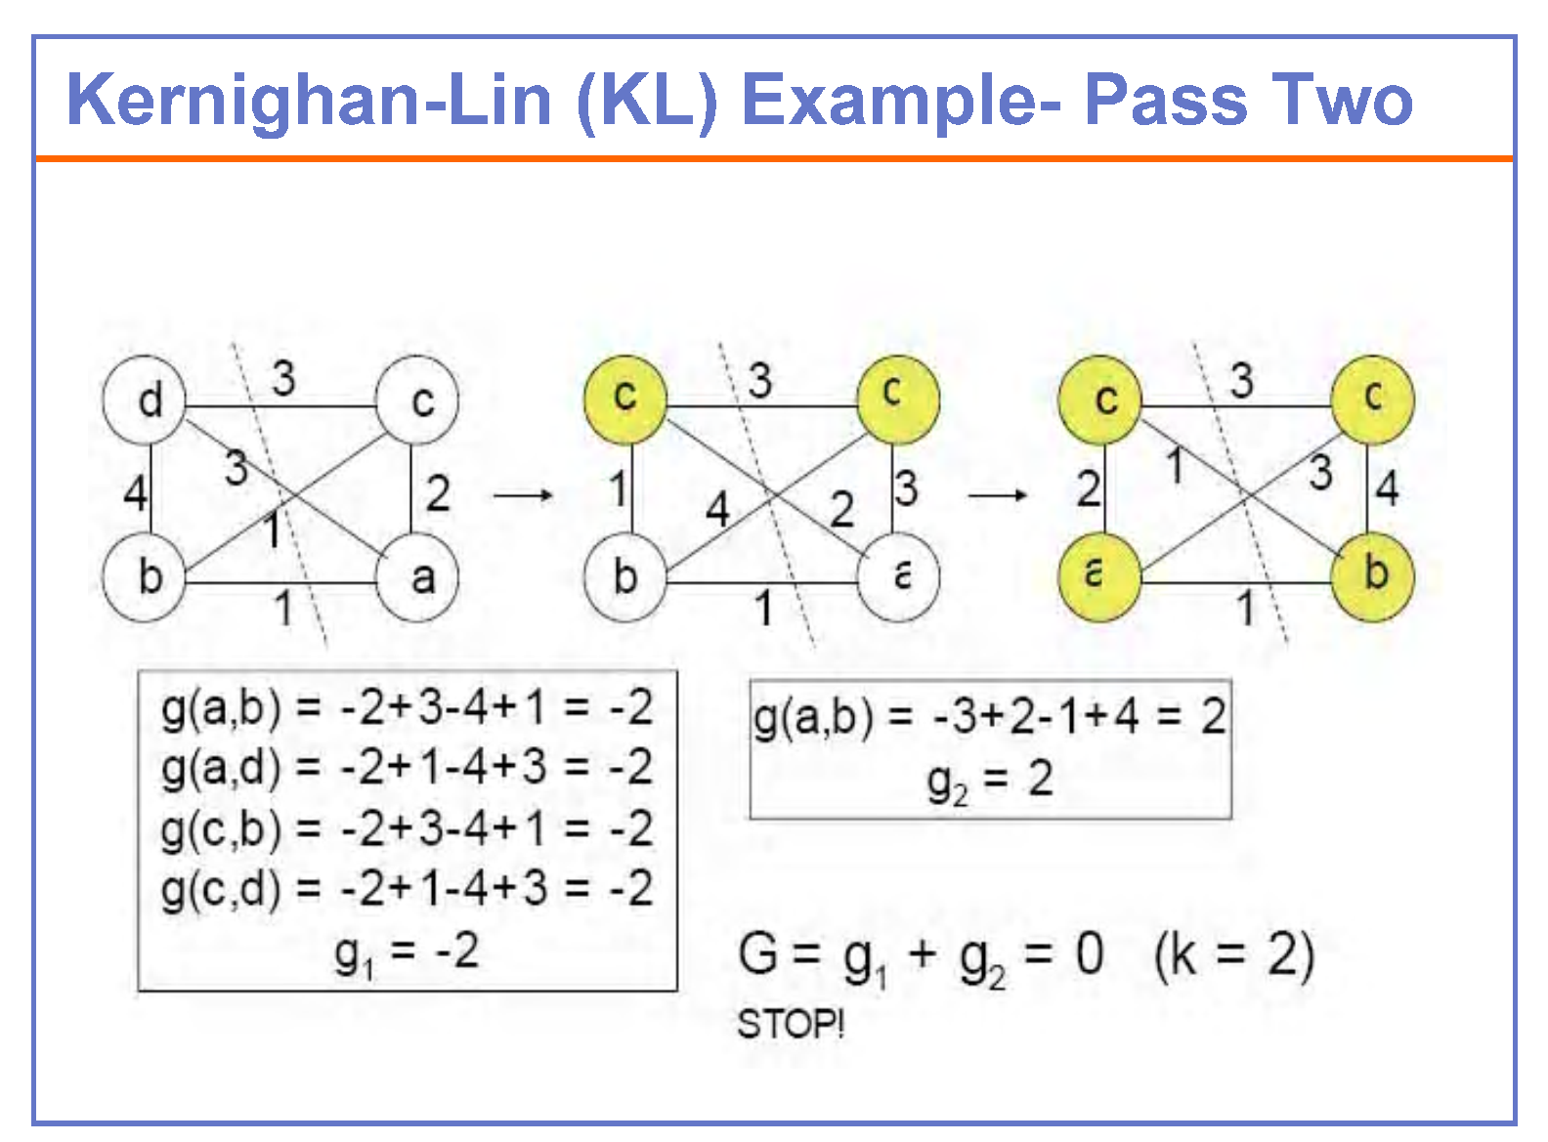

Slide 25
Kernighan-Lin Algorithm: Time Complexity
•Initialize –Bipartition G into V₁and V₂, s.t., |V₁| = |V₂| ±1
–n = |V|
•Repeat –for i=1 to n/2
•Find a pair of unlocked vertices v_{ai}∈V₁ and v_{bi}∈V₂ whose exchange makes the largest decrease or smallest increase in cut-cost (gain)
•Mark v_{ai} and v_{bi} as locked
•Store the gain g_{i}.
–Find k, s.t. Σ_{i=1..k} g_{i}=Gain_{k} is maximized
–If Gain_{k}> 0 then
move v_{a1},...,v_{ak} from V₁ to V₂ and v_{b1},...,v_{bk} from V₂ to V₁.
•Until Gaink≤0
–Inner (for) loop
•Iterates n/2 times
•Iteration 1: (n/2) x (n/2)
•Iteration i: (n/2 –i + 1)².
–Passes? Usually independent of n
–O(n³)

Slide 26
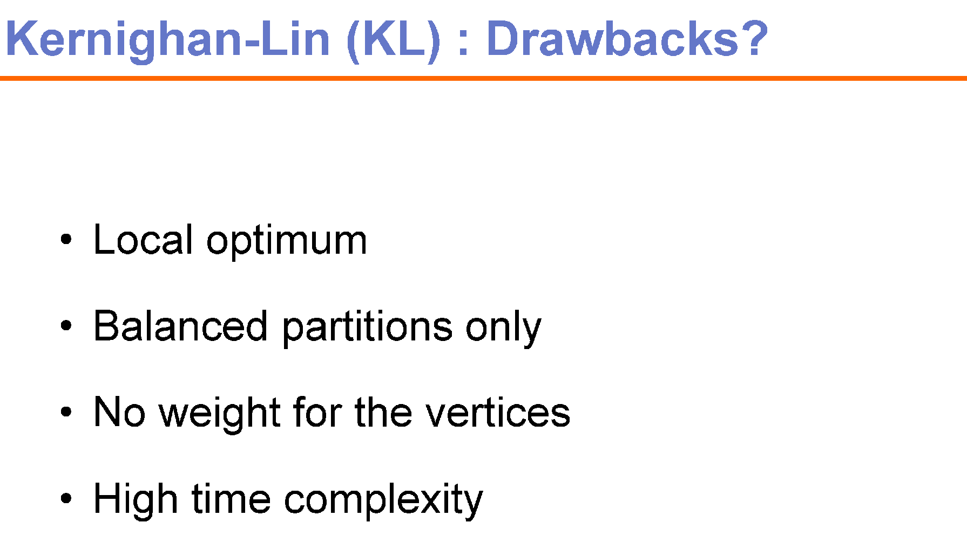
Difficult to tackle the problems of Hyper-edges and weighted edges

