Slide 1
Partitioning-3

Slide 2
Fiduccia-Mattheyses (FM) Algorithm
•Modified version of KL
•A single vertex is moved across the cut in a single move
–Unbalanced partitions
•Vertices are weighted
•Concept of cutsize extended to hypergraphs
•Special data structure to improve time complexity
–(Main feature)
•Can be extended to multi-way partitioning

Slide 3
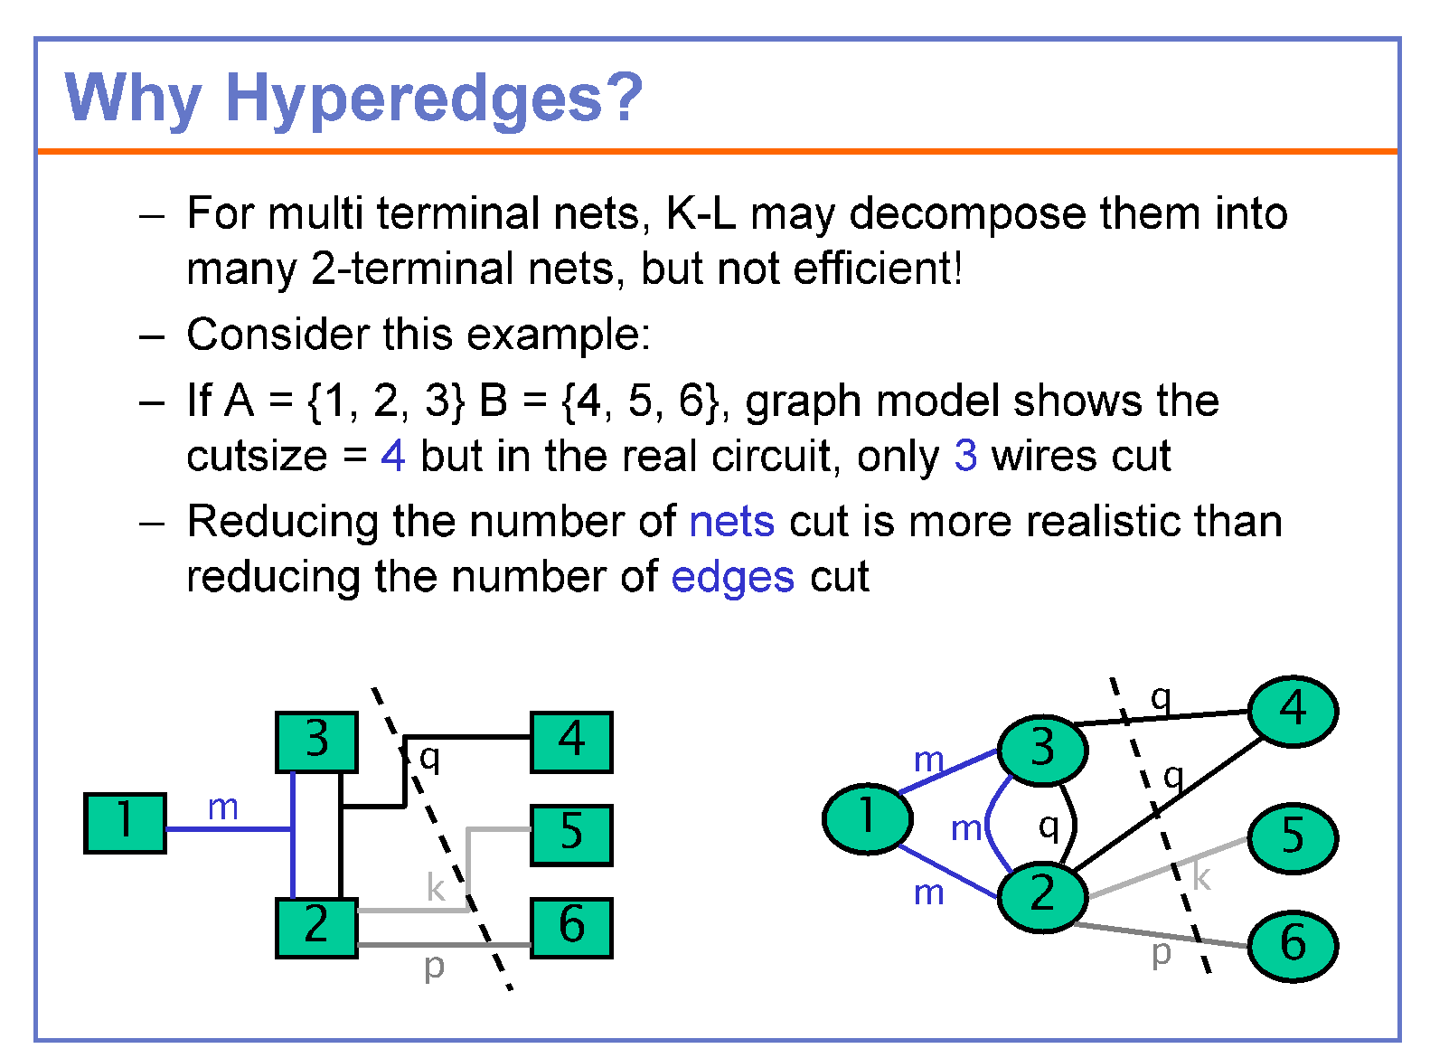

Slide 4
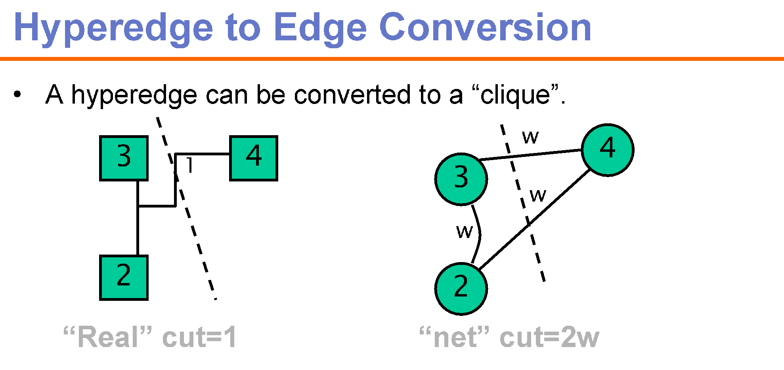

Slide 5
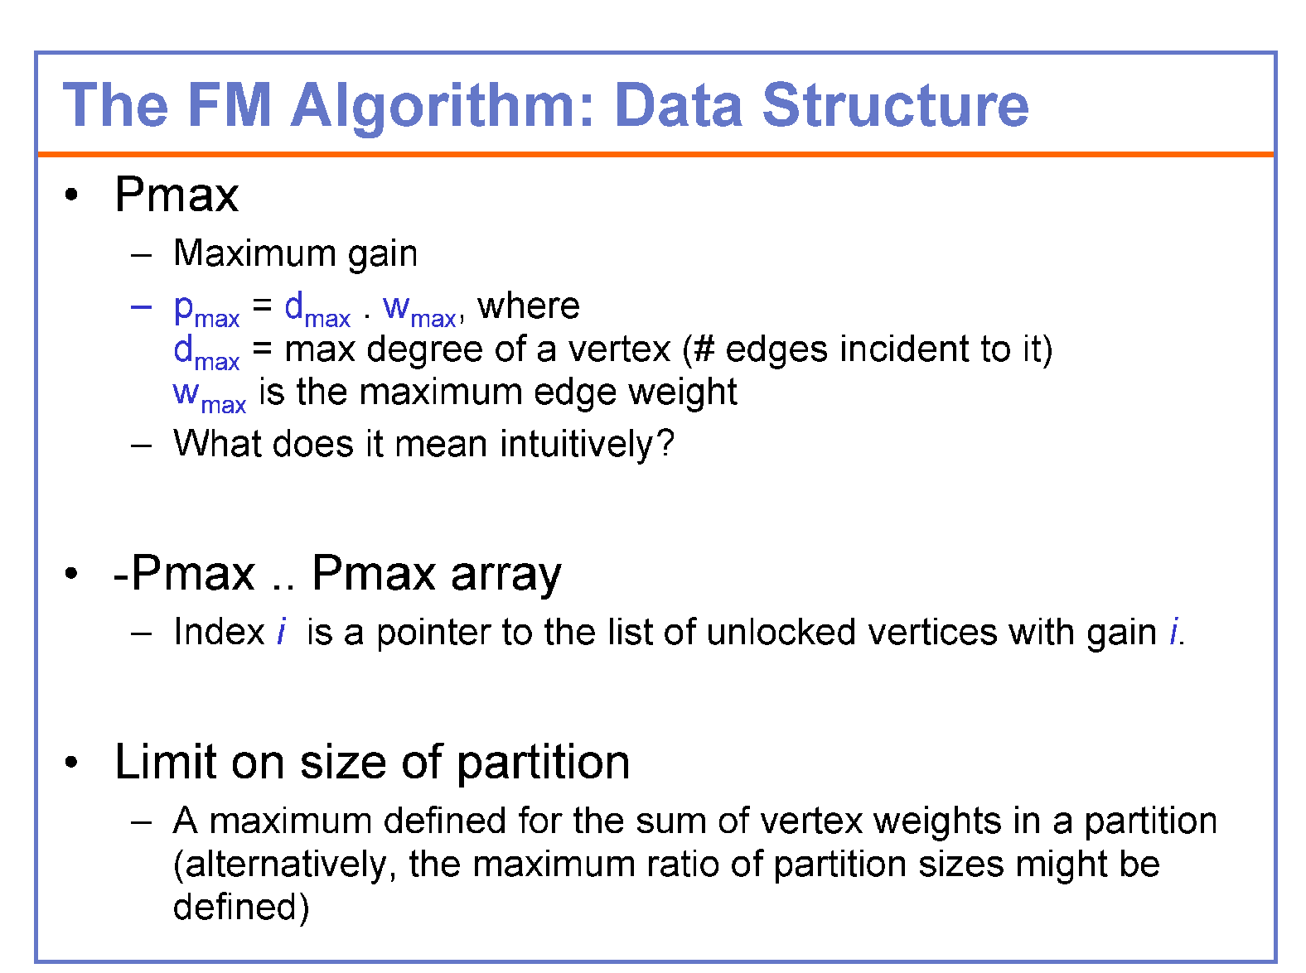

Slide 6
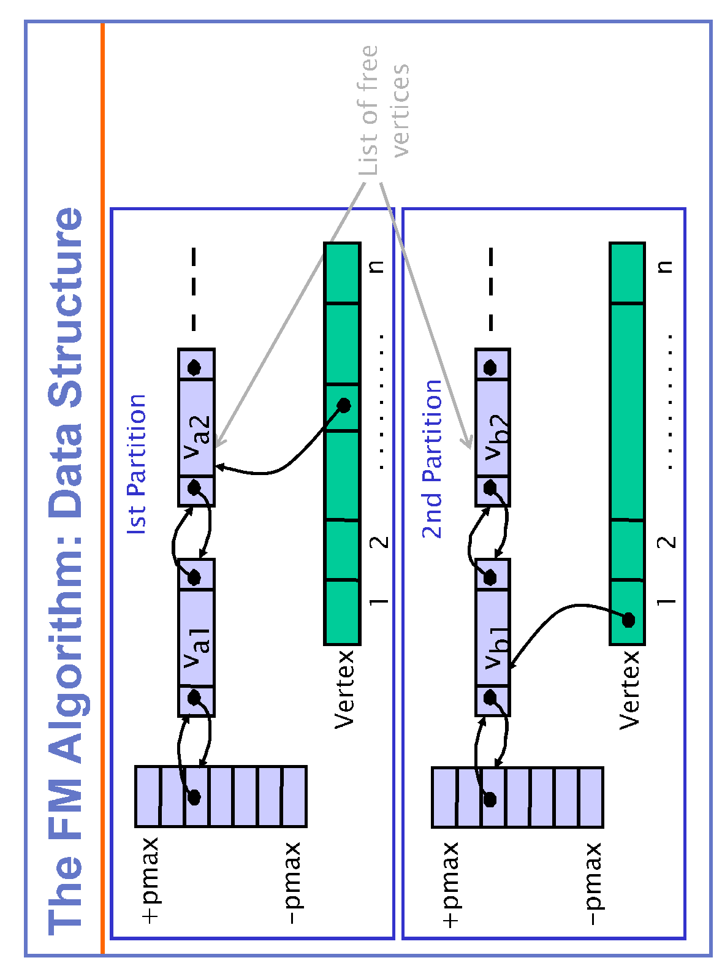
Each pointer in the array list A (or B) points to a linear list of unlocked vertices inside A (or B) with the corresponding gain

Slide 7

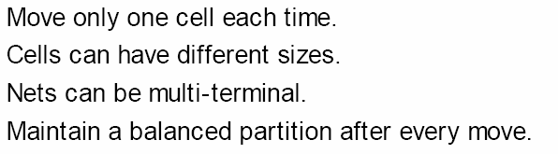
The FM Algorithm: Balanced Partition
•Definition. A maximum vertex weight W which satisfies the relation W >w(V)/2 + max_{vεV}{w(v)},
where w(v) = weight of vertex v,
w(V) = sum of the weights of all vertices
•Balanced partition {A|B} is one having a total vertex weight of at most W, i.e., w(A), w(B) <W.

Slide 8
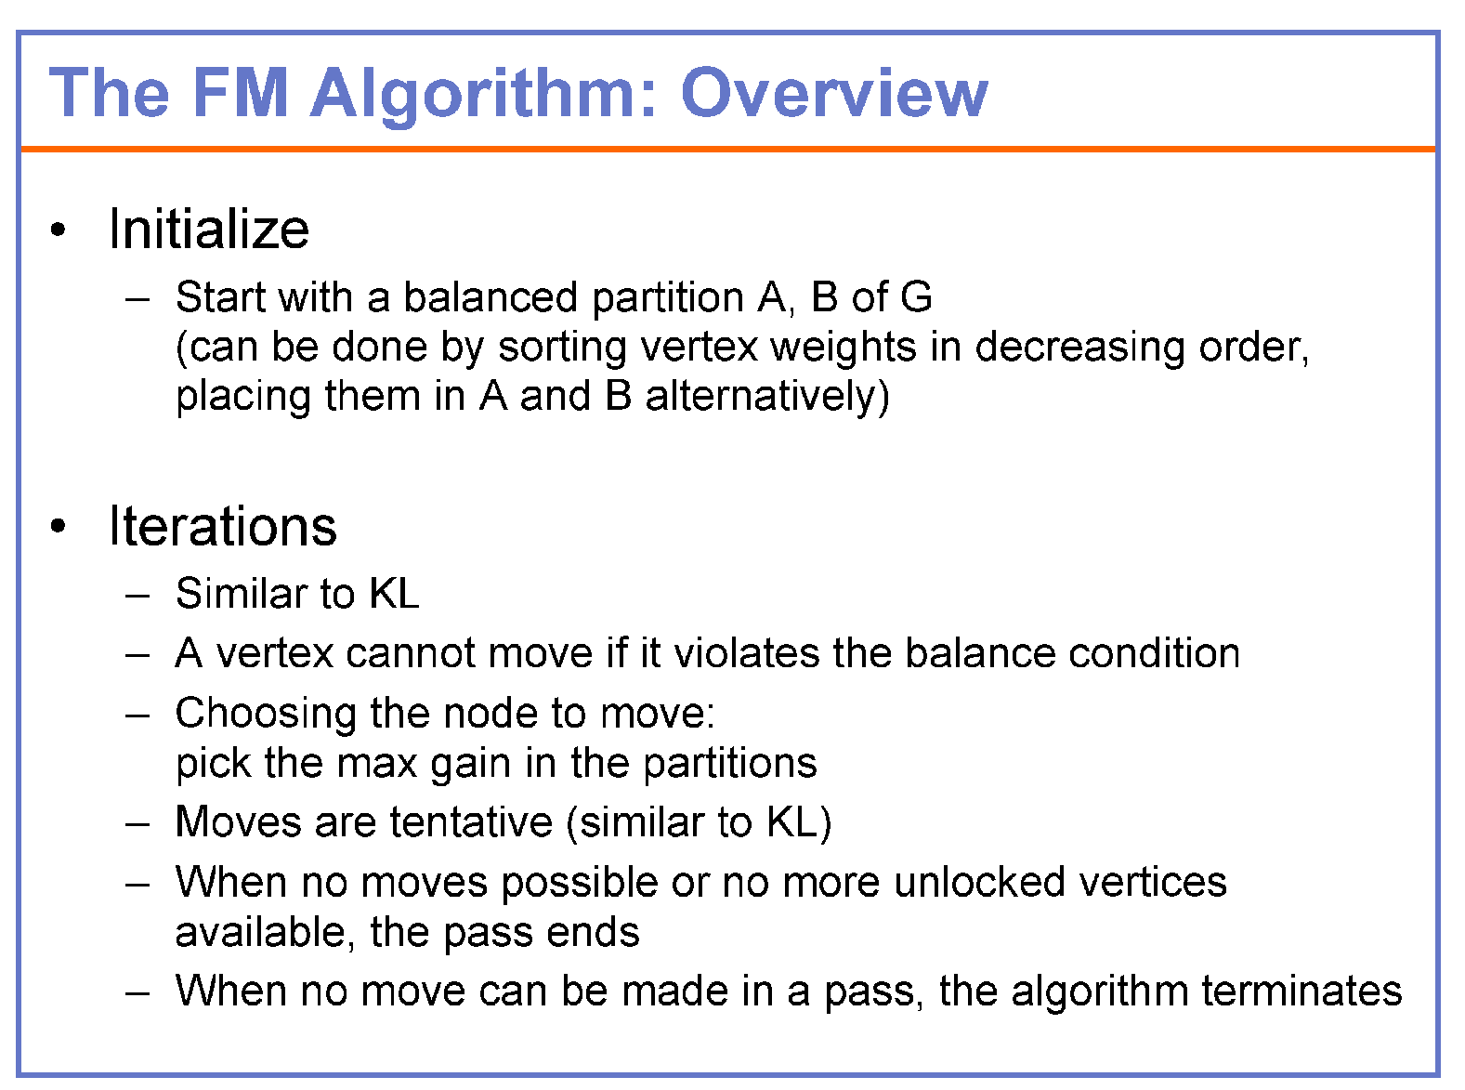

Slide 9
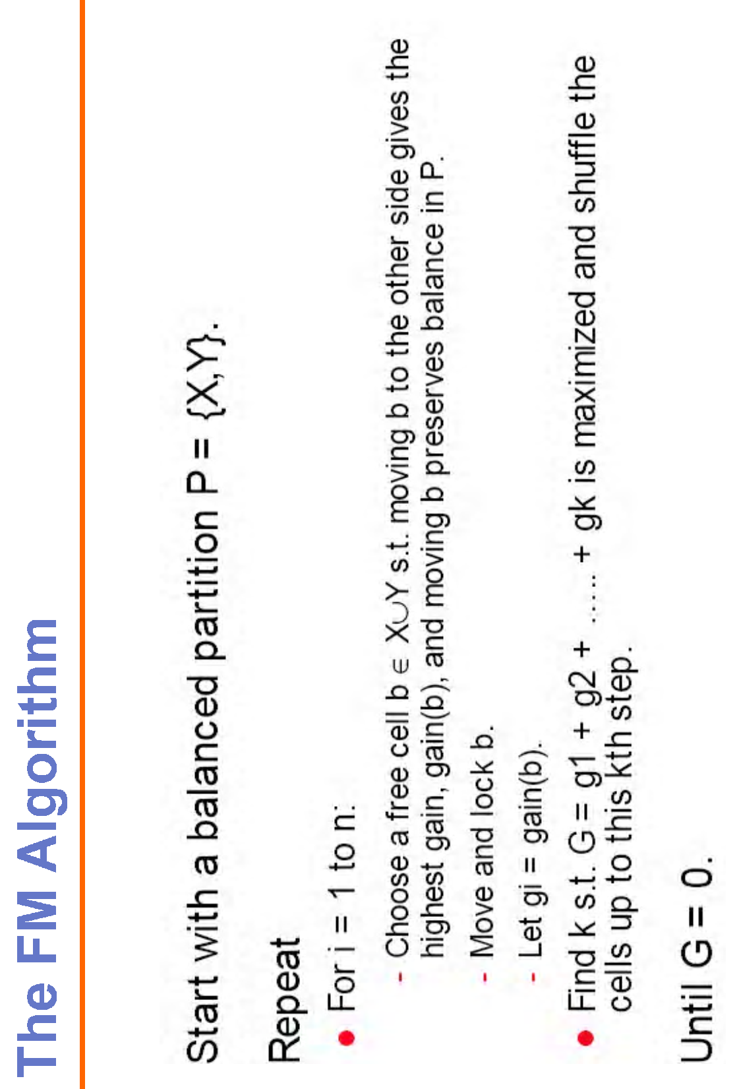
An initial balanced partition can be obtained by sorting vertex weights in decreasing order, and placing them in A and B alternatively

Slide 10
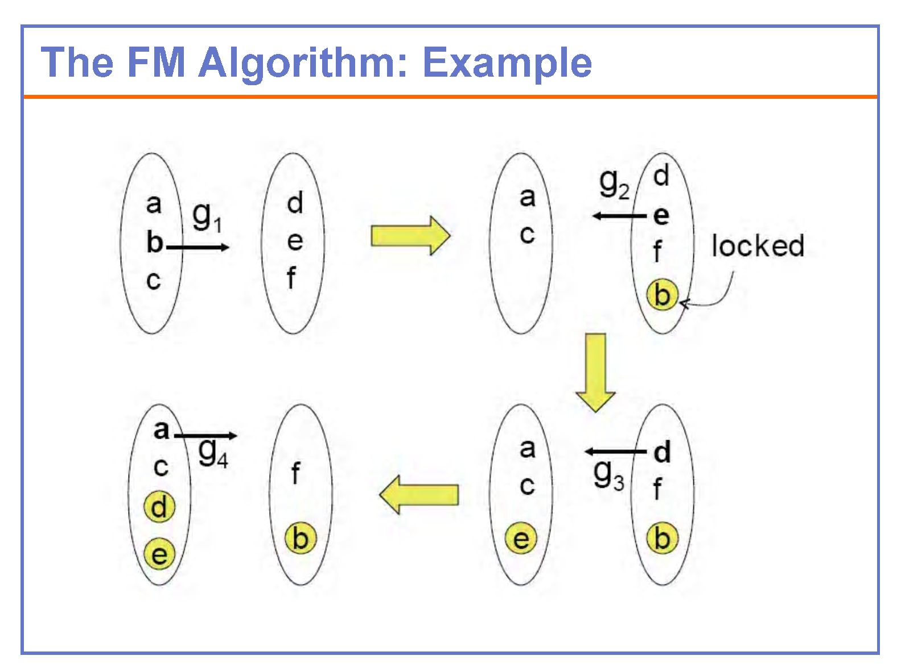

Slide 11
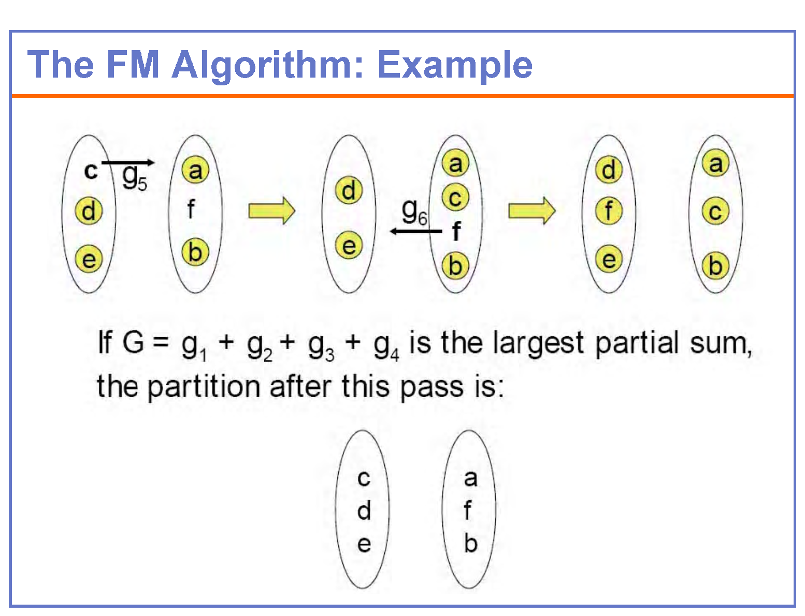

Slide 12
 | a | b | c | d | total
a (5) | 0 | 1 | 2 | 3 | 6
b(7) | 1 | 0 | 1 | 4 | 6
c(6) | 2 | 1 | 0 | 3 | 6
d(10) | 3 | 4 | 3 | 0 | 10
Degree x weight
20
28
0
40
Wmax=10
w(V)/2=14
Maximum weight allowed= 24
a
c
d is to be moved
b
d
g1=4
a
2
c
a
2
c
3
3
1
d
1
3
1
4
1
3
b
b
d
4

Slide 13
 | a | b | c | d | total
a (5) | 0 | 1 | 2 | 3 | 6
b(7) | 1 | 0 | 1 | 4 | 6
c(6) | 2 | 1 | 0 | 3 | 6
d(10) | 3 | 4 | 3 | 0 | 10
Degree x weight
-10
-28
36
a
2
c
3
3
d
a is to be moved
1
4
1
b
g1=4
3
d
c
g2=-2
3
4
2
1
b
a
1

Slide 14
 | a | b | c | d | total
a (5) | 0 | 1 | 2 | 3 | 6
b(7) | 1 | 0 | 1 | 4 | 6
c(6) | 2 | 1 | 0 | 3 | 6
d(10) | 3 | 4 | 3 | 0 | 10
Degree x weight
-14
-12
3
d
c
3
4
2
c is to be moved
1
b
a
1
g1=4
g2=-2
g3=2
d
3
3
4
c
1
2
b
a
1

Slide 15
 | a | b | c | d | total
a (5) | 0 | 1 | 2 | 3 | 6
b(7) | 1 | 0 | 1 | 4 | 6
c(6) | 2 | 1 | 0 | 3 | 6
d(10) | 3 | 4 | 3 | 0 | 10
Degree x weight
-28
d
3
3
4
c
b is to be moved
1
2
b
a
1
g1=4
g2=-2
g3=-2
d
b
g4=-4
4
1
3
1
3
c
2
a
G=g1

Slide 16
 | a | b | c | d | total
a (5) | 0 | 1 | 2 | 3 | 6
b(7) | 1 | 0 | 1 | 4 | 6
c(6) | 2 | 1 | 0 | 3 | 6
d(10) | 3 | 4 | 3 | 0 | 10
Degree x weight
-10
-28
36
-40
2
a
c
3
3
d
a is to be moved
1
4
1
b
g1=-2
3
d
c
3
4
2
1
b
a
1

Slide 17
 | a | b | c | d | total
a (5) | 0 | 1 | 2 | 3 | 6
b(7) | 1 | 0 | 1 | 4 | 6
c(6) | 2 | 1 | 0 | 3 | 6
d(10) | 3 | 4 | 3 | 0 | 10
Degree x weight
-14
-12
20
3
d
c
3
d is to be moved
4
2
1
b
a
1
g1=-2
c
g2=2
1
3
d
2
4
3
b
a
1

Slide 18
 | a | b | c | d | total
a (5) | 0 | 1 | 2 | 3 | 6
b(7) | 1 | 0 | 1 | 4 | 6
c(6) | 2 | 1 | 0 | 3 | 6
d(10) | 3 | 4 | 3 | 0 | 10
Degree x weight
-42
-24
20
c
1
3
d
c is to be moved
4
2
3
b
a
1
g1=-2
g2=2
3
c
d
g3=-4
1
2
3
4
b
a
1

Slide 19
 | a | b | c | d | total
a (5) | 0 | 1 | 2 | 3 | 6
b(7) | 1 | 0 | 1 | 4 | 6
c(6) | 2 | 1 | 0 | 3 | 6
d(10) | 3 | 4 | 3 | 0 | 10
Degree x weight
-28
3
c
d
1
2
3
4
b
a
1
b is to be moved
g1=-2
g2=2
g3=-4
g4=4
a
2
3
d
1
3
4
G=g1+g2=0
c
b
1
No change as G is not greater than 0

