Slide 1
Floorplanning-2

Slide 2
Hierarchical Floorplan
Four types of Internal nodes

Slide 3
Hierarchichal Approach
a
a
b
c
c
b
a
c
b
a
c
b
The number of possible floorplans increases exponentially with number of modules
d =2
d =3

Slide 4
Hierarchical Bottom up approach
Modules are represented as a graph where edges represent the connectivity of modules
Modules with high connectivity are clustered together
(limiting the number in each cluster to some level)
An optimal floorplan for each cluster is determined by exhaustive enumeration
The cluster is merged into a larger modules for higher level processing

Slide 5
Hierarchical Bottom up approach: Greedy procedure
a
c
3
2
10
3
10
e
1
b
d
3
Choose the heaviest edge, two modules of this edge are clustered together (restrict the number of each cluster to some d )
Vertices in a cluster are merged and edge weights are summed up accordingly
Repeat the above procedure unless finished

Slide 6
Hierarchical Bottom up approach: Greedy procedure
a
c
3
2
10
3
10
e
1
b
d
3
|
|
e
a
c
e
|
|
b
d
a
b
c
d
The problem: Some lightweight edges may be chosen at some higher levels of hierarchy
The possible solution: Arbitrarily assign a small cluster to a neighboring cluster when its size is too small

Slide 7
Hierarchical Bottom up approach: Greedy procedure
a
c
3
2
10
3
10
e
1
b
d
3
|
a
c
|
|
a
b
c
|
b
d
e
d
e
Assign a small cluster to a neighboring cluster when its size is too small

Slide 8
Cost of Floorplan
Cost is dependent on area and connections
Area can be obtained from dimensions of each cluster
Routing cost= the edge weights multiplied by distance between the centres of clusters

Slide 9
Cost of Floorplan:
Estimating routing cost: an example
a
1
2
c
b
5
a
b
c
b
a
c
distance(a,b)= distance (a,c)= 2.24
distance (b,c)=2
Cost= 2.24 x 2 +2.24 x 1 +2.0 x 5
= 16.72
distance(a,b)= distance (b,c)= 2.24
distance (a,c)=2
Cost= 2.24 x 5 +2.24 x 2 +2.0 x 1
= 17.68

Slide 10
Hierarchical Top Down approach
Partition of the module
Each partition is assigned to a child floorplan
Repeat the above procedure recursively
May result two partitions of incompatible sizes
Top Down and Bottom up approaches may be combined

Slide 11
Floorplanning: Simulated annealing approach
The idea originated from observations of crystal formation
When a material is heated, molecules move around randomly
When it is cooled, it forms the crystal
The above process is executed repeatedly
The annealing process moves from one solution to other
Random moves of molecules is simulated by randomly accepting moves during the initial phases of algorithm
As algorithm proceeds, the temperature decreases
The algorithm accepts a move (v_{i}, v_{j}) if cost (v_{i}) ≤ cost (v_{j})
The best cost among all the solutions are recorded

Slide 12
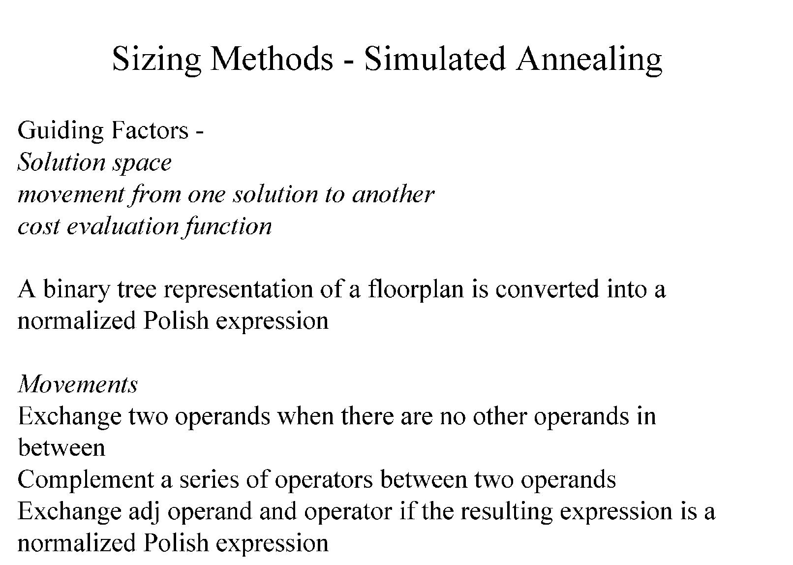
Floorplanning: Simulated annealing approach

Slide 13
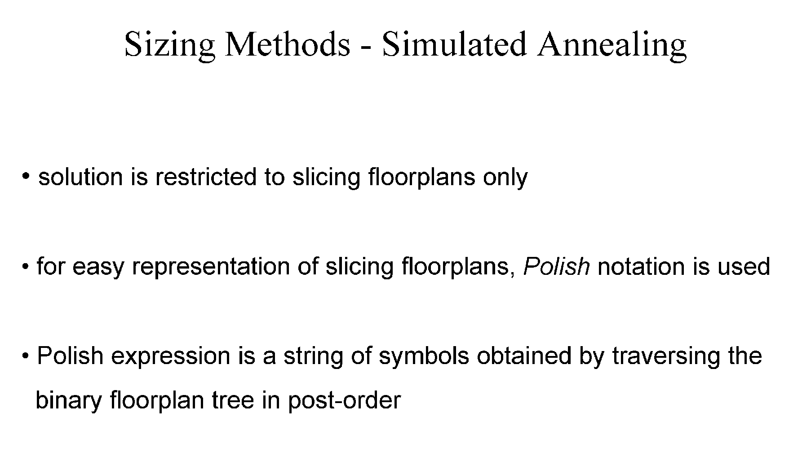
Floorplanning: Simulated annealing approach

Slide 14
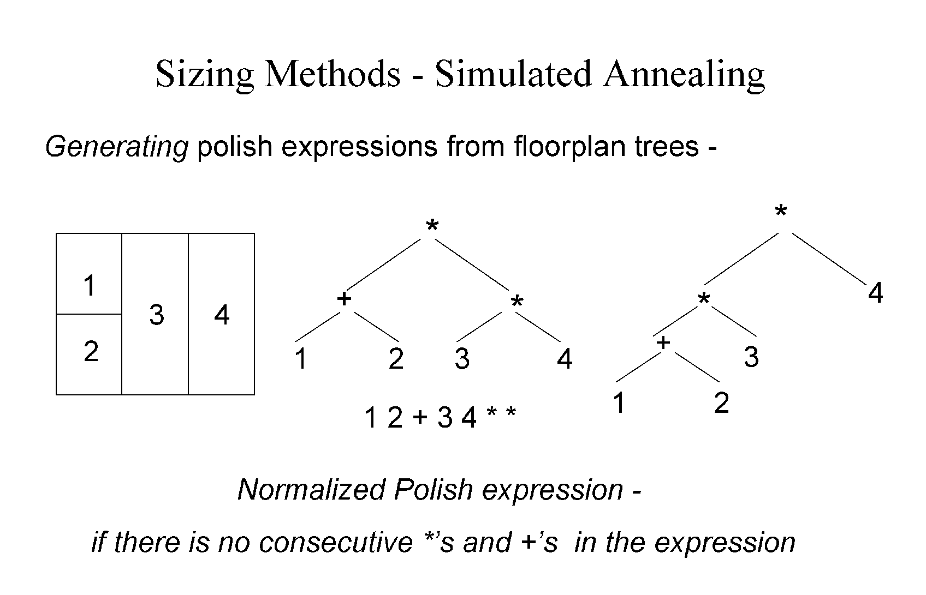
Floorplanning: Simulated annealing approach
12+3*4*

Slide 15
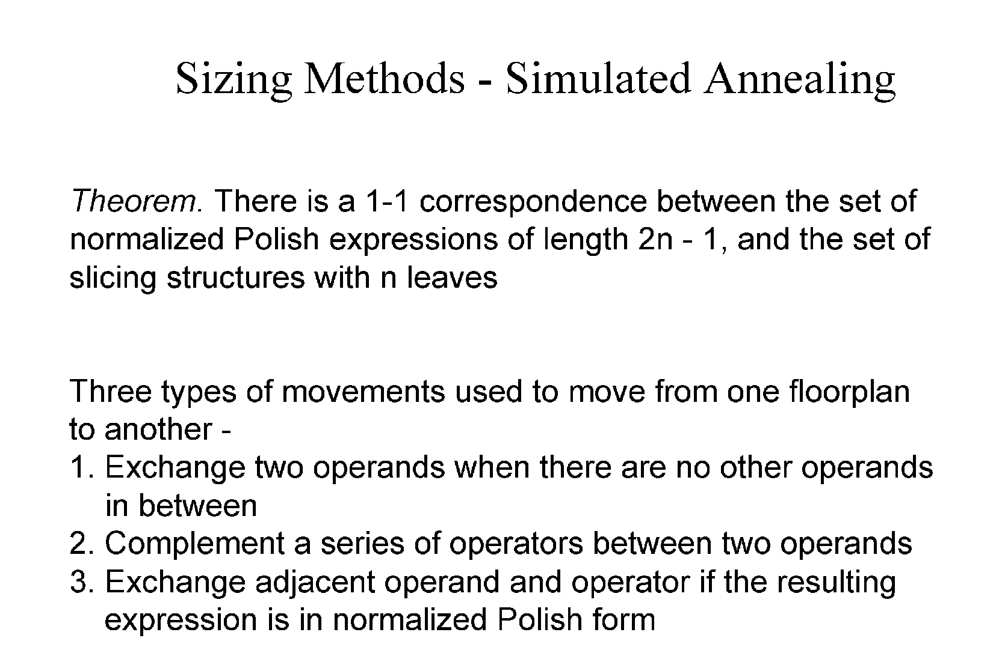
Floorplanning: Simulated annealing approach

Slide 16
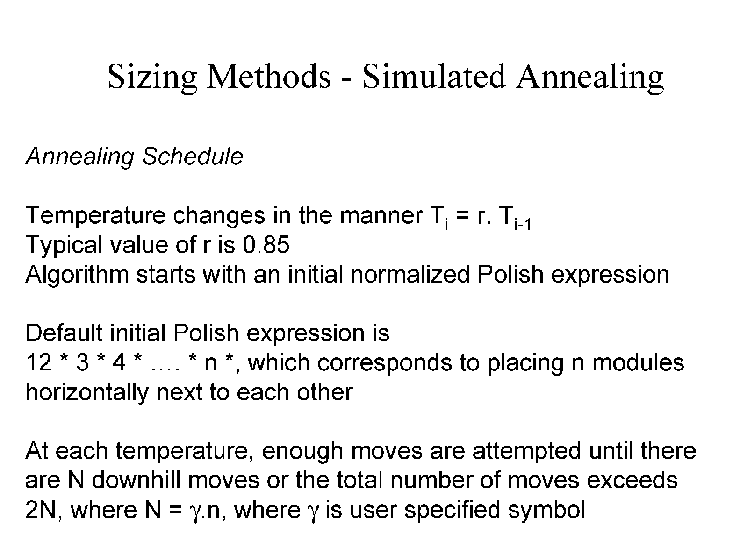
Floorplanning: Simulated annealing approach

Slide 17
Simulated annealing approach
12*4+3*
12*3+4*
Exchange two operands
3
4
4
3
1
2
Complement a series of operators between two operands
1
2
12+3+4*
3
12+34+*
Exchange adjacent operator and operand
2
2
4
4
1
1
3

