Slide 1
Floorplanning-3

Slide 2
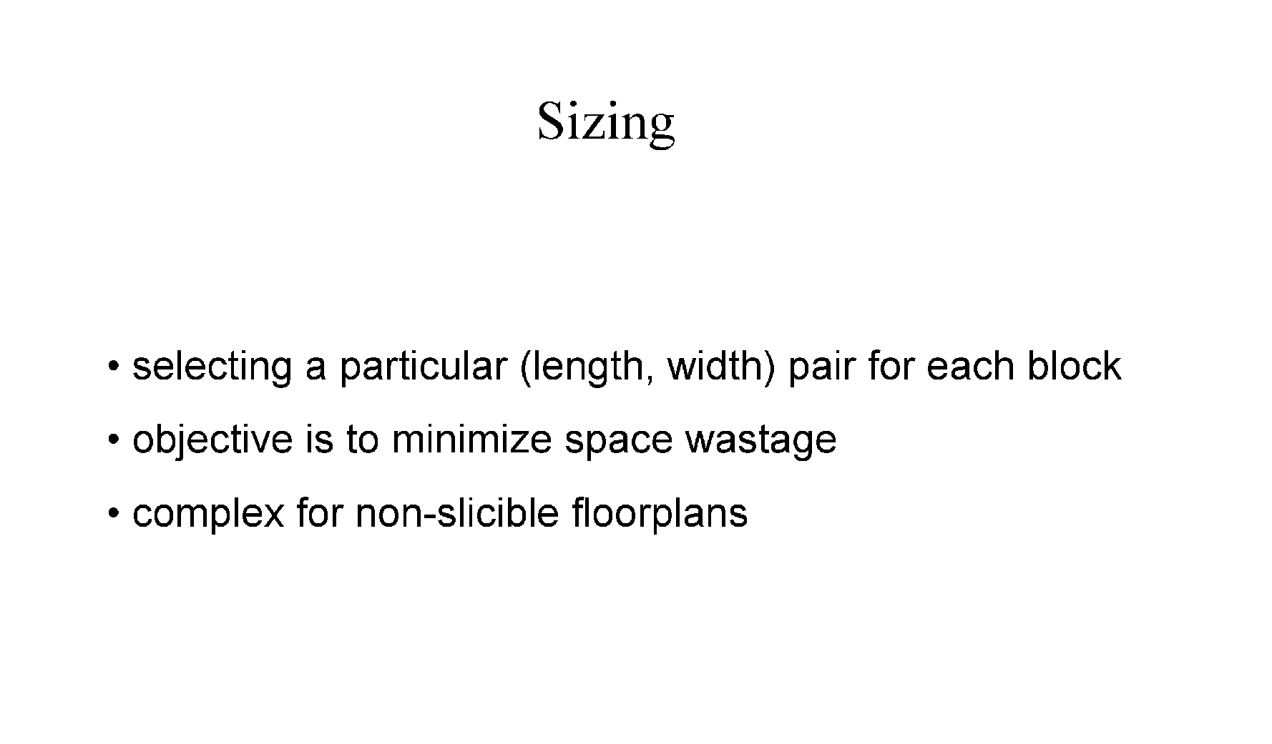

Slide 3
Floorplan sizing problem
The circuit models can usually be implemented in different sizes
Each module has many implementations with different size, speed, and power consumption trade off
The floorplan sizing problem is actual module implementation
If a cell has only one implementation, it is called a fixed cell

Slide 4
Floorplan sizing problem
Assume a fixed cell environment
b
a
2
b
4
a
1
d
d
c
e
3
c
e
2
1
3
4
Horizontal dependency graph
Floorplan
Maximal vertical segments
Horizontal dependency graph:
- A directed acyclic graph
- The length of each edge is the width of the corresponding module in the floorplan
- The longest path from leftmost to rightmost segment is the minimum width of the chip
The height of the chip can be determined by vertical dependency graph

Slide 5
Hierarchical Floorplan Sizing
Consider variable cells on a sliceable floorplan
Given:
A sliceable floorplan F, and for each module M_{i}, a set of possible implementations of the module, where each implementation is described by a pair of real numbers (w_{k}, h_{k}) representing width and height of module
If a module has the realizations (w₁, h₁), (w₂, h₂), (w₃, h₃), ……….., the realizations of are sorted in a manner such that w_{p} < w_{q} and h_{p}> h_{q} for all p < q
For w_{p} <w_{q} if h_{p} ≮h_{q}, exclude (w_{q}, h_{q}) from the list
If a module M_{i} has si realizations, then
w₁< w₂ < w₃,……… <w_{si}, and
h₁> h₂ > h₃,……… >h_{si},

Slide 6
Hierarchical Floorplan Sizing
v
Lemma: Given two subfloorplans corresponding to two subtrees of a node v, one with t and other with s nonredundant implementations, then v has at most s+t-1 nonredundant realizations
L
R
Procedure vertical node sizing
Input: Two sorted lists L= {(a₁,b₁), (a₂,b₂), …….,(a_{s},b_{s})}, and R= {(x₁,y₁), (x₂,y₂), ……….., (x_{t},y_{t})}, where a_{i}<a_{j}, b_{i}>b_{j}, x_{i},<x_{j}, y_{i}>y_{j} for all i < j
Output: A sorted list H= {(c₁,d₁), (c₂,d₂), …….,(c_{u},d_{u})}, where c_{i}<c_{j}, d_{i}>d_{j}, for all i < j
H= Ø, i=1, j=1, k=1
while (i ≤s) and (j≤ t) do
(c_{k}, d_{k})= (a_{i}+ x_{j}, max(b_{i}, y_{j}); H= H ⋃(c_{k}, d_{k}); k=k+1
if max(b_{i}, y_{j})= b_{i}, then i=i+1;
if max(b_{i}, y_{j})= y_{j}, then j=j+1;

Slide 7
Hierarchical Floorplan Sizing: Algorithm
Input: A binary tree corresponding to floorplan with leave nodes representing the modules
Output: Complete floorplan
From each leaf node traverse the tree up to root
by vertical node sizing procedure
The sizing algorithm runs in O(dn) time, where n is the number of modules and d is the height of the the slicing tree
For a balanced binary tree, d= logn
In the worst case, d=n

Slide 8
Linear Programming Technique
Nonhierarchical floorplan sizing method
No restriction on the organization of modules
Notation
(w_{i},h_{i}) : width and height of module M_{i}
(x_{i},y_{i}) : coordinates of the lower left corner of module M_{i}
(x,y) : width and height of the final floorplan
(a_{i},b_{i}) : min and max values of the aspect ratio w_{i}/h_{i} of module M_{i}
For any module M_{i}, a_{i}≤ w_{i}/h_{i} ≤ b_{i}
Usually, a_{i}= 1/b_{i}
The solution is to find (x_{i}, y_{i}, w_{i}, h_{i}) such that all constraints are satisfied and xy is minimized

Slide 9
Linear Programming Technique: Constraints
For any two modules M_{i} and M_{j}
(x_{j,} y_{j})
(x_{i,} y_{i})
(x_{i,} y_{i})
(x_{j,} y_{j})
(x_{j,} y_{j})
(x_{i,} y_{i})
(x_{i,} y_{i})
(x_{j,} y_{j})
Nonoverlap constraint
x_{i}+w_{i} ≤ x_{j} (M_{j} is to the right of M_{i}), or
x_{j}+w_{j} ≤ x_{i} (M_{j} is to the left of M_{i}), or
y_{i}+h_{i} ≤ y_{j} (M_{j} is to the above of M_{i}), or
y_{j}+h_{j} ≤ y_{i} (M_{j} is to the below of M_{i})
At least one of the above constraints must be satisfied

Slide 10
Linear Programming Technique: Constraints
Nonoverlap constraint
x_{i}+w_{i} ≤ x_{j} (M_{j} is to the right of M_{i}), or
x_{j}+w_{j} ≤ x_{i} (M_{j} is to the left of M_{i}), or
y_{i}+h_{i} ≤ y_{j} (M_{j} is to the above of M_{i}), or
y_{j}+h_{j} ≤ y_{i} (M_{j} is to the below of M_{i})
At least one of the above constraints must be satisfied
For each pair (M_{i} , M_{j}), p_{ij} (0 or 1) and q_{ij} (0 or 1) are introduced
W and H = upper bounds of the width and height of feasible solution region
x_{i}+w_{i} ≤ x_{j} + W(p_{ij} + q_{ij})
x_{j}+w_{j} ≤ x_{i} + W(1- p_{ij} + q_{ij})
y_{i}+h_{i} ≤ y_{j} + H(1+ p_{ij} - q_{ij})
y_{j}+h_{j} ≤ y_{i}+ H(2- p_{ij} - q_{ij})
The above system of inequalities solves the overlap constraint

Slide 11
Linear Programming Technique: Constraints
Module size constraint
Consider that the blocks are not of fixed sizes
For each module M_{i}, a lower bound on area A_{i} and aspect ratios a_{i},b_{i} are given, s.t., w_{i}h_{i} ≥ A_{i} , and a_{i} ≤ w_{i} /h_{i} ≤ b_{i}
w_{min} =√A_{i}a_{i,} w_{max} =√A_{i}b_{i}, h_{min} =√A_{i}/b_{i} , h_{max} =√A_{i}/a_{i}
h
h_{i}=Δ_{i}w_{i} + c_{i}
Δ_{i}-= (h_{max} - h_{min} ) /(w_{min} - w_{max})
c_{i}=h_{max} - Δ_{i} w_{min}
h_{max}
h_{i}=Δ_{i}w_{i} + c_{i}
The ineuqualities to be solved
x_{i}+w_{i} ≤ x_{j} + W(p_{ij} + q_{ij})
x_{j}+w_{j} ≤ x_{i}+ W(1- p_{ij} + q_{ij})
y_{i}+ Δ_{i}w_{i} +c_{i} ≤ y_{j} + H(1+ p_{ij} - q_{ij})
y_{j}+ Δ_{j}w_{j} +c_{j} ≤ y_{i}+ H(2- p_{ij} - q_{ij})
w_{i}h_{i} = A_{i}
h_{min}
w
w_{min}
w_{max}

Slide 12
The Cost function
The function to be minimized = the total area of the floorplan A= xy
Let us fix the width W and minimize the height of floorplan
min y
x_{i}+w_{i} ≤ W
y ≥ y_{i}+h_{i}

Slide 13
Complete LP formulation
The function to be minimized = the total area of the floorplan A= xy
Let us fix the width W and minimize the height of floorplan
min y
x_{i}, w_{i} , y_{i} ≥ 0
p_{ij}, q_{ij} =0 or 1
x_{i}+w_{i} ≤ W
y ≥ y_{i}+h_{i}
x_{i}+w_{i} ≤ x_{j} + W(p_{ij} + q_{ij})
x_{j}+w_{j} ≤ x_{i} + W(1- p_{ij} + q_{ij})
y_{i}+ Δ_{i}w_{i} +c_{i} ≤ y_{j} + H(1+ p_{ij} - q_{ij})
y_{j}+ Δ_{j}w_{j} +c_{j} ≤ y_{i}+ H(2- p_{ij} - q_{ij})

Slide 14


