Slide 1
Semiconductor Devices

Slide 2
Semiconductor Diode
Acceptor ion
Junction
Donor ion
-
-
-
-
+
+
+
+
holes
electrons
-
-
-
-
+
+
+
+
-
-
-
-
+
+
+
+
-
-
-
-
+
+
+
+
p type
n type
Donor and acceptor impurities are introduced in two sides of a single crystal of semiconductor
By donating an electron a donor impurity atom becomes a positive ion
An acceptor impurity atom becomes a negative ion after accepting an electron
Holes diffuse to the right and electrons to the left across the junction
As holes and electrons combine across the junction, they disappear near the junction

Slide 3
Semiconductor Diode
Acceptor ion
Junction
Donor ion
-
-
-
-
+
+
+
+
holes
electrons
-
-
-
-
+
+
+
+
-
-
-
-
+
+
+
+
-
-
-
-
+
+
+
+
p type
n type
0.5 cm
An electric field appears across the junction
Equilibrium is established, when field is large enough to restrain the process of diffusion
For further movement of holes and electrons, they have to cross a potential barrier (i.e. we have to apply an external field)
Unneutralized ions in the neighborhood of the junction are uncovered charges
The region across is called space charge region or depletion region
Thickness of depletion region is very small (10⁻⁴ cm)

Slide 4
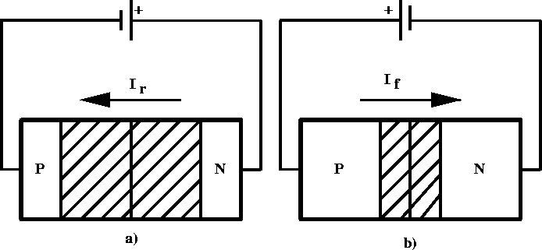
P-N Junction – Forward Bias
positive voltage placed on p-type material
holes in p-type move away from positive terminal, electrons in n-type move further from negative terminal
depletion region becomes smaller - resistance of device decreases
voltage increased until critical voltage is reached, depletion region disappears, current can flow freely
+

Slide 5
P-N Junction – Reverse Bias
positive voltage placed on n-type material
electrons in n-type move closer to positive terminal, holes in p-type move closer to negative terminal
width of depletion region increases
allowed current is essentially zero (small “drift” current)
+

Slide 6
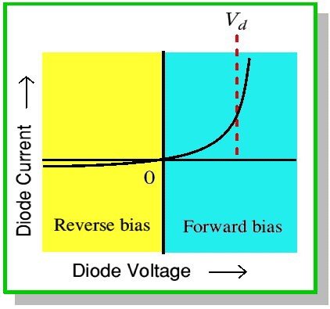
IV Characteristics of Diode

Slide 7
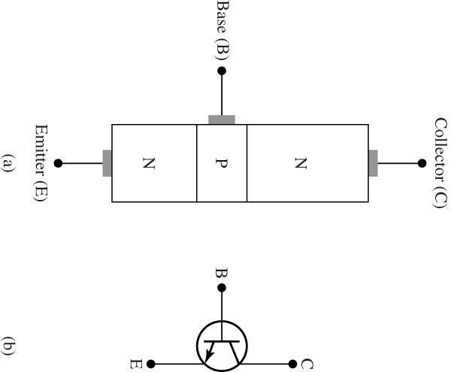
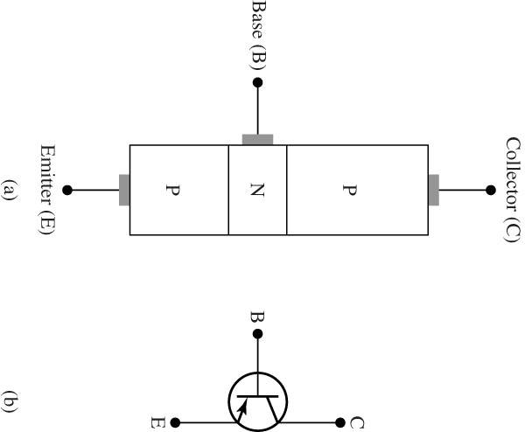
Semiconductor Transistor
n-type semiconductor is sandwiched between two layers of p-type
p-type semiconductor is sandwiched between two layers of n-type

Slide 8
Bipolar Junction Transistor (BJT)
base
base
Emitter
Emitter
collector
collector
n p n
p n p
Flow of electrons
Flow of holes
Currents flow mainly due to majority carriers

Slide 9
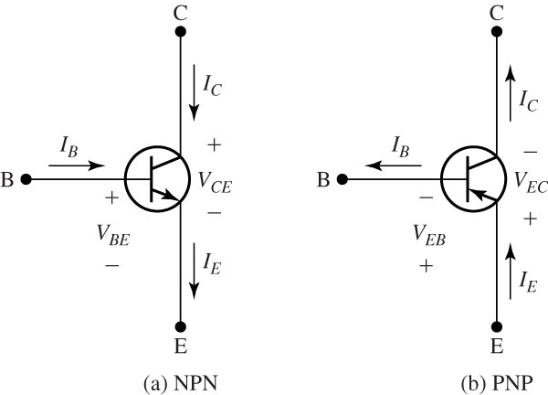
Reference positive directions for both NPN and PNP transistors.

Slide 10
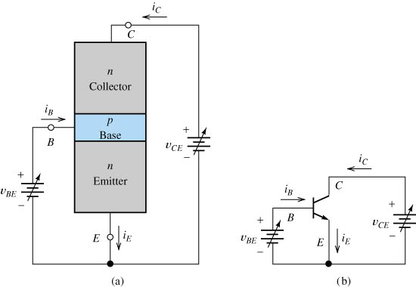
An npn transistor with variable biasing sources (common-emitter configuration).

Slide 11
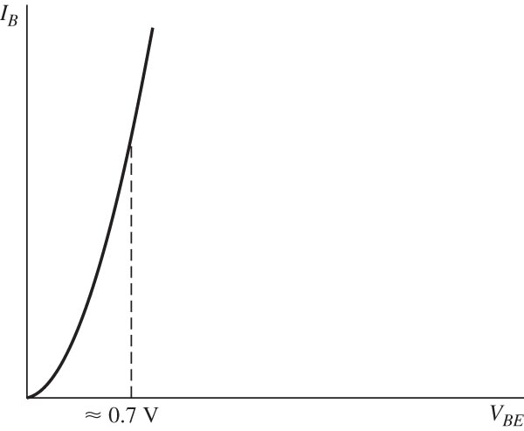
Base characteristic with collector-to-emitter voltage constant.

Slide 12
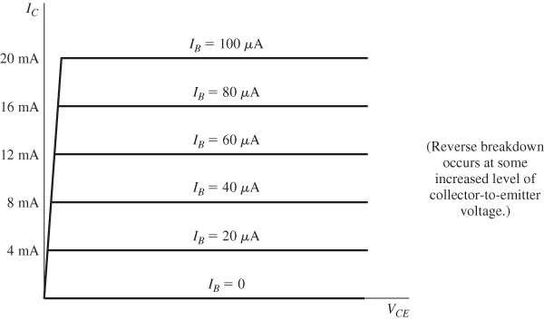
Collector characteristics of an ideal representative BJT.

Slide 13
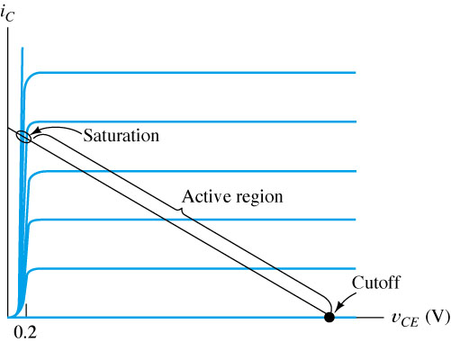
Three regions of operation for a BJT.
Amplification occurs in the active region. In saturation, v_{CE} < 0.2 V.

Slide 14
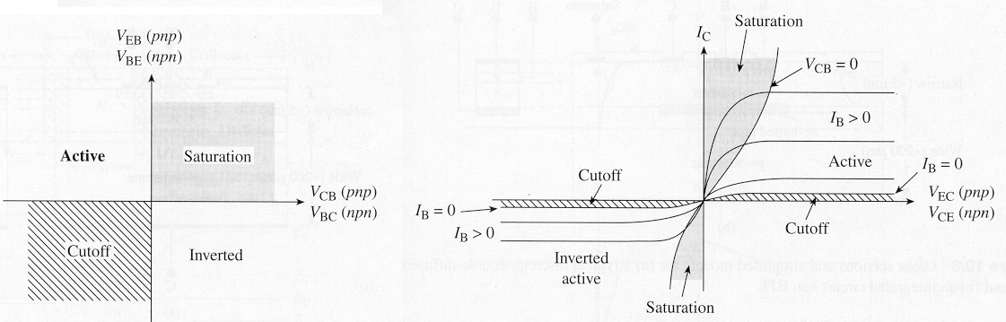
Modes of Operation
Common-emitter output characteristics
(I_{C} vs. V_{CE})
Mode | Emitter Junction | Collector Junction
CUTOFF | reverse bias | reverse bias
Forward ACTIVE | forward bias | reverse bias*
Reverse ACTIVE | reverse bias* | forward bias
SATURATION | forward bias | forward bias
*or not strongly forward biased

Slide 15
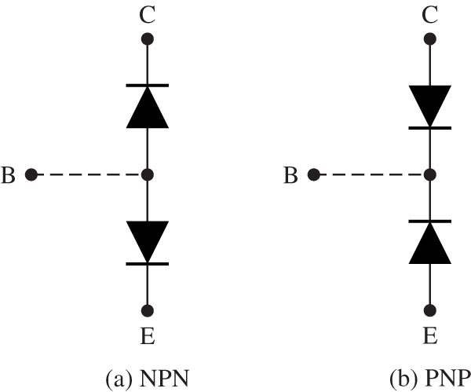
Models to assist in visualizing BJT as two diodes.

Slide 16
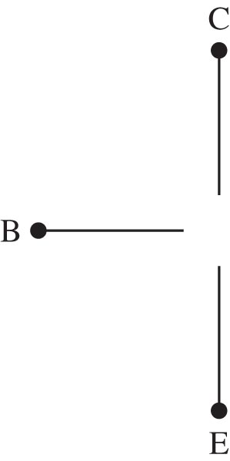
Ideal model of BJT in cutoff region.

Slide 17
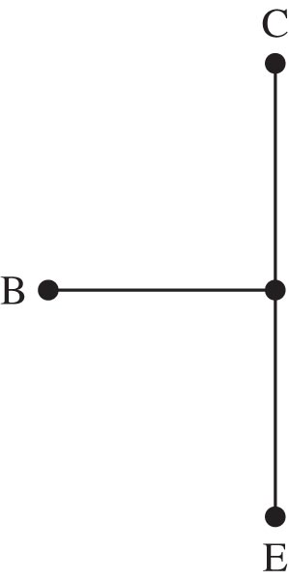
Ideal model of BJT in saturation region.

Slide 18
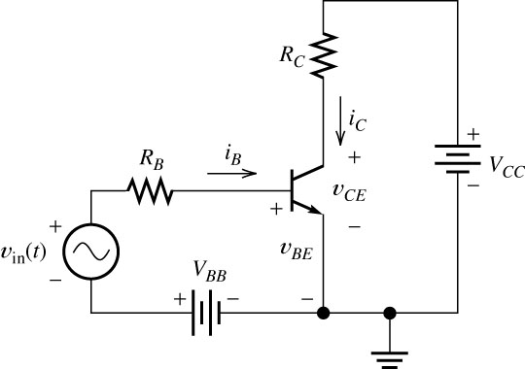
Transistor as an amplifier.

Slide 19
Transistor Amplifier Basics
i_{b}
0
+
I_{B}
=
i_{B}

Slide 20
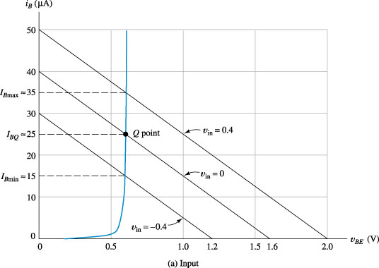
Load-line analysis

Slide 21
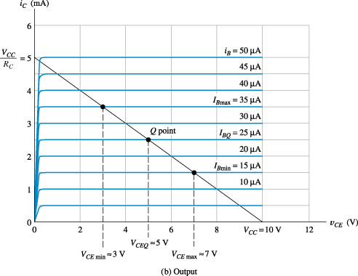
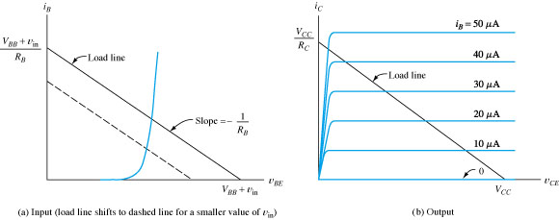
Load-line analysis of the amplifier

Slide 22
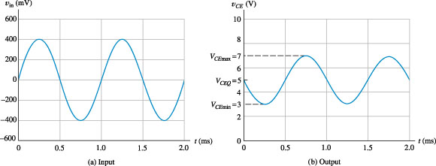
Voltage waveforms for the amplifier

Slide 23
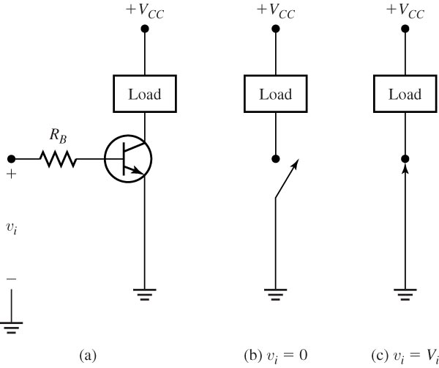
BJT switch using an NPN transistor.

