Slide 1
Metal Oxide Semiconductor Field-Effect Transistor

Slide 2
MOSFET: Metal Oxide Semiconductor Field-Effect Transistor
n channel MOSFET
In lightly doped p-type substrate, two highly doped n regions (source and drain) are diffused
Insulator is grown over surface and holes are cut into it to have contact with source and drain
For Si substrate, SiO₂ is used as the Insulator

Slide 3
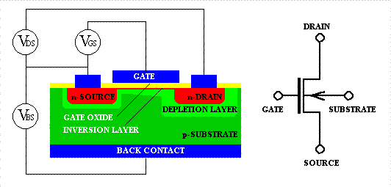
Metal-Oxide-Semiconductor Field-Effect Transistor (MOSFET)
n-channel

Slide 4
(+)
MOSFET operation
Substrate: Grounded
Gate : + ve voltage
+ + + + + + + + + + + + +
_ _ _ _ _ _ _ _ _ _
+ + + + + + + + + + + +
- - - - - - - - - - - -
An electric field is directed perpendicularly through oxide
Negative charge is induced on semiconductor
A channel is formed between drain and source
Width of channel depends on gate voltage
Induced channel

Slide 5
Electrons may flow through Channel

Slide 6
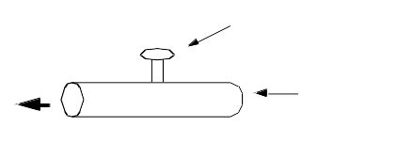
Basic Operation
1) Source and substrate grounded (zero voltage)
2) (+) voltage on the gate
  Attracts e⁻s to Si/SiO2 interface; forms channel
3) (+) voltage on the drain
  e⁻s in the channel drift from source to drain
  current flows from drain to source

Slide 7
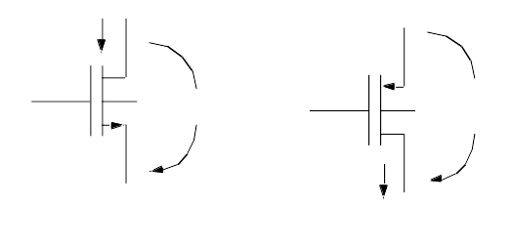
MOSFET
Metal-oxide-semiconductor field-effect transistor
G = gate, D = drain, S = source, B = body (substrate)

Slide 8
N enhance FET at Pinchoff

Slide 9
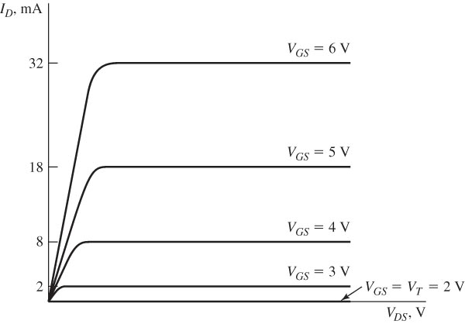
Drain characteristics for an ideal representative N-channel enhancement-mode MOSFET.

Slide 10
Terminal Voltages
Mode of operation depends on V_{g}, V_{d}, V_{s}
  V_{gs} = V_{g} – V_{s}
  V_{gd} = V_{g} – V_{d}
  V_{ds} = V_{d} – V_{s} = V_{gs} - V_{gd}
Source and drain are symmetric diffusion terminals
  By convention, source is terminal at lower voltage
  Hence V_{ds} ≥ 0
nMOS body is grounded. First assume source is 0 too.
Three regions of operation
  Cutoff
  Linear
  Saturation

Slide 11
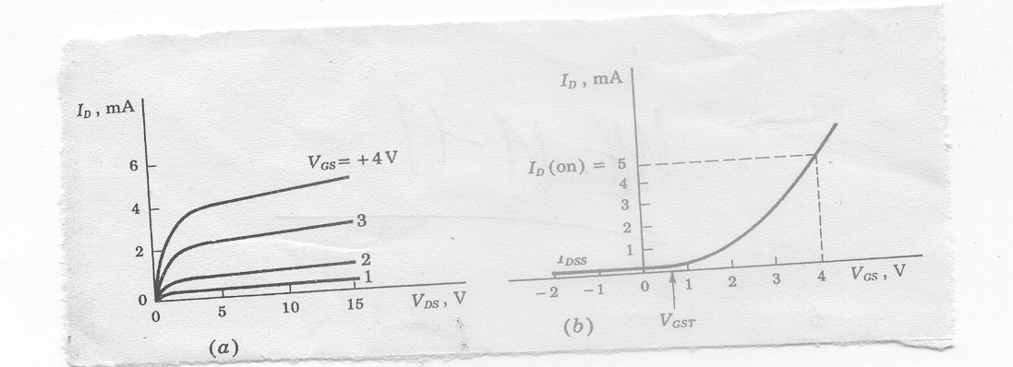
(a) I_{D} versus V_{DS} (b) I_{D} versus V_{GS} for a fixed V_{DS}
As V_{GS} is made positive I_{D} increases slowly at first and then much rapidly
I_{D} reaches significant value (some predefined small ) at threshold voltage

Slide 12
I-V Characteristics
I_{ds} is dependent on both V_{ds} and V_{gs}
In Linear region, I_{ds} depends on
  How much charge is in the channel?
  How fast is the charge moving?

Slide 13
N channel Depletion mode FET
ON – No gate bias
A channel is diffused between source and Drain

Slide 14
(- ve)
Channel Depletion with application of
negative voltage
- - - - - - - - - - - - - - -
+ + + + + + + + + + + + + + + +
- - - - - - - - - - - - - - - - - - - - - - - - - -
Induced +ve charge makes the channel less conductive
Causes effective depletion of majority carriers
Analogous to JFET characteristics
+ + + + + + + + + + + + + + +
+ + + + + + + + + + +
+ + + + +

Slide 15
N channel Depletion mode FET off

Slide 16
nMOS Cutoff
No channel
I_{ds} ≈ 0

Slide 17
nMOS Linear
Channel forms
Current flows from d to s
  e⁻ from s to d
I_{ds} increases with V_{ds}
Similar to linear resistor

Slide 18
nMOS Saturation
Channel pinches off
I_{ds} independent of V_{ds}
We say current saturates
Similar to current source

Slide 19
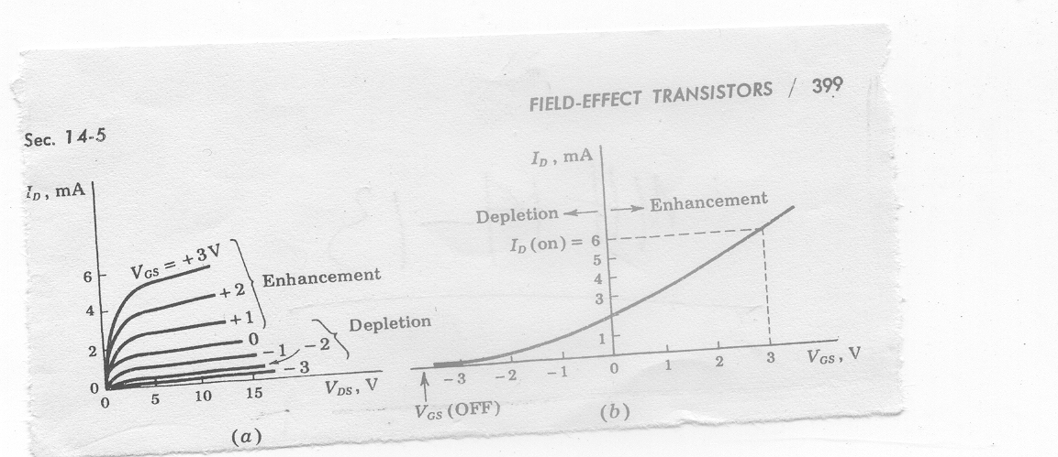
N channel Depletion mode MOSFET
(a) I_{D} versus V_{DS} (b) I_{D} versus V_{GS} for a fixed V_{DS}
May be used for both enhancement and depletion mode
Lower threshold voltage than enhancement type

Slide 20
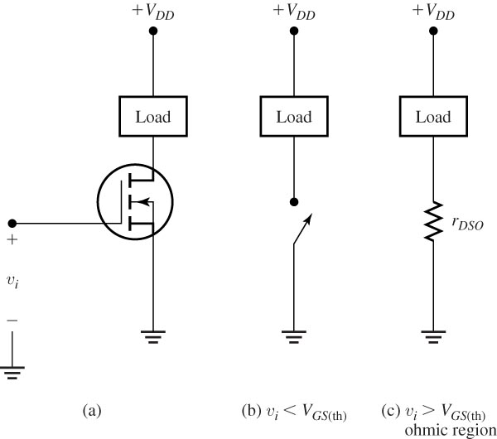
Switch using an N-channel enhancement-mode MOSFET.

Slide 21
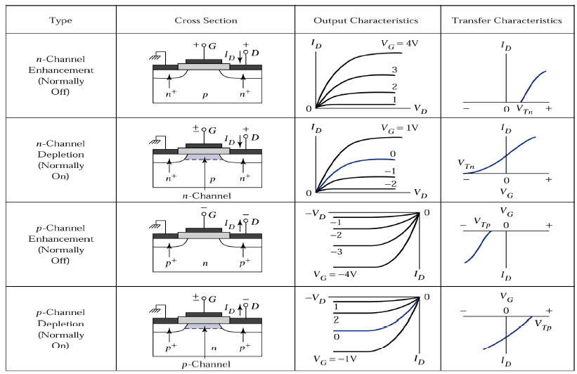
Types of MOSFET

Slide 22
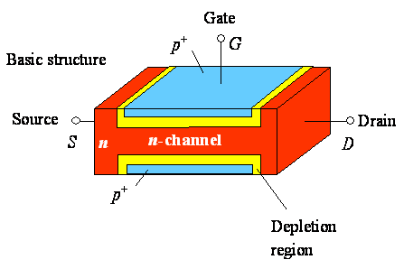
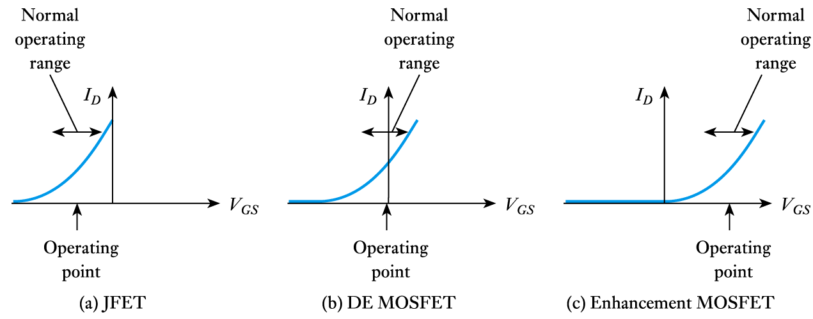
Transfer characteristics (n channel FET)
D
G
S
Operating range decides the type of FET

Slide 23
Comparison between p- with n-channel FET
p-channel is easier to fabricate
n-channel is faster as the mobility of electrons is 3 times greater than the mobility of holes
n-channel takes less space

Slide 24
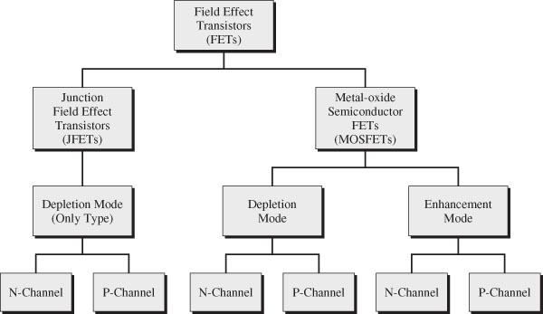
Classification scheme for field effect transistors

