Slide 1
Syntactic Pattern Recognition

Slide 2
Syntactic Pattern Recognition
Statistical pattern recognition attempts to classify patterns based on a set of extracted features and an underlying statistical model for the generation of these patterns. Ideally, this is achieved with a rather straightforward method.
determine the feature vector,
train the system,
classify the patterns
Patterns that include structural or relational information are difficult to represent as feature vectors.
Syntactic pattern recognition uses this structural information for classification and description.

Slide 3
Syntactic Pattern Recognition
Grammars can be used to create a definition of the structure of each pattern class.
Then, recognition and classiﬁcation are done using either:
Parsing using formal grammars (called Syntactic Pattern Recognition)
or
Relational graph matching( called Hierarchical approach )

Slide 4
Classification
Classification can be done based on a measure of structural similarity in patterns.
Each pattern class can be represented by a structural representation or description.

Slide 5
Description
A description of the pattern structure is useful for recognizing entities when a simple classification isn’t possible.
Can also describe aspects that cause a pattern not to be assigned to a particular class.
In complex cases, recognition can only be achieved through a description for each pattern rather than through classification.

Slide 6
Definitions
The simplest sub-patterns are called pattern primitives, and should be much easier to recognize than the overall patterns.
The language used to describe the structure of the patterns in terms of sets of pattern primitives is called the pattern description language.
The pattern description language will have a grammar that specifies how primitives can be composed into patterns

Slide 7
Syntax Analysis
When a primitive within the pattern is identified, syntax analysis (parsing) is performed on the sentence describing the pattern to determine if it is correct with respect to the grammar.
Syntax analysis also gives a structural description of the sentence associated with the pattern.
One advantage of this approach is that a grammar (rewriting) rule can be applied many times.

Slide 8
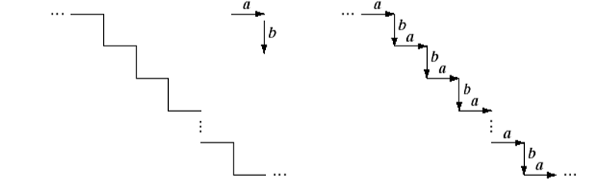
Pattern Description Using Grammar
Fig 1: (a) Staircase structure (b) structure encoded in terms of primitive a and b to yield the description …ababab…
a b

Slide 9
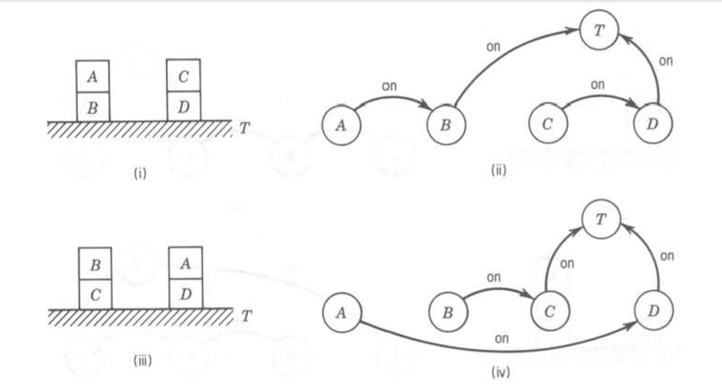
Pattern Description Using Grammar
Fig 2: A grammar describing four blocks arranged in 2-block stacks. (i) An example. (ii) Graphical description corresponding to (i). (iii) Another example. (iv) Graphical description corresponding to (iii).

Slide 10
Pattern Description Using Grammar
A grammar describing four blocks arranged in 2-block stacks:
V_{T} = { table , block , + , ↑ } (terminal symbols)
V_{N} = { DESK,LEFT STACK,RIGHT STACK}
(non-terminal symbols)
S = DESK ∈ V_{N} (root symbol)
P = {DESK → LEFT STACK + RIGHT STACK
DESK → RIGHT STACK + LEFT STACK
LEFT STACK → block ↑ block ↑ table
RIGHT STACK → block ↑ block ↑ table}
(production rules)

Slide 11
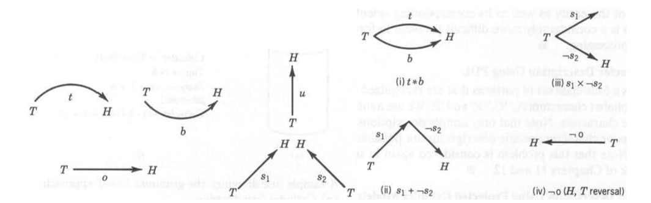
Pattern Description Using Grammar
Fig 3: A 2-D line drawing picture description grammar
A set of terminal symbols { t, b, u, o, s ,*,-,+} where
+ represents head to tail concatenation,
* represents head-head and tail-tail attachment,
– represents the head-tail reversal. ( x should be * in (iii) )

Slide 12
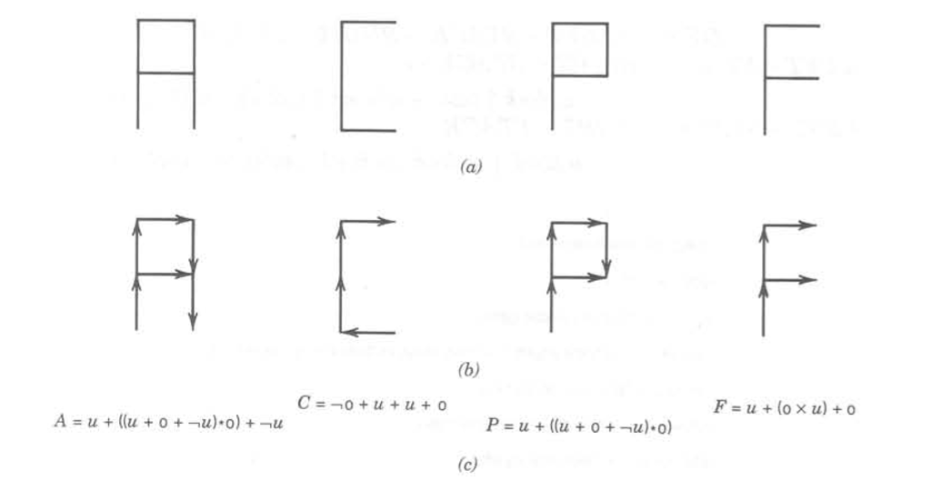
Pattern Description Using Grammar
.
Fig 4: Representation of four characters using the line drawing picture description grammar
(a) Pattern data. (b) Primitive representation and interconnection. (c) Corresponding descriptions

Slide 13
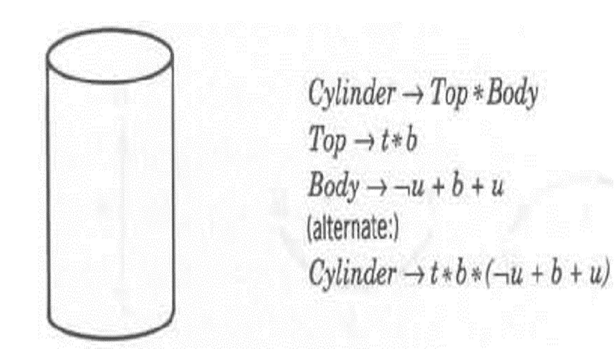
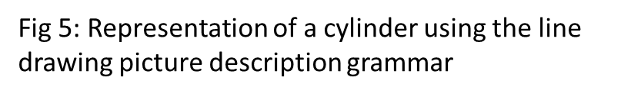
Pattern Description Using Grammar

Slide 14
When to Use It
Picture recognition and scene analysis are problems in which there are a large number of features and the patterns are complex.
For example, recognizing areas such as highways, rivers, and bridges in satellite pictures.
In this case, a complex pattern can be described in terms of a hierarchical composition of simpler sub patterns.

Slide 15
Syntactic System
.
Pattern Representation
preprocessing
Segmentation or Decomposition
Primitive Recognition
Syntax (or structural) analysis
Classification
Input pattern
And Description
recognition
- - - - - - - - - - - - - - - - - - - - - - - - -- -
- - - - - - -- -
- - - - - - - - - - - - - - - - - - - - -- -
- - - - - - - - - - - - - - - --
Analysis
Primitive (and relation) selection
Grammatical (or structural) inference
sample
pattern
Fig 6 :Block Diagram of a syntactic pattern recognition system

Slide 16
Syntactic System
Fig 7: Using Syntactic Patter Recognition for Classification
Library of classes categorized by structures
Class1 Structure
Class2 Structure
Class C Structure
….
Structural Analysis
Structural Matcher
Relevant Matches
Input

Slide 17
Syntactic System
Consists of two main parts:
Analysis -primitive selection and grammatical or structural inference
Recognition -preprocessing, segmentation or decomposition, primitive and relation recognition, and syntax analysis.
Preprocessing includes the tasks of pattern encoding and approximation, filtering, restoration, and enhancement.
After preprocessing, the pattern is segmented into sub-patterns and primitives using predefined operations.
Sub-patterns are identified with a given set of primitives, so each pattern is represented by a set of primitives with the specified syntactic operations.

Slide 18
Syntax Parsing
For example, using the concatenation operation, each pattern is recognized by a string of concatenated primitives.
At this point, the parser will determine if the pattern is syntactically correct.
It belongs to the class of patterns described by the grammar if it is correct.
During parsing/syntax analysis, a description is produced in terms of a parse tree, assuming the pattern is syntactically correct.
If it isn’t correct, it will either be rejected or analyzed based on a different grammar, which could represent other possible pattern classes.

Slide 19
Matching
The simplest form of recognition is template matching, in which a string of primitives representing an input pattern is compared to strings of primitives representing reference patterns.
The input pattern is classified in the same class as the prototype that is the best match, which is determined by a similarity criterion.
Matching vs. Complete Parsing
In this case, the structural description is ignored.
The opposite approach is a complete parsing that uses the entire structural description.
There are many intermediate approaches; for example, a series of tests designed to test the occurrence of certain primitives, sub-patterns, or combinations of these. The result of these tests will determine a classification

Slide 20
Parsing is required if the problem necessitates using a complete pattern description for recognition.
Efficiency of the recognition process is improved by simpler approaches that do not require a complete parsing.
Basically, parsing can be expensive, so don’t use it unnecessarily.
Inferring Grammars
Grammatical inference machine similar to “learning” in the discriminant approach; it infers a grammar from a set of training patterns.
The inferred grammar can then be used for pattern description and syntax analysis.

