Slide 1
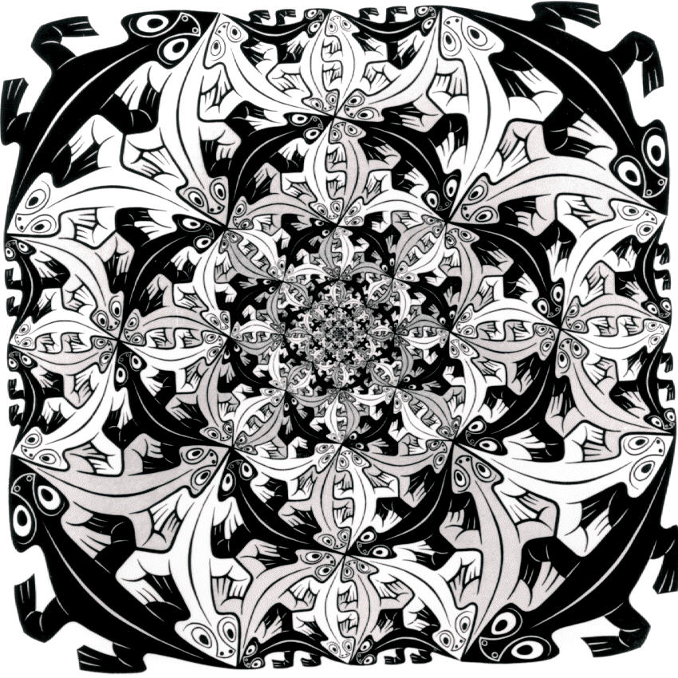
Computer Graphics
Lecture 4
Transformations
M.C. Escher – Smaller and Smaller (1956)

Slide 2
Overview
2D Transformations
  Basic 2D transformations
  Matrix representation
  Matrix composition
3D Transformations
  Basic 3D transformations
  Same as 2D
Subhadip Basu

Slide 3
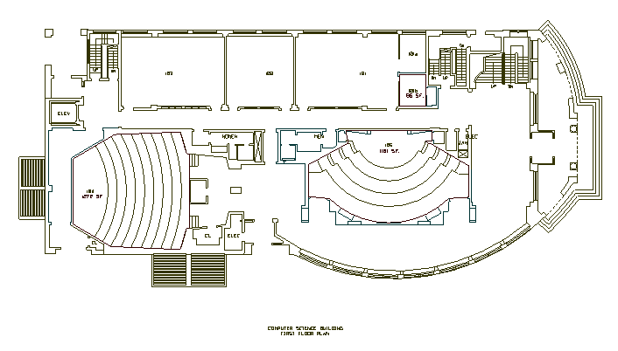
2D Modeling Transformations
Modeling
Coordinates
Scale
Translate
y
x
Scale
Rotate
Translate
World Coordinates
Subhadip Basu

Slide 4
2D Modeling Transformations
Modeling
Coordinates
y
x
Let’s look
at this in
detail…
World Coordinates
Subhadip Basu

Slide 5
2D Modeling Transformations
Modeling
Coordinates
y
x
Initial location
at (0, 0) with
x- and y-axes
aligned
Subhadip Basu

Slide 6
2D Modeling Transformations
Modeling
Coordinates
y
x
Scale .3, .3
Rotate -90
Translate 5, 3
Subhadip Basu

Slide 7
2D Modeling Transformations
Modeling
Coordinates
y
x
Scale .3, .3
Rotate -90
Translate 5, 3
Subhadip Basu

Slide 8
2D Modeling Transformations
Modeling
Coordinates
y
x
Scale .3, .3
Rotate -90
Translate 5, 3
World Coordinates
Subhadip Basu

Slide 9
Scaling
Scaling a coordinate means multiplying each of its components by a scalar
Uniform scaling means this scalar is the same for all components:
× 2
Subhadip Basu

Slide 10
Scaling
Non-uniform scaling: different scalars per component:
How can we represent this in matrix form?
X × 2,
Y × 0.5
Subhadip Basu

Slide 11
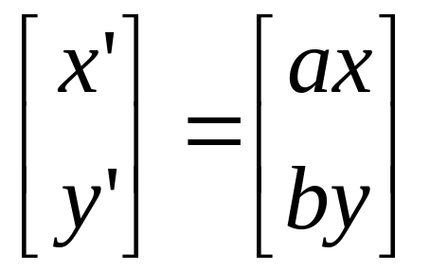
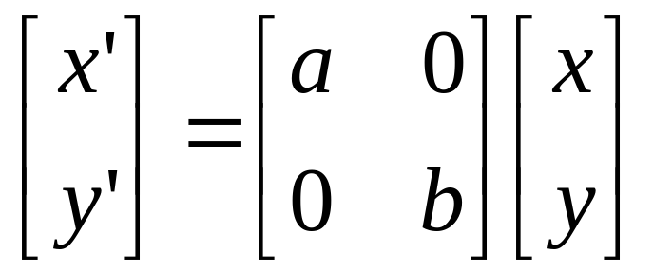
Scaling
Scaling operation:
Or, in matrix form:
scaling matrix
Subhadip Basu

Slide 12
2-D Rotation
(x’, y’)
(x, y)
x’ = x cos(θ) - y sin(θ)
y’ = x sin(θ) + y cos(θ)
θ
Subhadip Basu

Slide 13
2-D Rotation
x = r cos (φ)
y = r sin (φ)
x’ = r cos (φ + θ)
y’ = r sin (φ + θ)
Trig Identity…
x’ = r cos(φ) cos(θ) – r sin(φ) sin(θ)
y’ = r sin(φ) cos(θ) + r cos(φ) sin(θ)
Substitute…
x’ = x cos(θ) - y sin(θ)
y’ = x sin(θ) + y cos(θ)
(x’, y’)
(x, y)
θ
φ
Subhadip Basu

Slide 14
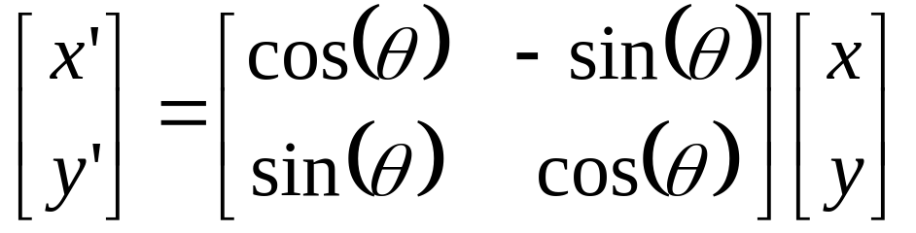
2-D Rotation
This is easy to capture in matrix form:
Even though sin(θ) and cos(θ) are nonlinear functions of θ,
  x’ is a linear combination of x and y
  y’ is a linear combination of x and y
Subhadip Basu

Slide 15
Basic 2D Transformations
Translation:
  x’ = x + t_{x}
  y’ = y + t_{y}
Scale:
  x’ = x * s_{x}
  y’ = y * s_{y}
Shear:
  x’ = x + h_{x}*y
  y’ = y + h_{y}*x
Rotation:
  x’ = x*cosΘ - y*sinΘ
  y’ = x*sinΘ + y*cosΘ
Transformations
can be combined
(with simple algebra)
Subhadip Basu

Slide 16
Basic 2D Transformations
Translation:
  x’ = x + t_{x}
  y’ = y + t_{y}
Scale:
  x’ = x * s_{x}
  y’ = y * s_{y}
Shear:
  x’ = x + h_{x}*y
  y’ = y + h_{y}*x
Rotation:
  x’ = x*cosΘ - y*sinΘ
  y’ = x*sinΘ + y*cosΘ
Subhadip Basu

Slide 17
Basic 2D Transformations
Translation:
  x’ = x + t_{x}
  y’ = y + t_{y}
Scale:
  x’ = x * s_{x}
  y’ = y * s_{y}
Shear:
  x’ = x + h_{x}*y
  y’ = y + h_{y}*x
Rotation:
  x’ = x*cosΘ - y*sinΘ
  y’ = x*sinΘ + y*cosΘ
(x,y)
(x’,y’)
x’ = x*s_{x}
y’ = y*s_{y}
Subhadip Basu

Slide 18
Basic 2D Transformations
Translation:
  x’ = x + t_{x}
  y’ = y + t_{y}
Scale:
  x’ = x * s_{x}
  y’ = y * s_{y}
Shear:
  x’ = x + h_{x}*y
  y’ = y + h_{y}*x
Rotation:
  x’ = x*cosΘ - y*sinΘ
  y’ = x*sinΘ + y*cosΘ
(x’,y’)
x’ = (x*s_{x})*cosΘ - (y*s_{y})*sinΘ
y’ = (x*s_{x})*sinΘ + (y*s_{y})*cosΘ
Subhadip Basu

Slide 19
Basic 2D Transformations
Translation:
  x’ = x + t_{x}
  y’ = y + t_{y}
Scale:
  x’ = x * s_{x}
  y’ = y * s_{y}
Shear:
  x’ = x + h_{x}*y
  y’ = y + h_{y}*x
Rotation:
  x’ = x*cosΘ - y*sinΘ
  y’ = x*sinΘ + y*cosΘ
(x’,y’)
x’ = ((x*s_{x})*cosΘ - (y*s_{y})*sinΘ) + t_{x}
y’ = ((x*s_{x})*sinΘ + (y*s_{y})*cosΘ) + t_{y}
Subhadip Basu

Slide 20
Basic 2D Transformations
Translation:
  x’ = x + t_{x}
  y’ = y + t_{y}
Scale:
  x’ = x * s_{x}
  y’ = y * s_{y}
Shear:
  x’ = x + h_{x}*y
  y’ = y + h_{y}*x
Rotation:
  x’ = x*cosΘ - y*sinΘ
  y’ = x*sinΘ + y*cosΘ
x’ = ((x*s_{x})*cosΘ - (y*s_{y})*sinΘ) + t_{x}
y’ = ((x*s_{x})*sinΘ + (y*s_{y})*cosΘ) + t_{y}
Subhadip Basu

Slide 21
Overview
2D Transformations
  Basic 2D transformations
  Matrix representation
  Matrix composition
3D Transformations
  Basic 3D transformations
  Same as 2D
Subhadip Basu

Slide 22
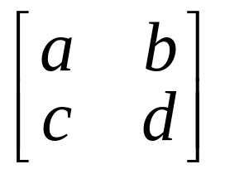
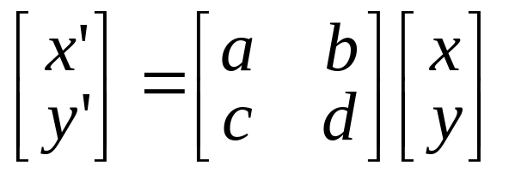
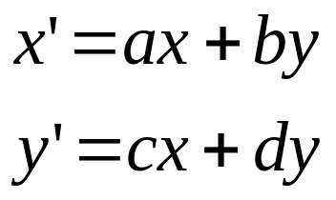
Matrix Representation
Represent 2D transformation by a matrix
Multiply matrix by column vector
⇔ apply transformation to point
Subhadip Basu

Slide 23
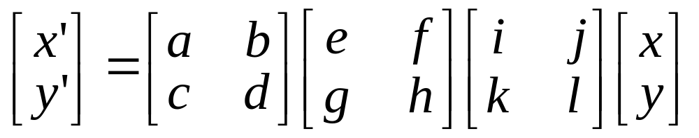
Matrix Representation
Transformations combined by multiplication
  Matrices are a convenient and efficient way
  to represent a sequence of transformations!
Subhadip Basu

Slide 24
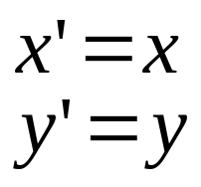
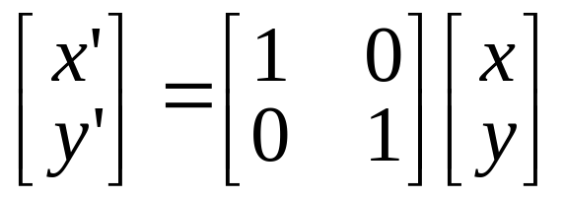
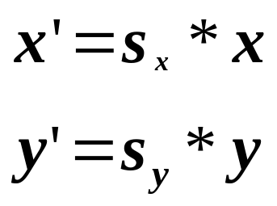
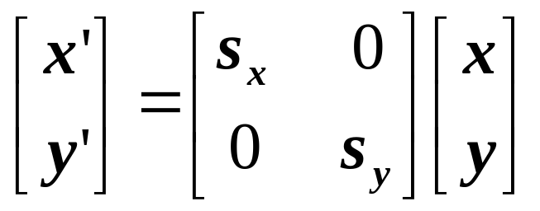
2x2 Matrices
What types of transformations can be
represented with a 2x2 matrix?
2D Identity?
2D Scale around (0,0)?
Subhadip Basu

Slide 25
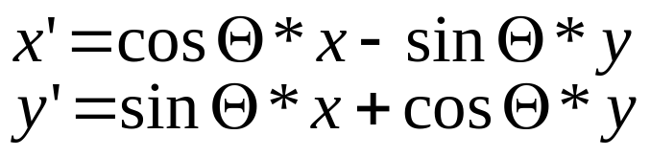
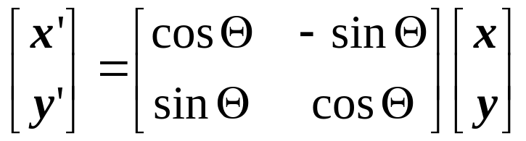
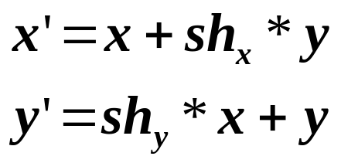
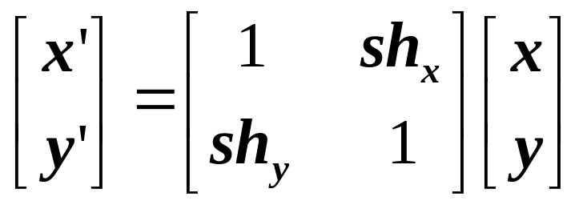
2x2 Matrices
What types of transformations can be
represented with a 2x2 matrix?
2D Rotate around (0,0)?
2D Shear?
Subhadip Basu

Slide 26
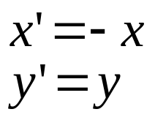
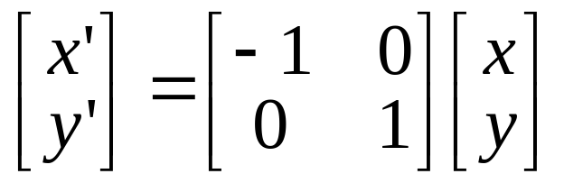
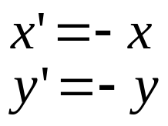
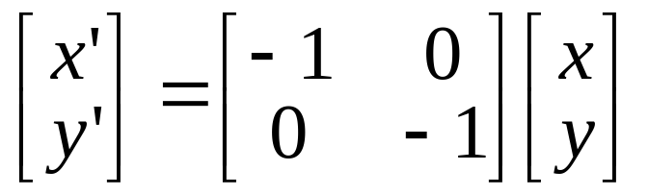
2x2 Matrices
What types of transformations can be
represented with a 2x2 matrix?
2D Mirror about Y axis?
2D Mirror over (0,0)?
Subhadip Basu

Slide 27
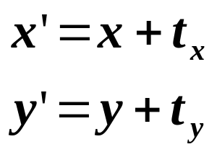
2x2 Matrices
What types of transformations can be
represented with a 2x2 matrix?
2D Translation?
NO!
Only linear 2D transformations
can be represented with a 2x2 matrix
Subhadip Basu

Slide 28
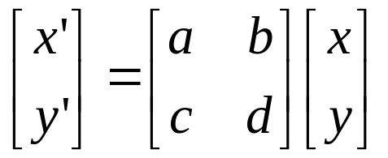
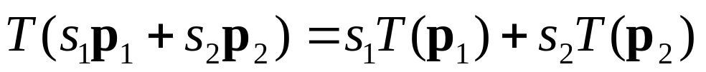
Linear Transformations
Linear transformations are combinations of …
  Scale,
  Rotation,
  Shear, and
  Mirror
Properties of linear transformations:
  Satisfies:
  Origin maps to origin
  Lines map to lines
  Parallel lines remain parallel
  Ratios are preserved
  Associative but not commutative
Subhadip Basu

Slide 29

Homogeneous Coordinates
Q: How can we represent translation as a 3x3 matrix?
Subhadip Basu

Slide 30
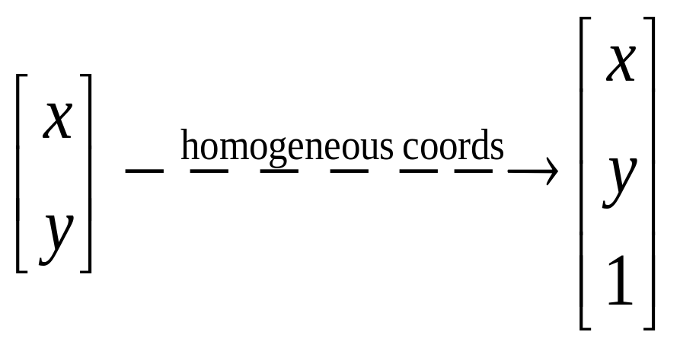
Homogeneous Coordinates
Homogeneous coordinates
  represent coordinates in 2 dimensions with a 3-vector
Homogeneous coordinates seem unintuitive, but they make graphics operations much easier
Subhadip Basu

Slide 31
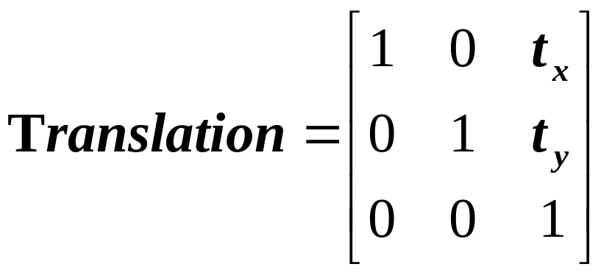
Homogeneous Coordinates
Q: How can we represent translation as a 3x3 matrix?
A: Using the rightmost column:
Subhadip Basu

Slide 32
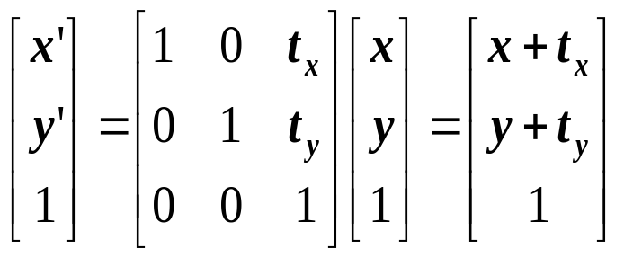
Translation
Homogeneous Coordinates
Example of translation
α
t_{x} = 2
t_{y} = 1
Subhadip Basu

Slide 33
Homogeneous Coordinates
Add a 3rd coordinate to every 2D point
  (x, y, w) represents a point at location (x/w, y/w)
  (x, y, 0) represents a point at infinity
  (0, 0, 0) is not allowed
y
2
(2,1,1)
or (4,2,2)
or (6,3,3)
1
Convenient coordinate system to
represent many useful transformations
x
1
2
Subhadip Basu

Slide 34
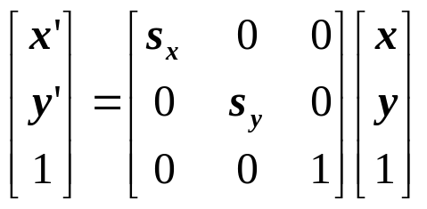
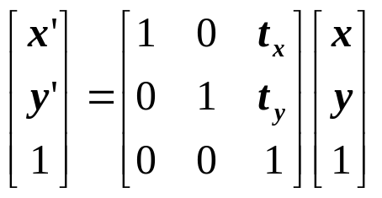
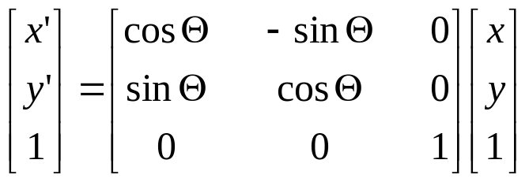
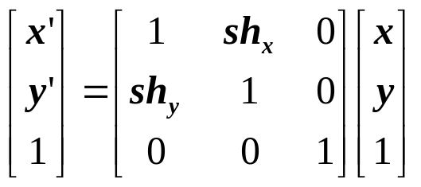
Basic 2D Transformations
Basic 2D transformations as 3x3 matrices
Translate
Scale
Rotate
Shear
Subhadip Basu

Slide 35
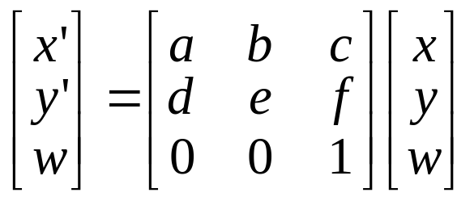
Affine Transformations
Affine transformations are combinations of …
  Linear transformations, and
  Translations
Properties of affine transformations:
  Origin does not necessarily map to origin
  Lines map to lines
  Parallel lines remain parallel
  Ratios are preserved
  Associative but not commutative
Subhadip Basu

Slide 36
Overview
2D Transformations
  Basic 2D transformations
  Matrix representation
  Matrix composition
3D Transformations
  Basic 3D transformations
  Same as 2D
Subhadip Basu

Slide 37
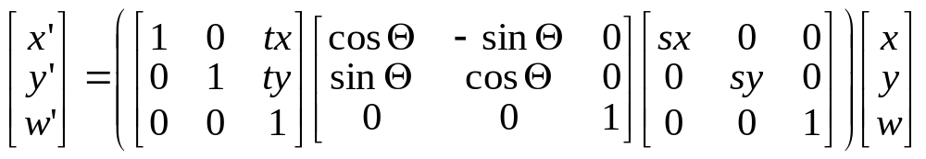
Matrix Composition
Transformations can be combined by
matrix multiplication
p’ = T(t_{x},t_{y}) R(Θ) S(s_{x},s_{y}) p
Subhadip Basu

Slide 38
Matrix Composition
Matrices are a convenient and efficient way to represent a sequence of transformations
  General purpose representation
  Hardware matrix multiply
p’ = (T * (R * (S*p) ) )
p’ = (T*R*S) * p
Subhadip Basu

Slide 39
Matrix Composition
Be aware: order of transformations matters
    Matrix multiplication is not commutative
p’ = T * R * S * p
“Global”
“Local”
Subhadip Basu

Slide 40
Matrix Composition
What if we want to rotate and translate?
  Ex: Rotate line segment by 45 degrees about endpoint a
  and lengthen
a
a
Subhadip Basu

Slide 41
Multiplication Order – Wrong Way
Our line is defined by two endpoints
  Applying a rotation of 45 degrees, R(45), affects both points
  We could try to translate both endpoints to return endpoint a to its original position, but by how much?
a
a
a
Wrong
Correct
T(-3) R(45) T(3)
R(45)
Subhadip Basu

Slide 42
Multiplication Order - Correct
Isolate endpoint a from rotation effects
  First translate line so a is at origin: T (-3)
  Then rotate line 45 degrees: R(45)
  Then translate back so a is where it was: T(3)
a
a
a
a
Subhadip Basu

Slide 43
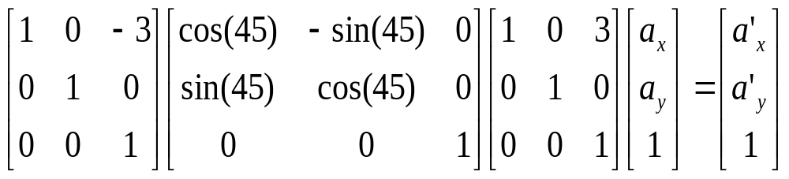
Matrix Composition
Will this sequence of operations work?
p’ = (T * (R * (S*p) ) )
p’ = (T*R*S) * p
Subhadip Basu

Slide 44
Matrix Composition
After correctly ordering the matrices Multiply matrices together
What results is one matrix – store it (on stack)!
Multiply this matrix by the vector of each vertex
All vertices easily transformed with one matrix multiply
Subhadip Basu

Slide 45
Reflection about an arbitrary line
Translate the line as well as the object so that the line passes through origin
Rotate the line and the object about the origin until the line is coincident with one of the coordinate axes
Reflect the object through the coordinate axis
Rotate back
Translate back
Subhadip Basu

Slide 46
Reverse Rotations
Q: How do you undo a rotation of θ, R(θ)?
A: Apply the inverse of the rotation… R⁻¹(θ) = R(-θ)
How to construct R⁻¹(θ) = R(-θ)
  Inside the rotation matrix: cos(θ) = cos(-θ)
    The cosine elements of the inverse rotation matrix are unchanged
  The sign of the sine elements will flip: sin(-θ) = -sin (θ)
Therefore… R⁻¹(θ) = R(-θ) = R^{T}(θ)
Subhadip Basu

Slide 47
Overview
2D Transformations
  Basic 2D transformations
  Matrix representation
  Matrix composition
3D Transformations
  Basic 3D transformations
  Same as 2D
Subhadip Basu

Slide 48
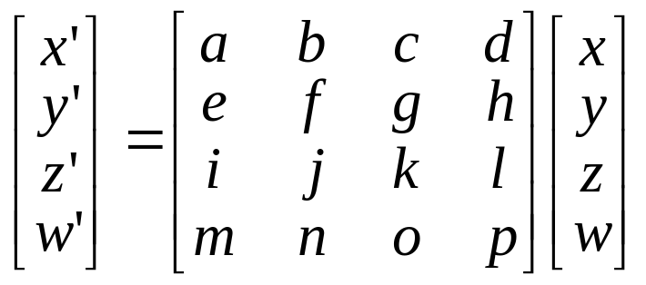
3D Transformations
Same idea as 2D transformations
  Homogeneous coordinates: (x,y,z,w)
  4x4 transformation matrices
Subhadip Basu

Slide 49
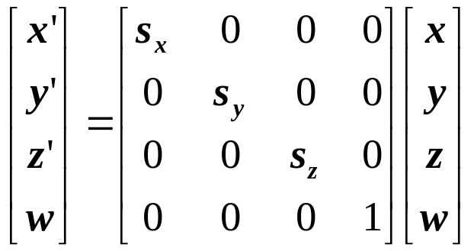
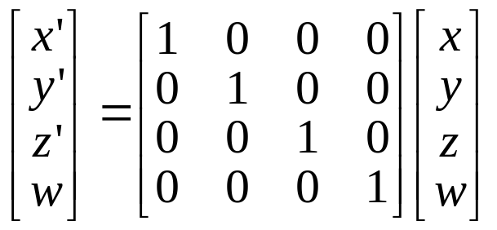
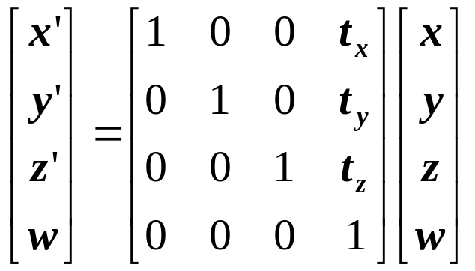
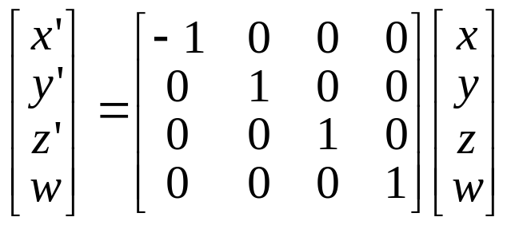
Basic 3D Transformations
Identity
Scale
Translation
Mirror about Y/Z plane
Subhadip Basu

Slide 50
3-D Rotation About an Axis
y
Positive rotation is counterclockwise, when looking from positive direction along an axis.
x
z
Subhadip Basu

Slide 51
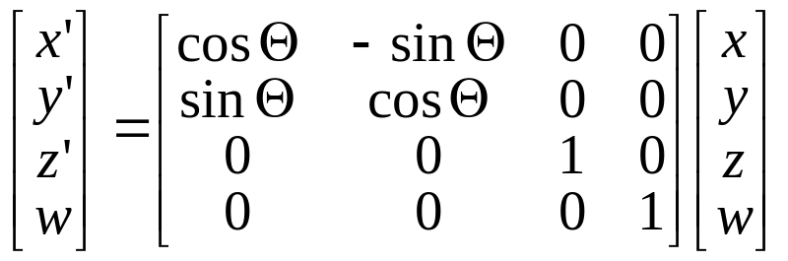
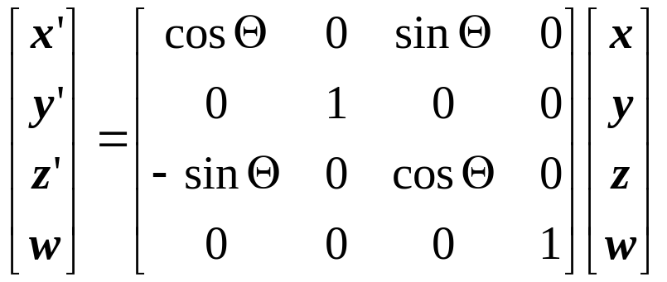
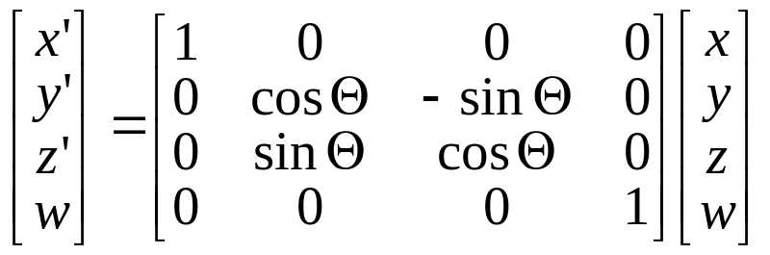
Basic 3D Transformations
Rotate around Z axis:
Rotate around Y axis:
Rotate around X axis:
Subhadip Basu

Slide 52
Summary
Coordinate systems
  World vs. modeling coordinates
2-D and 3-D transformations
  Trigonometry and geometry
  Matrix representations
  Linear vs. affine transformations
Matrix operations
  Matrix composition
Subhadip Basu

