Slide 1
Computer Graphics 14:
Surface Detection Methods

Slide 2
Contents
Today we will start to take a look at visible surface detection techniques:
  Why surface detection?
  Back face detection
  Depth-buffer method
  A-buffer method
  Scan-line method

Slide 3

Why?
We must determine what is visible within a scene from a chosen viewing position
For 3D worlds this is known as visible surface detection or hidden surface elimination

Slide 4
Two Main Approaches
Visible surface detection algorithms are broadly classified as:
  Object Space Methods: Compares objects and parts of objects to each other within the scene definition to determine which surfaces are visible
  Image Space Methods: Visibility is decided point-by-point at each pixel position on the projection plane
Image space methods are by far the more common

Slide 5
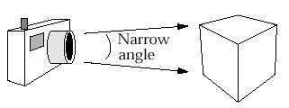
Back-Face Detection
The simplest thing we can do is find the faces on the backs of polyhedra and discard them

Slide 6

Back-Face Detection (cont…)
We know from before that a point (x, y, z) is behind a polygon surface if:
where A, B, C & D are the plane parameters for the surface
This can actually be made even easier if we organise things to suit ourselves

Slide 7
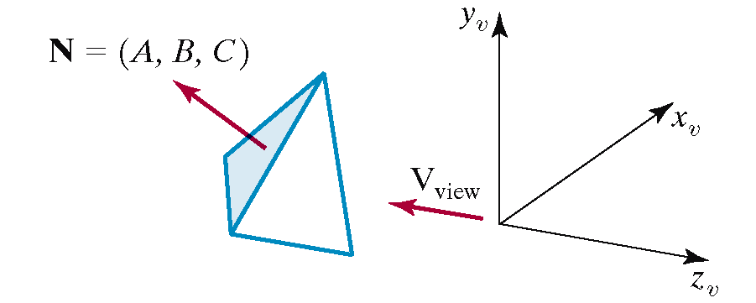
Back-Face Detection (cont…)
Ensure we have a right handed system with the viewing direction along the negative z-axis
Now we can simply say that if the z component of the polygon’s normal is less than zero the surface cannot be seen

Slide 8
Back-Face Detection (cont…)
In general back-face detection can be expected to eliminate about half of the polygon surfaces in a scene from further visibility tests
More complicated surfaces
though trouble us!
We need better techniques
to handle these kind of
situations

Slide 9
Depth-Buffer Method
Compares surface depth values throughout a scene for each pixel position on the projection plane
Usually applied to scenes only containing polygons
As depth values can be computed easily, this tends to be very fast
Also often called the z-buffer method

Slide 10
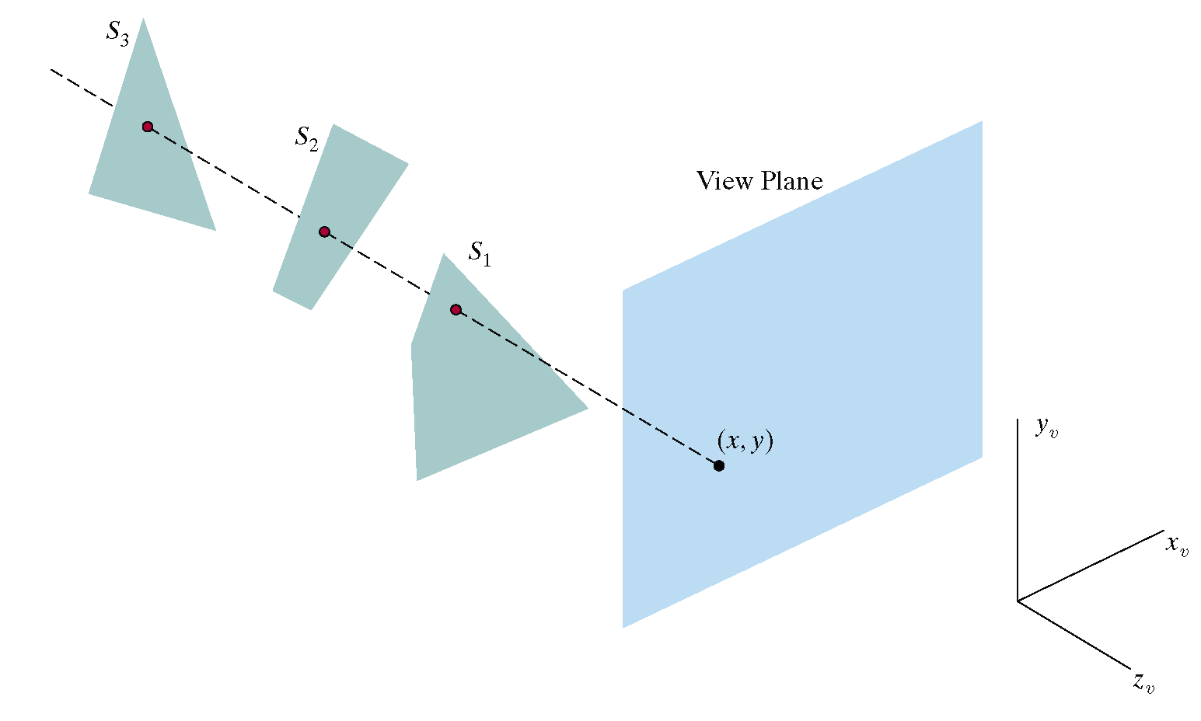
Depth-Buffer Method (cont…)

Slide 11
Depth-Buffer Algorithm
Initialise the depth buffer and frame buffer so that for all buffer positions (x, y)
depthBuff(x, y) = 1.0
frameBuff(x, y) = bgColour

Slide 12
Depth-Buffer Algorithm (cont…)
Process each polygon in a scene, one at a time
  For each projected (x, y) pixel position of a polygon, calculate the depth z (if not already known)
  If z < depthBuff(x, y), compute the surface colour at that position and set
  depthBuff(x, y) = z
  frameBuff(x, y) = surfColour(x, y)
After all surfaces are processed depthBuff and frameBuff will store correct values

Slide 13
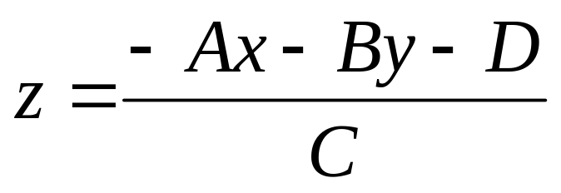
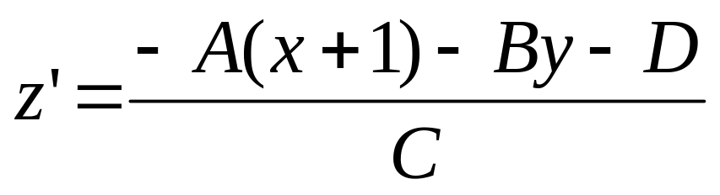
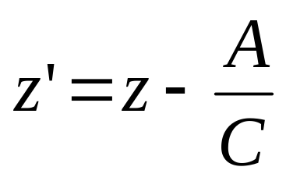
Calculating Depth
At any surface position the depth is calculated from the plane equation as:
For any scan line adjacent x positions differ by ±1, as do adjacent y positions

Slide 14
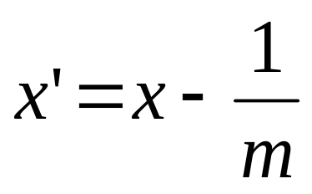
Iterative Calculations
The depth-buffer algorithm proceeds by starting at the top vertex of the polygon
Then we recursively calculate the x-coordinate values down a left edge of the polygon
The x value for the beginning position on each scan line can be calculated from the previous one
where m is the slope

Slide 15
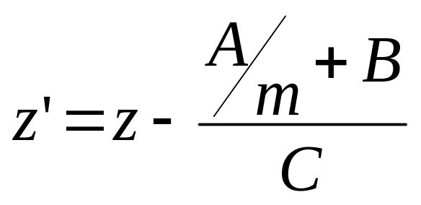
Iterative Calculations (cont…)
Depth values along the edge being considered are calculated using

Slide 16
Iterative Calculations (cont…)
top scan line
y scan line
y - 1 scan line
bottom scan line
x
x’

Slide 17
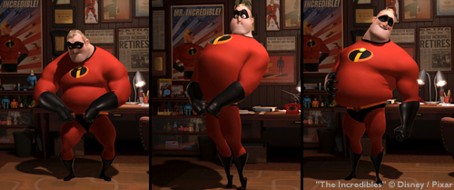
A-Buffer Method
The A-buffer method is an extension of the depth-buffer method
The A-buffer method is visibility detection method developed at Lucasfilm Studios for the rendering system REYES (Renders Everything You Ever Saw)

Slide 18
A-Buffer Method (cont…)
The A-buffer expands on the depth buffer method to allow transparencies
The key data structure in the A-buffer is the accumulation buffer

Slide 19
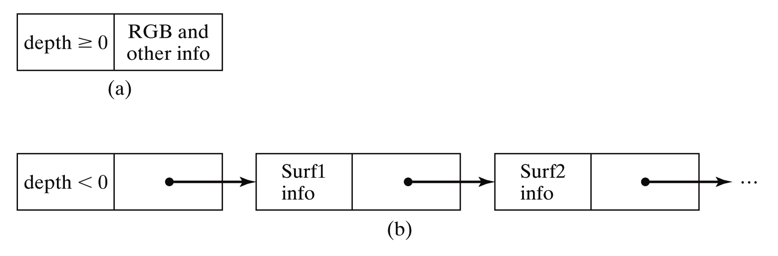
A-Buffer Method (cont…)
If depth is >= 0, then the surface data field stores the depth of that pixel position as before
If depth < 0 then the data filed stores a pointer to a linked list of surface data

Slide 20
A-Buffer Method (cont…)
Surface information in the A-buffer includes:
  RGB intensity components
  Opacity parameter
  Depth
  Percent of area coverage
  Surface identifier
  Other surface rendering parameters
The algorithm proceeds just like the depth buffer algorithm
The depth and opacity values are used to determine the final colour of a pixel

Slide 21
Scan-Line Method
An image space method for identifying visible surfaces
Computes and compares depth values along the various scan-lines for a scene

Slide 22
Scan-Line Method (cont…)
Two important tables are maintained:
  The edge table
  The surface facet table
The edge table contains:
  Coordinate end points of reach line in the scene
  The inverse slope of each line
  Pointers into the surface facet table to connect edges to surfaces

Slide 23
Scan-Line Method (cont…)
The surface facet tables contains:
  The plane coefficients
  Surface material properties
  Other surface data
  Maybe pointers into the edge table

Slide 24
Scan-Line Method (cont…)
To facilitate the search for surfaces crossing a given scan-line an active list of edges is formed for each scan-line as it is processed
The active list stores only those edges that cross the scan-line in order of increasing x
Also a flag is set for each surface to indicate whether a position along a scan-line is either inside or outside the surface

Slide 25
Scan-Line Method (cont…)
Pixel positions across each scan-line are processed from left to right
At the left intersection with a surface the surface flag is turned on
At the right intersection point the flag is turned off
We only need to perform depth calculations when more than one surface has its flag turned on at a certain scan-line position

Slide 26
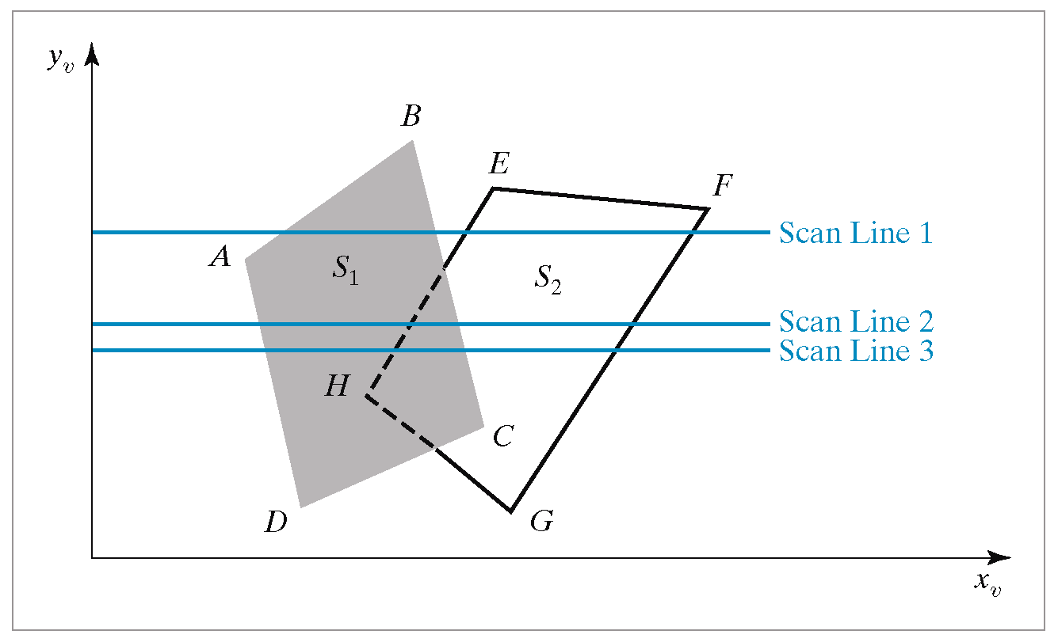

Scan Line Method Example
Images taken from Hearn & Baker, “Computer Graphics with OpenGL” (2004)

Slide 27
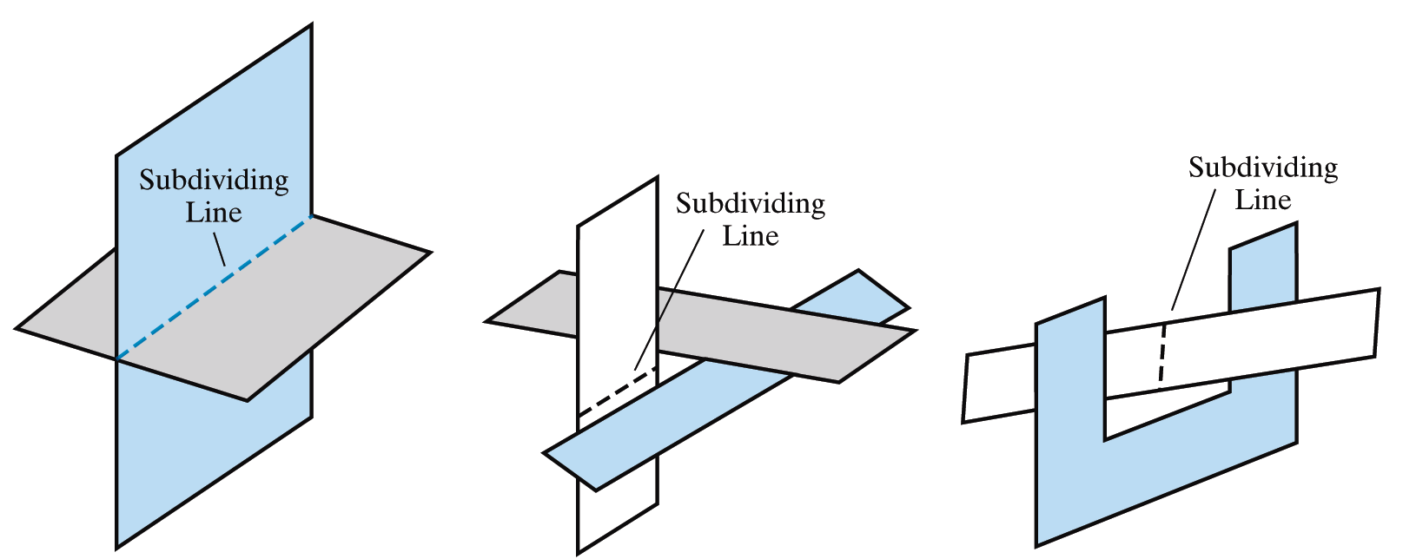
Scan-Line Method Limitations
The scan-line method runs into trouble when surfaces cut through each other or otherwise cyclically overlap
Such surfaces need to be divided
Images taken from Hearn & Baker, “Computer Graphics with OpenGL” (2004)

Slide 28
Summary
We need to make sure that we only draw visible surfaces when rendering scenes
There are a number of techniques for doing this such as
  Back face detection
  Depth-buffer method
  A-buffer method
  Scan-line method
Next time we will look at some more techniques and think about which techniques are suitable for which situations

