Slide 1
Intel 8086 MICROPROCESSOR ARCHITECTURE
Microprocessor & Microcontroller
An Introduction

Slide 2
Reference Books
“Advanced Microprocessors and Peripherals” K M Bhurchandi & A K Ray –McGraw Hill International Edition
“Microprocessors and Interfacing” Douglas V. Hall - McGraw Hill International Edition

Slide 3
Introduction:
What is a Microprocessor?
A microprocessor (abbreviated as µP or uP) is an electronic computers central processing unit (CPU) made from miniaturized transistors and other circuit elements on a single semiconductor integrated circuit (IC).
It performs arithmetic, logic and control operations. It contains a control unit, an arithmetic & logic unit, registers and links to store data and connect to peripherals.
What is a Microcontroller?
Dedicated to performing one task. Integrates the memory and other features of a microprocessor.

Slide 4
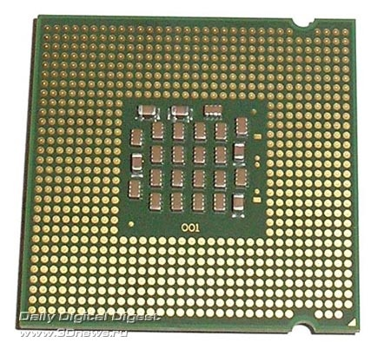
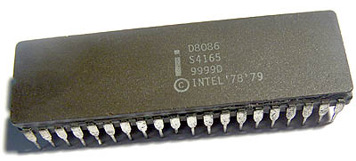
Intel Pentium
Intel 8086

Slide 5
Applications:
Uses:
Control – Where the processor is used to control/perform actions.
Data Processing – Data Manipulation and Calculations.
Application Types:
Low-end – Simple control use. (Traffic Lights.)
High-end –
Complicated Controllers .(Robotics, Avionics etc.)
Data Processing. (CPU)
Most applications we use are high-end and use microprocessors for both Control and Data Processing.

Slide 6
Microcomputer System
Interface
Memory Module
Timing
Microprocessor
(CPU)
Bus Control logic
Interface
Mass Storage Device
Interface
I/O Devices

Slide 7
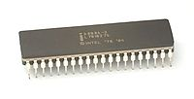
16 Bit Microprocessor 8086

Slide 8
Features
It is a 16-bit μp.
8086 has a 20 bit address bus can access up to 2²⁰ memory locations (1 MB).
It can support up to 64K I/O ports.
It provides 14, 16 -bit registers.
Word size is 16 bits and double word size is 4 bytes.
It has multiplexed address and data bus AD0- AD15 and A16 – A19.

Slide 9
8086 is designed to operate in two modes, Minimum and Maximum.
It can prefetches up to 6 instruction bytes from memory and queues them in order to speed up instruction execution.
It requires +5V power supply.
A 40 pin dual in line package.
Address ranges from 00000H to FFFFFH

Slide 10
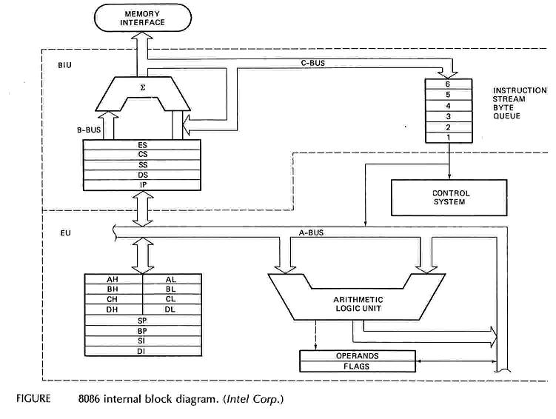
Intel 8086 Internal Architecture

Slide 11
Internal architecture of 8086
8086 has two blocks BIU and EU.
The BIU handles all transactions of data and addresses on the buses for EU.
The BIU performs all bus operations such as instruction fetching, reading and writing operands for memory and calculating the addresses of the memory operands. The instruction bytes are transferred to the instruction queue.
EU executes instructions from the instruction system byte queue.

Slide 12
BIU contains Instruction queue, Segment registers, Instruction pointer, Address adder.
EU contains Control circuitry, Instruction decoder, ALU, Pointer and Index register, Flag register.

Slide 13
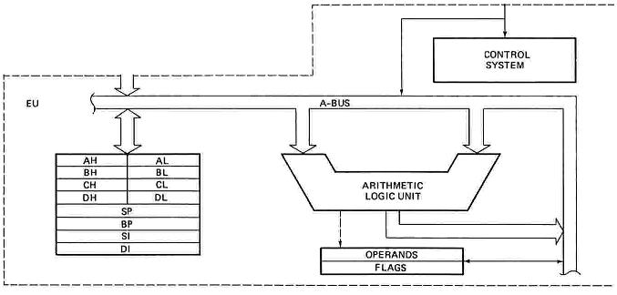
EXECUTION UNIT
Decodes instructions fetched by the BIU
Generate control signals,
Executes instructions.
The main parts are:
Control Circuitry
Instruction decoder
ALU

Slide 14
EXECUTION UNIT – General Purpose Registers
16 bits
16 bits
8 bits
8 bits
8 bits
8 bits
AH | AL
BH | BL
CH | CL
DH | DL
SP
BP
SI
DI
Accumulator
AX
Accumulator
Base
BX
Base
Count
CX
Count
DX
Data
Data
Stack Pointer
Stack Pointer
Pointer
Base Pointer
Base Pointer
Source Index
Source Index
Index
Destination Index
Destination Index

Slide 15
EXECUTION UNIT – General Purpose Registers
Register | Purpose
AX | Word multiply, word divide, word I /O
AL | Byte multiply, byte divide, byte I/O, decimal arithmetic
AH | Byte multiply, byte divide
BX | Store address information
CX | String operation, loops
CL | Variable shift and rotate
DX | Word multiply, word divide, indirect I/O (Used to hold I/O address during I/O instructions. If the result is more than 16-bits, the lower order 16-bits are stored in accumulator and higher order 16-bits are stored in DX register)

Slide 16
Pointer And Index Registers
used to keep offset addresses.
Used in various forms of memory addressing.
In the case of SP and BP the default reference to form a physical address is the Stack Segment (SS-will be discussed under the BIU)
The index registers (SI & DI) and the BX generally default to the Data segment register (DS).
SP: Stack pointer
– Used with SS to access the stack segment
BP: Base Pointer
– Primarily used to access data on the stack
– Can be used to access data in other segments

Slide 17
SI: Source Index register
– is required for some string operations
– When string operations are performed, the SI register points to memory locations in the data segment which is addressed by the DS register. Thus, SI is associated with the DS in string operations.
DI: Destination Index register
– is also required for some string operations.
– When string operations are performed, the DI register points to memory locations in the data segment which is addressed by the ES register. Thus, DI is associated with the ES in string operations.
The SI and the DI registers may also be used to access data stored in arrays

Slide 18
EXECUTION UNIT – Flag Register
A flag is a flip flop which indicates some conditions produced by the execution of an instruction or controls certain operations of the EU .
In 8086 The EU contains
a 16 bit flag register
9 of the 16 are active flags and remaining 7 are undefined.
6 flags indicates some conditions- status flags
3 flags –control Flags
U | U | U | U | OF | DF | IF | TF | SF | ZF | U | AF | U | PF | U | CF
Sign
Auxiliary
Carry
Interrupt
Trap
Zero
Parity
Over flow
Direction
U - Unused

Slide 19
EXECUTION UNIT – Flag Register
Flag | Purpose
Carry (CF) | Holds the carry after addition or the borrow after subtraction. Also indicates some error conditions, as dictated by some programs and procedures .
Parity (PF) | PF=0;odd parity, PF=1;even parity.
Auxiliary (AF) | Holds the carry (half – carry) after addition or borrow after subtraction between bit positions 3 and 4 of the result (for example, in BCD addition or subtraction.)
Zero (ZF) | Shows the result of the arithmetic or logic operation. Z=1; result is zero. Z=0; The result is 0
Sign (SF) | Holds the sign of the result after an arithmetic/logic instruction execution. S=1; negative, S=0

Slide 20
Flag | Purpose
Trap (TF) | A control flag. Enables the trapping through an on-chip debugging feature.
Interrupt (IF) | A control flag. Controls the operation of the INTR (interrupt request) I=0; INTR pin disabled. I=1; INTR pin enabled.
Direction (DF) | A control flag. It selects either the increment or decrement mode for DI and /or SI registers during the string instructions.
Overflow (OF) | Overflow occurs when signed numbers are added or subtracted. An overflow indicates the result has exceeded the capacity of the Machine

Slide 21
Execution unit – Flag Register
Six of the flags are status indicators reflecting properties of the last arithmetic or logical instruction.
For example, if register AL = 7Fh and the instruction ADD AL,1 is executed then the following happen
AL = 80h
CF = 0; there is no carry out of bit 7
PF = 0; 80h has an odd number of ones
AF = 1; there is a carry out of bit 3 into bit 4
ZF = 0; the result is not zero
SF = 1; bit seven is one
OF = 1; the sign bit has changed

Slide 22
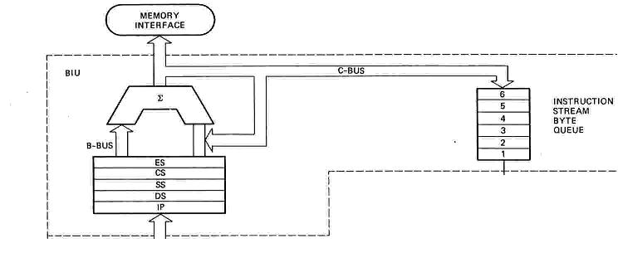
BUS INTERFACE UNIT (BIU)
Contains
6-byte Instruction Queue (Q)
The Segment Registers (CS, DS, ES, SS).
The Instruction Pointer (IP).
The Address Summing block (Σ)

Slide 23
Memory Address Generation
Offset Value (16 bits)
Segment Register (16 bits)
0 0 0 0
Adder
Physical Address (20 Bits)

Slide 24
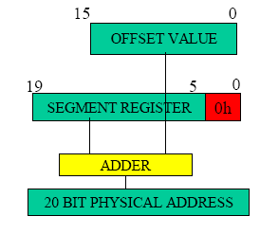

Slide 25
The following examples shows the CS:IP scheme of address formation:
CS
34BA
IP
8AB4
Code segment
34BA0
Inserting a hexadecimal 0H (0000B)
with the CSR or shifting the CSR
four binary digits left
8AB4 (offset)
3D654
3 4 B A 0 ( C S ) +
8 A B 4 ( I P )
3 D 6 5 4 (next address)
44B9F

Slide 26
Segment and Address register combination
CS:IP
SS:SP SS:BP
DS:BX DS:SI
DS:DI (for other than string operations)
ES:DI (for string operations)

Slide 27
Summary of Registers & Pipeline of 8086 µP
EU
BIU
AX
AH | AL
BH | BL
CH | CL
DH | DL
IP
BX
D
E
C
O
D
E
R
Fetch & store code bytes in PIPELINE
CX
CS
DS
ES
SS
DX
CODE OUT
CODE IN
PIPELINE
(or)
QUEUE
IP
BX
DI
SP
SP
BP
SI
DI
DI
BP
SI
Timing
control
Default Assignment
FLAGS
ALU

Slide 28
THE QUEUE (Q)
The BIU uses a mechanism known as an instruction stream queue to implement a pipeline architecture.
This queue permits pre-fetch of up to 6 bytes of instruction code. Whenever the queue of the BIU is not full, it has room for at least two more bytes and at the same time the EU is not requesting it to read or write operands from memory, the BIU is free to look ahead in the program by pre-fetching the next sequential instruction.

Slide 29


Segmented Memory
Physical Memory
Code segment (64KB)
Data segment (64KB)
Extra segment (64KB)
Stack segment (64KB)
00000
The memory in an 8086/88 based system is organized as segmented memory. In this scheme, the complete physically available memory may be divided into a number of logical segments.
Each segment is 64K bytes in size and is addressed by one of the segment registers.
The CPU 8086 is able to address 1Mbyte of memory.
The Complete physically available memory may be divided into a number of logical segments.
1 MB
FFFFF

Slide 30
Segmented Memory
The size of each segment is 64 KB
A segment may be located any where in the memory
Each of these segments can be used for a specific function.
Code segment is used for storing the instructions.
The stack segment is used as a stack and it is used to store the return addresses.
The data and extra segments are used for storing data byte.
The 4 segments are Code, Data, Extra and Stack segments.
A Segment is a 64kbyte block of memory.
The 16 bit contents of the segment registers in the BIU actually point to the starting location of a particular segment.
Segments may be overlapped or non-overlapped

Slide 31
Segment registers
In 8086/88 the processors have 4 segments registers
Code Segment register (CS), Data Segment register (DS), Extra Segment register (ES) and Stack Segment (SS) register.
All are 16 bit registers.
Each of the Segment registers store the upper 16 bit address of the starting address of the corresponding segments.

Slide 32
Memory Segmentation
The addresses of the segments may be assigned as 0000H to F000H respectively.
The offset address value s from 0000H to FFFFH so that the physical addresses range from 0000H to FFFFH.
In the above said case, the segments are non overlapping segments.
In some cases, however, the segments may be overlapping.
Suppose a segment starts at a particular address and its maximum size can be 64Kbytes. But, if another segment starts before this 64Kbytes location of the segment, the two segments are said to be overlapping segments.

Slide 33
Memory Segmentation
The main advantages of the segmented memory scheme are as follows:
Allows the memory capacity to be 1Mbytes although the actual addresses to be handled are of 16 bit size
Allows the placing of code, data and stack portions of the same program in different parts (segments) of memory, for data and code protection
Permits a program and/or its data to be put into different areas of memory each time the program is executed, i.e. provision for relation is done.

Slide 34
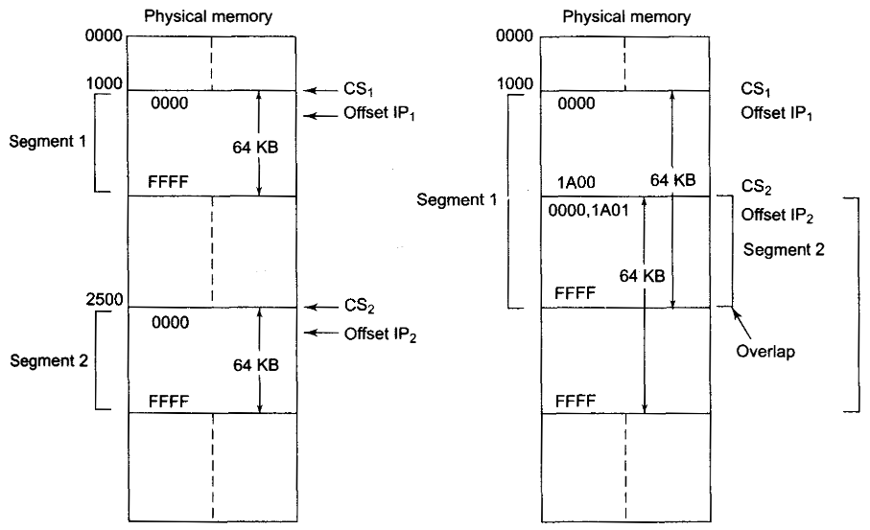
Memory Segmentation

