Slide 1
8086 Interrupts and Interrupt Applications

Slide 2
What is an interrupt?
capability to suspend the execution of running program and execution of another program to fulfill specific requirement upon request
after finishing the second program, automatically return to the first program and start execution from where it was left

Slide 3
Interrupt overview
Most microprocessors allow normal program execution to be interrupted by some external signal or by a special instruction in the program.
In response to an interrupt, the microprocessor stops executing its current program and calls a procedure which “services” the interrupt.
A special instruction --- IRET --- at the end of interrupt-service procedure returns execution to the interrupted main program.

Slide 4
Interrupt Cycle Of 8086/8088
Suppose an external device interrupts the CPU at the interrupt pin, either NMI or INTR of the 8086, while the CPU is executing an instruction of a program then 8086 performs following steps,
The CPU first completes the execution of the current instruction.
The IP is then incremented to point to the next instruction.
The CPU then acknowledges the requesting device on its INTA bar pin immediately if it is a NMI, TRAP or Divide by zero interrupt.
If it is an INT request, the CPU checks the IF flag.
If IF is set, the interrupt request is acknowledged using the INTA bar pin. If IF is not set, the interrupt requests are ignored.
After an interrupt is acknowledged, CPU computes the vector address from the type of interrupt that may be passed through the interrupt structure of the CPU internally (in case of software interrupt, NMI, TRAP and divide by zero interrupts) or externally, i.e. from an interrupt controller in case of external interrupts.
The contents of IP and CS are next pushed to the stack.

Slide 5
Interrupt Cycle Of 8086/8088
The contents of IP and CS now point to the address of the next instruction of the main program from which the execution is to be continued after executing the ISR.
The PSW is also pushed to the stack.
The interrupt flag (IF) is cleared.
The TF is also cleared, after every response to the single step interrupt.
The control is then transferred to the interrupt service routine for serving the interrupting device.
The new address of ISR is found out from interrupt vector table.
The execution of ISR starts.
If further interrupts are to be responded to during the time the first interrupt is being serviced, the IF should again be set to 1 by the ISR of the first interrupt.
Note that the responses to the NMI, TRAP and divide by zero interrupt requests are independent of the IF flag.

Slide 6
Interrupt Cycle Of 8086/8088
If the interrupt flag is not set, the subsequent interrupt signals will not acknowledged by the processor, till the current one is completed.
The programmable interrupt controller is used for managing such multiple interrupts based on their priorities.
At the end of ISR the last instruction should be IRET. When the CPU executes IRET, the contents of flags, IP and CS which were saved at the start by the CALL instruction are now retrieved to the respective registers.
The execution continues onwards from this address, received by IP and CS.

Slide 7
Interrupt Cycle Of 8086/8088
Every external and internal interrupt is assigned with a type (N) that is either implicit (in case of NMI, TRAP and divide by zero) or specified in the instruction INT N (in case of internal interrupts.) in case of external interrupts, the type is passed to the processor by an external hardware like programmable interrupt controller.
In the 0th segment of physical address space i.e. CS=0000, Intel has reserved 1024 locations for storing the interrupt vector table.
The 8086 supports a total of 256 types of the interrupts i.e. from 00 to FFH.
Each interrupt requires 4 bytes, i.e. two bytes each for IP and CS of its ISR.

Slide 8
Interrupt Cycle Of 8086/8088
Thus a total of 1024 bytes are required for 256 interrupts types, hence the interrupt vector table starts at location 0000: 0000 and ends at 0000: 03FF H.
The interrupt vector table contains the IP and CS of all the interrupt types stored sequentially from address 0000: 0000 to 0000: 03FF H.
The interrupt type N is multiplied by 4 and the hexadecimal multiplication obtained gives the offset address in the 0th code segment at which the IP and CS addresses of the interrupt service routine (ISR) are stored.
The execution automatically starts from the new CS: IP.

Slide 9
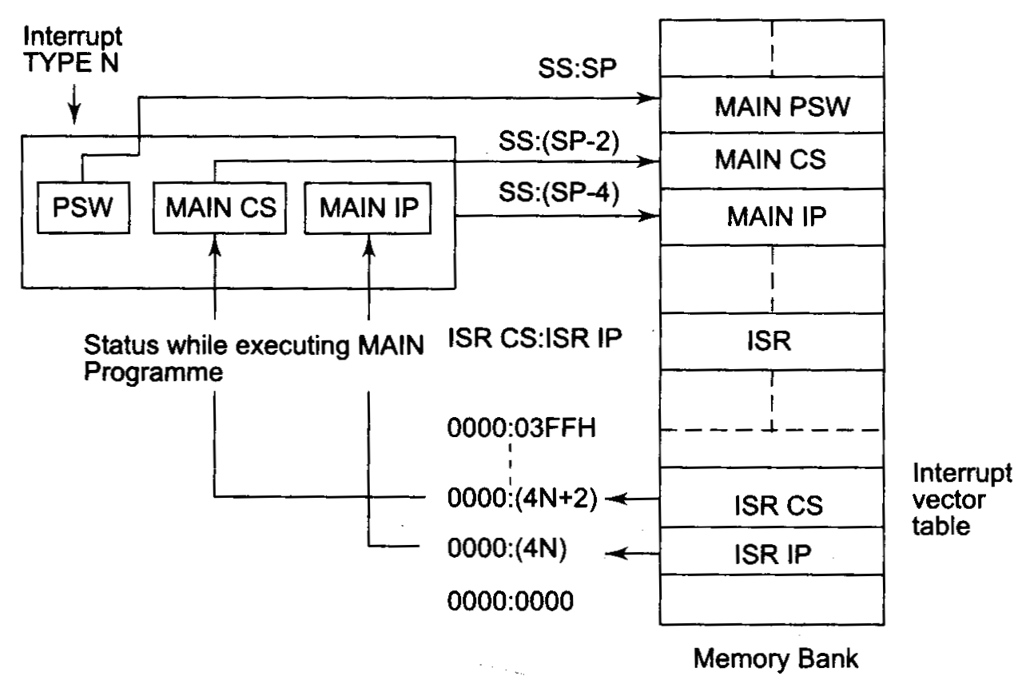
Interrupt Cycle Of 8086/8088
Interrupt Response Sequence

Slide 10
8086 Interrupt Response
1. Push FLAGS
2. Clear IF
3. Clear TF
4. Push CS
5. Push IP
6. Fetch ISR
address
Interrupt Service Routine (ISR)
main
Program
PUSH registers
...
...
...
....
...
....
POP registers
IRET
POP IP
POP CS
POP FLAGS

Slide 11
How does 8086 get to Interrupt Service Routine?
Simple. It loads its CS and IP registers with the address of ISR.
So, the next instruction to be executed is the first instruction of ISR

Slide 12
How does 8086 get the address of Interrupt Service Routine (ISR)?
It goes to specified memory location to fetch four consecutive bytes
higher two bytes to be used as CS
lower two bytes to be used as IP

Slide 13
How does 8086 get the address of that specified memory location?
In an 8086 system, the first 1Kbytes of memory, from 00000 to 003FF, is set aside as a Table for storing the starting addresses of interrupt service routines.
Since 4 bytes are required to store CS and IP values for each ISR, the Table can hold the starting addresses for up to 256 ISRs.

Slide 14
8086 Interrupt Pointer Table
The starting address of an ISR is often called
the interrupt vector or
the interrupt pointer.
So the Table is referred to as
interrupt-vector table or
interrupt-pointer table.

Slide 15
8086 Interrupt Pointer Table
Next slide shows how the 256 interrupt vectors are arranged in the table in memory
Note that
the IP value is put in as the low word of the vector
CS as high word of the vector
Each double word interrupt vector is identified by a number from 0 to 255
INTEL calls this number the TYPE of the interrupt

Slide 16
AVAILABLE |  | 3FFH |  | TYPE 255
FOR USER |  |  |  | ...
(224) |  | 080H |  | TYPE 32
 |  |  |  | TYPE 31
RESERVED (27) |  |  |  | ...
 |  | 014H |  | TYPE 5
 |  |  |  | TYPE 4
 |  | 010H |  | INTO OVERFLOW
 |  |  |  | TYPE 3
Predefined/ |  | 00CH |  | INT
Dedicated/Internal |  |  |  | TYPE 2
Interrupts Pointers |  | 008H |  | NON-MASKABLE
(5) |  |  |  | TYPE 1
 |  | 004H |  | SINGLE STEP
CS Base Address |  |  |  | TYPE 0
IP Offset |  | 000H |  | DIVIDE ERROR

Slide 17
How does 8086 get the address of a particular ISR?
In an 8086 system, each “interrupter” has an id#
8086 treat this id# as interruption type#
after receiving INTR signal, 8086 sends an INTA signal
after receiving INTA signal, interrupter releases it’s id#, i.e., type# of the interruption.
8086 multiplies this id# or type# by 4 to produced the desired address in the vector table
8086 reads 4 bytes of memory starting from this address to get the starting address of ISR
lower 2 byte is loaded in to IP
higher 2 bytes to CS

Slide 18
Non-Maskable Interrupt
The processor 8086/88 has a non-maskable interrupt pin (NMI), that has the highest priority among the external interrupts.
TRAP is an internal interrupt having the highest priority among the interrupts except the Divide by zero (Type-0) exception.
The NMI pin should remain high for at least two clock cycles and need not synchronized with the clock for being sensed.
When the NMI is activated, the current instruction being executed is completed and then the NMI is served.
In case of string type instructions, this interrupt will be served only after the complete string has been manipulated.

Slide 19
Maskable Interrupt
The processor 8086/88 also provides a pin INTR that has lower priority as compared to NMI.
Further the priorities within the INTR types are decided by the type of the INTR signal that is to be passed to the processor via data bus by some external device like the programmable interrupt controller.
The INTR signal is level triggered and can be masked by resetting the interrupt flag.
It is internally synchronized with the transition of the clock. For the INTR signal, to be responded to in the next instruction cycle, it must go high in the last clock cycle of the current instruction or before that.
The INTR requests appearing after the last clock cycle of the current instruction will be responded to after the execution of the next instruction.
The status of the pending interrupts is checked at the end of each instruction cycle.

Slide 20
Maskable Interrupt
If the IF is set, the processor is ready to respond to any INTR interrupt if the IF is reset, the processor will not serve any interrupt appearing at this pin.
However, once the processor responds to an INTR signal, the IF is automatically reset.
If one wants the processor to further respond to any type of INTR signal, the IF should again be set.
The interrupt acknowledge sequence is as shown in figure.
Suppose the external signal interrupts the processor and the pin LOCK bar goes low at the trailing edge of the first ALE pulse that appears after the interrupt signal preventing the use of bus for any other purpose.

Slide 21
Maskable Interrupt
The pin LOCK bar remains low till the start of next machine cycle.
When trailing the trailing edge of the LOCK bar, the INTA goes low and remains low for two clock states before returning back to the high state.
It remains high till the start of the next machine cycle i.e. next trailing edge of ALE.
Then INTA again goes low, remains low for the two states before returning to the high state.
The first trailing edge of ALE floats the bus AD0 - to - AD7, while second trailing edge prepares the bus to accept the type of interrupt.
The type of interrupt remains on the bus for a period of two cycles.

Slide 22
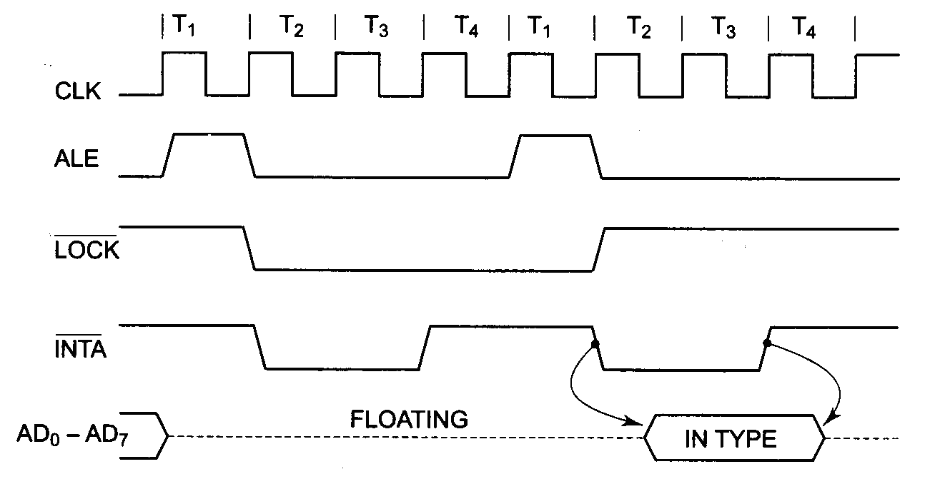
Maskable Interrupt
Interrupt acknowledge sequence of 8086

Slide 23
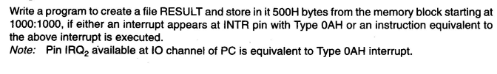
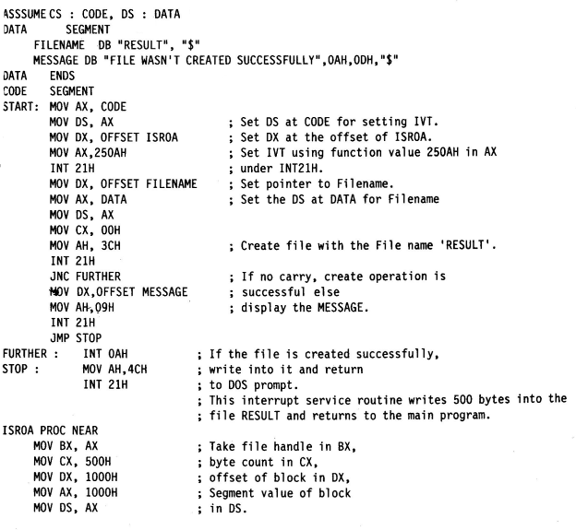
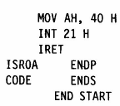
Interrupt Programming

Slide 24
Interrupt Programming
While programming for any type of interrupt, the programmer must, either externally or through the program, set interrupt vector table for that type preferably with the CS and IP addresses of the interrupt service routine.
The method of defining the interrupt service routine for software as well as hardware is the same.
To execute the above program,
first assemble it using MASM.EXE, link it using LINK.EXE.
Then execute the above program at a DOS prompt.
After execution, you will find a new file RESULT in the directory.
Then apply an external pulse to IRQ2 pin of the IBM PC IO channel.
This will again cause the execution of ISR that writes 500 H bytes into the file.

Slide 25
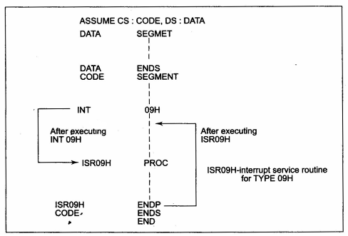
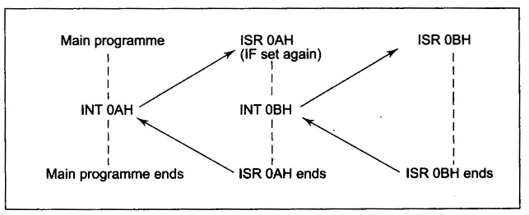
Interrupt Programming
Transfer of control during execution
of an interrupt service routine
Transfer of control for nested interrupts

Slide 26
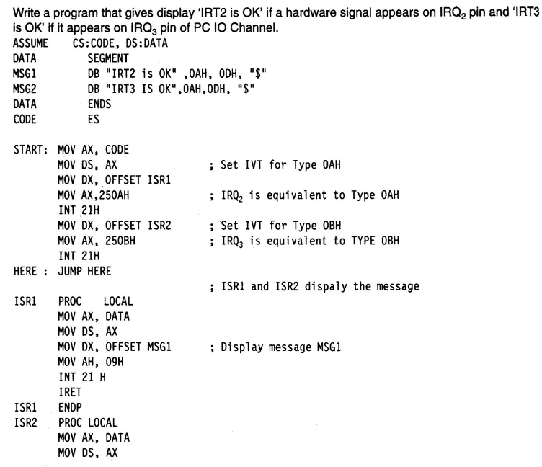
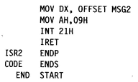
Interrupt Programming

