Slide 1
Lecture 05

Slide 2
Evaluating the Proposal
Once the proposals are generated, they are evaluated
It is necessary to check
  Technical Feasibility
  Operational Feasibility
  Economical Feasibility
Risk Analysis
Identify the areas ( uncertain ) of high risks for which uncertainty about getting successful outcome
  Identify and Special attention take

Slide 3
Economical Feasibility
Cost Benefit Analysis
Cost : Place actual money value against any purchase or activity needed to implement the project
Benefit : Place money value against any benefits that will accure from a new system created by the project
Two steps
  Estimation of Costs and Benefits
  Determine whether a project is worthwhile or not

Slide 4
Estimation of Costs and Benefits
Goal is to produce a list of what is required to implement the project
List of the new system benefits
Evaluating Costs
  Tangible Items ( Direct value can be attached )
  Intangible Items (Direct value can’t be attached , guess )
Evaluating Benefits
  Tangible Items ( Direct value can be attached )
  Intangible Items (Direct value can’t be attached , guess )

Slide 5
Cost of Tangible Items
Equipment costs for the new system
  Computing equipments costs, accommodation costs, furniture costs etc.
Personnel Costs – Analyst, Designers, Programmers etc.
Material Costs – Stationary, manuals, documents etc.
Conversion Cost – New forms, Procedures etc.
Training Costs – Users, developers etc.
Other Costs – Consultants costs, travel, management overhead etc.
Value can’t be precisely determined & subjective judgment
  How much save to complete the project earlier
  Provide new information to the decision makers

Slide 6
Benefits of Tangible & Intangible Items
Measure by actual value
  Reduce of production cost
  Reduce the processing cost
Can’t be measure ( only subjective judgement )
  Increase the sales in the market
  Wider market of marketing data
  Maintain good business image

Slide 7
Determine whether a project is worthwhile or not
Payback method ( Forward )
Present Value method( backward )
Payback method ( Forward )
  Define time required to recover the initial cost
  We know how much a project will cost to start
  Know cost and benefits for each succeeding year
Example
  Cost at start is $50,000 ( project tenure is 5 years )
  Benefits - $10,000 at the end of 1st year
    - $20,000 at the end of 2nd year payback period is
  - $30,000 at the end of 3rd year between 2nd and 3rd
  - $10,000 at the end of 4th year year
  - $5,000 at the end of 5th year

Slide 8
Determine whether a project is worthwhile or not (Cont.)
We assume for banking system, and rate of interest is 10% per annum
Present Value method( backward )
Determine how much money it is worthwhile for investing now in order to receive a given return in some years time
Project benefits are estimated for each year from today
Then compute the present value of savings
If the present cost exceeds the present value, then it is not worthwhile

Slide 9




Determine whether a project is worthwhile or not (Cont.)
Example
  At t=0, Initial investment is $50,000
  At t=1, Benefit = $10,000 then the amount deposited in the 0th year= $10000/(1+10/100)
  At t=2, Benefit = $20,000 then the amount deposited in the 0th year= $20000/
  At t=3, Benefit = $30,000 then the amount deposited in the 0th year= $30000/
  At t=4, Benefit = $10,000 then the amount deposited in the 0th year= $10000/
  At t=5, Benefit = $5,000 then the amount deposited in the 0th year= $,5000/
Sum of the present value > Initial investment

Slide 10
COCOMO (COnstructive COst MOdel) Model
COCOMO I
Barry Boehm introduce it
Hierarchy of software estimation model
Model takes the following form :
  Model1(Basic COCOMO) : is a static single valued model that computes software development effort (and cost) as a function of program size expressed in estimated line of code
  Model2(Intermediate COCOMO) :computes software development effort as a function of program size and a set of “cost drivers” that include subjective assessments of product, hardware, personnel and project attributes

Slide 11
COCOMO (COnstructive COst MOdel) Model
  Model3(Advanced COCOMO) :incorporates all characteristics of the intermediate version with an assessment of the cost driver’s impact on each step (analysis, design etc.) of the software engineering process
COCOMO may applied to 3 classes of the software projects :
  Organic mode: Small, simple s/w project
    Ex. Tharmal analysis program
  Semi-detached mode: Intermediate size and complexity
    Ex. Transaction processing
  Embedded mode:

Slide 12

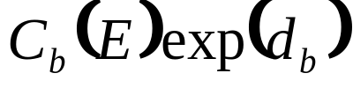
COCOMO (COnstructive COst MOdel) Model
Basic COCOMO equation take the form :
Effort= person-months
Duration= months
Cost driver attributes:
  Product attributes
    Required s/w reliability
    Size of application database
    Complexity of the product

Slide 13
COCOMO (COnstructive COst MOdel) Model
  H/W attributes
    Run-time performance constraints
    Memory constraints
    Volatility of the virtual m/c environment
    Required turnaround time
  Personnel attributes
    Analyst capability
    S/w engineer capability
    Applications experience
    Virtual m/c experience
    Programming Language experience
  Product attributes
    Use of s/w tools
    Application of S/w engineering methods
    Required development schedule

Slide 14
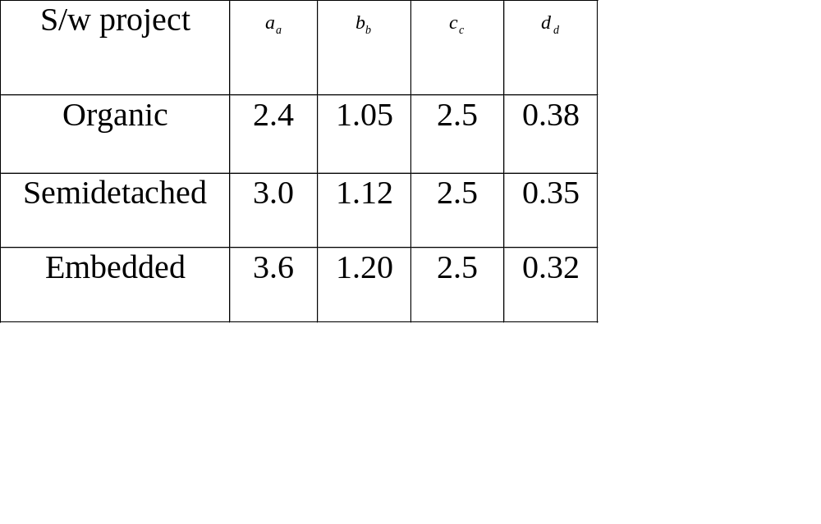
Attributes value ( Table by Boehm)

Slide 15
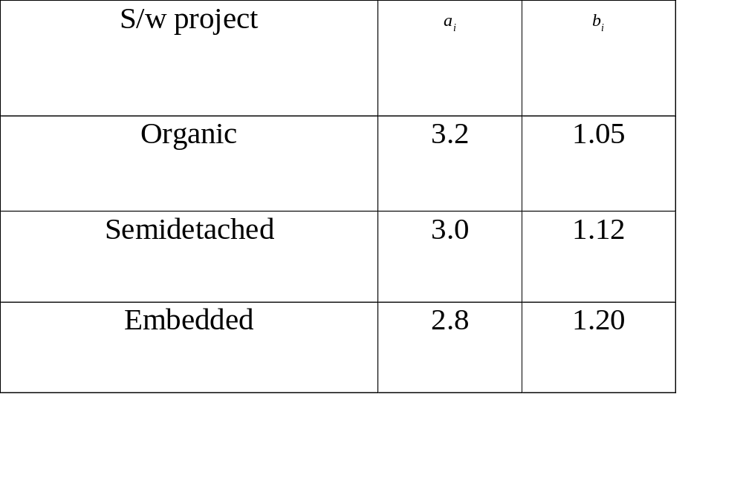
Attributes value (Table by Boehm)

Slide 16
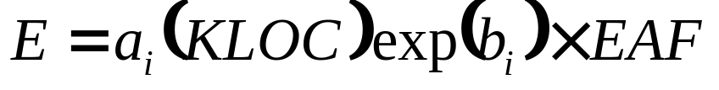
COCOMO (Cont.)
Each of the 15 attributes is rated on a 6-point scale that ranges from very low to extra high
Based on the rating effort multiplier is determined from table published by Boehm
Product of effort multipliers results is an effort adjustment factor (EAF) ranges from 0.9 to 1.4
Intermediate COCOMO Equation takes the form :

Slide 17
COCOMO II
Hierarchy of estimation models that address the following areas :
  Application composition model : used during early stage of s/w engg., when prototyping of user interfaces, consideration of s/w and system interaction, assessment of performance and evaluation of technology maturity are paramount.
  Early design stage model : used once requirements have been stabilized and basic s/w architecture has been established
  Post- architecture stage model : used during the construction of the s/w

Slide 18
COCOMO II (Cont.)
Sizing information :
  Object points
  Function points
  Lines of source code
The COCOMO II in application composition modes uses object points
An indirect s/w measure that is computed using counts of the number of (1) Screens (at the user interface), (2) Reports and (3) Components (likely to be required to build the application)

Slide 19
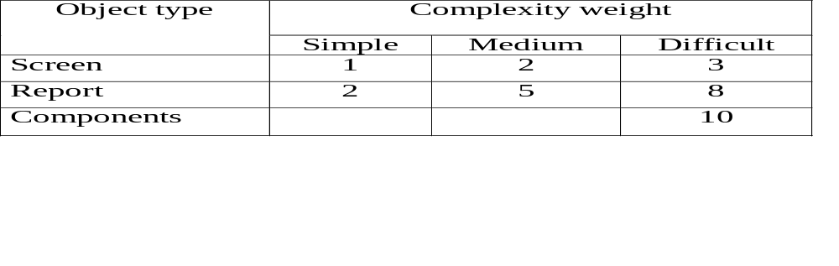
COCOMO II (Cont.)
Each object instance (screen or report) is classified into one of three complexity levels
Object point count is determine by multiplying the original number of object instances by the weighting factor in the table
Summing to obtain total object point
When component based development or general s/w reuse is to be applied, the % of reuse is estimated and the object point count is adjusted

Slide 20
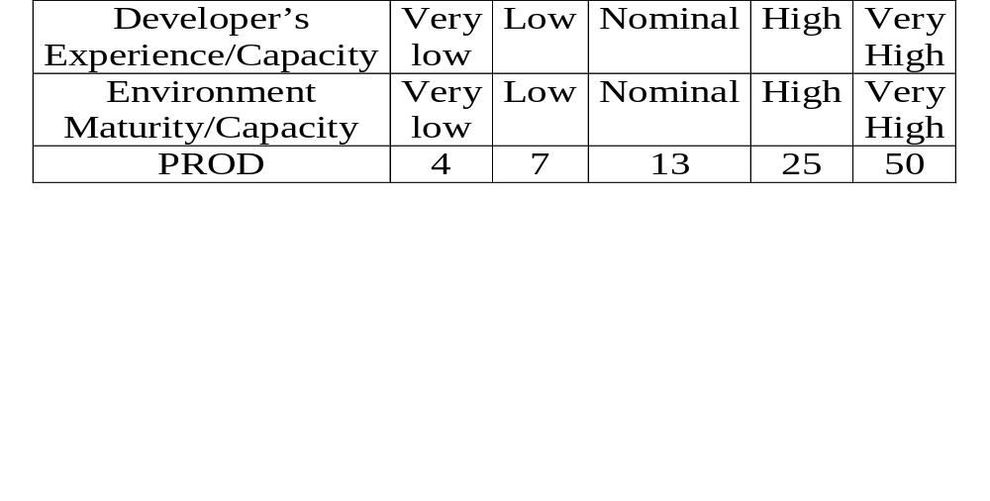
COCOMO II (Cont.)
New Object Point, NOP=(Object Point) Χ [(100-%reuse)/100]
Productivity Rate, PROD=NOP/Person-month
Estimated Effort, E= NOP/PROD
Productivity rate :

Slide 21
Problems
Using COCOMO I
  Determine the Effort to develop of a Software product
  Determine the Duration to develop of a Software product
  Determine the Number of People engaged to develop of a Software product.
Input of your program is Lines of Code and Effort Adjustment Factor.
Also determine the type of project (i) Organic, (ii) Semi-detached and (iii) Embedded.

Slide 22
Problems
Using COCOMO II
  Determine the Object Point to develop of a Software product
  Determine the New Object Point to develop of a Software product
  Determine the Effort to develop of a Software product
  Determine the Number of People engaged to develop Software product, if Duration of development of the software is 5 years.
If the software consist of 10 Screens, 4 Reports and 15 3GL Components. Assume component based development and 60% reuse is applied.

