Slide 1
Lecture 03
Requirements Engineering

Slide 2
Requirements Engineering
1. Introduction
2. Understanding Requirements
3. Process Modeling (Data Flow Diagram)
4. Data Modeling (Entity Relationship Diagram-ERD)
5. Other Techniques
6. Computer Aided Software Engineering (CASE)

Slide 3
Objectives
☞ To establish the importance / relevance of Requirement Specification
☞ To enlist the problems involved in specifying requirements
☞ To use modeling techniques to minimize problems in specifying requirements

Slide 4
What are Requirements ?
A condition or capability needed by a user to solve a problem or achieve an objective
A condition or capability that must be met or possessed by a system to satisfy a contract, standard, specification, or other formally imposed document
A software requirements specification (SRS) is a document containing a complete description of what the software will do without describing how it will do it.

Slide 5
Requirements…
May range from a high-level abstract statement of a service or of a system constraint to a detailed mathematical functional specification
This is inevitable as requirements may serve a dual function
  May be the basis for a bid for a contract - therefore must be open to interpretation
  May be the basis for the contract itself - therefore must be defined in detail
  Both these statements may be called requirements

Slide 6
Requirements…
Software requirements specify what the software must do to meet the business needs.
For example, a stores manager might state his requirements in terms of efficiency in stores management.
A bank manager might state his requirements in terms of time to service his customers.
It is the analyst's job to understand these requirements and provide an appropriate solution.
To be able to do this, the analyst must understand the client's business domain: who are all the stake holders, how they affect the system, what are the constraints, what are the alterables, etc

Slide 7
Requirements…
The analyst should not blindly assume that only a software solution will solve a client's problem.
He should have a broader vision.
Sometimes, re-engineering of the business processes may be required to improve efficiency
A detailed statement of what the software must do to meet the client's needs should be prepared. This document is called Software Requirements Specification (SRS) document.

Slide 8
Types of requirement
User requirements
  Statements in natural language plus diagrams of the services the system provides and its operational constraints. Written for customers
System requirements
  A structured document setting out detailed descriptions of the system services. Written as a contract between client and contractor
Software specification
  A detailed software description which can serve as a basis for a design or implementation. Written for developers

Slide 9
Requirements engineering
Requirements engineering is the process of establishing
the services that the customer requires from a system
the constraints under which it operates and is developed
Requirements
The descriptions of the system services and constraints
that are generated during the requirements engineering process

Slide 10
Why the Term Requirements Engineering ?
Engineering, not just Analysis
Standards/Guidelines, Tools
Breaking down of requirements, building up of solutions
(IEEE)
  Analysis
  Specification
  Management

Slide 11
Library Problem
Check out a copy of a book, return a copy of a book
Add a copy of a book to the Library
Remove a copy of a book from the library
Get the list of books by a particular author or in a particular subject area

Slide 12
Library Problem …Contd...
Find out the list of books currently checked out by particular borrower
Find out which borrower last checked out a particular copy of a book
There are two types of users : Staff Users and Ordinary Borrowers. Transactions 1 and 2 are restricted to staff users

Slide 13
Constraints
1. Copies in the library must be available for checkout or be checked out
2. Copy of the book may be both available and checked out at the same time
3. A borrower may not have more than a predefined number of books checked out at one time

Slide 14
Ambiguities
What is a Library ?
Who is a user ?
Confusion regarding “ Book ” and “ Copy ”
What does “ Available ” mean ?
What do “ Last Checked Out ” and “ Currently ” mean ?

Slide 15
Incompleteness
Initialization
Addition of a new book
Remove all copies of a book
Create a library
Add a staff user / ordinary user
Error Handling
Missing Constraints
  Period of Lending
  Not more than one copy of the same book can be borrowed

Slide 16
Further Examples for Bad Specification
The counter value is picked up from the last record.
Inversion of a square, matrix ‘M’ of size ‘n’ such as LM ML = I_{n}, where ‘L’ is the inverse matrix and I_{n} is the identity matrix of size ‘n’.
The software should be highly user friendly
The output of the program shall usually be given within 10 seconds.
The software should be developed on DOS system, but should be portable to other systems.

Slide 17
Further Examples for Bad Specification
In first statement, the word 'last' is ambiguous. It could mean the last accessed record, which could be anywhere in a random access file, or, it could be physically the last record in the file
Second statement though appears to be complete, is missing on the type of the matrix elements. Are they integers, real numbers, or complex numbers. Depending on the answer to this question, the algorithm will be different.
How does one determine, whether this requirement is satisfied or not.
What are the exceptions to the 'usual 10 seconds' requirement?

Slide 18
Characteristics of a Good SRS
Correct (No errors)
Unambiguous
Complete
No use of TBDs (To Be Determined )
Verifiable (words like “highly”, “usually” not to be used)
Consistent (non-conflict)
Modifiable
Traceable

Slide 19
Distribution of Errors in Requirements Specification
80
70
60
50
49 %
40
31 %
30
20
13 %
10
5 %
2 %
Incorrect
fact
omission
inconsistency
ambiguity
misplaced
requirement
(wrong section)
Error Type
[ NAVY A - 7E AIRCRAFTS OPERATIONAL FLIGHT PROGRAM;
5th INT. CONF. ON SOFTWARE ENGINEERING, 1981 ]

Slide 20
Requirements Definition & Analysis
The Requirements Definition and
Analysis Phase is Critical to
keep the Development and
Maintenance Costs to a Minimum

Slide 21
Types Of Requirements
Functional Requirements
- what system should do
Non-Functional Requirements
- specify the overall quality attributes the system must satisfy.

Slide 22
Functional Requirements
The requirements that specify the Inputs (Stimuli) to the system, the Outputs (Responses) from the system, and the behavioral relationship between them

Slide 23
Functional Requirements (Examples)
To calculate the compound interest @ 8% per annum on a Fixed Deposit for a period of three years
To calculate the Tax @ 30% on an annual income equal to and above Rs.2,00,000 but less than Rs.3,00,000
To invert a Square Matrix (Maximum size 100 X 100) of Real Numbers

Slide 24
Non-Functional Requirements
The requirements that describe the overall attributes of the system :
Portability
Reliability
Performance
Testability
Modifiability
Security
Presentation
Reusability
Understandability
Acceptance Criteria

Slide 25
Non-Functional Requirements (Examples)
Performance
Number of significant digits to which accuracy should be maintained in a numerical solution
Maximum response time in a transaction processing system
Delays and task completion time limits in a real-time system

Slide 26
Non-Functional Requirements (Examples) …Contd...
Environment
To run the software under a given operating system or use a specific programming language
Security
The addition and deletion of the book in the system can be carried out by the Library-Chief only

Slide 27
Non-Functional Requirements (Examples)
Testability
  All the off-diagonal elements, equal to or more than 10⁻³, should be printed out by the matrix diagonalisation program
Understandability / Usability
  Experienced Officers should be able to use all of the system functions after a total training of two hours. After this training, the average number of errors made by experienced officers should not exceed two per day

Slide 28
Categories of Requirements
Satisfiability
Service
Criticality
Stability
User Categories

Slide 29
Types of Satisfiability
Normal Requirements
Expected Requirements
Exciting Requirements

Slide 30
Normal Requirements
User responses to specific questions
Satisfy / dissatisfy in proportion to their presence / absence in system
The satisfaction is linear and Bi-Directional

Slide 31
Expected Requirements
Expected requirements may not be stated by the users, but the developer is expected to meet them. So basic that users may neglect to mention them
Their presence in solution may meet expectation but not enhance satisfaction
Absence is very dissatisfying
"Most Important" for analyst

Slide 32
Exciting Requirements
Beyond the users’ expectations; cannot be elicited from users
Highly satisfying when met
Their absence doesn’t dissatisfy because they are not expected

Slide 33
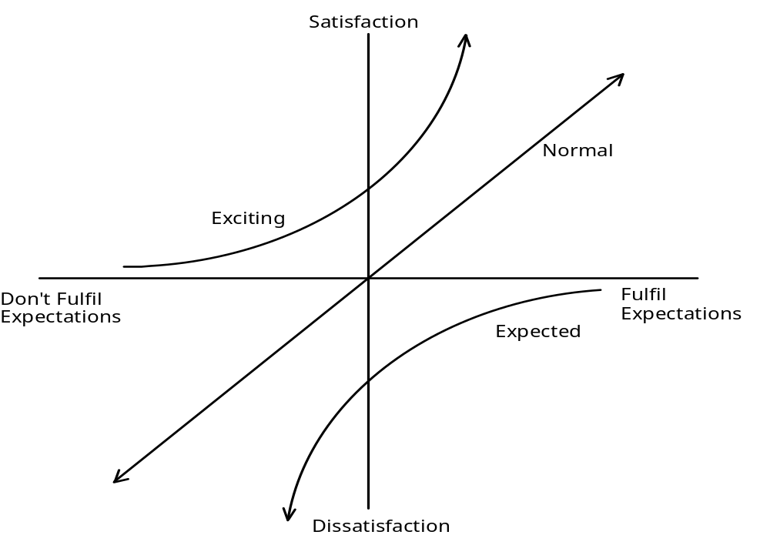
Satisfiability
Normal, Expected and Exciting Requirements

Slide 34
The Trend over the Years
Exciting requirements often become normal requirements
Some normal requirements become expected requirements
For example, on-line help feature was first introduced in the UNIX system in the form of man pages. At that time, it was an exciting feature. Later, other users started demanding it as part of their systems. Now a days, users do not ask for it, but the developer is expected to provide it.

Slide 35
Type of Services
Function-Related Requirements
  Users’ Information Needs
  Information Processing Aspects
Presentation-Related Requirements
  Manner or form of presenting information

Slide 36
Type of Services …Contd...
Performance-Related Requirements
Time-criticality of Information
Optimum Use of Resources
Administration-Related Requirements
Controls on the information processing
Organizational Climate

Slide 37
Types of Stability
Stable
Unstable
  Indicate the changes and their expected dates

Slide 38
Criticality
Classification
  Mandatory
  Desirable
  Non-Essential
Decision
  In consultation with the users by the application of appropriate prioritization rules
These define the problem domain
Can help in phased development, based on criticality

Slide 39
User Categories
Compile requirements against each defined user category to assure completeness of requirements
Broadly they are of two kinds. Those who dictate the policies of the system and those who utilise the services of the system. All of them use the system. It is important that all stakeholders are identified and their requirements are captured.

Slide 40
Modeling Requirements
Every software system has the following essential characteristics:
It has a boundary. The boundary separates what is with in system scope and what is outside
It takes inputs from external agents and generates outputs
It has processes which collaborate with each other to generate the outputs
These processes operate on data by creating, modifying, destroying, and querying it
The system may also use data stores to store data which has a life beyond the system

