Slide 1
Lecture 07
Software Reliability

Slide 2
Software Reliability
  In the broad sense
    S/w design will operate (execute ) well for a substantial time period.
  In a narrow sense
    Reliability is a metric which is probability of operational success of the s/w
  Probabilistic and Deterministic Model
    Example – Winding of a motor bourns out
      Due to temperature above melting point
    ( It will burns – it is certainly deterministic, But we are unable to predict when they will occur – it is probabilistic )

Slide 3
Software Reliability
Thus the model of failures become a probabilistic one and the random element (random variable ) is the time to failure
Failure Modes
  Hardware
  Software
  Skinware(Human)
Reliability Theory
  Modeling of failure and prediction of success probability
  Based on the concept of random/continuous variable, probability density function, probability distribution function

Slide 4



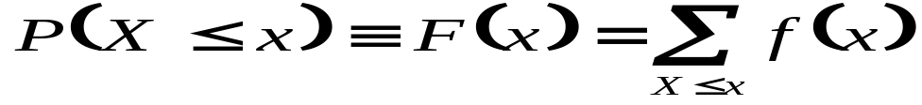

Software Reliability
Probability concept :
Discrete random variable, X is a discrete random variable
  Probability Density Function :
    Probability of occurrence =
  Distribution Function : Defined in term of the probability that :
    Continuous random variable,
    The variable is continuous over some range of definition
    Density function,

Slide 5

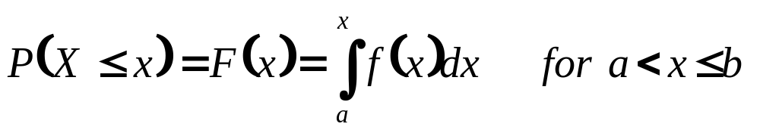

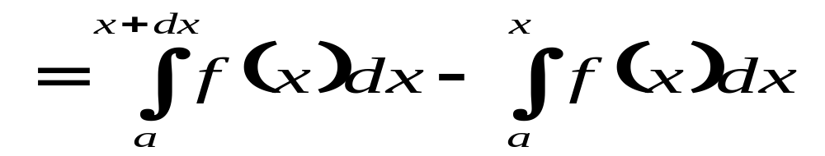
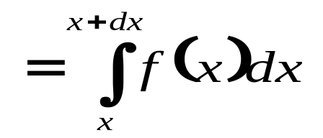
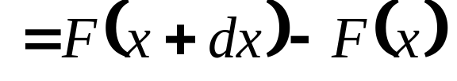
Software Reliability
Distribution Function: F(x)=
  Let x take on all values between points a and b,
  So,
  The Probability that X lies in an interval x < X <x+dx ,
  F(x) is a continuous, dx→0;P(X=x) is zero

Slide 6

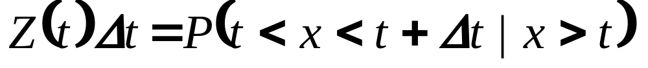
Definition of Reliability
R(t) =Reliability is the mathematical probability is function of time t, is the success.
R(t) = P(x>t) = 1- P(x<t) where x is continuous
  = P(x>=t) = 1 – P(x<=t) where x is discrete
Hazard rate (conitional failure rate), z(t)
  Defined in term of the probability that a failure occurs in the same interval t to t+ , given that system has survival up to time t
  We know, F(t)=1-R(t)

Slide 7


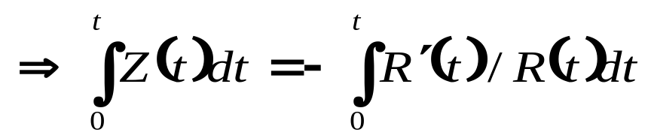
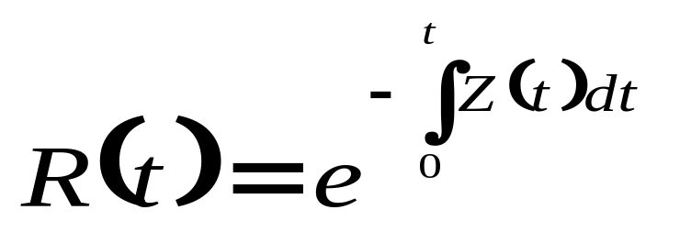
Relationship R(t) and Z(t)
We know, from definition of Hazard rate
  [P(AB)=P(A).P(B/A)]
  [P(AB)=P(B).P(A/B)]

Slide 8
Mean Time To Failure (MTTF)
Estimation theory:
  How one determines the parameters in a probabilistic model from statistical data taken on the items governed by the model
  Specifically, in reliability work we place a group of components on life test and observe the sequence of failure times t1,t2,…,tn
  On the basis of these data we compute time-to-failure models and hazard models
  Estimation theory provides guidelines for efficient and accurate components

Slide 9




Mean Time To Failure (MTTF)
(few data) → result must be questioned
→ result should be good
→many of the different computational scheme is need
→best for estimation theory
A point estimation formula, MTTF=(10+20+25+35+40)/5
=26h
It is often convenient to characterize a failure model using set of failure data by a single parameter (MTTF/MTBF)

Slide 10
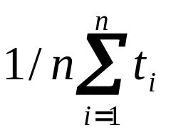
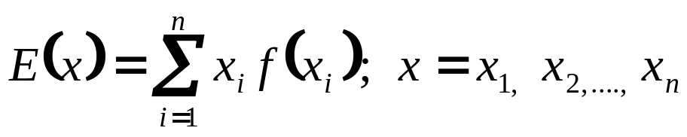
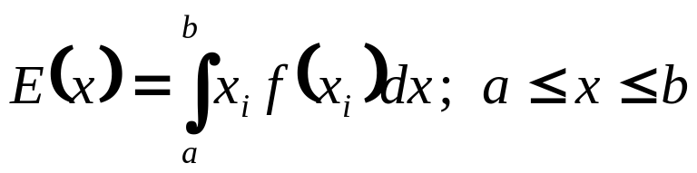
Mean Time To Failure (MTTF)
If we have life test information on a population of n items with failure times t1,t2,…tn
MTTF=
Expected value, where x
is discrete random variable
where x is continuous random variable

Slide 11
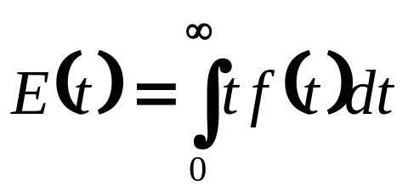
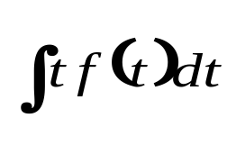
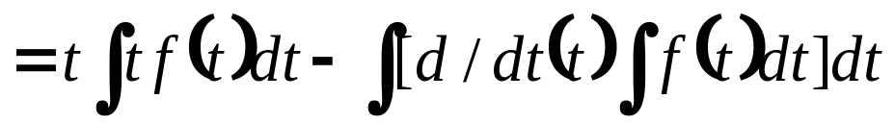
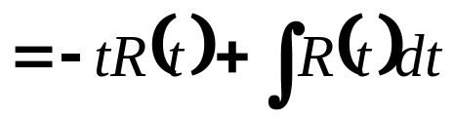
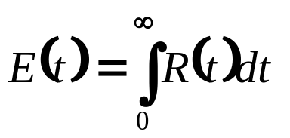
Mean Time To Failure (MTTF)
Using Hazard model, the MTTF for the probability distribution defined by the model is,
MTTF=
Let, I= f(t)=dF(t)/dt
=d(1-R(t))/dt
=-dR(t)/dt

Slide 12

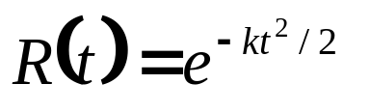
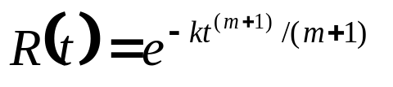
Mean Time To Failure (MTTF)
Case I :Constant hazard,
Case II : Linearly increasing hazard,
Case III : Weibull distribution,

