Slide 1

1-Slide Presentation
Review NeurIPS papers
develop parallelized version of the first PhD project
Read papers on LLM and decision transformers
Making slides for multiple presentations
Department of Computer Science
GRAINGER COLLEGE OF ENGINEERING
Notes:
We will focus on one line of work: distribution correction estimation (DICE). While there are several works that cannot fit in this framework, DICE has been a popular direction in offline IL for the past three years. There really wasn’t anything interesting in pure online RL/IL since TD3 and SAC in 2018.

Slide 2


Occupancy Matching Methods
Kai Yan
06/21/2023
Notes:
The word “policy” is because we want to cover both reinforcement learning and imitation learning in one presentation.

Slide 3
Overview
Reinforcement Learning / Imitation Learning (RL/IL) Basics
Markov Decision Process (MDP)
RL/IL Basics
State(-Action) Occupancy
Generative Adversarial Imitation Learning (GAIL)
DIstribution Correction Estimation (DICE)
“Honestly, I think Qianlan’s last two speech (DT, offline RL), RLHF, my first PhD project (skill-based learning) and this speech concludes almost all that is interesting in single-agent RL/IL in the past 5 years.”
--Ego Ipsum
Department of Computer Science
GRAINGER COLLEGE OF ENGINEERING
Notes:
We will focus on one line of work: distribution correction estimation (DICE). While there are several works that cannot fit in this framework, DICE has been a popular direction in offline IL for the past three years. There really wasn’t anything interesting in pure online RL/IL since TD3 and SAC in 2018.

Slide 4

Introduction: Markov Decision Process (MDP)
How to define a sequential decision-making environment?
Markov Decision Process (MDP)
State $s$, action $a$, reward $r(s,a)$, transition $p\left(s^{′} | s,a\right)$, discount factor $γ$
Department of Computer Science
GRAINGER COLLEGE OF ENGINEERING
Notes:
Step $t=\{1,2,…,n\}$
State $s$
Action $a$
Reward $r\left(s,a\right)$
Transition $p(s^{′}|s,a)$
Discount factor $γ∈(0, 1)$
Policy $π\left(a | s\right)$
Trajectory $τ$
State-only trajectory $\{s_{1},s_{2},…,s_{n}\}$
State-action trajectory $\{\left(s_{1},a_{1}\right),\left(s_{2},a_{2}\right),…,\left(s_{n},a_{n}\right)\}$
Agent
Objective
Episode

Slide 5
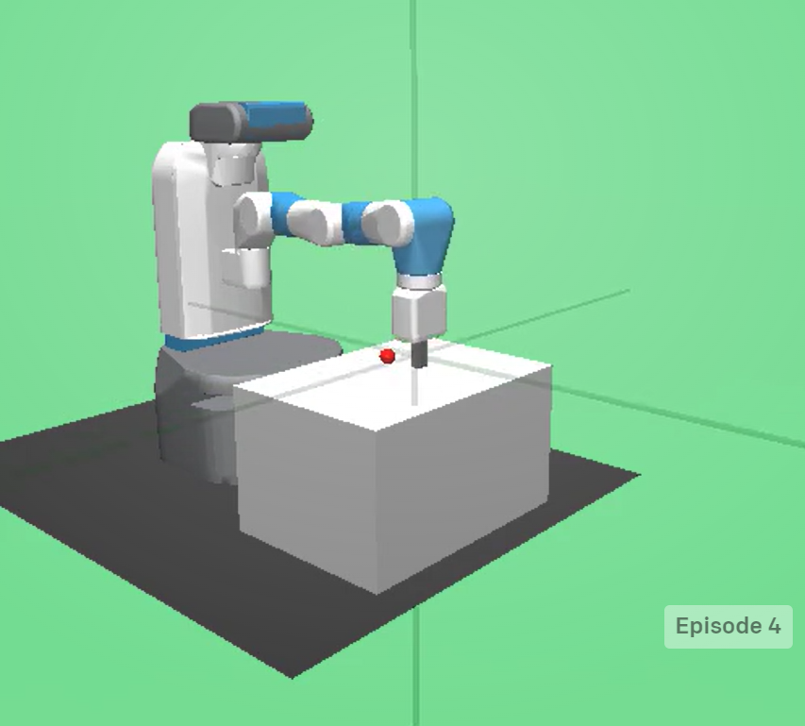

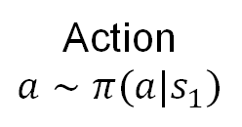

Introduction: Markov Decision Process (MDP)
How to define a sequential decision-making environment?
Markov Decision Process (MDP)
State $s$, action $a$, reward $r(s,a)$, transition $p\left(s^{′} | s,a\right)$, discount factor $γ$
State $s$: Description of current status, e.g., the location and velocity of the joints
Agent: The algorithm making decision
Action $a$: The decision made given state $s$,
e.g., the force applied on each joint
Policy $π(a|s)$: The distribution over actions given a particular state
Agent
Action
$$a∼π(a|s_{1})$$
State at step 1 $s_{1}$
Image Source: OpenAI Gym Website
Department of Computer Science
GRAINGER COLLEGE OF ENGINEERING
Notes:
Step $t=\{1,2,…,n\}$
State $s$
Action $a$
Reward $r\left(s,a\right)$
Transition $p(s^{′}|s,a)$
Discount factor $γ∈(0, 1)$
Policy $π\left(a | s\right)$
Trajectory $τ$
State-only trajectory $\{s_{1},s_{2},…,s_{n}\}$
State-action trajectory $\{\left(s_{1},a_{1}\right),\left(s_{2},a_{2}\right),…,\left(s_{n},a_{n}\right)\}$
Agent
Objective
Episode

Slide 6
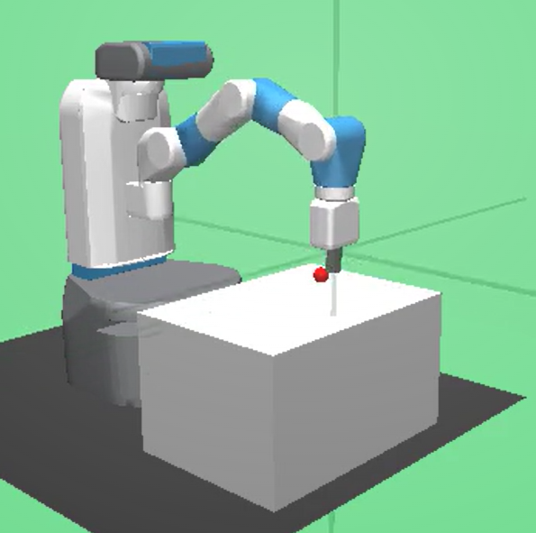
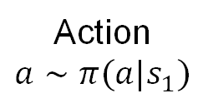
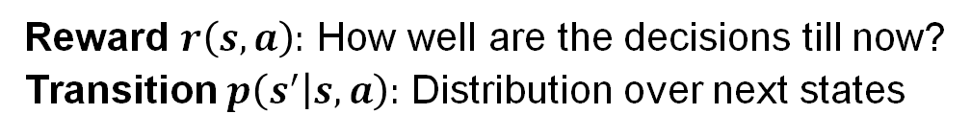

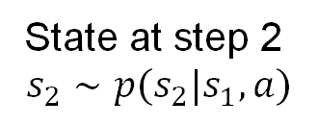
Introduction: Markov Decision Process (MDP)
How to define a sequential decision-making environment?
Markov Decision Process (MDP)
State $s$, action $a$, reward $r(s,a)$, transition $p\left(s^{′} | s,a\right)$, discount factor $γ$
Reward $r(s_{1},a)$
Agent
Action
$$a∼π(a|s_{1})$$
Environment
(Physics)
Reward $r\left(s,a\right):$ How well are the decisions till now?
Transition $p\left(s^{′} | s,a\right):$ Distribution over next states
State at step 1 $s_{1}$
State at step 2
$$s_{2}∼p(s_{2}|s_{1},a)$$
Repeat the process (steps) until termination (episode ends)
Image Source: OpenAI Gym Website
Department of Computer Science
GRAINGER COLLEGE OF ENGINEERING
Notes:
Remove text
Move the figure above; put the last point at the bottom
Repeat the process (steps) until termination (episode ends)
Step $t=\{1,2,…,n\}$
State $s$
Action $a$
Reward $r\left(s,a\right)$
Transition $p(s^{′}|s,a)$
Discount factor $γ∈(0, 1)$
Policy $π\left(a | s\right)$
Trajectory $τ$
State-only trajectory $\{s_{1},s_{2},…,s_{n}\}$
State-action trajectory $\{\left(s_{1},a_{1}\right),\left(s_{2},a_{2}\right),…,\left(s_{n},a_{n}\right)\}$
Agent
Objective
Episode

Slide 7
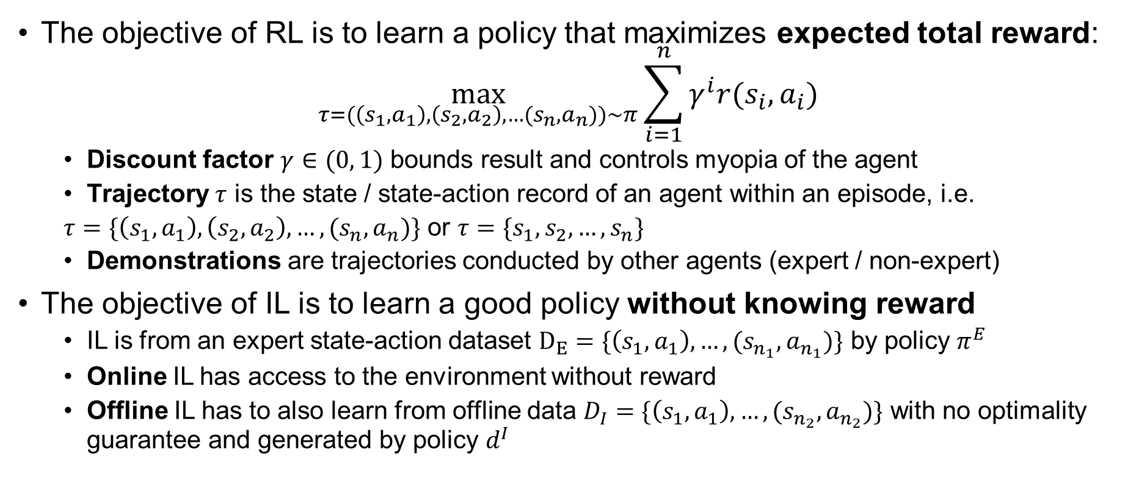
Introduction: Reinforcement / Imitation Learning (RL/IL)
The objective of RL is to learn a policy that maximizes expected total reward:
$$\max_{τ=(\left(s_{1},a_{1}\right),\left(s_{2},a_{2}\right),…(s_{n},a_{n}))∼π}{\sum_{i=1}^{n}{γ^{i}r(s_{i},a_{i})}}$$
Discount factor $γ∈(0, 1)$ bounds result and controls myopia of the agent
Trajectory $τ$ is the state / state-action record of an agent within an episode, i.e.
$τ=\{\left(s_{1},a_{1}\right),\left(s_{2},a_{2}\right),…,(s_{n},a_{n})\}$ or $τ=\{s_{1},s_{2},…,s_{n}\}$
Demonstrations are trajectories conducted by other agents (expert / non-expert)
The objective of IL is to learn a good policy without knowing reward
IL is from an expert state-action dataset $D_{E}=\{\left(s_{1},a_{1}\right),…,(s_{n_{1}},a_{n_{1}})\}$ by policy $π^{E}$
Online IL has access to the environment without reward
Offline IL has to also learn from offline data $D_{I}=\{\left(s_{1},a_{1}\right),…,(s_{n_{2}},a_{n_{2}})\}$ with no optimality guarantee and generated by policy $d^{I}$
Department of Computer Science
GRAINGER COLLEGE OF ENGINEERING

Slide 8

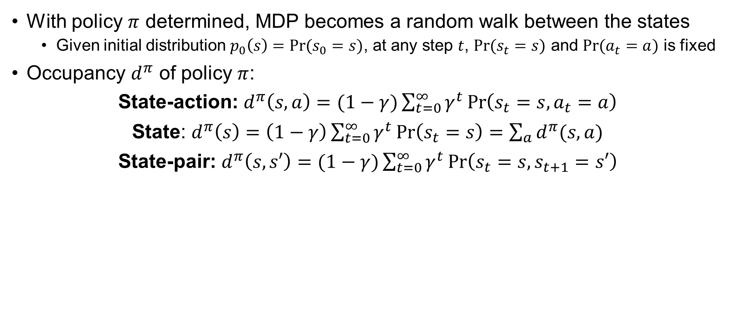







Introduction: Occupancy
With policy $π$ determined, MDP becomes a random walk between the states
Given initial distribution $p_{0}\left(s\right)=Pr⁡(s_{0}=s)$, at any step $t$, $Pr⁡(s_{t}=s)$ and $Pr⁡(a_{t}=a)$ is fixed
Occupancy $d^{π}$ of policy $π$:
State-action: $d^{π}\left(s,a\right)=(1−γ)\sum_{t=0}^{∞}{γ^{t}}\operatorname{Pr}\left(s_{t}=s,a_{t}=a\right)$
State: $d^{π}\left(s\right)=\left(1−γ\right)\sum_{t=0}^{∞}{γ^{t}}\operatorname{Pr}\left(s_{t}=s\right)=\sum_{a}{d^{π}(s,a)}$
State-pair: $d^{π}\left(s,s′\right)=(1−γ)\sum_{t=0}^{∞}{γ^{t}}\operatorname{Pr}\left(s_{t}=s,s_{t+1}=s′\right)$
$$a_{1}$$
$$d^{π}\left(s_{1},a_{1}\right)=d^{π}\left(s_{1},a_{2}\right)=d^{π}\left(s_{1},s_{2}\right)=d^{π}\left(s_{1},s_{3}\right)=0.01∗0.5$$
$$d^{π}\left(s_{2},a_{1}\right)=d^{π}\left(s_{3},a_{1}\right)=0.01∗0.5∗(0.99+{0.99}^{2}+…)$$
$$d^{π}\left(s_{1}\right)=0.01∗{0.99}^{0}∗1=0.01$$
$$d^{π}\left(s_{2}\right)=d^{π}\left(s_{3}\right)=0.01∗0.5∗(0.99+{0.99}^{2}+…)$$
Uniform policy
$$a_{1}$$
$$s_{2}$$
$$s_{1}$$
$$a_{1}$$
$$a_{2}$$
$$s_{3}$$
Department of Computer Science
GRAINGER COLLEGE OF ENGINEERING
Notes:
You might notice that we assume the episode has infinite steps. It’s kinda different if you want to do finite horizon theoretically, because in finite horizon, traditionally in tabular MDP you need to take the number of the remaining steps into account as well. But in the deep RL community, it seems that everyone is happy about using infinite horizon in theory and apply to finite horizon in practice.

Slide 9
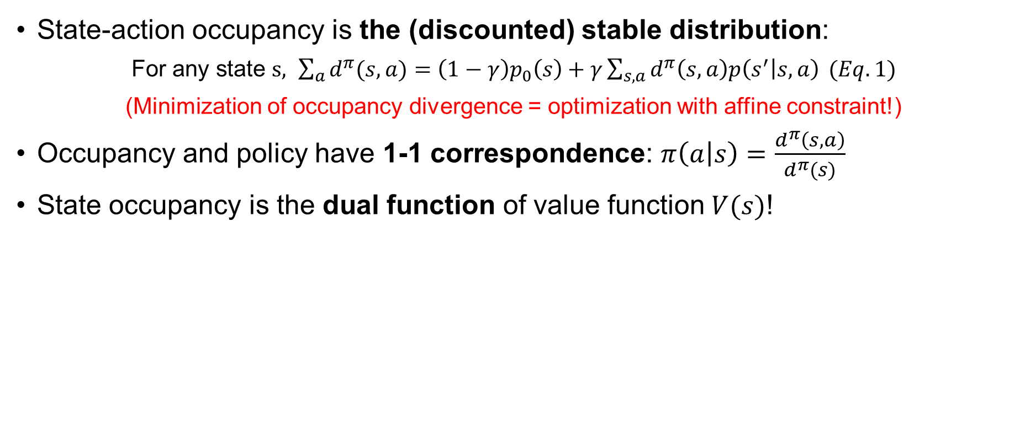
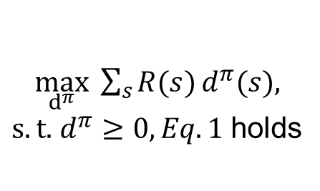
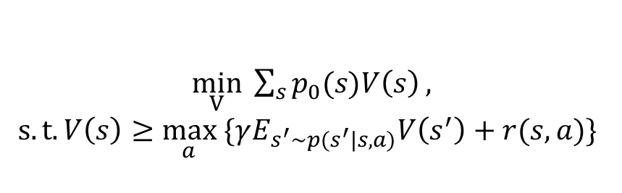
Properties of Occupancy
State-action occupancy is the (discounted) stable distribution:
For any state $s, \sum_{a}{d^{π}(s,a)}=\left(1−γ\right)p_{0}\left(s\right)+γ\sum_{s,a}{d^{π}\left(s,a\right)p\left(s^{′} | s,a\right)} (Eq. 1)$
(Minimization of occupancy divergence = optimization with affine constraint!)
Occupancy and policy have 1-1 correspondence: $π\left(a | s\right)=\frac{d^{π}\left(s,a\right)}{d^{π}(s)}$
State occupancy is the dual function of value function$V(s)$!
$\min_{V} \sum_{s}{p_{0}(s)V\left(s\right)},$
$$s.t. V\left(s\right)≥\max_{a} \{γE_{s^{′}∼p(s^{′}|s,a)}V\left(s^{′}\right)+r(s,a)\}⁡$$
Dual!
$\max_{d^{π}} \sum_{s}{R(s)}d^{π}(s),$
$s.t.$ $d^{π}≥0, Eq.1$holds
Department of Computer Science
GRAINGER COLLEGE OF ENGINEERING
Notes:
Value function, V(s), is the expected future sum of discounted reward on visiting this state with a particular policy \pi.
I will not go through the math about dual here due to time limit. But you can see that optimization with the occupancy form is easier because you only have the positivity constraint and equality constraint. While you can add slack variables to the left-hand side (and it amounts to “advantage” in RL), it is less direct than the occupancy form; with occupancy you get a clearer formulation.

Slide 10
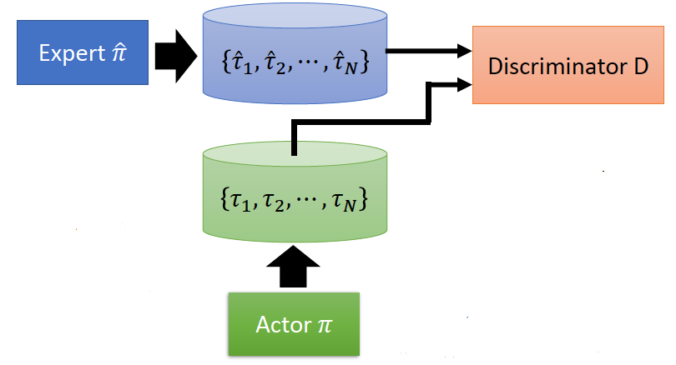




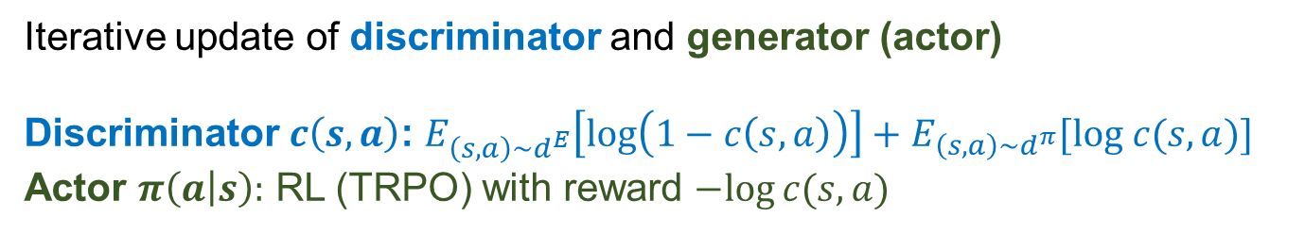

Generative Adversarial Imitation Learning (GAIL)
Monumental work of Inverse RL (IRL) in IL
a GAN that mimics agent’s state-action occupancy
Objective is $\min_{π} JS\left(d^{π}||d^{E}\right)−λH\left(π\right)$
Jenson-Shannon divergence is estimated by a discriminator $c\left(s\right)$; $c^{∗}\left(s,a\right)=\frac{d^{E}\left(s,a\right)}{d^{E}\left(s,a\right)+d^{π}(s,a)}$
$$E$$
$$(s,a)$$
$$c$$
Iterative update of discriminator and generator (actor)
Discriminator $c\left(s,a\right)$: $E_{\left(s,a\right)∼d^{E}}\left[log\left(1−c\left(s,a\right)\right)\right]+E_{\left(s,a\right)∼d^{π}}[log c(s,a)]$
Actor $π\left(a | s\right):$ RL (TRPO) with reward $−log⁡c(s,a)$
$$(s,a)$$
Image source: https://blog.csdn.net/weixin_37895339/article/details/82863379
[1] J. Ho and S. Ermon. Generative Adversarial Imitation Learning. In NIPS, 2016.
Department of Computer Science
GRAINGER COLLEGE OF ENGINEERING
Notes:
Actually, this is a little bit different from another paper that generates a whole trajectory with GAN. (A Connection between Generative Adversarial Networks, Inverse Reinforcement Learning, and Energy-Based Models)
Training a discriminator is a very common trick for obtaining any ratio between distributions.
They use TRPO because TRPO gives a constrained update that prevents the updated policy from deviating too far from the original policy, and thus automatically incorporates the entropy term

Slide 11
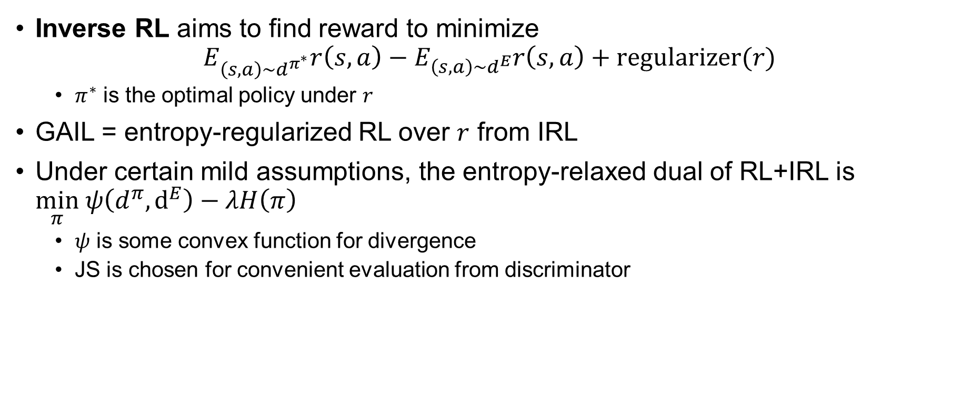
Then why GAIL is Inverse RL?
Inverse RL aims to find reward to minimize
$$E_{\left(s,a\right)∼d^{π^{∗}}}r\left(s,a\right)−E_{\left(s,a\right)∼d^{E}}r\left(s,a\right)+regularizer(r)$$
$π^{∗}$ is the optimal policy under $r$
GAIL = entropy-regularized RL over $r$ from IRL
Under certain mild assumptions, the entropy-relaxed dual of RL+IRL is $\min_{π} ψ\left(d^{π},d^{E}\right)−λH\left(π\right)$
$ψ$ is some convex function for divergence
JS is chosen for convenient evaluation from discriminator
Department of Computer Science
GRAINGER COLLEGE OF ENGINEERING
Notes:
One might ask: why is GAIL usually recognized as a work of inverse RL?
Actually, today nobody talks about inverse RL. Though I think DICE is a spiritual continuation of inverse RL.

Slide 12
Insights of GAIL
The first work that introduces occupancy matching in IL
Use entropy regularizers for generality of “out of distribution” data, which is a big problem in later works
Department of Computer Science
GRAINGER COLLEGE OF ENGINEERING

Slide 13
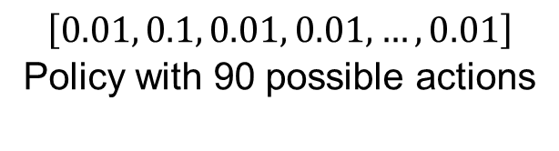
Limitations of GAIL
Why symmetric (Jenson-Shannon)?
Why entropy? – like SAC, problematic with large discrete space
GAIL needs online interactions, and has all the shortcomings of GAN
Do not work well in practice (like most IRL algorithms)
“Deviating from expert is
more severe than selection”
$$\left[0.01, 0.1, 0.01, 0.01, …, 0.01\right]$$
Policy with 90 possible actions
Department of Computer Science
GRAINGER COLLEGE OF ENGINEERING
Notes:
GAIL is actually inherited from Maximum entropy inverse RL in 2010. But it does not work that well.

Slide 14
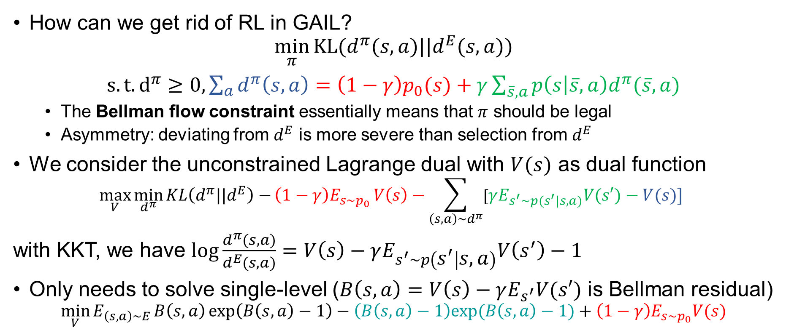
Distribution Correction Estimation (ValueDICE)
How can we get rid of RL in GAIL?
$$\min_{π}{KL(d^{π}(s,a)||d^{E}(s,a))}$$
$s.t. d^{π}≥0, \sum_{a}{d^{π}\left(s,a\right)}=\left(1−γ\right)p_{0}(s)+γ\sum_{\overline{s},a}{p\left(s | \overline{s},a\right)d^{π}(\overline{s},a)}$
The Bellman flow constraint essentially means that $π$ should be legal
Asymmetry: deviating from $d^{E}$ is more severe than selection from $d^{E}$
We consider the unconstrained Lagrange dual with $V(s)$ as dual function
$$\max_{V}{\min_{d^{π}}{KL\left(d^{π}||d^{E}\right)−}\left(1−γ\right)E_{s∼p_{0} }V\left(s\right)−\sum_{\left(s,a\right)∼d^{π}}{[γE_{s^{′}∼p(s^{′}|s,a)}V(s′)−V(s)] }}$$
with KKT, we have $\log{\frac{d^{π}(s,a)}{d^{E}(s,a)}=V\left(s\right)−γE_{s^{′}∼p\left(s^{′} | s,a\right)}V\left(s^{′}\right)−1}$
Only needs to solve single-level ($B\left(s,a\right)=V\left(s\right)−γE_{s^{′}}V(s′)$ is Bellman residual)
$$\min_{V}{E_{\left(s,a\right)∼E}}B\left(s,a\right)\exp\left(B\left(s,a\right)−1\right)−\left(B\left(s,a\right)−1\right)exp⁡(B\left(s,a\right)−1)+\left(1−γ\right)E_{s∼p_{0}}V(s)$$
I. Kostrikov et al. Imitation Learning via Off-Policy Distribution Matching. In ICLR, 2020.
Department of Computer Science
GRAINGER COLLEGE OF ENGINEERING
Notes:
Math-heavy; if you don’t understand the math, remember that it is write down the divergence, use Lagrange dual. Let me repeat this for three times: write down the divergence, use Lagrange dual; write down the divergence, use Lagrange dual; write down the divergence, use Lagrange dual!
Note, when using KKT we throw the non-negativity constraint and later we found that it is automatically satisified. While this is feasible, this derviation is inferior to what people use in papers, which I might cover if I have time. Nevertheless, the idea is the same.
Comment: many paper say they get rid of RL. But first learning value function, then update actor with weighted behavior cloning, this is inherently similar to RL. After all, what would you expect from a dual which is essentially the same problem? In fact, somehow you can derive the dual of conservative Q-learning in this way!

Slide 15
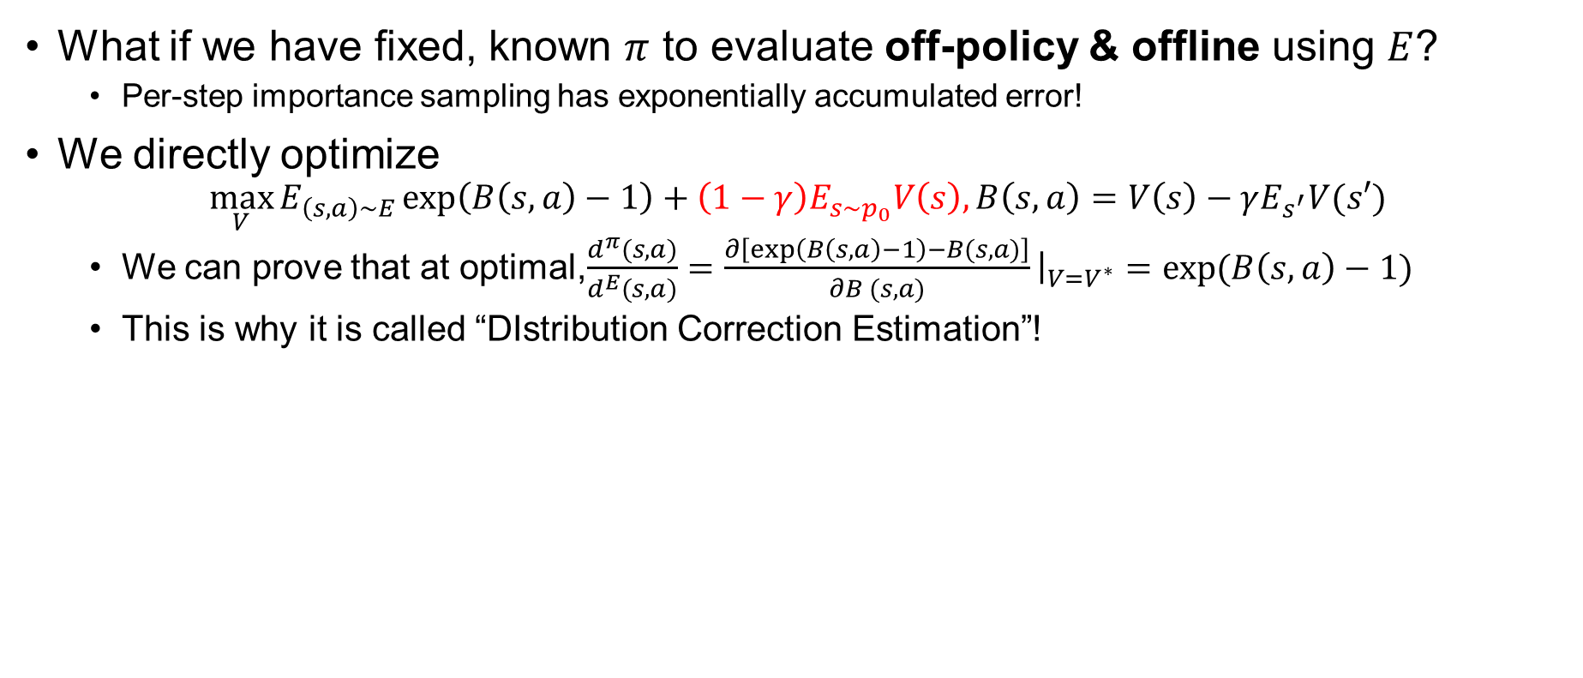
Distribution Correction Estimation (DualDICE)
What if we have fixed, known $π$ to evaluate off-policy & offline using $E$?
Per-step importance sampling has exponentially accumulated error!
We directly optimize
$$\max_{V}{E_{\left(s,a\right)∼E}}\exp\left(B\left(s,a\right)−1\right)+\left(1−γ\right)E_{s∼p_{0}}V\left(s\right),B\left(s,a\right)=V\left(s\right)−γE_{s^{′}}V(s′)$$
We can prove that at optimal,$\frac{d^{π}(s,a)}{d^{E}(s,a)}=\frac{∂\left[\exp\left(B\left(s,a\right)−1\right)−B(s,a)\right]}{∂B (s,a)}{\left.​\right|}_{V=V^{∗}}=\exp{(B\left(s,a\right)−1)}$
This is why it is called “DIstribution Correction Estimation”!
O. Nachum et al. DualDICE: Behavior-Agnostic Estimation of Discounted Stationary Distribution Corrections. In NIPS, 2019.
Department of Computer Science
GRAINGER COLLEGE OF ENGINEERING
Notes:
Some notes:
$s′$ can be estimated with 1-sample from $E$ (sample $(s,a,s′)$ instead of $(s,a)$)
All results can be extended to other $f$-divergences (usually $χ^{2}$)
In practice, Fenchel duality / Varadhan-Donsker representation is often used to get more stable objective than plain KKT
$\log{\frac{d^{π}}{d^{E}}}$ is an equivalence of reward, and $V(s)$ is an equivalence of value function

Slide 16
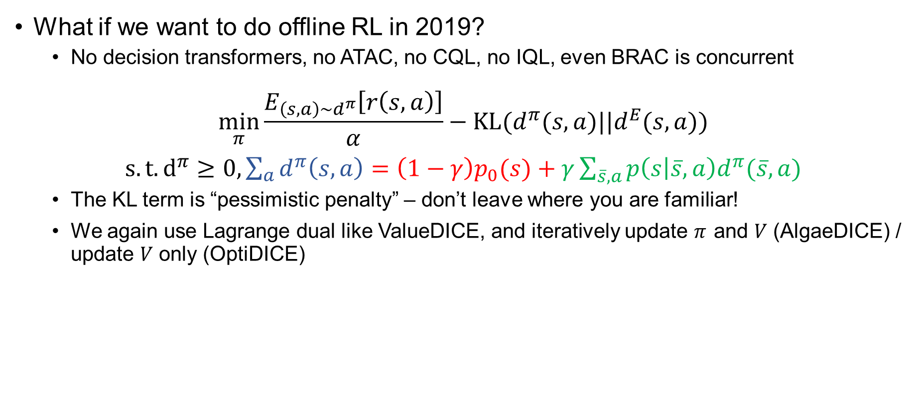
Distribution Correction Estimation (AlgaeDICE/OptiDICE)
What if we want to do offline RL in 2019?
No decision transformers, no ATAC, no CQL, no IQL, even BRAC is concurrent
$$\min_{π}{\frac{E_{\left(s,a\right)∼d^{π}}\left[r\left(s,a\right)\right]}{α}−KL(d^{π}(s,a)||d^{E}(s,a))}$$
$s.t. d^{π}≥0, \sum_{a}{d^{π}\left(s,a\right)}=\left(1−γ\right)p_{0}(s)+γ\sum_{\overline{s},a}{p\left(s | \overline{s},a\right)d^{π}(\overline{s},a)}$
The KL term is “pessimistic penalty” – don’t leave where you are familiar!
We again use Lagrange dual like ValueDICE, and iteratively update $π$ and $V$ (AlgaeDICE) / update $V$ only (OptiDICE)
O. Nachum et al. AlgaeDICE: Policy Gradient from Arbitrary Experience. In ArXiv, 2019.
J. Lee et al. OptiDICE: Offline Policy Optimization via Stationary Distribution Correction Estimation. In ICML, 2021.
Department of Computer Science
GRAINGER COLLEGE OF ENGINEERING

Slide 17

Distribution Correction Estimation (DemoDICE)
What if we want to do offline imitation learning with expert data $E$ and non-expert data $I$?
Consider $KL\left(d^{π}(s,a)||d^{E}(s,a)\right)=\sum_{\left(s,a\right)∼d^{π}}{\log{\frac{d^{π}\left(s,a\right)}{d^{E}(s,a)}}}=\sum_{\left(s,a\right)∼d^{π}}{[\log{\frac{d^{π}\left(s,a\right)}{d^{I}(s,a)}−\log{\frac{d^{E}\left(s,a\right)}{d^{I}\left(s,a\right)}}]}}$
The red part can be seen as a reward!
The rest of the problem is converted to OptiDICE
G-H Kim et al. DemoDICE: Offline Imitation Learning with Supplementary Imperfect Demonstrations. In ICLR, 2022.
Department of Computer Science
GRAINGER COLLEGE OF ENGINEERING

Slide 18

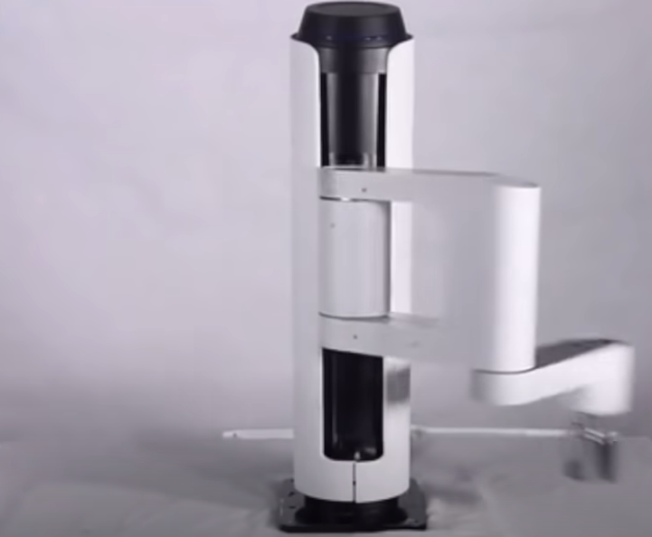

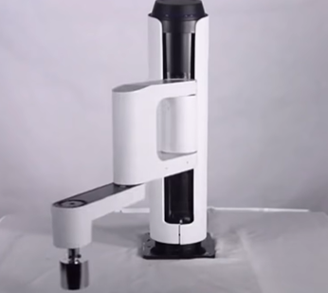

Distribution Correction Estimation (SMODICE/LobsDICE)
What if we want to do offline imitation learning from observation?
Only expert state is available
You cannot describe the Bellman flow constraint by state occupancy alone!
$KL\left(d^{π}(s,s′)||d^{E}(s,s′)\right)$ or $KL\left(d^{π}(s)||d^{E}(s)\right)≤E_{s∼d^{π}}\left[\log\left(\frac{d^{I}\left(s\right)}{d^{E}\left(s\right)}\right)\right]+KL(d^{π}(s,a)||d^{I}(s,a))$
Convert to DemoDICE
Learning from video
Embodiment difference
Y Ma et al. Versatile Offline Imitation from Observations and Examples via Regularized State-Occupancy Matching. In ICML, 2022.
G-H Kim. LobsDICE: Offline Learning from Observations via Stationary Distribution Correction Estimation. In NeurIPS, 2022.
Department of Computer Science
GRAINGER COLLEGE OF ENGINEERING
Notes:
Why? Because when summing up from last step, you either involve state-action occupancy, or a multiplication between policy and state occupancy. You need to include the message of policy in one way or another.

Slide 19
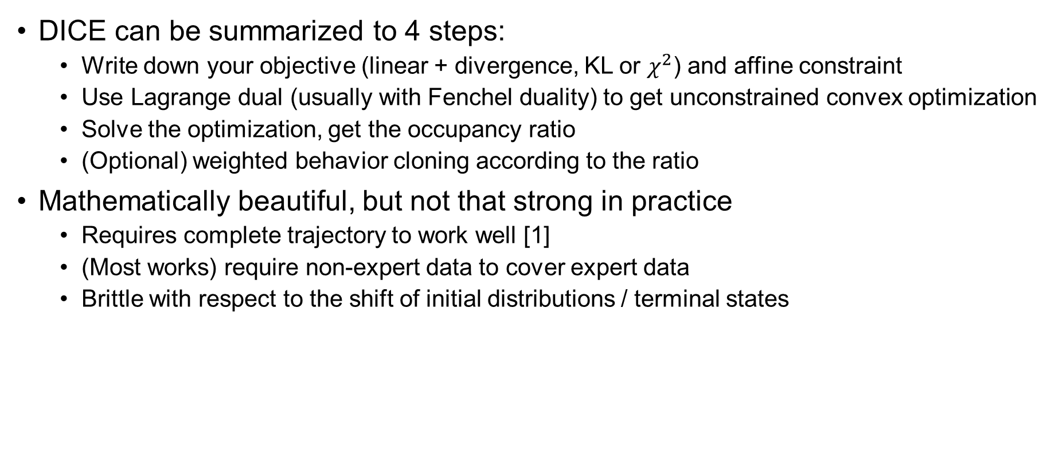
Summary for DICE
DICE can be summarized to 4 steps:
Write down your objective (linear + divergence, KL or $χ^{2}$) and affine constraint
Use Lagrange dual (usually with Fenchel duality) to get unconstrained convex optimization
Solve the optimization, get the occupancy ratio
(Optional) weighted behavior cloning according to the ratio
Mathematically beautiful, but not that strong in practice
Requires complete trajectory to work well [1]
(Most works) require non-expert data to cover expert data
Brittle with respect to the shift of initial distributions / terminal states
[1] Z. Li et al. Rethinking ValueDice: Does It Really Improve Performance? In ICLR, 2022.
Department of Computer Science
GRAINGER COLLEGE OF ENGINEERING

Slide 20
Other DICE works
Many DICE works has been proposed in the last 3 years
SoftDICE: from f-divergence to Wasserstein with Rubinstein duality
SparseDICE: solve the problem of subsampled trajectory
CoinDICE: calculate Q-value’s confidence interval
COptiDICE: OptiDICE with constraints, e.g. safe RL
GenDICE: improved DualDICE, estimate policy / offline pagerank
GradientDICE: improved GenDICE
OPOLO: off-policy online IL from observations
ReCOIL: unified framework of offline IL and RL; remove the need for non-expert to cover expert
CFIL: explicitly model DICE’s distribution with normalizing flow
Department of Computer Science
GRAINGER COLLEGE OF ENGINEERING
Notes:
Actually, this is a little bit different from another paper that generates trajectory with GAN.

Slide 21
Takeaways
Occupancy is the dual of value function in RL
You can interpret inverse RL as an occupancy matching problem
You can write an occupancy matching objective with Bellman flow constraints, use Lagrange dual, and turn it into a single-level unconstrained optimization
Off-policy RL / IL / IL from observation / evaluation
People are trying to unify offline RL, IL and IL from observations
A. Li et al. MAHALO: Unifying Offline Reinforcement Learning and Imitation Learning from Observations. In ICML, 2023.
H. Sikchi et al. Imitation from Arbitrary Experience: A Dual Unification of Reinforcement and Imitation Learning Methods. In ArXiv, 2023.
Department of Computer Science
GRAINGER COLLEGE OF ENGINEERING
Notes:
Which one are you more optimistic about, decision transformer or math form?

Slide 22
Appendix: How Does Fenchel Conjugate Work in DICE?
By using advanced math tricks, you can solve the problem with less relaxed constraints, which leads to a more numerically stable formulation.
Department of Computer Science
GRAINGER COLLEGE OF ENGINEERING
Notes:
The proof is non trivial

Slide 23
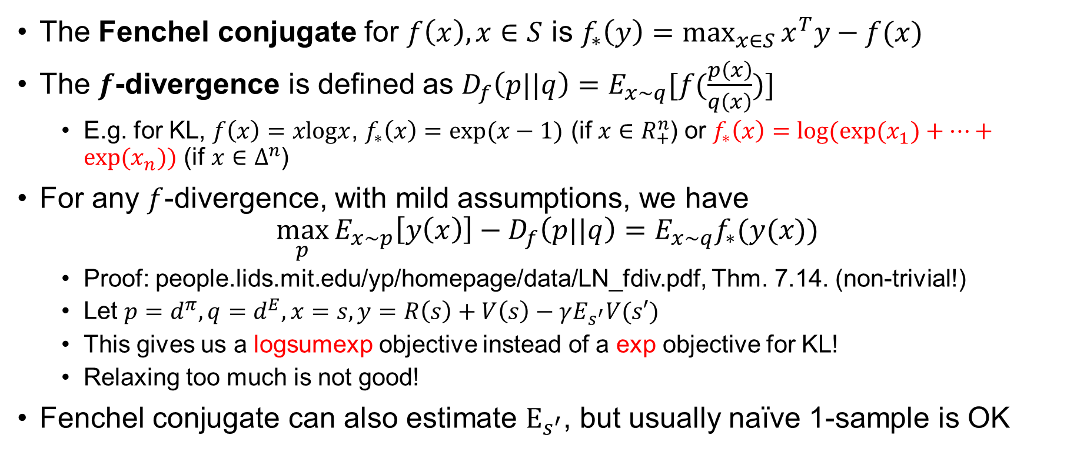
Appendix: How Does Fenchel Conjugate Work in DICE?
The Fenchel conjugate for $f\left(x\right), x∈S$ is $f_{∗}\left(y\right)=\max_{x∈S}{x^{T}y−f(x)}$
The $f$-divergence is defined as $D_{f}\left(p||q\right)=E_{x∼q}[f(\frac{p\left(x\right)}{q\left(x\right)})]$
E.g. for KL, $f\left(x\right)=xlogx$, $f_{∗}\left(x\right)=exp⁡(x−1)$ (if $x∈R_{+}^{n}$) or $f_{∗}\left(x\right)=log⁡(exp⁡(x_{1})+…+exp⁡(x_{n}))$ (if $x∈Δ^{n}$)
For any $f$-divergence, with mild assumptions, we have
$$\max_{p}{E_{x∼p}\left[y\left(x\right)\right]−D_{f}\left(p||q\right)=E_{x∼q}f_{∗}(y(x))}$$
Proof: people.lids.mit.edu/yp/homepage/data/LN_fdiv.pdf, Thm. 7.14. (non-trivial!)
Let $p=d^{π},q=d^{E},x=s, y=R\left(s\right)+V\left(s\right)−γE_{s^{′}}V(s′)$
This gives us a logsumexp objective instead of a exp objective for KL!
Relaxing too much is not good!
Fenchel conjugate can also estimate $E_{s^{′}}$, but usually naïve 1-sample is OK
Department of Computer Science
GRAINGER COLLEGE OF ENGINEERING
Notes:
The proof is non trivial

Slide 24
Appendix: How Does Fenchel Conjugate Work in DICE?
By using advanced math tricks, you can solve the problem with less relaxed constraints, which leads to a more numerically stable formulation.
Department of Computer Science
GRAINGER COLLEGE OF ENGINEERING
Notes:
The proof is non trivial

