Slide 1

Imitation from Observation
Kai Yan
Coordinated Science Lab
Department of Computer Science
University of Illinois at Urbana-Champaign

Slide 2
Overview
Preliminaries
Reinforcement Learning: A Quick Recap
Imitation Learning
Behavior Cloning
Adversarial Generative-based Methods
Imitation Learning from Observation
Inverse Dynamic Models
Reward Assignment
State Occupancy Matching
Other
Notes:
LfO + Visual imitation
The inner difference of subgoal proposer is too great.

Slide 3
Overview
Preliminaries
Reinforcement Learning: A Quick Recap
Imitation Learning
Behavior Cloning
Adversarial Generative-based Methods
Imitation Learning from Observation
Inverse Dynamic Models
Reward Assignment
State Occupancy Matching
Other
Notes:
LfO + Visual imitation
The inner difference of subgoal proposer is too great.

Slide 4
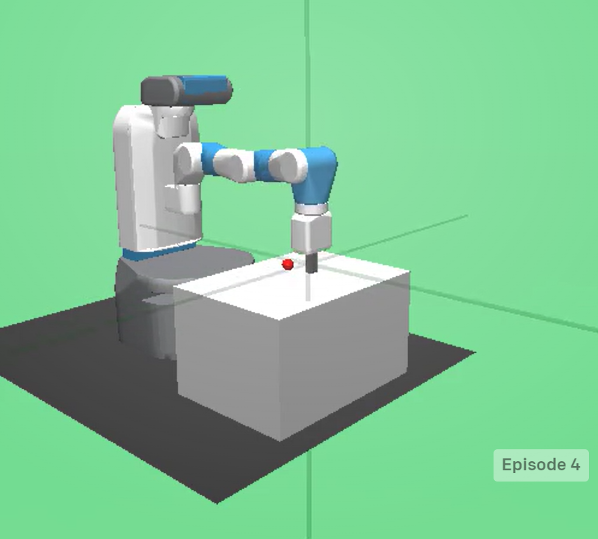
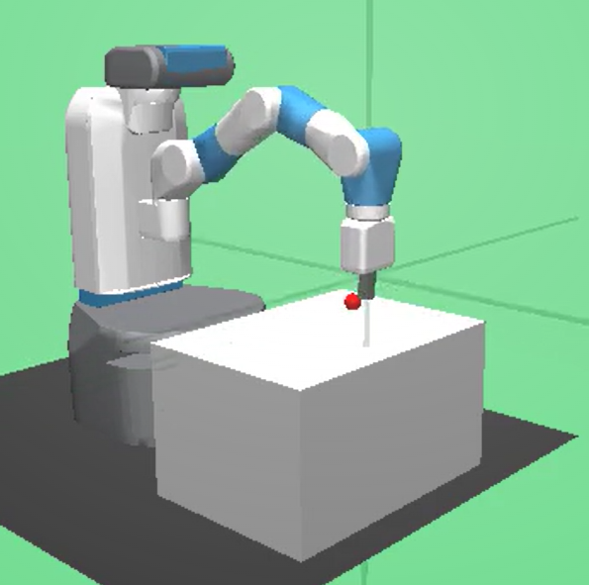
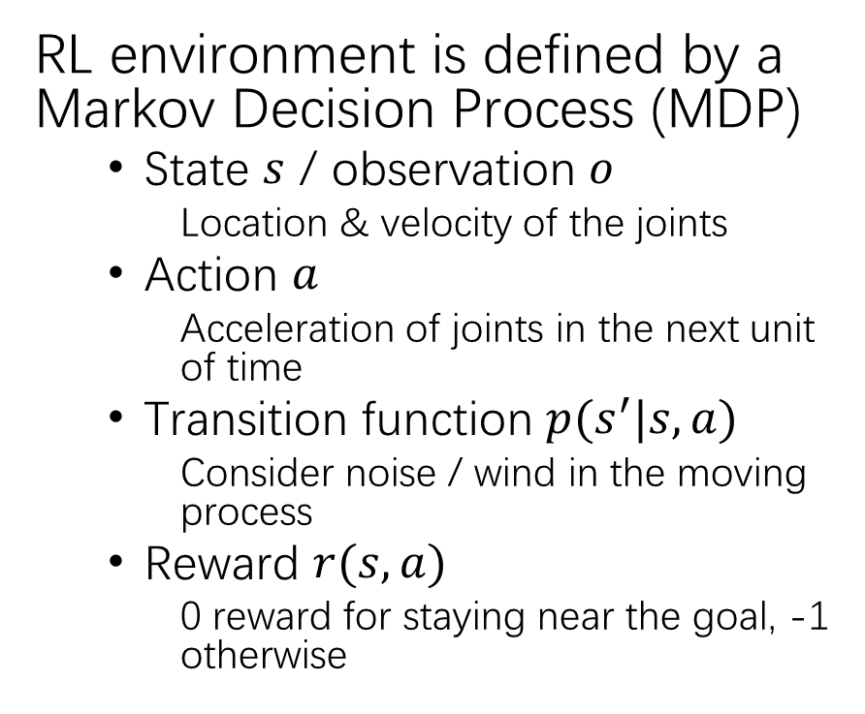
Reinforcement Learning: A Quick Recap
RL environment is defined by a Markov Decision Process (MDP)
State $s$ / observation $o$
Location & velocity of the joints
Action $a$
Acceleration of joints in the next unit of time
Transition function $p(s^{′}|s,a)$
Consider noise / wind in the moving process
Reward $r(s, a)$
0 reward for staying near the goal, -1 otherwise
State 1 $s_{1}$
State 2$s_{2}$
Action $a$
Without noise, the transition function is
$p\left(s_{2} | s_{1},a\right)=1$ (one-point distribution /
deterministic)
*For simplicity, we do not discriminate state (ground truth status of environment) and observation (obtainable input).
Notes:
We will often use state and observation interchangeably in this presentation.

Slide 5
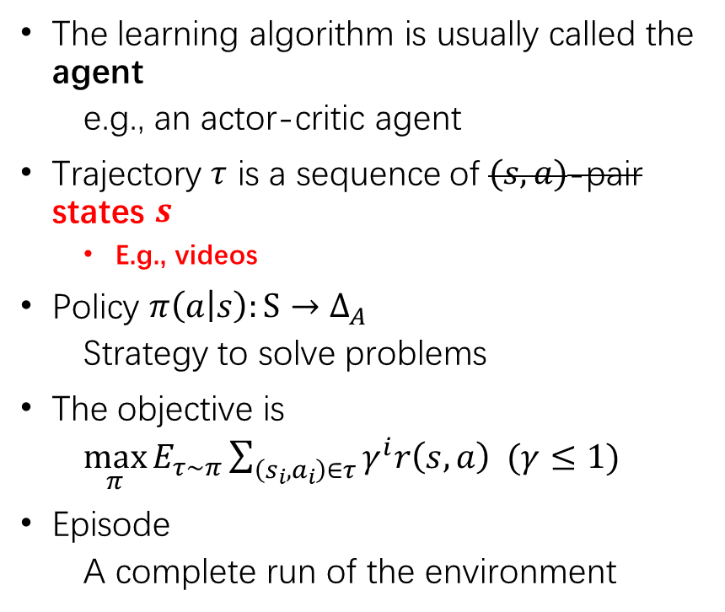
Reinforcement Learning: A Quick Recap
The learning algorithm is usually called the agent
e.g., an actor-critic agent
Trajectory $τ$ is a sequence of $(s,a)$-pair states $s$
E.g., videos
Policy $π\left(a | s\right):S→Δ_{A}$
Strategy to solve problems
The objective is
$\max_{π}{E_{τ∼π}}\sum_{\left(s_{i}, a_{i}\right)∈τ}{γ^{i}r\left(s,a\right) }(γ≤1)$
Episode
A complete run of the environment
$$s_{0}$$
Initial state
a trajectory of
another episode
$$a_{0}^{′}$$
$$a_{0}$$
$$s_{1}^{′}$$
$$s_{1}$$
$$π\left(a_{0} | s_{0}\right)=0.8,$$
$$π\left(a_{0}^{′} | s_{0}\right)=0.2$$
$$a_{1}^{′}$$
$$a_{1}$$
$$s_{2}^{′}$$
$$s_{2}$$
…
…
$$a_{n−1}^{′}$$
$$a_{n−1}$$
a trajectory of
an episode
$$s_{n}^{′}$$
$$s_{n}$$
Notes:
Consider a “policy” in Rock-paper-scissors

Slide 6
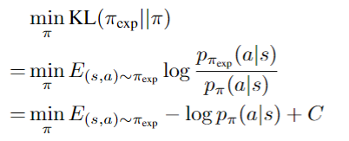
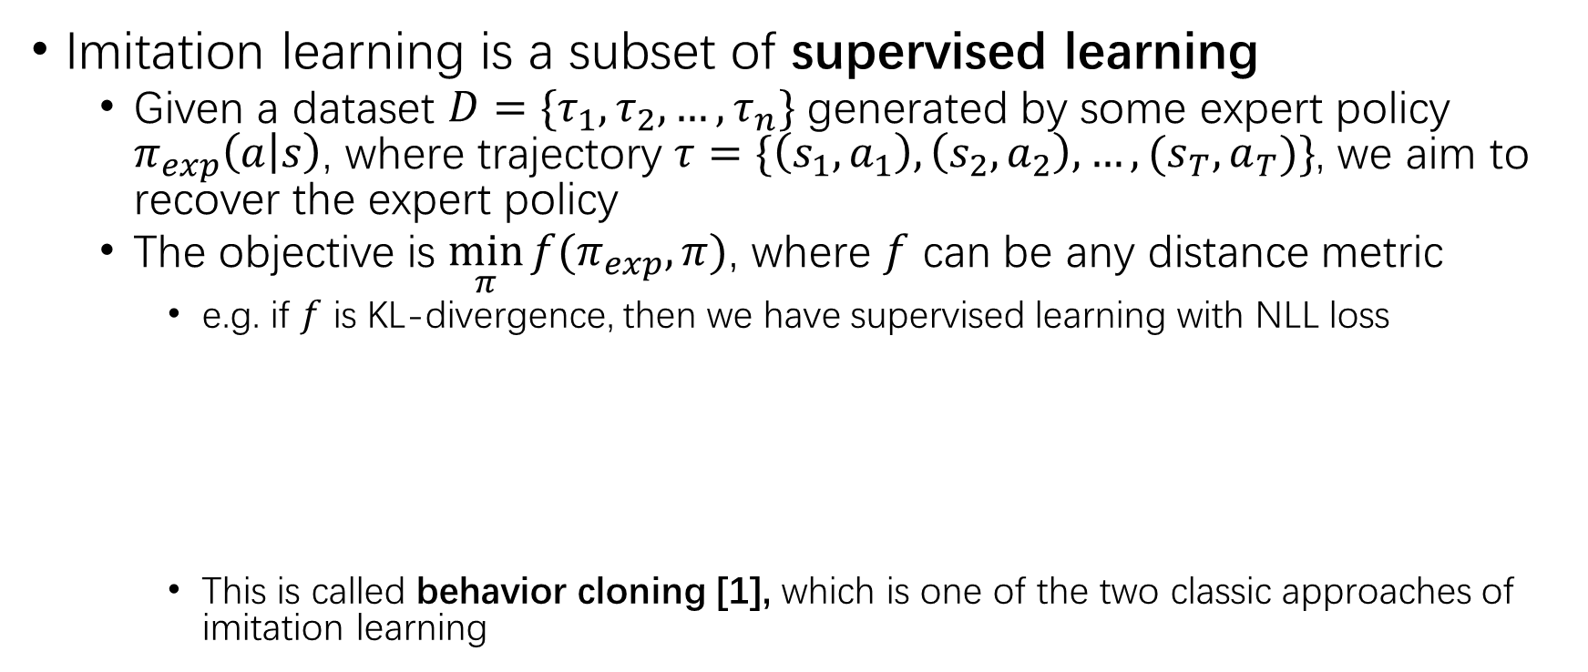
Definition of Imitation Learning
Imitation learning is a subset of supervised learning
Given a dataset $D=\{τ_{1},τ_{2},…,τ_{n}\}$ generated by some expert policy $π_{exp}\left(a | s\right)$, where trajectory $τ=\{\left(s_{1},a_{1}\right),\left(s_{2},a_{2}\right), …,(s_{T},a_{T})\}$, we aim to recover the expert policy
The objective is $\min_{π}{f(π_{exp},π)}$, where $f$ can be any distance metric
e.g. if $f$ is KL-divergence, then we have supervised learning with NLL loss
This is called behavior cloning [1], which is one of the two classic approaches of imitation learning

Slide 7
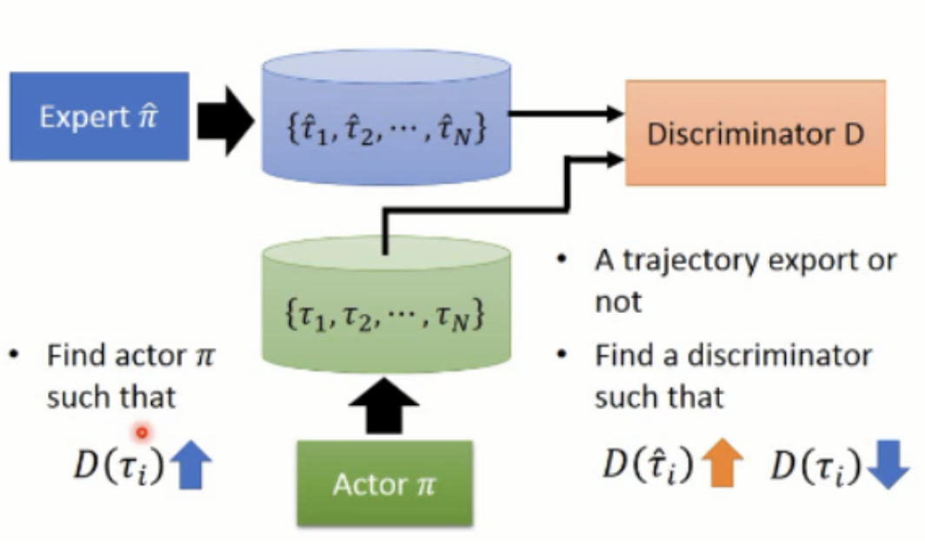
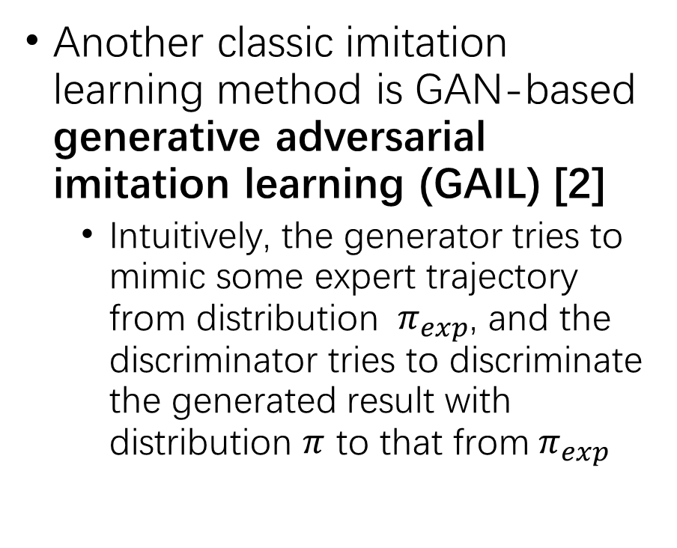
Generative Adversarial-based Methods
Another classic imitation learning method is GAN-based generative adversarial imitation learning (GAIL) [2]
Intuitively, the generator tries to mimic some expert trajectory from distribution ${ π}_{exp}$, and the discriminator tries to discriminate the generated result with distribution $π$ to that from${ π}_{exp}$

Slide 8
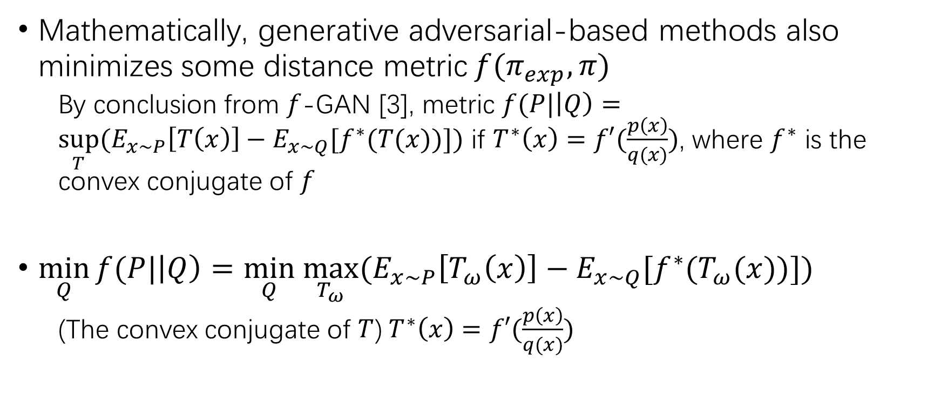
Generative Adversarial-based Methods
Mathematically, generative adversarial-based methods also minimizes some distance metric$f(π_{exp}, π)$
By conclusion from $f$-GAN [3], metric $f(P|\left|Q\right)=\sup_{T}{{(E}_{x∼P}\left[T\left(x\right)\right]−E_{x∼Q}[f^{∗}(T(x))])}$ if $T^{∗}\left(x\right)=f′(\frac{p\left(x\right)}{q(x)})$, where $f^{∗}$ is the convex conjugate of $f$
$\min_{Q}{f(P|\left|Q\right)}=\min_{Q} \max_{T_{ω}}{{(E}_{x∼P}\left[T_{ω}\left(x\right)\right]−E_{x∼Q}[f^{∗}(T_{ω}(x))])}$
(The convex conjugate of $T$)$T^{∗}\left(x\right)=f′(\frac{p\left(x\right)}{q(x)})$
generator
discriminator

Slide 9
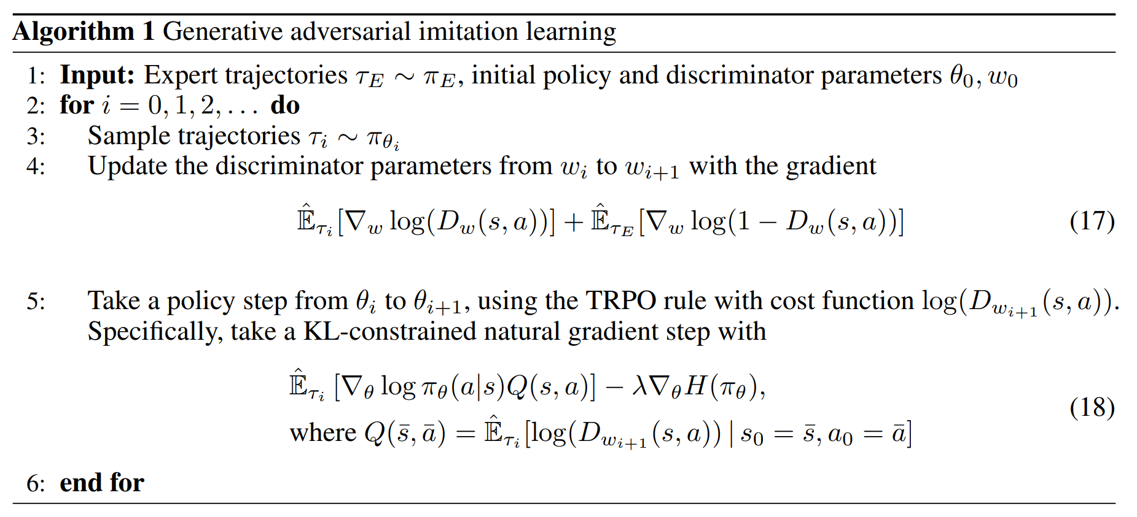
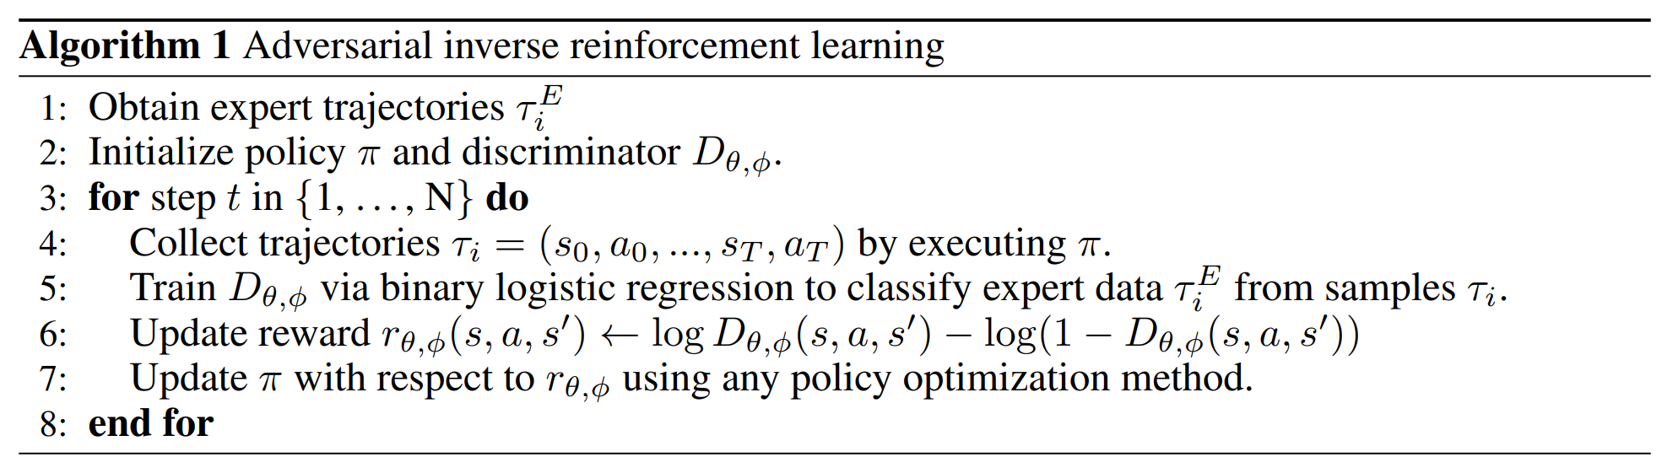
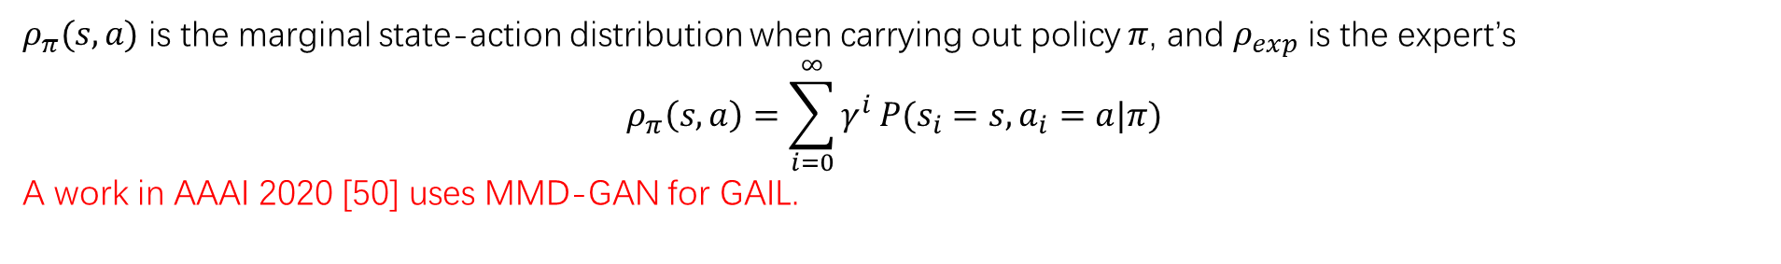


Generative Adversarial-based Methods
GAIL, $f=JS(ρ_{π}(s, a)||ρ_{exp}(s, a))−λH\left(π\right)$ [5]
AIRL, $f=KL(ρ_{π}(s, a)||ρ_{exp}(s, a))$ [4]
$ρ_{π}(s, a)$ is the marginal state-action distribution when carrying out policy $π$, and $ρ_{exp}$ is the expert’s
$$ρ_{π}\left(s,a\right)=\sum_{i=0}^{∞}{γ^{i}}P(s_{i}=s,a_{i}=a|π)$$
A work in AAAI 2020 [50] uses MMD-GAN for GAIL.
Notes:
[5] A Divergence Minimization Perspective on Imitation Learning Methods
This definition can be interpreted as an encoding of the convex hull of the function's epigraph in terms of its supporting hyperplanes.^{[1]}
Intuitively, in adversarial method all have the pi in the first term, because we are sampling from the generator

Slide 10
Overview
Preliminaries
Reinforcement Learning: A Quick Recap
Imitation Learning
Behavior Cloning
Adversarial Generative-based Methods
Imitation Learning from Observation
Inverse Dynamic Models
Reward Assignment
State Occupancy Matching
Other
Notes:
LfO + Visual imitation
The inner difference of subgoal proposer is too great.

Slide 11
Imitation Learning from Observation Only
Sometimes, we need to learn from video instead of running log, i.e., no action available
There are two literatures that are directly related to this field: learning from observation (LfO) and visual imitation (VI)
The former takes a RL perspective, and the latter takes a robotic perspective
There are three major directions of this field, and many minor directions
Inverse Dynamic Models
Reward Assignment
State Occupancy Matching

Slide 12
Overview
Preliminaries
Reinforcement Learning: A Quick Recap
Imitation Learning
Behavior Cloning
Adversarial Generative-based Methods
Imitation Learning from Observation
Inverse Dynamic Models
Reward Assignment
State Occupancy Matching
Other
Notes:
LfO + Visual imitation
The inner difference of subgoal proposer is too great.

Slide 13
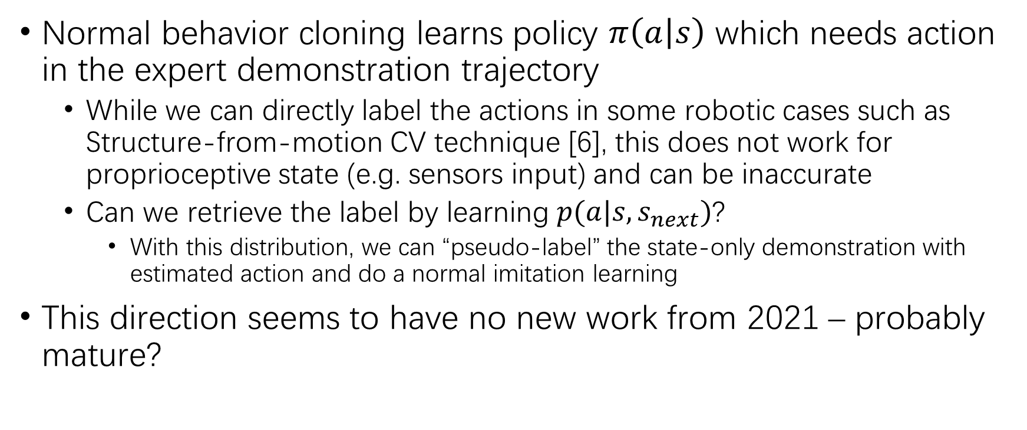
Inverse Dynamics Model
Normal behavior cloning learns policy $π\left(a | s\right)$ which needs action in the expert demonstration trajectory
While we can directly label the actions in some robotic cases such as Structure-from-motion CV technique [6], this does not work for proprioceptive state (e.g. sensors input) and can be inaccurate
Can we retrieve the label by learning $p(a|s,s_{next})$?
With this distribution, we can “pseudo-label” the state-only demonstration with estimated action and do a normal imitation learning
This direction seems to have no new work from 2021 – probably mature?
Notes:
[6] 40.Visual Imitation Made Easy

Slide 14
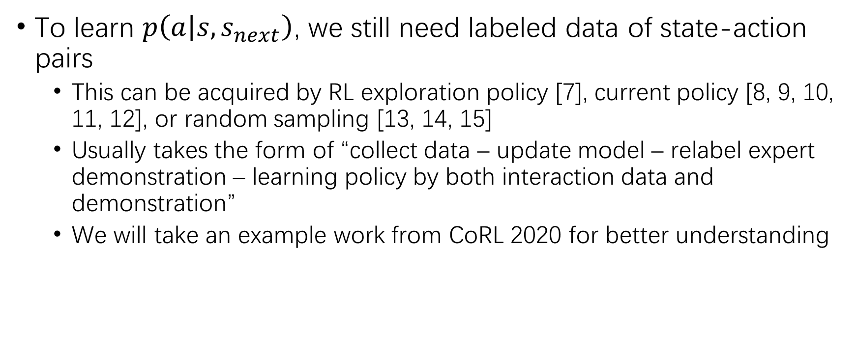
Inverse Dynamics Model
To learn $p\left(a | s,s_{next}\right)$, we still need labeled data of state-action pairs
This can be acquired by RL exploration policy [7], current policy [8, 9, 10, 11, 12], or random sampling [13, 14, 15]
Usually takes the form of “collect data – update model – relabel expert demonstration – learning policy by both interaction data and demonstration”
We will take an example work from CoRL 2020 for better understanding
Notes:
[7] 8. Reinforcement learning with videos: Combining offline observations with interaction.
[8] 17.Visual Adversarial Imitation Learning using Variational Models
[9] 30. State-only imitation learning for dexterous manipulation
[10] 38. Behavior cloning from observation
[13] 47. Combining self-supervised learning and imitation for vision-based rope manipulation
[11] 48. RIDM: Reinforced inverse dynamics modeling for learning from a single observed demonstration
[14] 49.Learning Navigation Subroutines from Egocentric Videos
[15] 50. Semantic Visual Navigation by Watching YouTube Videos
[12] 41. Hybrid reinforcement learning with expert state sequences

Slide 15
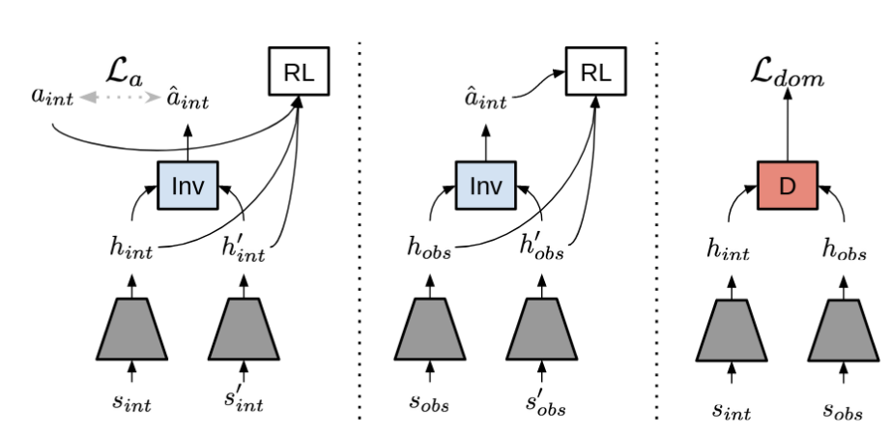
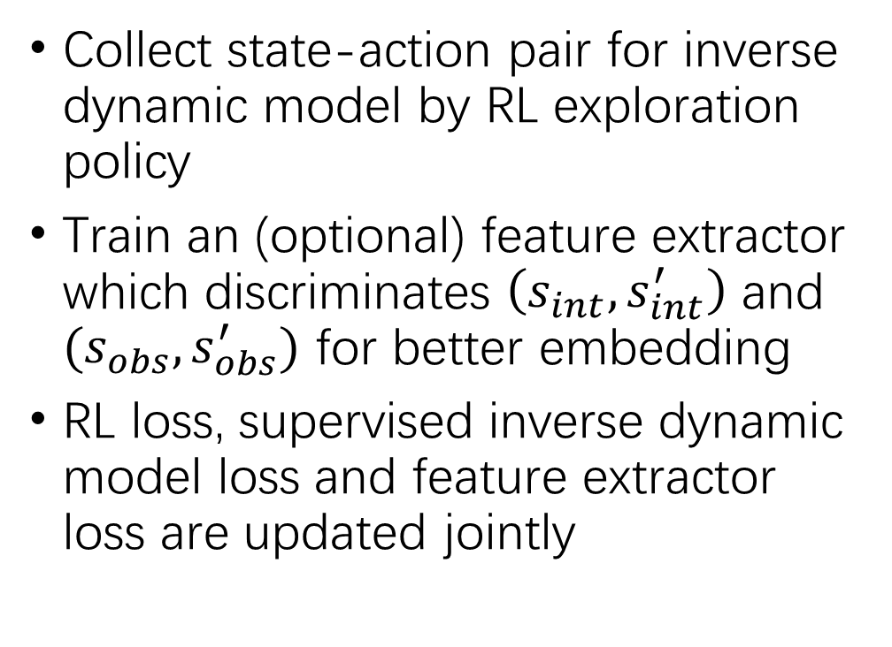
Reinforcement Learning with Videos: Combining Offline Observations with Interaction (CoRL 2020)
Collect state-action pair for inverse dynamic model by RL exploration policy
Train an (optional) feature extractor which discriminates $\left(s_{int},s_{int}^{′}\right)$ and $(s_{obs},s_{obs}^{′})$ for better embedding
RL loss, supervised inverse dynamic model loss and feature extractor loss are updated jointly
action recorded
from RL exploration
Some deep network for RL
put demo with labeled action in replay buffer
Feature extractor
Notes:
An example of paper
The latest work of inverse dynamic model?

Slide 16
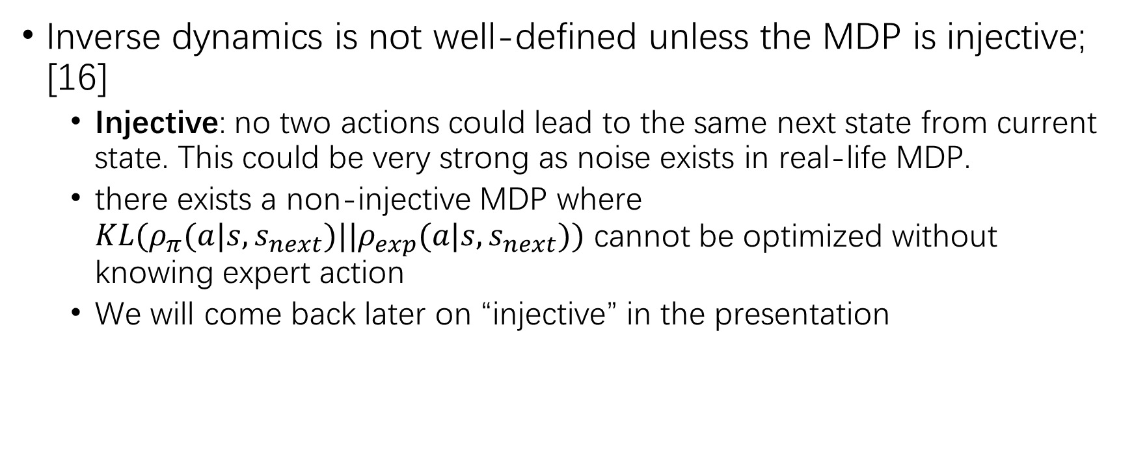
The (Theoretical) Limitation of Inverse Dynamic Model
Inverse dynamics is not well-defined unless the MDP is injective; [16]
Injective: no two actions could lead to the same next state from current state. This could be very strong as noise exists in real-life MDP.
there exists a non-injective MDP where $KL(ρ_{π}(a|s,s_{next})||ρ_{exp}(a|s,s_{next}))$ cannot be optimized without knowing expert action
We will come back later on “injective” in the presentation
Notes:
[16] 4.MobILE: Model-Based Imitation Learning From Observation Alone (2021)

Slide 17
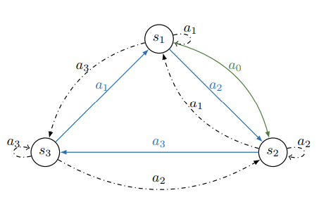
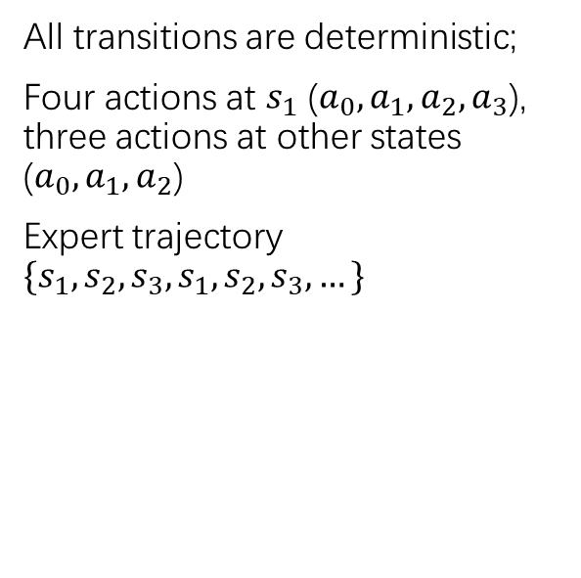
The (Theoretical) Limitation of Inverse Dynamic Model
This does not matter if the reward is state-based, which is common in robotics; yet [17] pointed out
the problem, and gives a solution that trains an expert-agent policy discrepancy discriminator and
takes the result as an auxiliary reward signal
All transitions are deterministic;
Four actions at $s_{1}$ ($a_{0},a_{1},a_{2},a_{3}$), three actions at other states ($a_{0},a_{1},a_{2}$)
Expert trajectory $\{s_{1},s_{2},s_{3},s_{1},s_{2},s_{3},…\}$
Blue: By expert
Green: learned
Dotted black: unused
What does the agent do in $s_{1}$ to transit to $s_{2}$? $a_{0}$ or $a_{2}$?
Notes:
[17] 25.Off-Policy Imitation Learning from Observations

Slide 18
Overview
Preliminaries
Reinforcement Learning: A Quick Recap
Imitation Learning
Behavior Cloning
Adversarial Generative-based Methods
Imitation Learning from Observation
Inverse Dynamic Models
Reward Assignment
State Occupancy Matching
Other
Notes:
LfO + Visual imitation
The inner difference of subgoal proposer is too great.

Slide 19
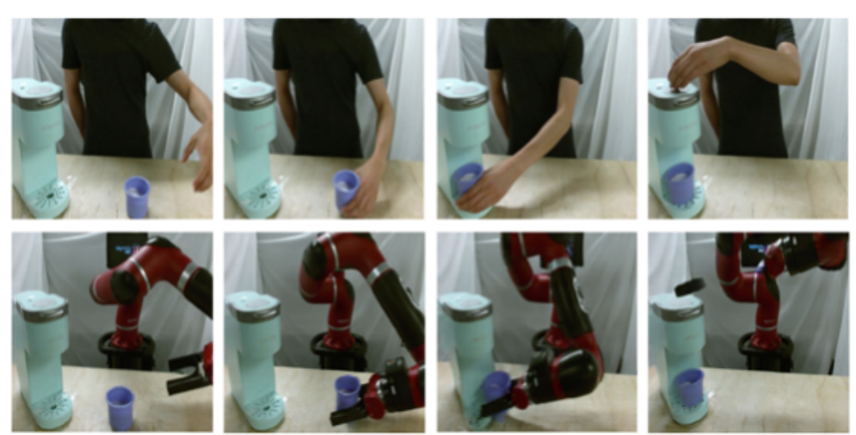
Reward Design
Demonstrated state can serve as a reward signal
It is good if we can achieve a state similar to that appeared in the expert demonstration; we assign a reward for this
But what is “similar” exactly?
There could be viewpoint difference, background noise, or even embodiment discrepancy [18]
There is no robot at all above. Are they similar?
Notes:
[18] 2. Recent Advances in Imitation Learning from Observation

Slide 20
State Embedding
Many works learn a representation of state, or sequences of states [19], in various ways:
Contrastive learning: states that are roughly at the same progress from different embodiment / viewpoint / demonstration should be close, from different progress within a trajectory should be apart [20, 21];
Supervised Learning of Time: [22] trains with a classifier on top of embedding which classifies the time interval between frames (0 frame, 1 frame, 2 frames, 3-4 frames, 5-20 frames, 21-200 frames)
Adversarial Training: [23] trains with CycleGAN [24], to train two translations which translates human image to robot image and robot image back to human image; [7] trains a discriminator on top of embeddings, which classifies expert trajectory and current state
CycleGAN [24] is a framework for learning unpaired image-to-image translation
[7] does not pair states; randomly draw states from expert demo and current policy
Notes:
[19] 36: Learning Generalizable Robotic Reward Functions from “In-The-Wild” Human Videos
[20] 34: Time Contrastive Networks
[21] 46: The Surprising Effectiveness of Representation Learning for Visual Imitation
[22] 10: Playing hard exploration games by watching YouTube *cycleness
[23] 23: AVID: Learning Multi-Stage Tasks via Pixel-Level Translation of Human Videos
[24] Unpaired Image-to-Image Translation using Cycle-Consistent Adversarial Networks cycle-GAN is a framework for learning unpaired image-to-image translation
[25] 6: Imitation from Observation: Learning to Imitate Behaviors from Raw Video via Context Translation
[26] 7: LEARNING INVARIANT FEATURE SPACES TO TRANSFER SKILLS WITH REINFORCEMENT LEARNING
[27] 33: XIRL: Cross-embodiment Inverse Reinforcement Learning
Neural Task Graphs: Generalizing to Unseen Tasks from a Single Video Demonstration (identify “node”)
Playing hard exploration games by watching YouTube (reward based on similarity in embedding space)
Reinforcement Learning with Videos: Combining Offline Observations with Interaction (discriminating interactive and observed transition)
Time-Contrastive Networks: Self-Supervised Learning from Video (reward based on similarity in embedding space)
The Surprising Effectiveness of Representation Learning for Visual Imitation: different viewpoint of same frame to be the same
Usually contrastive-learning style (even not contrastive learning loss)
AVID: Learning Multi-Stage Tasks via Pixel-Level Translation of Human Videos (solve human-robot difference)
Learning Generalizable Robotic Reward Functions from “In-The-Wild” Human Videos (embodiment difference by different human videos)
LEARNING INVARIANT FEATURE SPACES TO TRANSFER SKILLS WITH REINFORCEMENT LEARNING (different embodiment; two autoencoder, let embedding at middle similar)
Imitation from Observation: Learning to Imitate Behaviors from Raw Video via Context Translation
XIRL: Cross-embodiment Inverse Reinforcement Learning

Slide 21
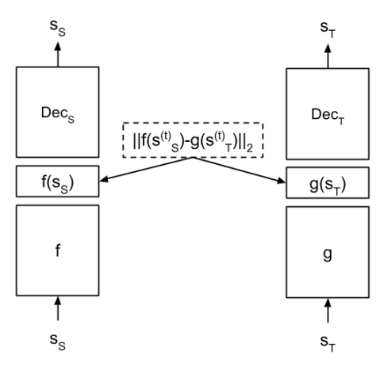
State Embedding
Siamese AE
Many works learn a representation of state, or sequences of states [19], in various ways:
Siamese Autoencoders: two autoencoder for two domains of aligned images (e.g. human and robot, 3-DOF/4-DOF robot) should have the same latent variable [25] for the “corresponding” pair of states
The “correspondence” starts from alignment by each time frame, and is in turn updated by choosing pairs of states whose distance between latent variables are small
Another example of Siamese Autoencoder (with slightly different architecture) is [26], where the length of demonstrations is fixed and assumed to be time-aligned
Cycle Consistency: [27] Use temporal cycle-consistency learning [49] for self-supervised correspondence
Cycle consistency learns an embedding, where for most image frames, the nearest neighbour of “nearest neighbour of the frame” should be the frame itself

Slide 22
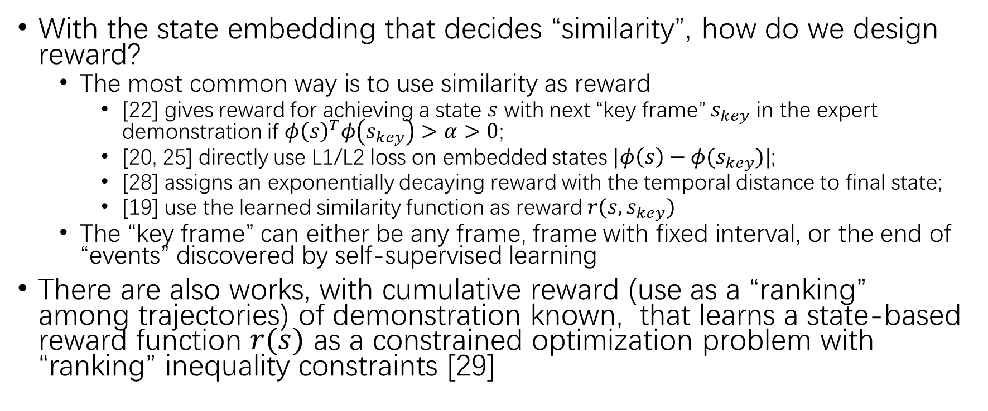
Reward Design
With the state embedding that decides “similarity”, how do we design reward?
The most common way is to use similarity as reward
[22] gives reward for achieving a state $s$ with next “key frame” $s_{key}$ in the expert demonstration if $φ{\left(s\right)}^{T}φ\left(s_{key}\right)>α>0$;
[20, 25] directly use L1/L2 loss on embedded states $|φ\left(s\right)−φ(s_{key})|$;
[28] assigns an exponentially decaying reward with the temporal distance to final state;
[19] use the learned similarity function as reward $r(s, s_{key})$
The “key frame” can either be any frame, frame with fixed interval, or the end of “events” discovered by self-supervised learning
There are also works, with cumulative reward (use as a “ranking” among trajectories) of demonstration known, that learns a state-based reward function $r(s)$ as a constrained optimization problem with “ranking” inequality constraints [29]
Notes:
36.Learning Generalizable Robotic Reward Functions from “In-The-Wild” Human Videos
[28] 42.Generalizable Imitation Learning from Observation via Inferring Goal Proximity
[29] 28.Extrapolating beyond suboptimal demonstrations via inverse reinforcement learning from observations
T-REX takes a sequence of ranked demonstrations and learns a reward function from these rankings that allows policy improvement over the demonstrator via reinforcement learning
T-REX has two steps: (1) reward inference and (2) policy optimization
Given the learned reward function rˆθ(s), T-REX then seeks to optimize a policy πˆ with better-than-demonstrator performance through reinforcement learning using rˆ

Slide 23
Overview
Preliminaries
Reinforcement Learning: A Quick Recap
Imitation Learning
Behavior Cloning
Adversarial Generative-based Methods
Imitation Learning from Observation
Inverse Dynamic Models
Reward Assignment
State Occupancy Matching
Other
Notes:
LfO + Visual imitation
The inner difference of subgoal proposer is too great.

Slide 24




State Occupancy Matching
In GAIL (and AIRL), we aim to minimize the discrepancy between $ρ_{π}\left(s, a\right)$ and $ρ_{exp}\left(s, a\right)$
We can first use an inverse dynamic model to pseudo-label the action [8], but we can also try to match $ρ_{π}\left(s, s_{next}\right)$, $ρ_{exp}\left(s, s_{next}\right)$ [30]
$$D_{ω}(s,s_{next})$$
$$D_{ω}(s,s_{next})$$
Note policy is never
conditioned on future
state; only reward
Function does
$${D_{ω}}_{i+1}(s,s_{next})$$
Notes:
[30]31.Generative Adversarial Imitation from Observation GAIL with observation alone (GAIfO); earliest work of this kind

Slide 25
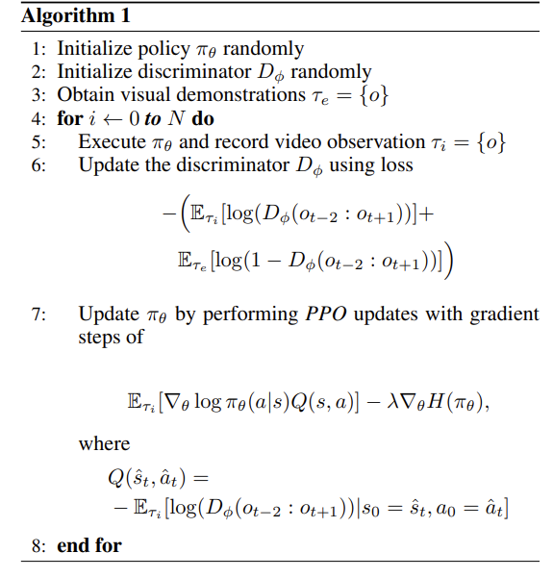
State Occupancy Matching
[31] does so with a “condition variable” vary for different tasks, for fast adaption; [32] does so with AIRL and stacks of 4 consecutive steps; [33] uses GAIL with mixture-of-experts [34]; [35, 36] only matches current state
Demonstration with state only
Demonstration with action
Notes:
[31] 37.Learning human behaviors from motion capture by adversarial imitation
[32] 51.Imitation learning from video by leveraging proprioception
[33] 35.Optiongan: Learning joint reward-policy options using generative adversarial inverse reinforcement learning
[34] https://zhuanlan.zhihu.com/p/335024684
[35] 9.Third-person imitation learning
[36] 22.STATE ALIGNMENT-BASED IMITATION LEARNING (uses Wasserstein distance)

Slide 26
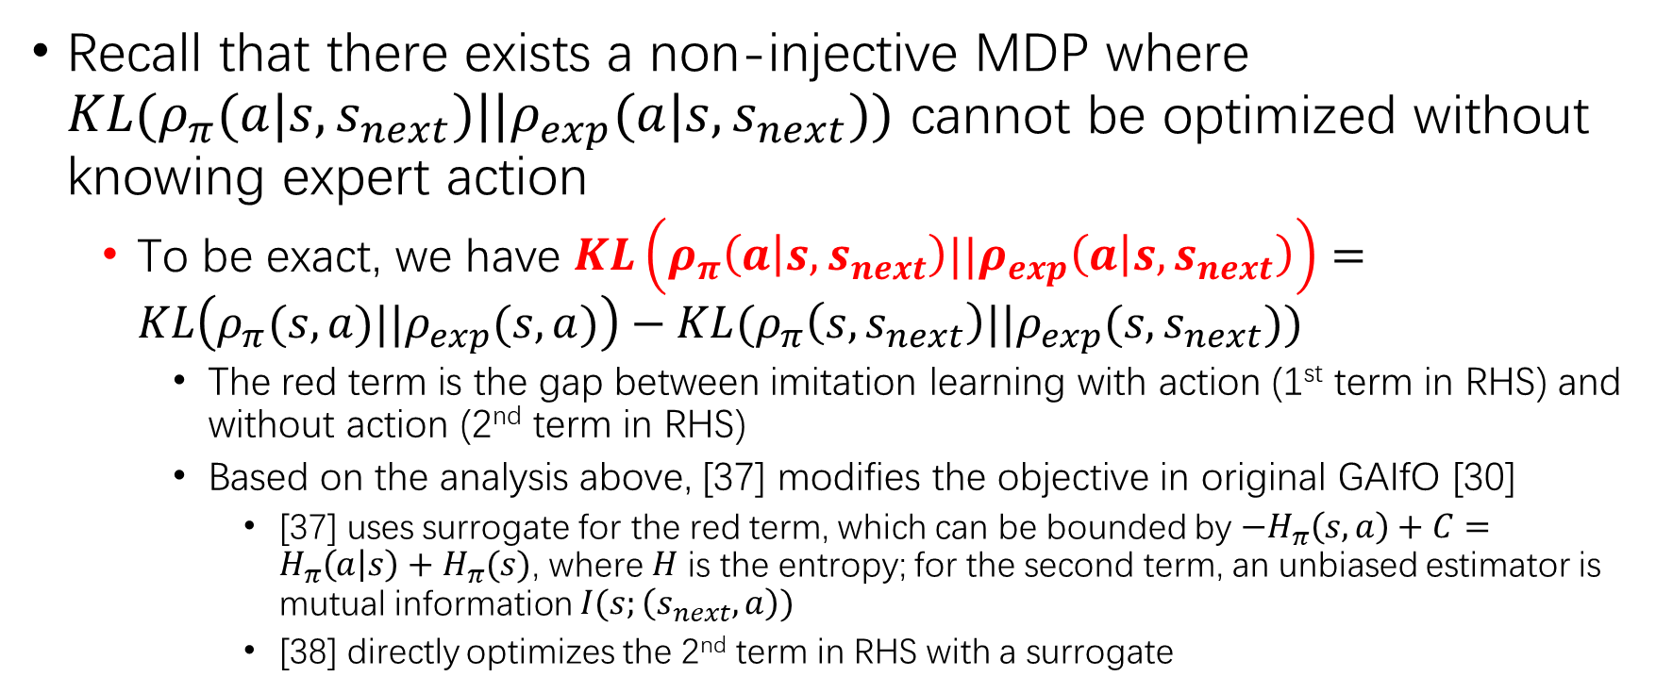
Revisit: Limitation of Inverse Dynamics Model
Recall that there exists a non-injective MDP where $KL(ρ_{π}(a|s,s_{next})||ρ_{exp}(a|s,s_{next}))$ cannot be optimized without knowing expert action
To be exact, we have $KL\left(ρ_{π}\left(a | s, s_{next}\right)||ρ_{exp}\left(a | s,s_{next}\right)\right)=KL\left(ρ_{π}(s,a)||ρ_{exp}(s,a)\right)−KL(ρ_{π}\left(s,s_{next}\right)||ρ_{exp}(s,s_{next}))$
The red term is the gap between imitation learning with action (1st term in RHS) and without action (2nd term in RHS)
Based on the analysis above, [37] modifies the objective in original GAIfO [30]
[37] uses surrogate for the red term, which can be bounded by $−H_{π}\left(s,a\right)+C=H_{π}\left(a | s\right)+H_{π}(s)$, where $H$ is the entropy; for the second term, an unbiased estimator is mutual information $I(s;\left(s_{next},a\right))$
[38] directly optimizes the 2nd term in RHS with a surrogate
Notes:
[37] 11. Imitation learning from observations by minimizing inverse dynamics disagreement.
[38] 25. Off-Policy Imitation Learning from Observations

Slide 27
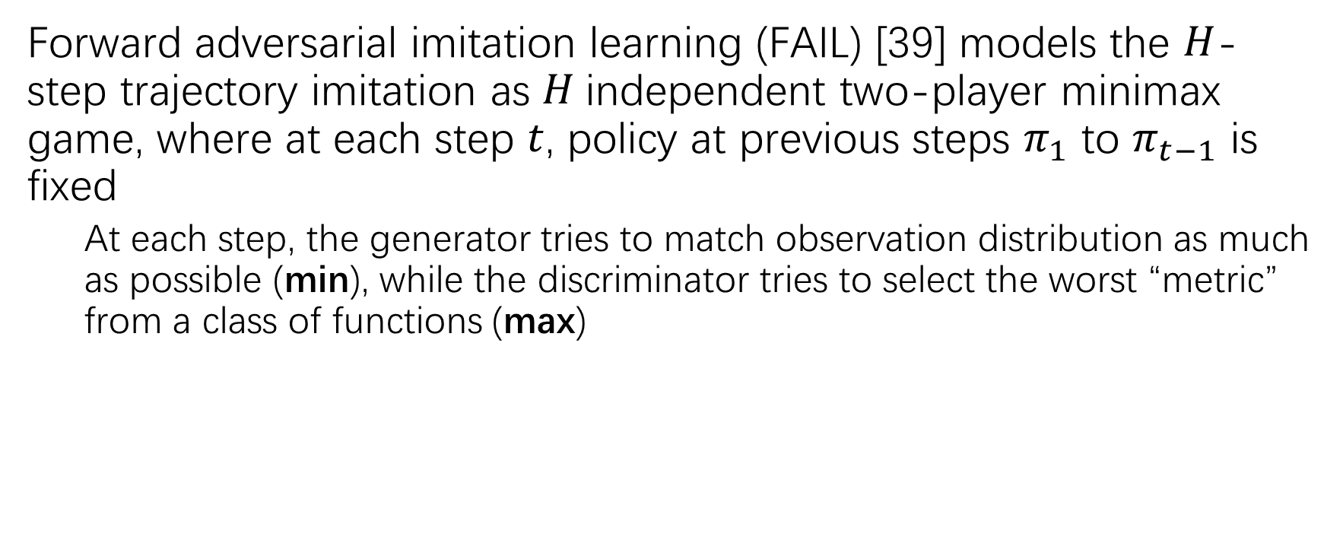
Similar Minor Direction
Forward adversarial imitation learning (FAIL) [39] models the $H$-step trajectory imitation as $H$independent two-player minimax game, where at each step $t$, policy at previous steps $π_{1}$ to $π_{t−1}$ is fixed
At each step, the generator tries to match observation distribution as much as possible (min), while the discriminator tries to select the worst “metric” from a class of functions (max)
Notes:
[39] 3.Provably Efficient Imitation Learning from Observation Alone

Slide 28
Other Minor Directions
Nearest neighbour + Local regression [21]
Need action in the task-agnostic dataset and only state in the task-specific dataset
deep net only used in state embedding
Meta-learning (MAML) [40, 41]
Usually requires state-action sequence at meta-training, and state at meta-testing
Bi-level optimization [42]
Hierarchical reinforcement learning [43]
Low-level policy learns to achieve goal proposed by the high-level policy; high-level policy selects a state in the demonstration that has the highest value by the low-level policy
Causal inference [44]
Object detection + Topological graph maintenance [45]
Maintain a graph representation by detecting the movement of the object of interest
Unsupervised event detection + Topological sort [46]
Dataset gives a graph; the task can be seen as finding a path through the graph
Transfer Dynamics from Human to Robot [47]
Use human demonstration to predict next state of robot doing a particular action
Subgoal Proposer with Low-level policy [48]
With symbolic guidance on the prerequisite of tasks in the dataset
Notes:
13.A Geometric Perspective on Visual Imitation Learning (see following slides) (?)
18, 24, 43, 12 (proposer is learned in dataset to form a graph, and the low-level controller recognizes where the current node is in the graph)
[40] 21. One-Shot Visual Imitation Learning via Meta-Learning
[41] 27. One-shot learning of multi-step tasks from observation via activity localization in auxiliary video
[42] 1. Provable Representation Learning for Imitation Learning via Bi-level Optimization
[43] 43.To follow or not to follow: Selective imitation learning from observations
[44] 19. Imitating latent policies from observation
[45] 13.A Geometric Perspective on Visual Imitation Learning
[46] 12. Neural Task Graphs: Generalizing to Unseen Tasks from a Single Video Demonstration
[47] 24. Third-person visual imitation learning via decoupled hierarchical controller (predict change in pixels)
[48] 18. Regression Planning Networks

Slide 29
Conclusions and Takeaways
Learning from observation is a well-established literature with many works that can be mainly categorized into three directions:
Inverse dynamics model: pseudo-labeling the missing action in expert demonstration
Reward assignment: reward the agent upon reaching key states “similar” to expert demonstration
Similarity is usually in a learned embedding space
In robotics, similarity usually includes learning across different embodiment
Similarity often requires frames to be aligned, which can be either time-aligned or aligned using self-supervised learning
“key” can be any state, some state with fixed interval, or the end of “event” discovered by self-supervised learning
State occupancy matching: variant of GAIL, fitting a slightly different measure

Slide 30
Reference
[1] Michael Bain and Claude Sammut. A Framework for Behavioural Cloning. In Machine Intelligence 15, Intelligent Agents, 1995.
[2] Jonathan Ho, Stefano Ermon. Generative Adversarial Imitation Learning. In NIPS, 2016.
[3] Sebastian Nowozin, Botond Cseke, Ryota Tomioka. f-GAN: Training Generative Neural Samplers using Variational Divergence Minimization. In NIPS, 2016.
[4] Justin Fu, Katie Luo, Sergey Levine. Learning Robust Rewards with Adverserial Inverse Reinforcement Learning. In ICLR, 2018.
[5] Seyed Kamyar Seyed Ghasemipour, Richard Zemel, Shixiang Gu. A Divergence Minimization Perspective on Imitation Learning Methods. In CoRL, 2019.
[6] Sarah Young, Dhiraj Gandhi, Shubham Tulsiani, Abhinav Gupta, Pieter Abbeel, Lerrel Pinto. Visual Imitation Made Easy. In CoRL, 2020.
[7] Karl Schmeckpeper, Oleh Rybkin, Kostas Daniilidis, Sergey Levine, Chelsea Finn. Reinforcement learning with videos: Combining offline observations with interaction. In CoRL, 2020.
[8] Rafael Rafailov, Tianhe Yu, Aravind Rajeswaran, Chelsea Finn. Visual Adversarial Imitation Learning using Variational Models. In NeurIPS, 2021.
[9] Ilija Radosavovic, Xiaolong Wang, Lerrel Pinto, Jitendra Malik. State-only imitation learning for dexterous manipulation. In ICML Workshop on Unsupervised Reinforcement Learning, 2021.
[10] Faraz Torabi, Garrett Warnell, Peter Stone. Behavior cloning from observation. In IJCAI, 2018.
[11] Brahma S. Pavse, Faraz Torabi, Josiah P. Hanna, Garrett Warnell, Peter Stone. RIDM: Reinforced inverse dynamics modeling for learning from a single observed demonstration. In IROS, 2020.
[12] Xiaoxiao Guo, Shiyu Chang, Mo Yu, Gerald Tesauro, Murray Campbell. Hybrid reinforcement learning with expert state sequences. In AAAI, 2019.
[13] Ashvin Nair, Dian Chen, Pulkit Agrawal, Phillip Isola, Pieter Abbeel, Jitendra Malik, Sergey Levine. Combining self-supervised learning and imitation for vision-based rope manipulation. In ICRA, 2017.
[14] Ashish Kumar, Saurabh Gupta, Jitendra Malik. Learning Navigation Subroutines from Egocentric Videos. In CoRL, 2019.
[15] Matthew Chang, Arjun Gupta, Saurabh Gupta. Semantic Visual Navigation by Watching YouTube Videos. In NeurIPS, 2020.
[16] Rahul Kidambi, Jonathan Chang, Wen Sun. MobILE: Model-Based Imitation Learning From Observation Alone. In NeurIPS, 2021.
[17] Zhuangdi Zhu, Kaixiang Lin, Bo Dai, Jiayu Zhou. Off-Policy Imitation Learning from Observations. In NeurIPS, 2021.
[18] Faraz Torabi, Garrett Warnell, Peter Stone. Recent Advances in Imitation Learning from Observation. In IJCAI, 2019.
Notes:
[7] 8. Reinforcement learning with videos: Combining offline observations with interaction.
[8] 17.Visual Adversarial Imitation Learning using Variational Models
[9] 30. State-only imitation learning for dexterous manipulation
[10] 38. Behavior cloning from observation
[13] 47. Combining self-supervised learning and imitation for vision-based rope manipulation
[11] 48. RIDM: Reinforced inverse dynamics modeling for learning from a single observed demonstration
[14] 49.Learning Navigation Subroutines from Egocentric Videos
[15] 50. Semantic Visual Navigation by Watching YouTube Videos
[12] 41. Hybrid reinforcement learning with expert state sequences
[16] 4.MobILE: Model-Based Imitation Learning From Observation Alone (2021)

Slide 31
Reference
[19] Annie S. Chen, Suraj Nair, Chelsea Finn. Learning Generalizable Robotic Reward Functions from “In-The-Wild” Human Videos. In Robotics: Science and Systems, 2021.
[20] Pierre Sermanet, Corey Lynch, Yevgen Chebotar, Jasmine Hsu, Eric Jang, Stefan Schaal, Sergey Levine. Time Contrastive Networks. In CVPRW, 2017.
[21] Jyothish Pari, Nur Muhammad Shafiullah, Sridhar Pandian Arunachalam, Lerrel Pinto. The Surprising Effectiveness of Representation Learning for Visual Imitation. In RSS, 2022.
[22] Yusuf Aytar, Tobias Pfaff, David Budden, Tom Le Paine, Ziyu Wang, Nando de Freitas. Playing hard exploration games by watching YouTube. In NeurIPS, 2018.
[23] Laura Smith, Nikita Dhawan, Marvin Zhang, Pieter Abbeel, Sergey Levine. AVID: Learning Multi-Stage Tasks via Pixel-Level Translation of Human Videos. In RSS, 2020.
[24] Jun-Yan Zhu, Taesung Park, Phillip Isola, Alexei A. Efros. Unpaired Image-to-Image Translation using Cycle-Consistent Adversarial Networks. In ICCV, 2017.
[25] Abhishek Gupta, Coline Devin, YuXuan Liu, Pieter Abbeel, Sergey Levine. Learning Invariant Feature Spaces to Transfer Skills with Reinforcement Learning. In ICLR, 2017.
[26] YuXuan Liu, Abhishek Gupta, Pieter Abbeel, Sergey Levine. Imitation from Observation: Learning to Imitate Behaviors from Raw Video via Context Translation. In ICRA, 2018.
[27] Kevin Zakka, Andy Zeng, Pete Florence, Jonathan Tompson, Jeannette Bohg, Debidatta Dwibedi. XIRL: Cross-embodiment Inverse Reinforcement Learning. In CoRL, 2021.
[28] Youngwoon Lee, Andrew Szot, Shao-Hua Sun, Joseph J. Lim. Generalizable Imitation Learning from Observation via Inferring Goal Proximity. In NeurIPS, 2021.
[29] Daniel S. Brown, Wonjoon Goo, Prabhat Nagarajan, Scott Niekum. Extrapolating beyond suboptimal demonstrations via inverse reinforcement learning from observations. In ICML, 2019.
[30] Faraz Torabi, Garrett Warnell, Peter Stone. Generative Adversarial Imitation from Observation GAIL with observation alone. In ICML Workshop on Imitation, Intent, and Interaction, 2019.
[31] Josh Merel, Yuval Tassa, Dhruva TB, Sriram Srinivasan, Jay Lemmon, Ziyu Wang, Greg Wayne, Nicolas Heess. Learning human behaviors from motion capture by adversarial imitation. In arXiv, 2017.
[32] Faraz Torabi, Garrett Warnell, Peter Stone. Imitation learning from video by leveraging proprioception. In IJCAI, 2019.
[33] Peter Henderson, Wei-Di Chang, Pierre-Luc Bacon, David Meger, Joelle Pineau, Doina Precup. Optiongan: Learning joint reward-policy options using generative adversarial inverse reinforcement learning. In AAAI, 2018.
[34] https://zhuanlan.zhihu.com/p/335024684
[35] Pratyusha Sharma, Deepak Pathak, Abhinav Gupta. Third-person imitation learning. In NeurIPS, 2019.
[36] Fangchen Liu, Zhan Ling, Tongzhou Mu, Hao Su. State Alignment-based Imitation Learning. In ICLR, 2020.
Notes:
XIRL: Cross-embodiment Inverse Reinforcement Learning is CoRL 2021 best paper candidate!

Slide 32
Reference
[37] Chao Yang, Xiaojian Ma, Wenbing Huang, Fuchun Sun, Huaping Liu, Junzhou Huang, Chuang Gan. Imitation learning from observations by minimizing inverse dynamics disagreement. In NeurIPS, 2019.
[38] Zhuangdi Zhu, Kaixiang Lin, Bo Dai, Jiayu Zhou. Off-Policy Imitation Learning from Observations. In NeurIPS, 2020.
[39] Wen Sun, Anirudh Vemula, Byron Boots, J. Andrew Bagnell. Provably Efficient Imitation Learning from Observation Alone. In ICML, 2019.
[40] Chelsea Finn, Tianhe Yu, Tianhao Zhang, Pieter Abbeel, Sergey Levine. One-Shot Visual Imitation Learning via Meta-Learning. In CoRL, 2017.
[41] Wonjoon Goo, Scott Niekum. One-shot learning of multi-step tasks from observation via activity localization in auxiliary video. In ICRA, 2019.
[42] Sanjeev Arora, Simon S. Du, Sham Kakade, Yuping Luo, Nikunj Saunshi. Provable Representation Learning for Imitation Learning via Bi-level Optimization. In arXiv, 2020.
[43] Youngwoon Lee, Edward S. Hu, Zhengyu Yang, and Joseph J. Lim. To follow or not to follow: Selective imitation learning from observations. In CoRL, 2019.
[44] Ashley D. Edwards, Himanshu Sahni, Yannick Schroecker, Charles L. Isbell. Imitating latent policies from observation. In ICML, 2019.
[45] Jun Jin, Laura Petrich, Masood Dehghan, Martin Jagersand. A Geometric Perspective on Visual Imitation Learning. In IROS, 2020.
[46] De-An Huang, Suraj Nair, Danfei Xu, Yuke Zhu, Animesh Garg, Li Fei-Fei, Silvio Savarese, Juan Carlos Niebles. Neural Task Graphs: Generalizing to Unseen Tasks from a Single Video Demonstration. In CVPR, 2019.
[47] Pratyusha Sharma, Deepak Pathak, Abhinav Gupta. Third-person visual imitation learning via decoupled hierarchical controller. In NeurIPS, 2019.
[48] Danfei Xu, Roberto Martín-Martín, De-An Huang, Yuke Zhu, Silvio Savarese, Li Fei-Fei. Regression Planning Networks. In NeurIPS, 2019.
[49] D. Dwibedi, Y. Aytar, J. Tompson, P. Sermanet, A. Zisserman. Temporal cycle-consistency learning. In CVPR, 2019.
[50] Fan Yang, Alina Vereshchaka, Yufan Zhou, Changyou Chen, Wen Dong. Variational Adversarial Kernel Learned Imitation Learning. In AAAI, 2020.

Slide 33
Thank you!
Any questions?

