Slide 1
Introduction
This Project aim to create an analysis of features for a people migrating to Scarborough to search a best neighborhood as a comparative analysis between neighborhoods.
It will help people to get awareness of the area and neighborhood before moving to a new city, state, country or place for their work or to start a new fresh life.

Slide 2
Data Section
Source of Data:
Link: https://en.wikipedia.org/wiki/List_of_postal_codes_of_Canada:_M
Will use Scarborough dataset which wescrapped from wikipedia on Week 3. Dataset consisting of latitude and longitude, zip codes.

Slide 3
Methodology
Clustering Approach:
To compare the similarities of two cities, we decided to explore neighborhoods, segment them, and group them into clusters to find similar neighborhoods in a big city like New York and Toronto. To be able to do that, we need to cluster data which is a form of unsupervised machine learning: k-means clustering algorithm.

Slide 4
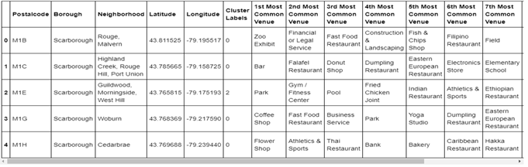
Using K-Means Clustering Approach

Slide 5
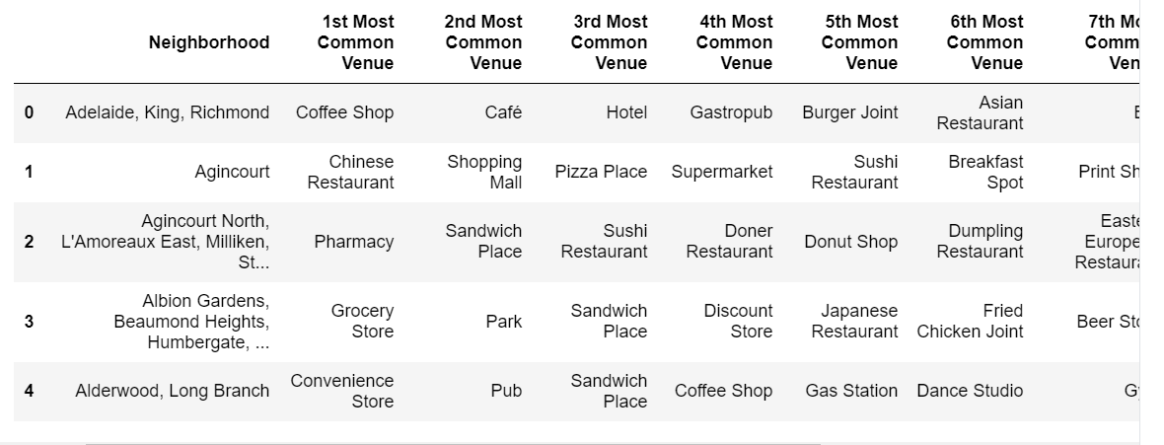
Most Common venues near Neighborhood

Slide 6
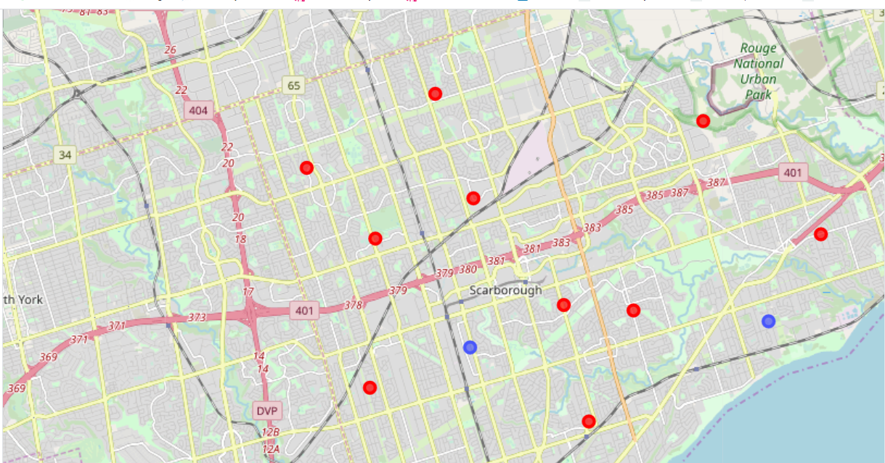
Results
Map of Clusters in Scarborough

Slide 7
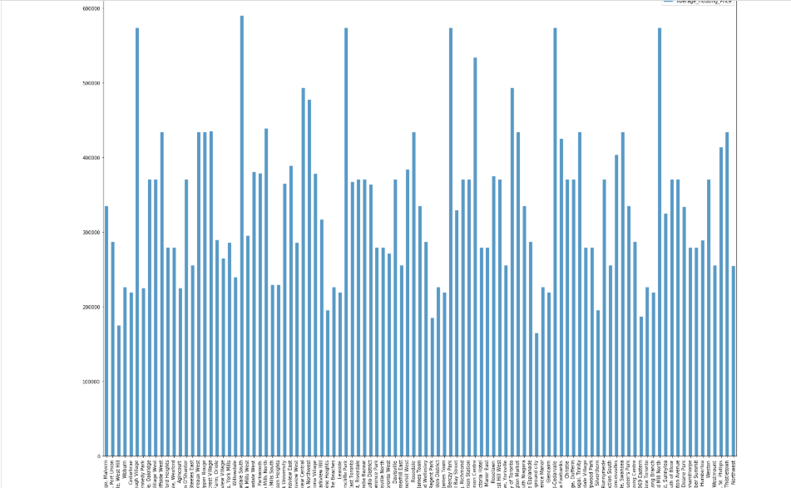
Average Housing Price by Clusters in Scarborough

Slide 8
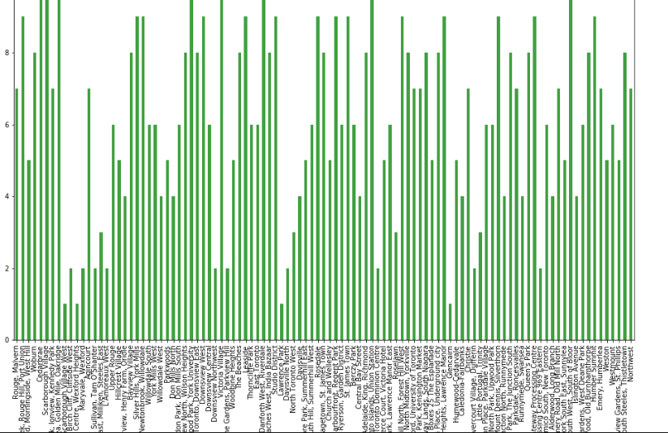
School Ratings by Clusters in Scarborough

Slide 9
The Location
Scarborough is a popular destination for new immigrants in Canada to reside. As a result, it is one of the most diverse and multicultural areas in the Greater Toronto Area, being home to various religious groups and places of worship.

Slide 10
Foursquare API
This project have used Four-square API as its prime data gathering source as it has a database of millions of places, especially their places API which provides the ability to perform location search, location sharing and details about a business

Slide 11
Conclusion
This project, using k-means cluster algorithm I separated the neighborhood into 10(Ten) different clusters and for 103 different lattitude and logitude from dataset, which have very-similar neighborhoods around them. Using the charts above results presented to a particular neighborhood based on average house prices and school rating have been made

Slide 12
Future Work
This project can be continued for making it more precise in terms to find best house in Scarborough. Best means on the basis of all required things(daily needs or things we need to live a better life) around and also in terms of cost effective

