Slide 1
Sparse Matrix Methods
Day 1: Overview
Day 2: Direct methods
  Nonsymmetric systems
  Graph theoretic tools
  Sparse LU with partial pivoting
  Supernodal factorization (SuperLU)
  Multifrontal factorization (MUMPS)
  Remarks
Day 3: Iterative methods

Slide 2
GEPP: Gaussian elimination w/ partial pivoting
P
=
x
PA = LU
Sparse, nonsymmetric A
Columns may be preordered for sparsity
Rows permuted by partial pivoting (maybe)
High-performance machines with memory hierarchy

Slide 3
Symmetric Positive Definite: A=R^{T}R [Parter, Rose]
symmetric
for j = 1 to n
add edges between j’s
higher-numbered neighbors
1
3
7
1
3
7
8
6
8
6
4
10
4
10
fill = # edges in G⁺
9
5
2
9
5
2
G(A)
G⁺(A)
[chordal]

Slide 4
Symmetric Positive Definite: A=R^{T}R
Preorder
  Independent of numerics
Symbolic Factorization
  Elimination tree
  Nonzero counts
  Supernodes
  Nonzero structure of R
Numeric Factorization
  Static data structure
  Supernodes use BLAS3 to reduce memory traffic
Triangular Solves
}
O(#nonzeros in A), almost
O(#nonzeros in R)
O(#flops)

Slide 5
Modular Left-looking LU
Alternatives:
  Right-looking Markowitz [Duff, Reid, . . .]
  Unsymmetric multifrontal [Davis, . . .]
  Symmetric-pattern methods [Amestoy, Duff, . . .]
Complications:
  Pivoting => Interleave symbolic and numeric phases
    Preorder Columns
    Symbolic Analysis
    Numeric and Symbolic Factorization
    Triangular Solves
  Lack of symmetry => Lots of issues . . .

Slide 6
Symmetric A implies G⁺(A) is chordal,
with lots of structure and elegant theory
For unsymmetric A, things are not as nice
No known way to compute G⁺(A) faster than
Gaussian elimination
No fast way to recognize perfect elimination graphs
No theory of approximately optimal orderings
Directed analogs of elimination tree:
Smaller graphs that preserve path structure
[Eisenstat, G, Kleitman, Liu, Rose, Tarjan]

Slide 7
Directed Graph
1
2
4
7
5
3
6
A
G(A)
A is square, unsymmetric, nonzero diagonal
Edges from rows to columns
Symmetric permutations PAP^{T}

Slide 8
Symbolic Gaussian Elimination [Rose, Tarjan]
1
2
4
7
5
3
6
A
+
L+U
G (A)
Add fill edge a -> b if there is a path from a to b through lower-numbered vertices.

Slide 9
Structure Prediction for Sparse Solve
1
2
=
4
7
5
3
6
A
x
b
G(A)
Given the nonzero structure of b, what is the structure of x?
Vertices of G(A) from which there is a path to a vertex of b.

Slide 10
Sparse Triangular Solve
1
1
2
3
4
5
=
2
3
5
4
L
x
b
G(L^{T})
Symbolic:
  Predict structure of x by depth-first search from nonzeros of b
Numeric:
  Compute values of x in topological order
Time = O(flops)

Slide 11
Left-looking Column LU Factorization
j
for column j = 1 to n do
  solve
  pivot: swap u_{jj} and an elt of l_{j}
  scale: l_{j} = l_{j} / u_{jj}
U
( )
( )
L 0
L I
u_{j}
l_{j}
L
= a_{j} for u_{j}, l_{j}
A
L
Column j of A becomes column j of L and U

Slide 12
GP Algorithm [G, Peierls; Matlab 4]
Left-looking column-by-column factorization
Depth-first search to predict structure of each column
+: Symbolic cost proportional to flops
-: BLAS-1 speed, poor cache reuse
-: Symbolic computation still expensive
=> Prune symbolic representation

Slide 13
Symmetric Pruning [Eisenstat, Liu]
Idea: Depth-first search in a sparser graph with the same path structure
r
j
k
Symmetric pruning:
Set L_{sr}=0 if L_{jr}U_{rj} ≠ 0
Justification:
A_{sk} will still fill in
r
= fill
j
= pruned
= nonzero
s
Use (just-finished) column j of L to prune earlier columns
No column is pruned more than once
The pruned graph is the elimination tree if A is symmetric

Slide 14
GP-Mod Algorithm [Matlab 5-6]
Left-looking column-by-column factorization
Depth-first search to predict structure of each column
Symmetric pruning to reduce symbolic cost
+: Symbolic factorization time much less than arithmetic
-: BLAS-1 speed, poor cache reuse
=> Supernodes

Slide 15
Symmetric Supernodes [Ashcraft, Grimes, Lewis, Peyton, Simon]
Supernode = group of (contiguous) factor columns with nested structures
Related to clique structure
of filled graph G⁺(A)
{
Supernode-column update: k sparse vector ops become
1 dense triangular solve
+ 1 dense matrix * vector
+ 1 sparse vector add
Sparse BLAS 1 => Dense BLAS 2

Slide 16
Nonsymmetric Supernodes
1
1
2
2
3
3
4
4
5
5
6
6
7
7
8
8
9
9
10
10
Original matrix A
Factors L+U

Slide 17
Supernode-Panel Updates
j
j+w-1
for each panel do
  Symbolic factorization:
  which supernodes update the panel;
  Supernode-panel update:
  for each updating supernode do
    for each panel column do
    supernode-column update;
  Factorization within panel:
  use supernode-column algorithm
}
}
supernode
panel
+: “BLAS-2.5” replaces BLAS-1
-: Very big supernodes don’t fit in cache
=> 2D blocking of supernode-column updates

Slide 18
Sequential SuperLU [Demmel, Eisenstat, G, Li, Liu]
Depth-first search, symmetric pruning
Supernode-panel updates
1D or 2D blocking chosen per supernode
Blocking parameters can be tuned to cache architecture
Condition estimation, iterative refinement, componentwise error bounds

Slide 19
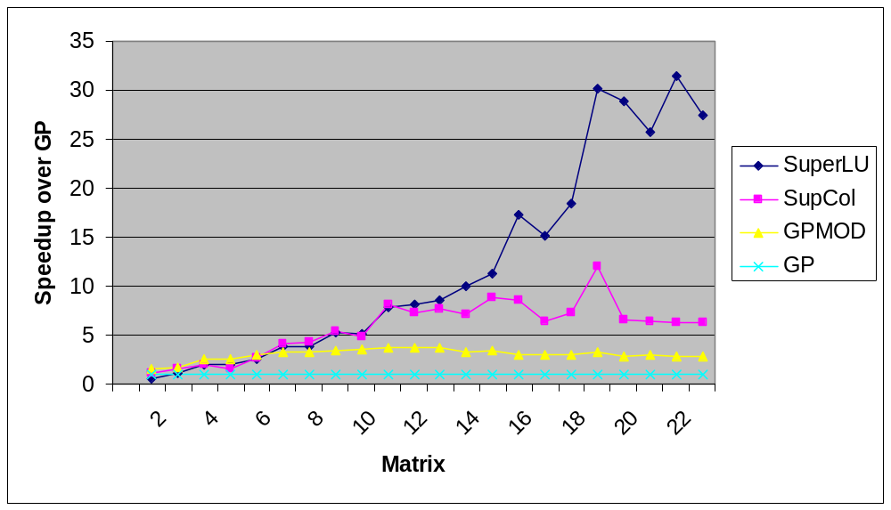
SuperLU: Relative Performance
Speedup over GP column-column
22 matrices: Order 765 to 76480; GP factor time 0.4 sec to 1.7 hr
SGI R8000 (1995)

Slide 20
Column Intersection Graph
1
2
3
4
5
1
2
3
4
5
3
1
2
4
5
3
4
5
1
2
A
A^{T}A
G∩(A)
G∩(A) = G(A^{T}A) if no cancellation (otherwise ⊇)
Permuting the rows of A does not change G∩(A)

Slide 21
Filled Column Intersection Graph
1
2
3
4
5
1
2
3
4
5
3
1
2
4
5
3
4
5
1
2
A
chol(A^{T}A)
+
G∩(A)
G∩(A) = symbolic Cholesky factor of A^{T}A
In PA=LU, G(U) ⊆ G∩(A) and G(L) ⊆ G∩(A)
Tighter bound on L from symbolic QR
Bounds are best possible if A is strong Hall
[George, G, Ng, Peyton]
+
+
+

Slide 22
Column Elimination Tree
5
1
2
3
4
5
1
2
3
4
5
1
4
2
3
2
3
4
5
1
A
chol(A^{T}A)
T∩(A)
Elimination tree of A^{T}A (if no cancellation)
Depth-first spanning tree of G∩(A)
Represents column dependencies in various factorizations
+

Slide 23
Column Dependencies in PA = LU
If column j modifies column k, then j ∈ T∩[k]. [George, Liu, Ng]
k
j
T∩[k]
If A is strong Hall then, for some pivot sequence, every column modifies its parent in T∩(A). [G, Grigori]

Slide 24
Efficient Structure Prediction
Given the structure of (unsymmetric) A, one can find . . .
  column elimination tree T∩(A)
  row and column counts for G∩(A)
  supernodes of G∩(A)
  nonzero structure of G∩(A)
. . . without forming G∩(A) or A^{T}A
[G, Li, Liu, Ng, Peyton; Matlab]
+
+
+

Slide 25
Shared Memory SuperLU-MT [Demmel, G, Li]
1D data layout across processors
Dynamic assignment of panel tasks to processors
Task tree follows column elimination tree
Two sources of parallelism:
  Independent subtrees
  Pipelining dependent panel tasks
Single processor “BLAS 2.5” SuperLU kernel
Good speedup for 8-16 processors
Scalability limited by 1D data layout

Slide 26
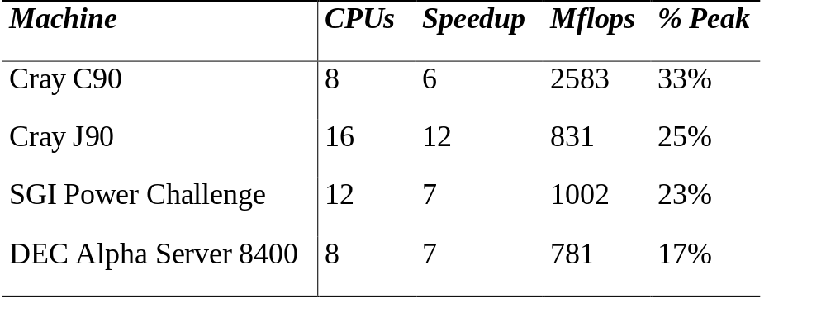
SuperLU-MT Performance Highlight (1999)
3-D flow calculation (matrix EX11, order 16614):

Slide 27
Column Preordering for Sparsity
Q
P
=
x
PAQ^{T} = LU: Q preorders columns for sparsity, P is row pivoting
Column permutation of A ⬄ Symmetric permutation of A^{T}A (or G∩(A))
Symmetric ordering: Approximate minimum degree [Amestoy, Davis, Duff]
But, forming A^{T}A is expensive (sometimes bigger than L+U).
Solution: ColAMD: ordering A^{T}A with data structures based on A

Slide 28
Column AMD [Davis, G, Ng, Larimore; Matlab 6]
row
col
1
1
1
2
3
4
5
1
I
A
2
2
row
2
3
3
3
4
col
A^{T}
0
4
4
5
5
5
A
aug(A)
G(aug(A))
Eliminate “row” nodes of aug(A) first
Then eliminate “col” nodes by approximate min degree
4x speed and 1/3 better ordering than Matlab-5 min degree,
2x speed of AMD on A^{T}A
Question: Better orderings based on aug(A)?

Slide 29
SuperLU-dist: GE with static pivoting [Li, Demmel]
Target: Distributed-memory multiprocessors
Goal: No pivoting during numeric factorization
Permute A unsymmetrically to have large elements on the diagonal (using weighted bipartite matching)
Scale rows and columns to equilibrate
Permute A symmetrically for sparsity
Factor A = LU with no pivoting, fixing up small pivots:
  if |a_{ii}| < ε · ||A|| then replace a_{ii} by ±ε^{1/2} · ||A||
Solve for x using the triangular factors: Ly = b, Ux = y
Improve solution by iterative refinement

Slide 30
Row permutation for heavy diagonal [Duff, Koster]
1
2
3
4
5
1
2
3
4
5
1
1
1
4
2
2
2
5
3
3
3
3
4
1
5
4
4
2
A
5
5
PA
Represent A as a weighted, undirected bipartite graph (one node for each row and one node for each column)
Find matching (set of independent edges) with maximum product of weights
Permute rows to place matching on diagonal
Matching algorithm also gives a row and column scaling
to make all diag elts =1 and all off-diag elts <=1

Slide 31
Iterative refinement to improve solution
Iterate:
r = b – A*x
backerr = max_{i} ( r_{i} / (|A|*|x| + |b|)_{i} )
if backerr < ε or backerr > lasterr/2 then stop iterating
solve L*U*dx = r
x = x + dx
lasterr = backerr
repeat
Usually 0 – 3 steps are enough

Slide 32
SuperLU-dist: Distributed static data structure
0
1
2
0
1
2
0
3
4
5
3
4
5
3
0
1
2
0
1
2
0
1
2
0
U
3
4
5
3
4
5
3
4
5
3
0
1
2
0
1
2
0
L
Process(or) mesh
3
4
5
3
4
5
3
0
1
2
0
1
2
0
Block cyclic matrix layout

Slide 33
Question: Preordering for static pivoting
Less well understood than symmetric factorization
  Symmetric: bottom-up, top-down, hybrids
  Nonsymmetric: top-down just starting to replace bottom-up
  Symmetric: best ordering is NP-complete, but approximation theory is based on graph partitioning (separators)
  Nonsymmetric: no approximation theory is known;
  partitioning is not the whole story

Slide 34
Symmetric-pattern multifrontal factorization
1
4
G(A)
7
3
6
1
2
3
4
5
6
7
8
9
8
1
2
2
5
9
3
4
5
6
9
7
T(A)
8
8
7
9
3
6
A
1
2
4
5

Slide 35
Symmetric-pattern multifrontal factorization
1
4
For each node of T from leaves to root:
  Sum own row/col of A with children’s Update matrices into Frontal matrix
  Eliminate current variable from Frontal matrix, to get Update matrix
  Pass Update matrix to parent
G(A)
7
3
6
8
2
5
9
9
T(A)
8
7
3
6
1
2
4
5

Slide 36
Symmetric-pattern multifrontal factorization
1
4
For each node of T from leaves to root:
  Sum own row/col of A with children’s Update matrices into Frontal matrix
  Eliminate current variable from Frontal matrix, to get Update matrix
  Pass Update matrix to parent
G(A)
7
3
6
8
2
5
9
9
T(A)
8
1
3
7
3
7
1
3
7
3
7
3
6
7
1
2
4
5
F₁ = A₁
=> U₁

Slide 37
Symmetric-pattern multifrontal factorization
1
4
For each node of T from leaves to root:
  Sum own row/col of A with children’s Update matrices into Frontal matrix
  Eliminate current variable from Frontal matrix, to get Update matrix
  Pass Update matrix to parent
G(A)
7
3
6
8
2
5
9
9
T(A)
8
1
3
7
3
7
2
3
9
3
9
1
3
2
3
7
3
3
7
9
3
6
7
9
1
2
4
5
F₁ = A₁
=> U₁
F₂ = A₂
=> U₂

Slide 38
Symmetric-pattern multifrontal factorization
1
4
G(A)
7
3
7
8
9
3
6
3
7
8
9
8
7
7
2
5
8
9
8
9
9
F₃ = A₃+U₁+U₂
=> U₃
9
T(A)
8
1
3
7
3
7
2
3
9
3
9
1
3
2
3
7
3
3
7
9
3
6
7
9
1
2
4
5
F₁ = A₁
=> U₁
F₂ = A₂
=> U₂

Slide 39
Symmetric-pattern multifrontal factorization
1
4
Really uses supernodes, not nodes
All arithmetic happens on
dense square matrices.
Needs extra memory for a stack of pending update matrices
Potential parallelism:
  between independent tree branches
  parallel dense ops on frontal matrix
G(A)
7
3
6
8
2
5
9
9
T(A)
8
7
3
6
1
2
4
5

Slide 40
MUMPS: distributed-memory multifrontal
[Amestoy, Duff, L’Excellent, Koster, Tuma]
Symmetric-pattern multifrontal factorization
Parallelism both from tree and by sharing dense ops
Dynamic scheduling of dense op sharing
Symmetric preordering
For nonsymmetric matrices:
  optional weighted matching for heavy diagonal
  expand nonzero pattern to be symmetric
  numerical pivoting only within supernodes if possible
  (doesn’t change pattern)
  failed pivots are passed up the tree in the update matrix

Slide 41
Remarks on (nonsymmetric) direct methods
Combinatorial preliminaries are important: ordering, bipartite matching, symbolic factorization, scheduling
  not well understood in many ways
  also, mostly not done in parallel
Multifrontal tends to be faster but use more memory
Unsymmetric-pattern multifrontal:
  Lots more complicated, not simple elimination tree
  Sequential and SMP versions in UMFpack and WSMP (see web links)
  Distributed-memory unsymmetric-pattern multifrontal is a research topic
Not mentioned: symmetric indefinite problems
Direct-methods technology is also needed in preconditioners for iterative methods

