Slide 1
Exploratory Data Analysis on Election Project by Group 11
Course Code: IT 462
Semester: Winter 2024
Under the guidance of
Dr. Gopinath Panda
Anurag Choudhury Aditya Tripathi KaranSharma
(202318059) (202318046) (202318018)

Slide 2
Purpose
The purpose of this project is to analyse voting patterns, vote share among different genders and to know about the voting infrastructure of different states in each year.
We have analysed the data of each Indian states and union territories in every year from 2008 to 2023 about their legislative assembly election that holds every 5 years.
By doing this we can predict the reason of dissatisfaction from the nota numbers and we can also somewhat predict the impact of female candidates through other information.

Slide 3
Dataset
We have taken a dataset from Election Commission of India website which comprises of 100 rows and 33 columns
In the dataset we have columns such as Reserved SC/ST Seats, Male Voters, Female Voters, State and Union Territory names and respective years, etc.

Slide 4
Data Cleaning
We have used missingno package for analyzing missing values in the dataset.
We also have used simple Imputer for imputing missing values in 4 numeric columns by their median as it is giving the correct estimate.

Slide 5
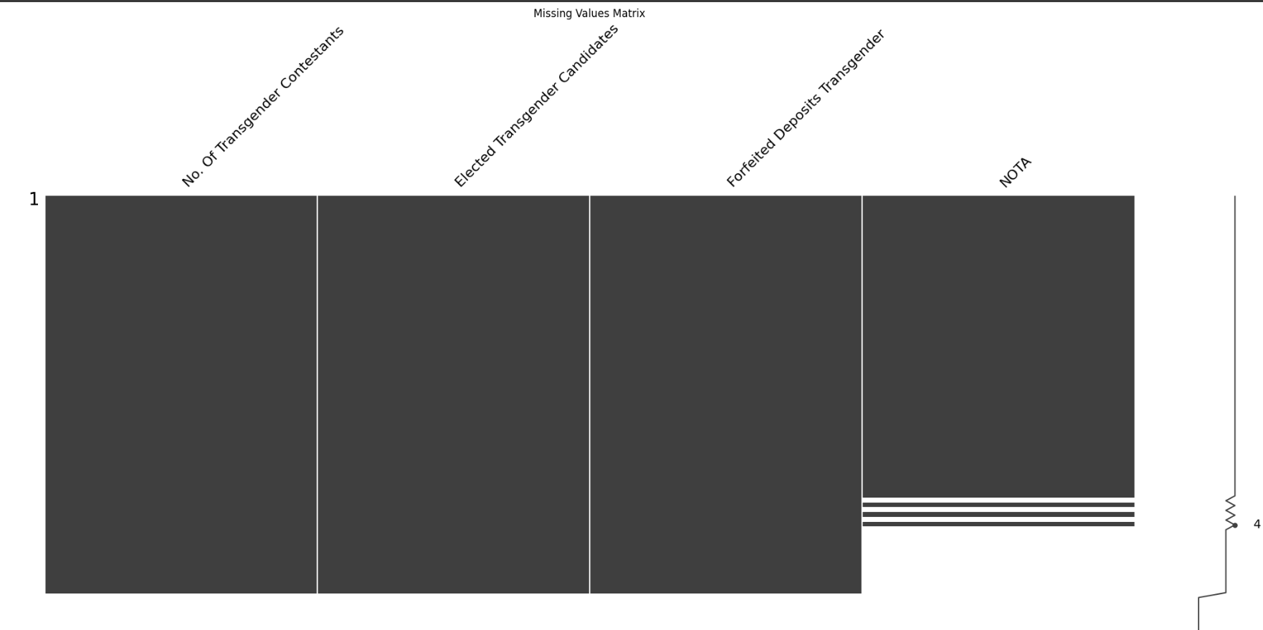
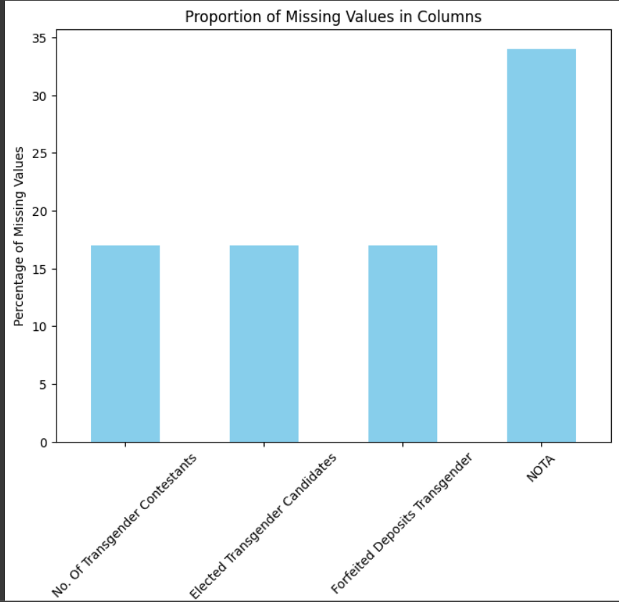
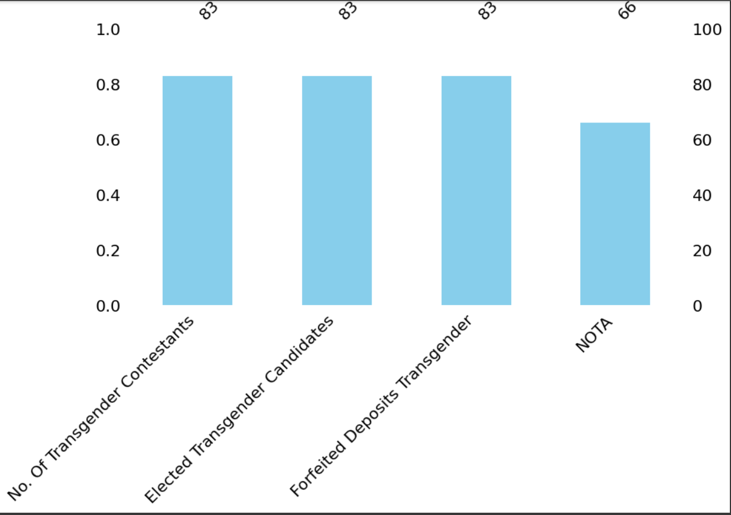
Missing Value Analysis
After conducting a thorough analysis of our dataset, we identified missing values in four key columns:
1. No. Of Transgender Contestants
2. Transgender Candidates
3. Deposits Transgender
4. NOTA (None of the Above)

Slide 6
Observations
The 1st graph represents a msno matrix depicting the missing values.
The 2nd graph represents a bar plot depicting the missing values.
The 3rd graph represents a msno barplot depicting the missing values.
Upon careful examination, it became evident that the column labeled ’NOTA’ exhibited the highest
count of missing values compared to the other three columns.

Slide 7
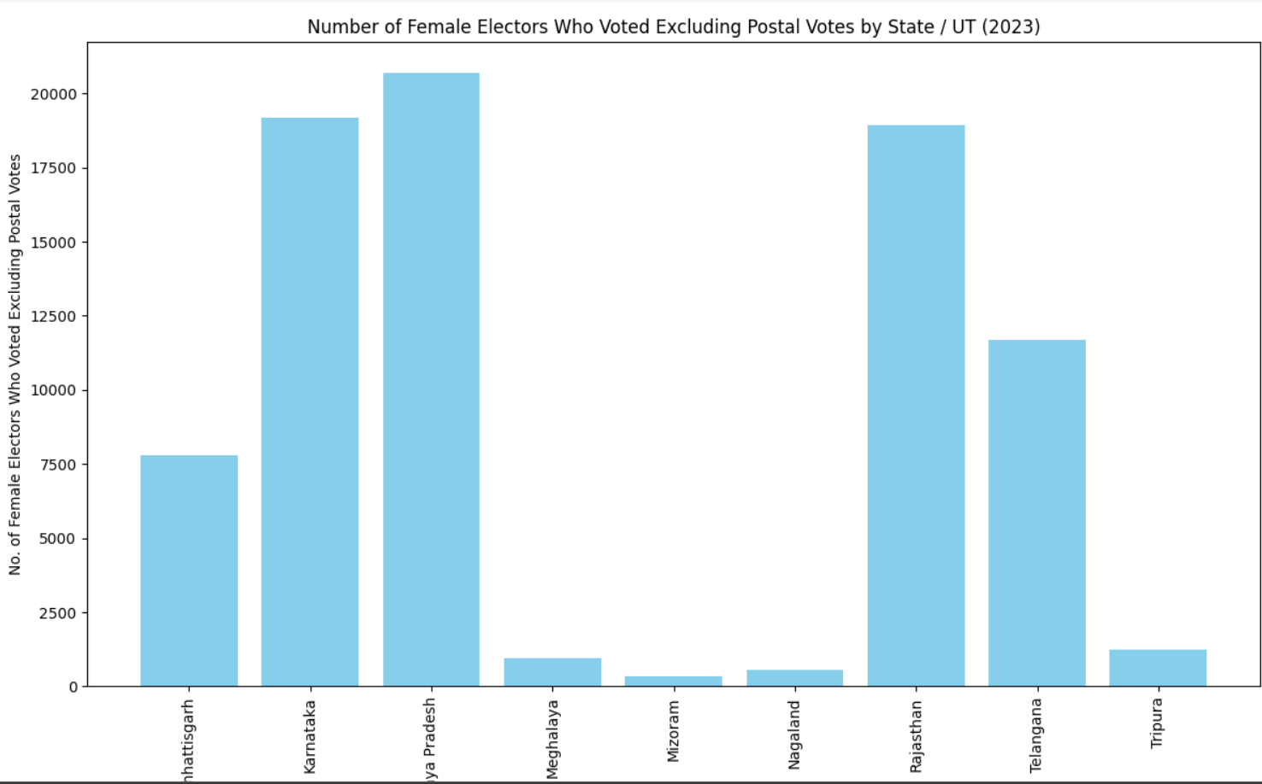
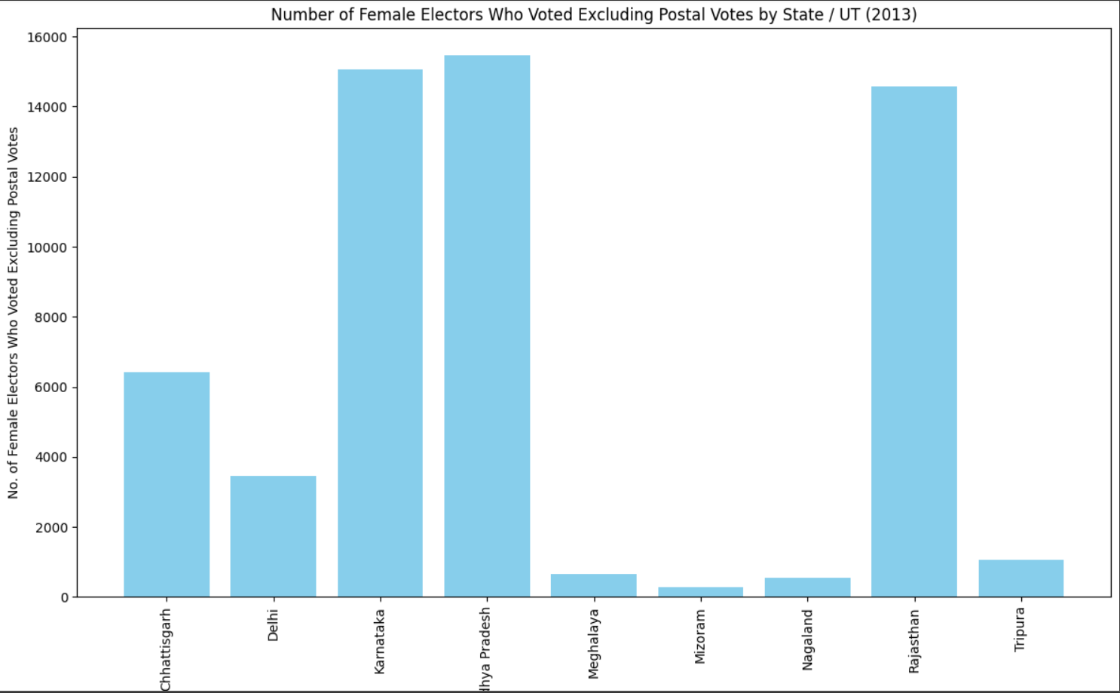
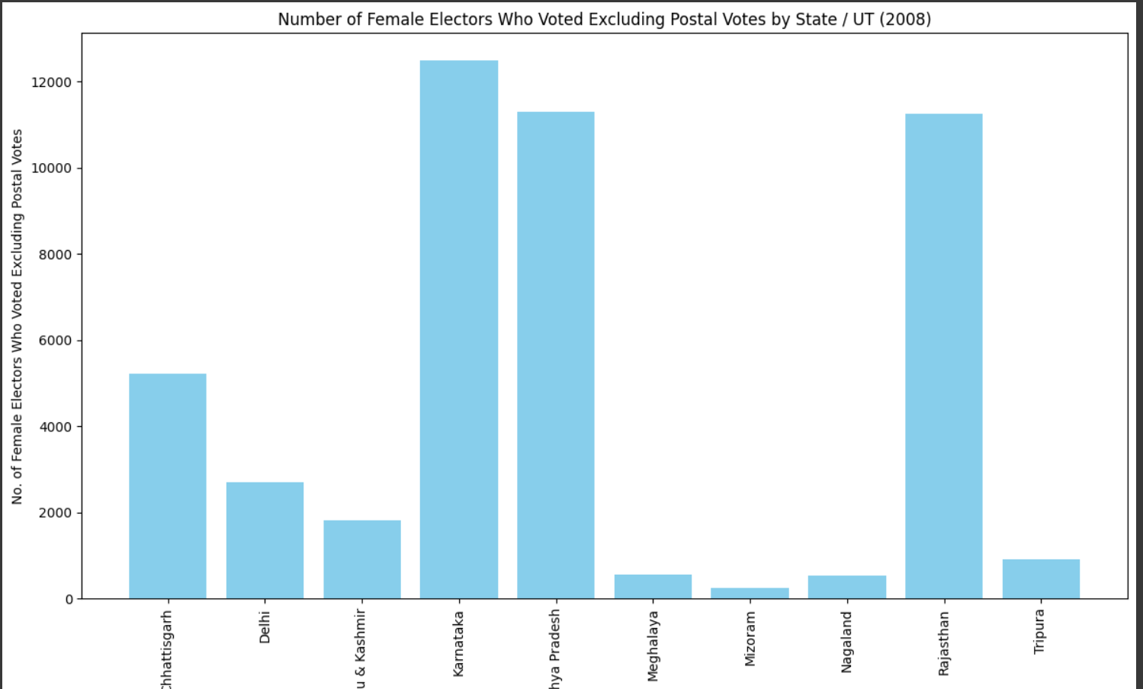
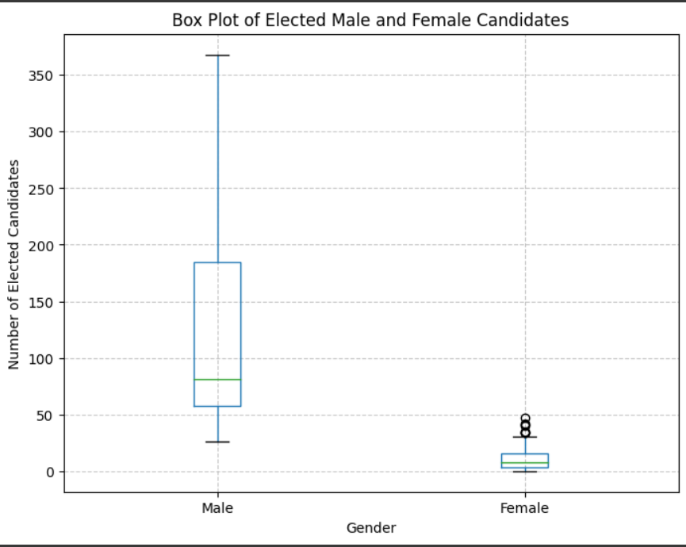
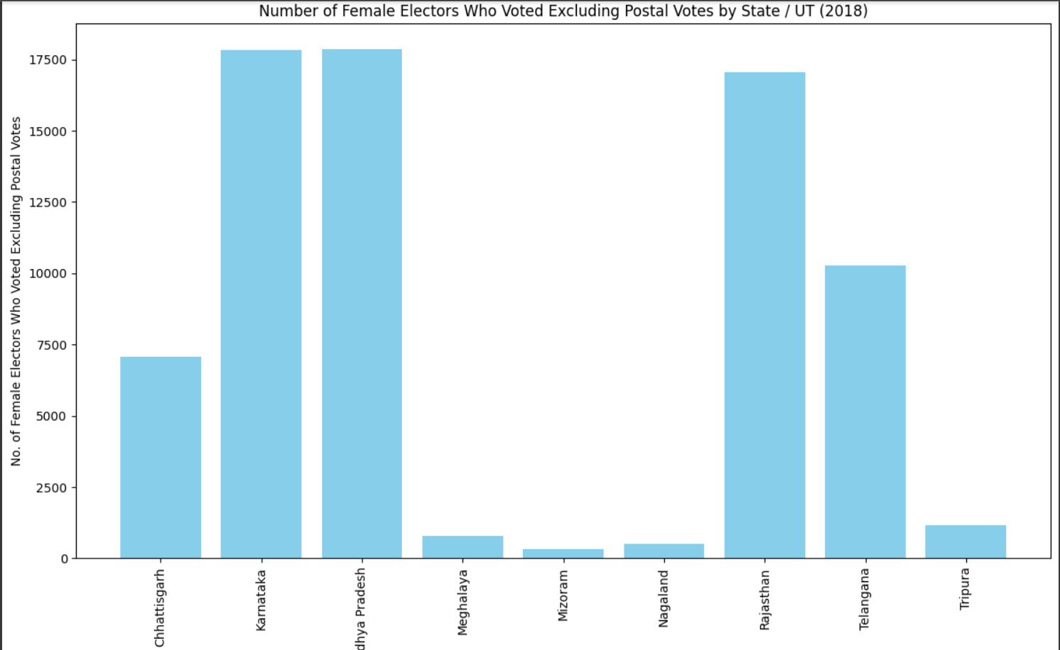
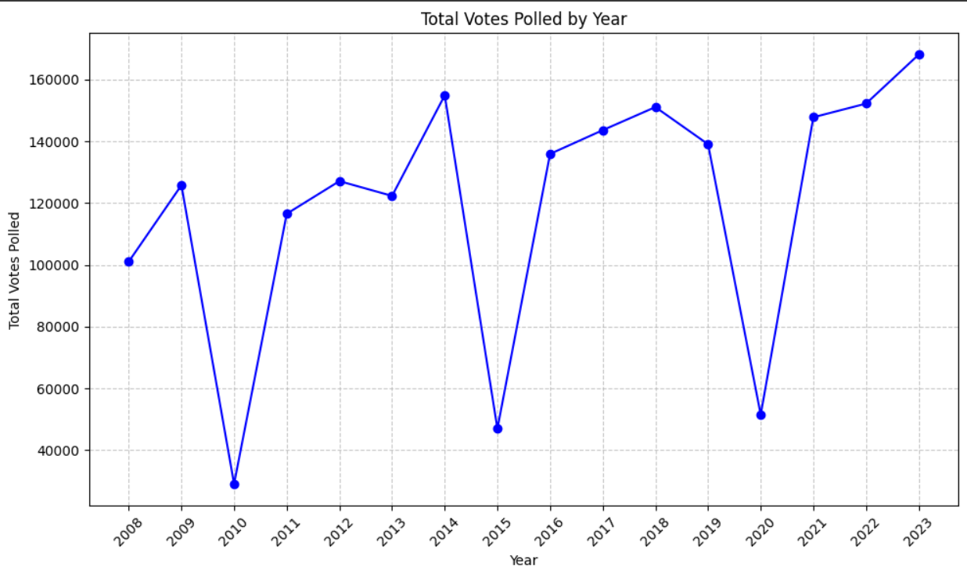
Univariate Analysis

Slide 8
The bar graphs in blue give the idea about the female vote share across different states in
the years 2008, 2013, 2018, 2023. some union territories did not voted before and for the remaining
states the pattern is almost identical.
The line chart gives the total votes polled in a year combining different states in a particular
year. The pattern is similar to the number of seats in a year. As the number of seats were less the no.
of polled votes were also less.
The box plot gives the number of
elected male and elected females. From the plot we can say that there are less number of female
candidates who got elected.

Slide 9
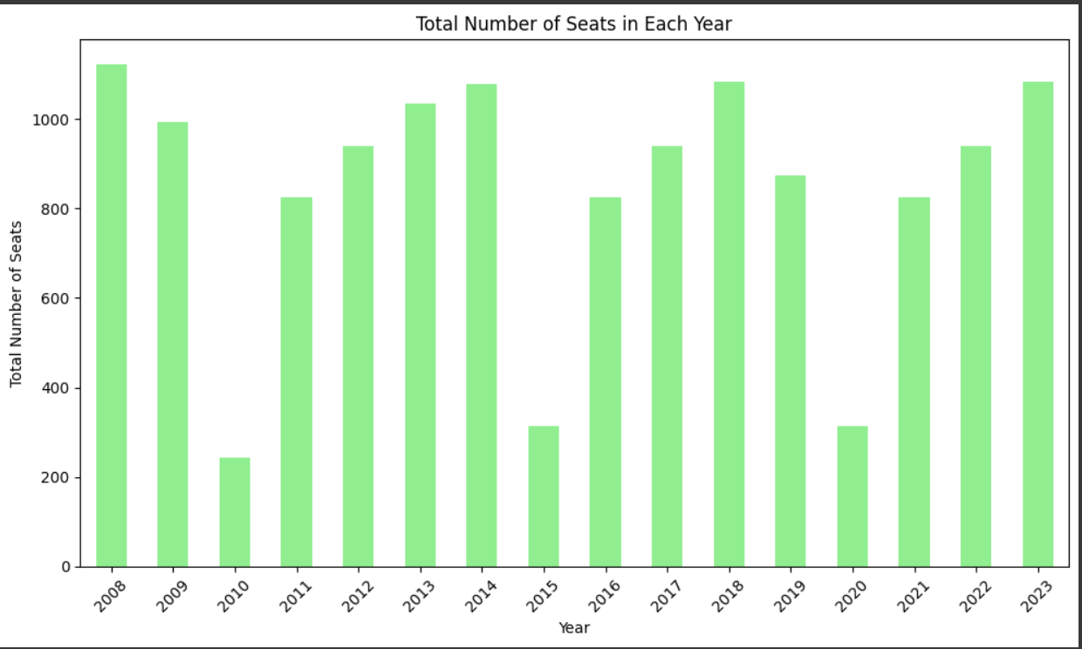
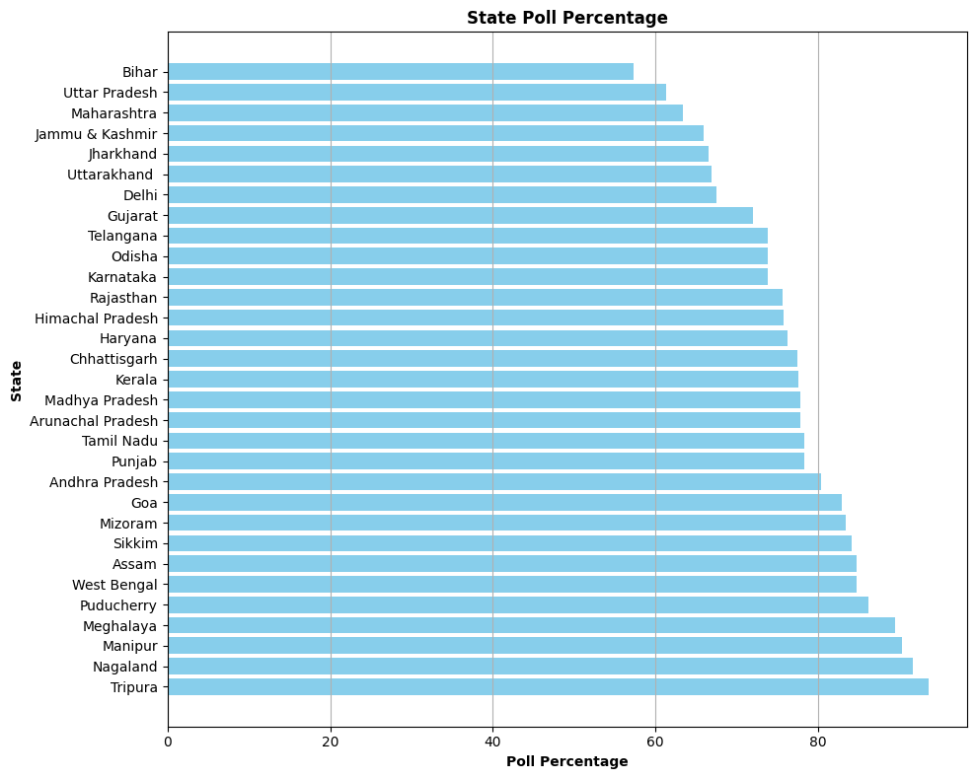
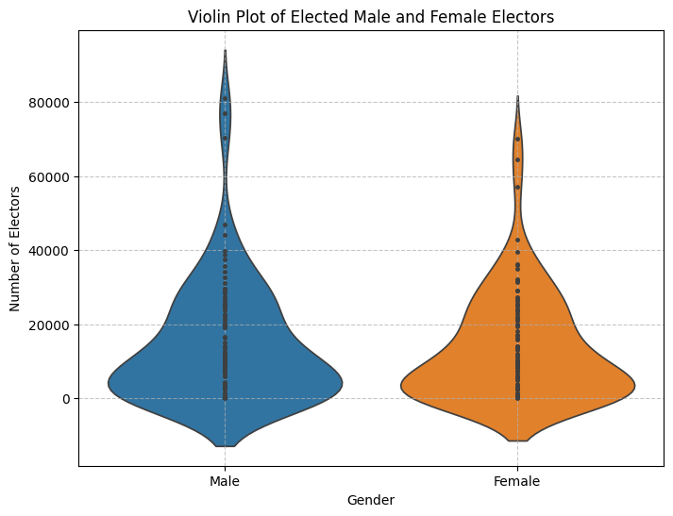
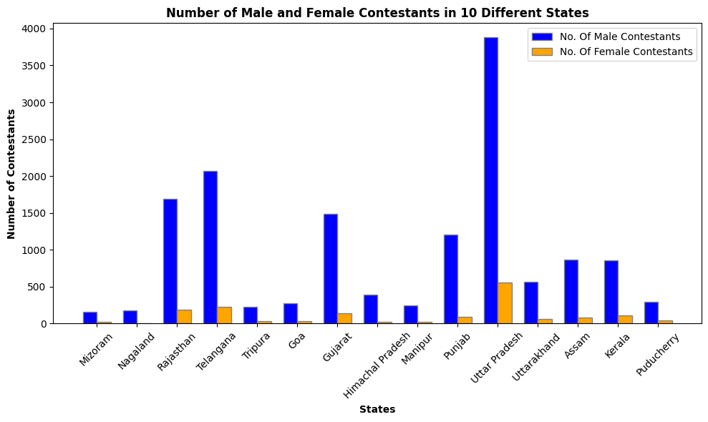
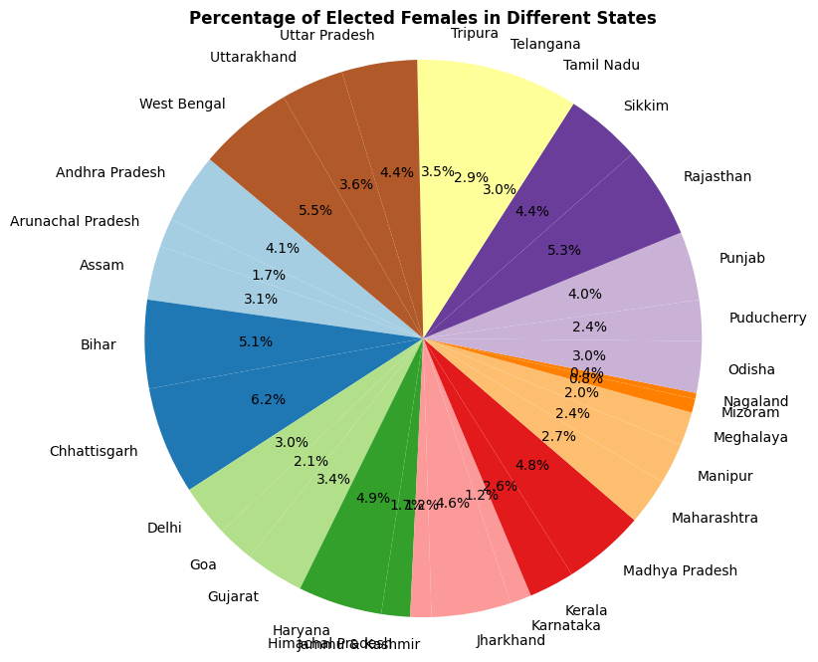
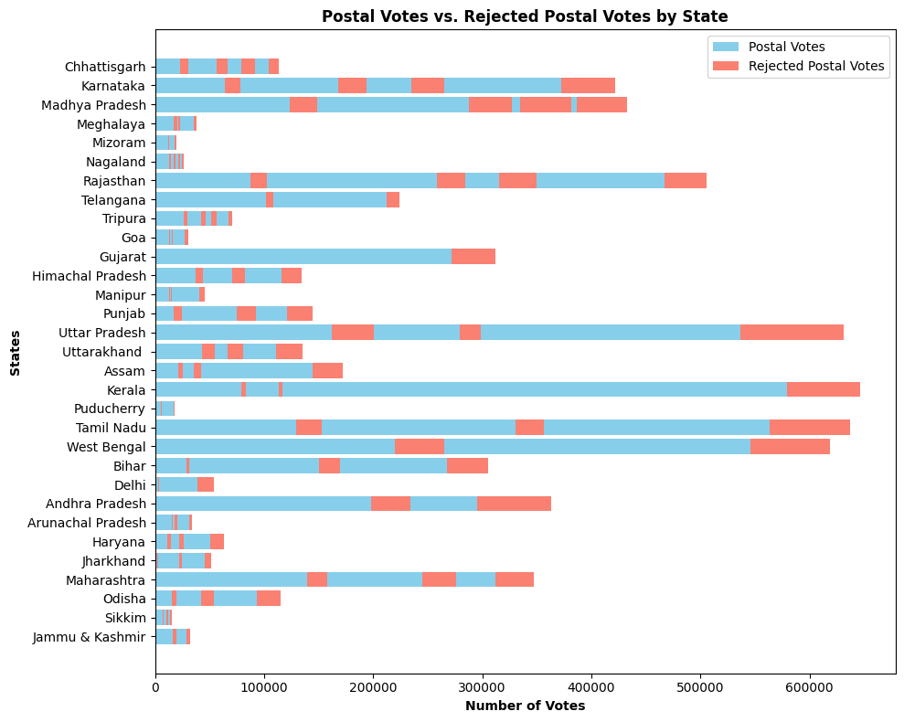

Slide 10
The bar graph in green (3.5) shows the total number of seats in each year combing by different states.
In 2010, 2015, 2020 the number of seats overall were less.
In the 6th figure i.e. the horizontal double bar plot , the blue represents the accepted postal votes and the red represents the rejected postal votes over the years in terms of 5 year difference.
The pie chart represents Percentage of Elected Females in Different States
Violin Plot represents number of Elected Male and Female Electors
Figure 4 represents Number of Male and Female Contestants in 10 Different States
Figure 2 represents the State Poll Percentage of different states

Slide 11
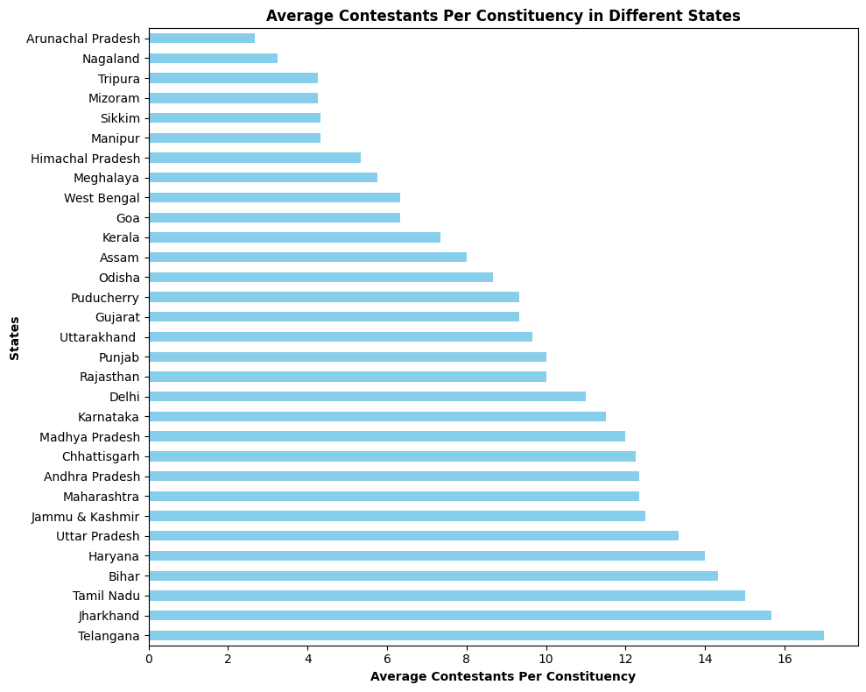
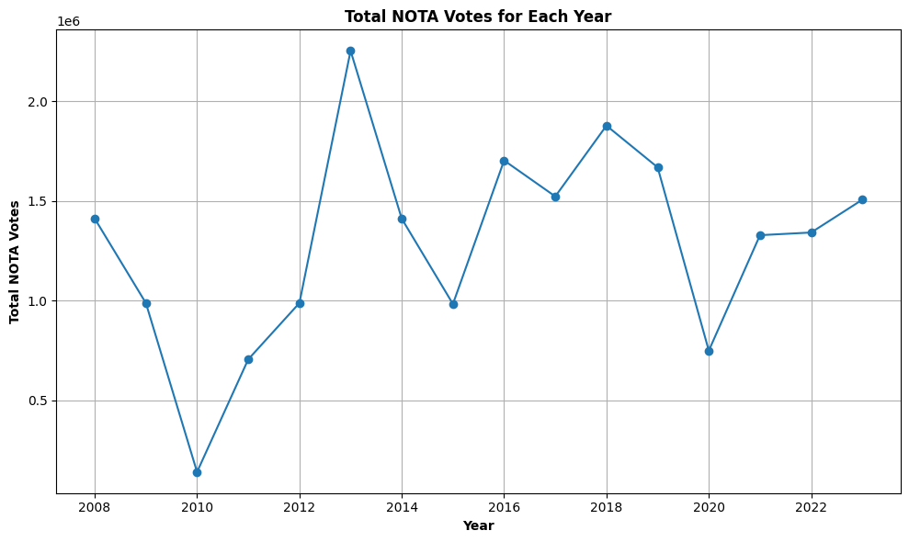
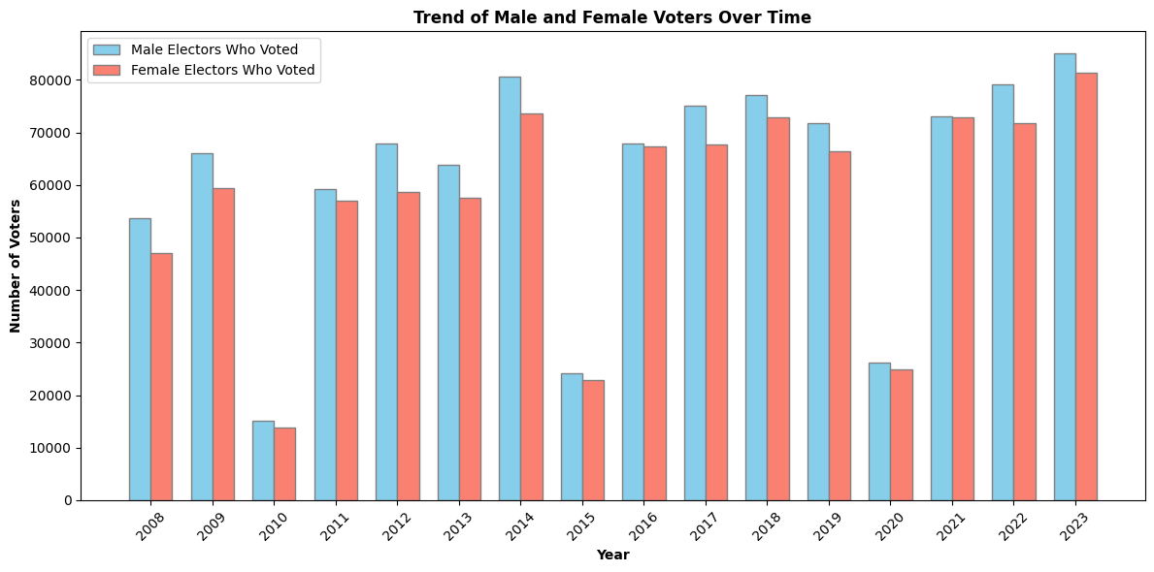
The line chart shows Total NOTA Votes for Each Year
The horizontal bar plot shows the average number of constituencies in different states
The double bar plot represents male and female voters in each year.

Slide 12
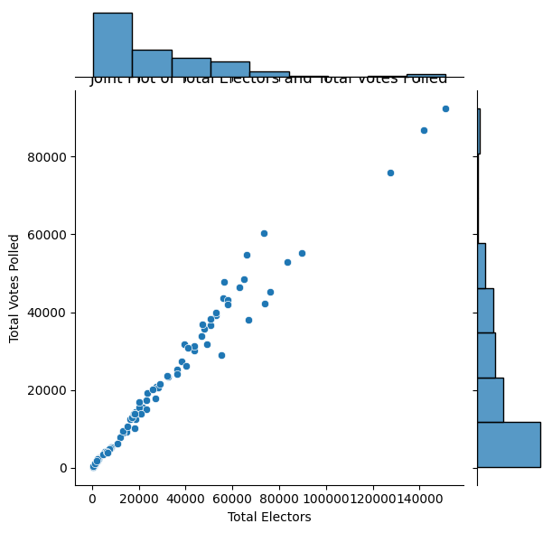
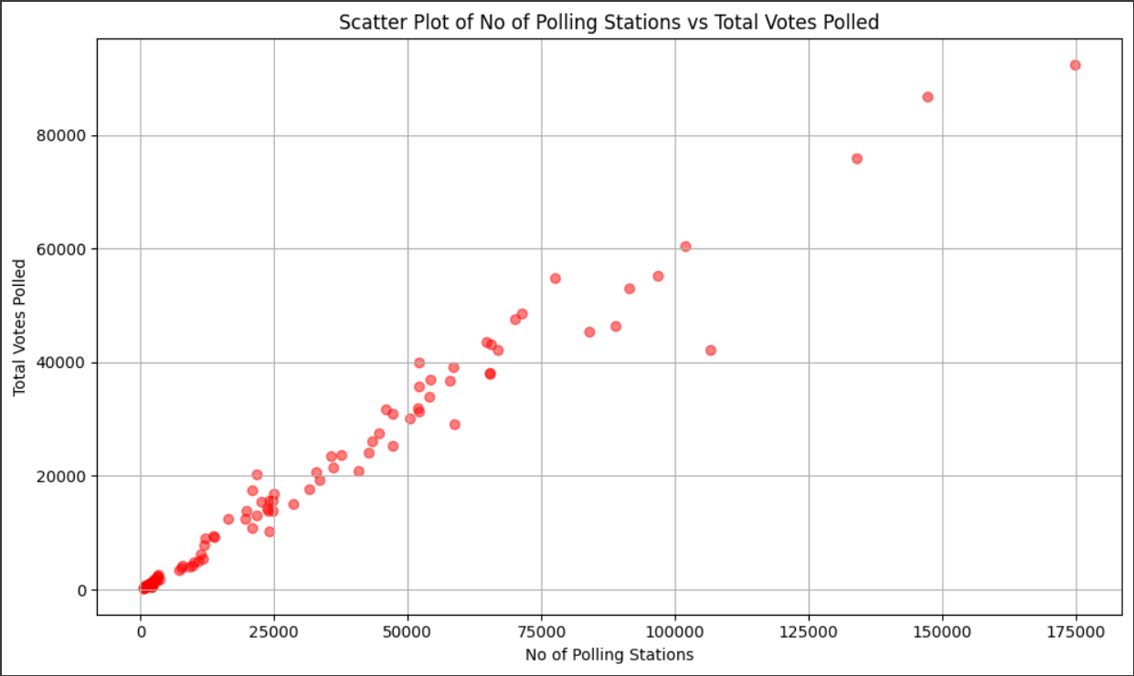
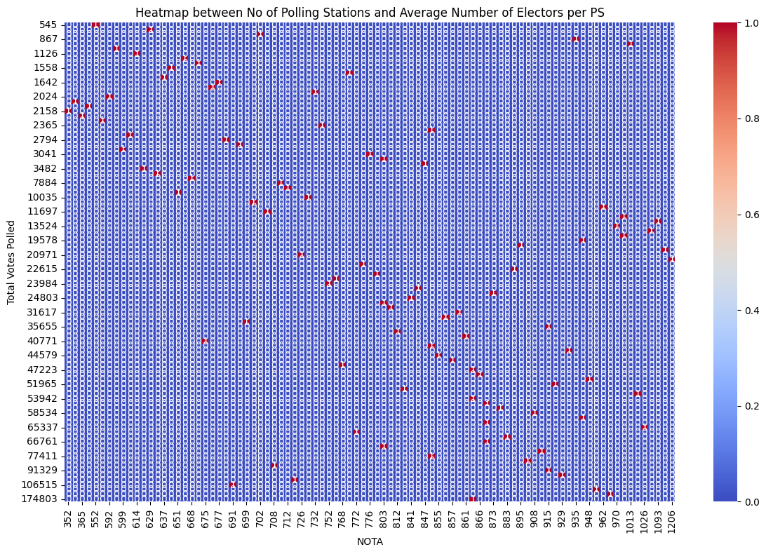
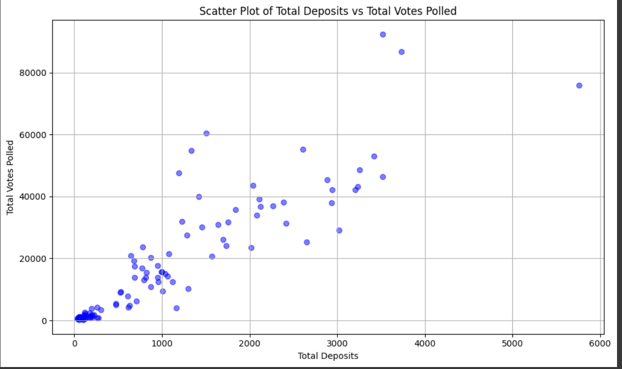
Multivariate Analysis

Slide 13
The red scatter plot represents the relationship between the number of polling stations and the number of votes polled
The joint plot represents the relationship between total number of electors and total number of votes polled
The heatmap represents relation between No of Polling Stations and Average Number of Electors per PS
The blue scatter plot represents the relationship between the number of forfeited deposits and the number of votes polled
After observing the graphs we found out that most of the plots have strong positive correlation indicating a strong relation between the variables.

Slide 14
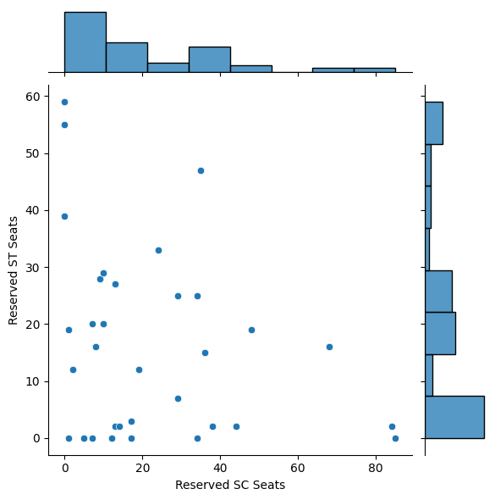
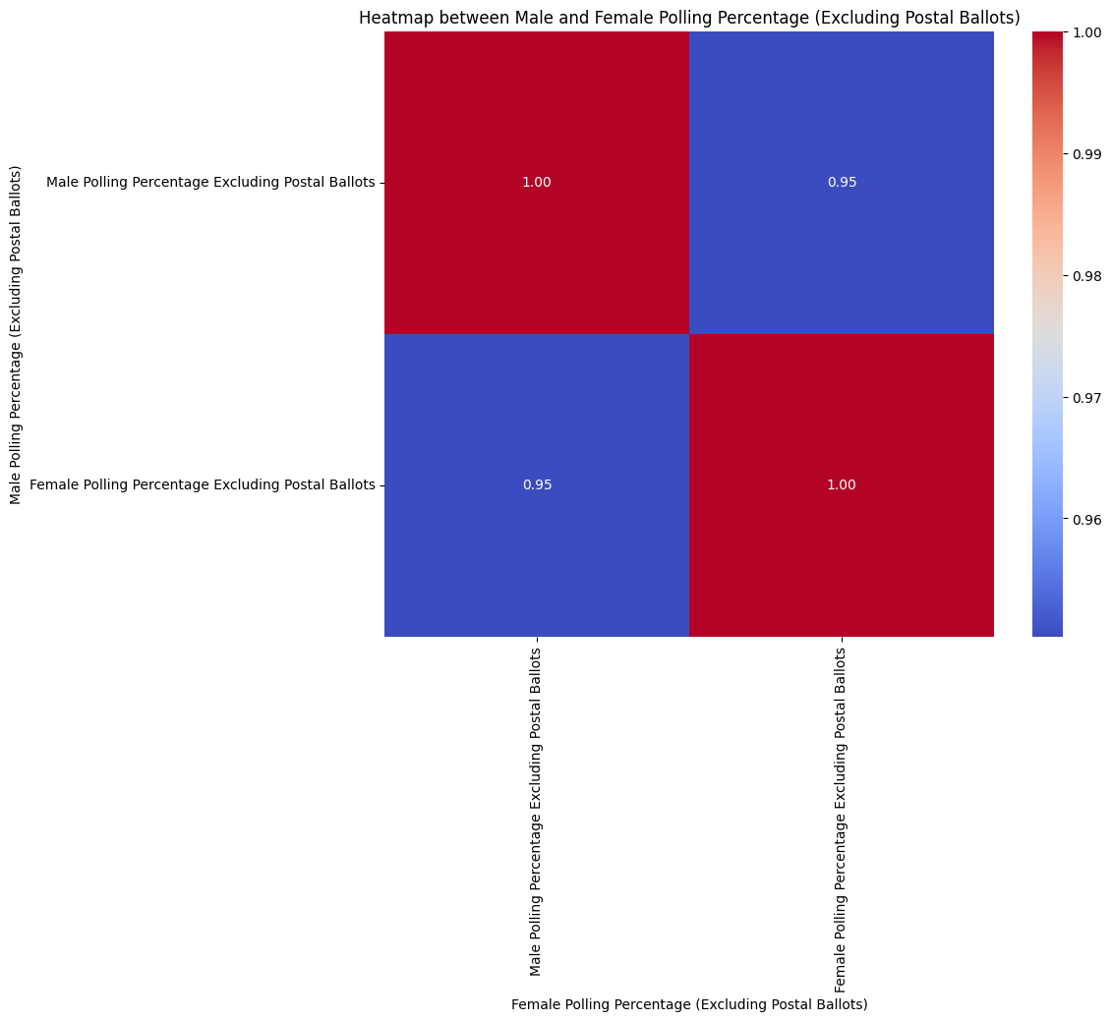
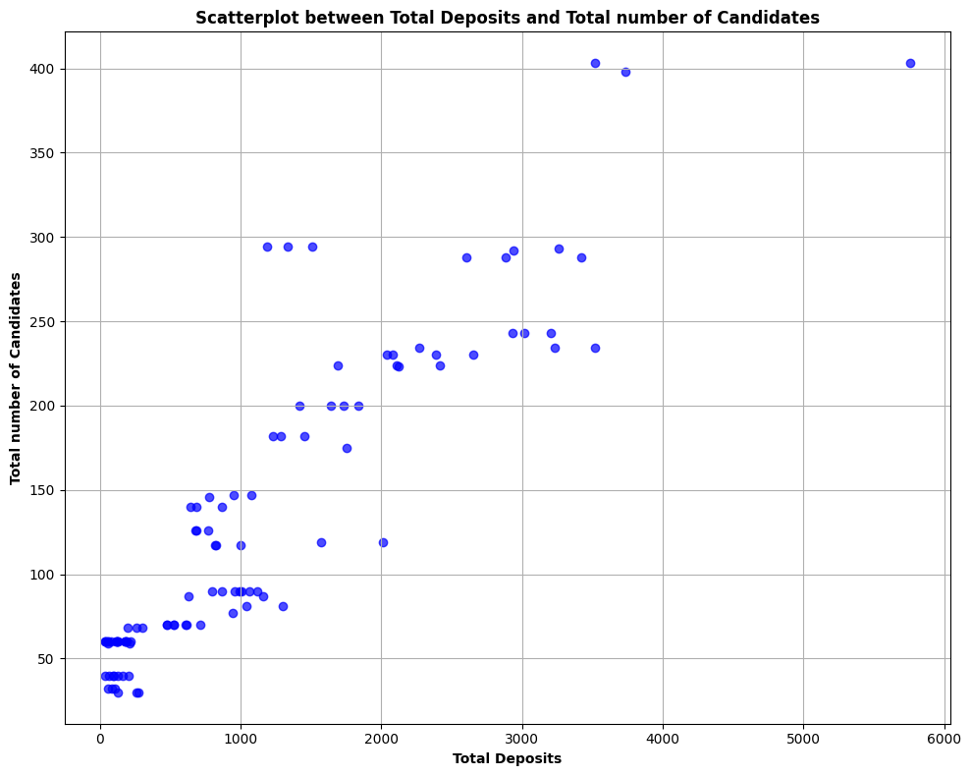
The scatter plot represents the relation between Total Deposits and Total number of Candidates
The Joint plot represents the relation between SC and ST seats.
The Heatmap represents the relation between Male and Female Polling Percentage (Excluding Postal Ballots)
Here the 1st and 2nd plot shows a weak correlation between the variables and the 3rd plot shows a strong correlation between male and female polling percentage

Slide 15
Model Training
Machine Learning Algorithm 1: Gradient Boosting Regressor
No scaling was necessary as Gradient Boosting Machines are less sensitive to the scale of the data.
OneHotEncoder: Used to convert categorical variables into a machine-readable form i.e in binary form.
All selected features were used in the initial model training.

Slide 16
Parameters:
n_estimators=100: The number of boosting stages to be run.
learning_rate=0.1: Controls the contribution of each tree to the outcome.
max_depth=3: Limits the number of nodes in the tree.
We have used 20 percent of the data for testing and rest 80 percent for training

Slide 17

Model Evaluation:
RMSE (Root Mean Squared Error): Measures the average magnitude of the errors between predicted and actual values, giving an absolute measure of fit.
R-squared: Indicates the proportion of variance in the dependent variable that is predictable from the independent variables, offering insight into the goodness of fit.

Slide 18
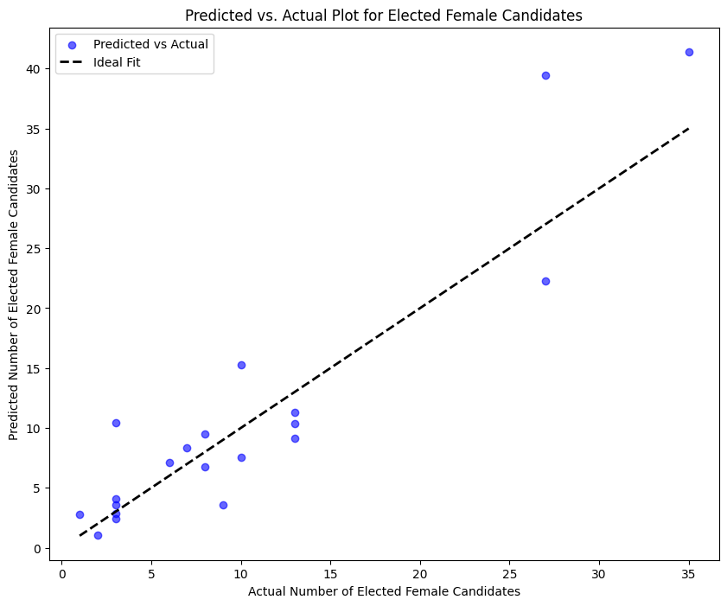

Slide 19
Observation
With an RMSE value of 4.33, the model’s predictions are close to the real outcomes, meaning it is effective at forecasting the number of female candidates elected within an acceptable error margin.
An R-squared of 0.773 suggests a strong model that explains a substantial portion of the variation in the election results concerning female candidates

Slide 20
Machine Learning Algorithm 2: Random Forest Classifier
No scaling was applied as Random Forest algorithms do not require feature scaling to perform effectively.
OneHotEncoder: Applied to categorical variables to transform them into a format that could be used in the model (binary variables for each category).
Intrinsic Random Forest Feature Importances: After the initial model fit, the top 10 most important features were identified using the feature importances attribute of the RandomForestClassifier.

Slide 21
Parameters
n_estimators=100: The number of trees in the forest.
We have used 20 percent of the data for testing and rest 80 percent for training

Slide 22
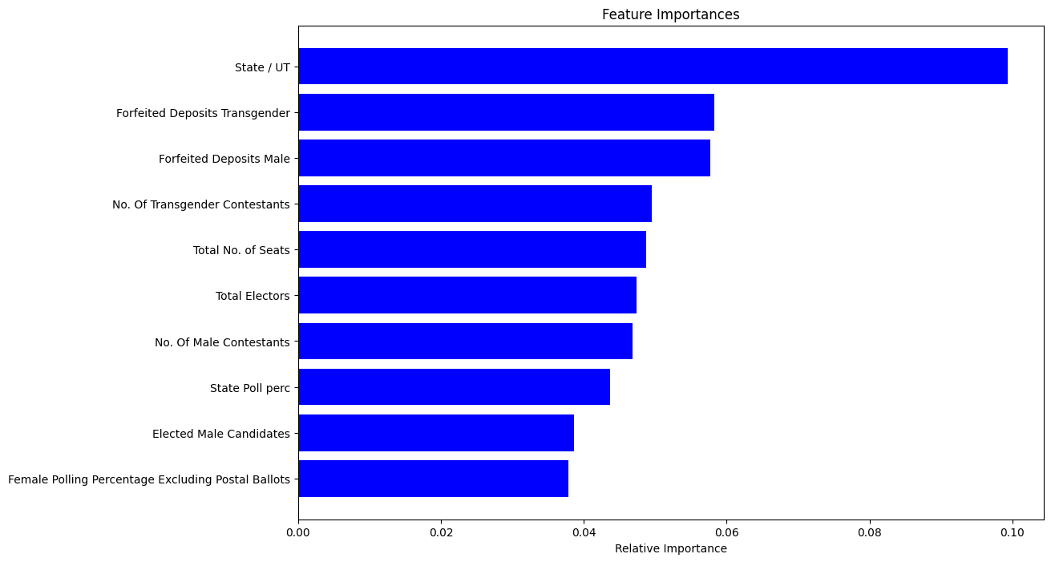
Model Evaluation
After fitting the Random Forest model, intrinsic feature importances were obtained, which reflect how valuable each feature was in constructing the forest by measuring how much each feature decreases the weighted impurity in a tree.

Slide 23
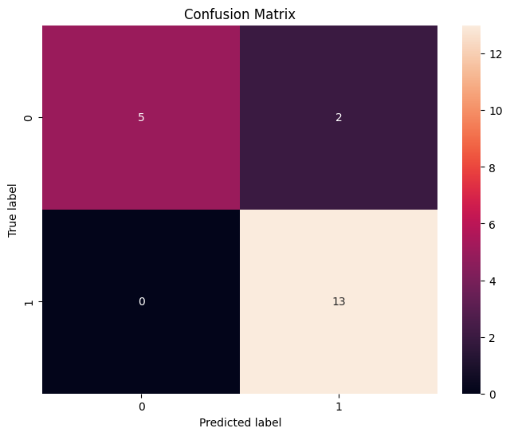
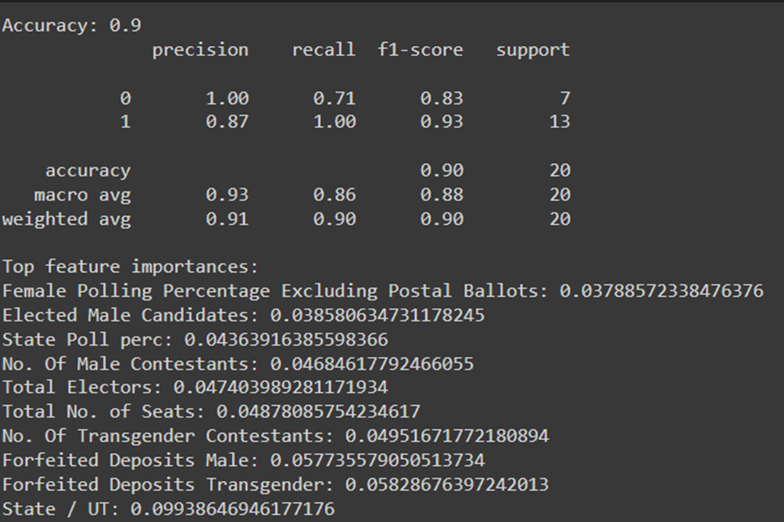
Accuracy: Measured the proportion of correct predictions.
Classification Report: Provided precision, recall, and F1-score for each

Slide 24
Observation
The feature ’Female Polling Percentage Excluding Postal Ballots’ being a top influencer indicates that the engagement level of female voters is a significant predictor of NOTA votes.
’Elected Male Candidates’ also appears as a key factor
State Poll perc’, reflecting overall voter turnout, suggests that general voter engagement in anelection can be a bellwether for NOTA votes

Slide 25
Top-left quadrant (True Negative): The number 5 indicates that there are five instances where the model correctly predicted the negative class (’Low NOTA’).
Top-right quadrant (False Positive): The number 2 shows that the model incorrectly predicted the positive class (’High NOTA’) two times when it was actually the negative class.
Bottom-left quadrant (False Negative): The number 0 indicates that there are no instances where the model predicted the negative class when it was actually the positive class.
Bottom-right quadrant (True Positive): The number 13 signifies that the model correctly predicted the positive class 13 times.

Slide 26
Conclusion
From the Eda
Furthermore, in regards to the distribution of elected male and female candidates. Notably, it reveals a concerning trend of fewer female candidates being elected compared to their male counterparts. This observation underscores potential disparities in political representation and highlights areas for further investigation and action to promote gender equality in elected offices.
Also we have studied about the relationship between different variables like number of votes, forfeited deposits, polling stations and number of electors. From the plots we have found that there is a linear relationship in most of the cases with various degrees of correlation. It means that if there are more polling stations, then there will be more number of electors and voters and vice versa. So it signifies the importance of good infrastructure in different locations over time.

Slide 27
From the ML:
Gradient Boosting Regressor tells a story about the factors contributing to the success of female candidates in elections. By focusing on the predictors of the number of elected female candidates, we gain insights into the elements that might enhance or impede their political victories.

Slide 28
Random Forest
The feature ’female polling percentage excluding postal ballots’ being a top influencer indicates That the engagement level of female voters is a significant predictor of NOTA votes.
This may suggest that when female voter turnout is higher, there is a higher likelihood of nota votes being utilized, ‘elected Male candidates’ also appears as a key factor, which might imply that the number of male candidates Elected (and, by extension, potentially the number of male candidates running) has a correlation with NOTA votes.
This could be interpreted as a proxy for gender representation in politics; when voters Perceive a gender imbalance, they might resort to NOTA as a form of protest.
’State poll perc’, reflecting overall voter turnout, suggests that general voter engagement in an Election can be a bellwether for NOTA votes.
This implies that higher voter turnout doesn’t necessarily translate into fewer NOTA votes; rather, it might indicate that a more politically active electorate feels the need to express dissatisfaction through NOTA.

Slide 29
To predict high NOTA voting instances, the model demonstrated a high degree of accuracy, with an overall correct classification rate of 90 percent.
It performed exceptionally well in identifying instances of low NOTA votes, with perfect precision.
However, it was slightly less precise but still very accurate in classifying high NOTA votes. The high recall for high NOTA votes indicates a strong sensitivity to detecting cases of voter dissatisfaction.
The F1-scores were also high, particularly for high NOTA votes, suggesting a well-balanced model that is reliable for both classes

Slide 30
Contribution
Member 1 (202318059)
Downloaded and finalized the dataset and made it usable for analysis
Done data preprocessing and analyzed the data and constructed plots
Report Making and finding insights
Member 2 (202318046)
Did feature engineering and made the data usable for applying ML algorithms.
Applied Machine learning models and tested accuracy, recall, precession and f1 score.
Aided in Report making and finalizing it.
Member 3 (202318018)
Presented ideas about the model to use and report making
Provided resources regarding datasets

Slide 31
References
https://old.eci.gov.in/files/file/15617-year-wise-information-on-important-parameters-of-general-election-to-state-legislative-assembly-sla-held-during-the-years-2008-to-2023/

