Slide 1
Final Project
SAN Jose state university
Cs166 spring 2017
Kaya ota

Slide 2
content
Behind the seen
SQL Injection
XSS (Cross Site Scripting)
Cookie Stealing
Authentication
Trojan House
Behind the scene tour of this site.
SQL Injection
XSS (Cross Site Scripting)
Cookie Stealing
Protocol
Authentication
Trojan House

Slide 3
Behind the scene tour of this site

Slide 4
Entry url for cs166 blog
Prevented codes are running at:
http://ec2-34-208-99-244.us-west-2.compute.amazonaws.com:8080/CS166_Final_Project/Project_Code/prevented/register_form.jsp
The given codes are running at:
http://ec2-34-208-99-244.us-west-2.compute.amazonaws.com:8080/CS166_Final_Project/Project_Code/attackable/register_form.html

Slide 5
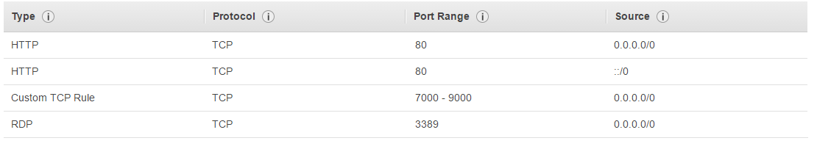
How to build this site
Download source code from the git hub: https://github.com/28kayak/CS166_Final_Project.git
Set up AWS windows server with the following security group.

Slide 6
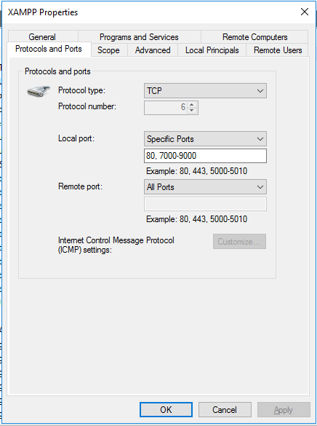
How to build this site
Set up XAMPP with Tomcat and Maria DB.
Check Windows server side of fire wall's setting. (image on the left)
Tomcat entry is on port 8080.

Slide 7
Sql table – login –
Use Maria DB
Login table contains user information
Fullname – user’s name
User – user ID
Pass – password
Random – salt for the password
Fullname | User | pass | role | Random

Slide 8
Sql table –blog–
Blog table contains posts for the blog.
Title is title of the post
Content is the articles in the post
ID is the post id and is the primary key
title | content | id

Slide 9
Sql injection

Slide 10
Sql injection – overview –
A type of injection attack
A SQL injection attack is by “injection” of SQL query via input data from the client to the application.
When SQL succeed the followings could happen
Read sensitive data
Modify DB data
Run administrative operation

Slide 11
Sql injection – Thread modeling –
SQL Injection lets attackers to spoof identity, and temper data in database.
SQL Injection lets cause repudiation issues
Voiding transaction
Changing balance
SQL injection is common with PHP and ASP
Because these older functional interfaces are widely used.
Nature of programmatic interface available
J2EE and ASP.NET application are less likely to have easily exploited SQL injection.

Slide 12
Sql injection – Prevention –
Use prepared statement / parameterized queries
Prepared statement force the developers to first define all SQL code and then pass the required parameters later to the query.
This allows DB to distinguish between code and data, independent from user-input.

Slide 13
Sql injection – Prevention –
No Use of Prepared Statement
String user = request.getParameter( "user" );
String pass = request.getParameter( "pass" );
String sqlStr = "SELECT fullname FROM login WHERE user='" + user + "' and pass = sha2('"+ pass + "', 256)";
Use of Prepared Statement
String sqlStr = "SELECT count(*) FROM login WHERE user=? and pass = sha2(?, 256)";
PreparedStatement stmt = con.prepareStatement(sqlStr);
stmt.setString(1,name);
stmt.setString(2,pwd);
ResultSet rs = stmt.executeQuery();

Slide 14
Sql injection – Prevention –
Use Stored Procedure
Not always safe from SQL Injection
Certain Stored Procedures have the similar effect as use of parameterized query
It requires to build SQL query with parameters that are automatically parametrized unless the developer does something out of norm.

Slide 15
Sql injection – Demonstration –
Not Preventing Site
http://ec2-34-208-99-244.us-west-2.compute.amazonaws.com:8080/CS166_Final_Project/Project_Code/attackable/login_form.html
Preventing Site
Running here

Slide 16
XSS – Cross site Scripting –

Slide 17
xss – overview –
A type of injection attack
Injects malicious script into benign and trusted website.
Occurs when an attacker users a web application to send malicious code
Generally in the form of a browser side script to different end user.

Slide 18
xss – thread modeling –
XSS lets attackers do the followings
Identity Thrift (fraud)
Redirect traffic by altering URL
Session Hijacking
Storing sensitive information in JavaScript variables

Slide 19
xss – Prevention –
Never accepts to insert untrusted data except in allowed location
Deny all – do not put untrusted data into your html document unless it is within one of the slot of defined in rule #1
Most importantly, never accept actual JavaScript code from an untrusted data and then run it.

Slide 20
xss –demonstration–
Demonstration running at
http://ec2-34-208-99-244.us-west-2.compute.amazonaws.com:8080/CS166_Final_Project/Project_Code/attackable/login_form.html

Slide 21
Protocol

Slide 22
PROTOCL
5 REQUEIREMENTS

Slide 23
Replay attack

Slide 24
reference

Slide 25
https://www.owasp.org/index.php/SQL_Injection

