Slide 1
CMS-based Blogging System
Presented By:
Sourav Adak
Sourav Kr. Das
Sk. Asfaque Hossain
Guided By:
Prof. Dipankar Hazra
H.O.D (Department Of CSE)

Slide 2


Slide 3
Introduction
Blogs are pieces of web content that are updated frequently and allow reader engagement in the form of blog comments and social media shares, likes, and follows.
Posts are typically displayed in reverse chronological order, so that the most recent post appears first, at the top of the web page.
Categories :-
(1) Personal blogs
(2) Collaborative blogs
(3) Microblogging
(4) Corporate blogs
(5) Educational Blogs

Slide 4
Project Brief
A content management system (CMS) manages the creation and modification of digital content. It typically supports multiple users in a collaborative environment.
There are lots of open-source popular framework available like WORDPRESS, DRUPAL, JOOMLA etc. using anyone of these a CMS can be developed.
But, our goal is to develop the same functionalities which these popular ready-made framework provides for us, by harnessing the power of Procedural PHP, Bootstrap, jQuery and CSS3 for mastering these web technologies and to grasp the working and creation logic behind those frameworks.

Slide 5
Project Illustration Tour

Slide 6
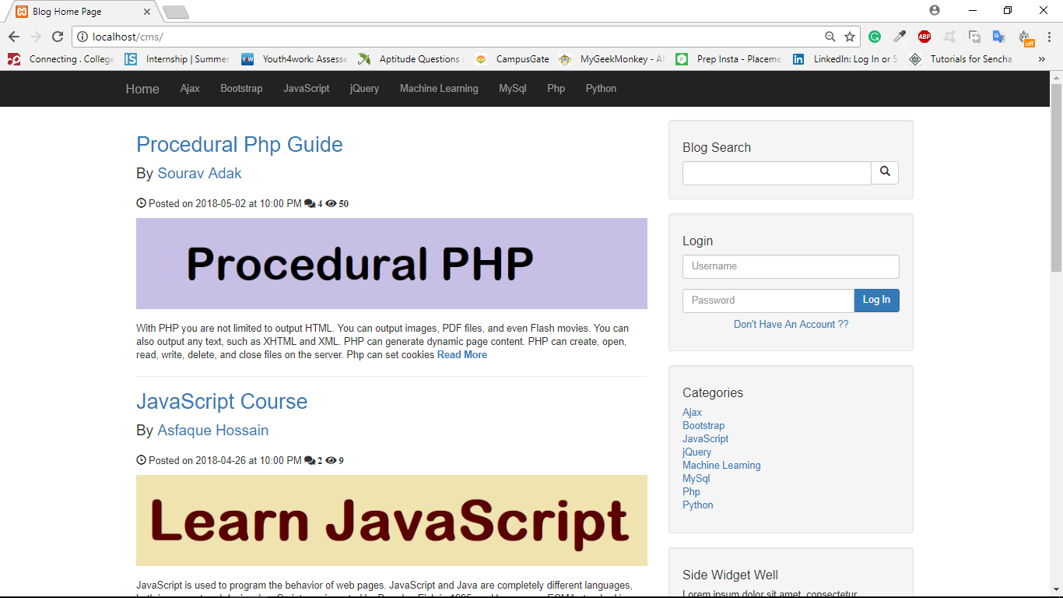
Blog-Home

Slide 7
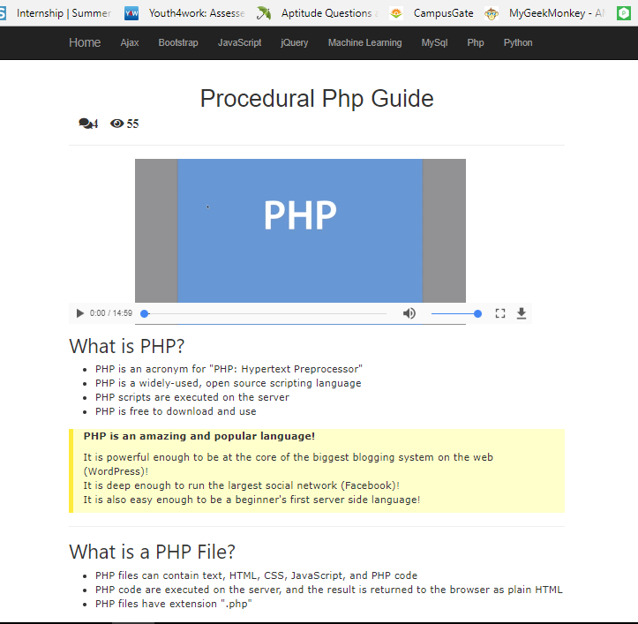

Slide 8
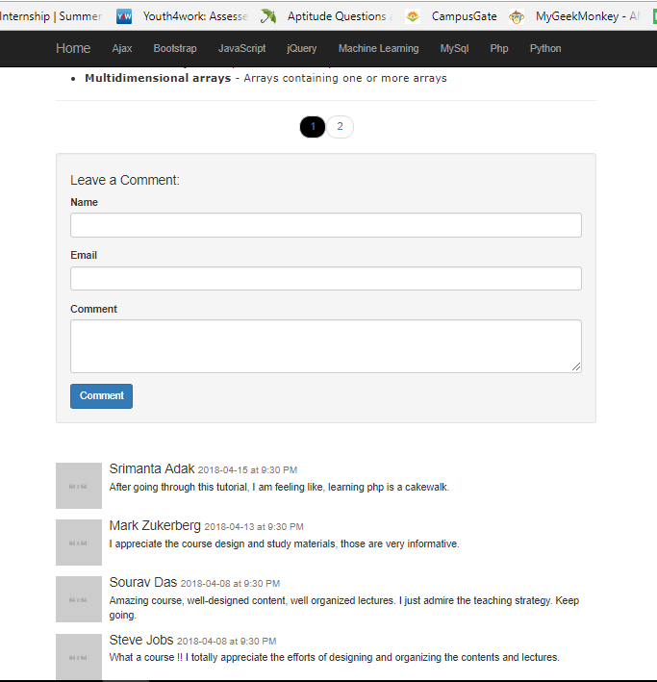

Slide 9
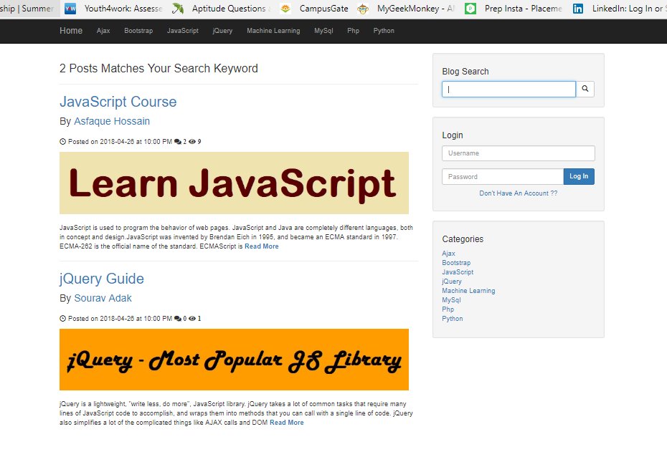

Slide 10
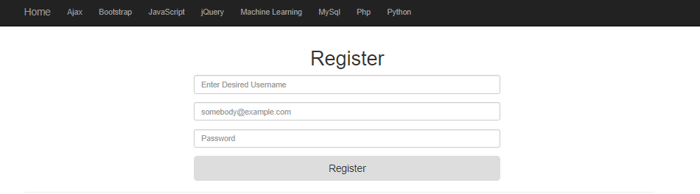
New User Registration

Slide 11
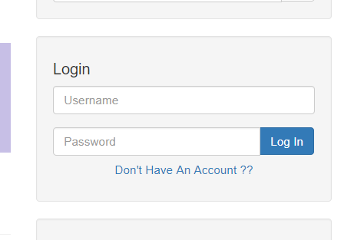
User Login Section

Slide 12
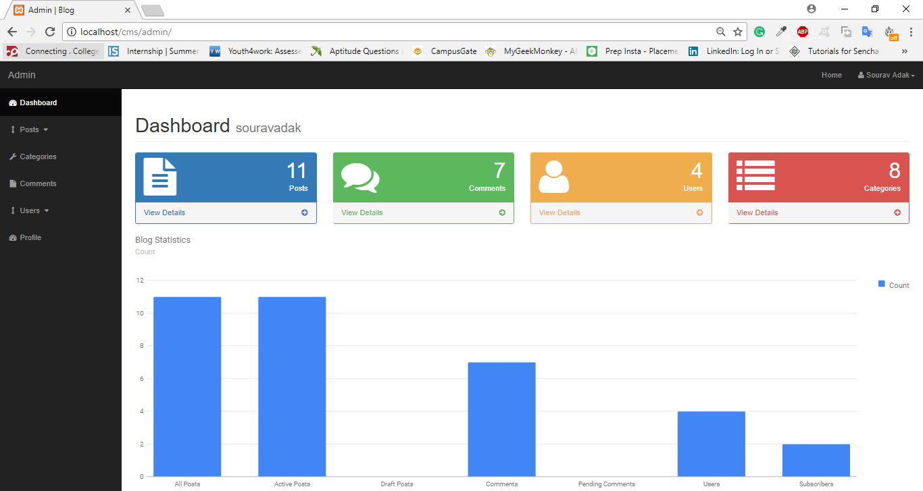

Slide 13
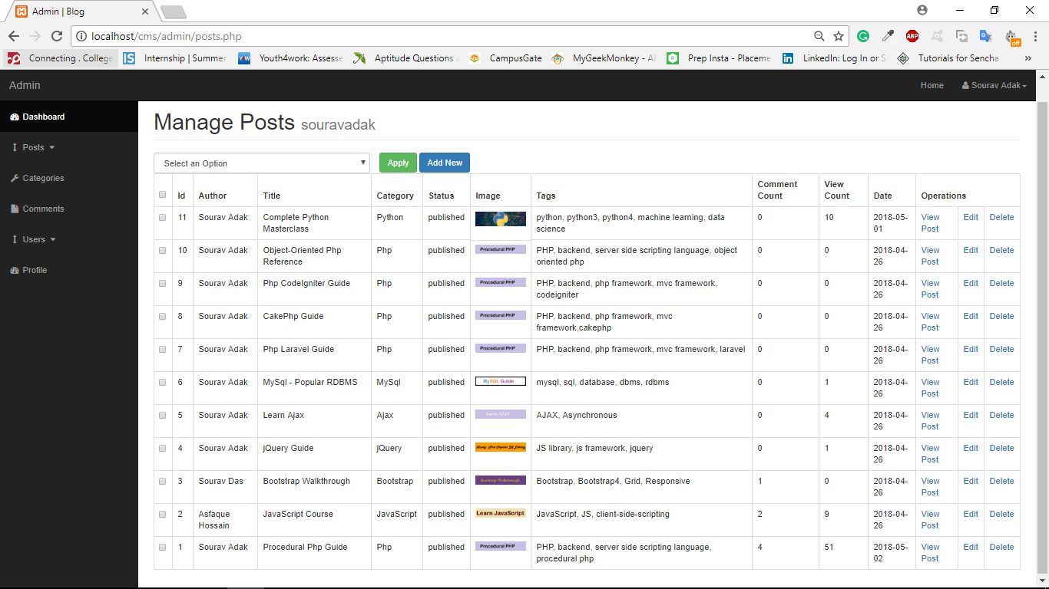

Slide 14
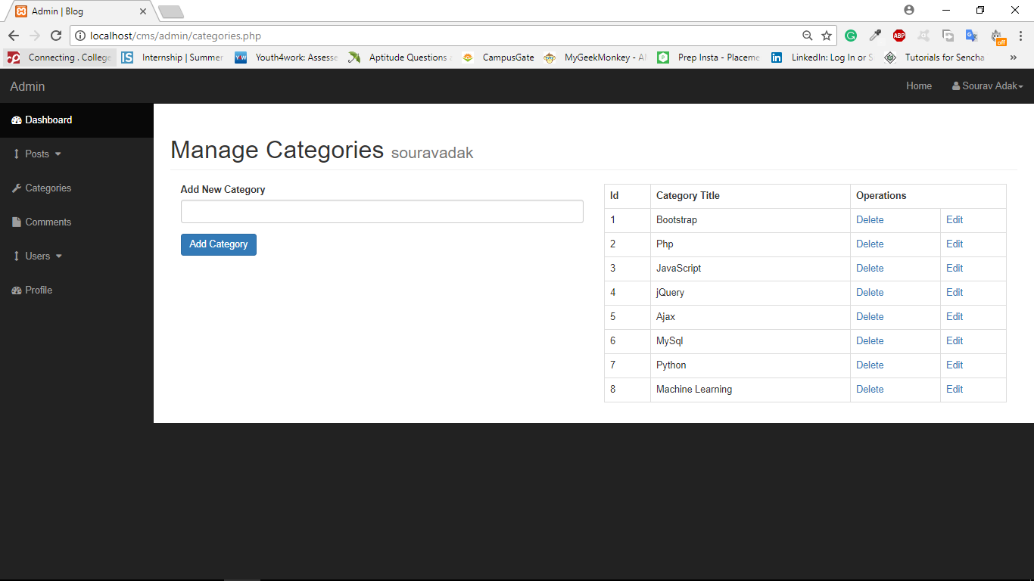

Slide 15
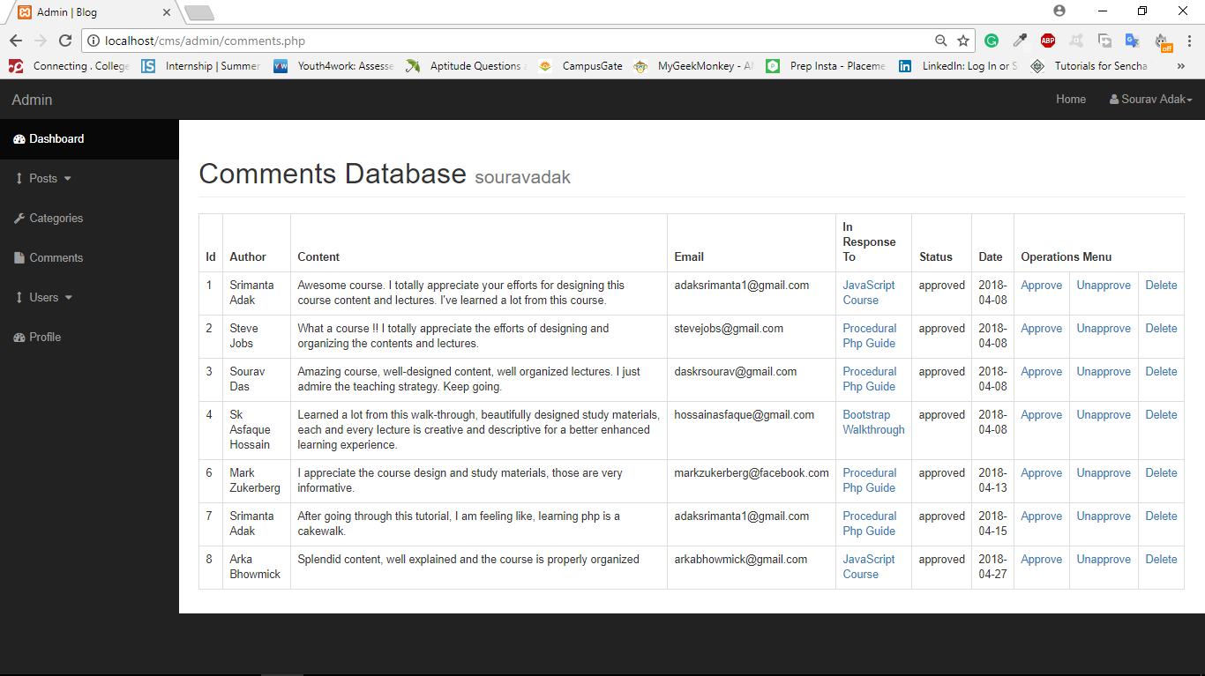

Slide 16
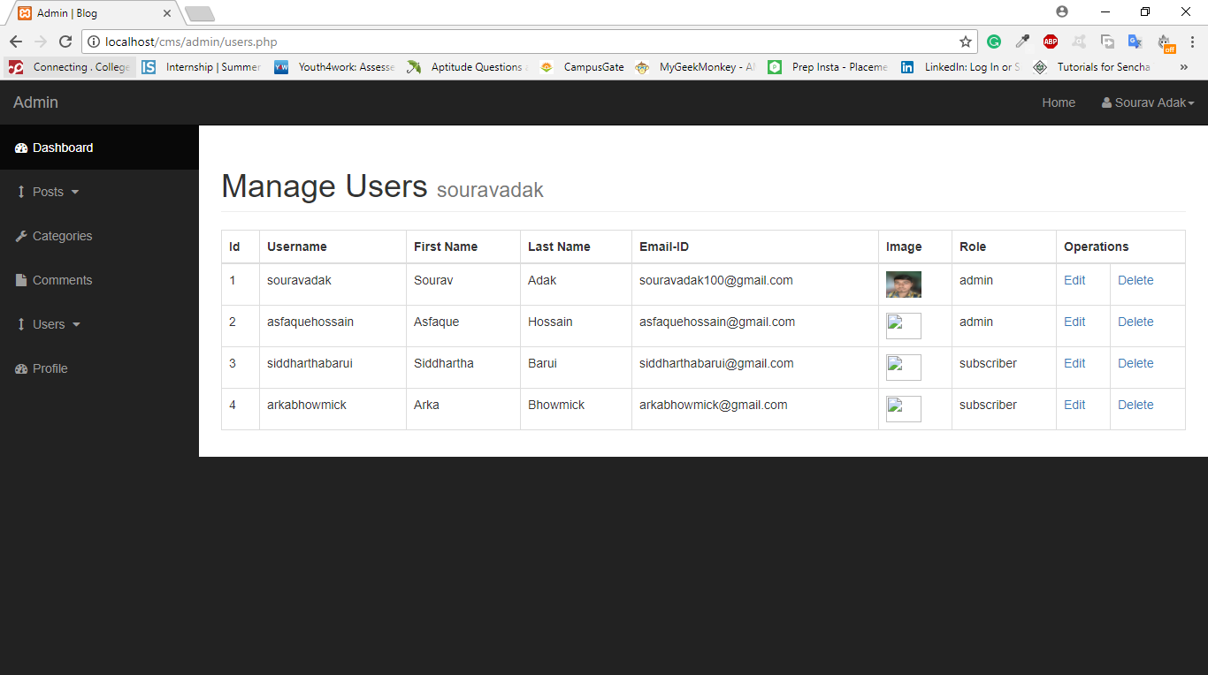

Slide 17
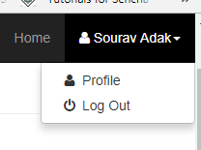
User Avatar Section

Slide 18
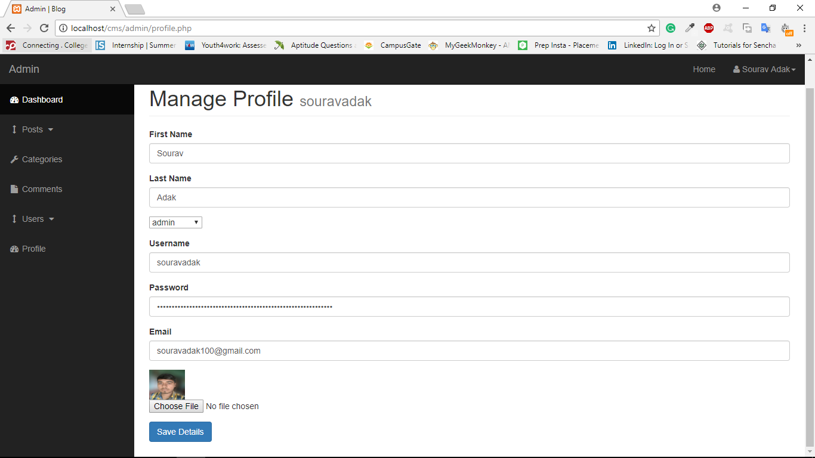

Slide 19
CMS access : Admin Can
Add, Remove or Edit Post Categories
View all posts, Edit posts
Delete Posts, Add new Post, Reset Views
View all Comments, Approved or Unapprove Comments
View User Details(Except Password), Add New User
Edit his/her profile information.

Slide 20
CMS access : Subscriber Can
Add New Post, Edit Specific post
Add New Post Category
Edit his/her profile information.
View all Posts

Slide 21
Features of our BLOGGING System
Password encryption using crypt() and blowfish algorithm.
Implemented SQL INJECTION prevention techniques.
Better access control of CMS section for an admin and a subscriber.
Faster page refresh and load.
Better post content and user feedback section in the form of comments.
Image compression without compromising quality.
Regular content updating, quality checks and bug fixes.

Slide 22
Tools and Technologies Used
Frontend Design | HTML5, CSS3, BOOTSTRAP4
Client-side Scripting | JQUERY
Server-side Scripting | PHP
Database | MYSQL
Development Tools | BRACKETS, XAAMP

Slide 23
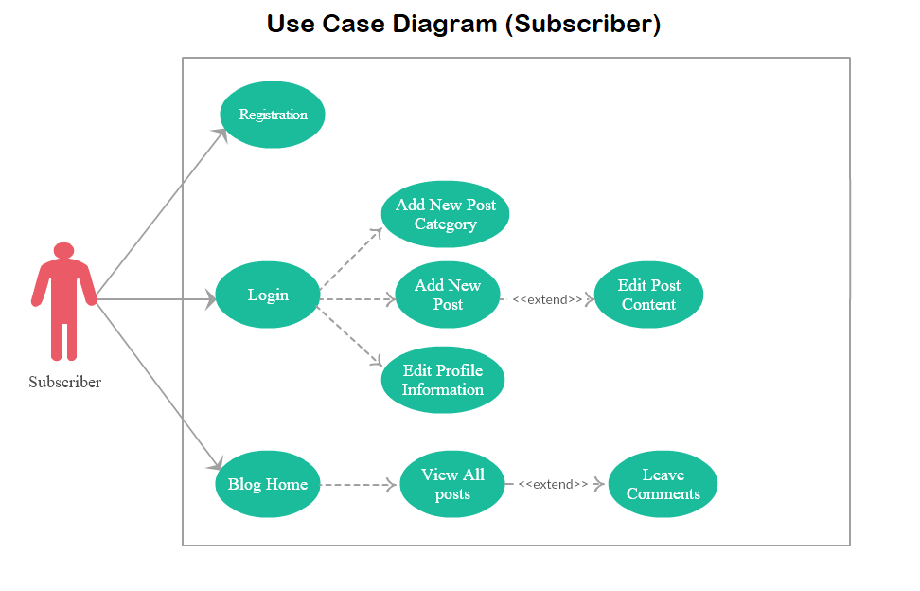
Use-Case Diagram
BLOGGING SYSTEM

Slide 24
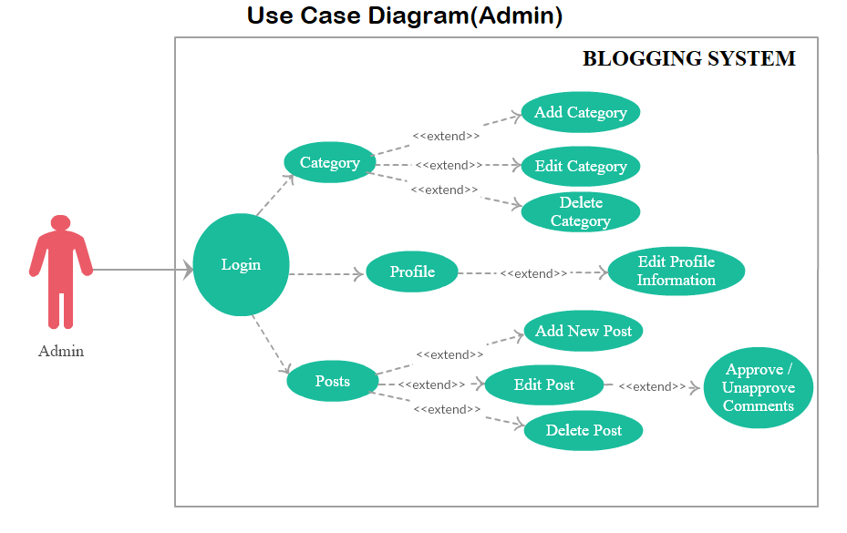

Slide 25
Bibliography
https://www.tutorialspoint.com
https://www.w3schools.com/
https://www.wikihow.com/
http://www.codecademy.com/
https://developer.mozilla.org/en-US/docs/Web/Tutorials
https://tutsplus.com/

Slide 26
Thank you

