Slide 1







TECHNOLOGY TRENDS AND ANALYSIS PRESENTATION
TANDLE RAJITHA RANI
3/07/2022

Slide 2



OUTLINE
Executive Summary
Introduction
Methodology
Results
  Visualization – Charts
  Dashboard
Discussion
  Findings & Implications
Conclusion
Appendix

Slide 3

EXECUTIVE SUMMARY
JavaScript, HTML 5, and Python are widely popular, in demand languages
SQL is necessary to work with popular DBs like MongoDB and PostgreSQL
The popularity of web languages and database languages imply heavy demand in these sectors
Better to know multiple languages than a single language

Slide 4

INTRODUCTION
Students seeking positions after graduation need to be prepared with the languages in demand
Using current job postings and salary information, as well as survey results from programmers, we can determine which languages are the future
We can extrapolate from the languages what the best sectors to be in are

Slide 5

METHODOLOGY
Github job posting scraped from API
Github salary information scraped from web
Survey results from Stack Overflow
  Popular website for programmers
  Representative subset of full survey results

Slide 6
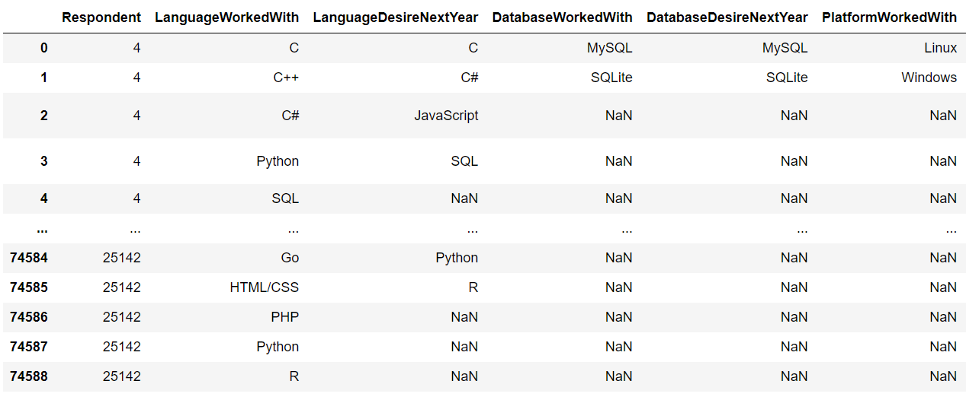
RESULTS

Slide 7
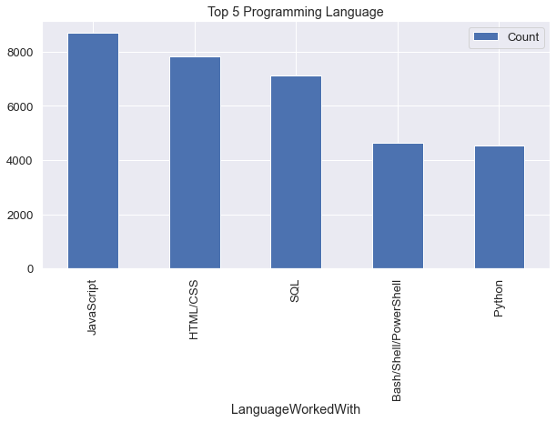
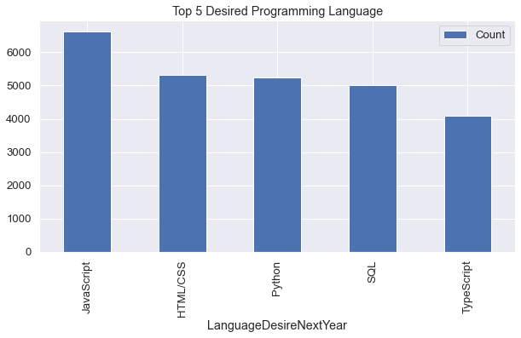
PROGRAMMING LANGUAGE TRENDS
Current Year
Next Year

Slide 8
PROGRAMMING LANGUAGE TRENDS - FINDINGS & IMPLICATIONS
Findings
JavaScript, HTML 5 & Python continue to be popular
SQL decreases in popularity, but remains high
Bash/Shell/PowerShell drops
Implications
Greater demand for JavaScript, HTML 5, and Python programmers
Bash/Shell/PowerShell decreases in use
SQL potentially saturated market – remains useful language

Slide 9
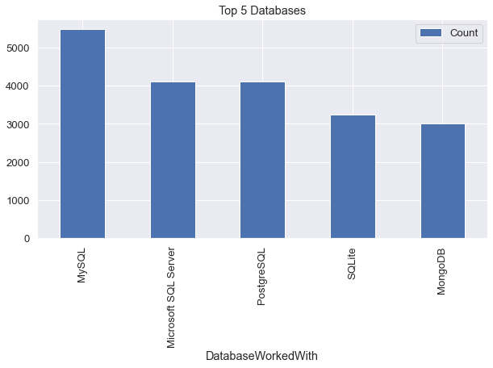
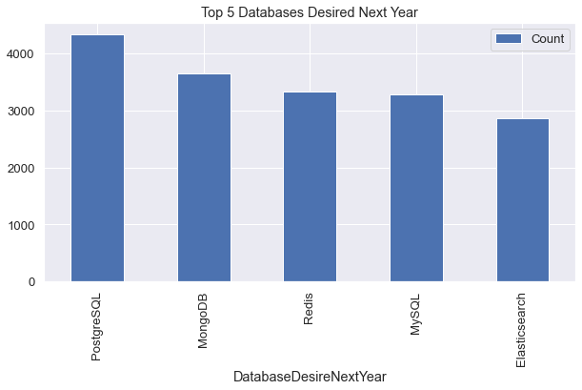
DATABASE TRENDS
Current Year
Next Year

Slide 10
DATABASE TRENDS - FINDINGS & IMPLICATIONS
Findings
MySQL decrease in popularity
PostgreSQL increase in popularity
MongoDB increase in popularity
Implications
MySQL demand is likely lower
PostgreSQL and MongoDB likely to be future in-demand languages

Slide 11

DASHBOARD
https://dataplatform.cloud.ibm.com/dashboards/5e125cd5-b399-4c69-b582-9ce42120337a/view/6c3ea30b23973edf68c9c0e4079a25047a317409b3bb825680d37b4959347497a93c1bc5c828185dd2475730a5ea17589b

Slide 12
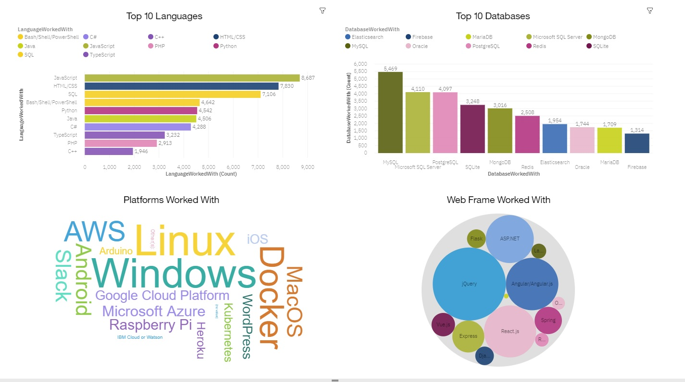
CURRENT TECHNOLOGY USAGE

Slide 13
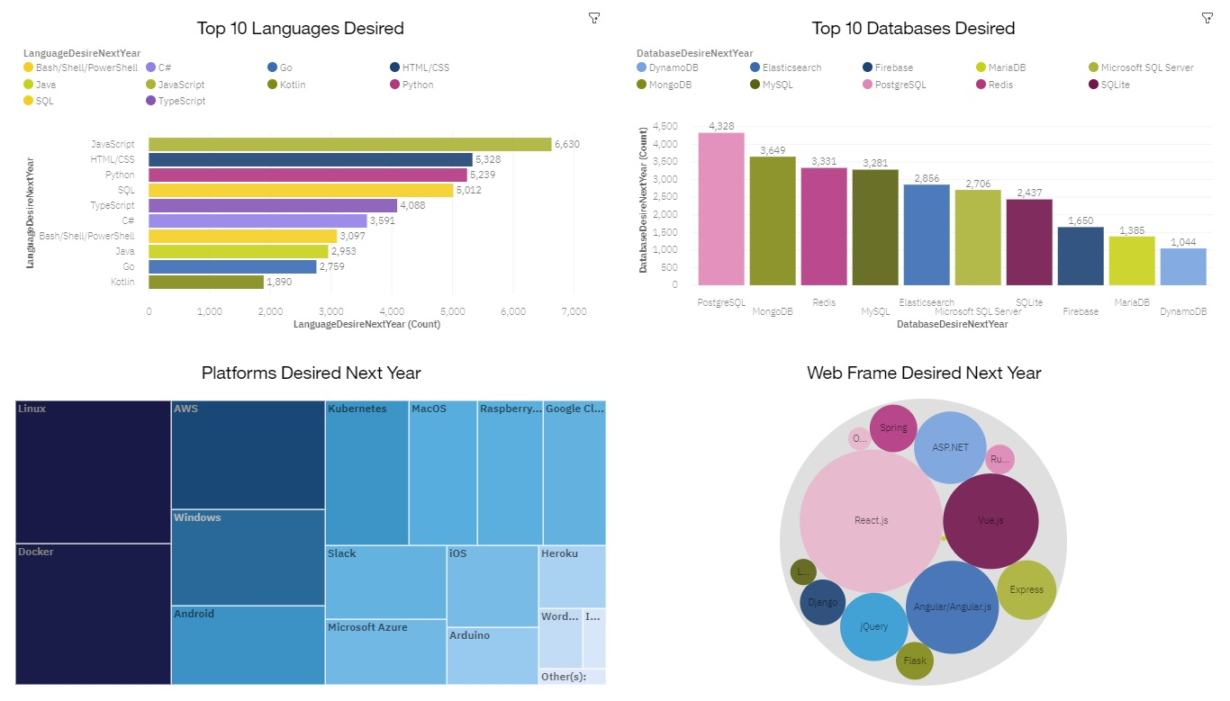
FUTURE TECHNOLOGY TREND

Slide 14
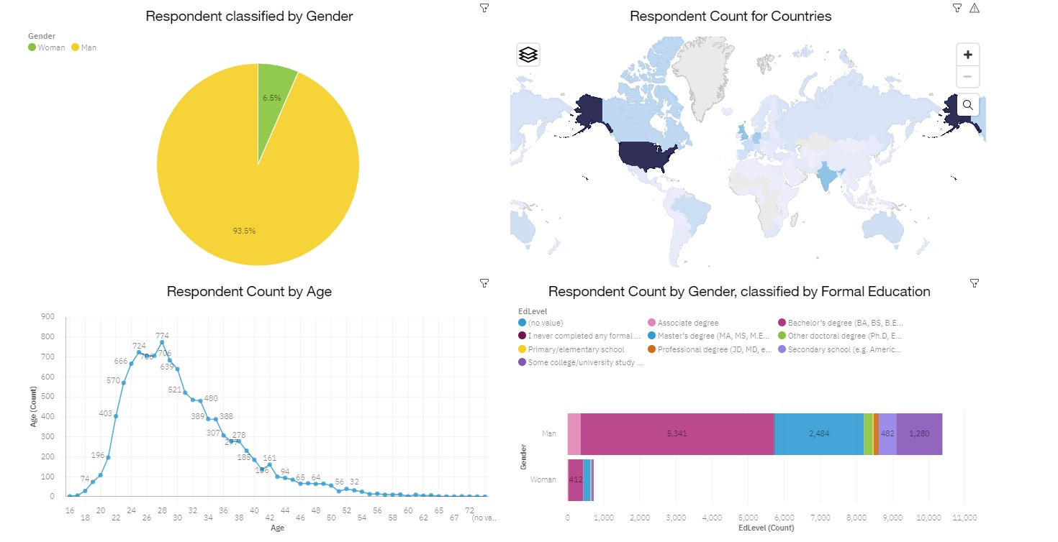
DEMOGRAPHICS

Slide 15
DISCUSSION
Python, HTML 5, and JavaScript are perennially popular, widely used languages with broad support
Niche languages, like Swift, are not present in large numbers
While increasing in popularity among programmers, MongoDB has relatively few job openings

Slide 16
OVERALL FINDINGS & IMPLICATIONS
Findings
JavaScript, HTML 5, and Python most popular language and in demand
SQL popularity is robust – DBs like MongoDB and PostgreSQL jump in popularity
Web and DB languages most popular
Implications
JavaScript, HTML 5, and Python remain best languages to learn
SQL and DBs are increasing in use and popularity
Web programming and DB programming have strong future

Slide 17

CONCLUSION
It is best to learn multiple languages in order to secure a position
Python and JavaScript are highly sought after - #2 and #5 in Github job postings
SQL is important in dealing with multiple databases – MongoDB and PostgreSQL especially
Web programming and Database programming are the sectors seeing increases

Slide 18
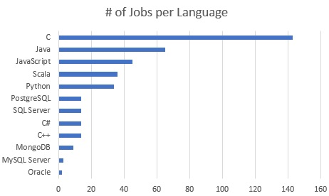
GITHUB JOB POSTINGS

Slide 19
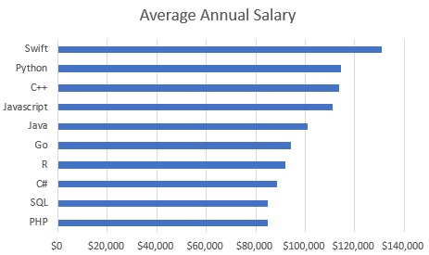
POPULAR LANGUAGES

