Slide 1

FLASHTILE
Knowledge that
finds you.
A tile-first enterprise learning companion
for continuous growth in the flow of work.
ENTERPRISE LEARNING CAPSTONE
Tran, Victoria • Edupuganti, Kranthima • Griffin, Trey
Neel, Jeffrey • Talley, Kyle • Patel, Shrenik
Notes:
Suggested presenter: Patel, Shrenik
Open with the promise: FlashTile brings learning to employees instead of asking employees to leave their workflow to find it.
[Sources]
- /Users/shree/Documents/Codex/2026-09-03/what-is-the-latest-version/presentation-build/assets/logo.png
- /Users/shree/Documents/Codex/2026-09-03/what-is-the-latest-version/FlashTile-RC15/docs/Vision.md
[/Sources]

Slide 2
FLASHTILE
THE OPPORTUNITY
Learning loses when it competes with the workday.
The intent to grow is real. The friction is where, when, and how learning begins.
01
Another destination
Traditional portals ask employees to stop, switch context, and search before learning can start.
02
Too much at once
Long modules are difficult to fit into a full calendar—and easy to postpone.
03
Weak daily momentum
Without a small next step, progress becomes invisible and consistency fades.
Knowledge that finds you. 02
Notes:
Suggested presenter: Patel, Shrenik
Frame the problem without criticizing existing learning platforms. The opportunity is to complement them with a lightweight daily entry point.
[Sources]
- /Users/shree/Documents/Codex/2026-09-03/what-is-the-latest-version/FlashTile-RC15/docs/Proposal.md
[/Sources]

Slide 3
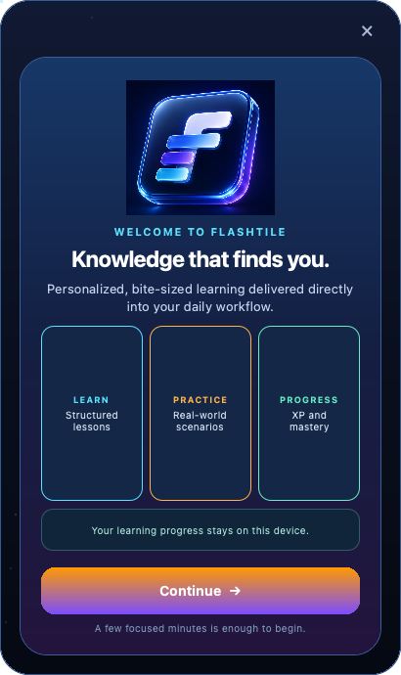
FLASHTILE
THE SOLUTION
FlashTile turns learning into a visible next step.
A compact, always-on-top tile keeps development present without becoming another full-screen application.
It arrives where work happens.
A focused tile stays at the edge of the desktop and opens with purpose—not clutter.
PERSONALIZED
Choose a learning goal.
PRACTICAL
Learn through realistic scenarios.
Knowledge that finds you. 03
Notes:
Suggested presenter: Tran, Victoria
Demonstrate the fixed tile size and emphasize that the product deliberately avoids a dashboard or full-screen shell.
[Sources]
- /Users/shree/Documents/Codex/2026-09-03/what-is-the-latest-version/presentation-build/assets/welcome.png
- /Users/shree/Documents/Codex/2026-09-03/what-is-the-latest-version/FlashTile-RC15/README.md
[/Sources]

Slide 4
FLASHTILE
THE EXPERIENCE
One continuous loop converts intent into progress.
Every launch follows the same clear path; every completion creates the next learning moment.
01
02
03
04
05
WELCOME
CHOOSE GOAL
LEARN
CHECK
PROGRESS
Understand the promise
Select one category
Explore one concept
Apply it in context
Earn XP and recall
Complete a flash, choose confidence, and continue—without a daily ceiling.
The tile remembers progress locally and returns with the next relevant lesson.
Knowledge that finds you. 04
Notes:
Suggested presenter: Tran, Victoria
Walk left to right. Stress that the sequence is deterministic and category-bound: AWS remains AWS until the learner changes it.
[Sources]
- /Users/shree/Documents/Codex/2026-09-03/what-is-the-latest-version/FlashTile-RC15/README.md
- /Users/shree/Documents/Codex/2026-09-03/what-is-the-latest-version/FlashTile-RC15/services/learning_service.py
[/Sources]

Slide 5
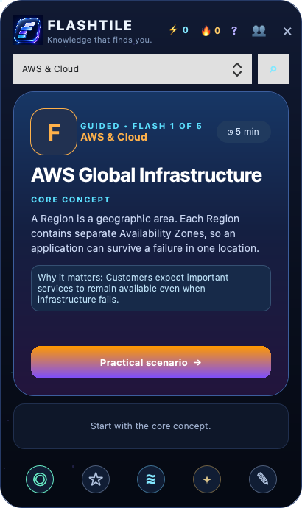
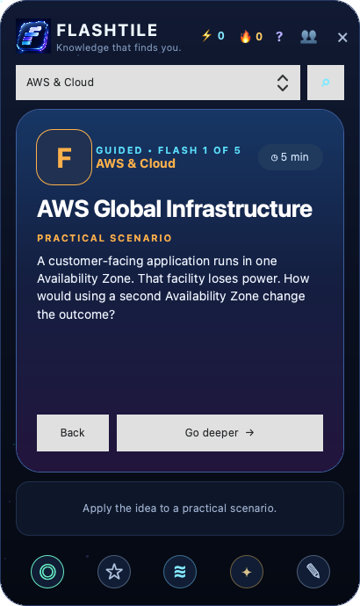
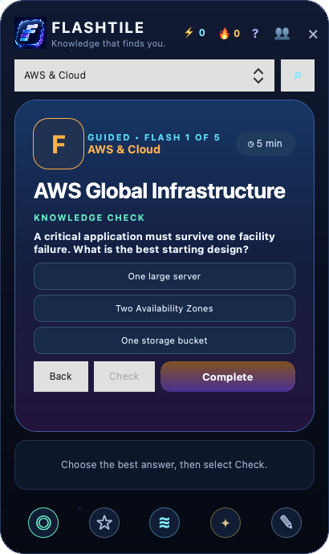
FLASHTILE
LEARNING DESIGN
Learning moves from clarity to application.
The same evidence-informed sequence works across cloud, AI/ML, and digital trust.
Go deeper is optional.
Reflection and recall make it stick.
Clear first.
Relevant next.
Test differently.
CORE CONCEPT
PRACTICAL SCENARIO
KNOWLEDGE CHECK
Knowledge that finds you. 05
Notes:
Suggested presenter: Edupuganti, Kranthima
Use the screenshots to show that FlashTile teaches before it tests. The practical scenario is deliberately different from the quiz formulation.
[Sources]
- /Users/shree/Documents/Codex/2026-09-03/what-is-the-latest-version/presentation-build/assets/lesson.png
- /Users/shree/Documents/Codex/2026-09-03/what-is-the-latest-version/presentation-build/assets/scenario.png
- /Users/shree/Documents/Codex/2026-09-03/what-is-the-latest-version/presentation-build/assets/quiz.png
- /Users/shree/Documents/Codex/2026-09-03/what-is-the-latest-version/FlashTile-RC15/docs/LearningMethod.md
[/Sources]

Slide 6
FLASHTILE
WHY IT STANDS OUT
The differentiator is delivery—not another content catalog.
FlashTile combines a distinctive form factor with practical learning mechanics.
TILE-FIRST
CATEGORY-BOUND
Learning stays visible at the edge of the workday.
The selected goal controls every following lesson.
SMART RECALL
HUMAN DETAILS
Confidence schedules a different future scenario.
Notes, bookmarks, breathing reset, and recognition support consistency.
Small interactions. One coherent learning habit.
Knowledge that finds you. 06
Notes:
Suggested presenter: Edupuganti, Kranthima
Connect every differentiator back to learning. The breathing action and team recognition are intentionally secondary, not separate product pillars.
[Sources]
- /Users/shree/Documents/Codex/2026-09-03/what-is-the-latest-version/FlashTile-RC15/README.md
- /Users/shree/Documents/Codex/2026-09-03/what-is-the-latest-version/FlashTile-RC15/docs/LearningMethod.md
[/Sources]

Slide 7
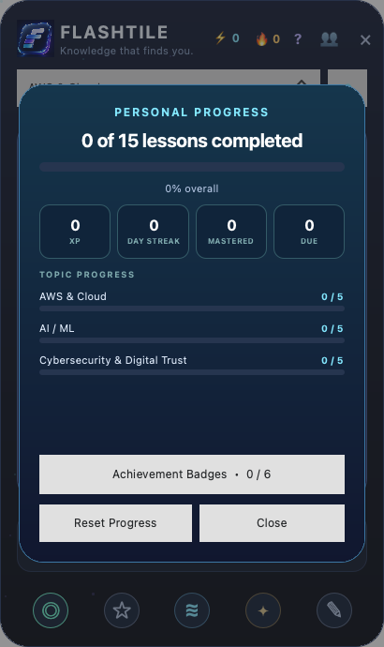
FLASHTILE
WHAT WORKS NOW
RC15 proves the complete tile-first learning loop.
The current candidate is runnable on macOS, Windows-ready, and backed by automated checks.
15
3
CURATED LESSONS
LEARNING CATEGORIES
29
410×690
AUTOMATED TESTS
FIXED TILE GEOMETRY
Verified: onboarding, goal mapping, category filtering, completion, XP, notes, recall, and asset integrity.
Knowledge that finds you. 07
Notes:
Suggested presenter: Griffin, Trey
These are implementation facts from RC15—not adoption claims. Mention that 29 tests cover the corrected three-goal mapping and category-only navigation.
[Sources]
- /Users/shree/Documents/Codex/2026-09-03/what-is-the-latest-version/presentation-build/assets/progress.png
- /Users/shree/Documents/Codex/2026-09-03/what-is-the-latest-version/FlashTile-RC15/README.md
- /Users/shree/Documents/Codex/2026-09-03/what-is-the-latest-version/FlashTile-RC15/tests/test_learning_service.py
[/Sources]

Slide 8
FLASHTILE
ENTERPRISE TRUST
Trust is designed in before intelligence is connected.
The current release is local by default; future AI and identity integrations remain replaceable services.
LOCAL TODAY
CONTROLLED TOMORROW
Progress and settings stay in a local Excel workbook.
SSO, grounded AI, and team services connect behind clear interfaces.
No customer data, credentials, secrets, or confidential business information is required.
Leaderboard participation remains optional; raw identity keys stay out of the interface; approved sources ground future content.
Design principle
Minimum data. Clear purpose. Replaceable integrations.
Knowledge that finds you. 08
Notes:
Suggested presenter: Griffin, Trey
Be explicit that RC15 does not claim production SSO or live AI. The architecture is ready for those controlled integrations after governance approval.
[Sources]
- /Users/shree/Documents/Codex/2026-09-03/what-is-the-latest-version/FlashTile-RC15/docs/Vision.md
- /Users/shree/Documents/Codex/2026-09-03/what-is-the-latest-version/FlashTile-RC15/README.md
[/Sources]

Slide 9
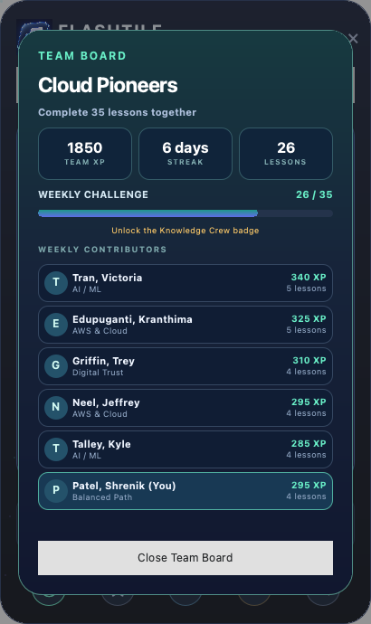
FLASHTILE
SOCIAL LEARNING
Team momentum adds encouragement without adding noise.
Shared goals and recognition stay secondary to the individual learning experience.
SIX CONTRIBUTORS
01
Tran, Victoria
02
Edupuganti, Kranthima
03
Griffin, Trey
04
Neel, Jeffrey
05
Talley, Kyle
06
Patel, Shrenik
Shared challenge • Appreciation • Opt-in leaderboard
Knowledge that finds you. 09
Notes:
Suggested presenter: Neel, Jeffrey
Position Team Board as a capability preview using local illustrative data. Emphasize privacy: no personal notes, quiz answers, or confidence ratings are shared.
[Sources]
- /Users/shree/Documents/Codex/2026-09-03/what-is-the-latest-version/presentation-build/assets/team.png
- /Users/shree/Documents/Codex/2026-09-03/what-is-the-latest-version/FlashTile-RC15/services/learning_service.py
- /Users/shree/Documents/Codex/2026-09-03/what-is-the-latest-version/FlashTile-RC15/docs/UserTestChecklist.md
[/Sources]

Slide 10
FLASHTILE
ARCHITECTURE
One interface connects the MVP to enterprise services.
The UI does not need to change when storage, identity, or content providers evolve.
FLASH TILE
LEARNING
SERVICES
DATA
ENTERPRISE
PySide6 + QML
Lesson + recall
Clear interfaces
Excel today
SSO • AI • APIs
Replace the adapter—not the learning experience.
Cross-platform UI • local-first resilience • controlled upgrade path
Knowledge that finds you. 10
Notes:
Suggested presenter: Neel, Jeffrey
Explain the architecture at a business level. Excel proves the workflow now; a later repository or API can replace it behind the same service boundary.
[Sources]
- /Users/shree/Documents/Codex/2026-09-03/what-is-the-latest-version/FlashTile-RC15/README.md
- /Users/shree/Documents/Codex/2026-09-03/what-is-the-latest-version/FlashTile-RC15/services/excel_service.py
- /Users/shree/Documents/Codex/2026-09-03/what-is-the-latest-version/FlashTile-RC15/services/learning_service.py
[/Sources]

Slide 11
FLASHTILE
PATH TO V1.0
The next milestone is a controlled pilot.
Stabilize the core, measure learning behavior, then earn the right to expand.
NOW
NEXT
PILOT
EXPAND
RC15 candidate
v1.0 release
Small cohort
Approved services
Mac acceptance
Windows package
Measure usage
SSO + grounded AI
Measure what matters
Activation • Lesson completion • Recall success • Repeat use • User feedback
Knowledge that finds you. 11
Notes:
Suggested presenter: Talley, Kyle
The roadmap deliberately prioritizes acceptance and packaging before AI expansion. Proposed pilot measures are evaluation categories, not claimed results.
[Sources]
- /Users/shree/Documents/Codex/2026-09-03/what-is-the-latest-version/FlashTile-RC15/docs/Roadmap.md
- /Users/shree/Documents/Codex/2026-09-03/what-is-the-latest-version/FlashTile-RC15/docs/ReleaseChecklist.md
[/Sources]

Slide 12
FlashTile brings learning
to the employee.
Small enough for the workday.
Practical enough to remember.
Structured for enterprise trust.
OUR ASK
Support a controlled v1.0 pilot.
Tran, Victoria • Edupuganti, Kranthima • Griffin, Trey
Neel, Jeffrey • Talley, Kyle • Patel, Shrenik
Notes:
Suggested presenter: Talley, Kyle
Close by returning to the opening promise. Ask judges to evaluate FlashTile as a focused pilot candidate with a working core and a disciplined enterprise path.
[Sources]
- /Users/shree/Documents/Codex/2026-09-03/what-is-the-latest-version/presentation-build/assets/logo.png
- /Users/shree/Documents/Codex/2026-09-03/what-is-the-latest-version/FlashTile-RC15/docs/Proposal.md
[/Sources]

