Slide 1
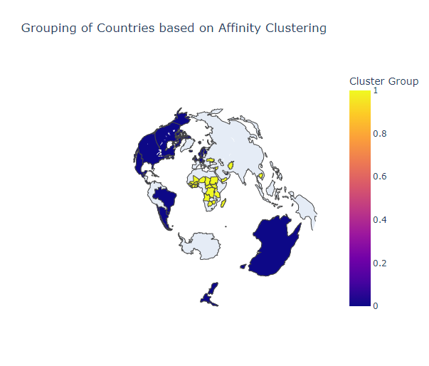
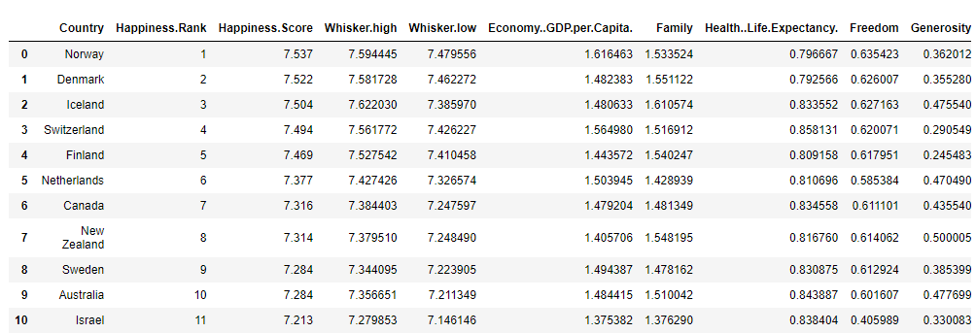
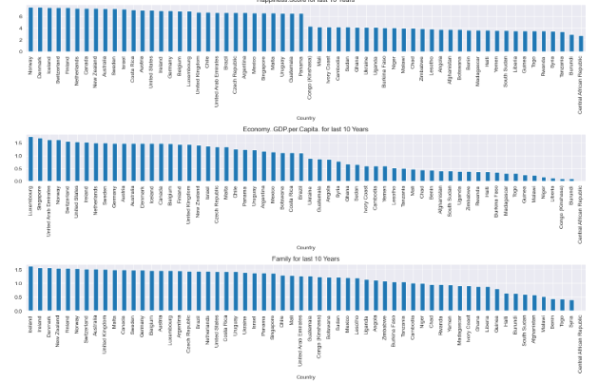
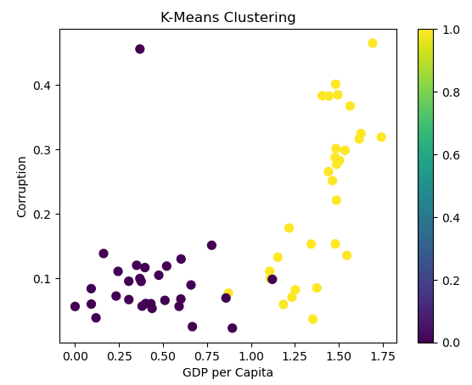
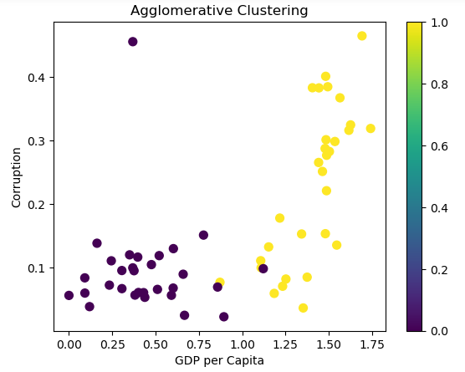
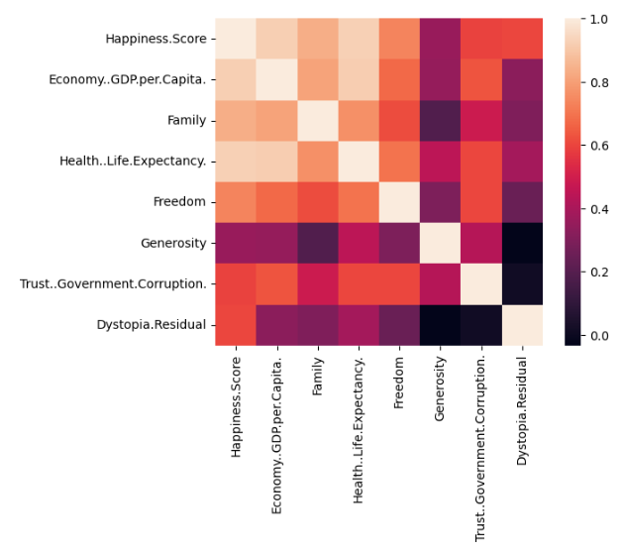
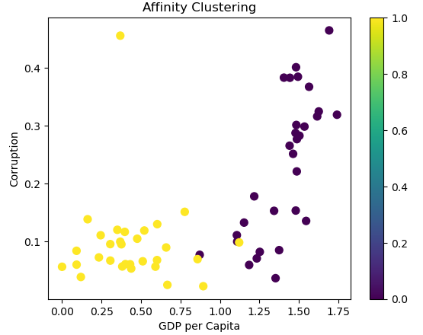
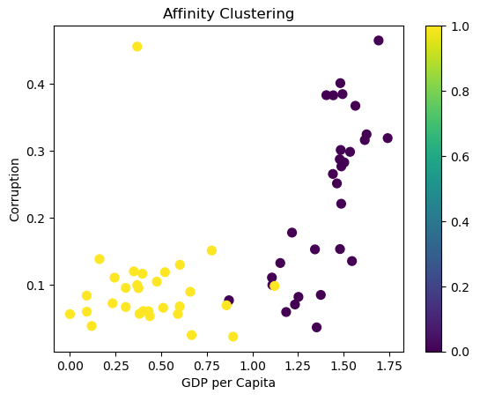
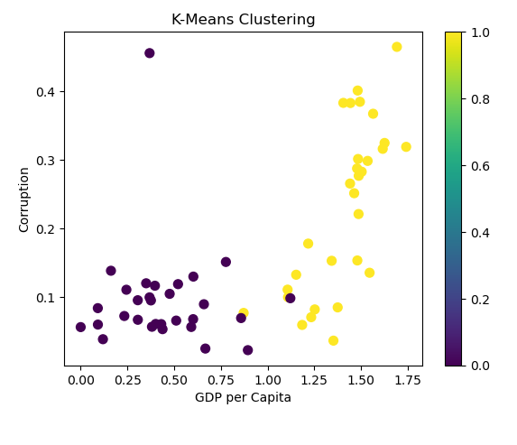
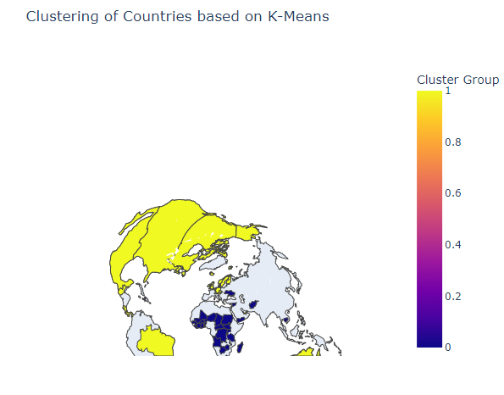
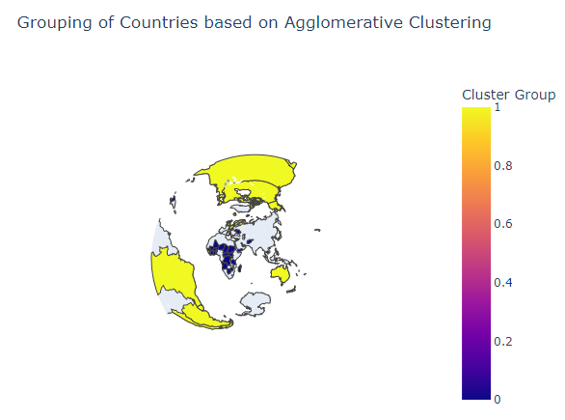
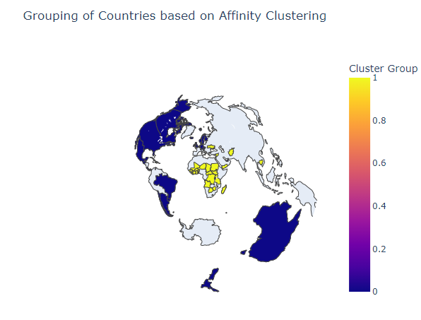
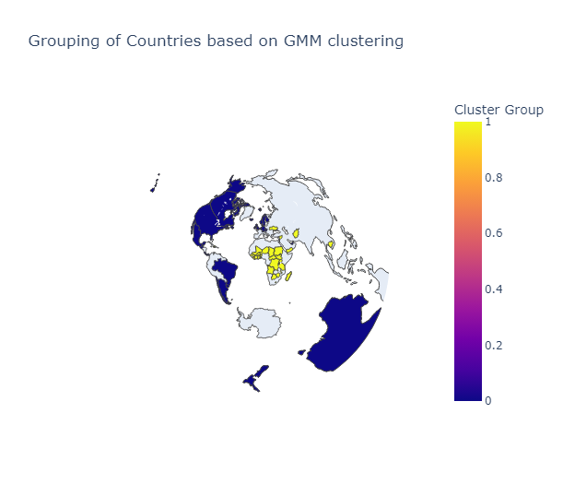
SHERIN DOROTHY
BAKKIARAJ
21032279
Clustering & GDP of World Happiness Report
Your name and the names of the people who have contributed to this presentation go here. The names and addresses of the associated institutions go here. Github:
https://github.com/29-sherin/clustering-and-fitting
Introduction
Data Distribution
Importing Tables & Graphs
This project shows basic visualization of data using Choropleth maps. Further, it tries to cluster the data using few clustering algorithms including K-means and Gaussian Mixture Model based on several factors such as GDP per capita, life expectancy, corruption etc. We have considered 2017 data only.
The data set that we have used have preprocess data and organized data. In our data set we have 12 Column in which One is integer and rest of them are float while one is object type which is the names of Country.
GITHUB LINK:
Data set that I have used and the some of the chart that I designed through all process are as follow:
Figure 5
Clustering and Fitting
Clustering is a technique used to group similar data points together. There are various clustering algorithms available in Python, such as K-Means, Hierarchical Clustering, and DBSCAN. Each algorithm has its own advantages and disadvantages, and the choice of algorithm depends on the specific use case.
We have use the Visualize the data using 4 different clustering techniques that are shown as follow:
https://github.com/29-sherin/clustering-and-fitting
Data Distribution
Research Poster Design Services
Quick visual analysis of heat map of clustering of countries shows that k-means, Agglomerative and GMM gives similar results. Affinity propagation clustering has grouped the countries into 10 clusters. Since clustering is unsupervised learning algorithm and since there is no clustering/target provided in the dataset, we are not able to analyse which algorithm performs better.
Otherwise, the best model for our data can be determined using metrics such as Normalized Mutual Information and Adjusted Rand Score.
Then using the above clustering data we have Visualized the country base clustering like how much people are happy in a particular county and shown that through the map and different colors as you can see below:
Figure 1
Figure 2
Contact Information
Figure 9: Original image at 100%, enlarged 200% and 400%.
Headers
The blue header bars are used to identify and separate the main topics of your presentation. The most commonly used headers in poster presentations are:
Introduction, Summary or Abstract | Table & Graph
Data Distribution | Conclusion
Clustering & Fitting | Contact Info
Figure 3

