Slide 1
Priya Sakthi A
Recurrent Neural Network
3/21/2024 Annual Review

Slide 2
Recurrent Neural Network
3/21/2024 Annual Review

Slide 3


AGENDA
1.Problem Statement
2.Problem Overview
3.End Users
4.Proposed Solution
5.Wow content
6.Modelling
7.Results
3/21/2024 Annual Review

Slide 4

PROBLEM STATEMENT
1.Utilize weather parameters such as temperature, rainfall, and humidity.
2.Incorporate past crop yield records for training.
3.Optimize model architecture and hyperparameters for accuracy.
4.Aim to improve agricultural planning and resource allocation.
5.Ensure scalability for diverse crop types and regions.
6.Enhance food security by providing reliable yield forecasts.

Slide 5

PROJECT OVERVIEW
1.Merge weather and crop yield datasets.
2.Normalize data for model training.
3.Design and train RNN model architecture.
4.Evaluate model performance with test data.
5.Optimize hyperparameters for accuracy.
6.Aim to improve agricultural planning and food security.
3/21/2024 Annual Review

Slide 6

END USERS
1.Upload historical weather and crop yield datasets.
2.Run the RNN model to predict crop yields.
3.View predicted crop yields for planning and decision-making.
4.Adjust model settings for accuracy if needed.
5.Utilize forecasted yields for resource allocation.
6.Enhance agricultural planning and ensure food security.
3/21/2024 Annual Review

Slide 7

Proposed Solution
1.Merge weather and crop yield data for each region.
2.Normalize input data for model training.
3.Design RNN architecture with LSTM cells for sequence prediction.
4.Train the model on historical data.
5.Evaluate model performance using test dataset.
6.Utilize model for accurate crop yield forecasts.
3/21/2024 Annual Review

Slide 8

WOW Content
1.Introduction: Explain the importance of accurate crop yield prediction for agriculture.
2.Data Preparation: Merge historical weather and crop yield datasets.
3.Preprocessing: Normalize data and prepare it for model training.
4.Model Development: Design RNN architecture using LSTM cells.
5.Training and Evaluation: Train the model on historical data and evaluate its performance.
6.Conclusion: Discuss the potential impact of accurate yield prediction on agriculture and food security.
3/21/2024 Annual Review
‹#›

Slide 9
MODELLING
1.Data Preprocessing: Merge weather and yield datasets, handle missing values.
2.Feature Engineering: Extract relevant features, normalize data.
3.Model Selection: Choose RNN architecture (e.g., LSTM, GRU).
4.Model Training: Train RNN on historical data, optimize hyperparameters.
5.Validation: Evaluate model performance using test dataset.
6.Deployment: Deploy model for real-time crop yield prediction.
3/21/2024 Annual Review
‹#›

Slide 10
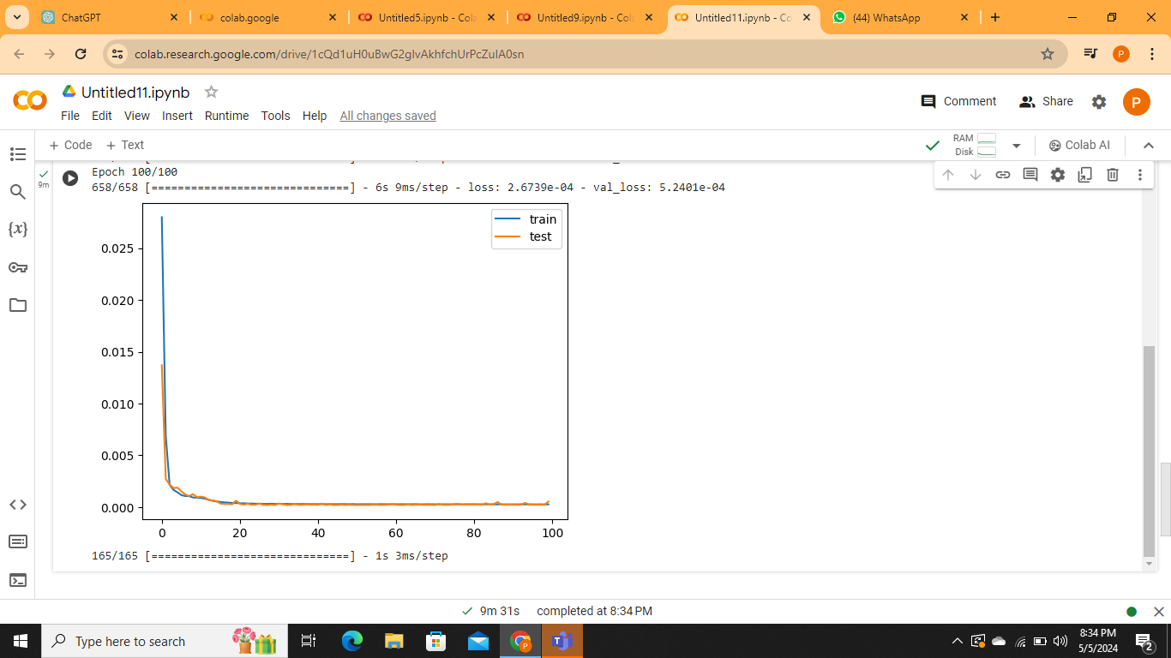
RESULTS
‹#›

