Slide 1
Priya Sakthi A
Convolutional Neural Network
3/21/2024 Annual Review

Slide 2
Convolutional Neural Network
3/21/2024 Annual Review

Slide 3


AGENDA
1.Problem Statement
2.Problem Overview
3.End Users
4.Proposed Solution
5.Wow content
6.Modelling
7.Results
3/21/2024 Annual Review

Slide 4

PROBLEM STATEMENT
The CIFAR-10 dataset is a widely-used benchmark in the field of computer vision for image classification tasks. It consists of 60,000 32x32 color images in 10 classes, with 6,000 images per class. The task is to build a Convolutional Neural Network (CNN) model to accurately classify these images into their respective categories.The primary challenge lies in developing a CNN architecture that can effectively learn and extract features from the low-resolution, small-sized images in CIFAR-10 while maintaining a high level of accuracy. Additionally, given the diversity of objects and scenes in the dataset, the model must generalize well to unseen data and avoid overfitting.

Slide 5

PROJECT OVERVIEW
This project aims to develop a Convolutional Neural Network (CNN) for classifying images in the CIFAR-10 dataset. The CNN architecture will be implemented, trained, and evaluated for accurate classification. Preprocessing techniques will be applied to enhance model performance. Through rigorous analysis, the model's efficacy will be assessed and compared with existing benchmarks.
3/21/2024 Annual Review

Slide 6

END USERS
1.Researchers in Computer Vision
2.Academic Institutions
3.Industry Professionals
4.Developers and Engineers
5.Startups and Entrepreneurs
6.Government Agencies
7.Nonprofit Organizations
3/21/2024 Annual Review

Slide 7

Proposed Solution
1.Import Dependencies: Import necessary libraries, such as TensorFlow and Keras.
2.Load Dataset: Load the CIFAR-10 dataset using the provided functions in TensorFlow/Keras.
3.Preprocess Data: Preprocess the images by scaling pixel values to the range [0, 1] and one-hot encode the labels.
4.Define Model Architecture: Define the CNN model architecture using convolutional layers, pooling layers, and fully connected layers.
5.Compile Model: Compile the model by specifying the optimizer, loss function, and metrics to monitor during training.
6.Train Model: Train the model on the training data using the fit() function, specifying the number of epochs and batch size.
7.Evaluate Model: Evaluate the trained model on the test data to measure its performance in terms of accuracy.
8.Iterate and Optimize: Experiment with different architectures, hyperparameters, and regularization techniques to improve performance.
3/21/2024 Annual Review

Slide 8

WOW Content
The CIFAR-10 dataset is loaded and preprocessed by scaling pixel values and one-hot encoding labels. A sequential CNN model is defined with convolutional and pooling layers, followed by flattening and dense layers. The model is compiled with Adam optimizer and categorical cross-entropy loss. Training is performed on the training data for 10 epochs with a batch size of 64, validating on the test data. Finally, the model is evaluated for accuracy on the test set. This concise approach encapsulates the entire process of building and training a CNN for the CIFAR-10 dataset.
3/21/2024 Annual Review
‹#›

Slide 9
MODELLING
1.Import necessary libraries such as TensorFlow or PyTorch for deep learning operations and CIFAR-10 dataset.
2.Load the CIFAR-10 dataset, including training and testing sets, ensuring to normalize the pixel values to be between 0 and 1.
3.Define the architecture of the CNN model. Typically, it consists of convolutional layers, activation functions (e.g., ReLU), pooling layers, and fully connected layers.
4.Compile the model by specifying the loss function (e.g., categorical cross-entropy), optimizer (e.g., Adam), and metrics (e.g., accuracy).
5.Train the model on the training data, specifying the number of epochs and batch size.
6.Evaluate the model's performance on the testing data to assess its accuracy and generalization.
7.Optionally, fine-tune hyperparameters or the model architecture based on the evaluation results to improve performance.
8.Save the trained model for future use or deployment.
3/21/2024 Annual Review
‹#›

Slide 10
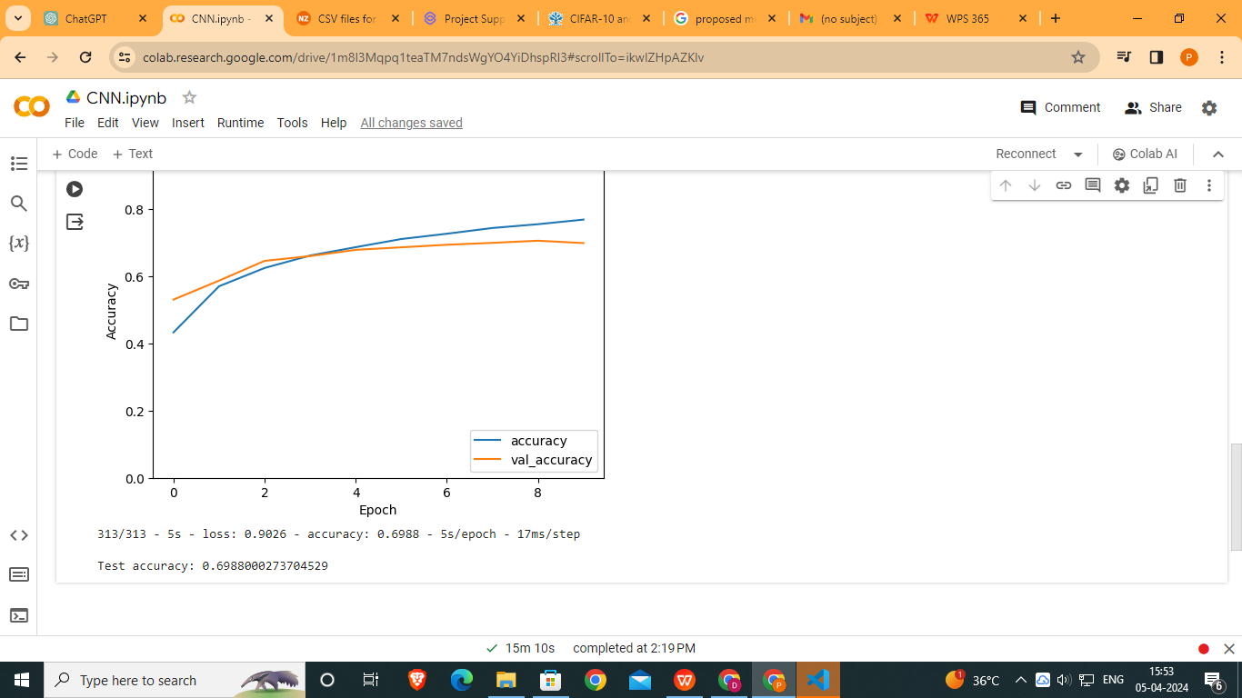
RESULTS
‹#›

