Slide 1
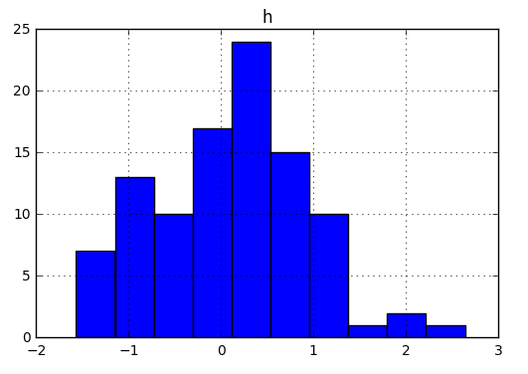
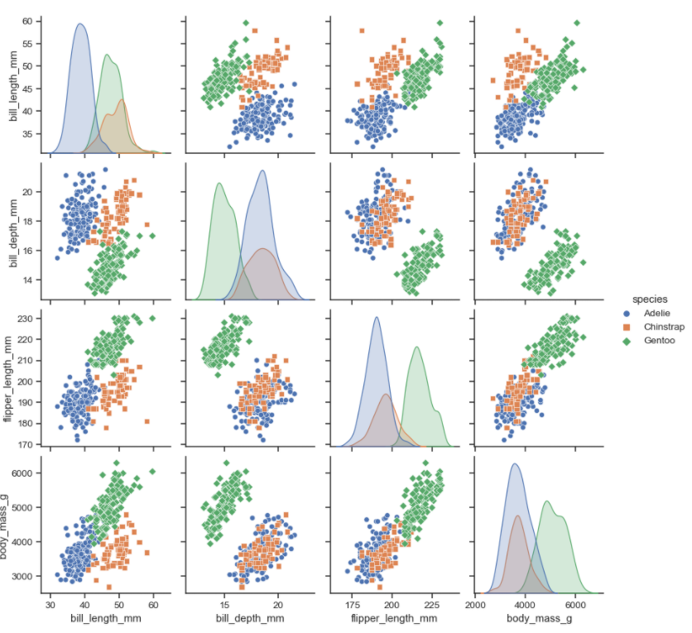
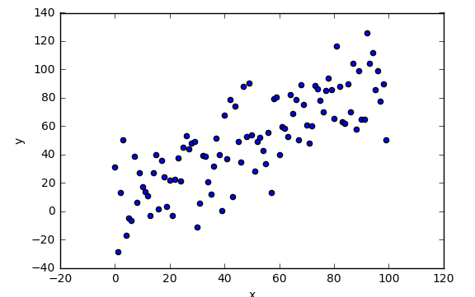
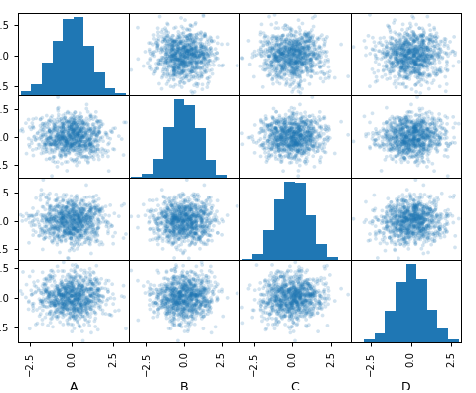
General
Display & Visualize data
Pandas API Reference Pandas User Guide
Seaborn API Reference
Matplotlib API Reference
Display options for DataFrames: pd.set_option('display.max_rows', 4) pd.reset_option('display.max_rows‘) with pd.option_context('display.max_rows', 4):
only sets options within the „with“ codeblock
Style options for DataFrames (Cell highlighting, heatmapping ..)
Visualize Data in plots
seaborn.pairplot(df, hue=‘column_name’)
Matrix of pairwise relationship (for classification)
df.plot.hist()
Histogram for each column
df.plot.scatter(x='w',y='h')
Scatter chart using pairs of points
df.plotting.scatter_matrix(…) Matrix of scatter plots and histograms (for regression)
Creating DataFrames
 | a | b | c
1 | 4 | 7 | 10
2 | 5 | 8 | 11
3 | 6 | 9 | 12
Reshaping Data – Change layout, sorting, reindexing, renaming
df.sort_values('mpg')
Order rows by values of a column (low to high).
df.sort_values('mpg',ascending=False)
Order rows by values of a column (high to low).
df.rename(columns = {'y':'year'})
Rename the columns of a DataFrame
df.sort_index()
Sort the index of a DataFrame
df.reset_index()
Reset index of DataFrame to row numbers, moving index to columns.
df.drop(columns=['Length','Height'])
Drop columns from DataFrame
use IO-Tools to import from files df = pd.read_csv(“filepath”)
df = pd.DataFrame(
{"a" : [4 ,5, 6],
"b" : [7, 8, 9],
"c" : [10, 11, 12]},
index = [1, 2, 3])
Specify values for each column.
df = pd.DataFrame(
[[4, 7, 10],
[5, 8, 11],
[6, 9, 12]],
index=[1, 2, 3],
columns=['a', 'b', 'c'])
Specify values for each row.
pd.melt(df)
Gather columns into rows.
df.pivot(columns='var', values='val')
Spread rows into columns.
pd.concat([df1,df2])
Append rows of DataFrames
pd.concat([df1,df2], axis=1)
Append columns of DataFrames
 |  | a | b | c
n | v
d | 1 | 4 | 7 | 10
 | 2 | 5 | 8 | 11
e | 2 | 6 | 9 | 12
Subset Observations – Selecting Data: rows or columns
df[df.Length > 7]
Extract rows that meet logical criteria.
df.drop_duplicates()
Remove duplicate rows (only considers columns).
df.head(n)
Select first n rows.
df.tail(n)
Select last n rows.
df.sample(frac=0.5)
Randomly select fraction of rows.
df.sample(n=10)
Randomly select n rows.
df.iloc[row_ind, column_ind]
df.iloc[10:20]
Select rows by position.
df.iloc[:,[1,2,5]]
Select columns in positions 1, 2 and 5 (first column is 0).
df.loc[row_ind, column_ind]
df.loc[:,'x2':'x4']
Select all columns between x2 and x4 (inclusive).
df.loc[df['a'] > 10, ['a','c']]
Select rows meeting logical condition, and only the specific columns .
df[['width','length','species']]
Select multiple columns with specific names.
df['width'] or df.width
Select single column with specific name.
df.filter(regex='regex')
Select columns whose name matches regular expression regex.
df.nlargest(n, 'value')
Select and order top n entries.
df.nsmallest(n, 'value')
Select and order bottom n entries.
df = pd.DataFrame(
{"a" : [4 ,5, 6],
"b" : [7, 8, 9],
"c" : [10, 11, 12]}, index = pd.MultiIndex.from_tuples(
[('d',1),('d',2),('e',2)],
names=['n','v']))
Create DataFrame with a MultiIndex
Method Chaining
Most pandas methods return a DataFrame so that another pandas method can be applied to the result. df = (pd.melt(df)
.rename(columns={
'variable' : 'var',
'value' : 'val'})
.query('val >= 200')
)
Logic in Python (and pandas)
< | Less than | != | Not equal to
> | Greater than | df.column.isin(values) | Group membership
== | Equals | pd.isnull(obj) | Is NaN
<= | Less than or equals | pd.notnull(obj) | Is not NaN
>= | Greater than or equals | &,|,~,^,df.any(),df.all() | Logical and, or, not, xor, any, all
regex (Regular Expressions) Examples
'\.' | Matches strings containing a period '.'
'Length$' | Matches strings ending with word 'Length'
'^Sepal' | Matches strings beginning with the word 'Sepal'
'^x[1-5]$' | Matches strings beginning with 'x' and ending with 1,2,3,4,5
'^(?!Species$).*' | Matches strings except the string 'Species'
Cheatsheet for pandas (http://pandas.pydata.org/ ) based on the official cheatsheet which itself was inspired by Rstudio Data Wrangling Cheatsheet Written by Irv Lustig, Princeton Consultants. Source: https://github.com/OliEfr

Slide 2
Summarize Data
Handling Missing Data
Combine Data Sets
df['w'].value_counts()
Count number of rows with each unique value of variable
len(df)
# of rows in DataFrame.
df['w'].nunique()
# of distinct values in a column.
df.describe()
Basic descriptive statistics for each column (or GroupBy)
df.shape
Length and width of dataset
df.dropna()
Drop rows with any column having NA/null data.
df.fillna(value)
Replace all NA/null data with value.
adf
bdf
x1 | x2
A | 1
B | 2
C | 3
x1 | x3
A | T
B | F
D | T
Make New Columns
Standard Joins
x1 | x2 | x3
A | 1 | T
B | 2 | F
C | 3 | NaN
pd.merge(adf, bdf,
how='left', on='x1')
Join matching rows from bdf to adf.
pd.merge(adf, bdf,
how='right', on='x1')
Join matching rows from adf to bdf.
pd.merge(adf, bdf,
how='inner', on='x1')
Join data. Retain only rows in both sets.
pd.merge(adf, bdf,
how='outer', on='x1')
Join data. Retain all values, all rows.
df.assign(Area=lambda df: df.Length*df.Height)
Compute and append one or more new columns.
df['Volume'] = df.Length*df.Height*df.Depth
Add single column.
pd.qcut(df.col, n, labels=False)
Bin column into n buckets.
x1 | x2 | x3
A | 1.0 | T
B | 2.0 | F
D | NaN | T
pandas provides a large set of summary functions that operate on different kinds of pandas objects (DataFrame columns, Series, GroupBy, Expanding and Rolling (see below)) and produce single values for each of the groups. When applied to a DataFrame, the result is returned as a pandas Series for each column. Examples:
x1 | x2 | x3
A | 1 | T
B | 2 | F
sum()
Sum values of each object.
count()
Count non-NA/null values of each object.
median()
Median value of each object.
quantile([0.25,0.75])
Quantiles of each object.
apply(function)
Apply function to each object.
min()
Minimum value in each object.
max()
Maximum value in each object.
mean()
Mean value of each object.
var()
Variance of each object.
std()
Standard deviation of each object.
Vector function
Vector function
pandas provides a large set of vector functions that operate on all columns of a DataFrame or a single selected column (a pandas Series). These functions produce vectors of values for each of the columns, or a single Series for the individual Series. Examples:
x1 | x2 | x3
A | 1 | T
B | 2 | F
C | 3 | NaN
D | NaN | T
max(axis=1)
Element-wise max.
clip(lower=-10,upper=10)
Trim values at input thresholds
min(axis=1)
Element-wise min.
abs()
Absolute value.
Filtering Joins
adf[adf.x1.isin(bdf.x1)]
All rows in adf that have a match in bdf.
adf[~adf.x1.isin(bdf.x1)]
All rows in adf that do not have a match in bdf.
x1 | x2
A | 1
B | 2
Group Data
df.groupby(by="col“).max()
Return a GroupBy object, grouped by values in column named "col".
df.groupby(level="ind") .mean()
Return a GroupBy object, grouped by values in index level named "ind".
Possibly use df.reset_index() after!
The examples below can also be applied to groups. In this case, the function is applied on a per-group basis, and the returned vectors are of the length of the original DataFrame.
x1 | x2
C | 3
ydf
zdf
shift(1)
Copy with values shifted by 1.
rank(method='dense')
Ranks with no gaps.
rank(method='min')
Ranks. Ties get min rank.
rank(pct=True)
Ranks rescaled to interval [0, 1].
rank(method='first')
Ranks. Ties go to first value.
shift(-1)
Copy with values lagged by 1.
cumsum()
Cumulative sum.
cummax()
Cumulative max.
cummin()
Cumulative min.
cumprod()
Cumulative product.
x1 | x2
A | 1
B | 2
C | 3
x1 | x2
B | 2
C | 3
D | 4
Set-like Operations
All of the summary functions listed above can be applied to a group. Additional GroupBy functions:
x1 | x2
B | 2
C | 3
pd.merge(ydf, zdf)
Rows that appear in both ydf and zdf (Intersection).
pd.merge(ydf, zdf, how='outer')
Rows that appear in either or both ydf and zdf (Union).
pd.merge(ydf, zdf, how='outer',
indicator=True)
.query('_merge == "left_only"')
.drop(columns=['_merge'])
Rows that appear in ydf but not zdf (Setdiff).
size()
Size of each group.
agg(function)
Aggregate group using function.
x1 | x2
A | 1
B | 2
C | 3
D | 4
Windows
Apply Functions
df.expanding()
Return an Expanding object allowing summary functions to be applied cumulatively.
df.rolling(n)
Return a Rolling object allowing summary functions to be applied to windows of length n.
df.pipe() when chaining functions; tablewise fct. application
df.apply() row (axis=1) or column(axis=0) wise fct. application
df.agg()and df.transform() use multiple aggregating operations
df.assign() assigns new columns to a df df.applymap() elementwise function application
x1 | x2
A | 1
Cheatsheet for pandas (http://pandas.pydata.org/ ) based on the official cheatsheet which itself was inspired by Rstudio Data Wrangling Cheatsheet Written by Irv Lustig, Princeton Consultants. Source: https://github.com/OliEfr

