Slide 1
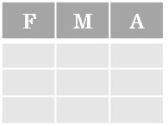
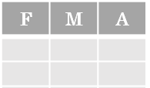



Data Wrangling with pandas Cheat Sheet
http://pandas.pydata.org
Tidy Data – A foundation for wrangling in pandas
&
*
Tidy data complements pandas’s vectorized operations. pandas will automatically preserve observations as you manipulate variables. No other format works as intuitively with pandas.
In a tidy data set:
Pandas API Reference Pandas User Guide
Each variable is saved in its own column
Each observation is saved in its own row
M
*
A
Creating DataFrames
Reshaping Data – Change layout, sorting, reindexing, renaming
 | a | b | c
1 | 4 | 7 | 10
2 | 5 | 8 | 11
3 | 6 | 9 | 12
df.sort_values('mpg')
Order rows by values of a column (low to high).
df.sort_values('mpg’, ascending=False)
Order rows by values of a column (high to low).
df.rename(columns = {'y':'year'})
Rename the columns of a DataFrame
df.sort_index()
Sort the index of a DataFrame
df.reset_index()
Reset index of DataFrame to row numbers, moving index to columns.
df.drop(columns=['Length’, 'Height'])
Drop columns from DataFrame
df = pd.DataFrame(
{"a" : [4, 5, 6],
"b" : [7, 8, 9],
"c" : [10, 11, 12]},
index = [1, 2, 3])
Specify values for each column.
df = pd.DataFrame(
[[4, 7, 10],
[5, 8, 11],
[6, 9, 12]],
index=[1, 2, 3],
columns=['a', 'b', 'c'])
Specify values for each row.
pd.melt(df)
Gather columns into rows.
df.pivot(columns='var', values='val')
Spread rows into columns.
pd.concat([df1,df2])
Append rows of DataFrames
pd.concat([df1,df2], axis=1)
Append columns of DataFrames
Subset Observations - rows
Subset Variables - columns
Subsets - rows and columns
 |  | a | b | c
N | v
D | 1 | 4 | 7 | 10
 | 2 | 5 | 8 | 11
e | 2 | 6 | 9 | 12
Use df.loc[] and df.iloc[] to select only rows, only columns or both. Use df.at[] and df.iat[] to access a single value by row and column.
First index selects rows, second index columns.
df[df.Length > 7]
Extract rows that meet logical criteria.
df.drop_duplicates()
Remove duplicate rows (only considers columns).
df.sample(frac=0.5)
Randomly select fraction of rows.
df.sample(n=10) Randomly select n rows.
df.nlargest(n, 'value’) Select and order top n entries.
df.nsmallest(n, 'value')
Select and order bottom n entries.
df.head(n)
Select first n rows.
df.tail(n)
Select last n rows.
df[['width’, 'length’, 'species']]
Select multiple columns with specific names.
df['width'] or df.width
Select single column with specific name.
df.filter(regex='regex')
Select columns whose name matches regular expression regex.
df = pd.DataFrame(
{"a" : [4 ,5, 6],
"b" : [7, 8, 9],
"c" : [10, 11, 12]}, index = pd.MultiIndex.from_tuples(
[('d’, 1), ('d’, 2), ('e’, 2)], names=['n’, 'v']))
Create DataFrame with a MultiIndex
df.iloc[10:20]
Select rows 10-20.
df.iloc[:, [1, 2, 5]]
Select columns in positions 1, 2 and 5 (first column is 0).
df.loc[:, 'x2':'x4']
Select all columns between x2 and x4 (inclusive).
df.loc[df['a'] > 10, ['a’, 'c']]
Select rows meeting logical condition, and only the specific columns .
df.iat[1, 2] Access single value by index
df.at[4, 'A'] Access single value by label
Using query
query() allows Boolean expressions for filtering rows.
df.query('Length > 7')
df.query('Length > 7 and Width < 8')
df.query('Name.str.startswith("abc")', engine="python")
Method Chaining
Most pandas methods return a DataFrame so that another pandas method can be applied to the result. This improves readability of code.
df = (pd.melt(df)
.rename(columns={
'variable':'var',
'value':'val'})
.query('val >= 200')
)
Logic in Python (and pandas)
< | Less than | != | Not equal to
> | Greater than | df.column.isin(values) | Group membership
== | Equals | pd.isnull(obj) | Is NaN
<= | Less than or equals | pd.notnull(obj) | Is not NaN
>= | Greater than or equals | &,|,~,^,df.any(),df.all() | Logical and, or, not, xor, any, all
regex (Regular Expressions) Examples
'\.' | Matches strings containing a period '.'
'Length$' | Matches strings ending with word 'Length'
'^Sepal' | Matches strings beginning with the word 'Sepal'
'^x[1-5]$' | Matches strings beginning with 'x' and ending with 1,2,3,4,5
'^(?!Species$).*' | Matches strings except the string 'Species'
Cheatsheet for pandas (http://pandas.pydata.org/ originally written by Irv Lustig, Princeton Consultants, inspired by Rstudio Data Wrangling Cheatsheet

Slide 2
Summarize Data
Handling Missing Data
Combine Data Sets
df['w'].value_counts()
Count number of rows with each unique value of variable
len(df)
# of rows in DataFrame.
df.shape
Tuple of # of rows, # of columns in DataFrame.
df['w'].nunique()
# of distinct values in a column.
df.describe()
Basic descriptive and statistics for each column (or GroupBy).
df.dropna()
Drop rows with any column having NA/null data.
df.fillna(value)
Replace all NA/null data with value.
adf
bdf
x1 | x2
A | 1
B | 2
C | 3
x1 | x3
A | T
B | F
D | T
Make New Columns
Standard Joins
pd.merge(adf, bdf,
how='left', on='x1')
Join matching rows from bdf to adf.
pd.merge(adf, bdf,
how='right', on='x1')
Join matching rows from adf to bdf.
pd.merge(adf, bdf,
how='inner', on='x1')
Join data. Retain only rows in both sets.
pd.merge(adf, bdf,
how='outer', on='x1')
Join data. Retain all values, all rows.
x1 | x2 | x3
A | 1 | T
B | 2 | F
C | 3 | NaN
df.assign(Area=lambda df: df.Length*df.Height)
Compute and append one or more new columns.
df['Volume'] = df.Length*df.Height*df.Depth
Add single column.
pd.qcut(df.col, n, labels=False)
Bin column into n buckets.
x1 | x2 | x3
A | 1.0 | T
B | 2.0 | F
D | NaN | T
pandas provides a large set of summary functions that operate on different kinds of pandas objects (DataFrame columns, Series, GroupBy, Expanding and Rolling (see below)) and produce single values for each of the groups. When applied to a DataFrame, the result is returned as a pandas Series for each column. Examples:
x1 | x2 | x3
A | 1 | T
B | 2 | F
sum()
Sum values of each object.
count()
Count non-NA/null values of each object.
median()
Median value of each object.
quantile([0.25,0.75])
Quantiles of each object.
apply(function)
Apply function to each object.
min()
Minimum value in each object.
max()
Maximum value in each object.
mean()
Mean value of each object.
var()
Variance of each object.
std()
Standard deviation of each object.
Vector function
Vector function
pandas provides a large set of vector functions that operate on all columns of a DataFrame or a single selected column (a pandas Series). These functions produce vectors of values for each of the columns, or a single Series for the individual Series. Examples:
x1 | x2 | x3
A | 1 | T
B | 2 | F
C | 3 | NaN
D | NaN | T
max(axis=1)
Element-wise max.
clip(lower=-10,upper=10)
Trim values at input thresholds
min(axis=1)
Element-wise min.
abs()
Absolute value.
Filtering Joins
adf[adf.x1.isin(bdf.x1)]
All rows in adf that have a match in bdf.
adf[~adf.x1.isin(bdf.x1)]
All rows in adf that do not have a match in bdf.
x1 | x2
A | 1
B | 2
Group Data
df.groupby(by="col")
Return a GroupBy object, grouped by values in column named "col".
df.groupby(level="ind")
Return a GroupBy object, grouped by values in index level named "ind".
The examples below can also be applied to groups. In this case, the function is applied on a per-group basis, and the returned vectors are of the length of the original DataFrame.
x1 | x2
C | 3
ydf
zdf
x1 | x2
A | 1
B | 2
C | 3
shift(1)
Copy with values shifted by 1.
rank(method='dense')
Ranks with no gaps.
rank(method='min')
Ranks. Ties get min rank.
rank(pct=True)
Ranks rescaled to interval [0, 1].
rank(method='first')
Ranks. Ties go to first value.
shift(-1)
Copy with values lagged by 1.
cumsum()
Cumulative sum.
cummax()
Cumulative max.
cummin()
Cumulative min.
cumprod()
Cumulative product.
x1 | x2
B | 2
C | 3
D | 4
Set-like Operations
pd.merge(ydf, zdf)
Rows that appear in both ydf and zdf (Intersection).
pd.merge(ydf, zdf, how='outer')
Rows that appear in either or both ydf and zdf (Union).
pd.merge(ydf, zdf, how='outer',
indicator=True)
.query('_merge == "left_only"')
.drop(columns=['_merge'])
Rows that appear in ydf but not zdf (Setdiff).
All of the summary functions listed above can be applied to a group. Additional GroupBy functions:
x1 | x2
B | 2
C | 3
size()
Size of each group.
agg(function)
Aggregate group using function.
x1 | x2
A | 1
B | 2
C | 3
D | 4
Windows
Dropping a Column
df.expanding()
Return an Expanding object allowing summary functions to be applied cumulatively.
df.rolling(n)
Return a Rolling object allowing summary functions to be applied to windows of length n.
> df = pd.DataFrame([('falcon', 'bird', 389.0),
('parrot', 'bird', 24.0),('lion', 'mammal', 80.5),
('monkey','mammal', np.nan)],columns=('name', 'class', 'max_speed'))
> df.pop('class')
The pop functions is used to drop a column in a dataframe
x1 | x2
A | 1
Cheatsheet for pandas (http://pandas.pydata.org/) originally written by Irv Lustig, Princeton Consultants, inspired by Rstudio Data Wrangling Cheatsheet

Slide 3
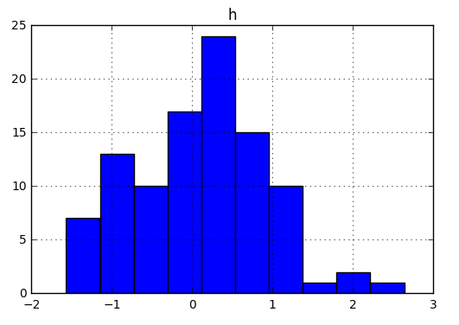
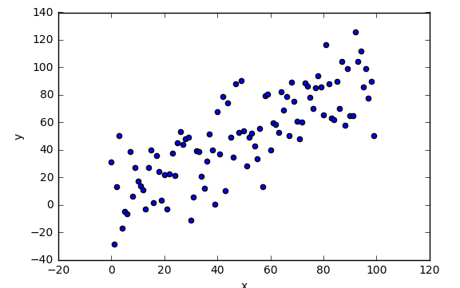
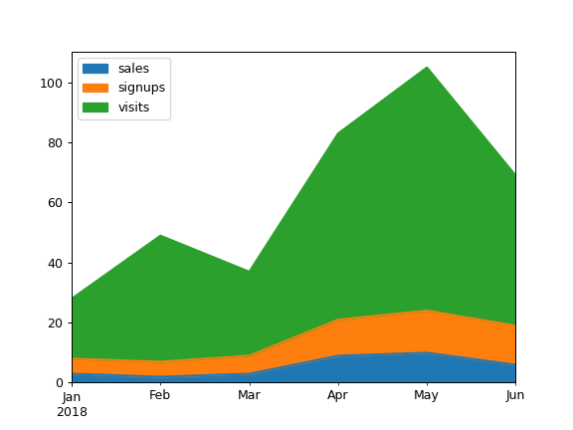
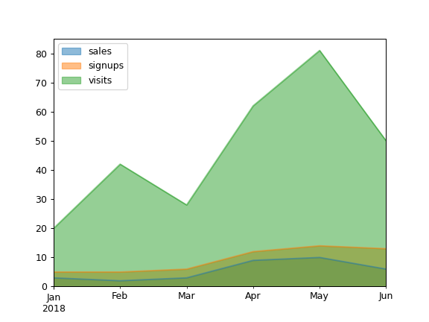
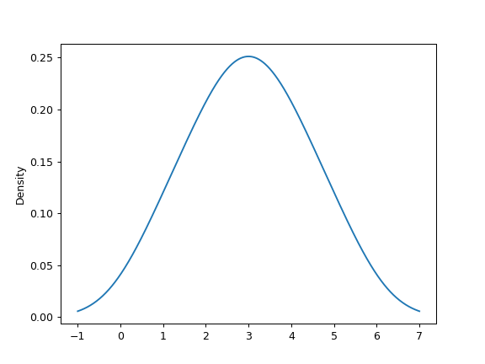
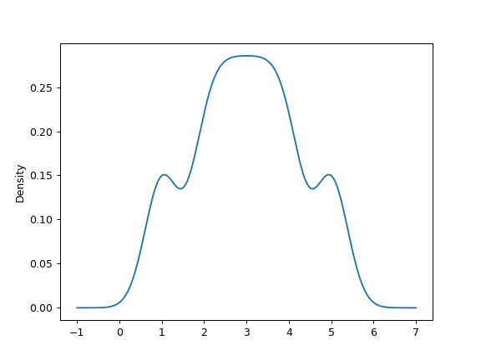
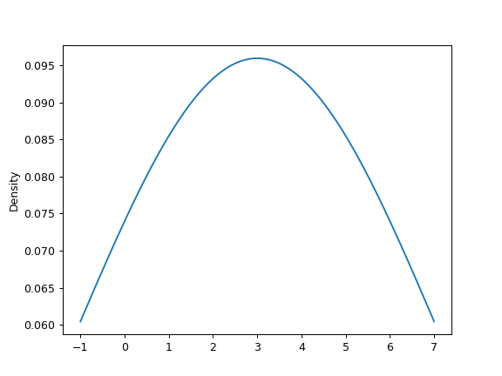
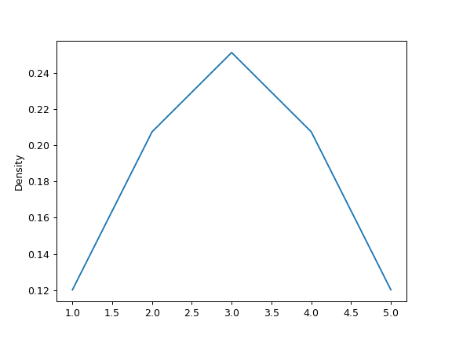
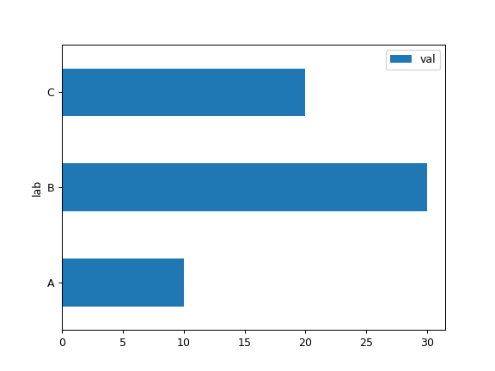
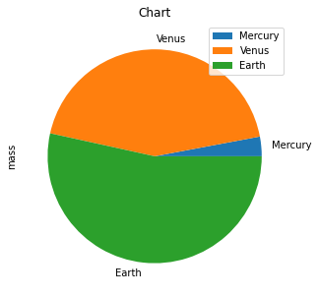
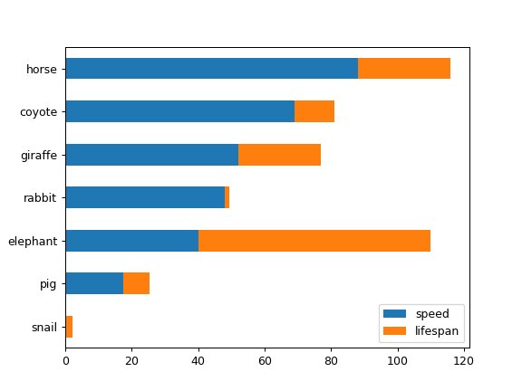
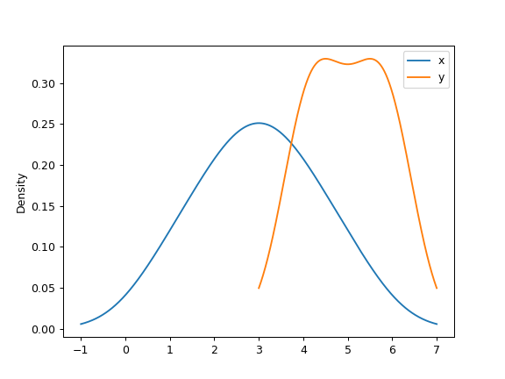
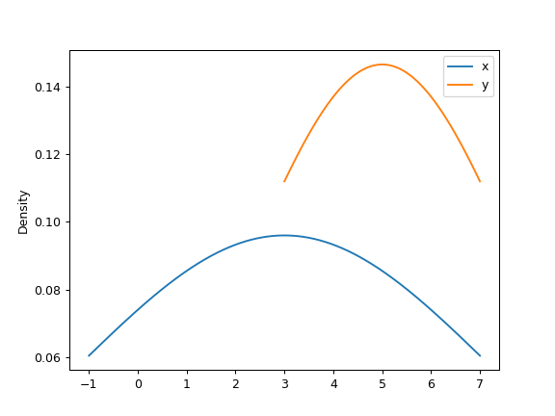
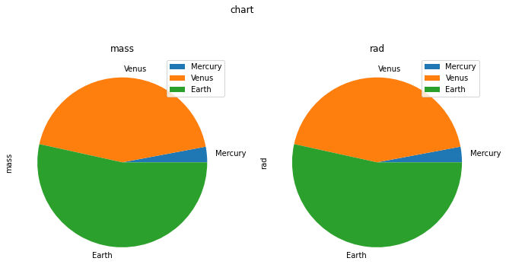
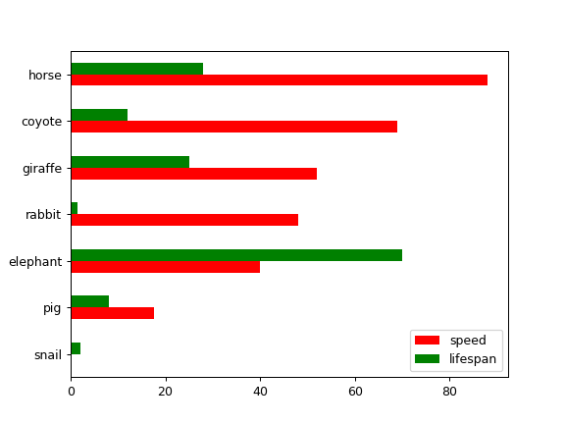
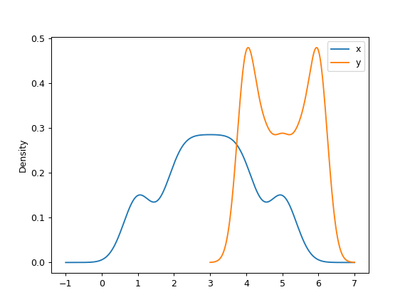
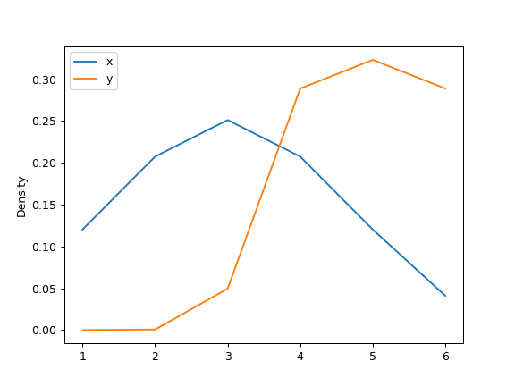
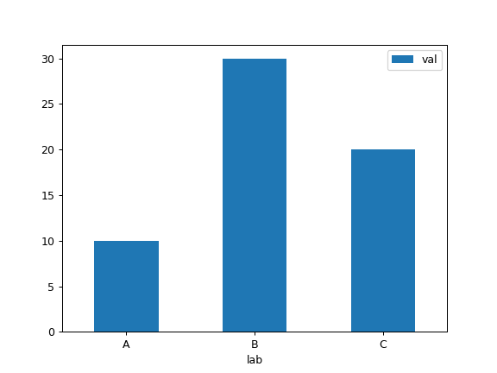
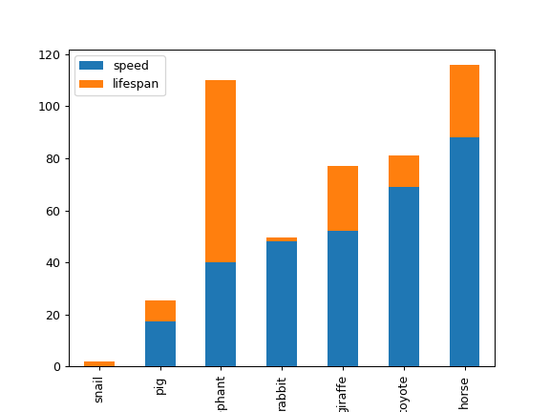
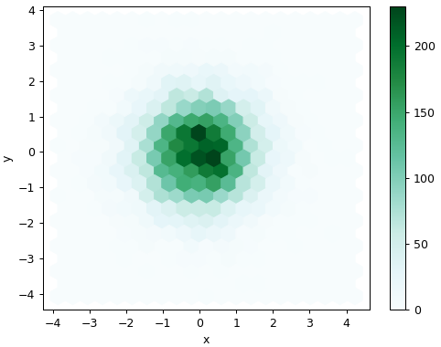
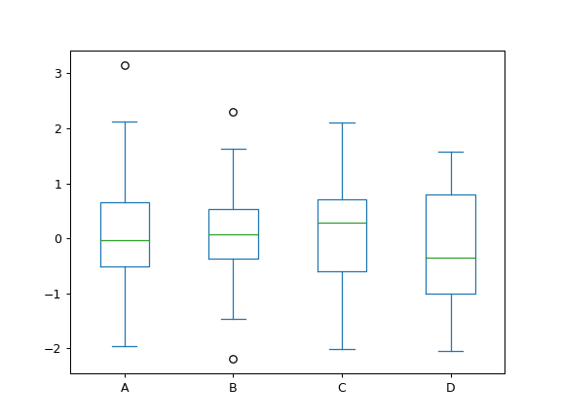
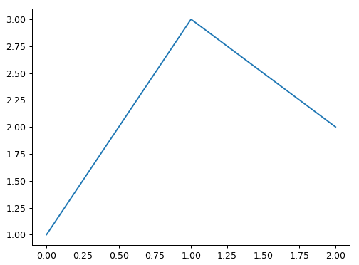
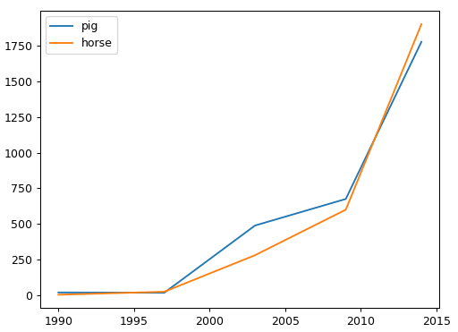
Plotting
Area Plots
Density Plots
df.plot.hist()
Histogram for each column
df.plot.scatter(x='w',y='h')
Scatter chart using pairs of points
df.plot.area()
s.plot.kde()
df.plot.area(stacked=False)
s.plot.kde(bw_method=0.3)
Pie Charts
Horizontal Bar Plot
> df = pd.DataFrame(
{ 'mass': [0.330, 4.87 , 5.97],
'radius': [2439.7, 6051.8, 6378.1]
}, index=['Mercury', 'Venus', 'Earth'])
> plot = df.plot.pie(y='mass', figsize=(5, 5),
title="Chart")
df.plot.barh(x='lab', y='val')
s.plot.kde(bw_method=3)
s.plot.kde(ind=[1, 2, 3, 4, 5])
df.plot.barh(stacked=True)
For Dataframes:
> df = pd.DataFrame({'x': [1, 2, 2.5, 3, 3.5, 4, 5],'y': [4, 4, 4.5, 5, 5.5, 6, 6],})
> ax = df.plot.kde()
> plot = df.plot.pie(subplots=True, figsize=(11, 6))
ax1 = plt.subplot(plot[0])
ax1.title.set_text('mass')
ax1 = plt.subplot(plot[1])
ax1.title.set_text('rad')
df.plot.kde(bw_method=3)
df.plot.barh(color={"speed": "red",
"lifespan": "green"})
df.plot.kde(bw_method=0.3)
df.plot.kde(
ind=[1, 2, 3, 4, 5, 6])
Bar Plots
Hexbins
Box Plots
df.plot.hexbin(x='x',
y='y', gridsize=20)
df.plot.bar()
df.plot.bar(stacked=True)
df.plot.box()
Line Charts
s.plot.line()
df.plot.line()
Cheatsheet for pandas (http://pandas.pydata.org/) originally written by Irv Lustig, Princeton Consultants, inspired by Rstudio Data Wrangling Cheatsheet

Slide 4
I/O with Pandas
Frequently Used Options
Format type | Data Format | Reader Function | Writer Function
text | CSV | read_csv(filepath) | to_csv(filepath)
text | JSON | read_json(filepath) | to_json(filepath)
text | HTML | read_html(io) | to_html(io)
text | XML | read_xml(path) | to_xml(path)
text | Local Clipboard | read_clipboard() | to_clipboard()
binary | MS Excel | read_excel(filepath, sheet_name) | to_excel(filepath)
binary | HDF5 | read_hdf(path) | to_hdf(path)
binary | Feather | read_feather(path) | to_feather(path)
binary | Parquet | read_parquet(path) | to_parquet(path)
binary | Stata | read_stata(filepath) | to_stata(filepath)
binary | Python Pickle | read_pickle(filepath) | to_pickle(filepath)
SQL | SQL | read_sql(sql_query, con) where con = SQLAlchemy connectable, str or sqlite3 connection | to_sql(table_name, con)
SQL | Google BigQuery | read_gbq(query) | to_gbq(destination_table)
Option | Function | Value type
display.chop_threshold | If set to a float value, all float values smaller than the given threshold will be displayed as 0 | Float
display.colheader_justify | Controls the justification of the headers | Left/Right
display.expand_frame_repr | Whether to print out the full DataFrame representation for wide DataFrames across multiple lines | True/False
display.large_repr | Whether to display DataFrames that exceed max_columns/max_rows as a truncated frame, or as a summary. | Truncate/info
display.max_cols | Sets the maximum number of columns displayed | Integer
display.max_colwidth | Sets the maximum width of columns | Integer
display.max_info_columns | Sets a threshold for when by-column info will be given. | Integer
display.max_info_rows: df.info() | Will show null-counts for each column (for large frames this can be quite slow) | Integer
display.max_rows | Sets the maximum number of rows displayed | Integer
display.precision | Sets the output display precision in terms of decimal places | Integer
All file paths are strings with relevant extensions.
pd.NA
Missing values indicator that can be used consistently across data types (nullable integer, boolean and dedicated string data types)
The above functions can be called using the below getting/setting options, available directly from the pandas namespace:
pd.get_option(option)
pd.set_option(option, value)
pd.reset_option(option)
Function | Default data type
np.nan | Float
None | Object
pd.NaT | Float
pd.NA | Integer, float, string
Apply Functions
axis = 1
df.apply(func, axis)
Apply a function along an axis of the DataFrame.
df.applymap(func, na_action)
Apply a function to a Dataframe elementwise.
Set na_action to ’ignore’ if NaN values are to be ignored.
axis = 0
Cheatsheet for pandas (http://pandas.pydata.org/) originally written by Irv Lustig, Princeton Consultants, inspired by Rstudio Data Wrangling Cheatsheet

