Slide 1

SOFTWARE ENGINEERING PROJECT
Meiti Shangcheng
Employee Management
and Shift Scheduling
Final Presentation
Fontys and ZZULI · Group Project
October 2026
01

Slide 2
Background and problem
BACKGROUND
01
Scattered records
A central system
before opening
Employee information is spread across files.
02
Slow manual checking
Weekly overviews require repeated work.
03
Excel schedules
Online calendars and sheets are hard to maintain.
New Zhengzhou store
04
Missed changes and conflicts
Updates can be lost or overwritten.
Meiti Admin System · 02

Slide 3
Project goal
GOAL
100
CORE DELIVERY
Employee records
+ manual scheduling
employees
Design capacity
5
concurrent users
A focused administrative baseline
Target to verify
Capacity figures are design targets, not reported test results.
Meiti Admin System · 03

Slide 4
Employee management
OUR SOLUTION
01
02
03
04
05
Add
Find
View
Edit
Delete
One employee record
Clear validation
Confirmed deletion
A single place to add, retrieve and maintain employee information.
TC-08 to TC-14
Meiti Admin System · 04

Slide 5
Weekly scheduling
OUR SOLUTION
7
3
1
days per week
morning / noon / evening
shift per day
MON
TUE
WED
THU
FRI
SAT
SUN
Manual assignment
Conflict confirmation
Meiti Admin System · 05

Slide 6
Leave approval
OUR SOLUTION
01
02
03
Request
Pending
Decision
Employee submits leave
Waiting for approval
Approve or reject
3
5
6th
per day
maximum
blocked
Normal quota
Special approval for 4th and 5th
Above the absolute limit
Approved leave blocks scheduling
Meiti Admin System · 06

Slide 7
Access by role
OUR SOLUTION
Administrator
Maintain records, shifts and leave
Manager
Read only · wage hidden
Staff
Own shifts and leave portal
IMPLEMENTATION
React + TypeScript · Browser localStorage
Meiti Admin System · 07

Slide 8
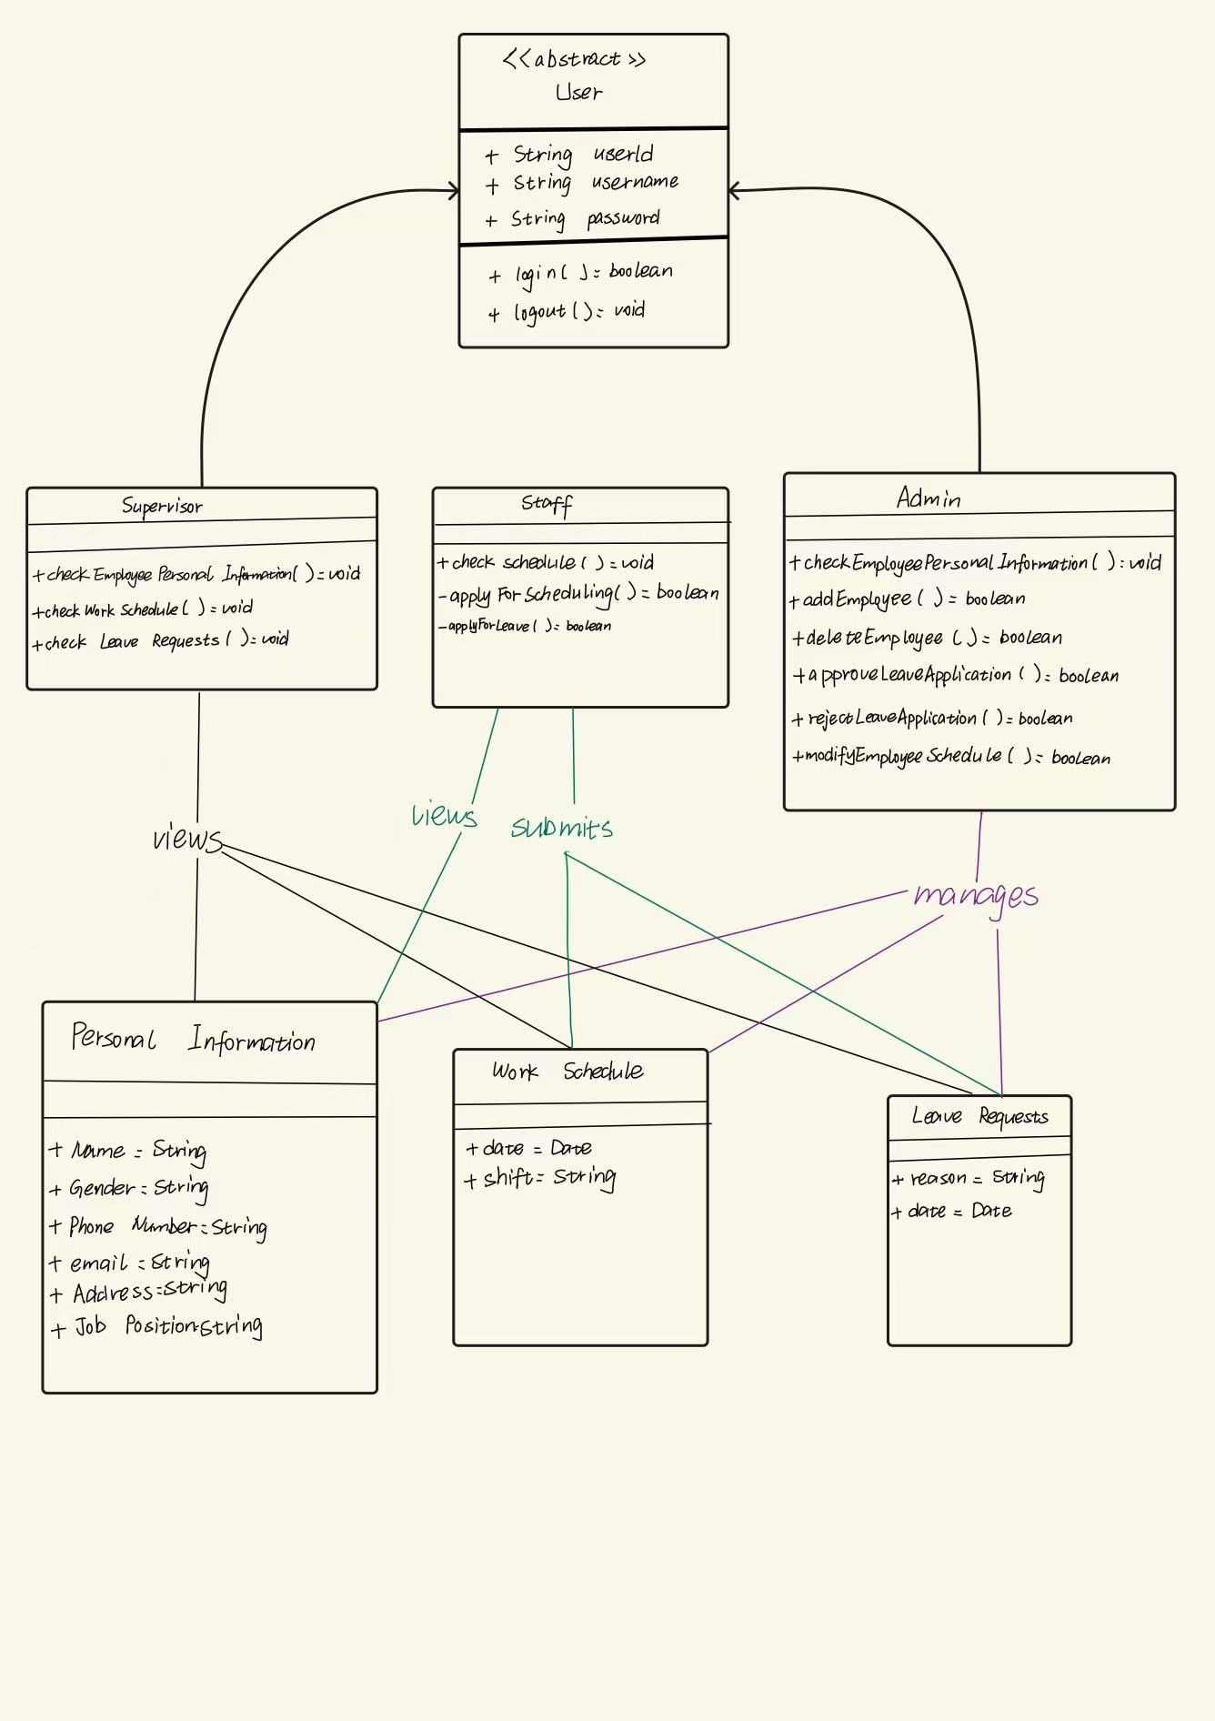
Role and domain sketch
DESIGN
01
Users
Roles and access
02
Records
Employee information
03
Shifts and leave
Scheduling rules and approval
Project design evidence · role and domain sketch
Meiti Admin System · 08

Slide 9
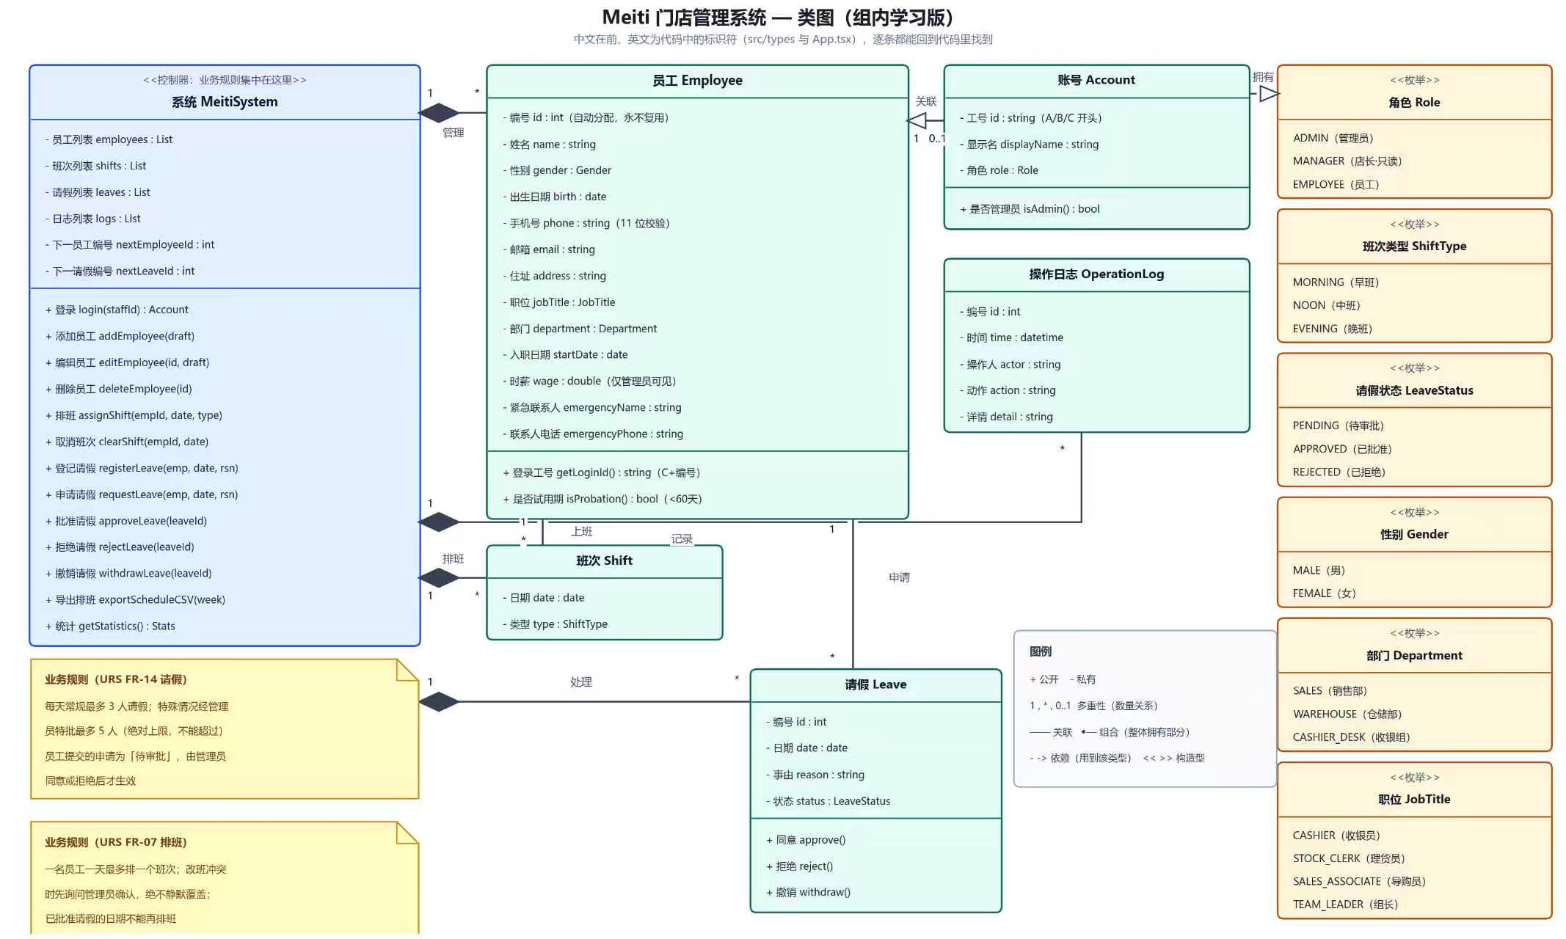
Detailed class model
DESIGN
Detailed domain model · design evidence
Meiti Admin System · 09

Slide 10
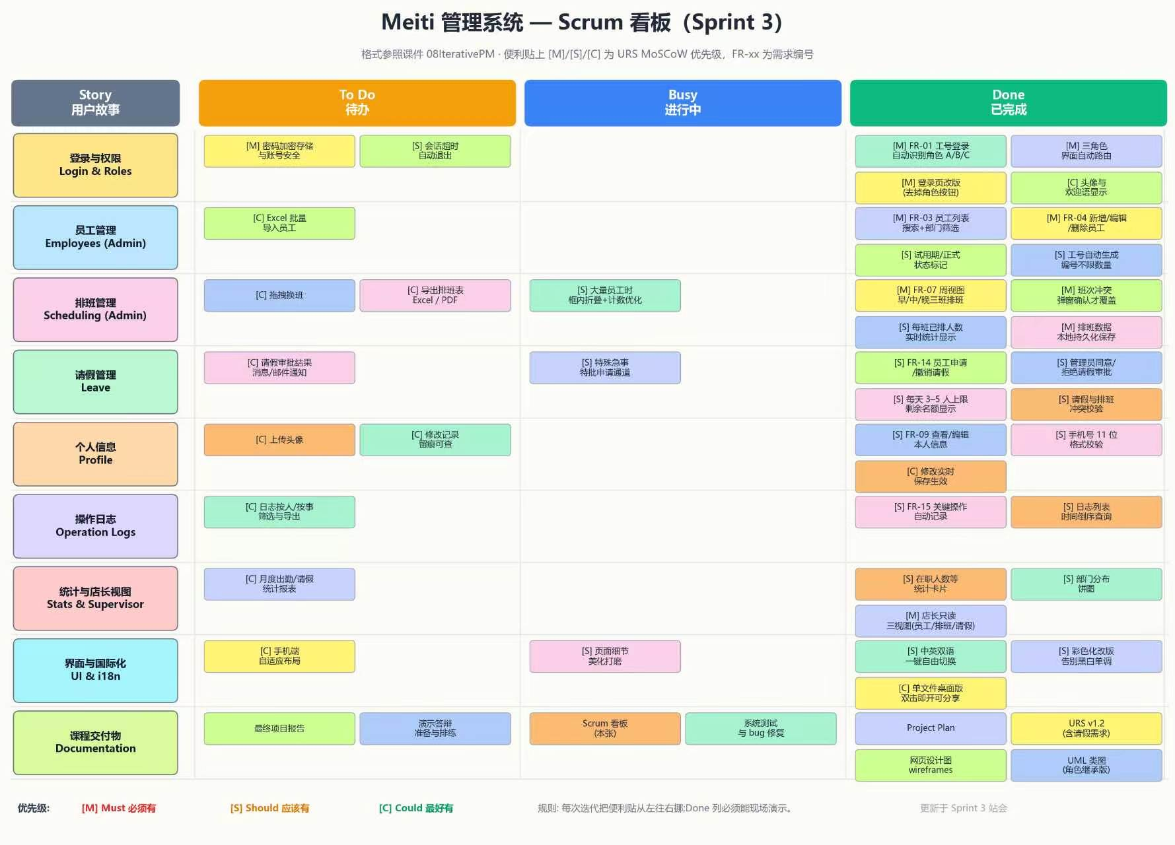
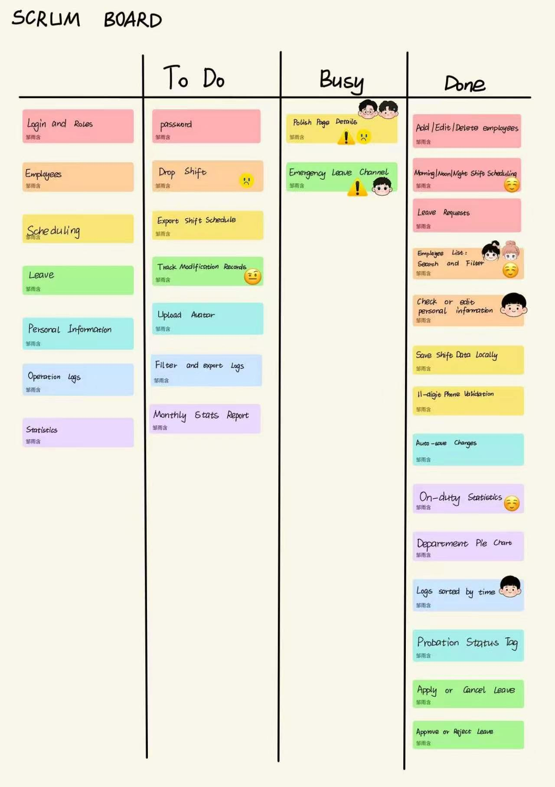
Plan and task tracking
PROCESS
TASK BOARD
PLAN / STATUS
W4–6 Design
W7–8 Build
W8–9 Test and deliver
Meiti Admin System · 10

Slide 11
Division of labor
DIVISION OF LABOR
Wang Weihao
Wang Yijie
Team lead + backend
Frontend design PPTreport
Zou Yuhan
Xue Yifei
Class diagrams + board
Class diagrams + board
Li Yang
Jiang Yiming
Testing
Documentation
Meiti Admin System · 11

Slide 12
Test results
TESTING
28 / 28
7
7
6
reported cases passed
5
22 October 2026
Cases grouped once
by primary function
1
1
1
Login / roles
Employees
Scheduling
Export
Leave
Statistics
Logs
Reported result; remaining checks are listed on slide 14.
Meiti Admin System · 12

Slide 13
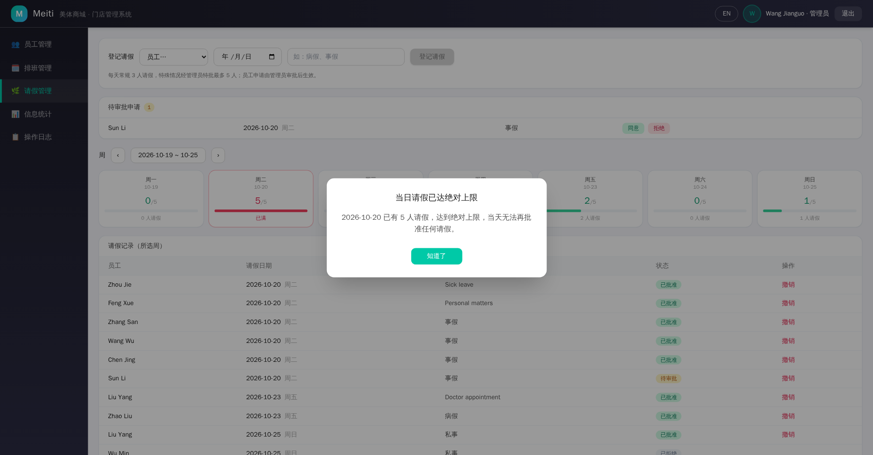
Leave quota test evidence
TESTING
3 normal
5 maximum
6th blocked
Observed boundary behaviour
Meiti Admin System · 13

Slide 14
Challenges and remaining checks
CHALLENGES
01
Authentication
Staff ID tests ≠ password verification
02
Quality targets
Response time, concurrency and recovery still require verification
03
Document alignment
Scope and boundary rules must agree across URS, tests and product
CLEARLY SEPARATING REPORTED RESULTS FROM REMAINING CHECKS
Meiti Admin System · 14

Slide 15
Deviation from the original plan
DEVIATION
Scope update
01
Leave and staff portal
Status mismatch
02
Board status vs export test
Actual schedule
03
Use the final project log as the reference
Keep URS, board, test report and presentation consistent
Meiti Admin System · 15

Slide 16
Benefits and conclusion
CONCLUSION
Central records
REPORTED BASELINE
One place for employee information, with less repeated checking.
28 passed
Clear schedules
test cases
with remaining checks
Conflict checks and weekly views make changes easier to follow.
A more reliable baseline for employee administration.
Meiti Admin System · 16

Slide 17
Reflection
REFLECTION
01
Confirm earlier
Scope and business rules
02
Link evidence
Requirements and tests
03
Use real examples
Explain what the team would do differently
Thank you · Questions
Meiti Shangcheng · Final Presentation
Meiti Admin System · 17

