Slide 1

SOFTWARE ENGINEERING PROJECT 软件工程项目
Meiti Shangcheng
美特商城
Employee Management
and Shift Scheduling
员工管理与排班系统
Final Presentation 终期汇报
Fontys and ZZULI · Group Project
October 2026
方提斯与郑州轻工业大学 · 小组项目 · 2026 年 10 月
01

Slide 2
Background and problem
背景与问题
BACKGROUND 背景
01
Scattered records 记录分散
A central system
before opening
开业前的统一管理系统
Employee information is spread across files.
员工信息分散存储在多份文件中
02
Slow manual checking 人工核对缓慢
Weekly overviews require repeated work.
每周汇总需要重复劳动
03
Excel schedules Excel 排班表
Online calendars and sheets are hard to maintain.
在线日历与表格难以维护
New Zhengzhou store 郑州新店
04
Missed changes and conflicts
变更遗漏与冲突
Updates can be lost or overwritten.
更新可能丢失或被覆盖
Meiti Admin System · 02

Slide 3
Project goal 项目目标
GOAL 目标
100
CORE DELIVERY 核心交付
Employee records
+ manual scheduling
员工档案 + 手动排班
employees 员工
Design capacity 设计容量
5
concurrent users
并发用户
A focused administrative baseline
一个专注的行政管理基线
Target to verify 验证目标
Capacity figures are design targets, not reported test results.
容量数据是设计目标，并非已报告的测试结果
Meiti Admin System · 03

Slide 4
Employee management 员工管理
OUR SOLUTION 我们的解决方案
01
02
03
04
05
Add 新增
Find 查找
View 查看
Edit 编辑
Delete 删除
One employee record
一个员工档案
Clear validation
Confirmed deletion
校验明确；删除需确认
A single place to add, retrieve and maintain employee information.
一个统一的地方用于添加、查询与维护员工信息
TC-08 to TC-14
Meiti Admin System · 04

Slide 5
Weekly scheduling 每周排班
OUR SOLUTION 我们的解决方案
7
3
1
days per week 每周天数
morning / noon / evening
早 / 午 / 晚班
shift per day 每日一班
MON 周一
TUE 周二
WED 周三
THU 周四
FRI 周五
SAT 周六
SUN 周日
Manual assignment 手动排班
Conflict confirmation 冲突确认
Meiti Admin System · 05

Slide 6
Leave approval 请假审批
OUR SOLUTION 我们的解决方案
01
02
03
Request 申请
Pending 待审批
Decision 审批决定
Employee submits leave
员工提交请假
Waiting for approval 等待审批
Approve or reject 通过或驳回
3
5
6th
per day 每天
maximum 上限
blocked 已拦截
Normal quota 常规额度
Special approval for 4th and 5th 第 4、5 次需特别审批
Above the absolute limit 超出绝对上限
Approved leave blocks scheduling 已批准的请假阻塞排班
Meiti Admin System · 06

Slide 7
Access by role 按角色访问
OUR SOLUTION 我们的解决方案
Administrator 管理员
Maintain records, shifts and leave
维护记录、排班与请假
Manager 经理
Read only · wage hidden 只读 · 隐藏工资
Staff 员工
Own shifts and leave portal 个人排班与请假入口
IMPLEMENTATION 技术实现
React + TypeScript · Browser localStorage 浏览器 localStorage
Meiti Admin System · 07

Slide 8
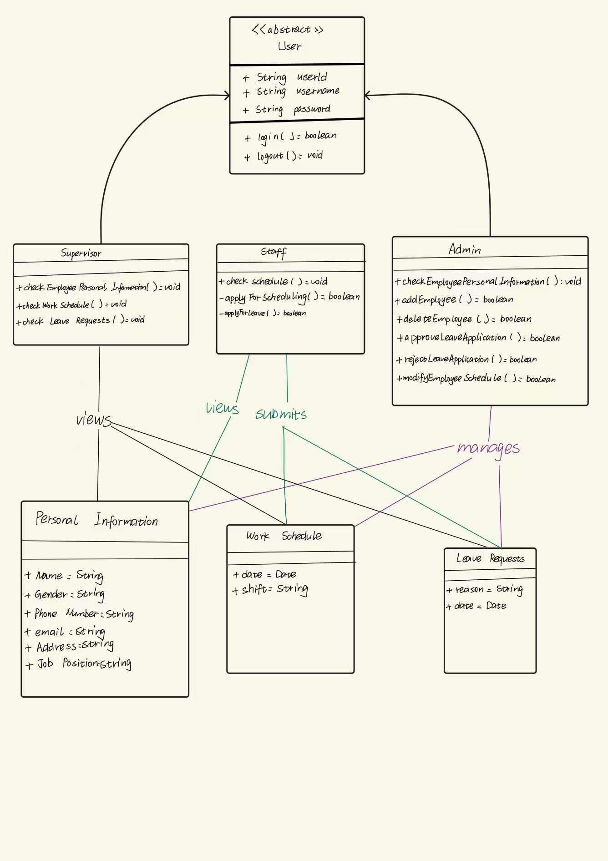
Role and domain sketch 角色与领域草图
DESIGN 设计
01
Users 用户
Roles and access 角色与访问权限
02
Records 记录
Employee information 员工信息
03
Shifts and leave
排班与请假
Scheduling rules and approval
排班规则与审批
Project design evidence · role and domain sketch 项目设计依据 · 角色与领域草图
Meiti Admin System · 08

Slide 9
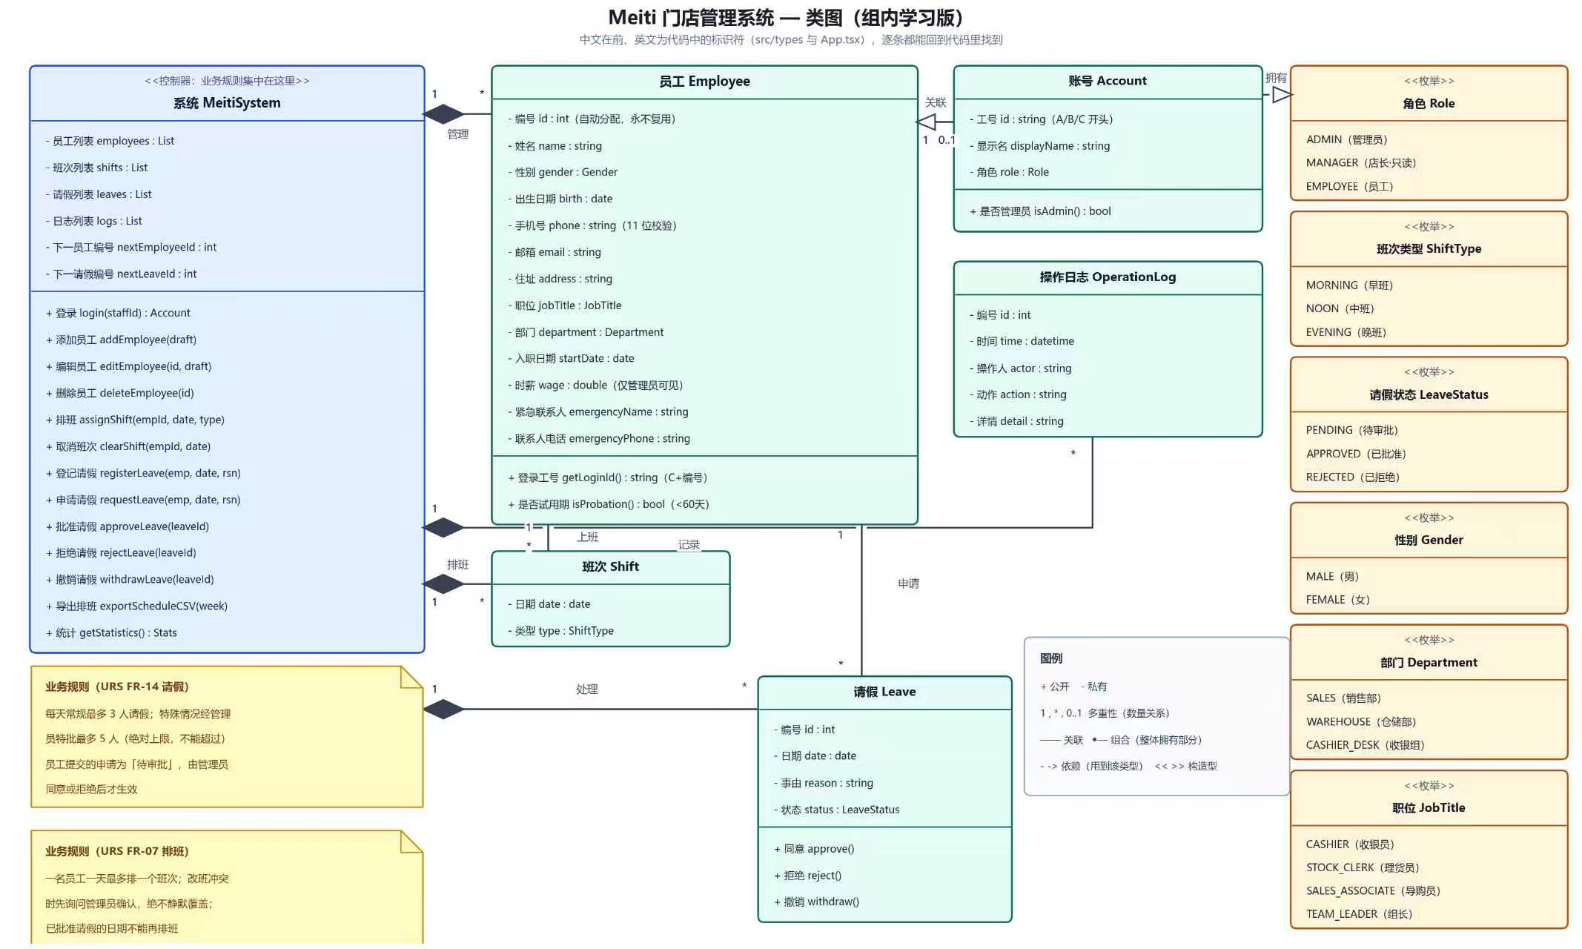
Detailed class model
DESIGN 设计
Detailed domain model · design evidence 领域模型详图 · 设计依据
Meiti Admin System · 09

Slide 10
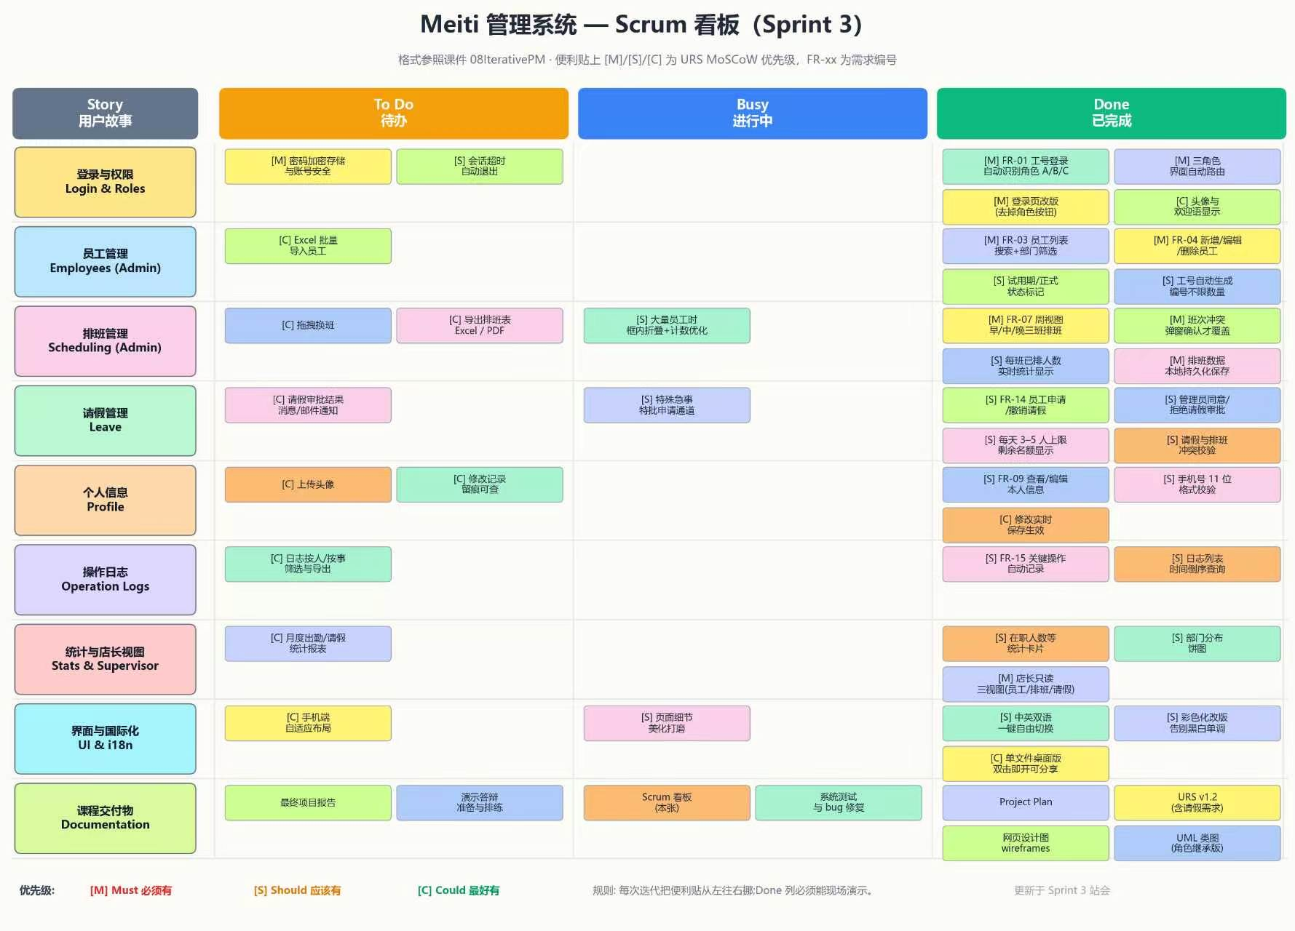
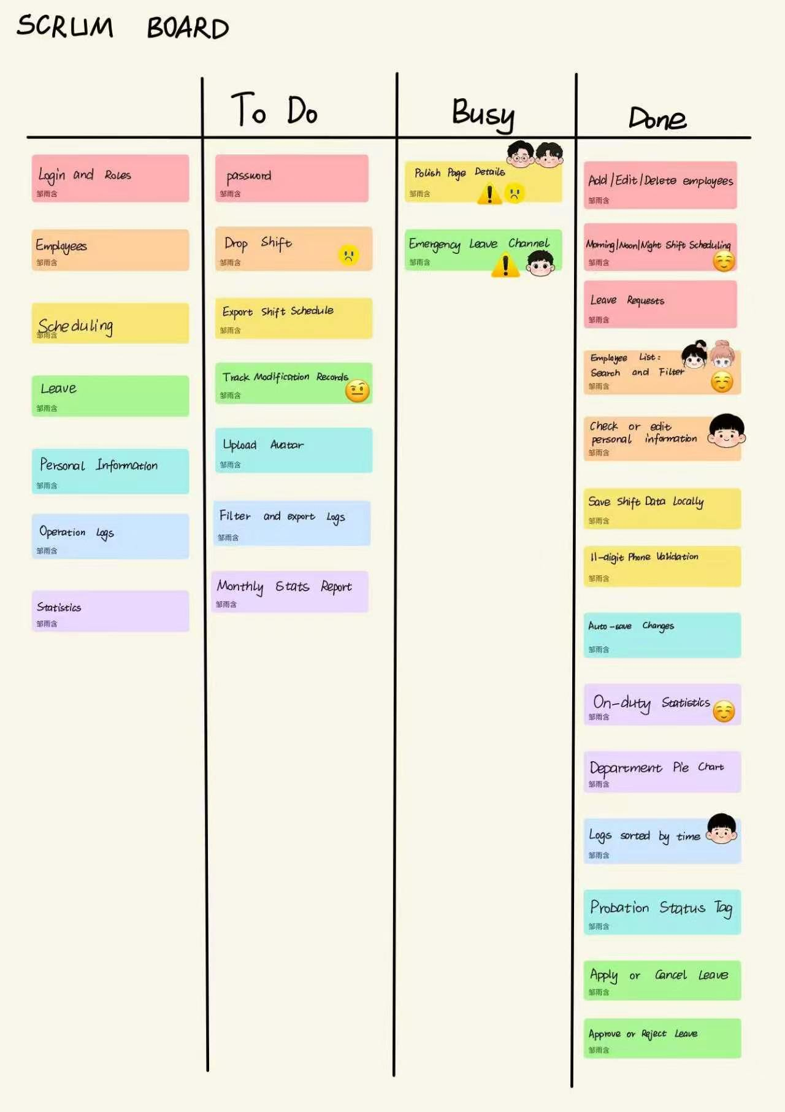
Plan and task tracking 计划与任务跟踪
PROCESS 过程
TASK BOARD 任务看板
PLAN / STATUS 计划 / 状态
W4–6 Design 设计
W7–8 Build 构建
W8–9 Test and deliver 测试与交付
Meiti Admin System · 10

Slide 11
Division of labor 分工
DIVISION OF LABOR 分工
Wang Weihao
Wang Yijie
Team lead + backend 组长 + 后端
Frontend 前端
Zou Yuhan
Xue Yifei
Class diagrams + board 类图 + 看板
URS + Project Plan URS + 项目计划
Li Yang
Jiang Yiming
Testing 测试
Documentation 文档
Meiti Admin System · 11

Slide 12
Reported test results 已报告的测试结果
TESTING 测试
28 / 28
7
7
6
reported cases passed
已报告用例通过
5
22 October 2026 2026年10月22日
Cases grouped once
by primary function
用例按主要功能分组
1
1
1
Login / roles 登录 / 角色
Employees 员工
Scheduling 排班
Export 导出
Leave 请假
Statistics 统计
Logs 日志
Reported result; remaining checks are listed on slide 14.
已报告结果；其余检查项见第 14 页
Meiti Admin System · 12

Slide 13
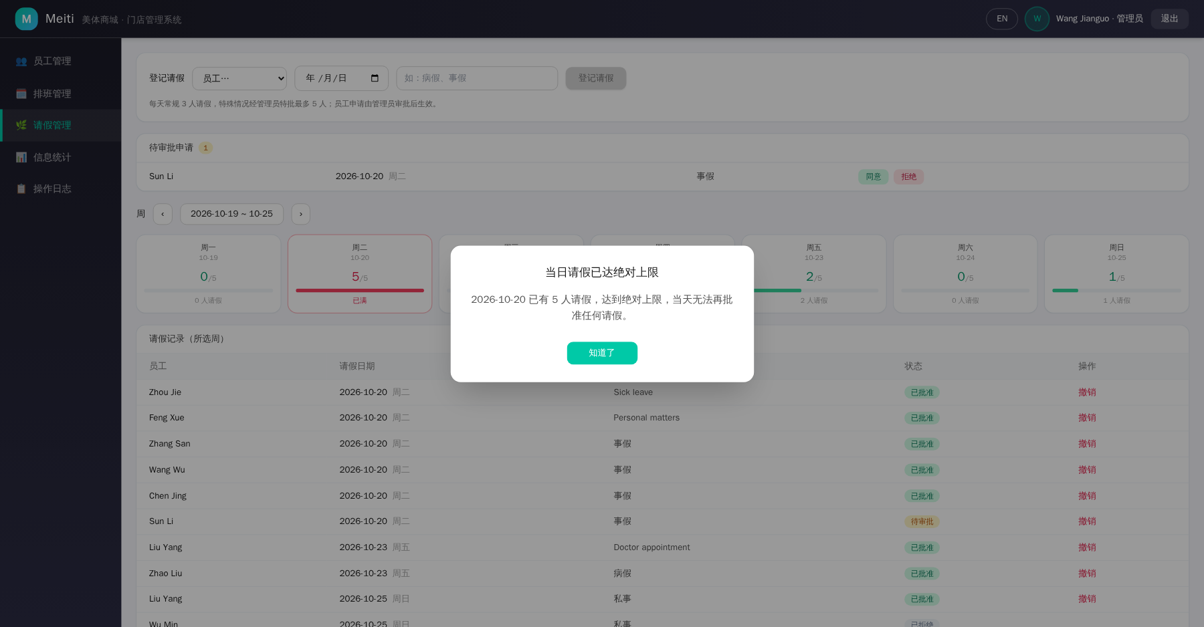
Leave quota test evidence 请假额度测试证据
TESTING 测试
3 normal
常规 3 次
5 maximum
最多 5 次
6th blocked
第 6 次被拦截
Observed boundary behaviour 观察到的边界行为
Meiti Admin System · 13

Slide 14
Challenges and remaining checks
挑战与待办检查项
CHALLENGES 挑战
01
Authentication 身份认证
Staff ID tests ≠ password verification 工号测试 ≠ 密码验证
02
Quality targets 质量目标
Response time, concurrency and recovery still require verification
响应时间、并发与恢复仍需验证
03
Document alignment
文档一致性
Scope and boundary rules must agree across URS, tests and product
范围与边界规则须在 URS、测试与产品中保持一致
CLEARLY SEPARATING REPORTED RESULTS FROM REMAINING CHECKS
明确区分已报告结果与待办检查
Meiti Admin System · 14

Slide 15
Deviation from the original plan
与原计划的偏差
DEVIATION 偏差
Scope update 范围更新
01
Leave and staff portal 请假与员工门户
Status mismatch 状态不一致
02
Board status vs export test 看板状态与导出测试
Actual schedule 实际进度
03
Use the final project log as the reference
以最终项目日志为参考
Keep URS, board, test report and presentation consistent 保持 URS、看板、测试报告与演示文稿一致
Meiti Admin System · 15

Slide 16
Benefits and conclusion 收益与结论
CONCLUSION 结论
Central records 集中式记录
REPORTED BASELINE 已报告基线
One place for employee information, with less repeated checking.
员工信息集中一处，减少重复核对
28 passed
28 项通过
Clear schedules 清晰排班
test cases
with remaining checks
测试用例，含待办检查
Conflict checks and weekly views make changes easier to follow.
冲突检查与周视图让变更更易跟踪
A more reliable baseline for employee administration.
为员工管理提供更可靠的基线
Meiti Admin System · 16

Slide 17
Reflection 反思
REFLECTION 反思
01
Confirm earlier 尽早确认
Scope and business rules 范围与业务规则
02
Link evidence 关联证据
Requirements and tests 需求与测试
03
Use real examples 使用真实案例
Explain what the team would do differently 说明团队会做出的不同
Thank you · Questions
谢谢 · 提问
Meiti Shangcheng · Final Presentation 终期汇报
Meiti Admin System · 17

