Slide 1
SQL Project – Superstore Data Analysis
Using SQL
Presented by Ritesh Nirmal

Slide 2
Introduction
- Superstore dataset simulates retail sales across products, customers, and regions.
- SQL used to analyze business trends and performance.
- Project Objective: Extract insights using SQL queries.

Slide 3
Dataset Overview
- Format: CSV file (Superstore.csv)
- Rows: 9,994 (approx.)
- Key Columns: Order_ID, Customer_Name, Sales, Profit, Region, Category
- Tool Used: MySQL (Workbench or Command Line)

Slide 4
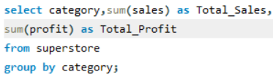
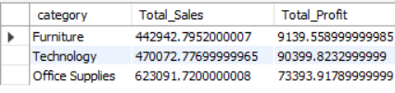
1.Total Sales and Profit by Category
Query
Output

Slide 5
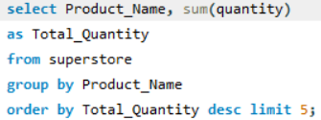
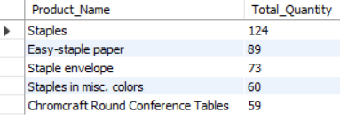
2. Most sold products by quantity
Query
Output

Slide 6
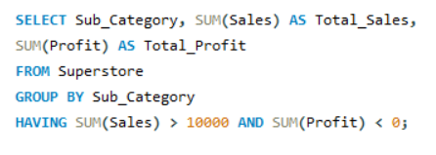
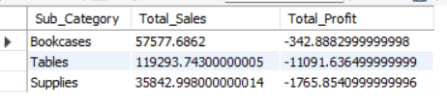
7. Sub-categories with high sales but negative profit
Query
Output

Slide 7
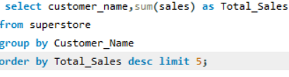
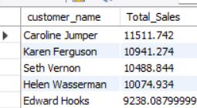
3. Top 5 customers by sales
Query
Output

Slide 8
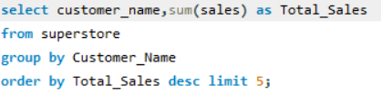
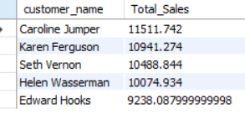
5. Top 5 Products By Quantity
Query
Output

Slide 9
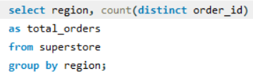
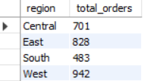
4.TOTAL NUMBER OF ORDERS IN EACH REGION
Query
Output

Slide 10




5. Total profit , total sales , total order.
Query
Output

Slide 11
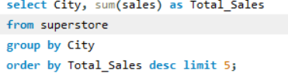
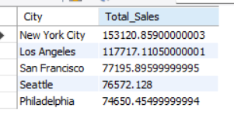
6.Top 5 city by sales
Query
Output

Slide 12
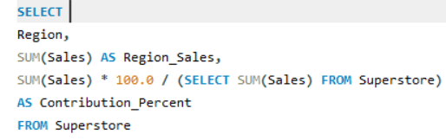
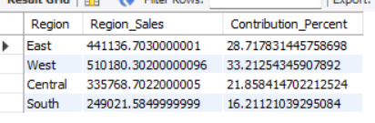
8. Sales contribution % of each region
Query
Output

Slide 13
Key SQL Queries (Part 2)
- Sub-Categories with High Sales but Loss:
SELECT Sub_Category, SUM(Sales), SUM(Profit) FROM superstore GROUP BY Sub_Category HAVING SUM(Sales) > 10000 AND SUM(Profit) < 0;
- Monthly Sales Trend for Central Region:
SELECT DATE_FORMAT(Order_Date, '%Y-%m') AS Month, SUM(Sales), SUM(Profit) FROM superstore WHERE Region = 'Central' GROUP BY Month;
- Ship Mode with Fastest Delivery:
SELECT Ship_Mode, AVG(DATEDIFF(Ship_Date, Order_Date)) FROM superstore GROUP BY Ship_Mode;

Slide 14
Conclusion
- SQL helps extract actionable insights from Superstore dataset.
- Focus on top performing categories, customers, and regions.
- Optimize shipping methods and target high-value customers.
- Future Scope: Visualize with Power BI/Tableau.

