Slide 1
The Eye
B Ricks PhD, Spring 2018
Most content from https://en.wikipedia.org/wiki/Human_eye

Slide 2
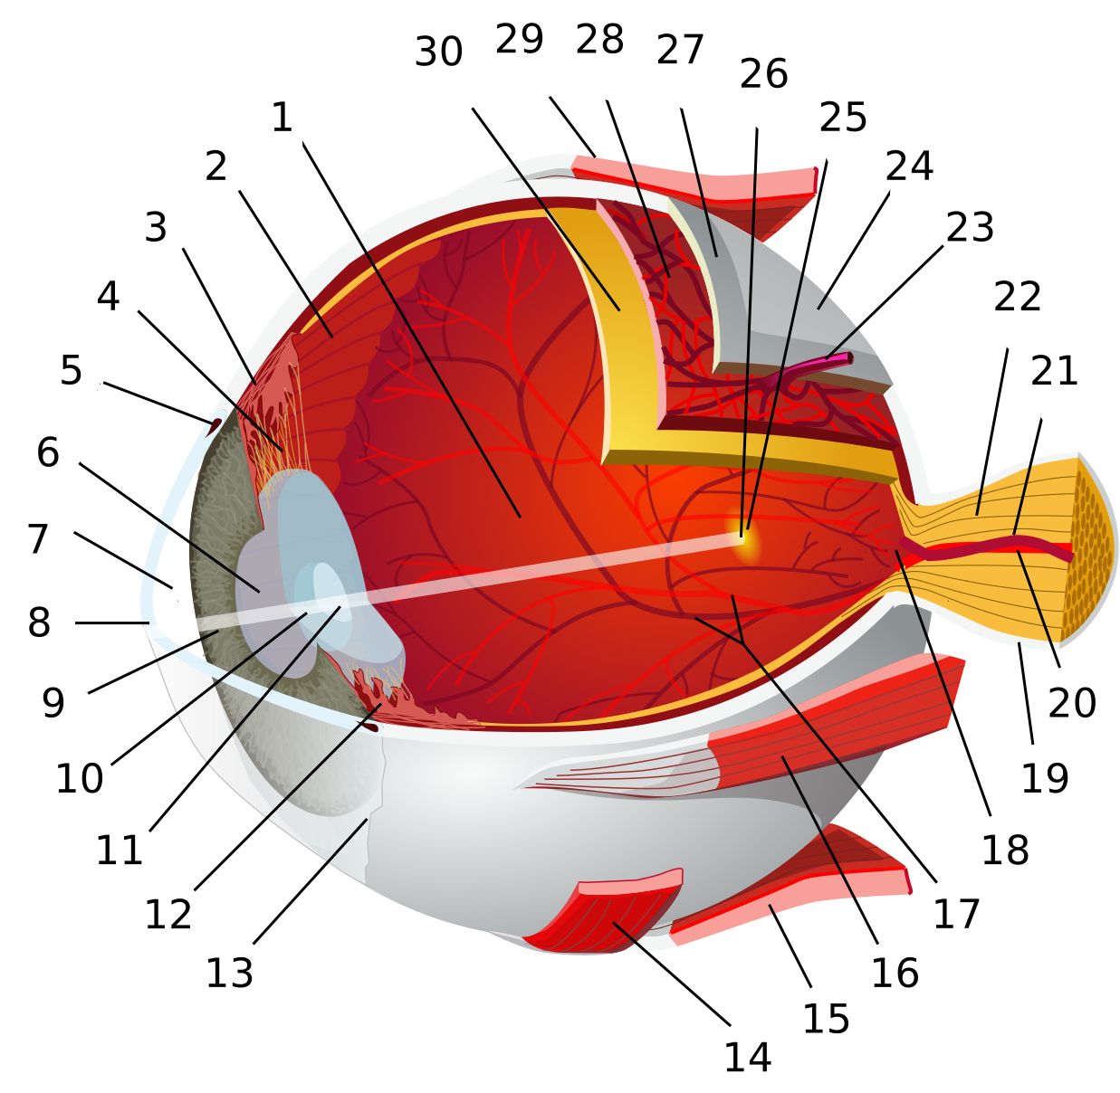

Slide 3
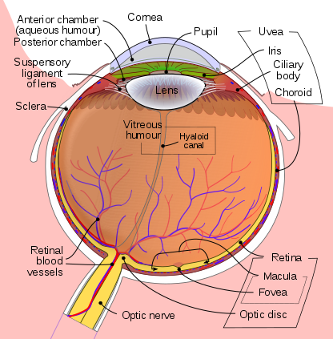

Slide 4
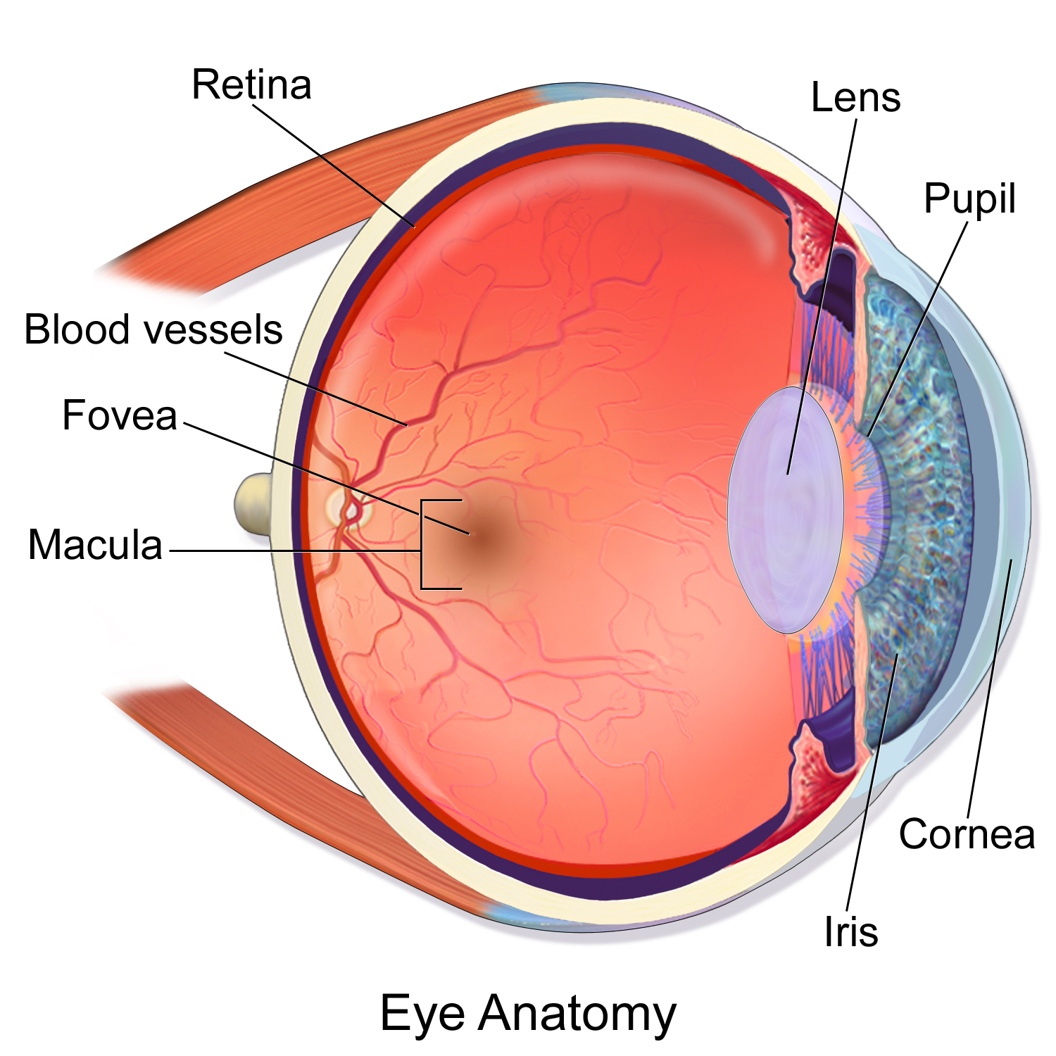

Slide 5
