Slide 1
The Burrows-Wheeler Transform
姓名：袁瑞
学号：170819

Slide 2
What is BWT
The Burrows and Wheeler transform(BWT) is a block sorting lossless and reversible data transform
The BWT can permute a text into a new sequence which usually more “compressible”
1994, by Michael Burrows and David Wheeler
The transformed text can be better compressed with fast locally-adaptive algorithms, such as run-length-encoding (or move-to-front coding) in combination with Huffman coding (or arithmetic coding).

Slide 3
How to transform
Three steps
Form a N*N matrix by cyclically rotating(left) the given text to form the rows of the matrix.
Sort the matrix according to the alphabetic order.
Extract the last column of the matrix

Slide 4
Preliminaries
Alphabet
{a, b, c, $}
We assume an order on the alphabet
a < b < c < $
A character is available to be used as the sentinel, denoted as $

Slide 5
One example
How the BWT transforms mississippi
T = mississippi$

Slide 6
Step 1: form the matrix
First treat the input string as a cyclic string and construct N*N matrix from it
The N * N sysmetric matrix, OM, originally constructed from the texts obtained by rotating the text $T$
The matrix MO has S as its first row, i.e. OM[1, 1: N] = T.
The rest rows of OM are constructed by applying successive cyclic left-shifts to T, i.e. each of the remaining rows, a new text T_i is obtained by cyclically shifting the previos text T_{i-1} one column to the left.
The matrix OM obtained is shown in the next slide.

Slide 7
Step 1: form the matrix
m i s s i s s i p p i $
i s s i s s i p p i $ m
s s i s s i p p i $ m i
s i s s i p p i $ m i s
i s s i p p i $ m i s s
s s i p p i $ m i s s i
s i p p i $ m i s s i s
i p p i $ m i s s i s s
p p i $ m i s s i s s i
p i $ m i s s i s s i p
i $ m i s s i s s i p p
$ m i s s i s s i p p i

Slide 8
Step 2: transform the matrix
Now, we sort all the rows of the matrix OM in ascending order with the leftmost element of each row being the most significant position
Consequencently, we obtain the transformed matrix M as given below.
i p p i $ m i s s i s s
i s s i p p i $ m i s s
i s s i s s i p p i $ m
i $ m i s s i s s i p p
m i s s i s s i p p i $
p i $ m i s s i s s i p
p p i $ m i s s i s s i
s i p p i $ m i s s i s
s i s s i p p i $ m i s
s s i p p i $ m i s s i
s s i s s i p p i $ m i
$ m i s s i s s i p p i
Completely sorted from the leftmost column to the rightmost column.

Slide 9
Step 3: get the transformed text
The Burrows Wheeler transform is the last column in the sorted list, together with the row number where the original string ends up.

Slide 10
Step 3: get the transformed text
From the above transform, L is easily obtained by taking the transpose of the last column of M together with the primary index.
4
L = s s m p $ p i s s i i i
Notice how there are 3 i ‘s in a row
and 2 consecutive s’s and
another 2 consecutive s’s - this
makes the text easier to compress
than the origin string “mississippi$”
i p p i $ m i s s i s s
i s s i p p i $ m i s s
i s s i s s i p p i $ m
i $ m i s s i s s i p p
m i s s i s s i p p i $
p i $ m i s s i s s i p
p p i $ m i s s i s s i
s i p p i $ m i s s i s
s i s s i p p i $ m i s
s s i p p i $ m i s s i
s s i s s i p p i $ m i
$ m i s s i s s i p p i
4

Slide 11
What is the benefit
The transformed text is more amenable to subsequence compression algorithms.

Slide 12
BWT is reversible and lossless
The remarkable thing about the BWT is not only that is generates a more easily compressible output, but also that it is reversible, i.e. it allows the original text to be re-generated from the last column data and the primary index.

Slide 13
BWT is reversible and lossless
mississippi$
BWT
Index 4 and ssmp$pissiii
Inverse BWT
??? How to achieve the goal?
mississippi$

Slide 14
The trick is
Where to start? Who is the first one to ask?
The last one.
Finding immediate preceding character
By finding immediate preceding row of the current row
A loop is needed to recover all
Each iteration involves two matters
Recover the current character
In addition to that, to point out the next people(by index) to keep the loop running.

Slide 15
How to find the preceding character
F
L
i p p i $ m i s s i s s
i s s i p p i $ m i s s
i s s i s s i p p i $ m
i $ m i s s i s s i p p
m i s s i s s i p p i $
p i $ m i s s i s s i p
p p i $ m i s s i s s i
s i p p i $ m i s s i s
s i s s i p p i $ m i s
s s i p p i $ m i s s i
s s i s s i p p i $ m i
$ m i s s i s s i p p i
Based on the already know primary index 4
we know, L[4], ie.
$ is the first character to retrieve, backwardly,
But our question is which character is the next
Character to retrieve?
4

Slide 16
How to find the preceding character
F
L
i p p i $ m i s s i s s
i s s i p p i $ m i s s
i s s i s s i p p i $ m
i $ m i s s i s s i p p
m i s s i s s i p p i $
p i $ m i s s i s s i p
p p i $ m i s s i s s i
s i p p i $ m i s s i s
s i s s i p p i $ m i s
s s i p p i $ m i s s i
s s i s s i p p i $ m i
$ m i s s i s s i p p i
We know that the next character is going to be
‘i’?
But L[6]=L[9]=L[10]=L[11]=[‘i’]. Which index
Should be chosen？
Any of 6, 9, 10, 11 can give us the right character ‘i’, but the correct strategy also has to determine which index is the next index continue the restoration.
4

Slide 17
The solution
The solution turns out te be very simple:
Using LF mapping
Continue to see what LF mapping is?

Slide 18
LP mapping
i p p i $ m i s s i s s
i s s i p p i $ m i s s
i s s i s s i p p i $ m
i $ m i s s i s s i p p
m i s s i s s i p p i $
p i $ m i s s i s s i p
p p i $ m i s s i s s i
s i p p i $ m i s s i s
s i s s i p p i $ m i s
s s i p p i $ m i s s i
s s i s s i p p i $ m i
$ m i s s i s s i p p i
0
1
0
0
0
1
0
2
3
1
2
3
7
8
4
5
11
6
0
9
10
1
2
3
4
? Which one

Slide 19
Search
Search str = “sip”
i . . . . . . s
i . . . . . . s
i . . . . . . m
i . . . . . . p
m . . . . . . $
p . . . . . . p
p . . . . . . i
s . . . . . . s
s . . . . . . s
s . . . . . . i
s . . . . . . i
$ . . . . . . i

Slide 20
Pros and cons of BWT
Pros:
The transformed text does enjoy a compression-favorable property which tends to group identical characters together so that the probability of finding a character is increased substantially.
More importantly, there exist efficient and smart algorithms to restore the original string from the transformed result
Cons:
The need of sorting all the contexts up to their full lengths of $N$ is the main cause for the super-linear time complexity of BWT
Super-linear time algorithms are not hardware friendly.

Slide 21
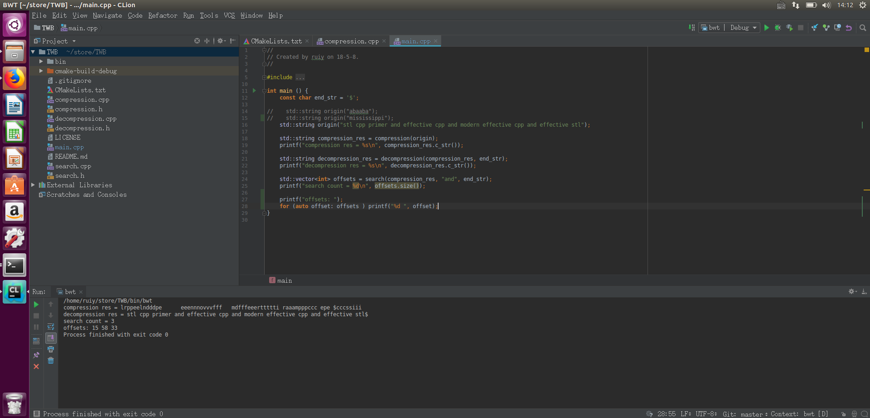
代码

