Slide 1
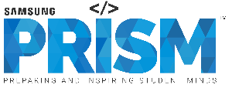
Work-let Name: Personal Documentation and masking
Worklet Details
Worklet ID:23RSG33CU
College Name: Chandigarh University
Completed YOLO model with all datasets( Bank card, I’d card, number plate)
Completed the masking technique for all these datasets.
Finalized the pipeline and created the User interface
Created an ORC model that can read data from the image.
Annotating the images having multiple instances belonging to the same class
Finding out the best masking technique for the OCR module
KPIs achieved till now
Any Challenges/ Issues faced
Next Steps
Exploration of masking techniques for the OCR module
Integrate OCR and YOLO model into ongoing pipeline for PD masking
Completed the YOLO model with an accuracy of 97.7%.
Complete implementation of the OCR model
Key Achievements/ Outcome till now
Date: 13-05-2024

