Slide 1
SKYTRAX AIRLINE
REVIEW ANALYSIS
Presented BY-Team B

Slide 2
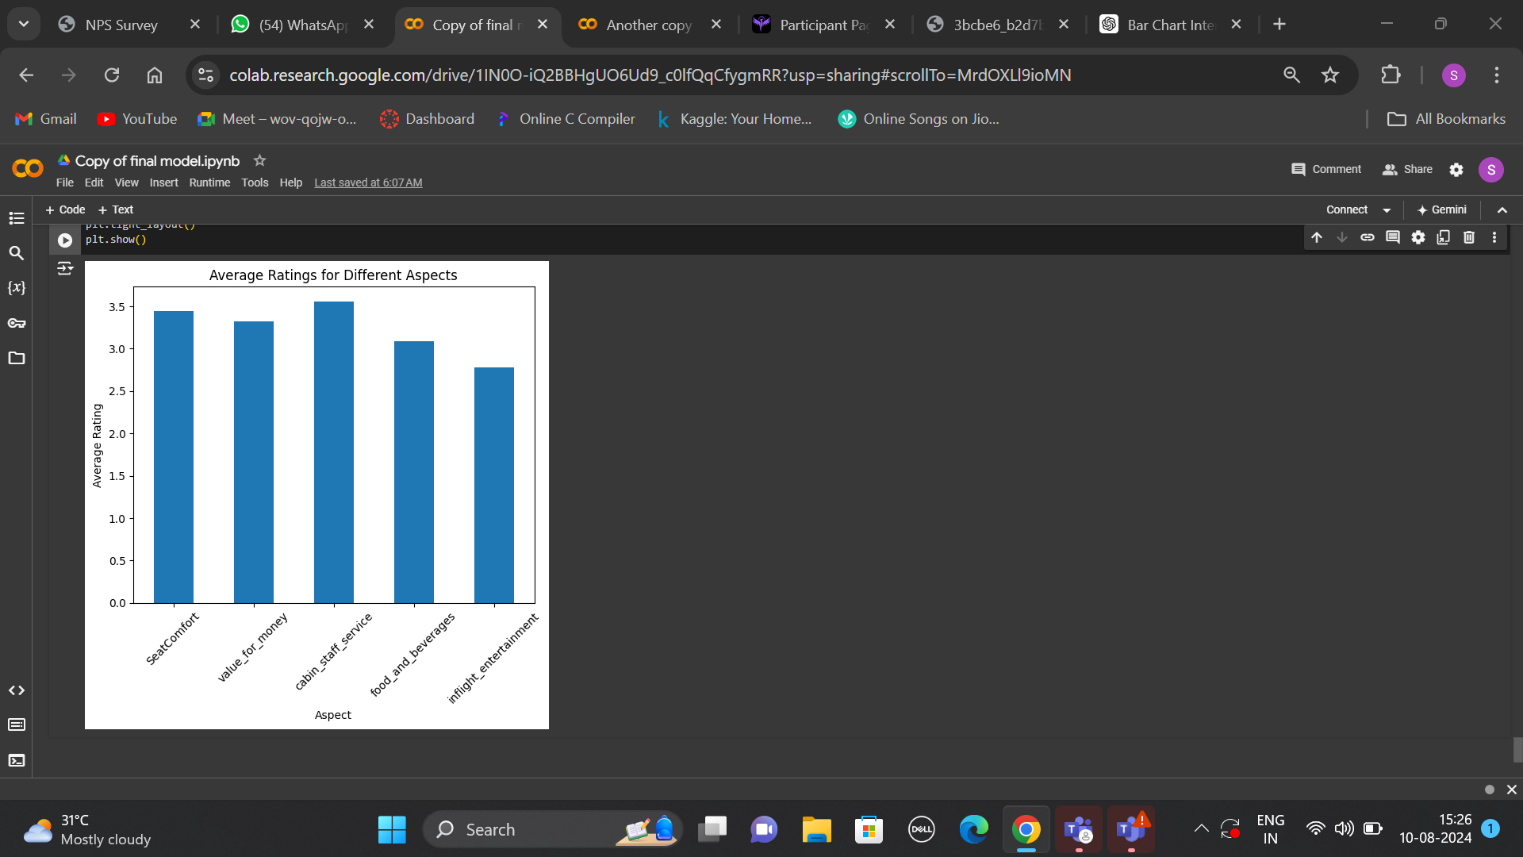

RESULTS ANALYSIS
The analysis also shows that out of the total reviews, there are 2,266 positive reviews compared to 1,029 negative reviews. This indicates that the majority of customer feedback is positive, with approximately twice as many positive reviews as negative ones.
The Bar Graph here reveals that "staff rating" has the highest average score among all evaluated aspects. This indicates that the staff's performance is a key strength and is highly valued by customers. In contrast, other aspects received lower average ratings, suggesting areas where improvements could be made to enhance overall customer satisfaction.
32% Negative
68% Positive

