Slide 1
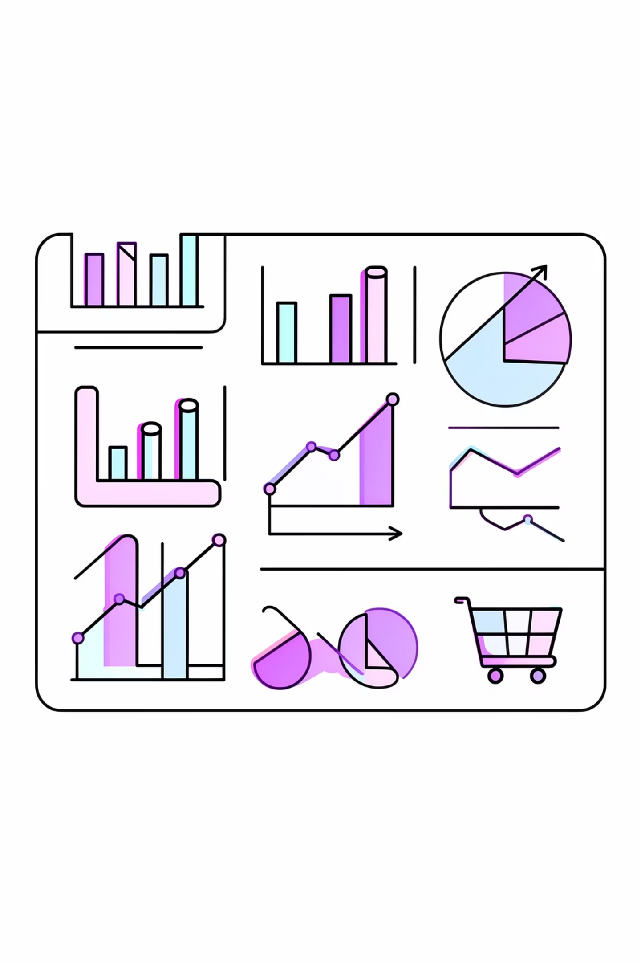
Customer Shopping Behavior Analysis
Transactional data insights across ~3,900 records — spending trends, segmentation, product preferences & subscription behavior

Slide 2
Dataset at a Glance
3,900
18
Total Records
Attributes
37
$59.76
Missing Ratings
Avg Purchase
review_rating column
Customer Data
Purchase Data
Age, gender, location, subscription status
Product, category, price, season, size, color

Slide 3
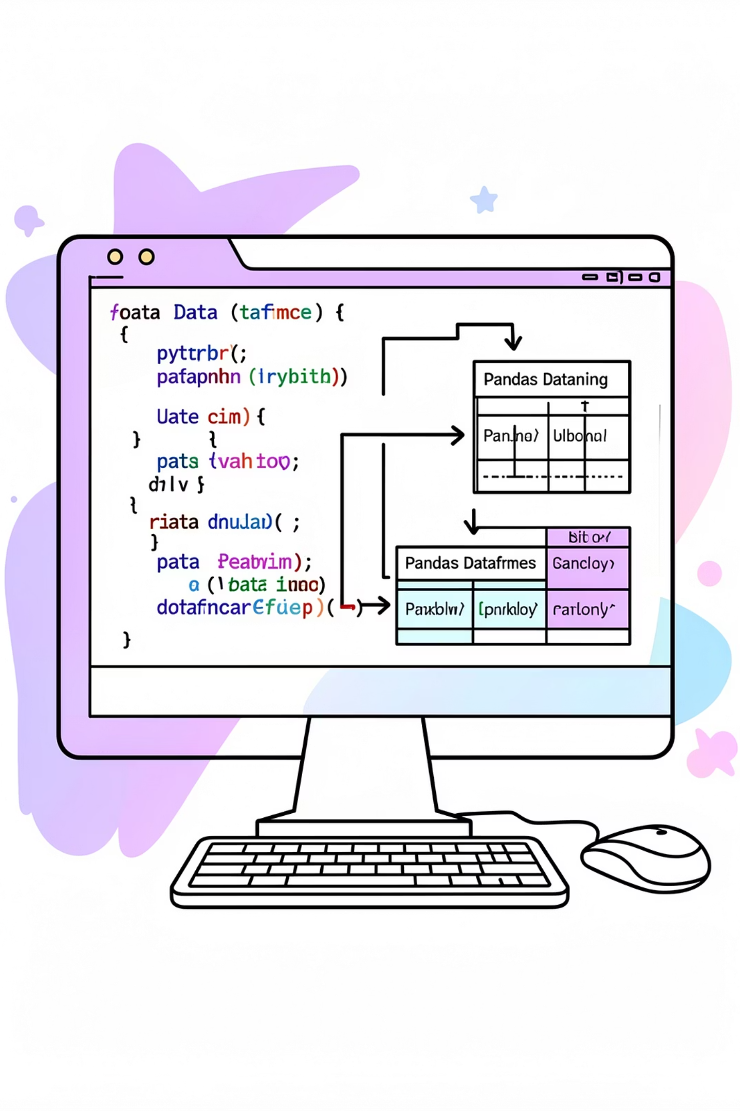
Data Preparation — Python
01
Import & Inspect
pandas, info(), describe()
02
Handle Missing Values
Median fill by product category
03
Feature Engineering
age_group, purchase_frequency_days
04
Clean & Load
snake_case, removed promo_code, PostgreSQL

Slide 4
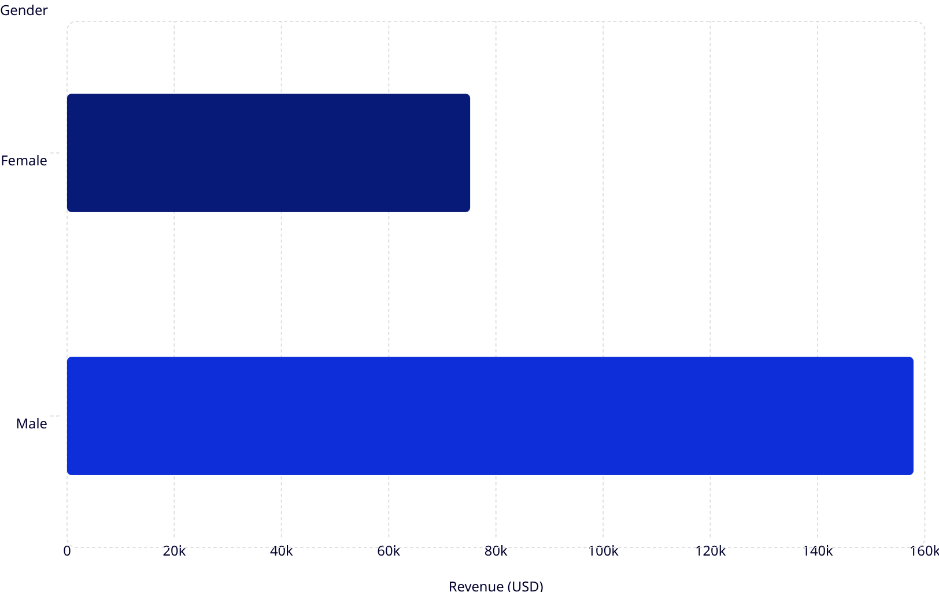
Revenue by Gender
Key Insight
Male customers generated 2.1x more revenue than female customers
Male
Female
$157,890 total
$75,191 total

Slide 5
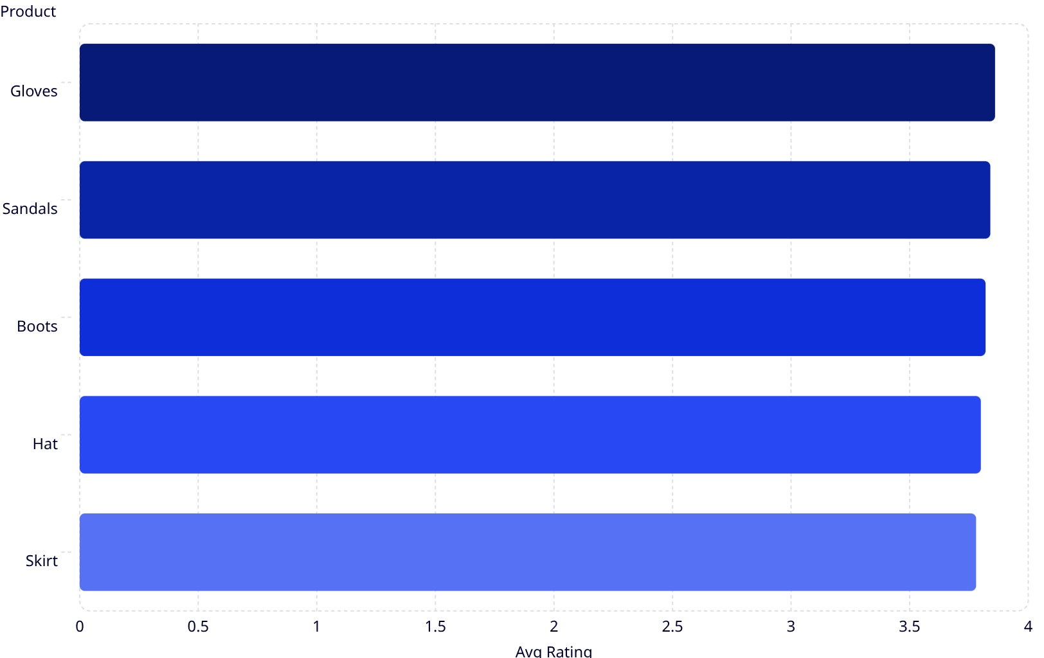
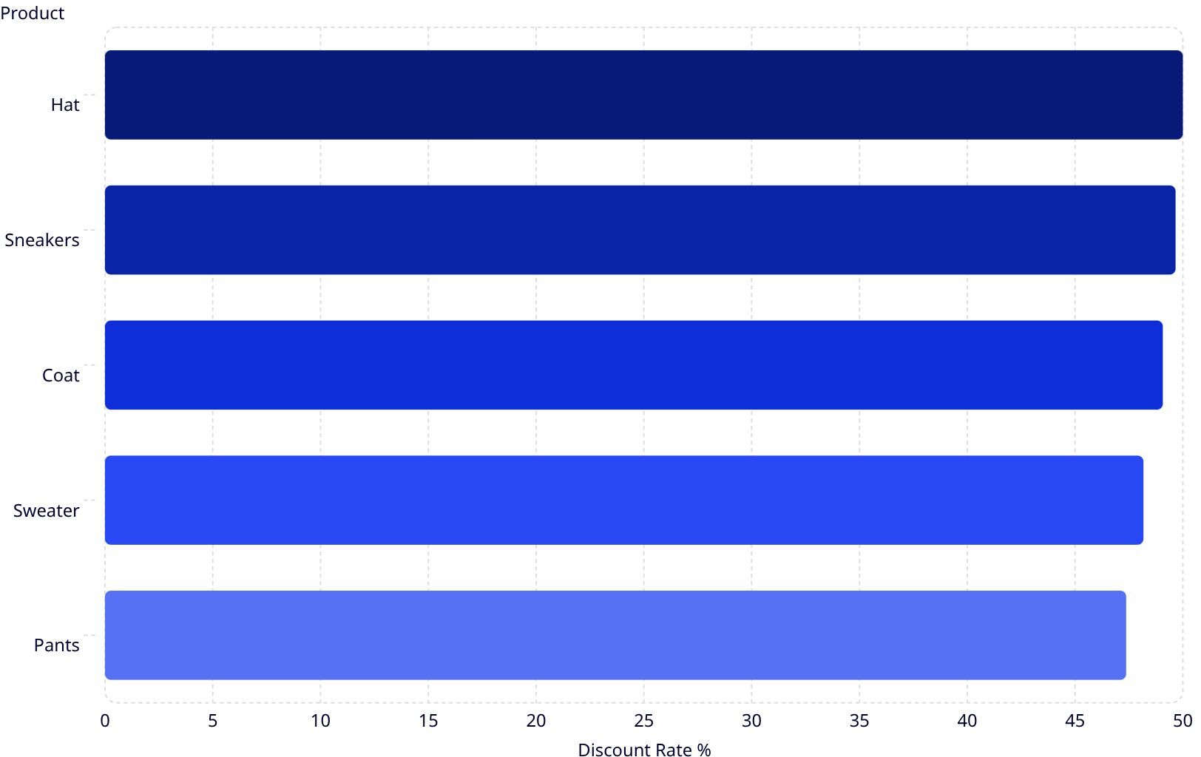
Top-Rated Products & Discount Drivers
Top 5 by Rating
Most Discounted Products

Slide 6
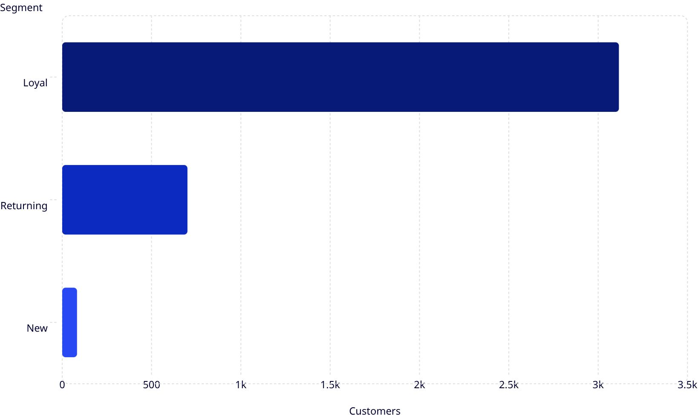

Customer Segmentation
Segment Breakdown
Loyal
Returning
3,116 customers — dominant segment
701 customers
New
83 customers — growth opportunity
839 high-value discount users identified spending above average

Slide 7
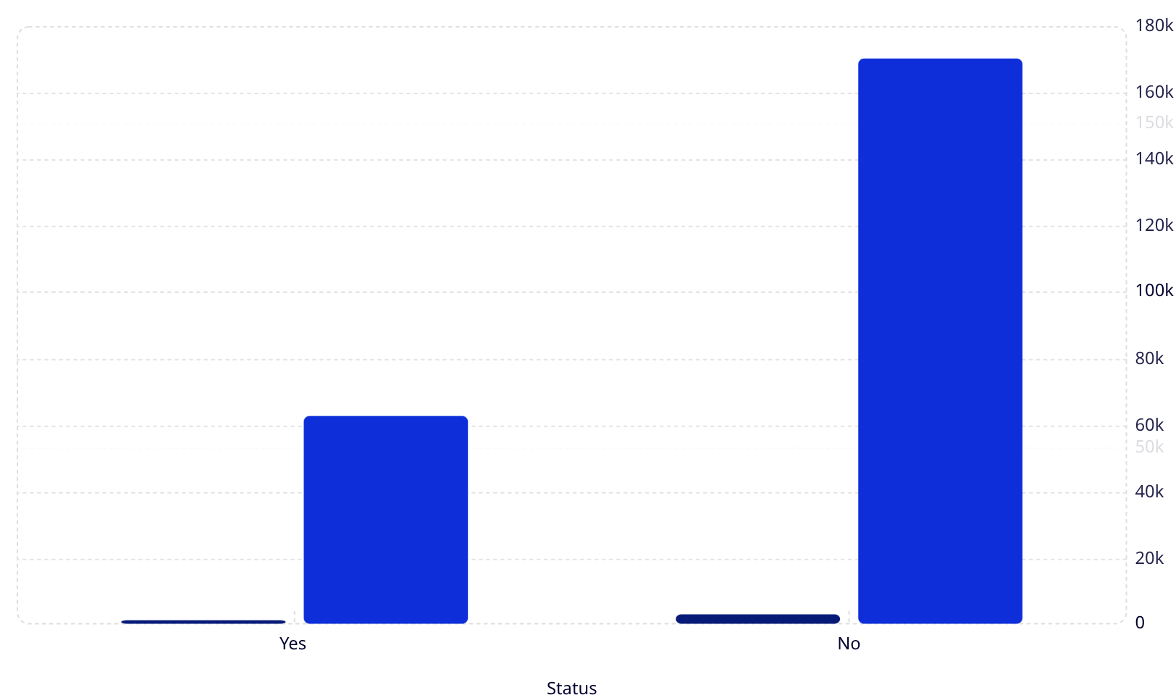
Subscription & Shipping Insights
Subscribers vs Non-Subscribers
Shipping Type Impact
Customers
Revenue (USD)
Standard Shipping
Express Shipping
Avg order: $60.48
Avg order: $58.46
Express buyers spend $2.02 more per order on average

Slide 8
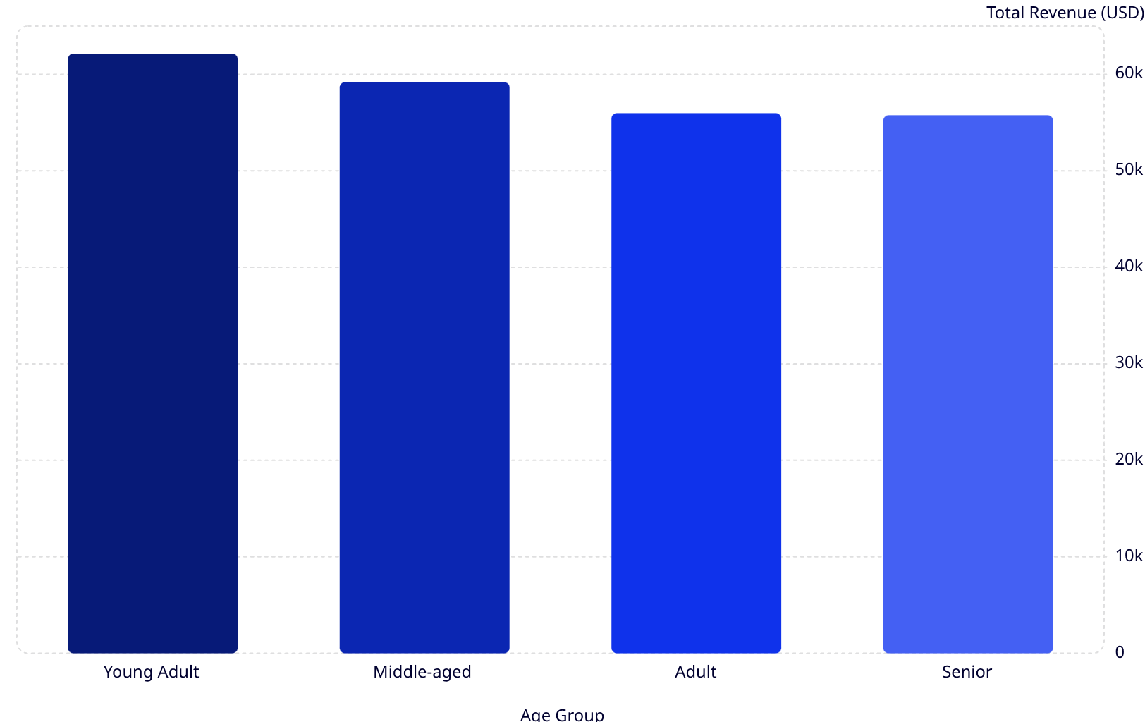
Revenue by Age Group
Age Distribution
Average customer age: 44 years
Age range: 18–70
Young Adults Lead
Even Spread
Highest revenue contributor at $62,143
Revenue fairly balanced across all segments

Slide 9
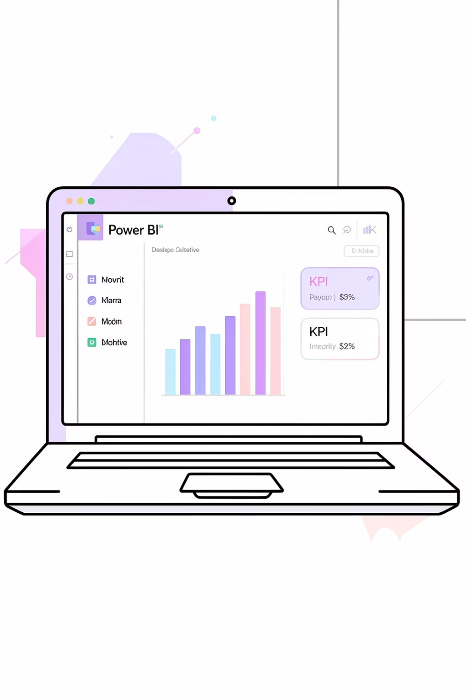

Power BI Dashboard
Subscription Status
27% Yes / 73% No
Category Revenue
Clothing, Accessories, Footwear, Outerwear
Age Group Sales
Revenue & sales by age segment
Interactive Filters
Gender, category, shipping type

Slide 10

Business Recommendations
Grow Subscriptions
Attractive benefits to convert non-subscribers
Loyalty Programs
Incentivize the 3,116 loyal customers
Optimize Discounts
Drive sales without hurting margins
Targeted Campaigns
Focus on young adults & express-shipping buyers

