Slide 1

LOGO
New User?
Forget Password?
Notes:
First page of website (Login page)

Slide 2

LOGO
Welcome User
HOME REQUEST FOR NOTES QUESTION PAPER SYLLABUS NOTICE
recent uploads
SORT BY: FILTER:
by subject
SEARCH
PENDING REQUESTS: (random requests)
M
DS
NW
2
MATHS
DATA STRUCTURE
NETWORKING
TODAY’S NOTES: (category wise)
M
DS
NW
MATHS
DATA STRUCTURE
NETWORKING
Notes:
After login user will see

Slide 3
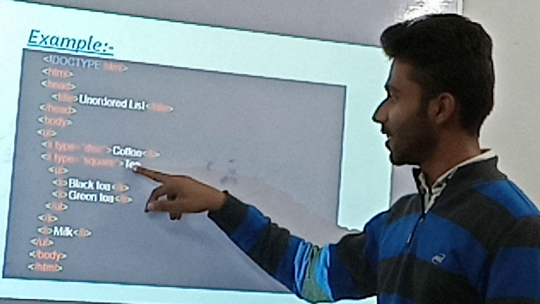
LOGO
Welcome User
HOME REQUEST FOR NOTES QUESTION PAPER SYLLABUS NOTICE
Q: PLEASE UPLOAD TODAY’S AutoCad NOTES?
Requested by: Abhigyan Prakash at 11:13:34AM on 22 Feb 2020
Uploads:
Uploaded By: Vikas Sinha
12:34:12AM on 22 Feb 2020
Uploaded By: Vikas Sinha
12:34:12AM on 22 Feb 2020
Uploaded By: Vikas Sinha
12:34:12AM on 22 Feb 2020
or upload yours
Title:
Comment:
Attach File:
SUBMIT
choose file
Some other notes suggestions
Notes:
If clicked on a notes

Slide 4
LOGO
Welcome User
HOME REQUEST FOR NOTES QUESTION PAPER SYLLABUS NOTICE
Q: PLEASE UPLOAD TODAY’S AutoCad NOTES?
Requested by: Abhigyan Prakash at 11:13:34AM on 22 Feb 2020
Be the first uploader!!!
Title:
Comment:
Attach File:
choose file
SUBMIT
Notes:
If clicked on pending notes

Slide 5
LOGO
Welcome User
HOME REQUEST FOR NOTES QUESTION PAPER SYLLABUS NOTICE
TITLE:
TOPIC: <choose from drop down>
DATE: <dd/mm/yyyy>
Need: Copy Notes or A File (if C or CAD) <optional>
Comment:
CORRECT RESET
Confirmation of request with a dialog box after clicking on CORRECT and request submited
Notes:
If clicked request for notes

