Slide 1
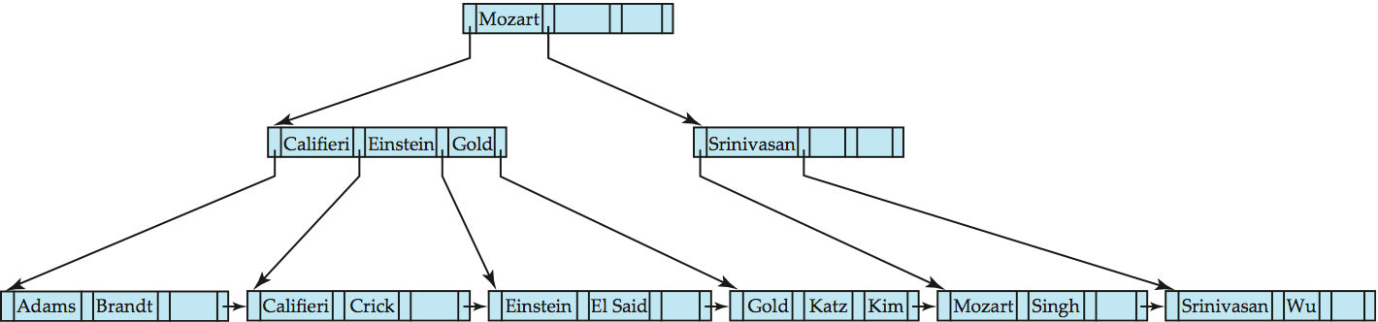
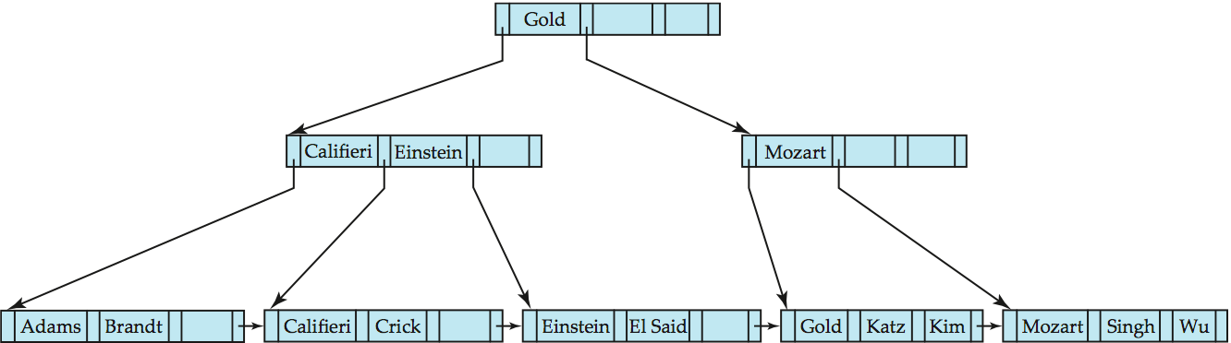
Examples of B⁺-Tree Deletion
Before and after deleting “Srinivasan”
Deleting “Srinivasan” causes merging of under-full leaves

Slide 2
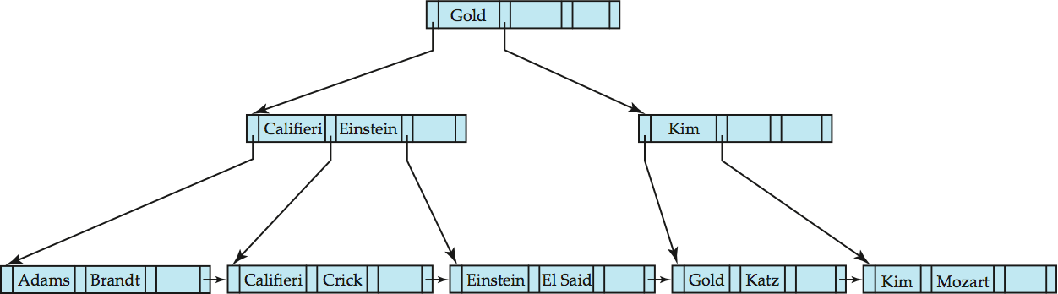
Examples of B⁺-Tree Deletion (Cont.)
Deletion of “Singh” and “Wu” from result of previous example
Leaf containing Singh and Wu became underfull, and borrowed a value Kim from its left sibling
Search-key value in the parent changes as a result

Slide 3
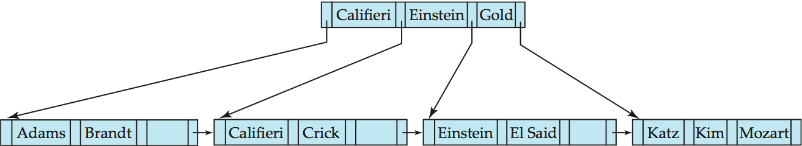
Example of B⁺-tree Deletion (Cont.)
Before and after deletion of “Gold” from earlier example
Node with Gold and Katz became underfull, and was merged with its sibling
Parent node becomes underfull, and is merged with its sibling
Value separating two nodes (at the parent) is pulled down when merging
Root node then has only one child, and is deleted

Slide 4
Updates on B⁺-Trees: Deletion
Find the record to be deleted, and remove it from the main file and from the bucket (if present)
Remove (search-key value, pointer) from the leaf node if there is no bucket or if the bucket has become empty
If the node has too few entries due to the removal, and the entries in the node and a sibling fit into a single node, then merge siblings:
Insert all the search-key values in the two nodes into a single node (the one on the left), and delete the other node.
Delete the pair (K_{i–1}, P_{i}), where P_{i} is the pointer to the deleted node, from its parent, recursively using the above procedure.

Slide 5
Updates on B⁺-Trees: Deletion
Otherwise, if the node has too few entries due to the removal, but the entries in the node and a sibling do not fit into a single node, then redistribute pointers:
Redistribute the pointers between the node and a sibling such that both have more than the minimum number of entries.
Update the corresponding search-key value in the parent of the node.
The node deletions may cascade upwards till a node which has ⎡n/2⎤ or more pointers is found.
If the root node has only one pointer after deletion, it is deleted and the sole child becomes the root.

Slide 6
Hash-Based Indexes
Static Hash indexes
Dynamic Hash indexes
Extendible, Linear indexes
Notes:
1

Slide 7
Static Hashing
A bucket is a unit of storage containing one or more records (a bucket is typically a disk block).
In a hash file organization we obtain the bucket of a record directly from its search-key value using a hash function.
Hash function h is a function from the set of all search-key values K to the set of all bucket addresses B.
Hash function is used to locate records for access, insertion as well as deletion.
Records with different search-key values may be mapped to the same bucket; thus entire bucket has to be searched sequentially to locate a record.

Slide 8
Static Hashing
# primary pages fixed, allocated sequentially, never de-allocated; overflow pages if needed.
h(k) mod M = bucket to which data entry with key k belongs. (M = # of buckets)
h(key) mod N
0
2
key
h
N-1
Primary bucket pages
Overflow pages
Notes:
3

Slide 9
Static Hashing (Contd.)
Buckets contain data entries.
Hash fn works on search key field of record r. Must distribute values over range 0 ... M-1.
h(key) = (a * key + b) usually works well.
a and b are constants; lots known about how to tune h.
Long overflow chains can develop and degrade performance.
Extendible and Linear Hashing: Dynamic techniques to fix this problem.
Notes:
4

Slide 10
Example of Hash File Organization
Hash file organization of instructor file, using dept_name as key (See figure in next slide.)
There are 8 buckets,
The binary representation of the ith character is assumed to be the integer i.
The hash function returns the sum of the binary representations of the characters modulo 8
E.g. h(Music) = 1 h(History) = 2 h(Physics) = 3 h(Elec. Eng.) = 3

Slide 11

Example of Hash File Organization
Hash file organization of instructor file, using dept_name as key (see previous slide for details).

Slide 12
Hash Functions
Worst hash function maps all search-key values to the same bucket; this makes access time proportional to the number of search-key values in the file.
An ideal hash function is uniform, i.e., each bucket is assigned the same number of search-key values from the set of all possible values.
Ideal hash function is random, so each bucket will have the same number of records assigned to it irrespective of the actual distribution of search-key values in the file.
Typical hash functions perform computation on the internal binary representation of the search-key.
For example, for a string search-key, the binary representations of all the characters in the string could be added and the sum modulo the number of buckets could be returned. .

Slide 13
Handling of Bucket Overflows
Bucket overflow can occur because of
Insufficient buckets
Skew in distribution of records. This can occur due to two reasons:
multiple records have same search-key value
chosen hash function produces non-uniform distribution of key values
Although the probability of bucket overflow can be reduced, it cannot be eliminated; it is handled by using overflow buckets.

Slide 14
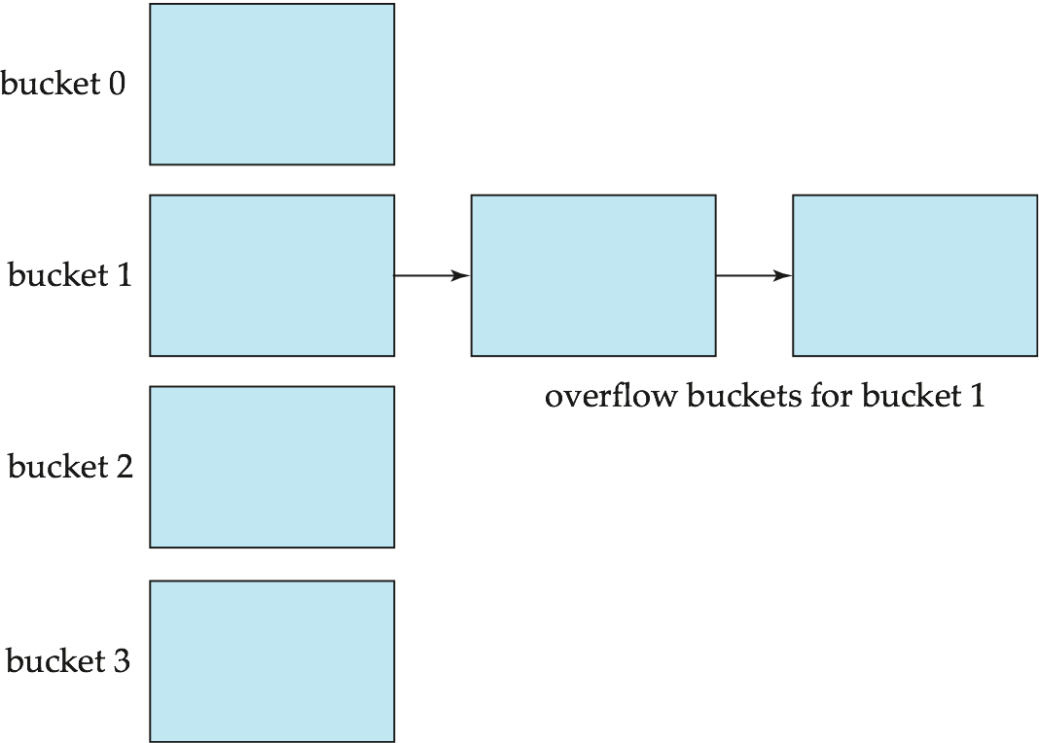
Handling of Bucket Overflows (Cont.)
Overflow chaining – the overflow buckets of a given bucket are chained together in a linked list.
Above scheme is called closed hashing.
An alternative, called open hashing, which does not use overflow buckets, is not suitable for database applications.

Slide 15
Hash Indices
Hashing can be used not only for file organization, but also for index-structure creation.
A hash index organizes the search keys, with their associated record pointers, into a hash file structure.
Strictly speaking, hash indices are always secondary indices
if the file itself is organized using hashing, a separate primary hash index on it using the same search-key is unnecessary.
However, we use the term hash index to refer to both secondary index structures and hash organized files.

Slide 16
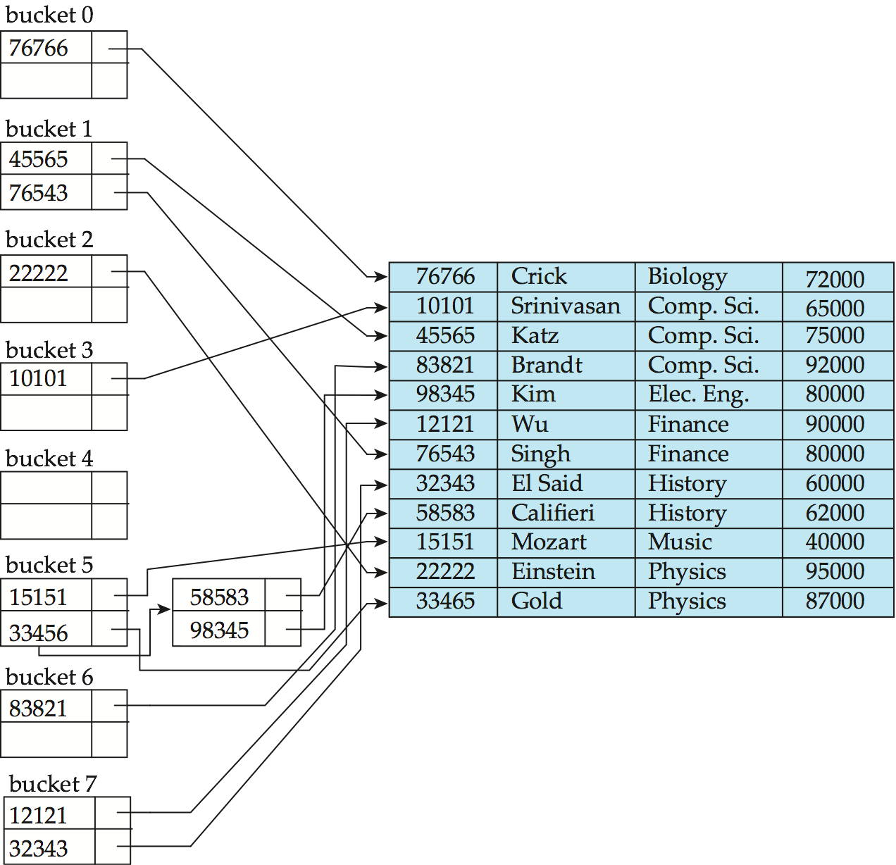
Example of Hash Index
hash index on instructor, on attribute ID

Slide 17
Deficiencies of Static Hashing
In static hashing, function h maps search-key values to a fixed set of B of bucket addresses. Databases grow or shrink with time.
If initial number of buckets is too small, and file grows, performance will degrade due to too much overflows.
If space is allocated for anticipated growth, a significant amount of space will be wasted initially (and buckets will be underfull).
If database shrinks, again space will be wasted.
One solution: periodic re-organization of the file with a new hash function
Expensive, disrupts normal operations
Better solution: allow the number of buckets to be modified dynamically.

Slide 18
Dynamic Hashing
Good for database that grows and shrinks in size
Allows the hash function to be modified dynamically
Extendable hashing – one form of dynamic hashing
Hash function generates values over a large range — typically b-bit integers, with b = 32.
At any time use only a prefix of the hash function to index into a table of bucket addresses.
Let the length of the prefix be i bits, 0 ≤ i ≤ 32.
Bucket address table size = 2^{i.} Initially i = 0
Value of i grows and shrinks as the size of the database grows and shrinks.
Multiple entries in the bucket address table may point to a bucket (why?)
Thus, actual number of buckets is < 2^{i}
The number of buckets also changes dynamically due to coalescing and splitting of buckets.

Slide 19
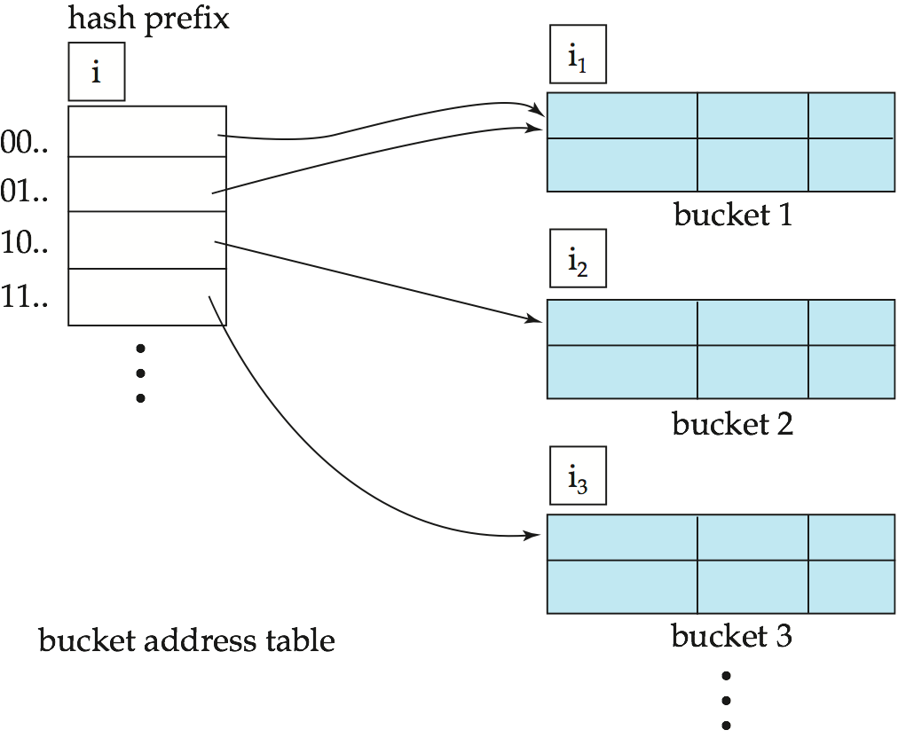
General Extendable Hash Structure
In this structure, i₂ = i₃ = i, whereas i₁ = i – 1 (see next slide for details)

Slide 20
Extendible Hashing
Situation: Bucket (primary page) becomes full. Why not re-organize file by doubling # of buckets?
Reading and writing all pages is expensive!
Idea: Use directory of pointers to buckets, double # of buckets by doubling the directory, splitting just the bucket that overflowed!
Directory much smaller than file, so doubling it is much cheaper. Only one page of data entries is split. No overflow page!
Trick lies in how hash function is adjusted!
Notes:
5

Slide 21
Example
LOCAL DEPTH
2
4*
12*
32*
16*
Bucket A
GLOBAL DEPTH
2
2
00
1*
5*
21*
13*
Bucket B
Directory is array of size 4.
To find bucket for r, take last `global depth’ # bits of h(r); we denote r by h(r).
If h(r) = 5 = binary 101, it is in bucket pointed to by 01.
01
10
2
10*
Bucket C
11
DIRECTORY
2
15*
7*
19*
Bucket D
DATA PAGES
Insert: If bucket is full, split it (allocate new page, re-distribute).
If necessary, double the directory. (As we will see, splitting a
bucket does not always require doubling; we can tell by
comparing global depth with local depth for the split bucket.)
Notes:
6

Slide 22
Insert h(r)=20 (Causes Doubling)
LOCAL DEPTH
2
3
Bucket A
LOCAL DEPTH
GLOBAL DEPTH
32*
16*
32*
16*
Bucket A
GLOBAL DEPTH
2
2
3
2
00
1*
5*
21*
13*
Bucket B
1*
5*
21*
13*
000
Bucket B
01
001
10
2
010
2
11
10*
Bucket C
011
10*
Bucket C
2
100
DIRECTORY
Bucket D
101
2
15*
7*
19*
15*
7*
19*
Bucket D
110
2
111
Bucket A2
3
4*
12*
20*
(`split image'
DIRECTORY
4*
12*
20*
Bucket A2
of Bucket A)
(`split image'
of Bucket A)
Notes:
7

Slide 23
Points to Note
20 = binary 10100. Last 2 bits (00) tell us r belongs in A or A2. Last 3 bits needed to tell which.
Global depth of directory: Max # of bits needed to tell which bucket an entry belongs to.
Local depth of a bucket: # of bits used to determine if an entry belongs to this bucket.
When does bucket split cause directory doubling?
Before insert, local depth of bucket = global depth. Insert causes local depth to become > global depth; directory is doubled by copying it over and `fixing’ pointer to split image page. (Use of least significant bits enables efficient doubling via copying of directory!)
Notes:
8

Slide 24
Comments on Extendible Hashing
If directory fits in memory, equality search answered with one disk access; else two.
100MB file, 100 bytes/rec, 4K pages contains 1,000,000 records (as data entries) and 25,000 directory elements; chances are high that directory will fit in memory.
Directory grows in spurts, and, if the distribution of hash values is skewed, directory can grow large.
Multiple entries with same hash value cause problems!
Delete: If removal of data entry makes bucket empty, can be merged with `split image’. If each directory element points to same bucket as its split image, can halve directory.
Notes:
9

Slide 25
Use of Extendable Hash Structure
Each bucket j stores a value i_{j}
All the entries that point to the same bucket have the same values on the first i_{j} bits.
To locate the bucket containing search-key K_{j}:
1. Compute h(K_{j}) = X
2. Use the first i high order bits of X as a displacement into bucket address table, and follow the pointer to appropriate bucket
To insert a record with search-key value K_{j}
follow same procedure as look-up and locate the bucket, say j.
If there is room in the bucket j insert record in the bucket.
Else the bucket must be split and insertion re-attempted (next slide.)
Overflow buckets used instead in some cases (will see shortly)

Slide 26
Insertion in Extendable Hash Structure (Cont)
To split a bucket j when inserting record with search-key value K_{j}:
If i > i_{j} (more than one pointer to bucket j)
allocate a new bucket z, and set i_{j} = i_{z} = (i_{j} + 1)
Update the second half of the bucket address table entries originally pointing to j, to point to z
remove each record in bucket j and reinsert (in j or z)
recompute new bucket for K_{j} and insert record in the bucket (further splitting is required if the bucket is still full)
If i = i_{j} (only one pointer to bucket j)
If i reaches some limit b, or too many splits have happened in this insertion, create an overflow bucket
Else
increment i and double the size of the bucket address table.
replace each entry in the table by two entries that point to the same bucket.
recompute new bucket address table entry for K_{j} Now i > i_{j} so use the first case above.

Slide 27
Deletion in Extendable Hash Structure
To delete a key value,
locate it in its bucket and remove it.
The bucket itself can be removed if it becomes empty (with appropriate updates to the bucket address table).
Coalescing of buckets can be done (can coalesce only with a “buddy” bucket having same value of i_{j} and same i_{j} –1 prefix, if it is present)
Decreasing bucket address table size is also possible
Note: decreasing bucket address table size is an expensive operation and should be done only if number of buckets becomes much smaller than the size of the table

Slide 28
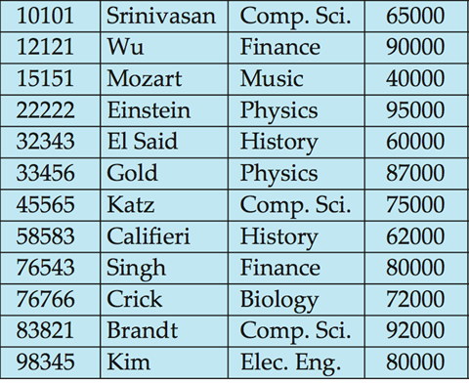
Instructor Data File

Slide 29
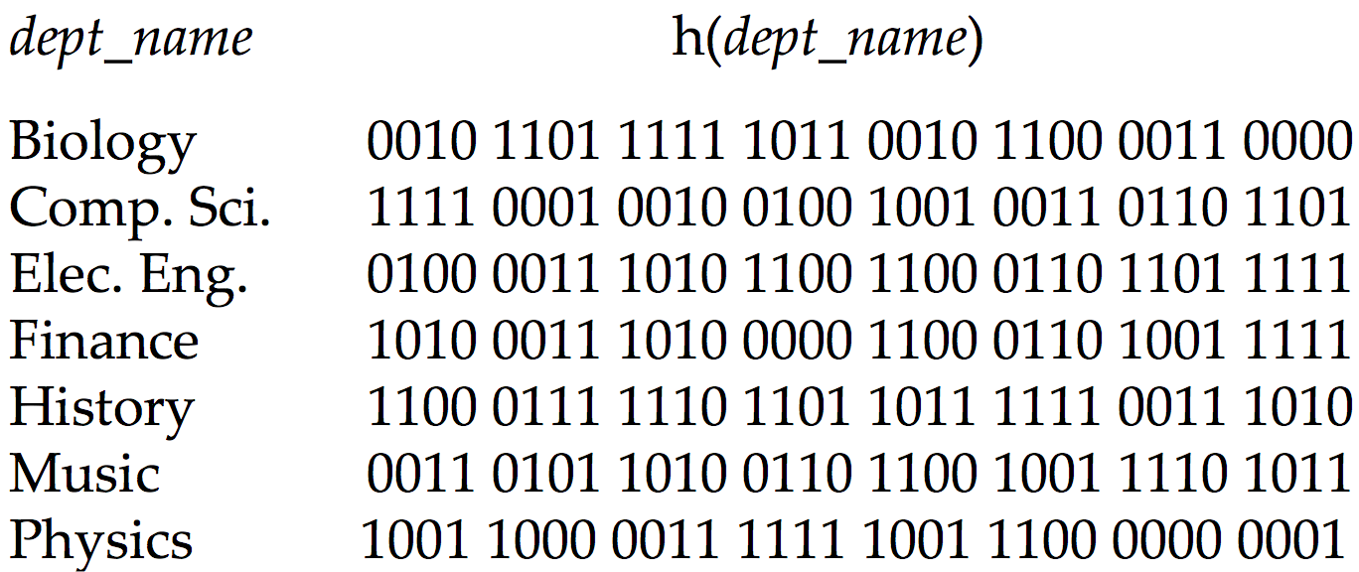
Use of Extendable Hash Structure: Example

Slide 30
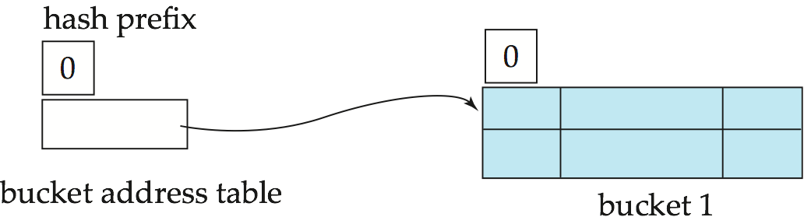
Example (Cont.)
Initial Hash structure; bucket size = 2

Slide 31
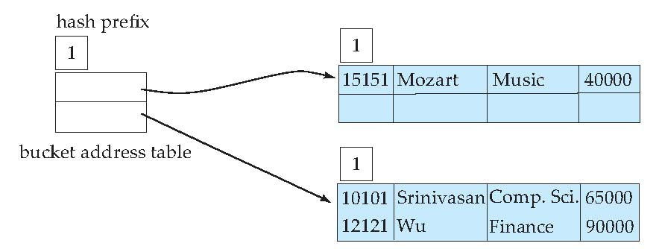
Example (Cont.)
Hash structure after insertion of “Mozart”, “Srinivasan”, and “Wu” records

Slide 32
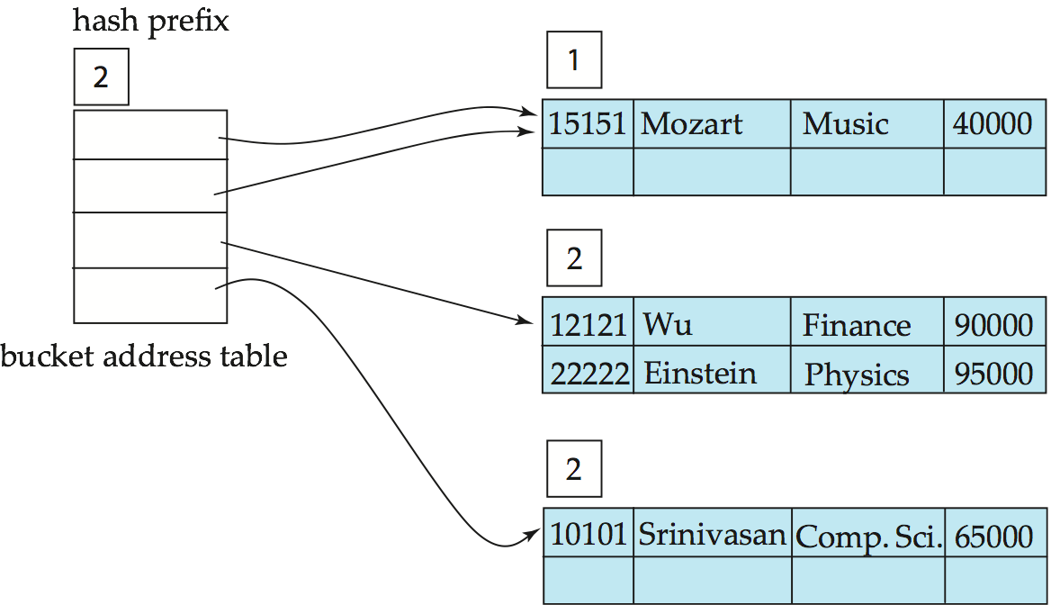
Example (Cont.)
Hash structure after insertion of Einstein record

Slide 33
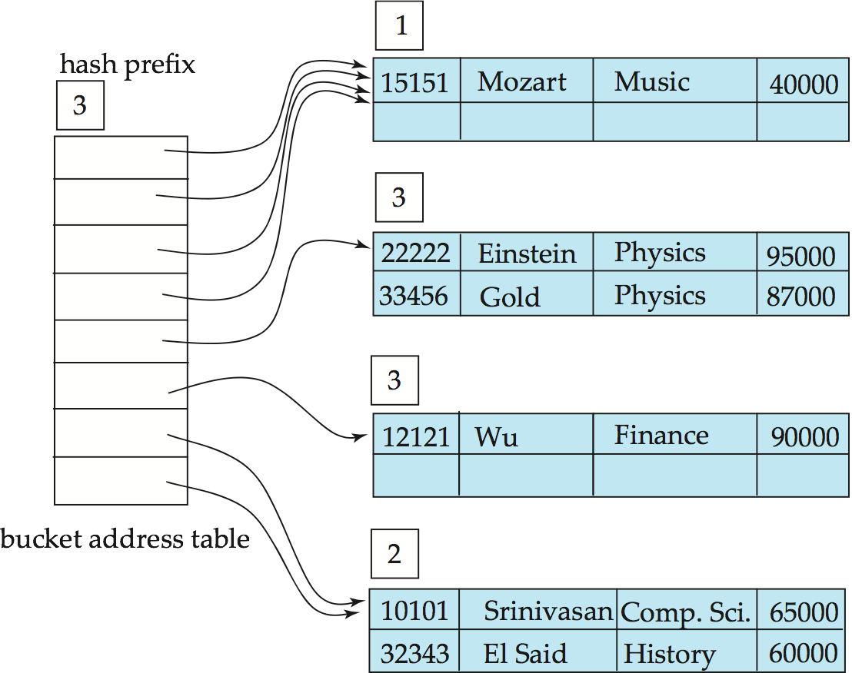
Example (Cont.)
Hash structure after insertion of Gold and El Said records

Slide 34
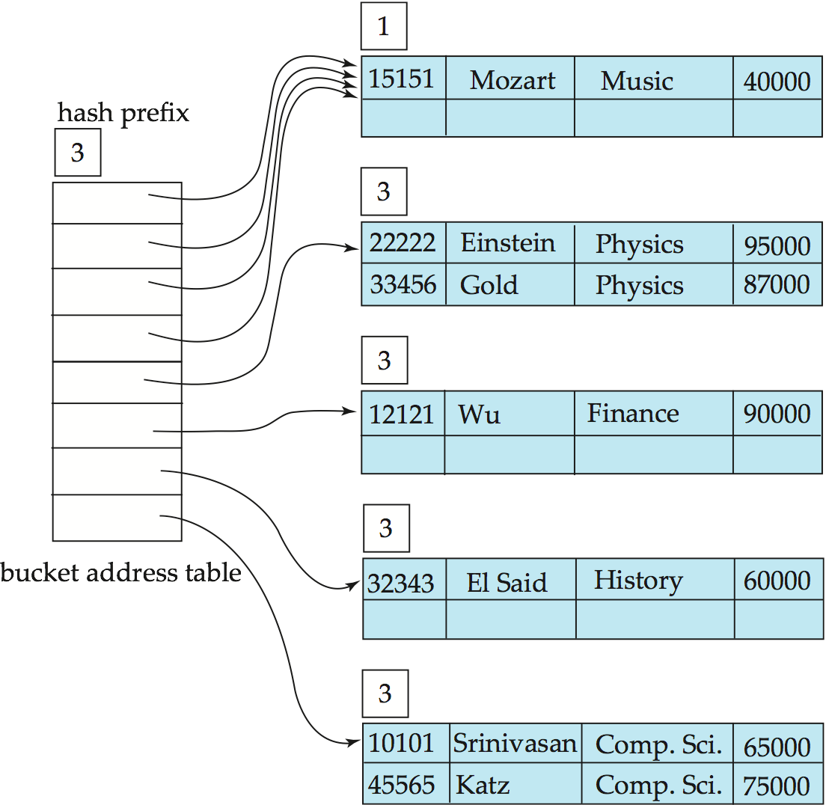
Example (Cont.)
Hash structure after insertion of Katz record

Slide 35
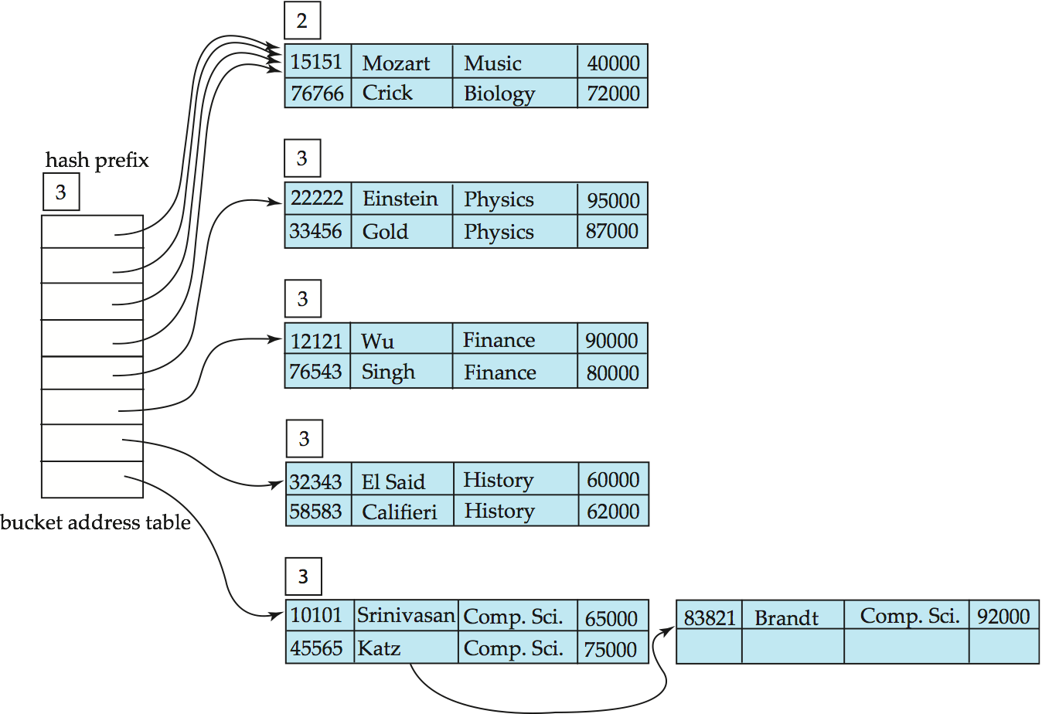
Example (Cont.)
And after insertion of
eleven records

Slide 36
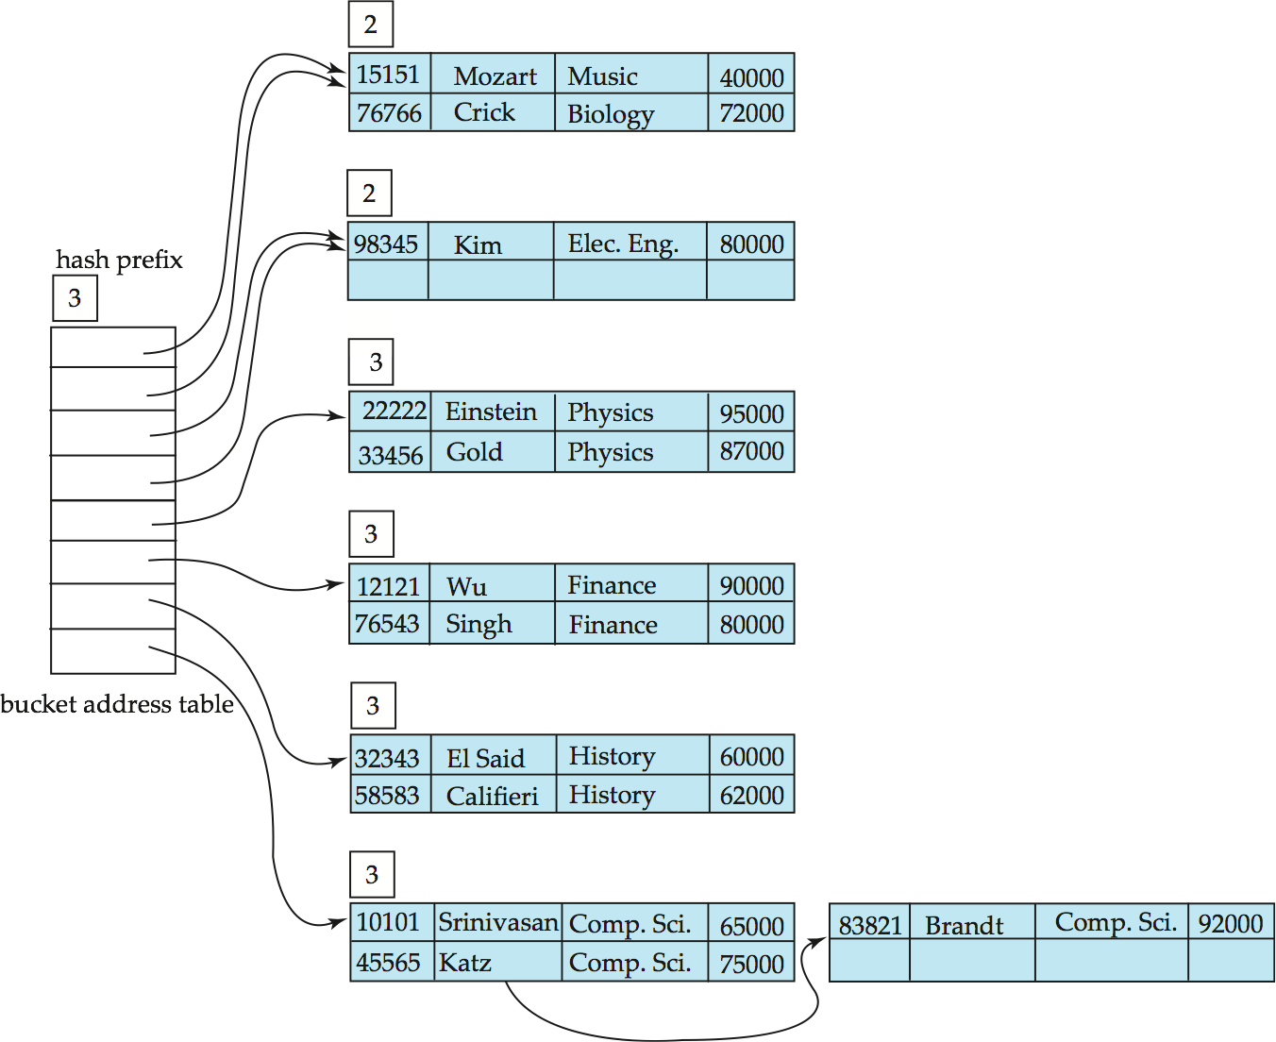
Example (Cont.)
And after insertion of
Kim record in previous
hash structure

