Slide 1
Play the maze!
© 2018 - Trí Nguyên – This Hue Van
Original Creator: Jeremy Winterrowd

Slide 2
The Maze
TM
Remade by 29_tringuyen, with PowerPoint
Original Creator: Jeremy Winterrowd
Test your skills!
Try to reach the goal without touching the walls
How steady is your hand?
Let’s find out! Try and beat all four levels!
sound effects will help
PLAY

Slide 3
Level 1

Slide 4
Level 2

Slide 5
Level 3

Slide 6
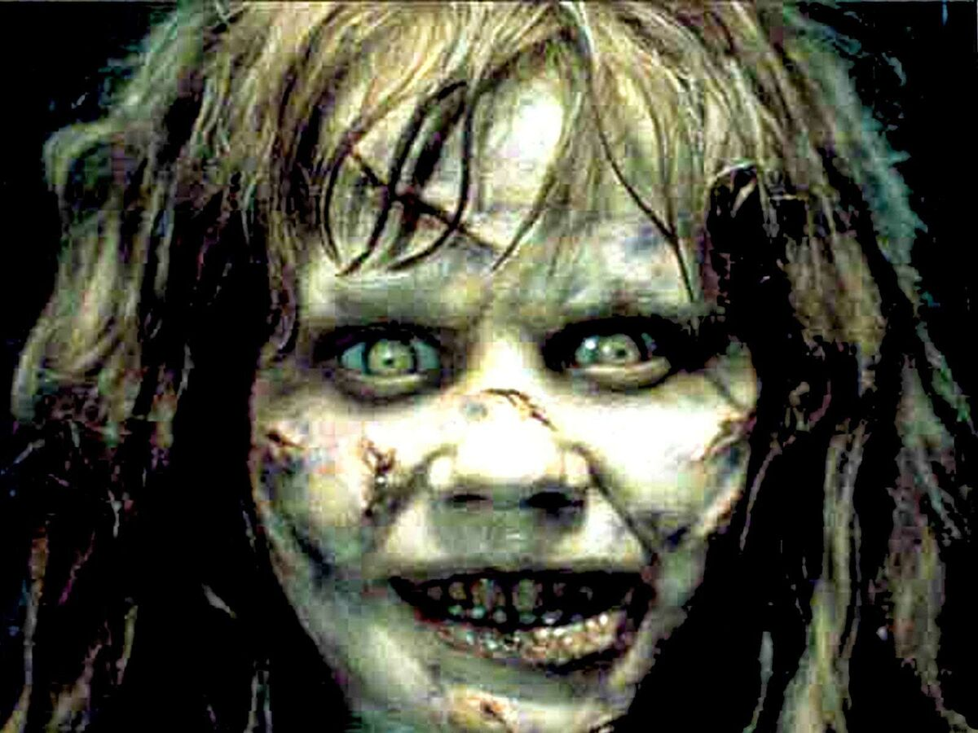

Slide 7

© 2018 - Trí Nguyên – This Hue Van
Original: by Jeremy Winterrowd
replay?
or exit?
www.winterrowd.com

