Slide 1
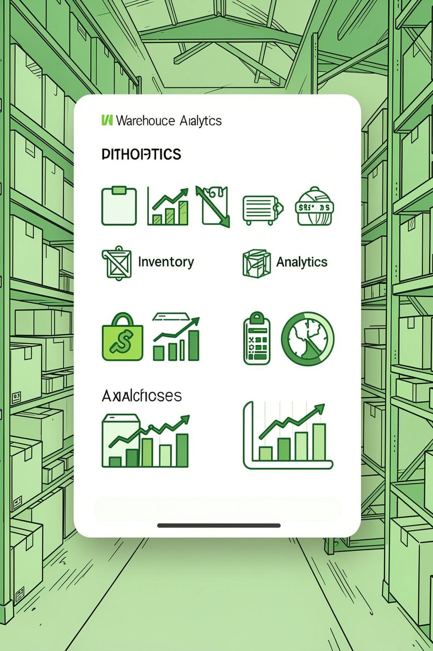
INVENTORY MANAGEMENT ANALYTICS
Inventory Performance & Replenishment Dashboard
Engineers’ Day Hackathon 2026 — Project 08 — Track 1: Excel Business Analytics • Tool: Microsoft Excel • Prepared by Vinayak Arote

Slide 2


Business Problem
Primary challenges
Stock‑out risk for SKUs requiring replenishment and excess inventory tying up capital.
Operational visibility
Difficulty monitoring inventory across warehouses and regions; inconsistent supplier and warehouse performance metrics.
Decision speed
Management needs a single analytical view to make faster, data-driven replenishment and allocation decisions.
“Which products require immediate replenishment and which products are overstocked?”

Slide 3
Objective & Dataset
Dataset
Objective
Inventory Management / Retail Inventory
Placeholders:
Analyze inventory levels, stock value, sales movement, reorder requirements and operational performance to support better inventory decisions.
Dataset Source: [ADD ACTUAL SOURCE]
Records Used: [ADD ACTUAL ROW COUNT]
Date Range: [ADD ACTUAL DATE RANGE]
Key Dimensions
Supplier · Region · Warehouse · SKU / Product
Do not fabricate source, row count or date range — fill when available.
Key Measures
Units Sold · Inventory Level · Stock Value · Order Quantity · Reorder Flag · Supplier Lead Time

Slide 4

Data Preparation & Analytical Approach
Data Cleaning
Calculations
Remove duplicates and standardize formats for consistency.
Compute metrics and transform fields for analysis.
Dashboard & Insights
Pivot Analysis
Aggregate and explore data to reveal patterns.
Visualize KPIs to derive actionable recommendations.
Data preparation highlights: checked duplicates, handled missing values, standardized formats, verified numeric fields, ensured categorical consistency, prepared data for PivotTables and dashboard analysis.

Slide 5




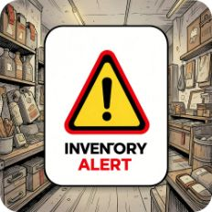



Key Performance Indicators
Total Units Sold
Total Inventory
Total Stock Value
Total Order Quantity
1,829,979
43,026,411
525,243,991.1
1,758,615
Items Requiring Reorder
Stockout Count
Average Stock Cover
Average Supplier Lead Time
0
44.69 days
5,041
7.984 days

Slide 6
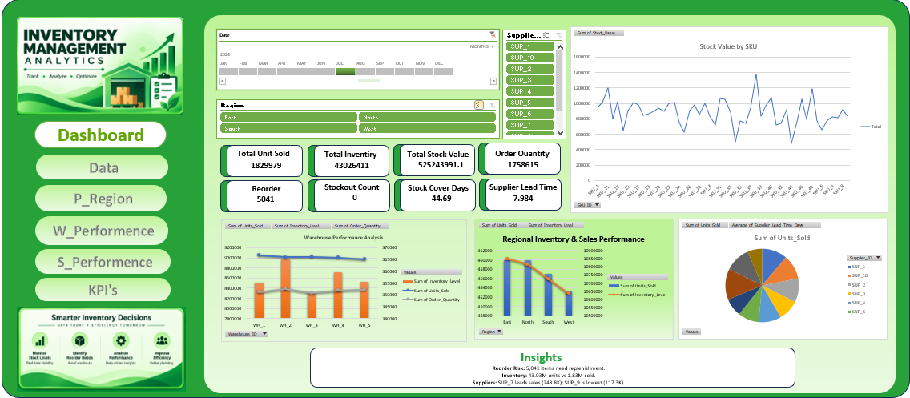

Interactive Inventory Management Dashboard
Dashboard Features
Date timeline and range selector
Region & Supplier slicers
Interactive KPI cards and drill-through
Stock value and movement analysis
Warehouse & regional performance charts
Supplier performance and lead‑time analytics
Inventory / Reorder insights with conditional formatting

Slide 7
Key Insights
Replenishment Risk
Inventory Position
Stockout Status
5,041 items flagged for reorder — prioritize these SKUs for procurement and expedited review.
43.03M units held vs 1.83M units sold — indicates significant capital tied in inventory; assess turnover by SKU.
0 recorded stockout incidents — current availability maintained, but replenishment flags require attention.
Inventory Coverage
Supplier Performance
Average stock cover ~44.69 days — useful for timing reorder cadence against supplier lead times.
Supplier contributions to sales vary significantly — monitor lead-time and fill rates to optimize procurement.

Slide 8
Recommendations & Conclusion
Recommendations
Conclusion
Prioritize Replenishment — focus on the 5,041 reorder‑flagged items for immediate action.
Monitor Excess Inventory — identify slow movers and excess stock to free working capital.
Improve Allocation — rebalance inventory across warehouses based on regional demand and performance.
Track Supplier Performance — monitor lead time and sales contribution to inform procurement choices.
Use Stock Cover for Planning — combine stock‑cover days with movement and reorder rules before placing orders.
The dashboard converts inventory data into actionable insights by identifying replenishment requirements, inventory exposure, and operational performance — enabling faster, more informed inventory decisions.
Final design: align visual language with existing Excel dashboard — green accents, white rounded cards, dark navy text, minimal design.

