Slide 1
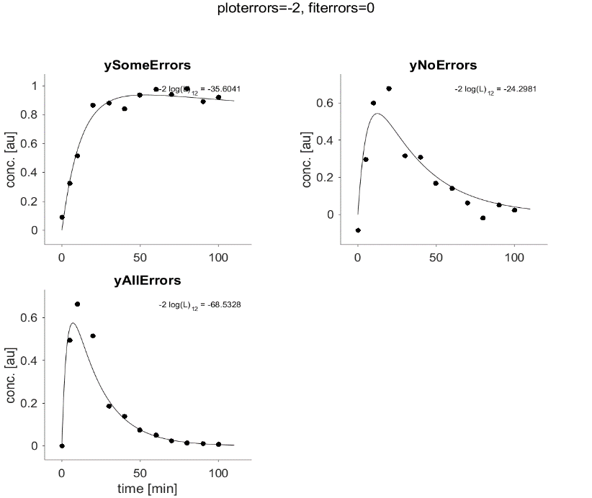

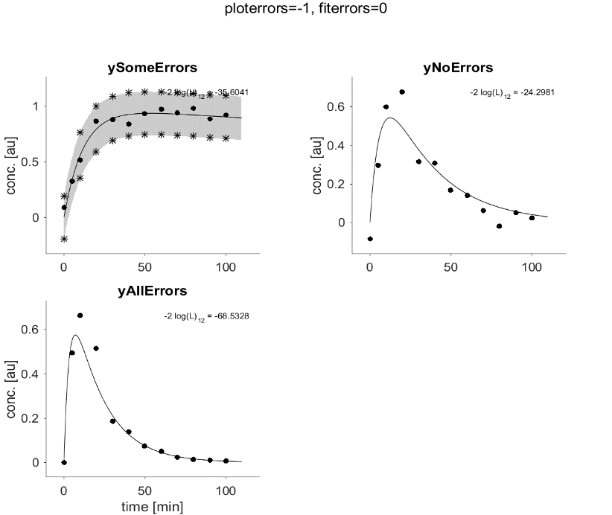

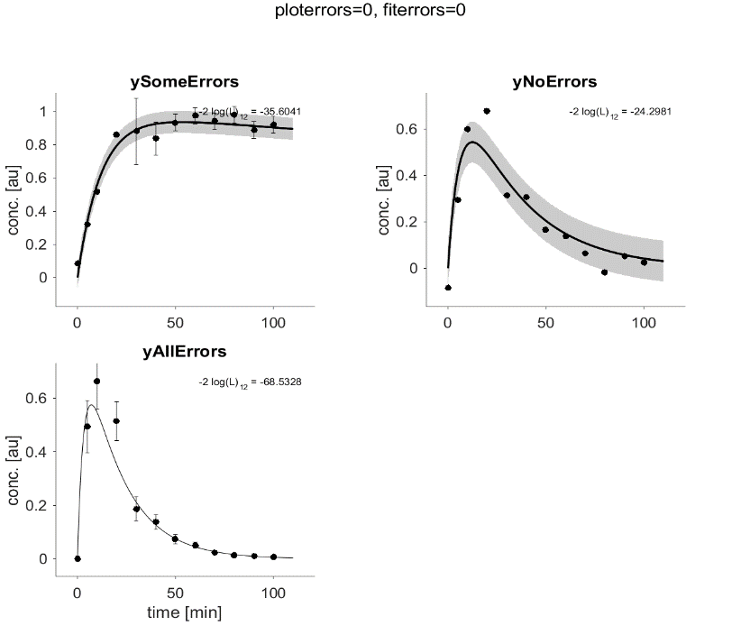
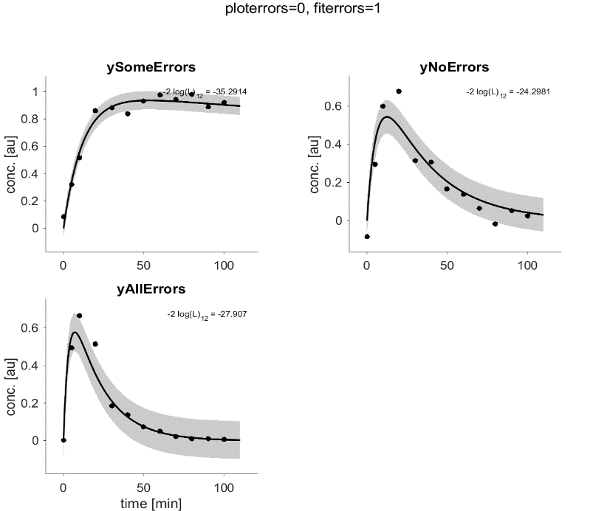
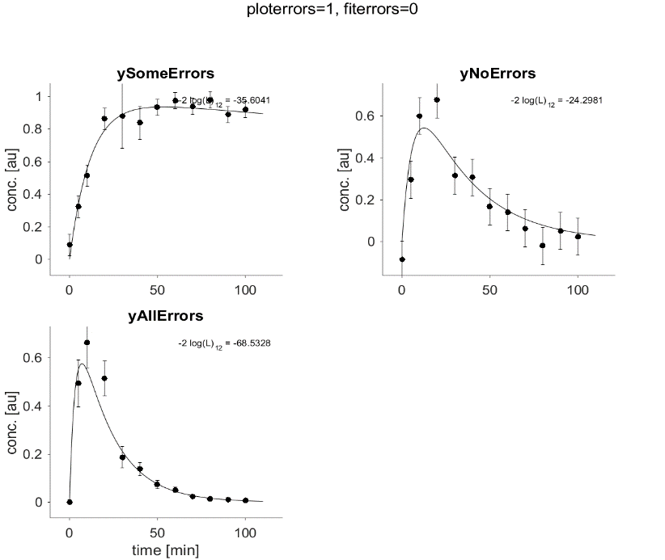
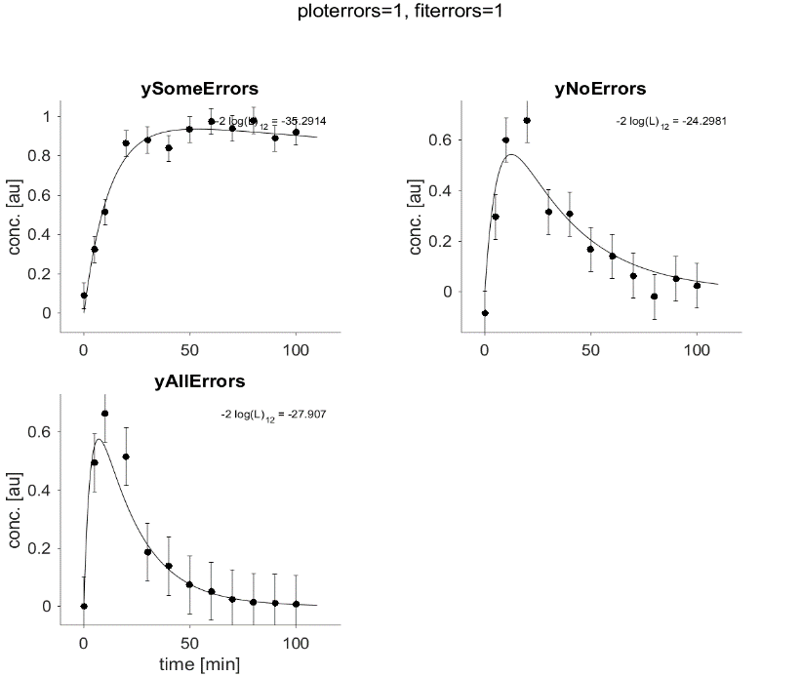
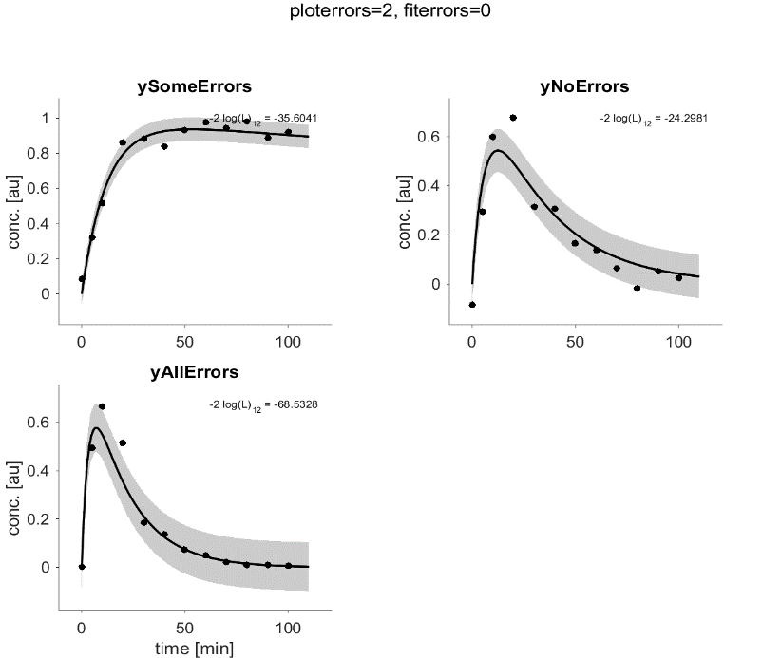

fiterrors=0
(exp. where available)
fiterrors=1
(only error model)
ploterrors=-2
ploterrors=-1 (PPL was available for „ySomeErrors“)
ploterrors=0 (like fitted)
ploterrors=1 (as errorbars)
ploterrors=2 (as bands)

