Slide 1
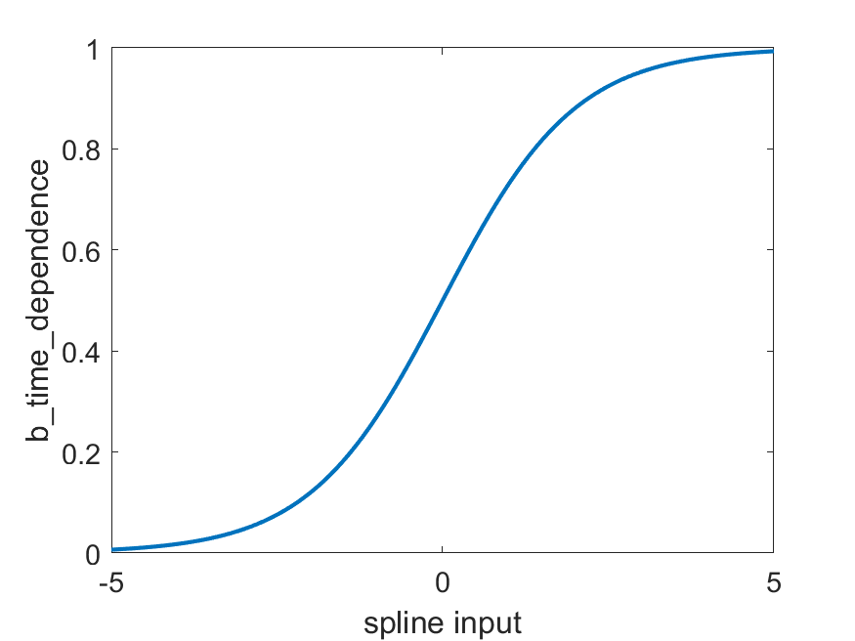
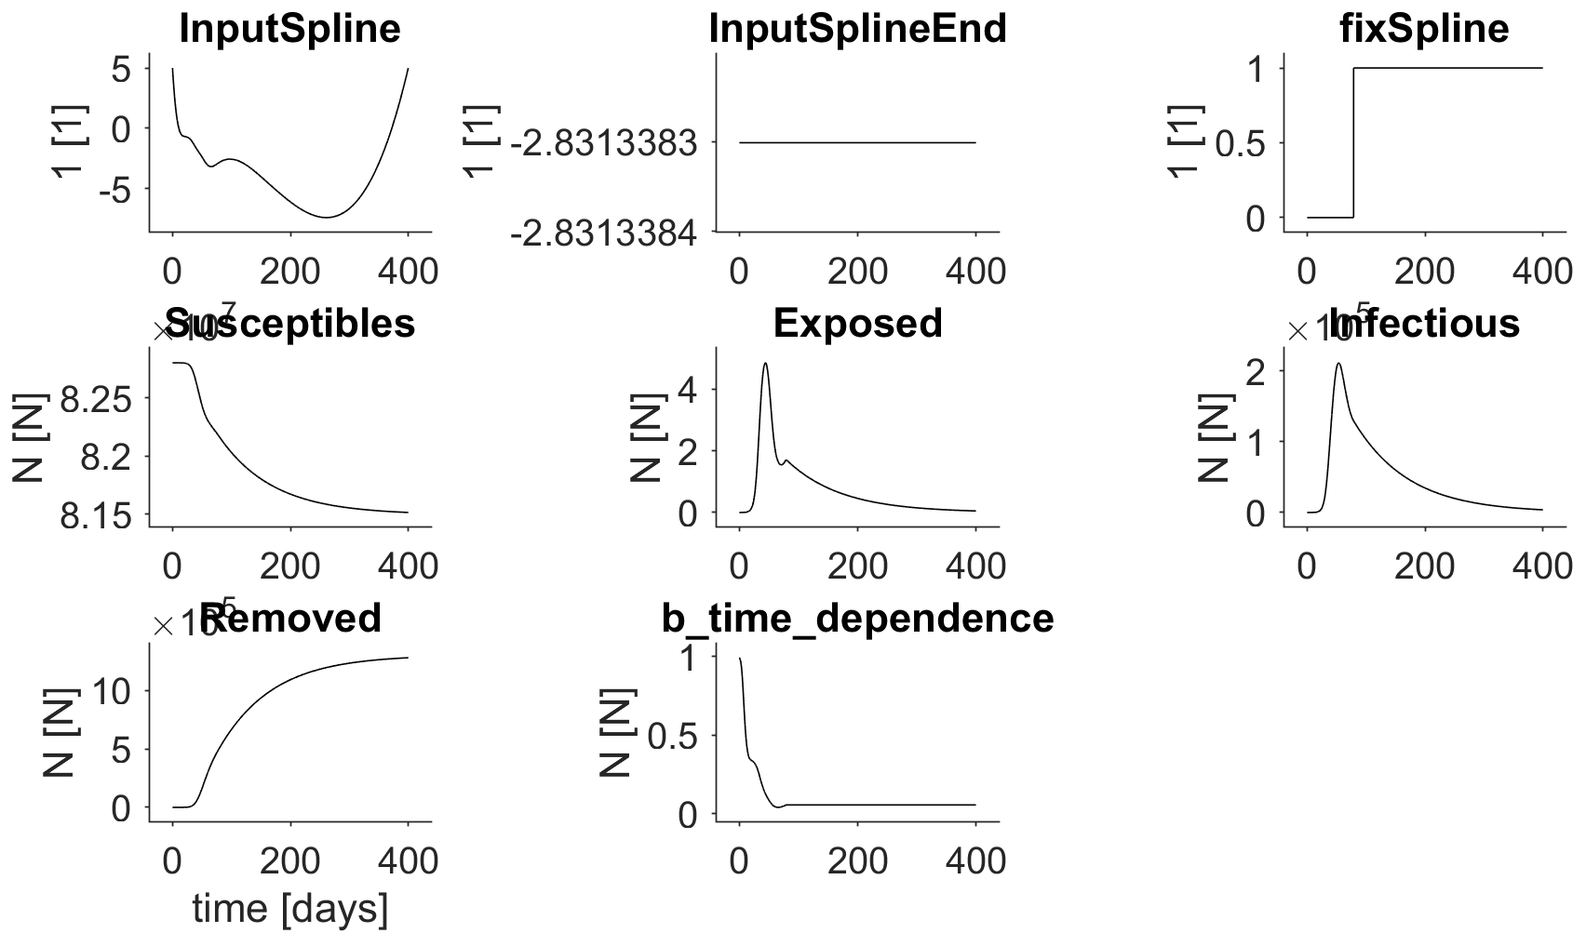
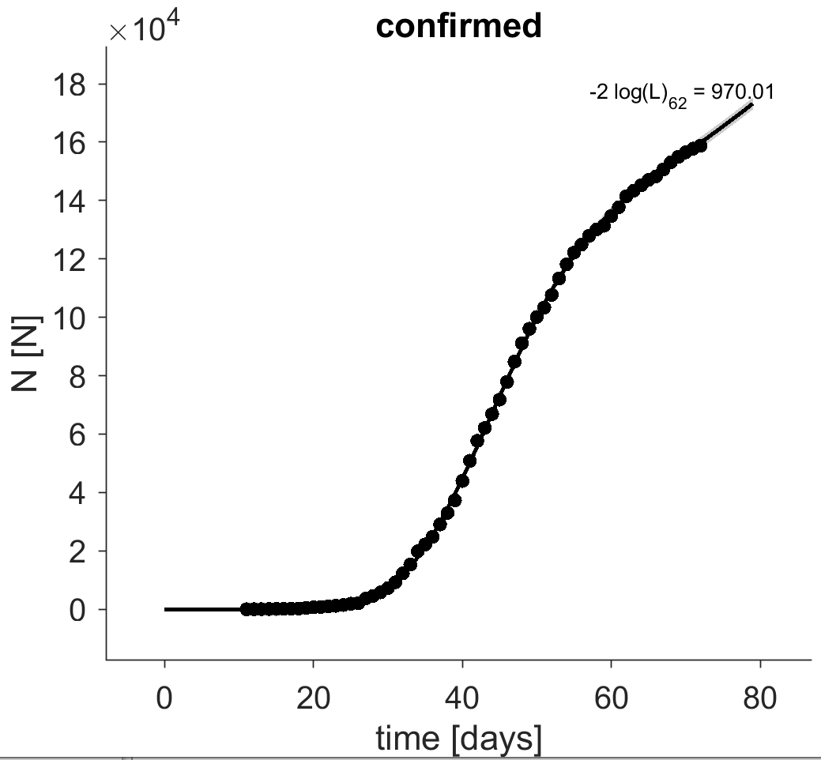
Fitted input spline that is
the argument of the sigmoidal function until tLast
Input argument of
sigmoidal function resulting
in constant input
Step function for switching to constant
Sigmoidal function
last
data
point
Data used for fitting
last
data
point
Resulting input
that is multiplied to the max. infection rate

