Slide 1
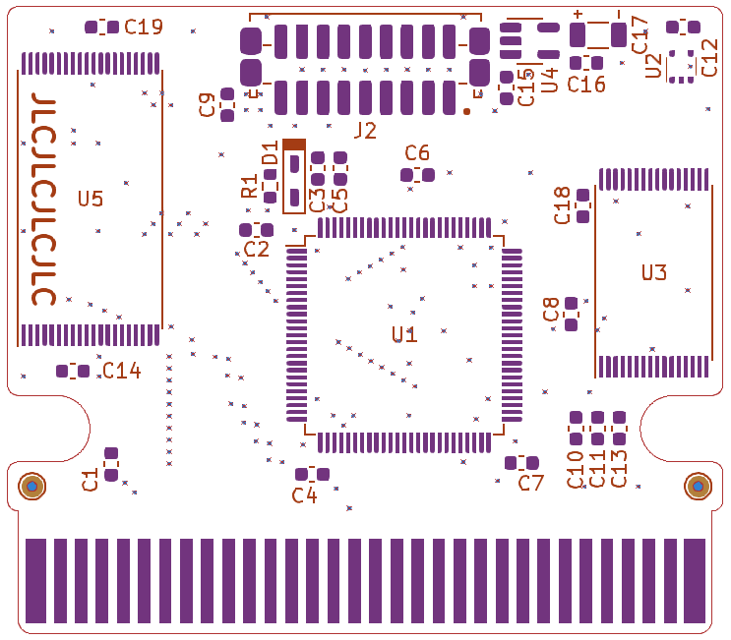
AM29F080B
FM28V100
MAC-GBD
22pF
10nF
100nF
22µF

