Slide 1
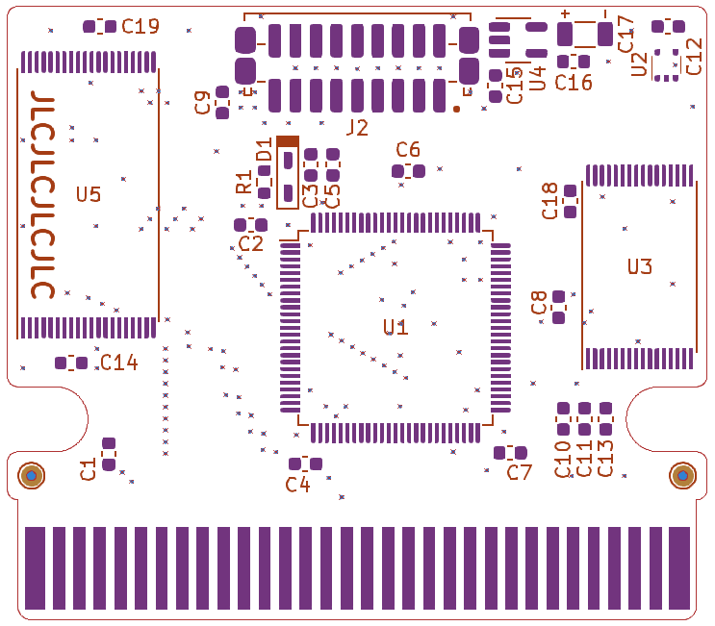
AM29F080B
cathode
FM28V100
anode
MAC-GBD
22 pF
10 nF
100 nF
22 µF
1 kΩ
chips

