Slide 1
DICT Capstone Project · 2026
18
Aking Bukid
PH Crops
AI Crop Recommendation System for Philippine Cooperatives
₱0
"Mas Matalinong Pagsasaka,"
Cloud AI Cost
Google Maps
IoT Sensors
Qwen AI (Ollama)
Meta NLLB Translation
Kaggle Dataset
Department of Information and
Communications Technology
Philippines · Capstone 2026
Sensor-to-Recommendation Pipeline · Google Maps Farm Mapping · Offline Qwen AI · NLLB Filipino Translation

Slide 2
Problem & Who Feels It
1
Philippine Agriculture Context · Named Stakeholders · Local Data Sources
The Problem
Named Stakeholders
1
No Real-Time Soil Data Tools
9.6M smallholder farmers have no system that collects live sensor readings and instantly recommends the right crop based on actual soil conditions.
PRIMARY USERS
• Smallholder rice/corn farmers (9.6M nationwide, CDA 2024)
• Agricultural cooperative member-farmers
• Cooperative managers & supervisors
2
Internet Dependency of Existing Solutions
Most AI crop tools require cloud connectivity. ~40% of rural barangays have unreliable internet (DICT 2023), making them useless in the field.
TECHNICAL & GOVERNMENT
• DA Extension Workers — reduced field advisory load
Language Barrier
All major crop advisory platforms are English-only. Over 70% of Filipino farmers are most comfortable in Filipino/Tagalog.
• DA-BSWM — Bureau of Soil & Water Management (data standards)
3
REGULATORY
• PhilRice — yield benchmarks & PH crop validation
4
Yield Loss from Wrong Crop-Soil Matching
Poor crop selection causes 8–12% of small-farm seasons to yield below target, costing ₱10K–₱50K per farm per season (PSA 2024).
• National Privacy Commission (NPC) — RA 10173 compliance
• CDA — Cooperative Development Authority (scale-up pathway)
9,600+
9.6M
Cooperatives (CDA)
Smallholder Farmers
Data Sources: PSA Crop Statistics 2024 · PhilRice Yield Benchmarks · DA-BSWM Soil DB · DICT Connectivity Report 2023 · CDA Registry

Slide 3
Current Process Map
2
How crop decisions are made today — no sensors, no AI, no real-time data
Farmer Observes Soil & Yield
Contacts Extension Worker (phone/walk)
WAIT: Days to Weeks
Manual Field Assessment Visit
Verbal Crop Recommendation
Planting Decision (uncertain)
▶
▶
▶
▶
▶
No sensor data collected
Only 1 worker per 50+ farms
2–4 weeks avg. window often missed
4–6 hrs travel per farm visit
No record kept; no data baseline
8–12% below-yield rate each season
⏱ TIME
💰 COST
📊 DATA
📈 SCALE
Average 2–4 weeks from identifying a problem to receiving crop advice. The optimal planting window is often missed by the time the farmer gets guidance.
Extension worker transport: ₱500–₱2,000 per farm visit. 30 farms × 2 visits/season = ₱30,000–₱120,000/cooperative/year in travel alone.
Zero sensor data is used in current decisions. Recommendations rely entirely on visual observation and farmer testimony — no N, P, K, or pH readings.
DA national ratio: 1 extension worker per 50–100 farms. Personalised, data-driven advice is impossible at this scale without technology.

Slide 4
Proposed AI Solution: Aking Bukid
3
IoT Sensors · Google Maps · Kaggle-Trained RF Model · Qwen AI (Ollama) · Meta NLLB Translation
ONLINE
HARDWARE
KAGGLE MODEL
OFFLINE AI
META AI
OUTPUT
Google Maps
IoT Sensors
Random Forest
Qwen (Ollama)
NLLB-200
Dashboard
Farm boundary drawing & sensor placement map
▶
Sends N, P, K pH · Temp Humidity · Rain
▶
Trained on Kaggle dataset 2,200 samples
▶
qwen2.5:3b Crop recommendation & explanation
▶
No Language Left Behind EN → Filipino
▶
Bilingual result Admin + Farmer Google Maps view
🌐 ONLINE COMPONENT
🔌 OFFLINE AI CORE — works with no internet after setup
Google Maps requires internet for farm mapping & visualization.
Random Forest (Kaggle-trained) + Qwen via Ollama + Meta NLLB all run locally on the cooperative server.
How Each Component Works
Google Maps
IoT Sensors
Random Forest (Kaggle)
Admin draws the farm polygon boundary directly on a live Google Map. The system calculates area in hectares and auto-places sensor markers at the correct GPS coordinates.
Physical sensors installed in the field continuously read soil N, P, K, pH, temperature, humidity, and rainfall. Readings are sent wirelessly to the FastAPI backend in real time.
Trained on the Kaggle Crop Recommendation Dataset (2,200 labeled samples). Takes live sensor values and outputs the top matching crop with a confidence score.
Qwen via Ollama
Meta NLLB-200
Dashboard Output
The offline Qwen 2.5 (3B) model, served by Ollama on the local server, generates a plain-language explanation of why that crop was recommended, referencing the actual sensor readings.
Meta's No Language Left Behind (NLLB-200-distilled-600M) translates the Qwen explanation from English to Filipino (Tagalog) entirely offline — no Google Translate API needed.
Both the admin dashboard and the farmer view display the crop name, confidence %, and the bilingual explanation (English + Filipino) alongside the Google Maps farm view.

Slide 5
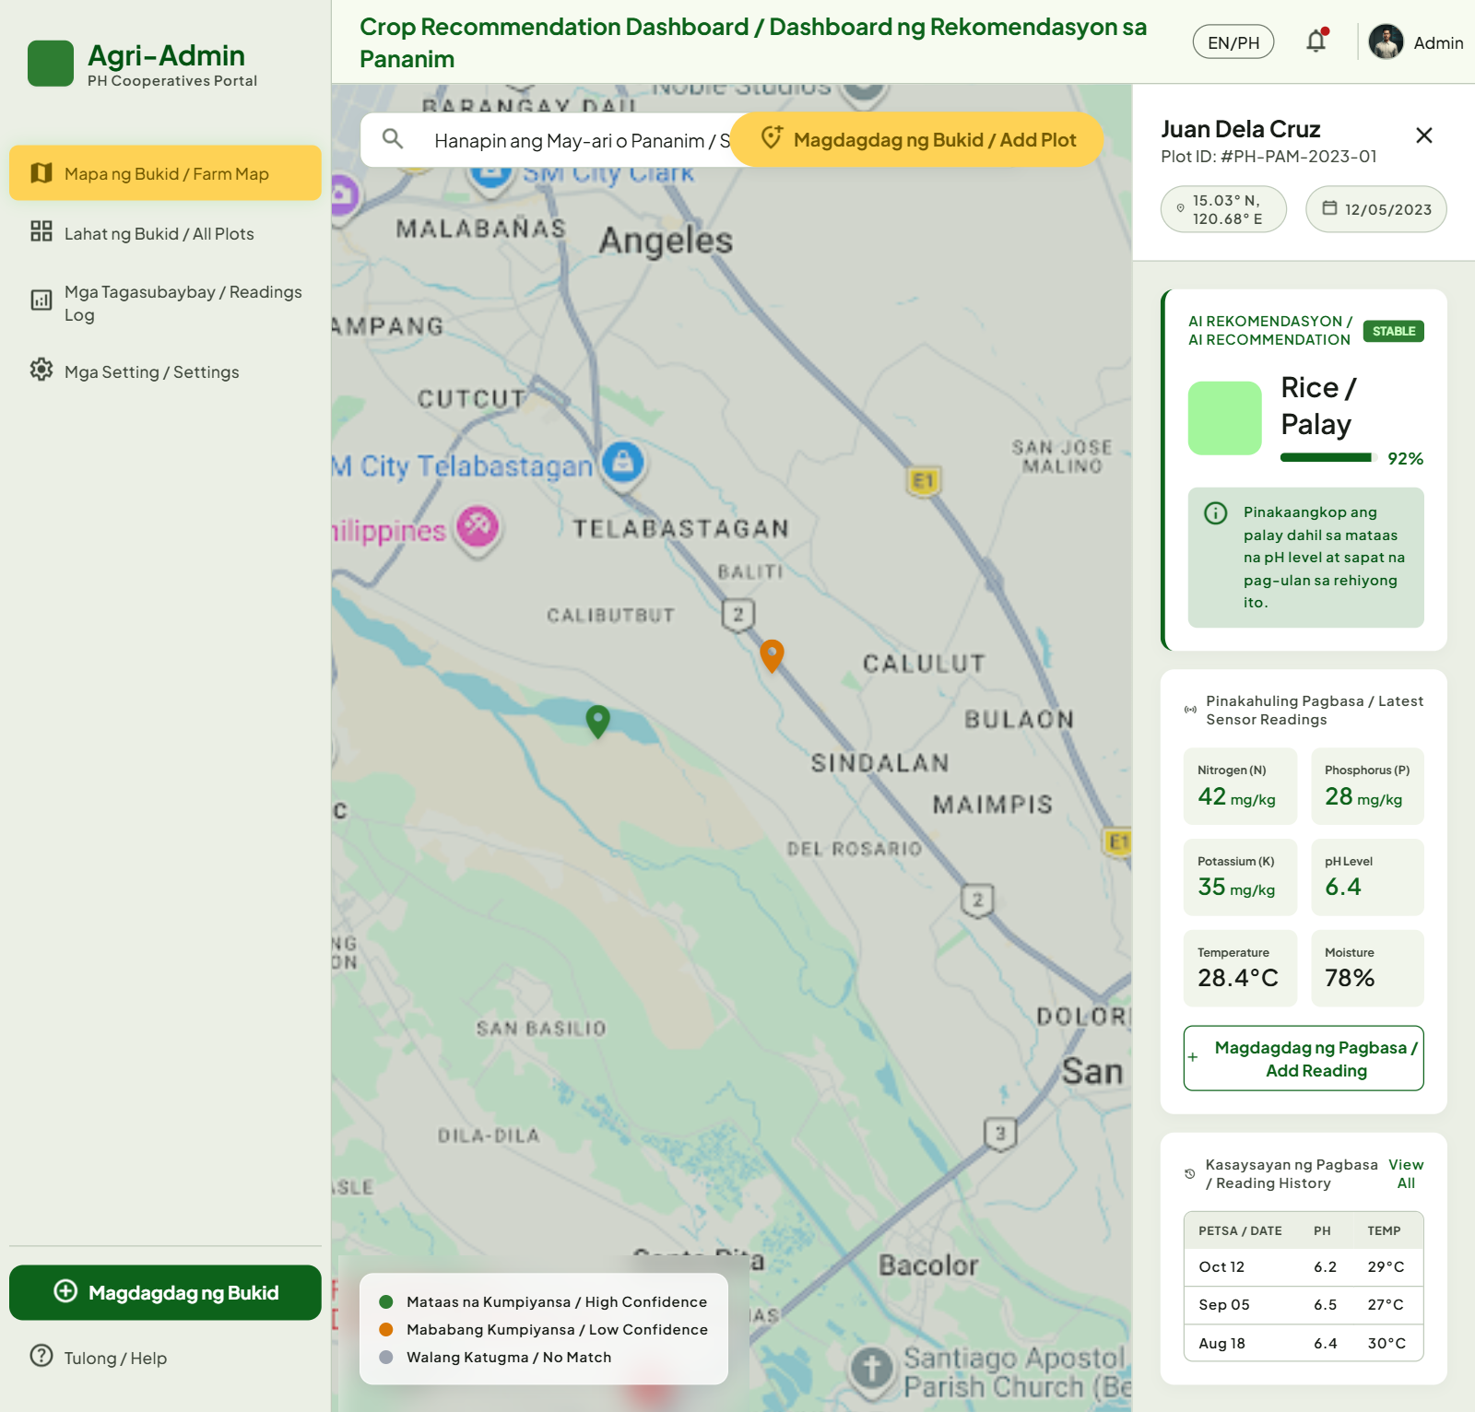
Google Stitch Prototype – Admin Dashboard
4
Google Maps farm view · Live IoT sensor readings · AI crop recommendations · Cooperative management

Slide 6
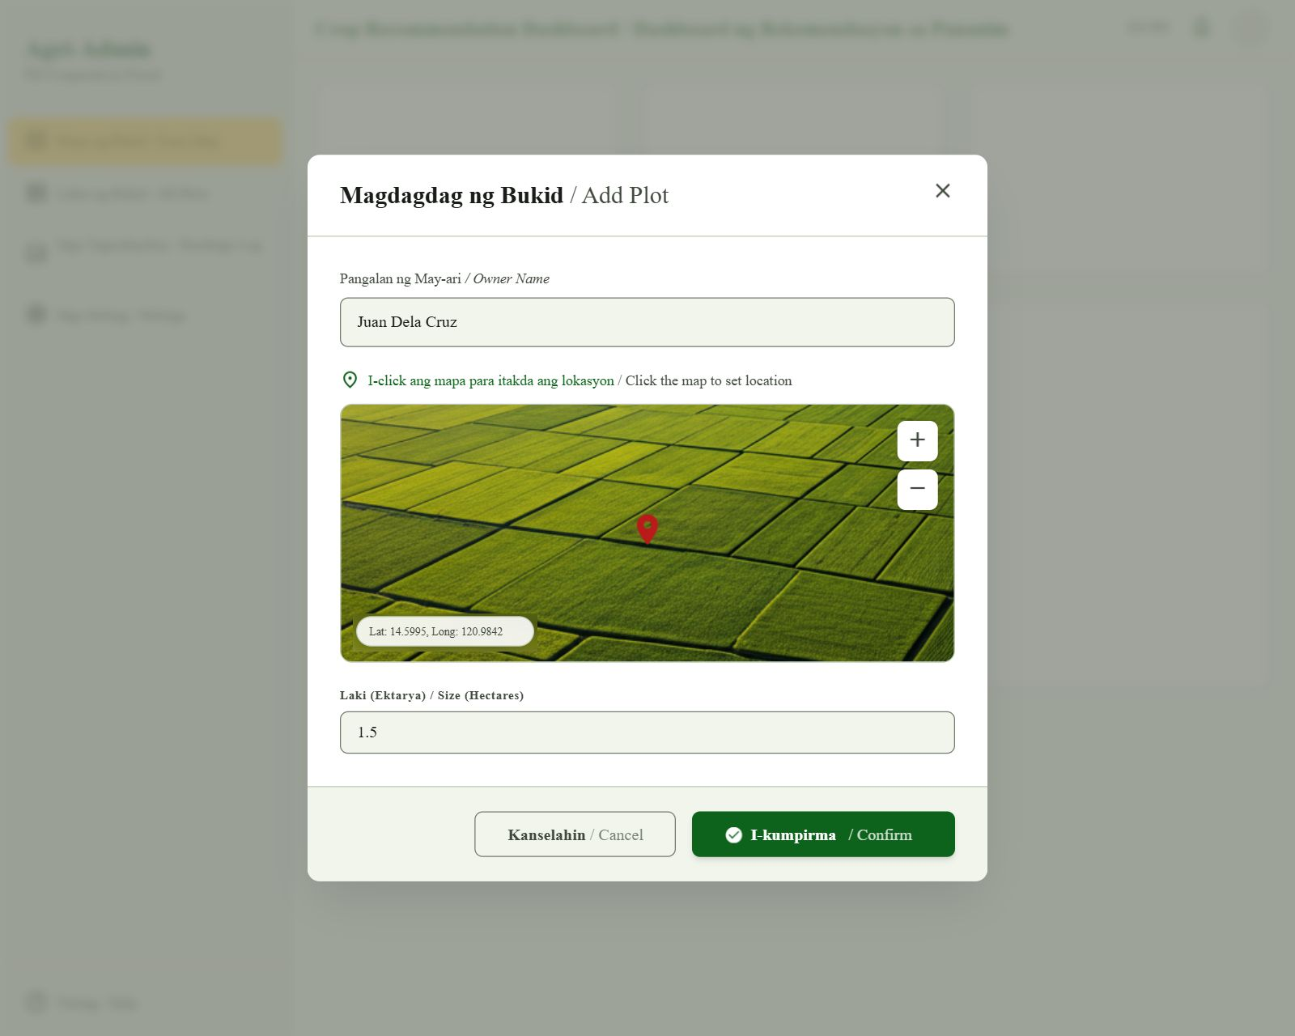
Google Stitch Prototype –
5
Farm name login · Live IoT sensor data · Qwen AI recommendation · NLLB Filipino translation

Slide 7
Offline AI Option for Low-Connectivity Areas
5
Hybrid system: Google Maps online · Qwen AI fully offline · NLLB offline · IoT sensors local network
System Architecture — Online & Offline Components
Why the AI Core Must Be Offline
🌐 ONLINE — requires internet
40%
₱0/month
Qwen Offline
Google Maps API
Farm boundary drawing, sensor GPS placement & live map dashboard view
of rural barangays have unreliable internet (DICT 2023)
cloud AI cost vs ₱3,000+/mo for cloud LLMs
AI recommendation continues even when internet is down
🔌 OFFLINE — works with no internet after setup
IoT Sensors
The Google Maps integration (online) is used only for farm mapping and visualization. All AI decisions — Qwen crop recommendation, NLLB Filipino translation, and Random Forest model inference — run fully offline on the cooperative's own server. Farmers in areas with no internet still receive AI-powered guidance.
Physical sensors send data over local WiFi/LAN to the server
▼
FastAPI Backend
Serves REST API on localhost — no internet needed
▼
Random Forest (Kaggle)
Pre-trained on Kaggle dataset — crop_model.pkl (3.5 MB, CPU only)
▼
Qwen 2.5:3b via Ollama
Generates crop recommendation + explanation — runs on local GPU/CPU
▼
Meta NLLB-200 Translator
No Language Left Behind — EN → Filipino offline (Hugging Face)
▼
SQLite Database
.db file on local disk — no database server needed
₱464,800 (₱428,000 setup + ₱18,400 × 2 recurring)

Slide 8
ROI Model: Time Saved × Cost × Volume
6
Local wage rates · PSA & PhilRice unit-cost data · Conservative scenario · 30 farmers · 45 hectares
ROI = (Total Annual Benefit − Total Annual Cost) ÷ Total Annual Cost × 100
₱453,960
₱428,000
₱25,960
193%
~11 mos
Annual Benefit
Year 1 Total Cost
Year 1 Net
3-Year ROI
Payback Period
Annual Benefit Breakdown
IoT Sensor Node — Cost per Unit
Benefit Category
Calculation
Annual Value
Component
Unit Price
Yield Optimization
18 ha × 3.8 MT × 10% Qwen AI gain × 2 seasons × ₱18,000/MT
₱246,240
Soil NPK Sensor (RS485)
₱2,500
pH Probe
₱800
Labor Savings
30 farms × 2 visits × 4 hrs × 60% reduction × ₱200/hr × 2
₱57,600
Temp + Humidity (DHT22)
₱200
Rain Gauge Sensor
₱700
Avoided Crop Failure
18 ha × 5% loss prevention × ₱136,800/ha/yr
₱123,120
ESP32 WiFi Microcontroller
₱400
Solar Panel + Battery Pack
₱1,200
Fertilizer Optimization
18 ha × ₱15,000/ha × 10% reduction (sensor-guided)
₱27,000
Weatherproof Enclosure
₱500
Cables + Connectors
₱200
TOTAL ANNUAL BENEFIT
₱453,960
Initial Setup (30 farms, 2 nodes/farm = 60 nodes)
60 Sensor Nodes × ₱6,500
Server Laptop
Install + Calibrate
Training (2 days)
Software Config
TOTAL YEAR 1
Total per Sensor Node
₱6,500
₱390,000
₱20,000
₱10,000
₱5,000
₱3,000
₱428,000

Slide 9
Risk Register & Governance Controls
7
Philippine Data Privacy Act 2012 (RA 10173) · Risk matrix · AI governance framework
Risk Register
Governance Framework
Risk
Likelihood
Impact
Mitigation Control
RA 10173 — Data Privacy Act
Qwen AI gives wrong crop advice
Medium
High
RF model makes the decision; Qwen only explains. 30% min. confidence enforced.
Farmer GPS & ownership data stored only on-premise. Written consent at enrollment. NPC-compliant retention.
IoT sensor hardware failure
Medium
Medium
Manual data entry fallback; multi-sensor averaging reduces single-point failures.
Qwen AI Transparency
Low farmer adoption
Medium
High
Bilingual UI (NLLB Filipino), simple login, cooperative onboarding sessions.
Every Qwen recommendation includes a sensor-referenced explanation. Confidence % always displayed.
Google Maps API outage / cost spike
Low
Medium
Maps used only for mapping, not for AI. Qwen/NLLB still work offline.
Data privacy breach (sensor/GPS data)
Low
High
SQLite on-premise, no cloud sync; RA 10173 consent forms at enrollment.
Human Override Always Available
Extension workers & managers retain final authority. Qwen AI is advisory only — never mandatory.
NLLB translation inaccuracy
Low
Medium
English version always shown alongside Filipino; farmer can request English.
Kaggle model accuracy drift over time
Low
Medium
Annual retraining with updated DA-BSWM soil data; Kaggle dataset versioned.
Translation Quality Control
NLLB Filipino translation shown alongside English original so farmers can verify meaning.
RA 10173
Aking Bukid processes personal data (farm owner name, GPS location from Google Maps) under the lawful basis of legitimate interest per RA 10173. All sensor readings and location data are stored exclusively on-premises — never sent to Google or any cloud. Farmers consent at enrollment. NPC breach notification procedures are followed.
DATA PRIVACY ACT 2012

Slide 10
Model Selection Justification
8
Kaggle Crop Recommendation Dataset · Random Forest vs. alternatives · Qwen AI for language · Meta NLLB for translation
Why This Model Stack?
Model Comparison (Kaggle Dataset)
Training Data: Kaggle — Crop Recommendation Dataset
Model
Accuracy
Offline
Speed
Size
Used?
2,200 labeled soil samples · 7 features (N, P, K, pH, temp, humidity, rainfall) · 22 crop classes
Random Forest
98.9%
✅
Fast
3.5 MB
⭐ Yes
✓
Random Forest — 98.9% on Kaggle Dataset
Decision Tree
90.1%
✅
Fast
<1 MB
No
Achieved 98.9% accuracy in cross-validation on the Kaggle Crop Recommendation Dataset. Outperformed Decision Tree (90.1%), KNN (97.1%), and SVM (97.8%) on the same data.
K-Nearest Neigh.
97.1%
✅
Slow
2 MB
No
✓
Offline-Ready — 3.5 MB .pkl File
The entire trained model is one serialized .pkl file. Runs in milliseconds on CPU. No GPU, no cloud API, no subscription. Deployable on a ₱20K laptop.
SVM
97.8%
✅
Medium
8 MB
No
Neural Network
99.1%
⚠
Slow
>100 MB
No
✓
Perfect for Tabular Sensor Data
Random Forest is the gold standard for structured tabular data. The Kaggle dataset features (N, P, K, pH, temp, humidity, rainfall) map directly to our IoT sensor readings.
Cloud LLM only
N/A
❌
Slow
Cloud
No
Full AI Stack
✓
Qwen (Ollama) for Recommendation Language
Random Forest
Kaggle-trained crop predictor (3.5 MB .pkl)
After RF selects the crop, the offline Qwen 2.5:3b model generates a plain-language explanation referencing the actual sensor values that drove the recommendation.
Qwen 2.5:3b
Ollama offline LLM — recommendation + explanation
Meta NLLB-200 for Filipino Translation
NLLB-200 (Meta)
No Language Left Behind — EN → Filipino offline
✓
Meta's No Language Left Behind (NLLB-200-distilled-600M) translates the Qwen explanation to Filipino — offline, zero API cost, 200+ language pairs supported.
Google Maps API
Farm boundary & sensor GPS mapping (online only)
IoT Sensor Layer
Real soil data: N · P · K · pH · Temp · Humidity · Rain

Slide 11
Q&A
10
Open floor for questions · DICT Capstone Project 2026
🙋
Questions & Answers
Maraming salamat po! Tanong tungkol sa sistema, datos, gastos, o susunod na hakbang?

