Slide 1
Project Blueberry – An Assistant Bot
Batch No: ECF17008
Github.com/2DSharp/BlueBerry
Guided by
Prof. Hari Seetha
Dept. of CSE
Team Members
1. Dedipyaman Das [17BCE7080]
2. Pujitha Pinninti [17BCD7058]
3. Kamrun Nisa [17BCD7046]
4. Niket Chandil [17BEE7015]
5. Amartya Raj Saha [17BME7056]

Slide 2
Agenda
Introduction
  Arduino
Abstract
  Module Identification
  Architecture Diagram
Equipment Identified
Time Line Chart
References

Slide 3
Building a robot
    We are building an Arduino based assistant bot to make our life easier.
    It provides the following functionalities:
Talk to the user. Greet them.
Turning lights on or off intelligently, based on a light sensor.
Help carry things from one place to another.
Wipe the floor.
Picking up magnetic substances with an electromagnetic arm.
Doing simple math and displaying on the screen.

Slide 4
1. Introduction
“Arduino is an open source computer hardware and software company, project, and user community that designs and manufactures single-board microcontrollers and microcontroller kits for building digital devices and interactive objects that can sense and control objects in the physical world.”
The assistant bot will be a crawler added with arms, lights and trays to provide functionality. This will be running controlled by a bluetooth device and also have respond to certain audio commands.

Slide 5
2.0 Module Identification
The robot will be semi-autonomous. It will be primarily be run by a Bluetooth interface, but it also has the ability to respond to human speech.
When the surrounding light fades away the photo-sensitive sensor detects that to turn the lamps mounted on its head with the information from a light sensor. The lamps can work like study lamps or guide lamps.
It has an electromagnetic arm controlled by servos mounted on a rotating base and can be used to carry magnetic materials.
Bicycle chain rings in the form of wheels are mounted to tracks (belts) so that it can move easily on smooth and rough surfaces and also have stability.

Slide 6
2.1 Module Identification
Sponge, brush and sprinklers are fixed at the base for wiping the floors.
It has a drawer for carrying things, which can be opened and closed.
It uses a basic speech recognition ability to recognize human speech and follow their commands.
It can perform simple mathematical computations based on speech and display results on a TFT screen.
It has a 360 degree rotating base helping direct lights in every direction and also helping the arms move.
A solar panel is used to store energy.

Slide 7
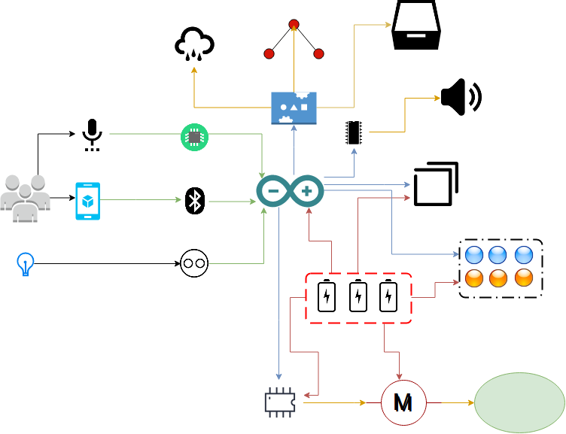
3.Architecture Diagram

Slide 8
4.Equipment Identified
 | Component Name | Component Type | Quantity | Price | Total
1 | Arduino Mega 2560 r3 Microcontroller Board ATmega2560 With Usb Cable | Microcontroller | 1 | 1099 | 1099
2 | HW 9V Batteries | Primary power Source | 6 | 15 | 90
3 | SLAEX039 L293D Motor Shield for Arduino | Motor Driver Shield | 1 | 285 | 285
4 | 12Volt DC Motor(Multipurpose Brushed Motor for DIY applications PCB Drill) | Primary wheel Motor | 4 | 199 | 796
5 | 8 V DC Motor | Secondary Wheel Motor | 2 | 80 | 160
6 | LDR Light Sensor Module(Photosensitive) Based on LM393 for Arduino | Light Sensor | 1 | 159 | 159
7 | 3mm LED Light Emitting Diodes Electronic 1/4 W Resistors | Lights | 20 | 3 | 60

Slide 9
4.Equipment Identified
 | Component Name | Component Type | Quantity | Price | Total
8 | Bluetooth Transceiver Module with TTL Outputs-HC05 | Bluetooth Module | 1 | 298 | 298
9 | Dusting brush | Sprinkler (Cleansing) | 1 | 20 | 20
10 | Shower | Cleansing Part | 1 | 50 | 50
11 | Sponge | Cleansing Part | 1 | 20 | 20
12 | Servo | Arm movements | 1 | 195 | 195
13 | TFT screen | Display | 1 | 530 | 530
14 | Electromagnet | Magnetic object holder | 1 | 630 | 630
15 | Mechanical arm | Arm | 2 | 699 | 1398
16 | Lithium rechargeable battery | Secondary Power Source | 1 | 399 | 399
17 | Tray | Carrying block | 1 | 50 | 50

Slide 10
4.Equipment Identified
 | Component Name | Component Type | Quantity | Price | Total
18 | Speakers | Audio Out | 1 | 80 | 80
19 | Cycle chain | Track Chain | 1 | 250 | 250
20 | PVC pipe | Track chain support | 1 | 425 | 425
21 | Chain ring | Wheels | 12 | 100 | 1200
22 | Screw and bolts | Track connector | 200 | 2 | 400
 |  |  |  | Estimated total: | Rs. 8594

Slide 11




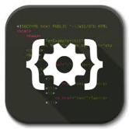


Timeline chart
Literature Survey
913/09/17
Problems Identified
16/09/17
Hardware Analysis
23/09/17
Programming the arduino board
22/10/17
Debugging and integration
23/10/17
Testing
31/10/17
DELIVERY
November Week #1

Slide 12
6.References
1. https://www.arduino.cc/en/Guide/ArduinoMega2560
2. http://playground.arduino.cc
3. https://learn.adafruit.com/category/learn-arduino
4. Sams Teach Yourself “ Arduino Programming” by Richard Blum ,Pearson Education 2015.

